Slide 1
WANDA2020
Catherine Romano
Workshop for Applied Nuclear Data Activities
March 3-5, 2019
Washington, DC

Slide 2
Welcome to Workshop for Applied Nuclear Data Activities 2020
2020
Sponsored by the Nuclear Data Interagency Working Group
Roadmapping Sessions:
Artificial Intelligence/Machine Learning for Nuclear Data
Detector Models, Atomic Data and Stopping Powers
Covariance/Sensitivity/Uncertainty/Validation and its impact on applications
Nuclear Data for Isotope Production and Target Fabrication
Neutron Induced Gamma Production and Gamma Decay
Scattering Transport and Shielding

Slide 3
Welcome to Workshop for Applied Nuclear Data Activities 2020
TUESDAY, MAR 3
Morning
Interagency Talks
Nuclear Data Pipeline
Afternoon
Artificial Intelligence and Machine Learning for Nuclear Data
Detector Models, Atomic Data and Stopping Powers
WEDNESDAY, MAR 4
Morning
Covariance/Sensitivity/Uncertainty/Validation and Its Impact on Applications
Nuclear Data for Isotope Production and Nuclear Data Target Fabrication
Afternoon
Neutron Induced Gamma Production and Gamma Decay
Scattering, Transport and Shielding
Optional No Host Social at the Elliott School
THURSDAY, MAR 5
Morning
The NDIAWG FOA
Funded Project Review Talks
Afternoon
Session Outcomes
Q&A Session
Workshop Closing and Next Steps
2020

Slide 4
The Need for a New Emphasis on Quality Nuclear Data
There has been little interest in nuclear data since the 1980s due to:
The end of the cold war
Lack of new nuclear power development
Nuclear data needs to be revisited due to:
Recent global resurgence in nuclear energy
Reliance on more accurate safeguards measurements
New potential nuclear threats
Greatly increased reliance on modeling and simulations
Modeling and Simulation capabilities have reached a level where, in many cases, nuclear data drive the total uncertainties.

Slide 5
Recent Events in Nuclear Data
Nuclear Data Interagency Working Group (PMs) (6,/16)
USNDP Review (7/14)
Nuclear Data Exchange Meeting presentations to program managers (4/16)
NDIWG FOA Released
NP, NE, IP, DNN R&D, DNDO (4/17)
NDIWG FOA Released
NP, ASCR, NE, DNN R&D, DP (3/18)
NDIWG FOA Released
NP, NE, IP DNN R&D (3/19)
Nuclear Data Needs and Capabilities for Applications (NDNCA) Workshop (5/15)
DNN R&D Nuclear Data Roadmapping Workshop (NDREW) (01/18)
Workshop for Applied Nuclear Data Activities (WANDA) (1/19)
Workshop for Applied Nuclear Data Activities (WANDA2020) (3/20)
Nuclear Data Working Group
DOE-NP, DOE-NE, NNSA, DTRA, DNDO
(11/15, 12/15, 2/16, 3/16)
https://www.nndc.bnl.gov/
Notes:
This is in your handout

Slide 6
The Nuclear Data Working group (NDWG)
In FY19 we formalized the collaboration with a new charter
MISSION STATEMENT
The goal of the Nuclear Data Working Group (NDWG) is to facilitate communication, collaboration, coordination and prioritization of nuclear data efforts across multiple program offices, the national laboratories, universities, and industry.
MEMBERSHIP
Members shall be experts in their respective fields and be nominated to serve on the committee by program managers or national laboratories.
Up to 2 members can be nominated per program manager
Up to 2 members can be nominated per national laboratory
Please contact me romanoce@ornl.gov for information on participation

Slide 7
Nuclear Data Interagency Working Group (NDIWG)
Led by the Office of Science, Office of Nuclear Physics (Tim Hallman)
Goal is to meet twice a year
Annual nuclear data “roadmapping” workshops
Annual collaborative NDIWG FOA
Benefits of participation in the NDIWG
Collaborative funding opportunities
Coordination of efforts
Incorporation of best practices in nuclear data funding
Increased probability of mission impact

Slide 8
NDWG/NDIAWG Participants
Office of Nuclear Physics
US Nuclear Data Program
Isotope Program
NNSA/Defense Programs (NA-113,NA-114)
NNSA/DNN R&D (NA-221,NA-222)
NNSA/Safeguards and Security (NA-24)
NNSA/Naval Reactors (NA-30)
NNSA/Nuclear Criticality and Safety Program (NA-511)
Office of Nuclear Energy
Nuclear Regulatory Commission (NRC)
Department of Homeland Security (DHS)
Defense Threat Reduction Agency (DTRA)
Air Force Technical Applications Center (AFTAC)
National Institute of Standards and Technology (NIST)

Slide 9
Why is communication so important?
Most nuclear data users do not have a background in nuclear data
They do not realize the uncertainties can be quite large.
Many program managers have no background in nuclear data
Many nuclear data “needs” documents are written, but programs often do not know where to begin to meet those needs.
The scope of nuclear data is large and no one program can resolve all issues.
There are many opportunities to collaborate on cross-cutting nuclear data needs.
Nuclear data producers can benefit in understanding user needs.

Slide 10
Communication Facilitated by Nuclear Data Workshops
USERS
Needs and
Impact
EVALUATORS/
PROCESSORS
Evaluation Code
Capabilities/Needs
EXPERIMENTALISTS
Experimental
Capabilities/Needs
PROGRAM MANAGERS
MISSION PRIORITIES
UNIVERSITIES
INTERNATIONAL
COLLABORATORS
Collaboration Opportunities
Coordinate efforts

Slide 11
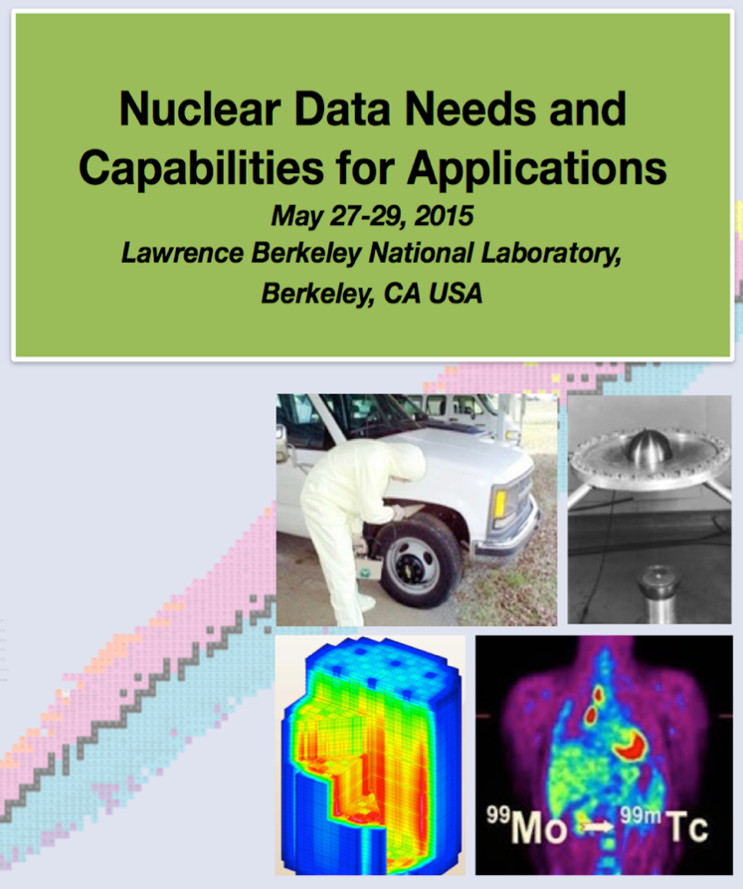
NDNCA Whitepaper: Compilation of Workshop Results and Needs from Current Literature
Cross-cutting needs
Dosimetry Standards: for E_{n} up to 60 MeV to support the International Fusion Materials Irradiation Facility (IFMIF), accelerator-driven systems (ADSs), and spallation sources
Fission: the “Mother of All Fission Experiments,” where TKE(A), n, g’s fragment yields for a range of actinides for E_{n}=thermal-20+ MeV
Decay Data and g-Branching Ratios: includes an International Atomic Energy Agency (IAEA) list of decay data for “certain medical isotopes”
Neutron Transport Covariance Reduction: particular need for actinide (n,x) cross sections from 1–1000 keV
Expanded Integral Validation: includes semi-integral data (e.g., pulsed sphere) to diagnose (n,n_{el}), (n,n_{inel}) shortcomings.
Antineutrinos from Reactors: includes a specific call for new data for ^{235,238}U and ^{239,241}Pu…fission yields for odd-odd nuclei and b-spectral measurements.

Slide 12
NDWG: 5-year plan to address high priority cross-cutting nuclear data needs
Revitalize the Nuclear Data Pipeline
Expand Covariance Data and Its Use
Improve Inelastic Scattering Data for Neutron Transport
Upgrade Capture Gamma-ray Data in ENDF
Improve Theory, Modeling, Data and Evaluation of Fission Fragment Yields
Reestablishment of Actinide Target Production Capabilities

Slide 13
Nuclear Data Roadmapping and Enhancement Workshop (NDREW)
Uncertainty, Sensitivity, and Covariance
Neutron Capture and Associated Spectra
Fission I, Independent and Cumulative Yields
Fission II, Prompt Gammas and Neutrons
Fission III, Decay Data
Inelastic Neutron Scattering and Associated Spectra
(α,n) Reactions
Targets, Facilities and Detector System
Development of Benchmark Exercises
Data Processing & Transport Code Needs
Actinide Cross Sections
Gamma-Induced Reactions

Slide 14
Workshop for Applied Nuclear Data Activities
January 22 – 24, 2019
George Washington University, Washington, DC
Program focus on:
Nuclear Energy
Materials Damage
Isotope Production
Atomic Data
Safeguards
(n,x) reactions
Review of NDIWG FOA funded projects
Program updates by program managers

Slide 15
Breakout Session Goals
Determine mission-driven nuclear data priorities with targeted uncertainties
Obtain user input
Determine all tasks required to ensure that nuclear data are available to users:
Measurements – differential and integral
Evaluations
Processing
Covariance data
Validation
Testing
Create a mechanism for peer reviewed ideas
Determine where needs overlap with other mission spaces
Capture opportunities to leverage or enhance existing funded/planned work
Think outside the confines of the typical funding mechanisms
What does it really take to get it done right?

Slide 16
Charge to Session Participants
Participate! All viewpoints are valuable.
Do not speak for your own interests, but in the interest of resolving the problem in the most beneficial and cost effective manner.
Do not confine your ideas to stay within a budget or timeframe. Determine the full solution.
Focus on mission impact.
Ask questions.

Slide 17
Thank You!
Office of Nuclear Physics for their support of the NDWG efforts
DP for their support of logistics staff
Julie Marchand and her team for organizational support
Session leads:
AI/Machine Learning: Vlad Sobes (UTK), Mike Grosskopf (LANL), Kyle Wendt (LLNL), Michael Smith (ORNL), Patrick Talou (LANL), Dave Brown (BNL)
Detector Models, Atomic Data, Stopping Powers: Bruce Pierson (PNNL), Bethany Goldblum (UCB), Matt Devlin (LANL)
Cov/Sen/Unc/Val: Denise Neudecker (LANL), Robert Casperson (LLNL), Rike Bostelmann (ORNL), Fredrik Tovesson (ANL)
Isotope Production: Etienne Vermeulen (LANL), Greg Severin (FRIB,MSU), Emily O’Brien (LANL)
Gamma Emission: Lee Bernstein (LBL, UCB), Amanda Lewis (UCB), Alejandro Sonzogni (BNL)
Scattering, Transport, Shielding: Brian Quiter (LANL), Mike Zerkle (NNL)

Slide 18
Questions?

Slide 19
For more information:
Hye Young Lee
(LANL)
hylee@lanl.gov

