Slide 1


WANDA Successes
and Lessons Learned
Lee Bernstein
Nuclear Science Division
Lawrence Berkeley National Laboratory
Department of Nuclear Engineering
University of California - Berkeley
Andrew S. Voyles
13 June 2018 – Program Review for NSSC2 – TA1

Slide 2
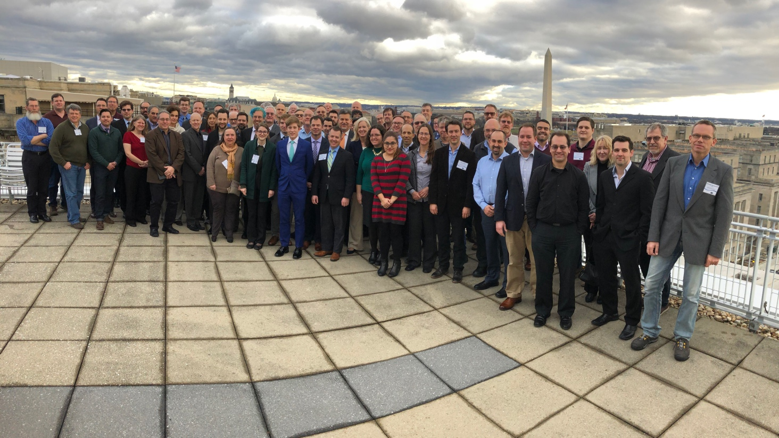
WANDA 2019 → WANDA 2020
The annual WANDA workshops are now providing a forum for nuclear data providers and users to address crosscutting needs
They are providing guidance to DOE NP, NE, Isotopes and several NNSA offices to plan collaborative NDIAWG efforts.
Having the focus areas move from year to year provides reflects the changing needs of nuclear applications
Workshop for Applied Nuclear Data Activities (WANDA)
January 22-24, 2019
George Washington University
Whitepaper* topics include Nuclear Energy, Isotope Production, Materials Damage Cross Sections, Safeguards and Atomic/XRF data
Many thanks to the WANDA 2020 Chair: Cathy Romano!
139 attendees from 48 labs, institutions and companies
*https://nucleardata.berkeley.edu/wanda/docs/WANDA_2019_Final_Report_040119.pdf
Notes:
I am the technical co-chair

Slide 3
The real WANDA success is in bringing together nuclear data Users and Providers to address crosscutting needs
At this “midway” point into the FY18 FOA activities we’ve seen many successes:
  New collaborations formed.
  New data products becoming available.
  New people joining the effort.
We’ve also learned lots about where improvements to the nuclear data pipeline process are needed.
USERS
Needs and
Impact
EVALUATORS/
PROCESSORS
EXPERIMEN-
TALISTS
Evaluation Code
Capabilities/
Needs
PROGRAM MANAGERS
Experimental
Capabilities/
Needs
MISSION PRIORITIES
Collaboration Opportunities
Coordinate efforts
INTERNATIONAL
COLLABORATORS
UNIVERSITIES
In this talk I’ll review some of the issues and success stories that I’ve learned about over the last 5 years

Slide 4
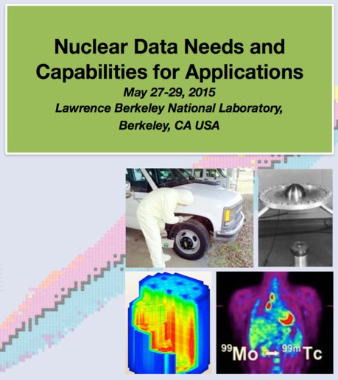
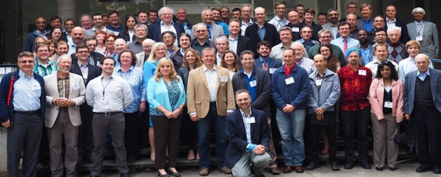


How we got here – Last year’s WANDA timeline
NSSC renewed with new Nuclear Data Crosscutting Area (10/16)
Nuclear
Data Exchange Program
Managers Meeting (4/16)
First Nuclear Data Interagency Working Group (NDIAWG) FOA, including three new starts
(7/17)
Second NDIAWG FOA including eight new starts
(6-10/18)
USNDP Review (7/14)
NDNCA Workshop and Whitepaper (5-10/15)
Nuclear Data Working Group
DOE-NP, DOE-NE, NNSA (Several), DTRA, DNDO, Isotope Program
(C. Romano)
(11/15-now)
NDNCBS Workshop and Whitepaper (8/18)
WANDA
NDREW
Nuclear Data Roadmapping Enhancement Workshop
(1/18)
Notes:
This is in your handout

Slide 5
The ever-growing nuclear data timeline
NSSC renewed with new Nuclear Data Crosscutting Area (10/16)
Nuclear
Data Exchange Program
Managers Meeting (4/16)
First Nuclear Data Interagency Working Group (NDIAWG) FOA, including three new starts
(7-12/17)
Second NDIAWG FOA including eight new starts
(6-10/18)
Third NDIAWG FOA
(6/19)
(Review – 1/20)
USNDP Review (7/14)
NDNCA Workshop and Whitepaper (5-10/15)
Nuclear Data Working Group
DOE-NP, DOE-NE, NNSA (Several), DTRA, DNDO, Isotope Program
(C. Romano)
(11/15-now)
NDNCBS Workshop and Whitepaper (8/18)
WANDA
2019 (1/19)
WANDA
2020 (3/20)
NDREW
Nuclear Data Roadmapping Enhancement Workshop
(1/18)
A coordinated national nuclear data plan is emerging
Notes:
This is in your handout

Slide 6
The shifting meeting topics foster collaboration, but force us to make tough choices each year
NDNCA (2015)
NDEM (2016)
1.Dosimetry Standards
2.Fission
3.Decay Data and γ-Branching Ratios
4.Neutron Transport Covariance Reduction
5.Expanded Integral Validation
6.Antineutrinos from Reactors
Improving the Pipeline infrastructure
Improved Covariance Data
Inelastic Scattering on actinides
Capture gamma spectra
Improved Fission yields
Target Prod. to Support ND Experiments
WANDA (2019)
NDREW (2019)
Nuclear Data for Isotope Production
Safeguards
Materials Damage
Nuclear Data for Nuclear Energy
(n,x) reactions
Atomic Data, NRF Data
Uncertainty, Sensitivity, and Covariance
Neutron Capture and Associated Spectra
Fission I, Independent and Cumulative Yields
Gamma-Induced Reactions
Inelastic Neutron Scattering & Assoc. Spectra
Fission II, Prompt Gammas and Neutrons
(α,n) Reactions
Targets, Facilities and Detector Systems
Fission III, Decay Data
Development of Benchmark Exercises
Data Processing & Transport Code Needs
Actinide Cross Sections
WANDA (2020)
Covariance/Uncertainty/Sensitivity/Validation
Nuclear Data for Isotope Prod. and Targetry needs
Machine Learning/Artificial Intelligence
Detector Models, Atomic Data & Stopping Powers
Scattering, Transport and Shielding
Neutron induced gammas and gamma decay

Slide 7
The meetings have led to new efforts in many areas
NDNCA (2015)
NDEM (2016)
1. Dosimetry Standards
2. Fission
3. Decay Data and γ-Branching Ratios
4. Neutron Transport Covariance Reduction
5. Expanded Integral Validation
6. Antineutrinos from Reactors
Improving the Pipeline infrastructure
Improved Covariance Data
Inelastic Scattering on actinides
Capture gamma spectra
Improved Fission yields
Target Prod. to Support ND Experiments
WANDA (2019)
NDREW (2019)
Nuclear Data for Isotope Production
Safeguards
Materials Damage
Nuclear Data for Nuclear Energy
(n,x) reactions
Atomic Data, NRF Data
Uncertainty, Sensitivity, and Covariance
Neutron Capture and Associated Spectra
Fission I, Independent and Cumulative Yields
Gamma-Induced Reactions
Inelastic Neutron Scattering & Assoc. Spectra
Fission II, Prompt Gammas and Neutrons
(α,n) Reactions
Targets, Facilities and Detector Systems
Fission III, Decay Data
Development of Benchmark Exercises
Data Processing & Transport Code Needs
Actinide Cross Sections
WANDA (2020)
Covariance/Uncertainty/Sensitivity/Validation
Nuclear Data for Isotope Prod. and Targetry needs
Machine Learning/Artificial Intelligence
Detector Models, Atomic Data & Stopping Powers
Scattering, Transport and Shielding
Neutron induced gammas and gamma decay
Areas where work has been supported

Slide 8
A key component of all these meetings has been a whitepaper that captures the lessons learned
NDNCA 2015
NDREW 2018
WANDA 2019
We need your input after the workshop is over too!

Slide 9
DOE Nuclear Physics has now organized three Nuclear Data Interagency Working Group FOAs
$1.5 M/year, ≤5 years
$4.0 M, ≤5 years
$4.0 M per year
  Participants included DOE/SC-NP, NE, Isotopes, NA-22, NA-11
Notes:
Emphasis on the last sentence

Slide 10
NDIAWG Efforts Funded to Date
Project | Sponsors | Year
Improving the Nuclear Data on Fission Product Decays at CARIBU | NP+NA-22 | 2017
Novel Approach for Improving Antineutrino Spectral Predictions for Nonproliferation Applications | NP+NA-22 | 2017
²³⁸U(p,xn) and ²³⁵U(d,xn) ²³⁵⁻²³⁷Np Nuclear Reaction Cross Sections Relevant to the Production of ^{236g}Np |  | 2017
State-of-the-art Gamma-ray Spectroscopy to Enhance the ENSDF | NP | 2018
Beta-strength function, reactor decay heat, and anti-neutrino properties from total absorption spectroscopy of fission fragments | NP | 2018
Improving the double-differential ²³⁸U(n,n’γ) cross section using neutron-gamma coincidences | NE+NP (+DP & AFIT) | 2018
Integral Measurements of Independent and Cumulative Fission Product Yields Supporting Nuclear Forensics and Other Applications | NA-222 | 2018
Evaluation of Energy Dependent Fission Product Yields | NA-221 | 2018
Measurement of Independent Fission Product Yields | DP | 2018
Independent Fission Product Yields from 0.5 to 20 MeV | DP | 2018
Energy Dependent Fission Product Yields | DP | 2018
Nuclear Data Scoping Studies | NA-22 | 2019
The coordinated fission yields efforts are directly due to this process

Slide 11
Many programs are becoming aware of the importance of nuclear data and they’re supporting it through other mechanisms as well
CINR (DOE-NE)
IDPRA (Isotope Program)
DTRA (Detection)
SSAA (NA-11)
…Plus many more
  Nuclear Data is moving out of the shadows ☺

Slide 12
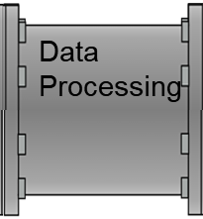
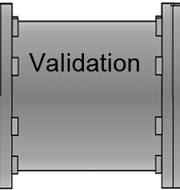
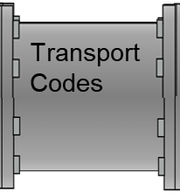
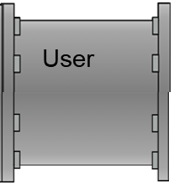
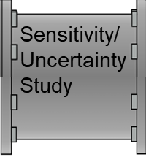
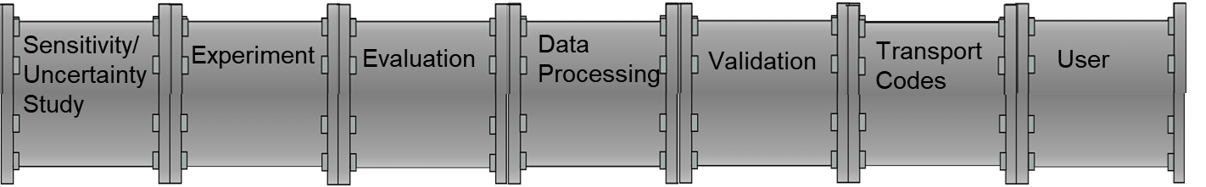
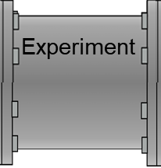
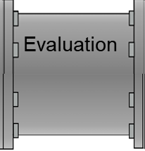
The Nuclear Data Pipeline isn’t quite up to Uniform Plumbing Code standards…
The segments aren’t always well-linked and there are leaks..
Templates are needed! (Neudecker, Lewis)
Sometimes there are no evaluators! (fission yields)
What’s “processing” ???
I’m part of a pipeline???
Experiment is often driven by curiosity, institutional needs and $
Publications often lack the info needed by evaluator
Sometimes no validation data sets are available e.g., (n,n’γ)
Proton transport issues in MCNP
Notes:
At step 7 – Sorry Jeremy!

Slide 13
On the other hand the Pipeline has lots of great features I didn’t know about…
WANDA
WANDA
WANDA
First of all, The ends are connected ☺
There is a torrent of new, high-quality data entering the system
Water quality sensors (many of whom are in this room) are an integral part of the pipeline

Slide 14
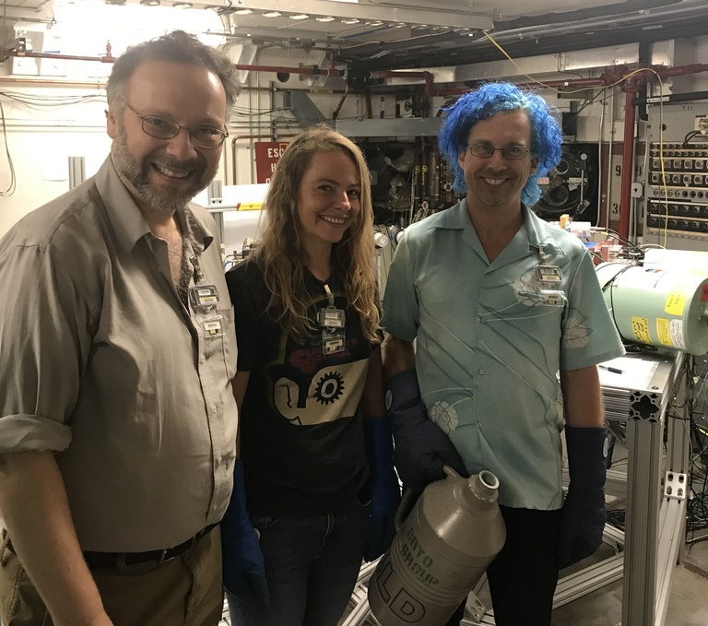
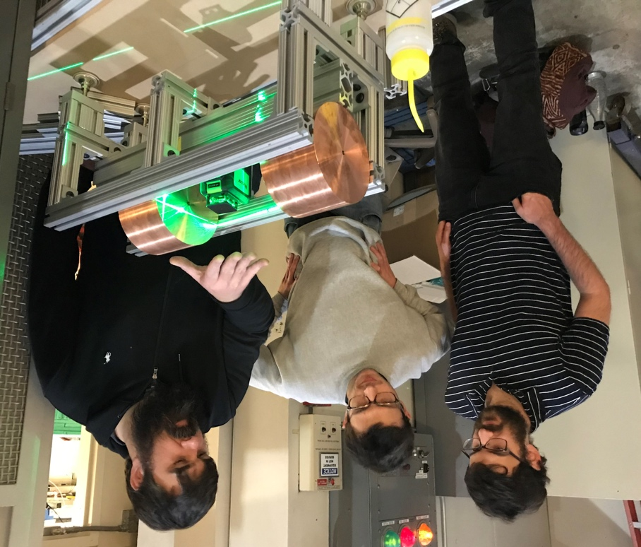
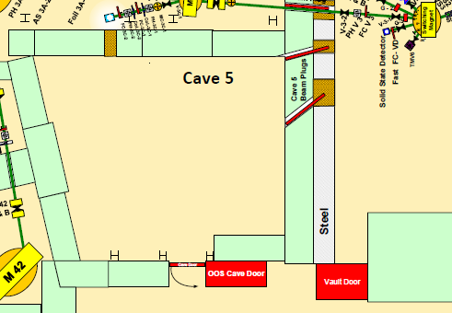
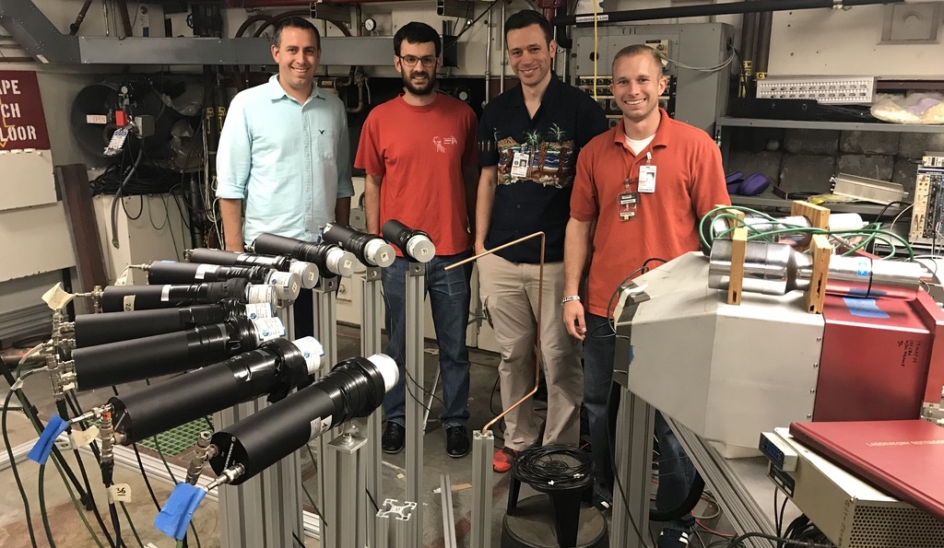
Success Example #1: The Joint NP-NE NDIAWG ²³⁸U(n,n’γ) program has grown to include partners from NA-11 (LLNL) & AFIT
The Gamma-Energy Neutron-Energy Spectrometer for Inelastic Scattering (GENESIS)
Collimator
Neutron
Target
GENESIS
Vault
Berkeley/Livermore team: LAB, B. Goldblum, T. Laplace, D. Bleuel, J. Brown
GENESIS provides coincident neutron−γ spectroscopy (see the talk on Thursday)
NA-11 is contributing to validate scattering libraries (First case: ⁵⁶Fe).
DNN & DTRA will get improved data for interrogation and effects testing.
Prompt (n,fγ) will aid the fission yields evaluation effort
AFIT team: Prof. James Bevins with students B. Frandsen and R. Chapman

Slide 15
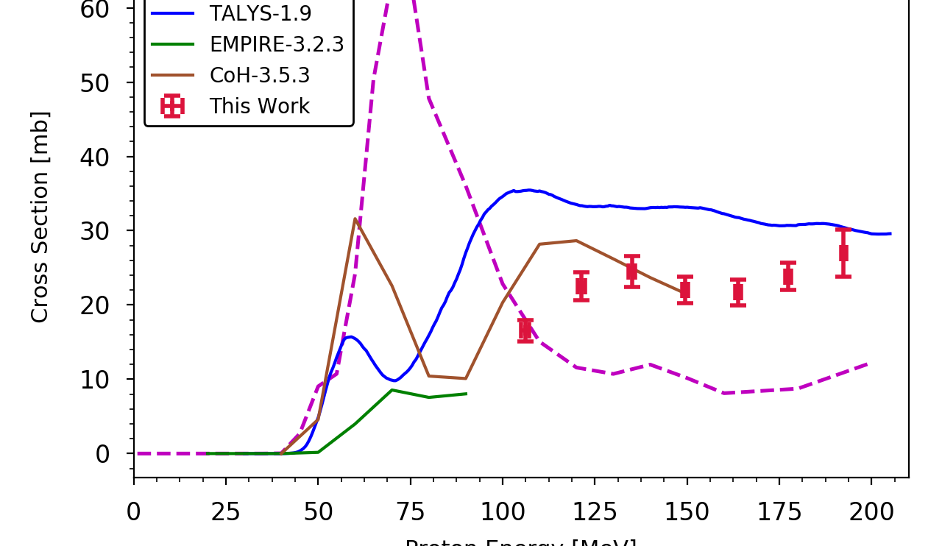
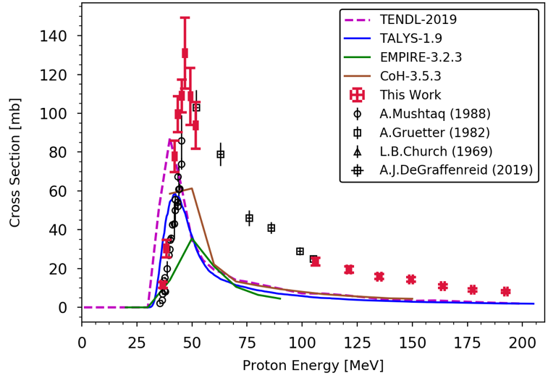
Example #2: The Isotope Program has started a Tri-lab effort to measure production cross sections up to 200 MeV
Isotope program is sponsoring a multi-lab effort at LBNL (≤ 60 MeV), LANL (≤ 100 MeV) and BNL (≤ 200 MeV) to cover the entire energy range of interest
The stacked target technique¹ is being used to measure important isotope production cross sections.
Dozens of long-lived ground states and isomers measured via activation.
Come to the Isotopes Section to see more!
Monitor
Foils
Foil of Interest
Al
Degraders
Beam
⁷⁵As(p,x)⁷²Se
Collaborators:
M. Fox, J. Morrell, A. Voyles, J.C. Batchelder, L.A. Bernstein (LBNL)
C. Cutler, D. Medvedev (BNL)
E. Birnbaum, F.M. Nortier, E. O’Brien,
C. Vermeulen (LANL)
Morgan
Fox
⁷⁵As(p,x)⁶⁸Ge
Notes:
Next up: protons on antimony and lead.

Slide 16

WANDA success story example #3: A γ-ray/X-ray coincident detector (DTRA/PNNL)
X-ray
Bruce Pierson is developing an “8π” system that utilizes both γ-ray and Si SDD X-ray detectors.
γ
γ
It required a new coincident γ-X decay database.
The database developed with Aaron Hurst (UC) can be used for fission yield measurements & more
106 keV Gate
The bigger success is that Bruce is now a key part of the “nuclear data family”
$${}_{93}^{239}{Np\underset{→}{β^{−}−decay}}{}_{94}^{239}{Pu}$$

Slide 17
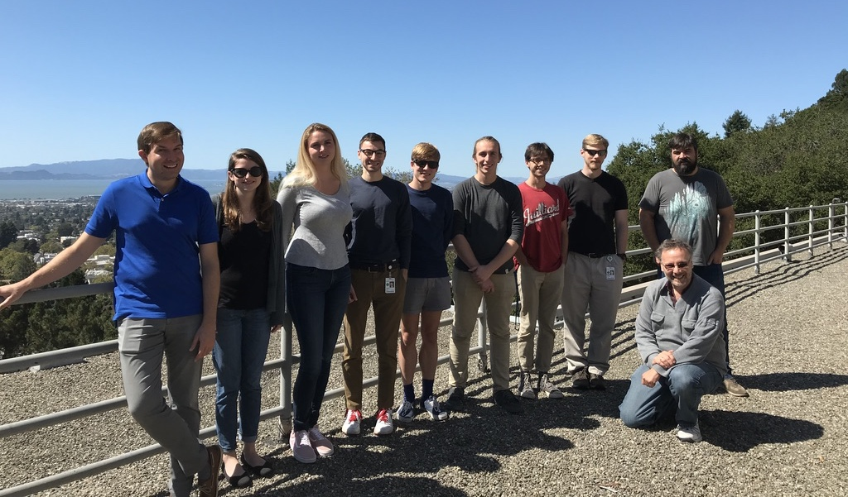
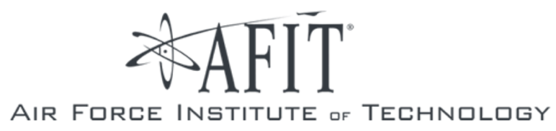



Another product of the nuclear data pipeline – Ph.D. students with Applied Nuclear Data Thesis Topics
Catherine
Apgar
Eric
Matthews
Joey
Gordon
Andrew
Voyles
Josh
Brown
Morgan
Fox
Jon
Morrell
Jason
Matheny
Amanda
Lewis
Lee Bernstein
  University engagement in applied nuclear data is growing!
Notes:
All of these young people will tell you that their Ph.D. is in nuclear data for applications!

Slide 18
Conclusion
  The NDNCA (2015) → NDREW (2018) → WANDA (2019) → WANDA (2020) meetings have brought together the providers and users of nuclear data and made them aware of:
    Cross-cutting nuclear data needs;
    The need to keep all parts of the nuclear data pipeline functioning and connected;
    New collaboration opportunities involving nuclear data
  Many agencies are supporting nuclear data outside of the NDIAWG FOA in coordination with members of the NDIAWG
  The capabilities being developed by the NDIAWG to address one need are being used to address other needs (e.g., spin-back)
  The WANDA/NDIAWG process is engaging a new generation of nuclear researchers to address outstanding societal needs.
Thanks to all of you for being a part of this!

Slide 19


Collaborators and Acknowledgments
L.A. Bernstein^{1,2}, J.C. Batchelder², E.R. Birnbaum³, D.L. Bleuel⁴, J.A. Brown², C.S. Cutler⁵, M. Fox¹, B.L. Goldblum², J.M. Gordon^{2,4}, T. Laplace², A. M. Lewis², D. Medvedev⁵, J. Morrell¹, F.M. Nortier³, E.M. O’Brien³, B. Pierson⁶, C. Vermeulen³, A.S. Voyles²
¹Lawrence Berkeley National Laboratory
²University of California – Berkeley Department of Nuclear Engineering
³Los Alamos National Laboratory
⁴Lawrence Livermore National Laboratory
⁵Brookhaven National Laboratory
⁶ Pacific Northwest National Lab.
This work has been performed under the auspices of the U.S. Department of Energy by Lawrence Berkeley National Laboratory under contract No. DE-AC02-05CH1123, Lawrence Livermore National Laboratory under Contract No. DE-AC52-07NA27344, Los Alamos National Laboratory operated by Triad National Security, LLC, for the National Nuclear Security Administration of U.S. Department of Energy (Contract No. 89233218CNA000001 and Pacific Northwest National Lab under Contract No. DE-AC05-76RL01830.. This research is also supported by the U.S. Department of Energy Isotope Program, managed by the Office of Science for Nuclear Physics.

