Slide 1
Evaluation of Energy Dependent Fission Product Yields
T. Kawano, LANL
contributed by A. Sonzogni (BNL), L. Bernstein (LBNL), L. Wood (PNNL), and N. Schunck (LLNL)
Notes:
Content Slide Notes
“UNCLASSIFIED” marking of slides is not a security requirement and may be deleted from the Slide Master (View › Master › Slide Master). In general, slides should be marked “UNCLASSIFIED” if there is potential for confusion or misinterpretation of something that could be deemed classified. For guidance on marking slides containing classified and unclassified controlled information, see the Protecting Information Web site at http://int.lanl.gov/security/protectinfo/.

Slide 2
Objectives
ENDF Fission Product Yield (FPY) library produced in 1990's, and limited upgrade made by Chadwick and Kawano to take account of energy-dependence
Revival of the FPY evaluation effort
  Demands for more accurate FPY data rapidly increasing, especially better representation of energy dependence of FPY
  New theoretical modeling for the fission, prompt and delayed decay processes available
  New experimental data, not only the FPY data but also relevant observable for the fission phenomena, also available
  Recognition of importance of new FPY data by international nuclear data communities
    IAEA will start a new international cooperative research project (CRP)

Slide 3
Energy-Dependent FPY Project Funded by NA22
Joint effort by 5 laboratories
  LANL (leading lab) develops FPY models and produce the final FPY data files
  BNL complies experimental FPY data and produces a set of recommended FPY values, performs FPY data validation calculations
  LBNL performs measurements of energy-integrated and differential CNAA (Cyclical Neutron Activation Analysis) using the intense neutron source by the LBNL cyclotron, and data interpretation by the FIER code
  PNNL develops a new Bragg curve based fission TPC (Time Projection Chamber) analysis in collaboration with LANL and LLNL (see Duke's talk)
  LLNL develops theories and methods to calculate primary fission fragment yields, and performs FREYA calculations for prompt decay

Slide 4
Project Status and Recent Highlights, LANL
Extending FPY model up to higher energies
  Inclusion of multi-chance fission by the LANL Hauser-Feshbach code CoH₃
  Extract required quantities, fission probabilities, average energy of pre-fission neutrons, probabilities of fission at each excitation energy, and calculate TKE at each excitation energies
Apply Okumura model [JNST 55, 1009 (2018)] to each fissioning CN

Slide 5
Project Status and Recent Highlights, LANL (cont'd)
Better modeling for fission fragment configurations
  number projection method by Verriere [PRC100, 024612 (2019)]
Maintaining international FPY evaluation network
  survey missing experimental data in EXFOR by BNL and IAEA [INDC(NDS)-0793 (2019)]
  preparatory FPY evaluation meetings at IAEA in Aug. 2019 and Jan. 2020 [IAEA-NDS-230]
    enhanced capabilities in TALYS (IAEA) and CCONE (JAEA) to produce FPY

Slide 6
Project Status and Recent Highlights, BNL
EXFOR Compilations | Neutron-induced | Charged particle-induced | Gamma-induced
Old articles | 53 | 56 | 6
New articles | 18 | 1 | 7
Number of Fission Yield articles added to NSR: 283
Compilation of all ²³⁸U neutron-induced data is nearly complete
Corrections of ²³⁸U fission yields to account for more precise decay data is about 50% complete
JSON format developed in cooperation with the IAEA (V. Zerkin)
Plots generated for comparison of measured data
BNL team: Andrea Mattera, Libby McCutchan, Boris Pritychenko, Alejandro Sonzogni, JoAnn Totans, Matteo Vorabbi, Olena Gritzvay, Stanislav Hlavac

Slide 7
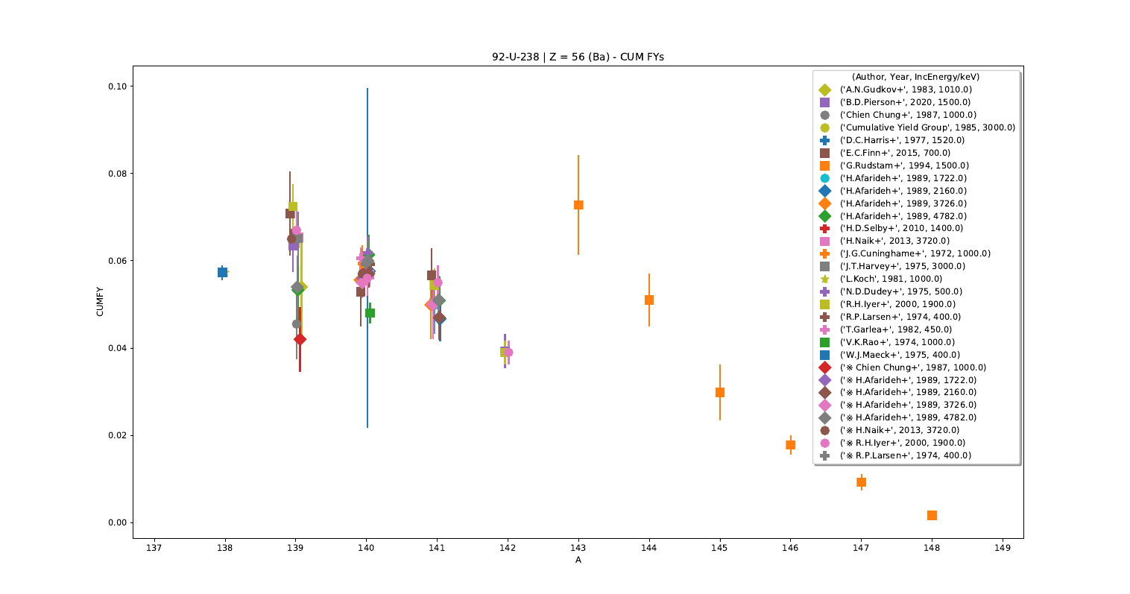
Project Status and Recent Highlights, BNL (cont'd)
²³⁸U | Z = 56 (Ba) | cumulative FYs
Data from ~130 NSR articles converted to new JSON format
Plots have been produced for all isotopes showing available cumulative and independent FYs.
19 entries (out of 40 with decay data in the reference) already corrected using up-to-date decay data.
Additional NSR entries for ²³⁸U(n_{14MeV},f) identified and collected

Slide 8
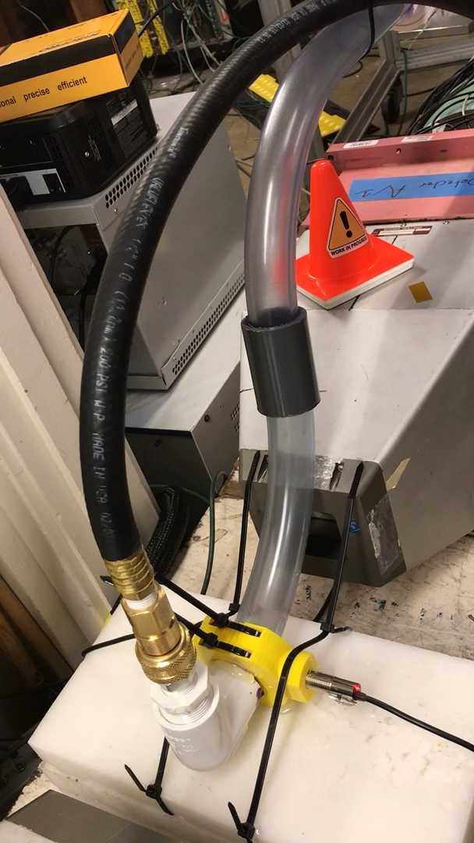

The Berkeley Group is measuring independent fission yields via cyclical neutron activation analysis
Cyclical Irradiation
Fast Loading & Unloading Facility for Fission Yields (FLUFFY)
7000
5 s irradiation
5000
≈750 ms transit
^{238,235}U + Al₂O₃ irradiated using d-breakup and Li(p,n) neutrons at the 88-Inch cyclotron to determine FPY relative to ²⁷Al(n,α)²⁴Na
5 s irrad. + 125 s counts
γ-spec compared to FIER*
125 s
count
Counts
3000
1000
0
30
60
90
120
150
180
210
Time (s)
¹⁰⁰Nb (1.5 s)
¹⁴⁵Ba (4.3 s)
Counts
Energy (keV)
The plan is to run ²³⁸U, ²³⁵U and ²³⁹Pu
*E.F. Matthews et al., NIM, A 891 (2018) 111
E. Matthews

Slide 9
They have also developed a model-independent method of determining fission yield covariances
Resample a FY about its uncertainty
Renormalize & generate the complementary FY using P(ν)
This method complements model-dependent FY covariance determination

Slide 10
FPY Project at LLNL
Use microscopic fission theory to compute initial fragment (distributions and excitation energy) as a function of neutron incident energy
Started this FY
Team
  N. Schunck, R. Vogt, M. Verriere
  Collaboration with LBNL on FREYA
Objectives
  Initial fission fragment distributions of major actinides for thermal neutrons (Q1-Q2)
  Fission fragment excitation energy from time-dependent density functional theory (Q2-Q3) calculations
  With LBNL: Integrate FIER capability into FREYA (Q2-Q4)
  Incorporate particle number dispersion in fission fragment calculations (Q4)

