Slide 1
Nuclear Data Interagency Working Group - Nonproliferation Scoping Studies
Catherine Romano and Seth McConchie
WANDA2020
March 3-5, 2020, Washington, DC

Slide 2
Project Overview
Goal is to provide ACTIONABLE plans to resolve nuclear data issues that impact applications
  Identify needs
  Quantify impact to specific applications where possible
  Quantify goal nuclear data uncertainties where possible
  Deliver science plan at end of FY

Slide 3
(alpha,n) Scoping Study

Slide 4
Project Team

Slide 5
Project Goals
Determine the state of the libraries and modeling capabilities.
Determine application needs: passive neutron and gamma measurements, reactor calculations
Determine a path forward to resolve the nuclear data and modeling needs.

Slide 6
TASKS
Task 1: Compilation of Historical Work
Task 2: Examination of the State of the (alpha,n) Data Libraries
Task 3: Uncertainty/Sensitivity Studies
Task 3.1: LANL uncertainty study of UF₆ cylinders
Task 3.2: LLNL study of (alpha,n) source term impact to emergency response
Task 3.3: Modeling study of spent fuel source terms
Task 4: Review of Experimental Methods to Reduce Uncertainties
Task 5: SOURCES4C and Other Code Modernization
Create a maintainable code that draws from ENDF libraries
Task 6: Science Plan

Slide 7
Nuclear Data Needs
There are known issues with several aspects of (alpha,n) data.
Total cross sections
Neutron energy spectrum
Neutron angular distribution
  impacts differential nuclear data measurements
Gamma emission energies
Stopping powers
  The effects of molecular bonds, temperature, particle size not known
Evaluation methods require updating
SOURCES4C is unsupported and outdated
ENDF library is mostly theoretical or based on JENDL

Slide 8
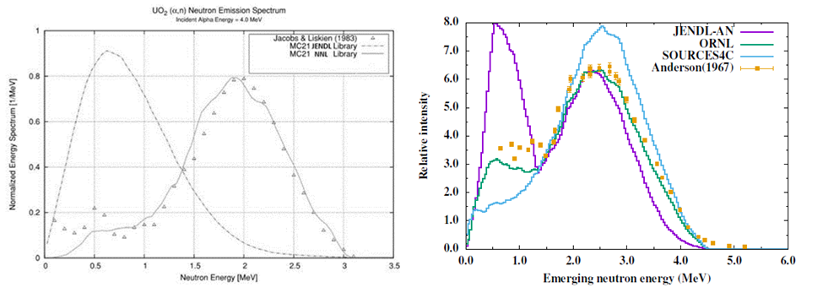
Nuclear Data Needs
Neutron Spectrum is not well known
Calculations of neutron spectrum using MC21 with the JENDL O(alpha,n) library and the Naval Nuclear Laboratory (alpha,n) library compared to experimental data (left) and theoretical calculations of the neutron spectrum from O(alpha,n) reaction compared to the JENDLE library, SOURCES4C, and experimental data (right) [Pigni, 2016].

Slide 9
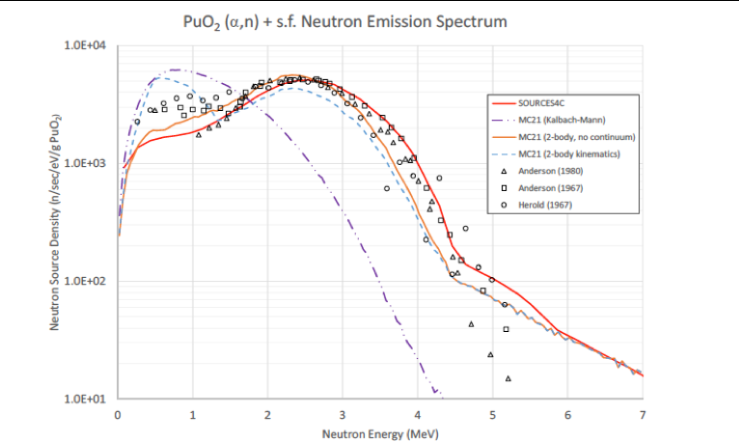

Slide 10
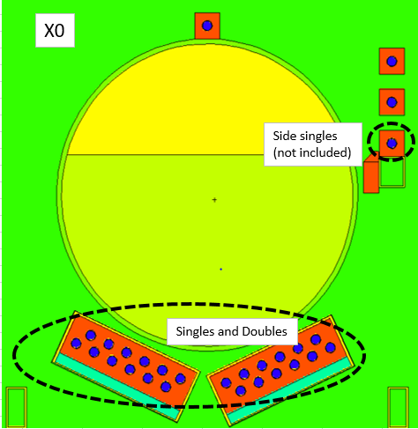
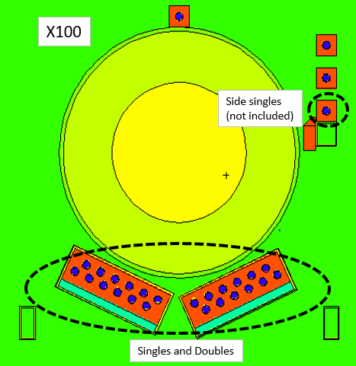
Uncertainty study of UF6 cylinders
Background: Majority of UF6 stored in cylinder at enrichment facilities
Goal: to determine the nuclear data contribution to the uncertainty budget for UF6 cylinder measurements to quantify the impact of the nuclear data uncertainties.
Method:
  MCNP modelling of detectors (2 briefcase size polyethylene pods (12 x10 atm 3He detectors). Enrichments, 235U-to-234U ratio; UF6 distribution (X-factor, percentage of UF6 bound to walls)
  (alpha,n) source terms built on the Jacobs &Liskien data (83 and 85), and on SOURCE-4C, including with a revaluation of the stopping power
  Neutrons tally in 45 bins from of 0.1 MeV width up to 4.5 MeV
Analysis and simulations in progress
Team: (LANL) A.Favalli, D.Broughton, M.Swinhoe; (ORNL) S.Croft, C.Romano

Slide 11
Some specific (alpha,n) data needs
From the radionuclide production perspective, a few reactions are poorly described at energies up to 30 MeV:
  Ga-69/71(a,n)As-72/74
  Ca-nat/Ca-40(a,n)Ti-43-->(decay)-->Sc-43
  Ni-58(a,n)Zn-51-->Zn-61(decay)-->Ni-61
  Nat In(a,2n)Sb-117-->(decay)-->Sn-117m
Li, Be, C, O, F, Al for 5-6 MeV alphas
Safeguards and Reactors: UF_{6,} UO₂, PuO_{2,} UN, UC, UCO, U+molten salts, Minor actinides +molten salts

Slide 12
Active Neutron Interrogation Scoping Study

Slide 13
Scoping Study Personnel
Primary performers
  ORNL
    Seth McConchie
    Matthew Blackston
  LLNL
    Jerome Verbeke
    Bonnie Canion
Supporting personnel
  LBL
    Lee Bernstein
  ORNL
    Catherine Romano
    Jason Newby
    Mitch Allmond
    Keith Bledsoe
  LLNL
    Les Nakae

Slide 14
Project Goals
Determine if we can predict, measure and identify gamma emission energies of importance to active interrogation methods.
Determine a path forward to fix the gaps?
Impact to: Emergency response, safeguards, reactors, oil well logging

Slide 15
Task Structure
Task 1: Evaluate the current state of the nuclear data
Task 2: Evaluate the current state of the modeling capability
Task 3: Identify application-specific signatures
Task 4: Develop science plan

Slide 16
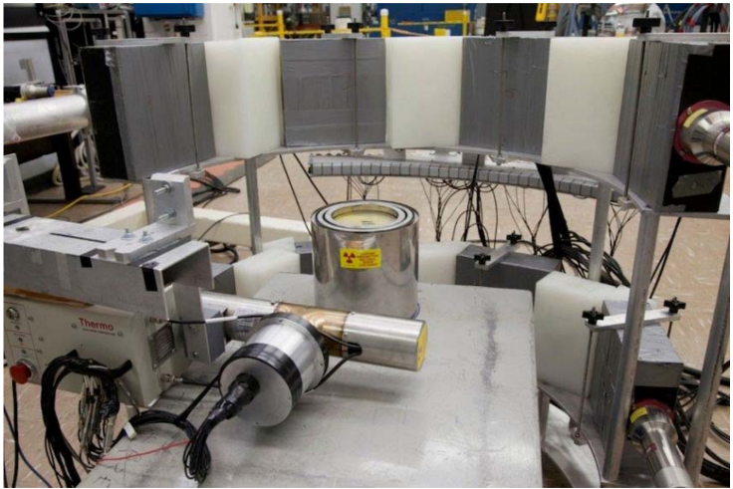
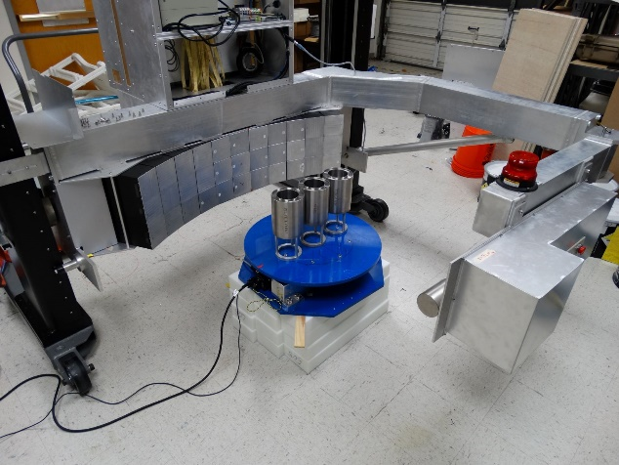
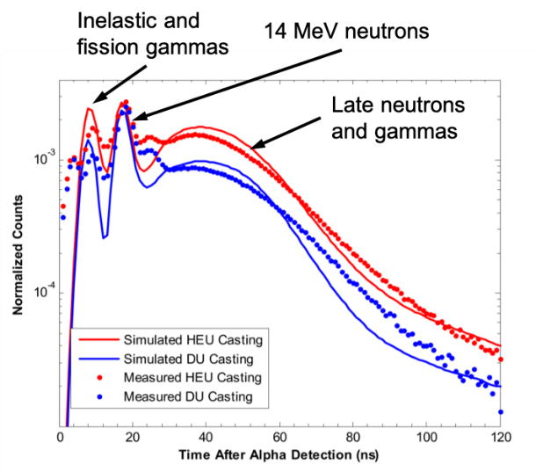
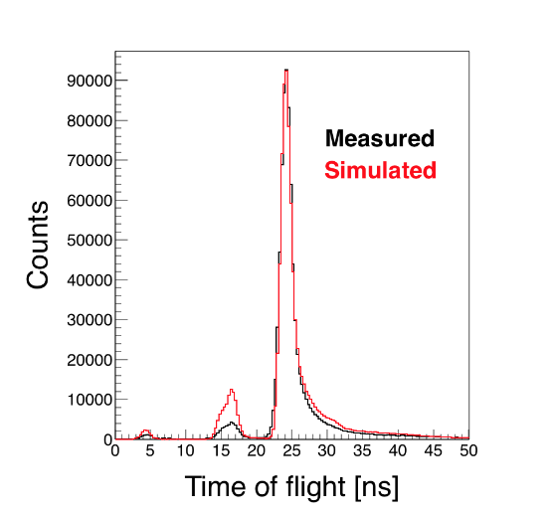
Examples of Model and Experiment Discrepancies
DU annuli
Plastic scintillator array
Various annuli
API D-T neutron generator and scintillators enable assay using time-of-flight features
Apparent modeling discrepancies with gammas (inelastic and induced fission)
Secondary gamma production (n,n’, etc) needs addressed to ensure understanding of gamma features
API D-T neutron generator
14 MeV neutrons
Inelastic
gammas
2017
2013
MCNP
Geant

Slide 17
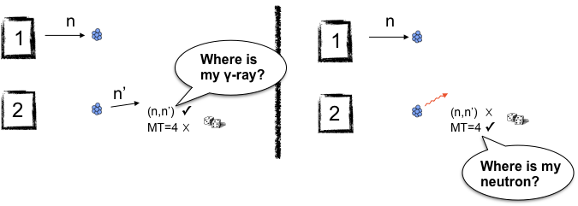
Example of Known Issues with Modeling Capability
For (n,n’), ENDF nuclear data separates inelastically scattered neutron from the photon
Need to scope the general issues of radiation transport physics modeling and their importance
  Are codes set up to simplify the neutron/gamma emission for convenience? Incomplete data libraries? Inconveniently structured data libraries?

Slide 18
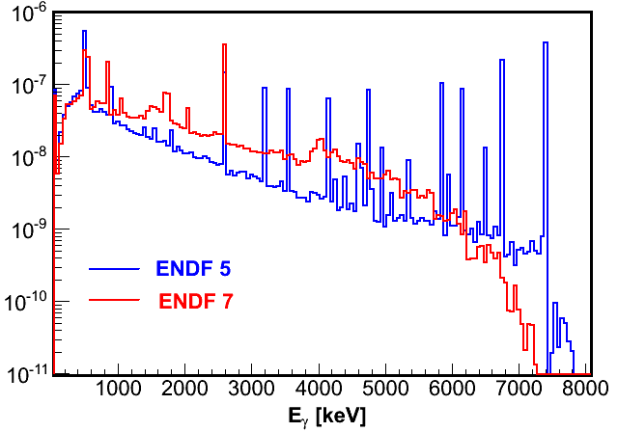
ENDF libraries for Pb
Simulation by Darren L. Bleuel (LLNL)
MCNP: ^{nat}Pb sphere; r = 30 cm
Centrally-located source
ENDF 5: ^{nat}Pb
ENDF 7:
²⁰⁴Pb (1.4%); ²⁰⁶Pb(24.1%); ²⁰⁷Pb(22.1%); ²⁰⁸Pb(52.4%)

Slide 19
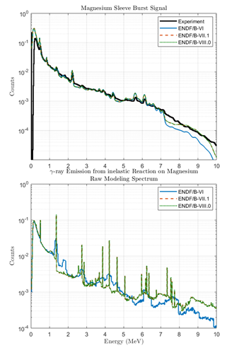
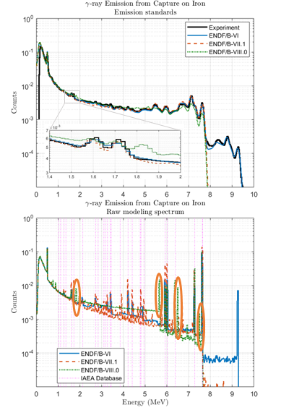
Impact to oil well logging
Marie-Laure Mauborgne R. J. Radtke
Fabien Haranger
Schlumberger

Slide 20
Give us your input!
We would like input on your needs for specific applications.
Contact:
  Catherine Romano, romanoce@ornl.gov
  Seth McConchie, mcconchiesm@ornl.gov

