Slide 1
Impact of Unrealistic or Missing Cross Section Covariances
Workshop for Applied Nuclear Data Activities 2020
Elliott School of International Affairs at The George Washington University
Teresa Bailey
Lawrence Livermore National Laboratory
March 4, 2020

Slide 2
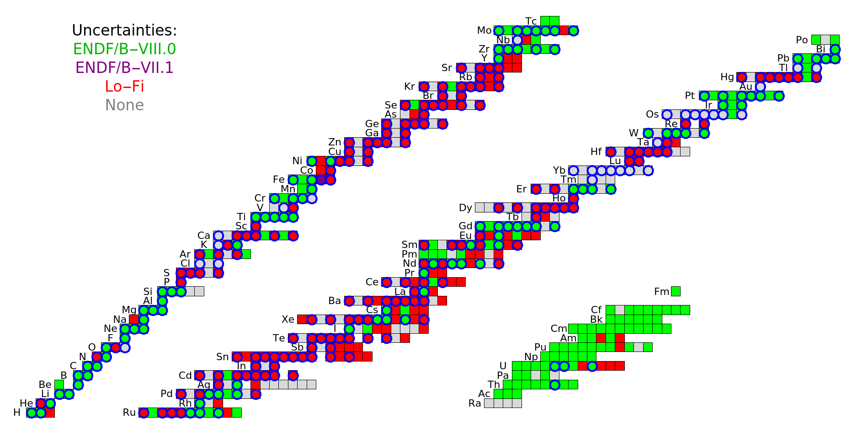
Distribution of data with select covariances
Evaluations that include (n,el), (n,n’), (n,2n), and (n,γ) covariances:
Naturally abundant

Slide 3
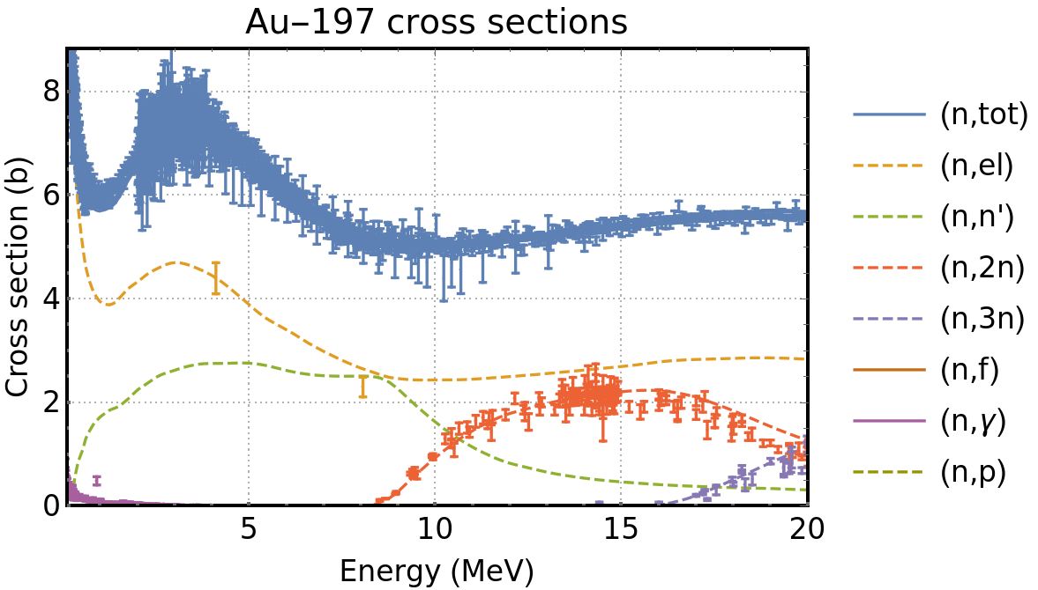
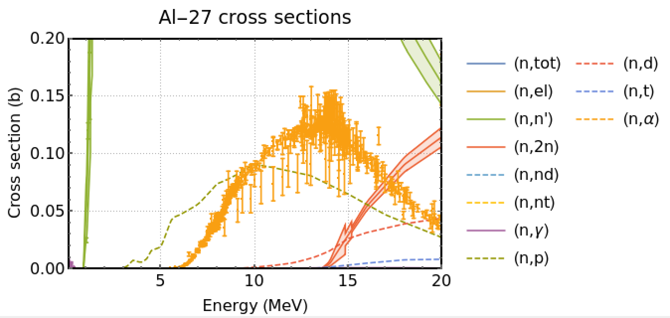
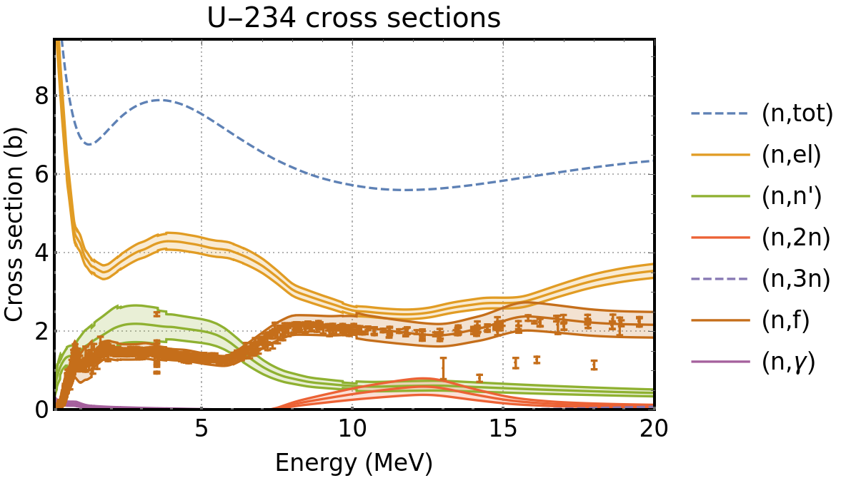
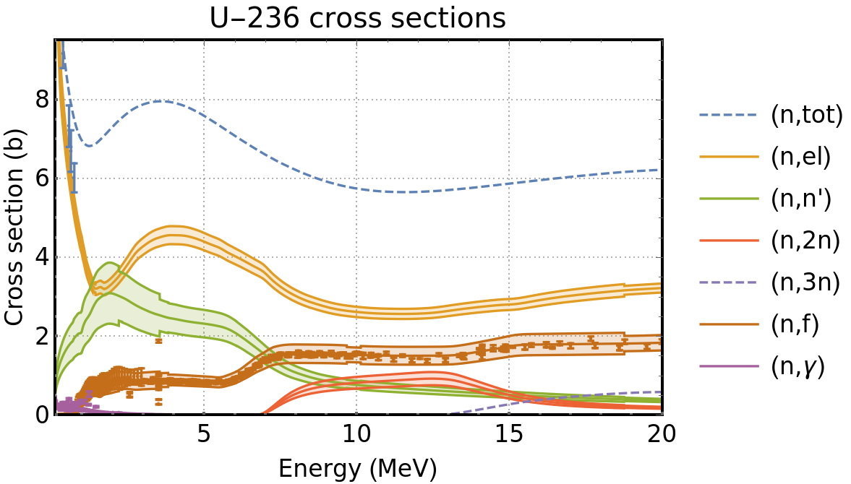
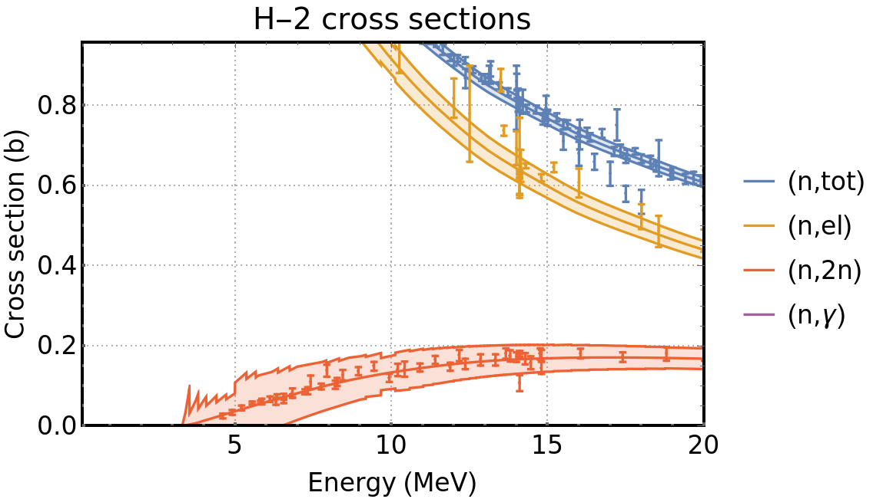
Missing and questionable covariances
Missing (n,n’), (n,2n), or (n,z) covariances: Gamma production, transport, destruction
ENDF/B-VIII.0
100% abundant
ENDF/B-VIII.0
100% abundant
Questionable covariances: Overestimates uncertainty contribution
ENDF/B-VIII.0
ENDF/B-VIII.0
ENDF/B-VIII.0

Slide 4
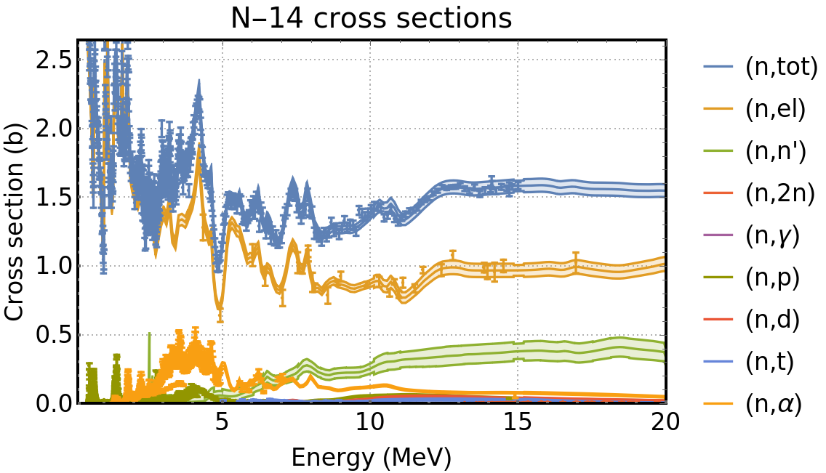
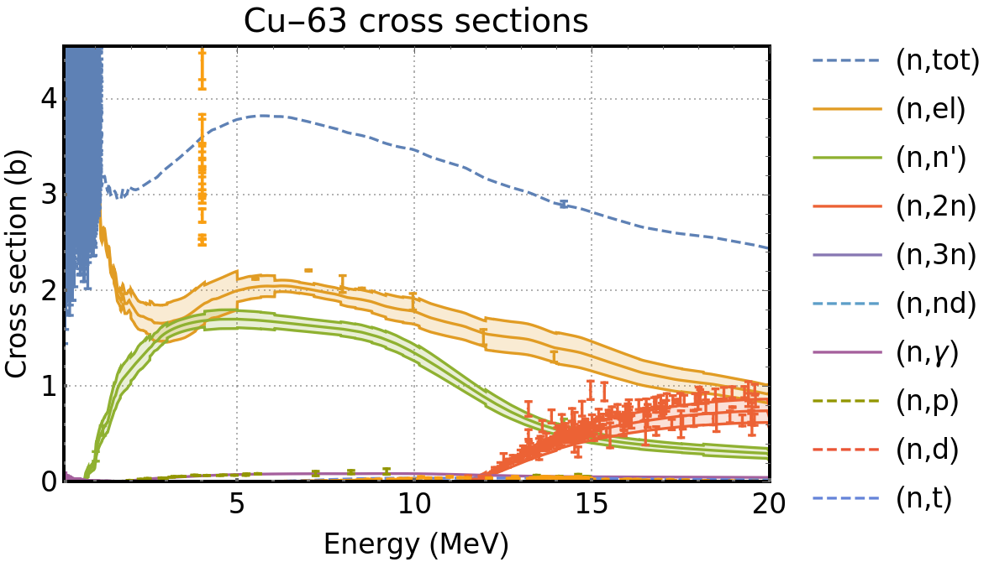
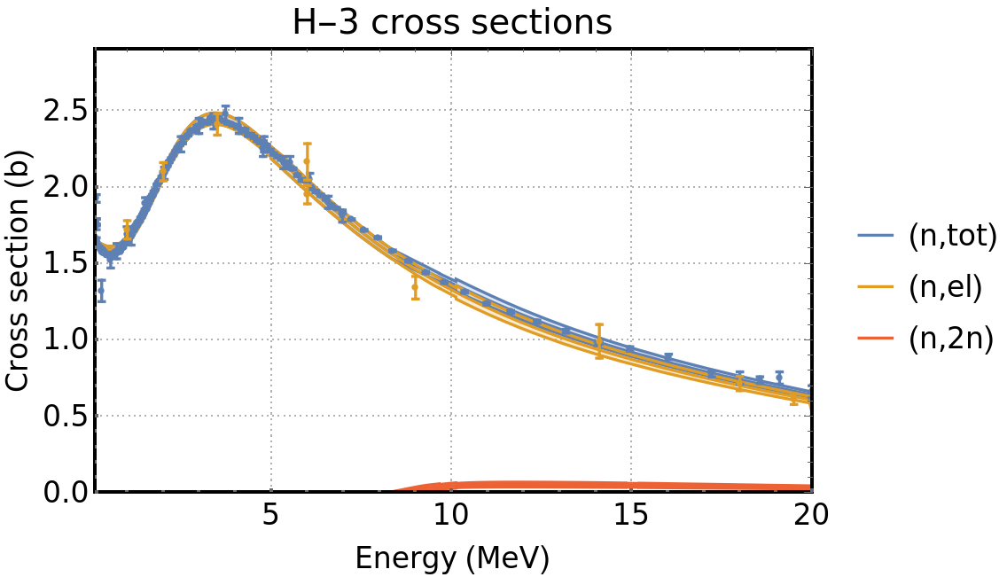
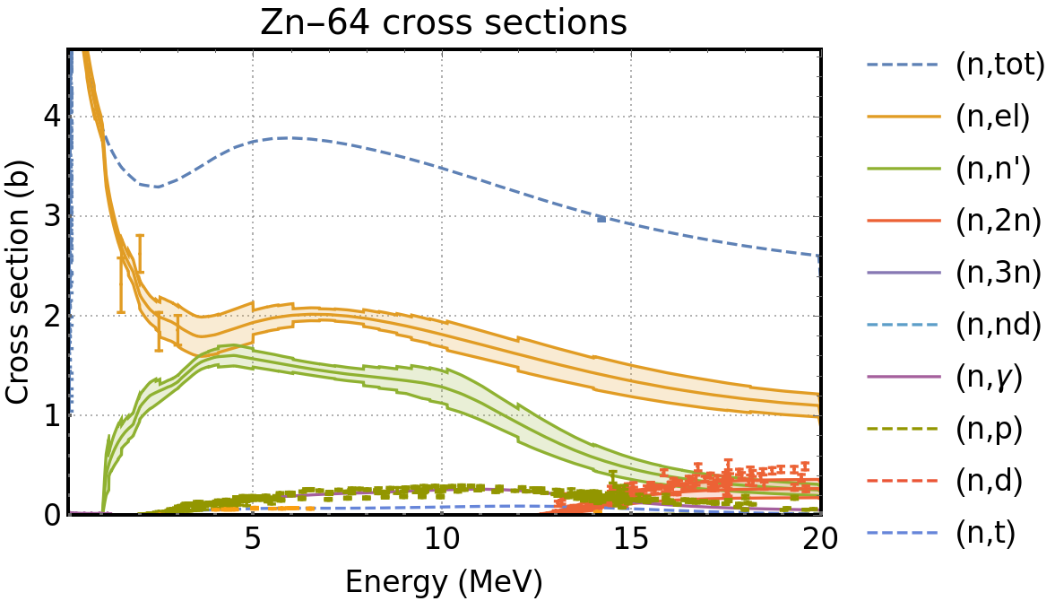
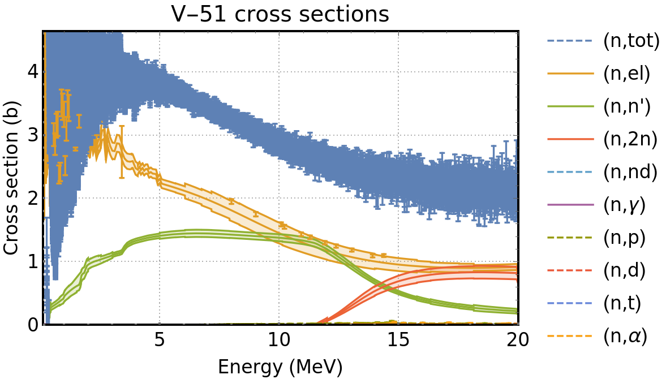
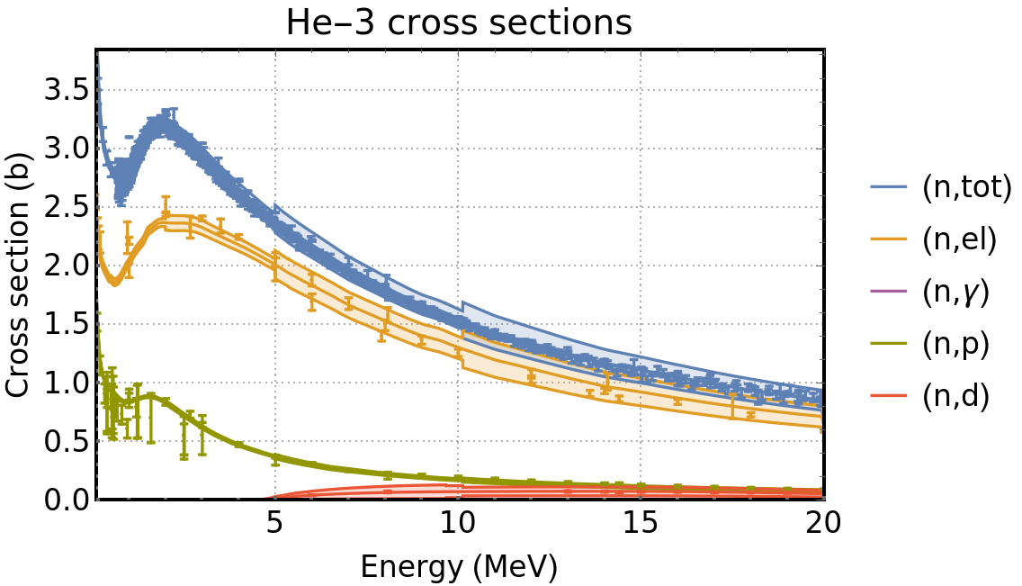
Low-Fi evaluations with available experimental data
Could experimental data be used to test whether these are credible or improve them?
Low-Fi
100% abundant
Low-Fi
69% abundant
Low-Fi
Low-Fi
49% abundant
Low-Fi
100% abundant
Low-Fi

Slide 5
LLNL consensus needs for covariances
Complete nuclear data covariances needed for applied UQ studies.
Needs can’t be established without these.
Methods for determining credibility of evaluation needed:
Visual validation provides initial approximation.
Covariances in (n,n’), (n,2n), and (n,z) needed for many isotopes:
(n,n’) and (n,2n) covariances often missing from ENDF/B-VIII.0.
Some ENDF/B-VIII.0 covariances are difficult to interpret (e.g. sums like (n,2n)+(n,2np) ).
(n,z) covariances frequently missing from ENDF/B-VIII.0 and Low-Fi.
Approximate methods for filling in missing and bad covariances needed:
Extension of Low-Fi strategy could be a useful starting point for missing reactions.
Kyle Wendt will present about a machine learning technique applied to experimental data.
Need for proper estimation of model and parameter uncertainties and their impact on pure theory covariances.

Slide 6
Some nuclear cross sections of interest with missing, limited, or inconsistent data
Isotope | Reaction | Notes
⁹Be | n-g | Two lines are fitted to one point
¹²C/¹⁴N/¹⁶O | n-n’g | Very limited data
⁵⁸Fe | n-g | Very limited data
¹⁸³W | n-p | No data to constrain the threshold
¹⁹⁰Pt | n-2n | No data to constrain the threshold
¹⁹⁰Pt | n-p | No data available
²³³U | n-2n | No data available
²³⁵U/²³⁹Pu | n-n’ | Incomplete energy-angle data
²³⁹U | n-g | Only one data point available
Peer review from LANL has begun
We would like help in assessing, choosing, or performing measurements with a minimum of 10% uncertainty
LLNL Presented this slide last year; we will continue to update this as needed and present it

Slide 7
Disclaimer
This document was prepared as an account of work sponsored by an agency of the United States government. Neither the United States government nor Lawrence Livermore National Security, LLC, nor any of their employees makes any warranty, expressed or implied, or assumes any legal liability or responsibility for the accuracy, completeness, or usefulness of any information, apparatus, product, or process disclosed, or represents that its use would not infringe privately owned rights. Reference herein to any specific commercial product, process, or service by trade name, trademark, manufacturer, or otherwise does not necessarily constitute or imply its endorsement, recommendation, or favoring by the United States government or Lawrence Livermore National Security, LLC. The views and opinions of authors expressed herein do not necessarily state or reflect those of the United States government or Lawrence Livermore National Security, LLC, and shall not be used for advertising or product endorsement purposes.

