Slide 1
Nuclear Data Uncertainties for Advanced Reactor Applications
Bradley T. Rearden, Ph.D.
Director of Engineering
Presented to:
Workshop on Applied Nuclear Data Activities
March 4, 2020

Slide 2
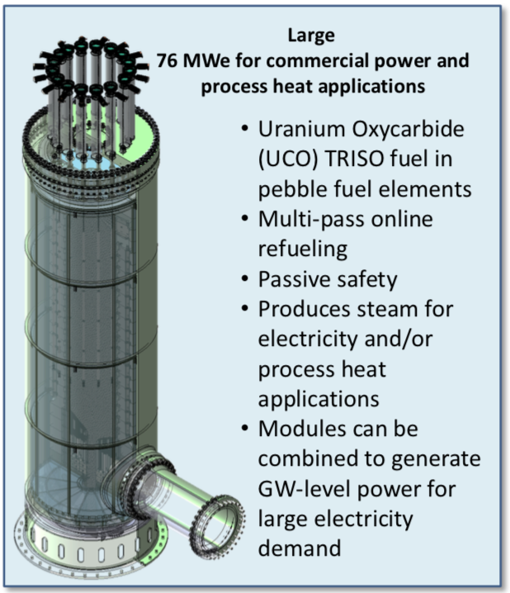
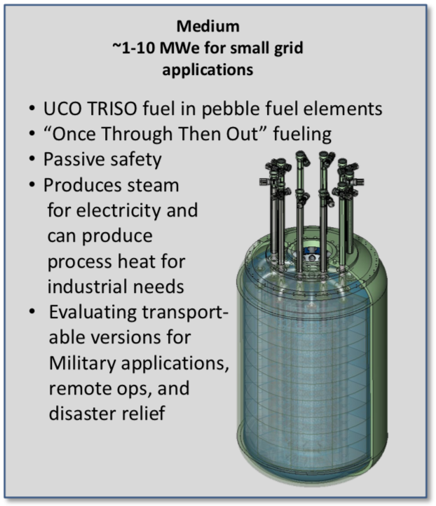
X-energy reactor solutions for different markets

Slide 3
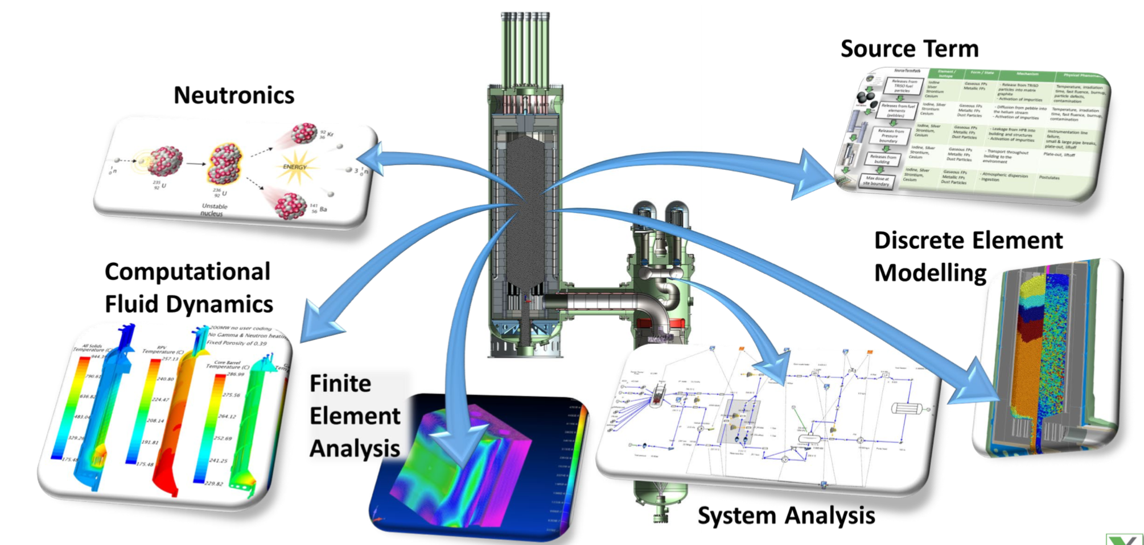
Established modeling and simulation capabilities are applied for design and licensing

Slide 4
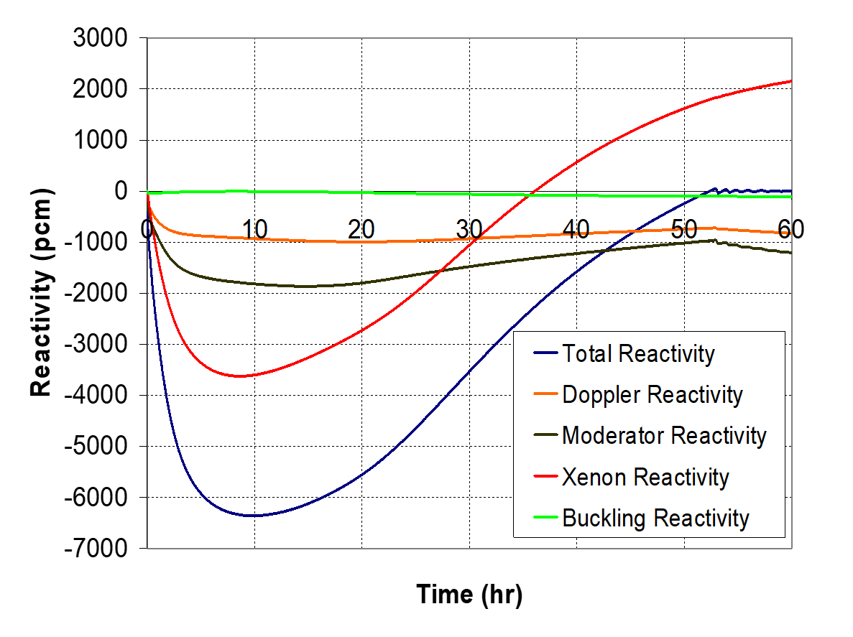
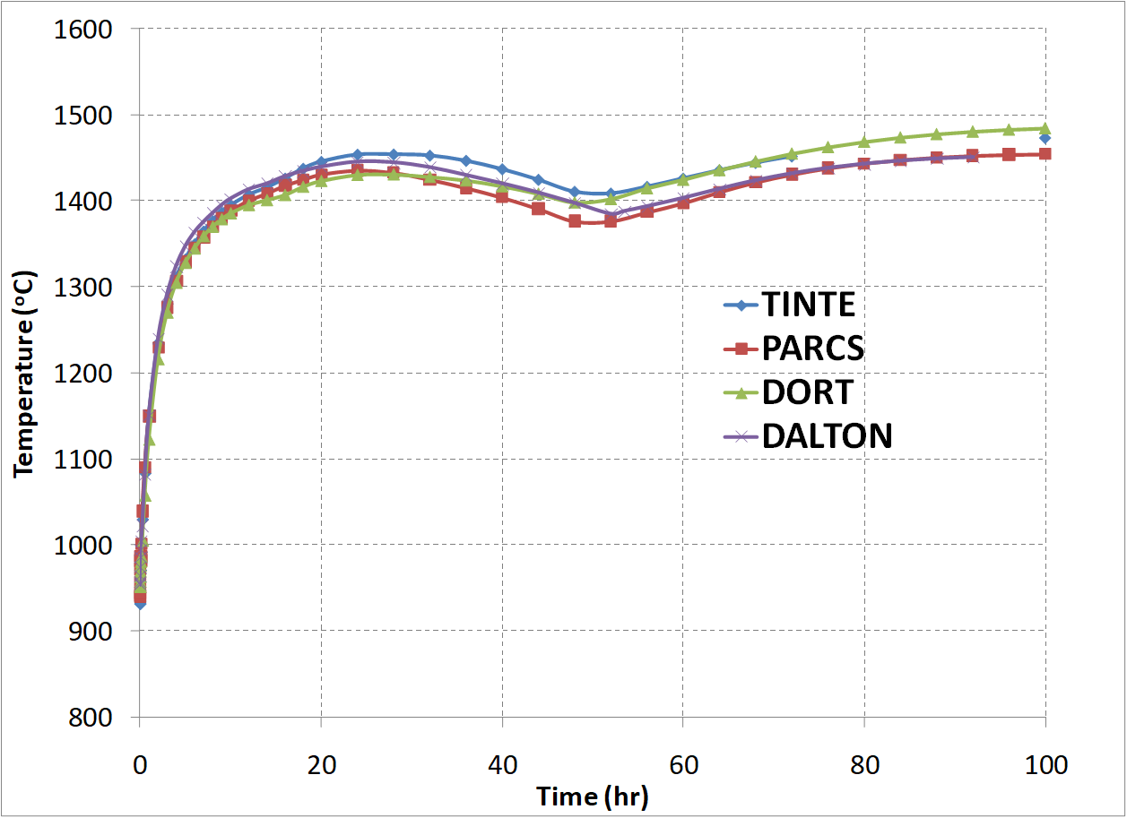
Depressurised Loss of Forced Cooling (DLOFC) without SCRAM from OECD Benchmark

Slide 5
Applications of nuclear data uncertainties
Establishing possible ranges of quantities of interest (QOIs) (e.g. TSUNAMI/Sampler)
Establishing defensible bias and bias uncertainty for validation (e.g. TSUNAMI)

Slide 6
Some quantities of interest
Enrichment, fuel fabrication, and transportation
  ~20% enriched ²³⁵U fuel and TRISO forms
Uncertainty margins for operational performance and safety
  Excess reactivity at startup
  Control rod worth for shutdown margin
  Power distribution
  Burnup and decay heat
  Doppler feedback
  Xenon concentrations
  Radiation damage to components
Uncertainty margins for radionuclide source terms
  Fission products and other radionuclides for decay heat and potential radiological release
  Hardware activation
  Gamma production from fission and decay

Slide 7
Areas of concern
Cross sections are tuned to integral k_{eff} benchmarks with little attention to accuracy of reaction rate predictions
Reaction cross section uncertainties are inconsistent with mean values used in design and safety analysis
Fission product yield uncertainties must be generated by code teams (e.g. ORIGEN)
Large changes in reaction cross sections in ENDF/B-VIII.0 make it difficult to use new data (e.g. reactor graphite thermal scattering data)
Uncertainties for thermal scattering law data are needed
Room temperature covariances are applied at all temperatures
Uncertainties in gamma yield data are needed

Slide 8

Clean • Safe • Secure • Affordable
X-energy develops Generation IV high temperature gas-cooled reactors (HTGR) and
TRISO fuel for advanced reactors world-wide.
J. Clay Sell, Chief Executive Officer

Slide 9
Backup Slides

Slide 10
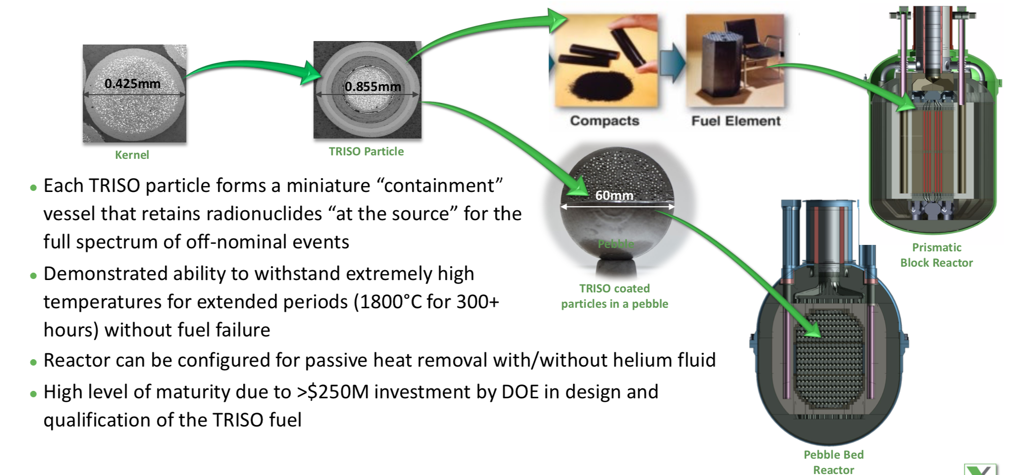
Advantages of TRISO coated particle fuel

Slide 11
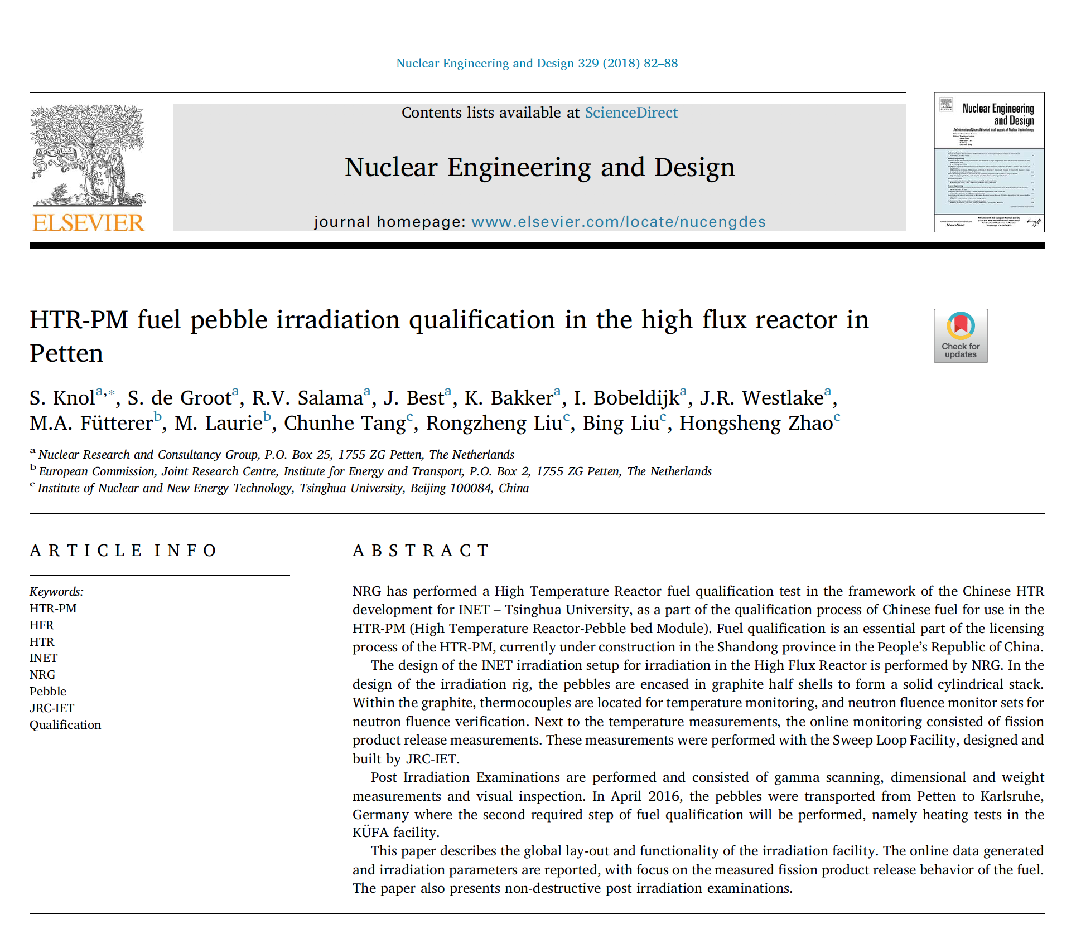
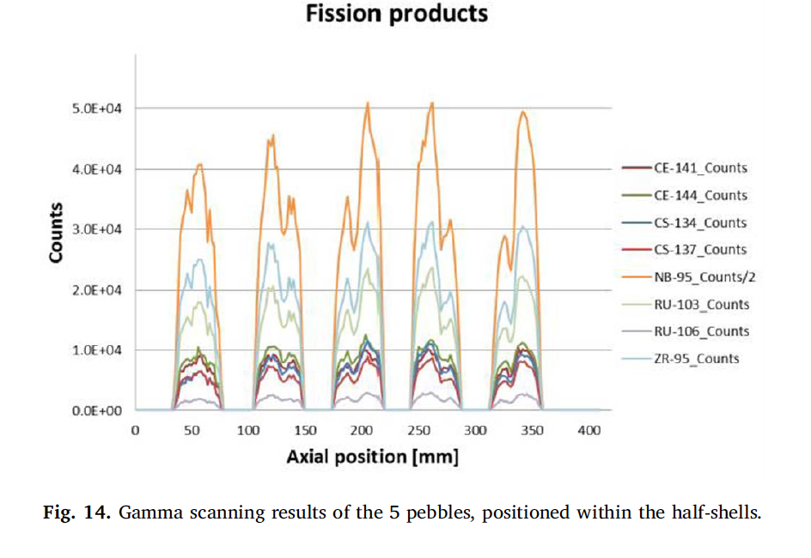
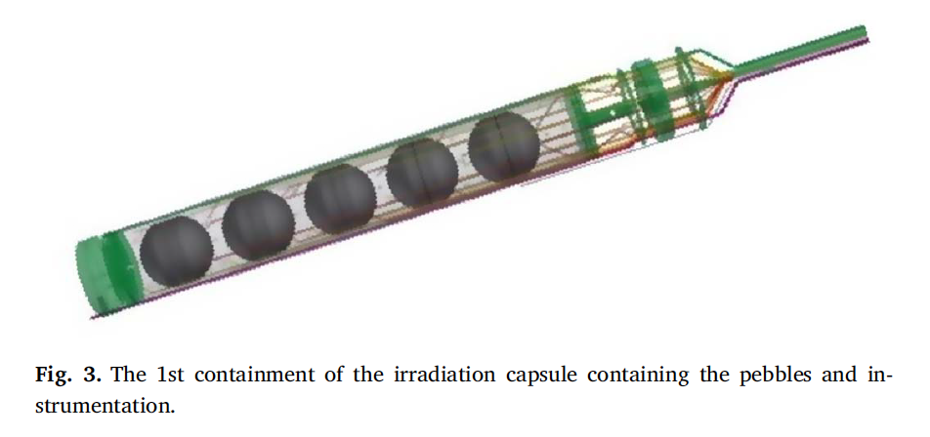
Burnup and decay data are needed for fuel cycle analysis and radioactive source terms

