Slide 1
Nuclear & Atomic Data Needs for Non-Destructive Assay of Special Nuclear Materials
Stephen Croft (ORNL)
Ramkumar Venkataraman (ORNL)

Slide 2
Acknowledgement
Attendance and preparatory work was funded by ORNL.

Slide 3
Introduction
International Nuclear Safeguards and Nuclear Material Accounting and Control (NMAC) rest on accurate physical inventory measurements.
A wide variety of non-destructive assay (NDA) methods and systems are in common use
From implementation to analysis and interpretation, NDA techniques depend on nuclear & atomic data.
  Design and optimization of measurement systems
  Characterization and calibration
  Correction factors (to reference conditions), interference corrections
  Inverse analyses

Slide 4
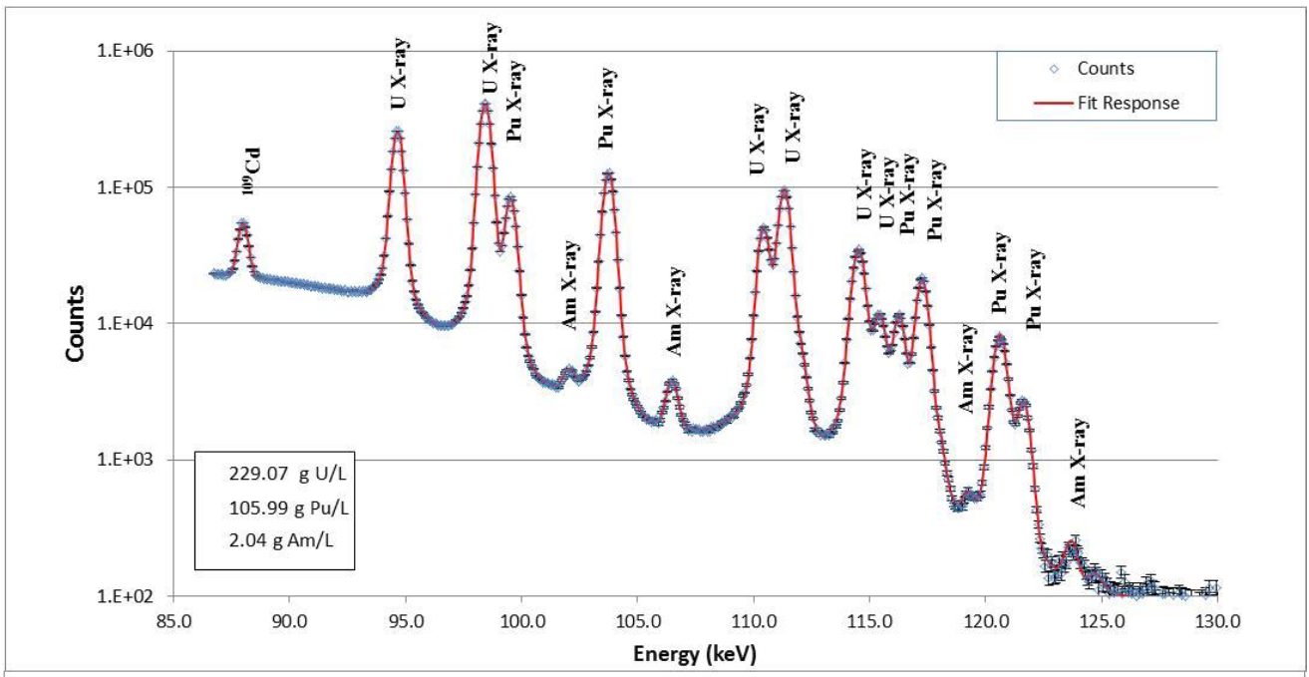
XRF Spectrum for MOX Sample
MOX Solution
5 elements
Typically each has 10 assigned peaks
(some “peaks” represent multiple transitions.
Branching ratios and peak energies appear to be dependent on actinide concentration
Fitted Peak Positions sensitive to isotopic distribution (differences on the order of a few eV).
Notes:
Ottmar and Eberle at KfK
U 115.596 NLW 96.3
Pu 121.790 NLW 101.4
Moving away from step at EK-/EK+ to full fit with minor elements
14 mm cyl SGN vial
Typ 50-400 g/L major or 5-30 XRF alone
LEGe <570 eV at 122kev (Co-57) 2 us and 50kHz

Slide 5
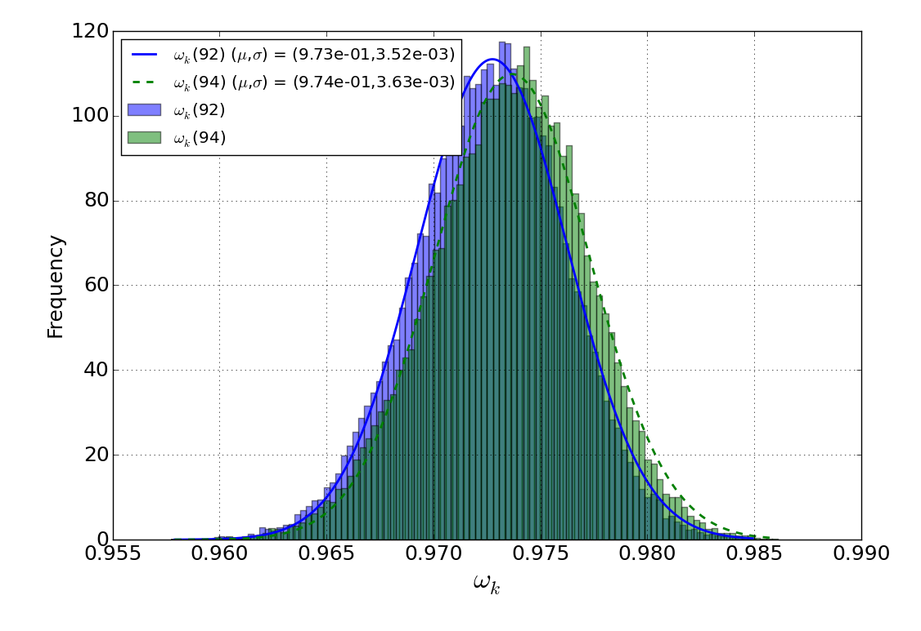
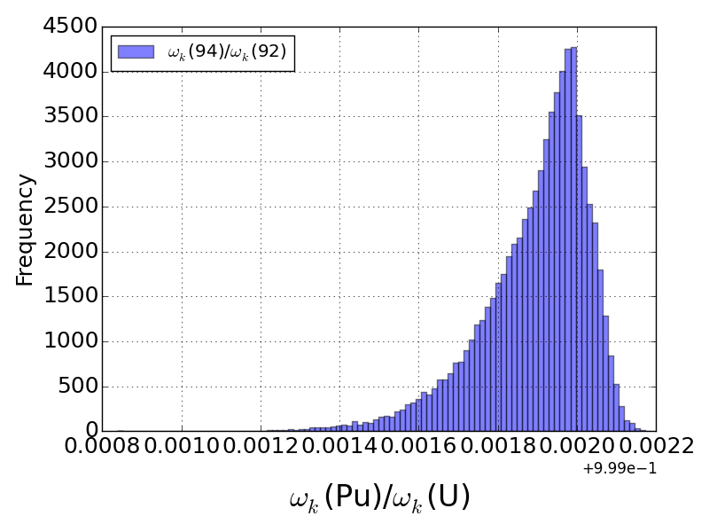
Branching Ratios
Histograms of ω_{K}(Pu) and ω_{K}(U)
From the collection of fits we can predict ω_{K}(Pu) and ω_{K}(U) and attach an error
  ω_{K}(U) = (9.73 ± 0.004)✕10⁻¹
  ω_{K}(Pu) = (9.74 ± 0.004)✕10⁻¹
But for HKED applications the important point is we can also take ratios for each sampled fit and take the average of the ratios
  ω_{K}(Pu)/ω_{K}(U) = 1.0009 ± 0.0001
Histogram of ω_{K}(Pu)/ω_{K}(U)
A Nicholson, S Croft, and RD McElroy
K-shell fluorescent yields and their uncertainties for use in hybrid K-edge densitometry
The Journal of Radioanalytical and Nuclear Chemistry 307(3)(2016)2069-2074.
We call it bootstrap but same as total Monte Carlo
Notes:
We need the ratio of values not the vale with a defensible uncertainty for physics based calculations
Natural line widths needed by isotope in solutions not metal.
Note the distribution is NOT normal.

Slide 6
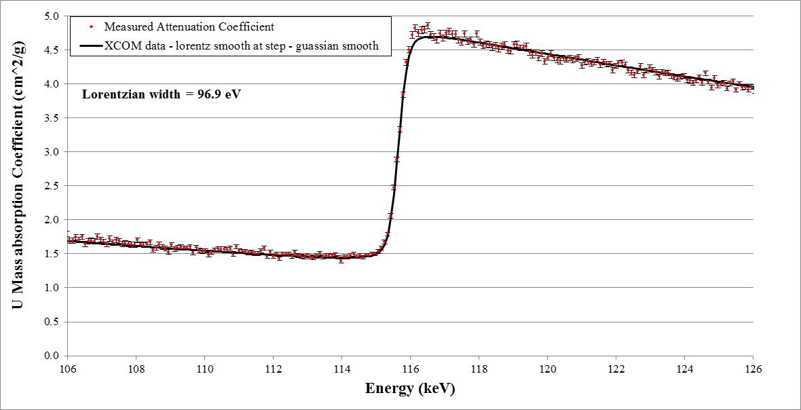
Mass Attenuation Coefficient from KED assay of DU
Voigt Broadened XCOM data (Scofield calculation!) vs. Observed Attenuation Coefficient
The plot shows a comparison of the inferred mass attenuation coefficients determined from the ratio of 2 KED transmission spectra.
What is the fine structure near the upper edge as the electrons just emerge and probe the electronic environment?
Voigt smoothing does not fit well!
Matches with simple Gaussian smoothing
Voigt smoothing fits well
Notes:
Gaussian X NLW (about 100 eV) = Voigt - BUT IT DOES NOT WORK!
Pe xs step is sharp in data bases
The step height is not known between data bases to about 2 % …. We need < 0.1 %
Full spectrum fitting requires full shape in hi-resol

Slide 7
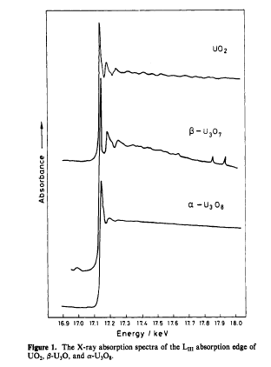
K-absorption Edges Shape & Fine Structure
Fine structure about the U and Pu L-Edges is well known and much data exists.
Fine structure data is available for low to intermediate elements but little data exists for fine structure about the High-Z K-Edges
Expect similar structures at the U K-edge which may explain the apparent lack of Lorentzian broadening.
Allen et al
EXAFS: A new approach to the structure of uranium oxides
J Phys Chem 89(1989)1334-1336
Notes:
EXAFS=Extended x-ray Absorption Fine Structure
XANES =x-ray Absorption Near to the right of the Absorption Edges fine Structure
17 keV is in reach of Synchrotron light sources
Compound
Phase
Environment – such as temperature
Configuration number (oxygen bonding)

Slide 8
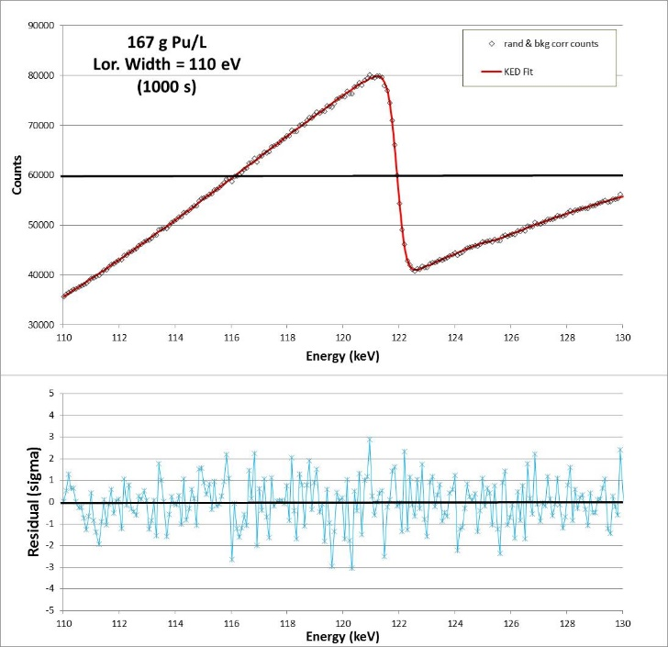
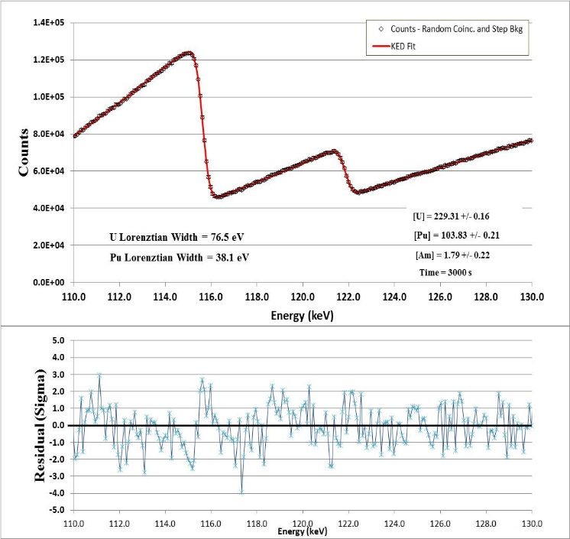
Pu and U/Pu K-Edge Fits
The Pu K-edge also fits well to the half and half Voigt and Gaussian shape.
NOTE: The reference atomic mass in XCOM is based on longest half-life for Pu its m = 244.06
However, there is indication that the Lorentzian width narrows for U-Pu mixtures.
Notes:
The motivation for full spectrum fitting is Multi-Elemental KED Analysis with minimal calibration and full cross-talk inclusion.

Slide 9
Dream
Progress from Th, to DU to Pu-239
Solutions, ρ.t <±0.05%, homogeneous! (vs foils)
E.g. for U (115.6 keV) cover 114.8 to 116.4 keV with 150 points with a 10 eV beam (CW beam/Ge-det to remove other orders)
TMU < 0.1%
Explore temperature and concentration and mixed solutions

Slide 10
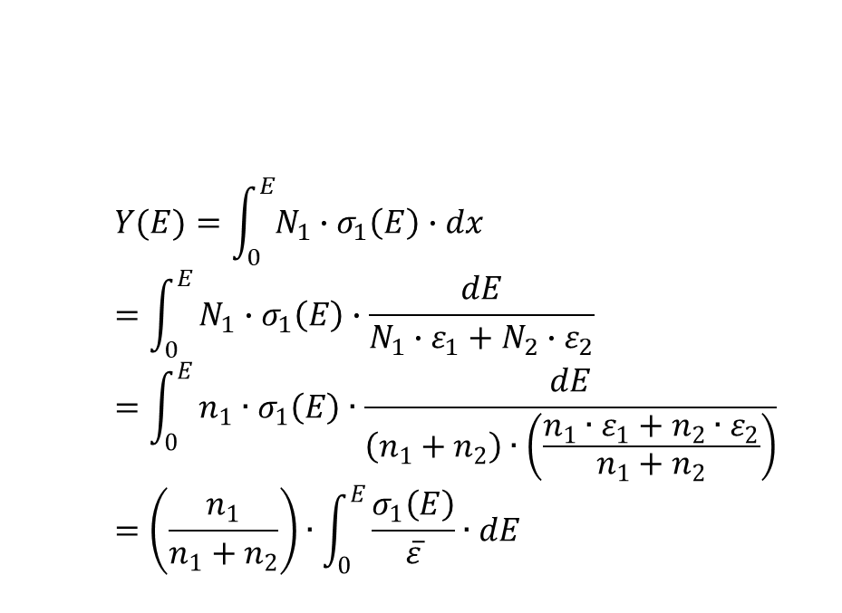
Alpha Stopping Cross Section
Consider the (α,n) production in a two component compound such as UF₆, in which only one element has a yield.
$$Y(E)=\int_{0}^{E}{N_{1}∙σ_{1}\left(E\right)∙dx}=\int_{0}^{E}{N_{1}∙σ_{1}\left(E\right)∙\frac{dE}{N_{1}∙ε_{1}+N_{2}∙ε_{2}}}=\int_{0}^{E}{n_{1}∙σ_{1}\left(E\right)∙\frac{dE}{\left(n_{1}+n_{2}\right)∙\left(\frac{n_{1}∙ε_{1}+n_{2}∙ε_{2}}{n_{1}+n_{2}}\right)}}=\left(\frac{n_{1}}{n_{1}+n_{2}}\right)∙\int_{0}^{E}{\frac{σ_{1}\left(E\right)}{\overline{ε}}∙dE}$$
Notes:
We must integrate from the initial alpha energy to threshold or until the particle stops.
We see that the incremental yield depends on the reciprocal of the average atomic stopping cross section of the compound.
Bias in the SP XS therefore affects the yield estimate made from the microscopic alpha-n XS directly and also how we scale between materials.
At each step the intensity of the emitted spectrum is also affected … but perhaps not strongly.
We have no data for Pu or Am
Bragg Kleeman additivity (independent atoms) is assume but we don’t know the accuracy
SRIM and other data bases don’t have good guidance on the unc in SP XS’s.
Direct yield measurements are one way to confirm scaling rules

Slide 11
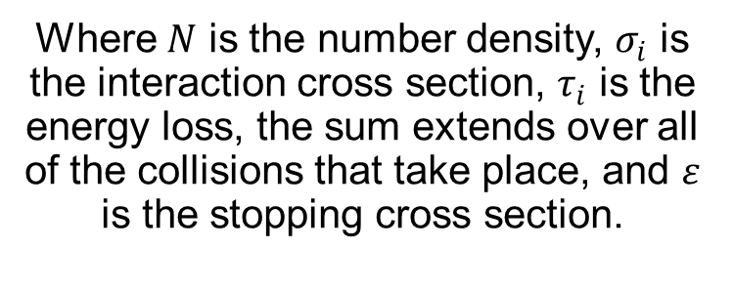
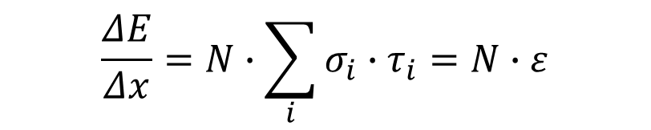
Idea Behind the Stopping Cross Section Concept
Energy loss is a statistical process there is a distribution of outcomes. Consider energy loss over a thin but finite layer:
$$\frac{ΔE}{Δx}=N∙\sum_{i}{σ_{i}∙τ_{i}}=N∙ε$$
Where $N$ is the number density, $σ_{i}$ is the interaction cross section, $τ_{i}$ is the energy loss, the sum extends over all of the collisions that take place, and $ε$ is the stopping cross section.
Traditional Unit:
10⁻¹⁵ eV.cm²/atom
Notes:
If we use alpha-n xs in mb/atom, stopping xs in E-15eV.cm^2/atom, and integrate in MeV then we get Yield/E6 alphas, which is a traditional unit also.

Slide 12
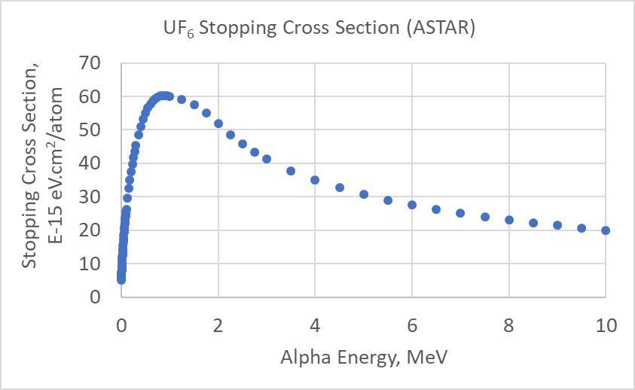
Example
Notes:
For F(a,n) we have a favourable case in the sense that the threshold is 2.36 MeV so we are in the smooth region
In the MeV region binding effects are also less
But in general we don’t have good guidance on how well the mixing ratio works and for other targets we do want to full shape.

Slide 13
ASTAR vs SRIM Alpha Stopping Powers

Slide 14
Conclusions
Knowledge of nuclear and atomic data can become the limiting factors in design and calibration of NDA systems and physics-based modeling of responses from NDA systems used in safeguards applications.
Alpha Stopping Cross Sections are not available for Pu or Am. Transforming (α,n) yields between compounds incurs an uncertainty comparable to the measurement accuracy.
Branching ratios of gamma-rays emitted by uranium, plutonium, and other actinide isotopes are needed with greater accuracies so that the uncertainties in the isotopic analyses can be driven down.
Atomic data such as interaction cross sections and X-ray yield data have large uncertainties. These limit the accuracy of U and Pu elemental concentration results that are of importance to nuclear safeguards.

