Slide 1
Detector Modeling for Associated Particle Imaging
Seth McConchie
WANDA 2020
2020 March 3-5

Slide 2
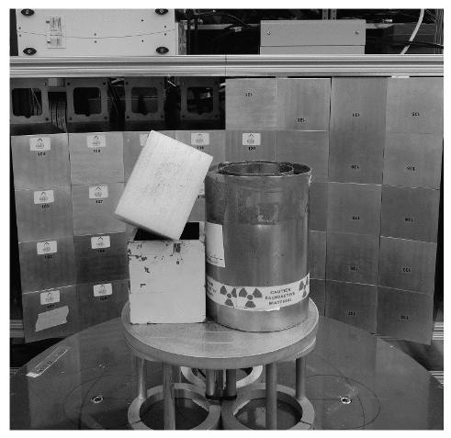
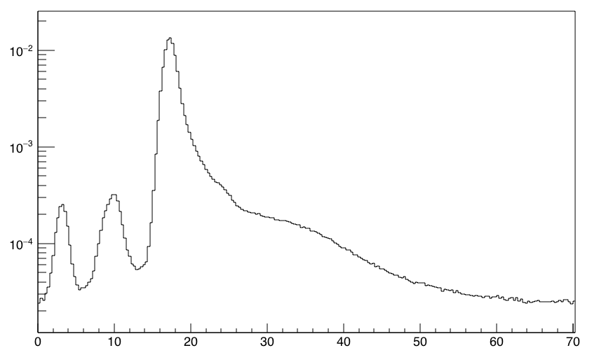
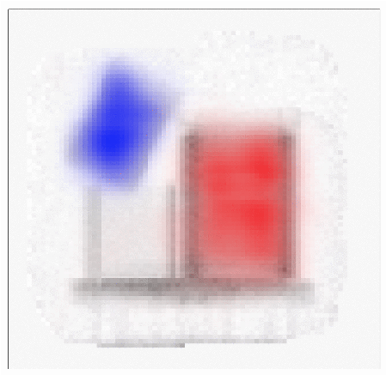
Associated Particle Imaging
Poly block
Detector
Item gammas (n,n’𝛾) and (n,f)
Transmission and small angle elastic scattering neutrons
API D-T neutron generator
Item to be characterized
Detector
d⁺
Fission neutrons
Low-Z elastic scatter neutrons
More gammas
n
Counts per alpha
Lead shield
DU annulus
α
D-T NG (n,n’𝛾)
Time of flight (ns)
Source neutron emission time and direction identified with alpha detection
Time-of-flight measurement with directional information improves transmission contrast by reducing background from scatter
Material characterization (low-Z, fissionable, etc.) made possible with alpha detection
Transmission Radiograph
Hydrogenous material Fissionable material

Slide 3
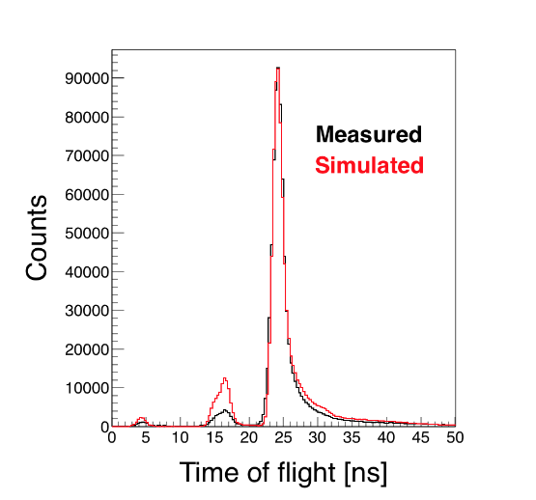
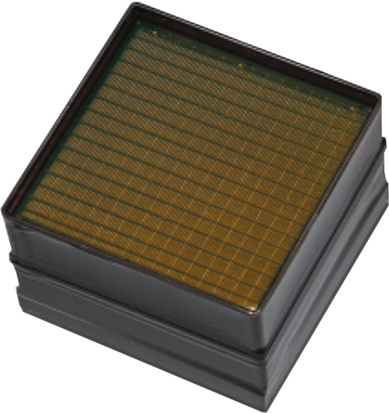
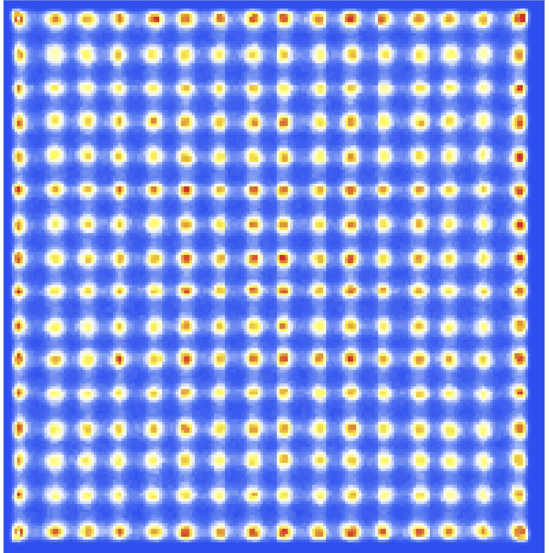
Neutron Source and Alpha Detector Modeling
API D-T NG
Outside NG
Inside NG
Position sensitive PMT
d⁺
Not shown
Item
Detector
Data acquisition
Fiber optic faceplate
Scintillator
Cu, Fe (n,n’𝛾)
n
α
Light
𝛾
Light
guide
n’
Geant4 used to model light transport and design light guides (no known data needs)
Modeling of alpha transport, photosensor/readout response, and angular resolution of 14 MeV neutron unneeded (for now)
Inelastic scatter gammas from copper and steel in NG are 50% higher in G4 model and spectrum is harder
Neutron interactions within the NG widen the neutron cones and increase scatter background
Data
Model
Potential need to improve nonelastic data for Cu and Fe for modeling performance

Slide 4
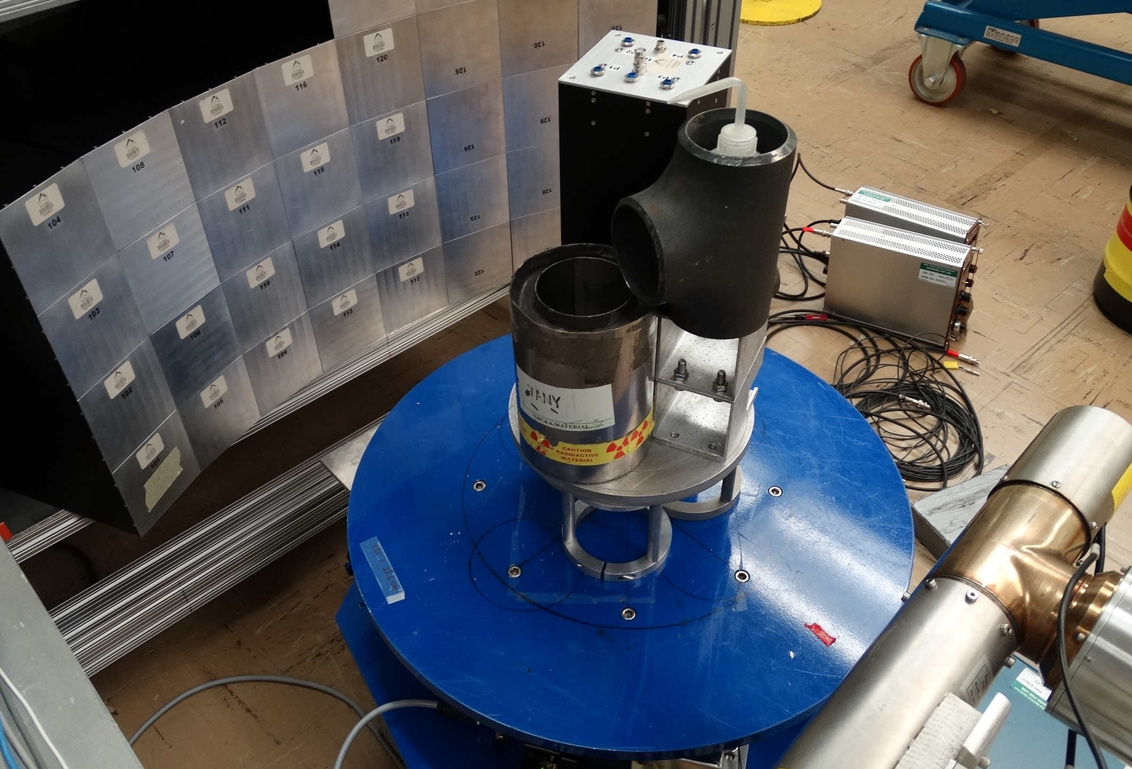
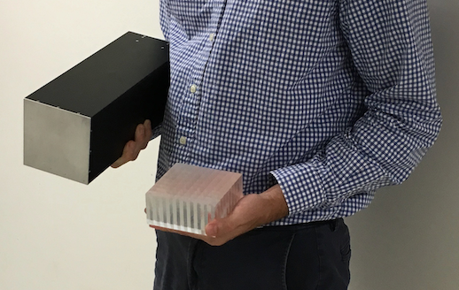
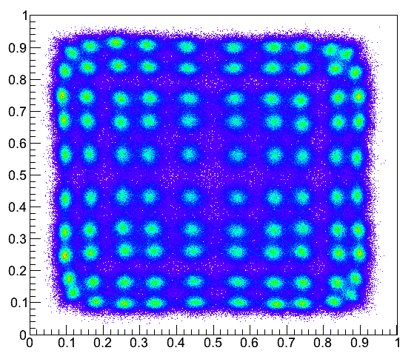
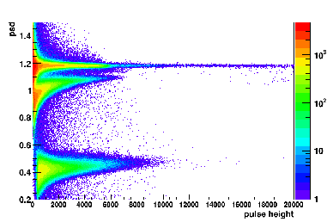
Detector Modeling
LiF/ZnS phosphor
PSD plastic
“Block” detector
Scintillator
block
Detector array
PMTs
Position response
Pulse-shape response
g
n
API D-T NG
Detector design relies on light transport and measurement calibration involves matching light output and thresholds until efficiency is accurately modeled (no known data needs)
Neutron interactions in the detector materials contribute to scatter background that affects image reconstruction performance, especially when the background terms are estimated with a model
Thermal n
Potential need to improve nonelastic data for Al, C, etc. for modeling performance

Slide 5
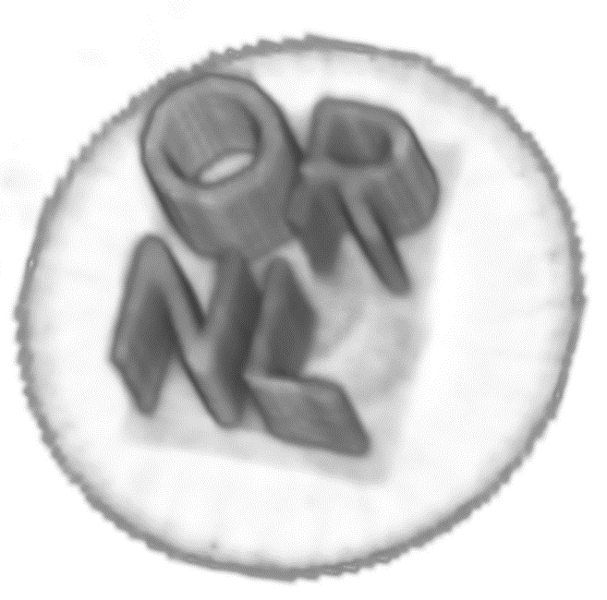
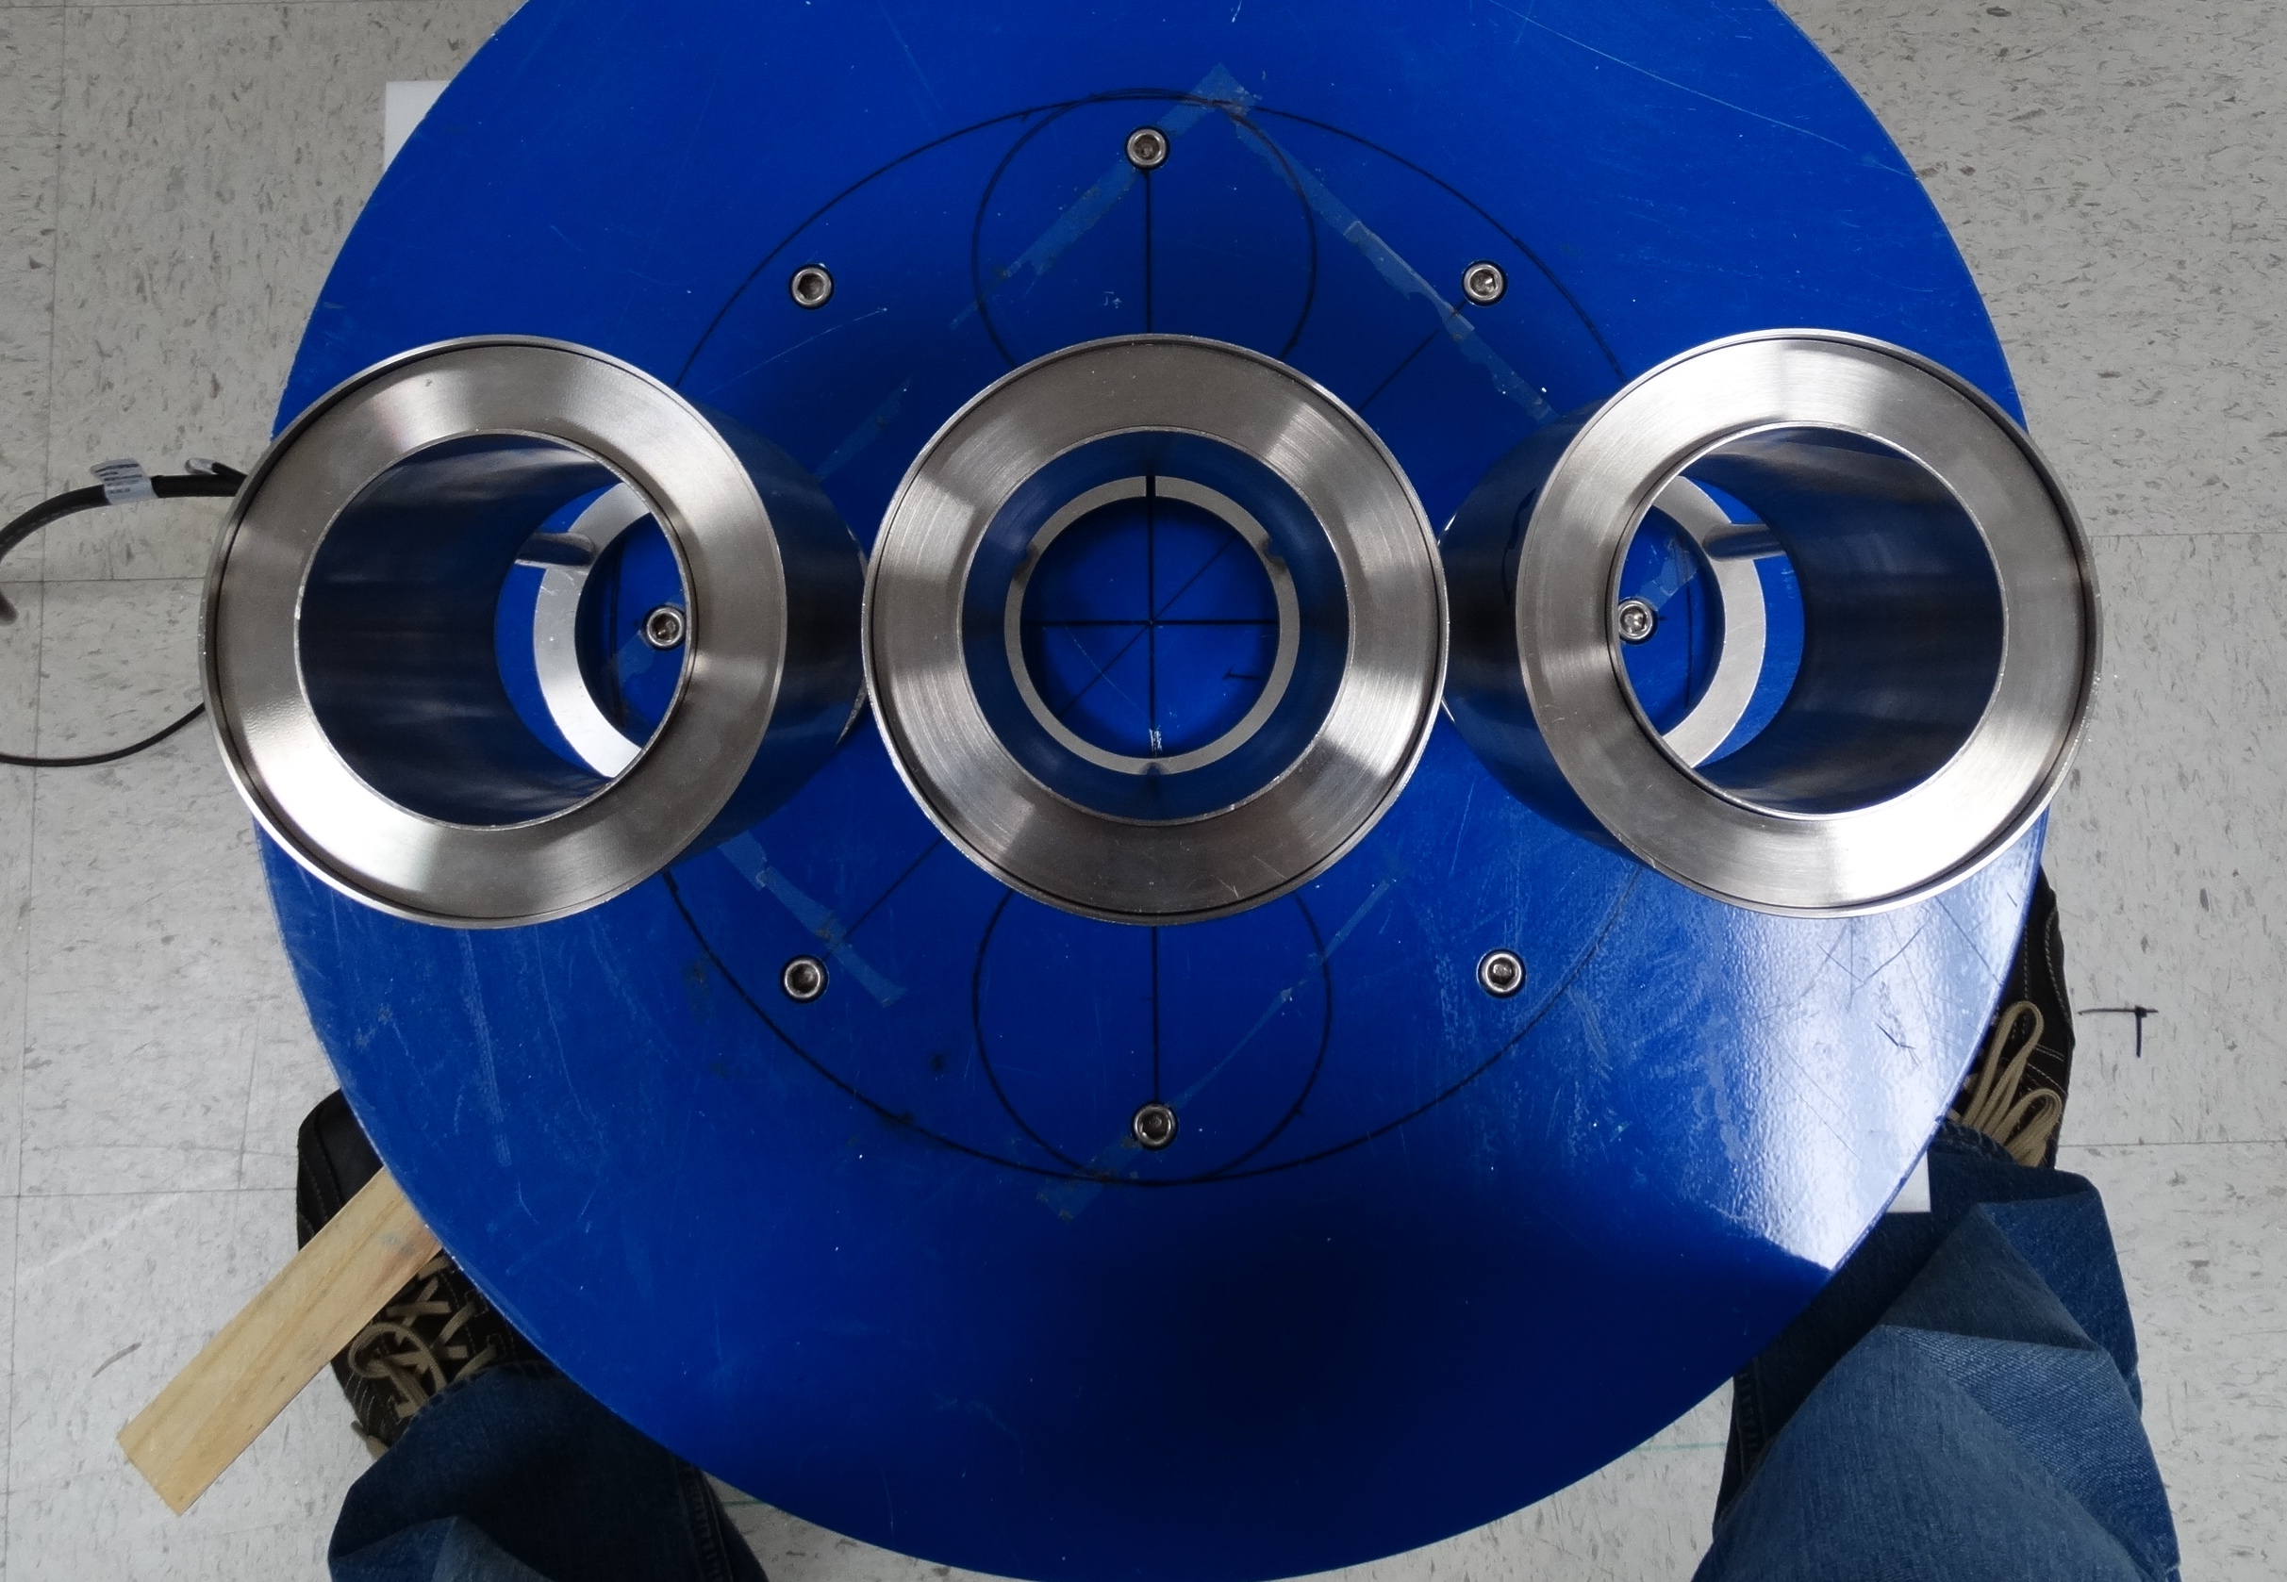
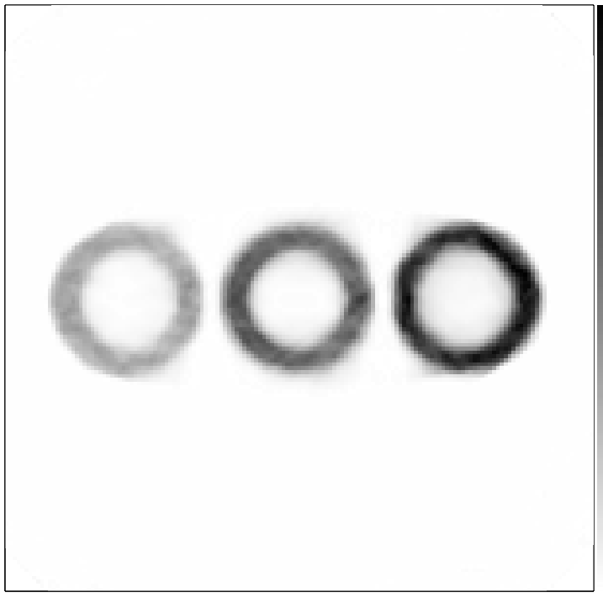
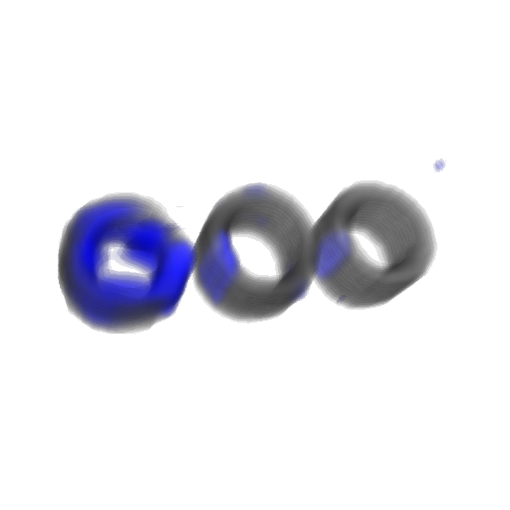
Item Modeling
Transmission
DU
Steel
W, Fe, C inelastic
gammas
HDPE
Steel
Tungsten
Doubles
3D recon overlay
3D recon overlay
Inelastic gamma overestimates:
Tungsten: 1.90
Steel: 2.84
HDPE: 2.55
Transmission
¹H elastic
Image reconstruction involves neutrons and gammas at various numbers, scatter angles, and energies, so accurate final state models are important for predicting performance
Modeling is used currently to extract signal from background but should be used to understand absolute values in images (not just relative contrast)

