Slide 1
Atomic Data Status
Atomic Data, Attenuation Coefficients, Scatting Form Factors
Brian Quiter (LBNL)
With significant assists from:
Dave Brown (BNL) and
Maria Grazia Pia (INFN-Genova)

Slide 2
Atomic Data Status
ENDF/B-VIII.0 contains:
Photo-atomic
Electro-atomic libraries
Atomic relaxation
ENSDF contains:
Auger
X-ray
EXFOR reported 4 (!) photoabsorption entries
NNDC working to add 1326 citations from Storm&Israel
EXFOR only contains electron-nuclear cross sections
(Originally) LLNL Atomic evaluations
EADL
EEDL
EPDL
Part of ENDF/B since VI.8
IAEA EPICS yr>2014
Collisional data 10 eV to 1 GeV

Slide 3
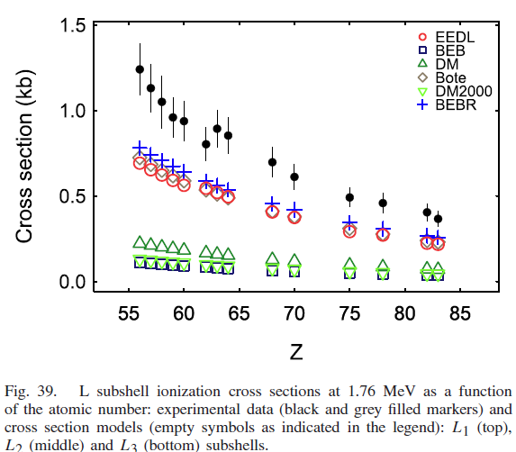
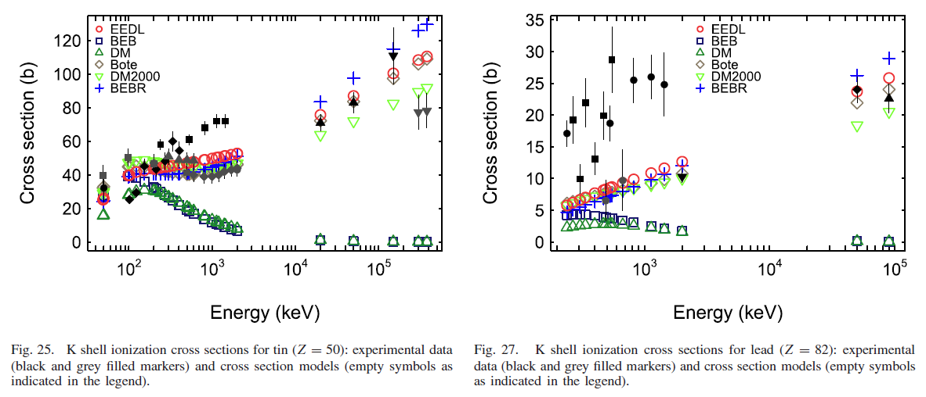
Examples
Energetic electron-induced K,L_{1,2,3} shell ionization cross sections
Notes:
Basaglia

Slide 4
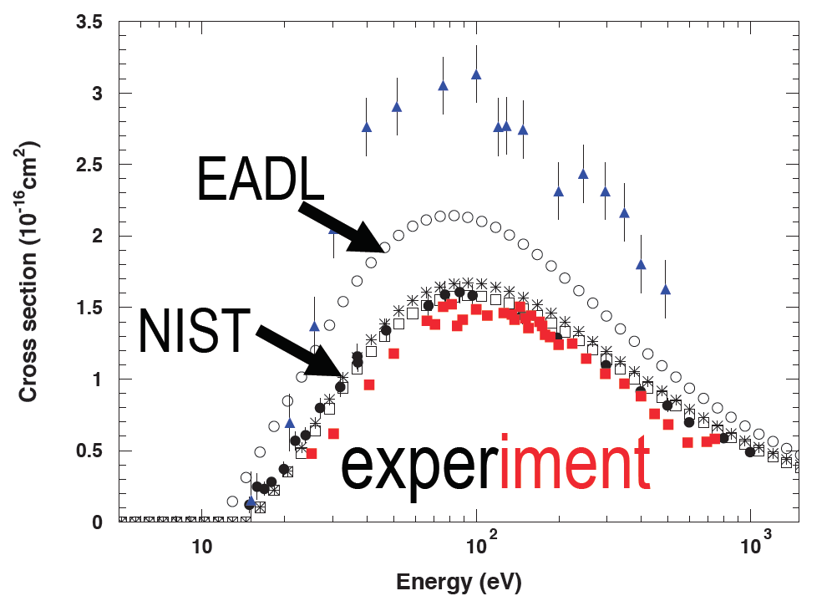
EPICS2017
EPICS2017 & ENDF/B-VIII
Replaced theoretical atomic binding energies with empirical measurements
Radiative and non-radiative transition energies are inconsistent with atomic binding energies
Electron ionization cross section

