Slide 1
Detector Models, Atomic Data, and Stopping Powers
Brian Quiter (LBNL)
Bethany Goldblum (LBNL/UC Berkeley)
Bruce Pierson (PNNL)

Slide 2
Why are we all here?
Attendees of WANDA 2019 expressed strong interest in atomic data evaluations
This session focuses on nuclear data needs related to the design, development, and interpretation of data from traditional and novel radiation detectors and accelerators for basic science and applications. This includes atomic, nuclear, and optical data for transport modeling, stopping powers, Cerenkov and scintillator light yields, and X-ray emission for detection and crosscutting application needs.

Slide 3
Why are we all here?
Attendees of WANDA 2019 expressed strong interest in atomic data evaluations
This session focuses on nuclear data needs related to the design, development, and interpretation of data from traditional and novel radiation detectors and accelerators for basic science and applications. This includes atomic, nuclear, and optical data for transport modeling, stopping powers, Cerenkov and scintillator light yields, and X-ray emission for detection and crosscutting application needs.
Data needs for Detector and Signal Modeling

Slide 4
Who Are We?
Brian Quiter
LBNL Staff Scientist/Engineer, Applied Nuclear Physics Program
Advanced detectors, modeling detectors and detector systems, nuclear nonproliferation, NRF
Bethany Goldblum
UC Berkeley Research Engineer, Department of Nuclear Engineering
Executive Director of NA-22 Nuclear Science and Security Consortium
Organic scintillators, nuclear reactions & structure physics, nuclear physics applications
Bruce Pierson
PNNL Staff Scientist/Engineer, Irradiated Materials
Detector development & modeling, fission yield studies, nuclear forensics, data science, radiolysis

Slide 5
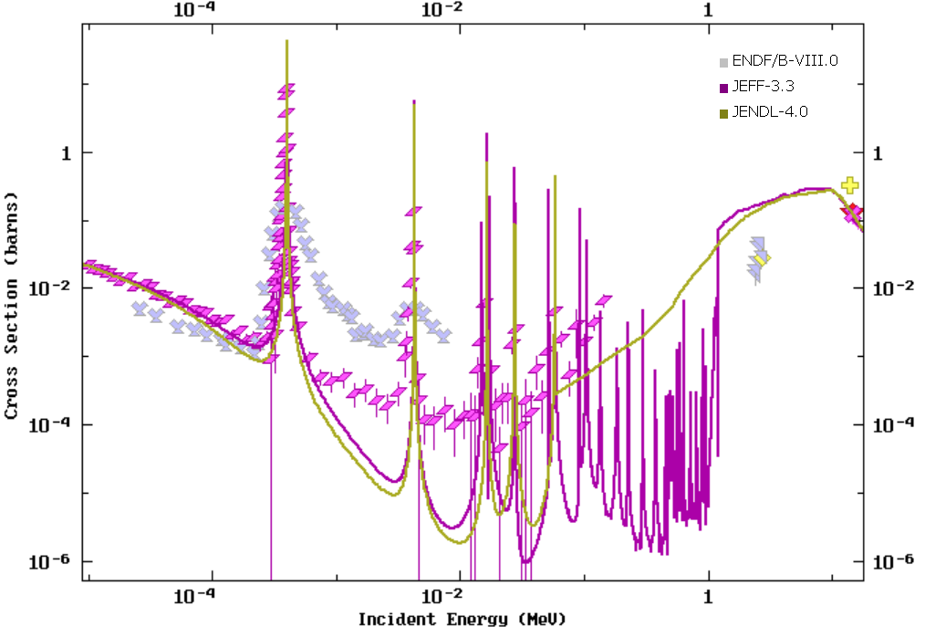
Broad Data Needs
e.g. Elpasolite scintillators
Cs₂ ⁶LiLa(Br,Cl)₆:Ce (CLLBC)
Nuclear data is important for modeling and quantifying neutron detectors
Fission chambers
Scintillators
Neutron thermalization
Cascades and angular correlations
³⁵Cl (n,p)
Notes:
A 2 + B + C + X 6 - where A B, are typically alkali metal cations, C⁺ is a trivalent cation such as a rare-earth or transition metal, and X⁻ is a halogen anion

Slide 6
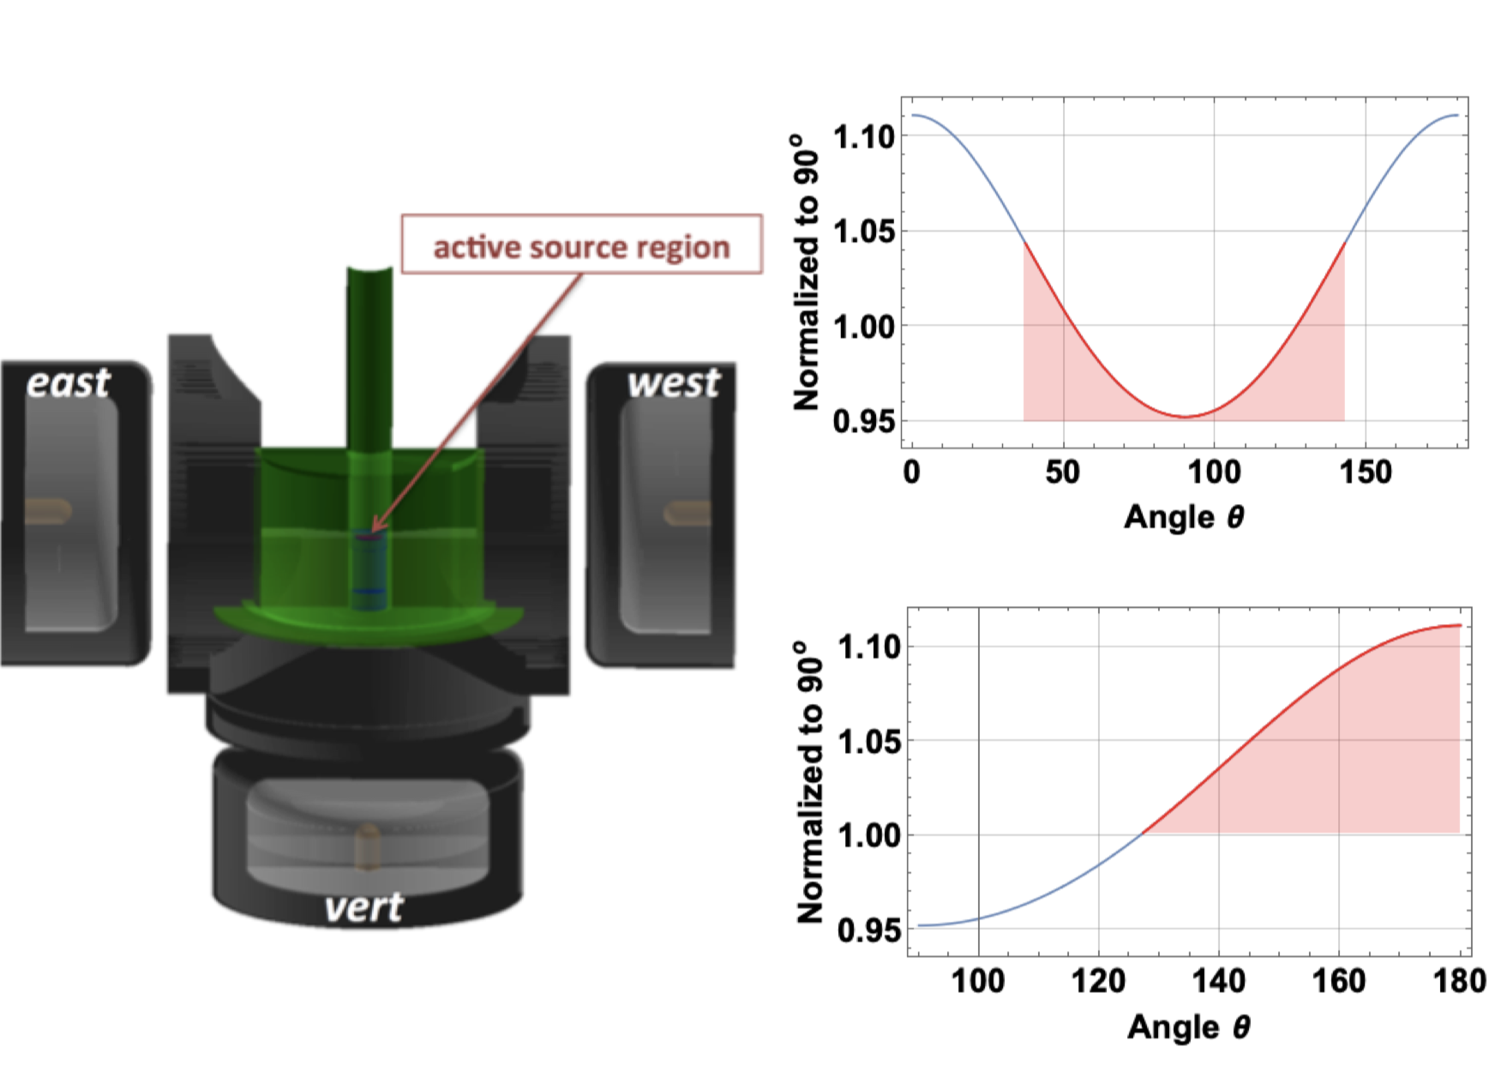
Broad Data Needs
Nuclear data is important for modeling and quantifying neutron detectors
Fission chambers
Scintillators
Neutron thermalization
Cascades and angular correlations
Notes:
A 2 + B + C + X 6 - where A B, are typically alkali metal cations, C⁺ is a trivalent cation such as a rare-earth or transition metal, and X⁻ is a halogen anion

Slide 7
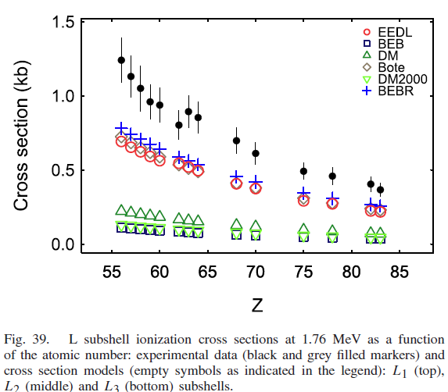
Broad Data Needs
Nuclear data
Atomic/EM data
Modeling and understanding γ-ray detectors
Compton kinematics/electron tracking
Atomic X-ray production
Bremsstrahlung
Attenuation data (heavy ions, electrons, photons)
Understanding accelerator-induced reactions
Photon detection efficiency
Shielding calculations (space and terrestrial)
Notes:
A 2 + B + C + X 6 - where A B, are typically alkali metal cations, C⁺ is a trivalent cation such as a rare-earth or transition metal, and X⁻ is a halogen anion

Slide 8
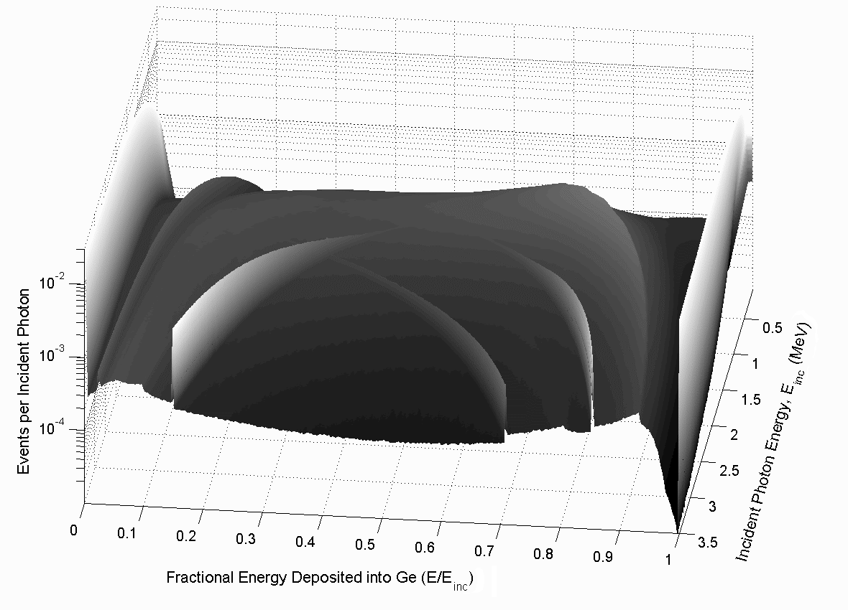
Broad Data Needs
Nuclear data
Atomic/EM data
Attenuation data
Optical Data
Scintillation light transport
Cherenkov phenomenology
Engineering databases
Detector tabulations?
Build-up factors for physics experiments and/or applications?
Notes:
A 2 + B + C + X 6 - where A B, are typically alkali metal cations, C⁺ is a trivalent cation such as a rare-earth or transition metal, and X⁻ is a halogen anion

Slide 9
Session Scope
Data!
Adding physics models to codes is outside WANDA scope
Data needs for understanding detectors and signals for basic science and applications
Signals include measurements of attenuation (densitometry etc.)
Goal is to close this session with:
prioritized list of needs
actionable tasks to address those needs

Slide 10
Our Questions
What are the needs?
How do they map to applications?
What would the impact be?
What fidelity is needed?
How do we address the needs? (actionable tasks)
Data collection campaign/one-off, data evaluation, new database, sensitivity study, scoping study?
How do we prioritize the needs?
Potential impact / application space
i.e. might be important to one sponsor but not another
Fidelity vs. impact vs. difficulty
Are there hurdles to actionable tasks? What? Level of difficulty?

Slide 11
Your Mission
Highlight needs
Have we omitted relevant applications?
Map to applications
Assess impact
Fidelity vs. impact vs. difficulty
Actionable recommendations
Help us out:
Provide feedback
Help our rapporteur
Google docs link
Applications we didn’t highlight
Light sources (SURF, NSLS, ALS…)
Medicine
Detector development for TOF-PET

Slide 12
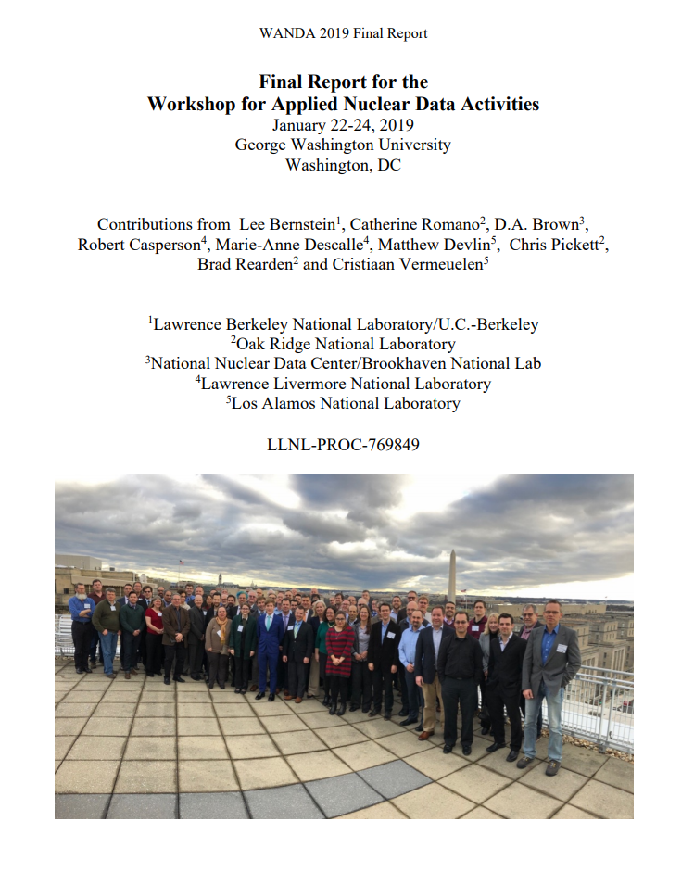
Outcomes
Report
Overview
Summarize session, explain logic and methods
Prioritized Needs
Need 1
Need 2
actionable means of addressing those needs

Slide 13
Logistics
Agenda
Note-taking
Eric Matthews (Rapporteur)
efmatthews@berkeley.edu
Feel free to contribute
1315 | Introduction | Quiter, Goldblum, Pierson
 | Programmatic Needs
1330 | NNSA NA-22 | Donny Hornback
 | DTRA | Joanna Ingraham
 | DHS | Namdoo Moon
 | User Briefs
1400 | Fission Product Stopping Power | Michael Moore
1410 | Stopping Power for Isotope Production Cross Sections | Morgan Fox
1420 | CGM Modeling in MCNP | Michael Rising
1430 | X-Ray Emission and stopping power | Ram Venkataramar
1445 | Gamma Cascade Summing | Bruce Pierson
1455 | Detector Modeling for Associated Particle Imaging | Seth McConchie
1505 | Antineutrino Signal Modeling for Detection | Bryce Littlejohn
1515 | Cerenkov and WbLS | Chris Grant
1525 | Fast Neutron Detector Modeling | Juan Manfredi
1535 | Photoatomic data | Brian Quiter
1545 | Break
1605 | Discussion
1715 | Adjourn

