Slide 1
HTS/LTS Hybrid Dipole Test
MDP Video meeting on January 29, 2020
Ramesh Gupta
For Superconducting Magnet Division
Brookhaven National Laboratory

Slide 2
Contributions from
Work presented here and the work being performed now is thanks to many individuals, including:
    Bill Sampson, Shresht Joshi, Anis Ben Yahia, Piyush Joshi, Bill McKeon, Sonny Dimaiuta, Denny Sullivan, Peter Galioto, Pat Doutney, Mike Anerella, John Cozzolino, Ray Ceruti, …

Slide 3
Overview
Main goal of this test is to perform field error measurements of the HTS coils with tape aligned primarily in field parallel direction.
Another technically important goal is to study high field HTS/LTS hybrid magnet, particularly the quench and mechanical studies
The program benefits from the unique geometry of DCC017, which allows insert coils to be inserted and become integral part of the magnet without disassembling or assembling magnet
This particular test should be very productive with four tests in one go (a) two tests for two sets of HTS double-pancake coils (both on two separate power supplies in two high field apertures for HEP, and (b) another two independent tests of two HTS cable samples for “fusion community” in other two high field region in the end sections, clear of interference from the straight section.

Slide 4
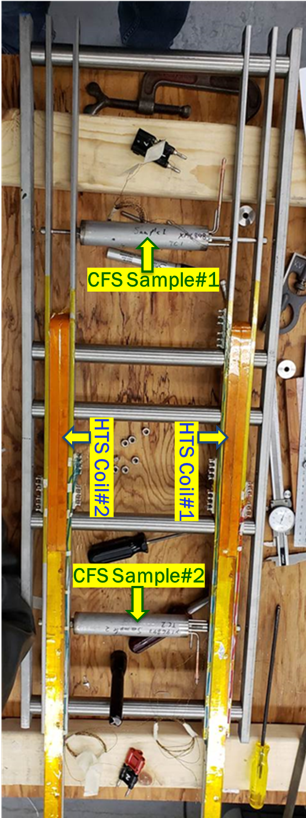
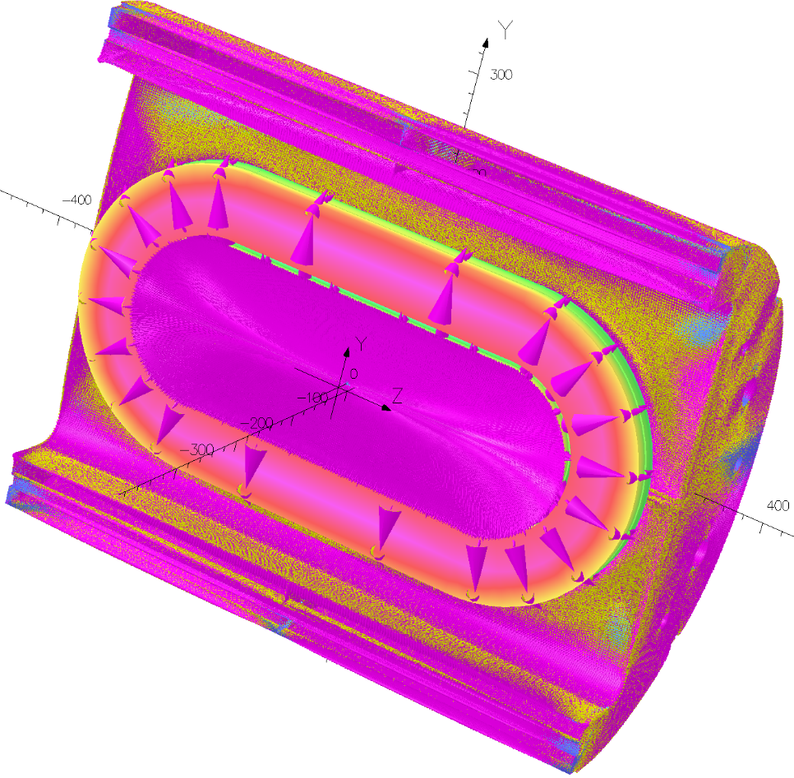
Four easily accessible high field regions for four independent high field tests
3
1
|B| at
y-z plane @10 kA
Locations
1 and 2 for
HTS coils; Locations
3 and 4 for
HTS samples
Basic test (1&2) supported by USMDP. Additional (3&4) by internal funds.
2
4

Slide 5
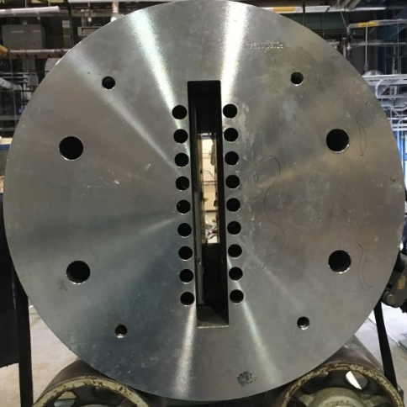
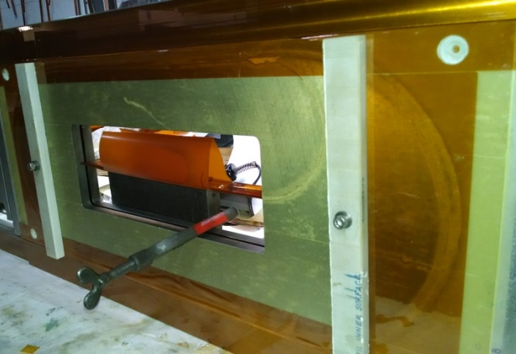
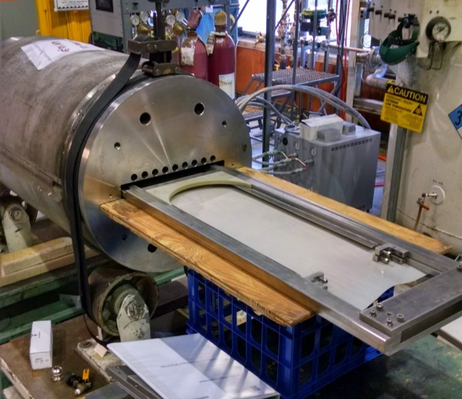
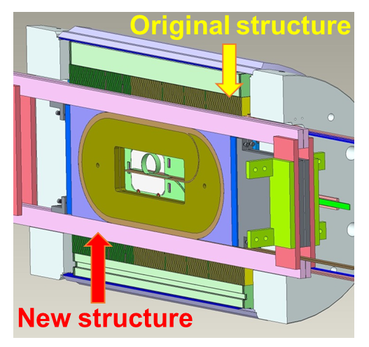
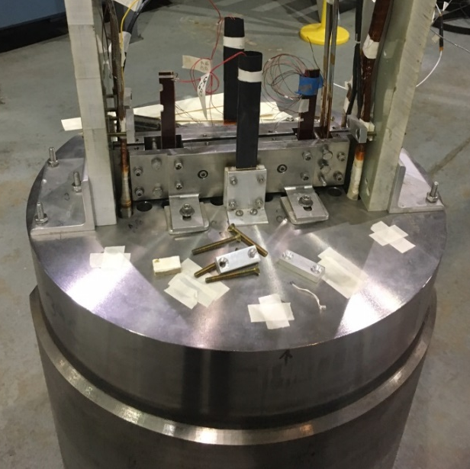
Testing of HTS Coil Technology @High Fields (rapid turn-around, low cost)
Five Steps:
Replaceable R&D Coil(s)
Magnet (dipole) with a large open space
R&D Coil for high field testing
Slide coil in the magnet
Coils become an integral part of the magnet
Magnet with new coil(s) ready for testing
1
2
Empty space
3
4
5
Insert coils in Empty space

Slide 6
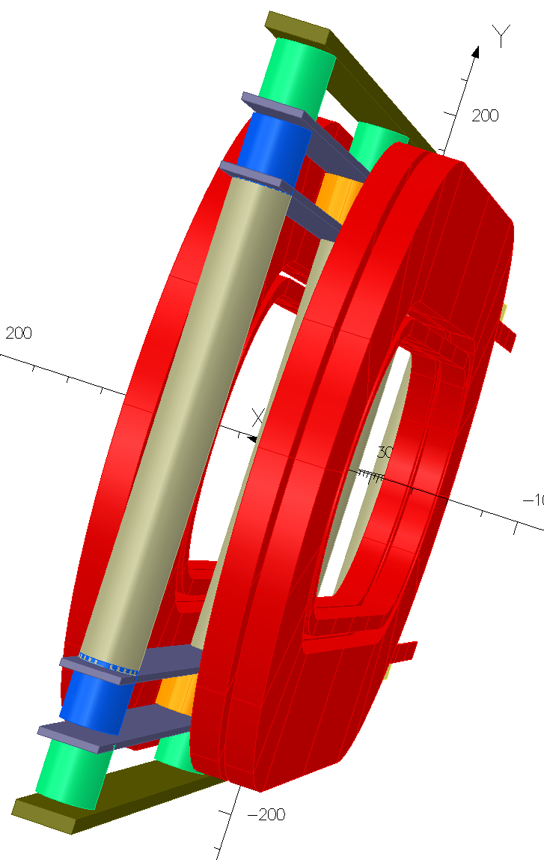
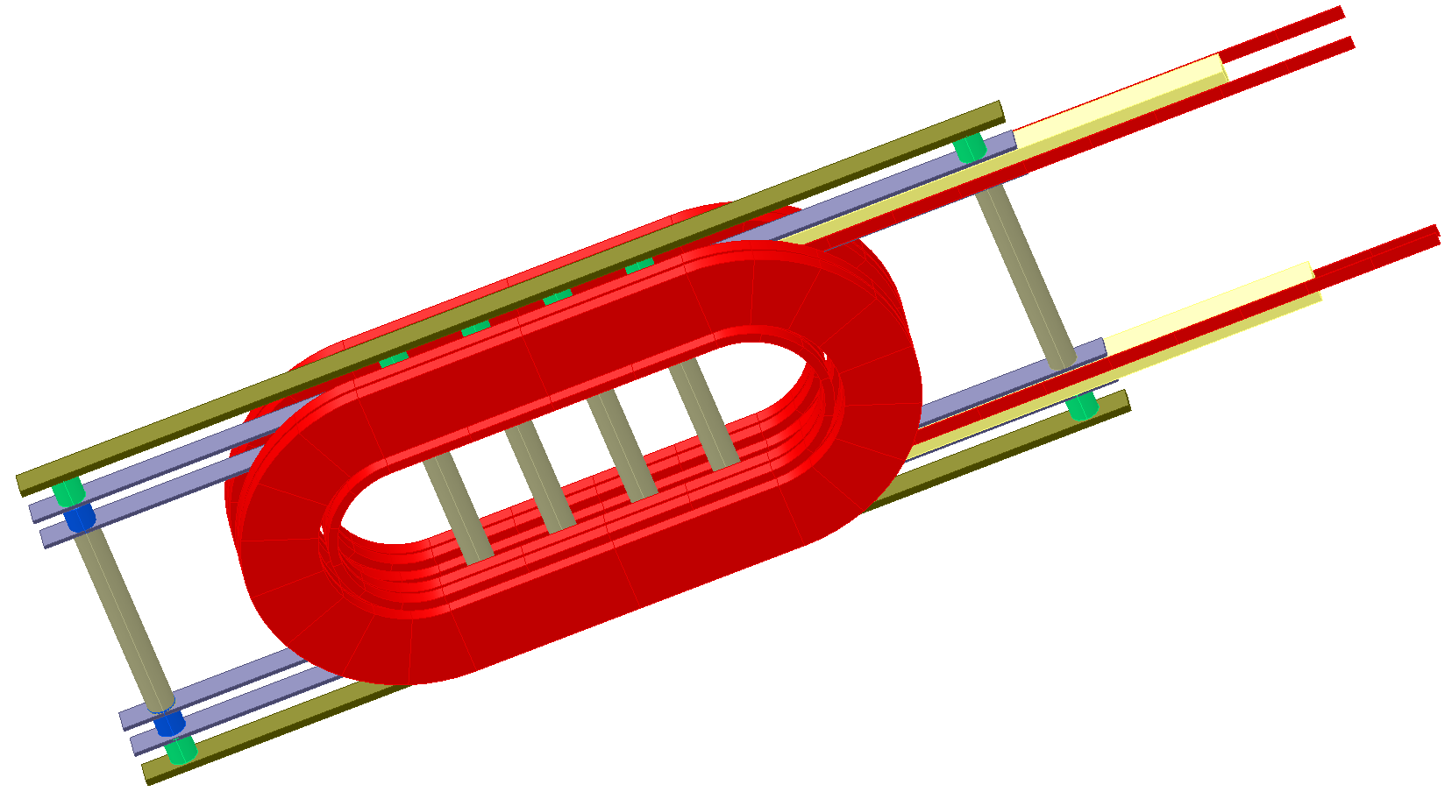
HTS Coils Structure Inserted in Nb₃Sn Coils
(addition of CFS samples incorporated later)
HTS Insert Coils
CFS Samples between two sets of Nb₃Sn coils in the end region
(clear access, no interference)

Slide 7
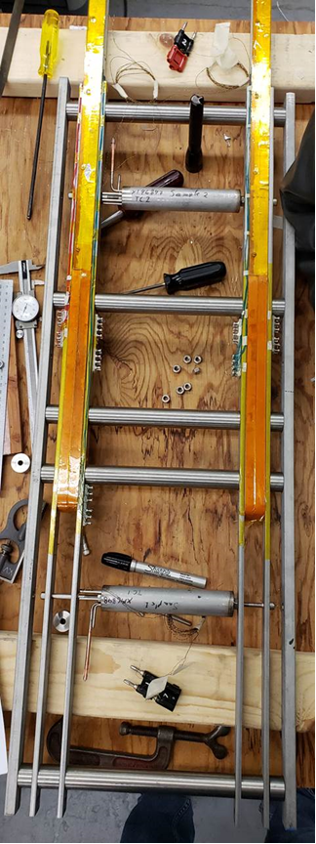
USMDP HTS/LTS Hybrid Dipole Test in February 2020 (4 tests in one go)
A simple fixture is inserted inside the BNL Nb₃Sn Common Coil Dipole DCC017 (without disassembling the magnet) to test insert coils, in addition to the cable samples, in a high background field.
HTS Coil#1
CFS Sample#1
CFS Sample#2
HTS Coil#2
HEP Working with the Fusion Community

Slide 8
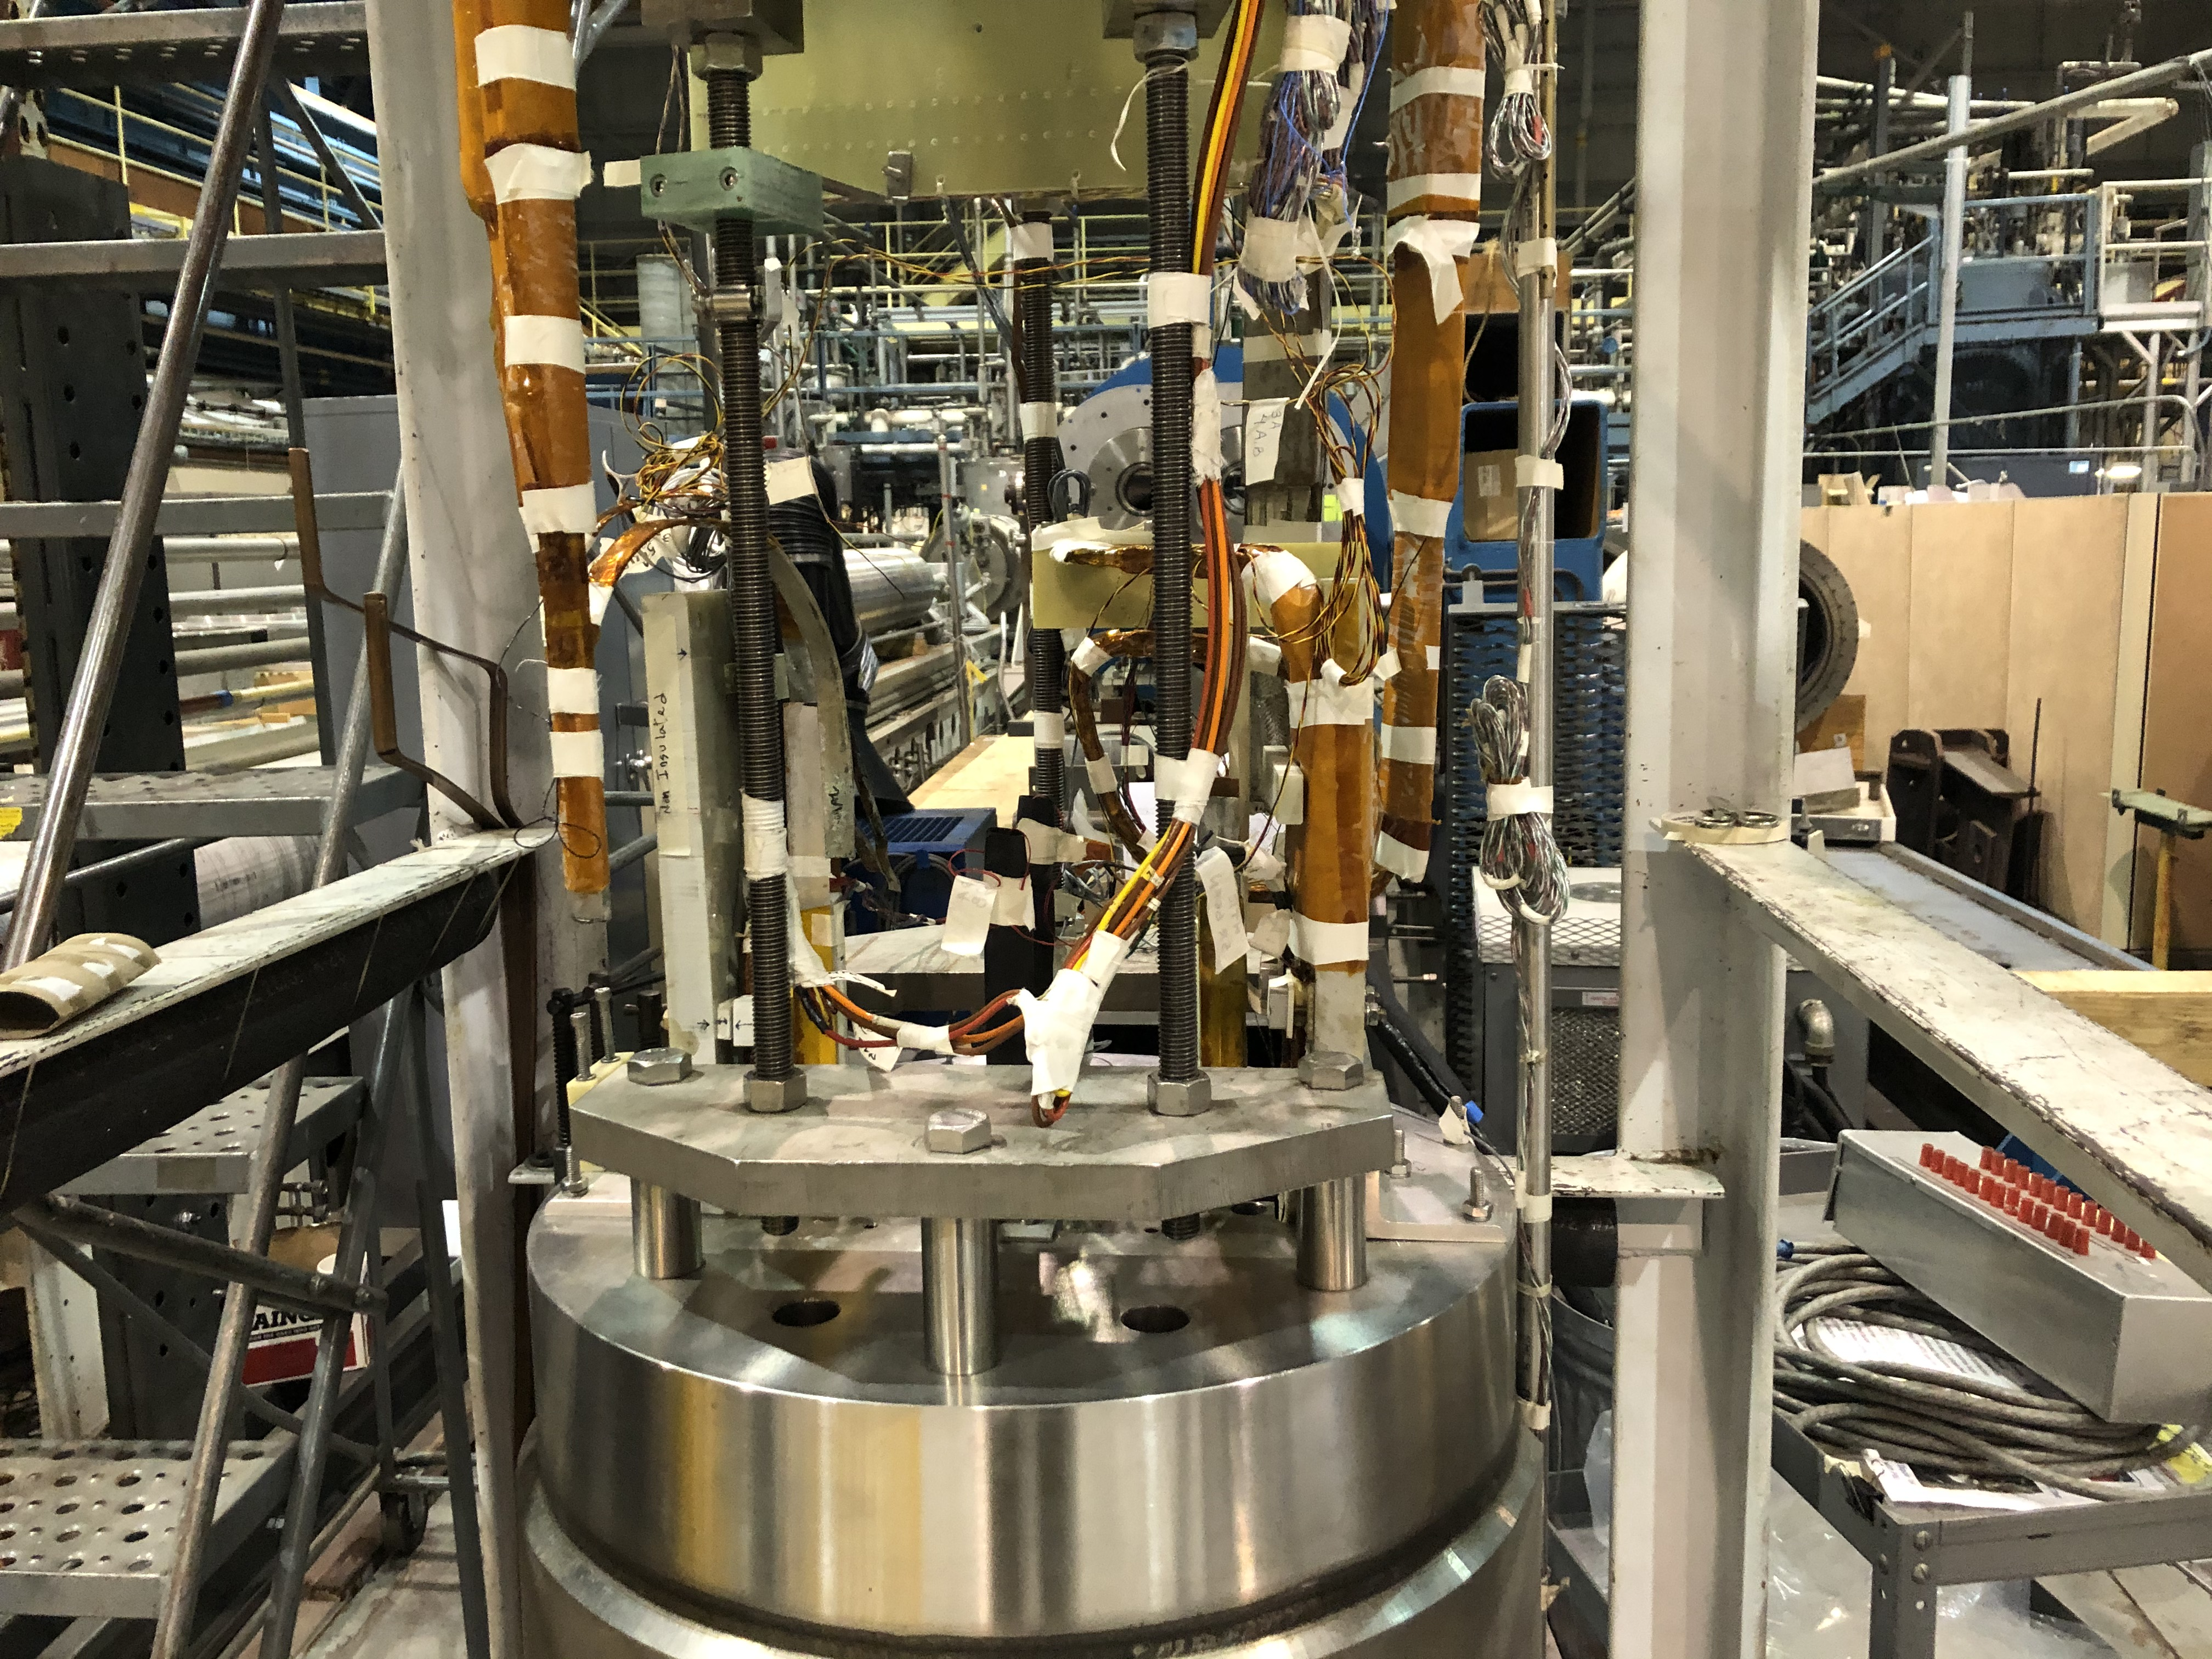
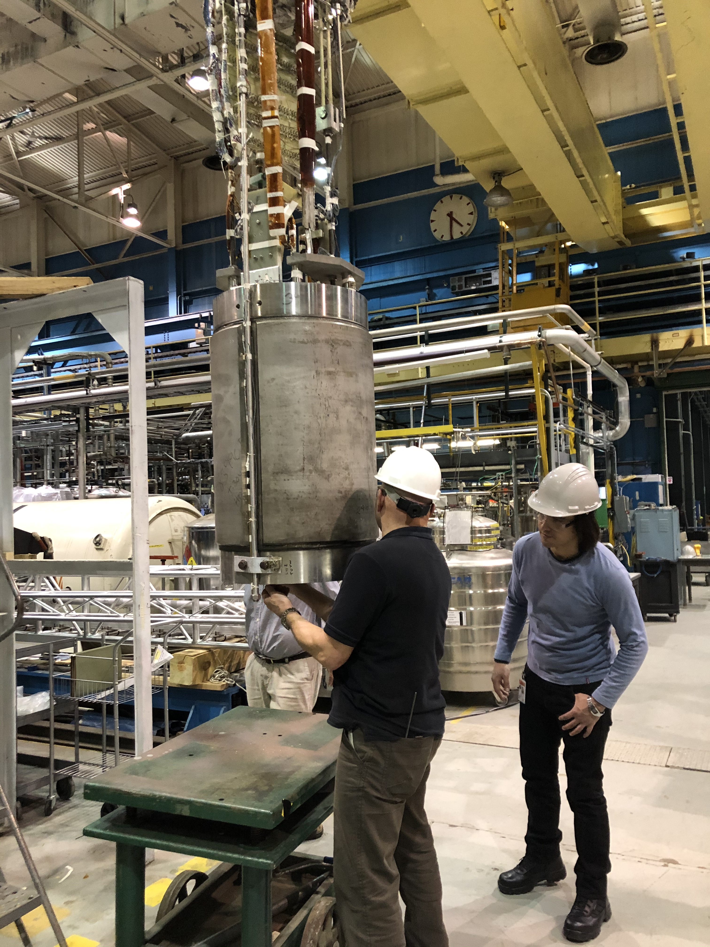
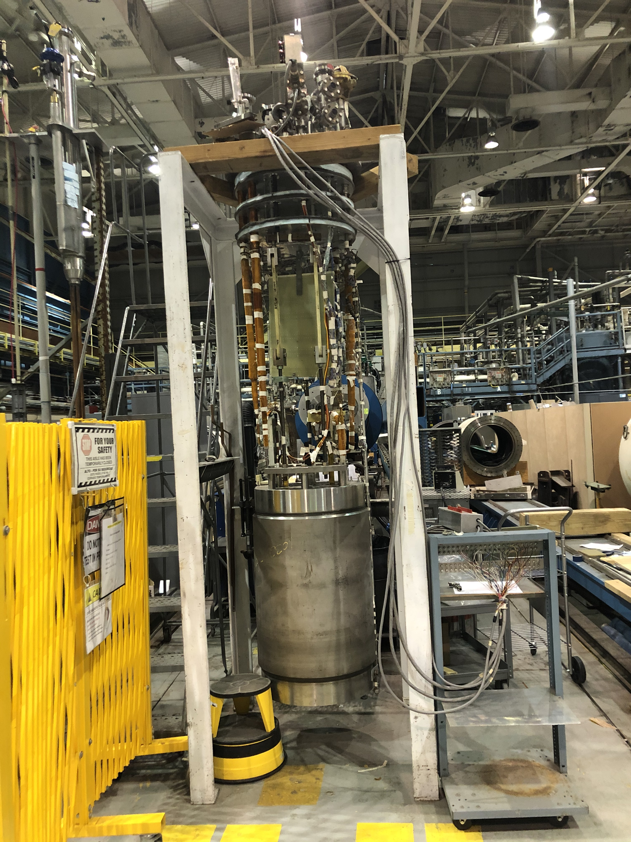
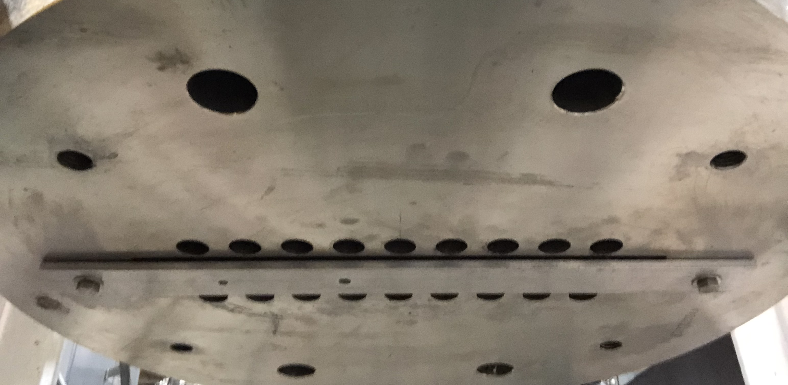
Magnet Test Assembly
Test run for inserting fixture in the magnet
Top
Fixture inside the common coil dipole
Bottom

Slide 9
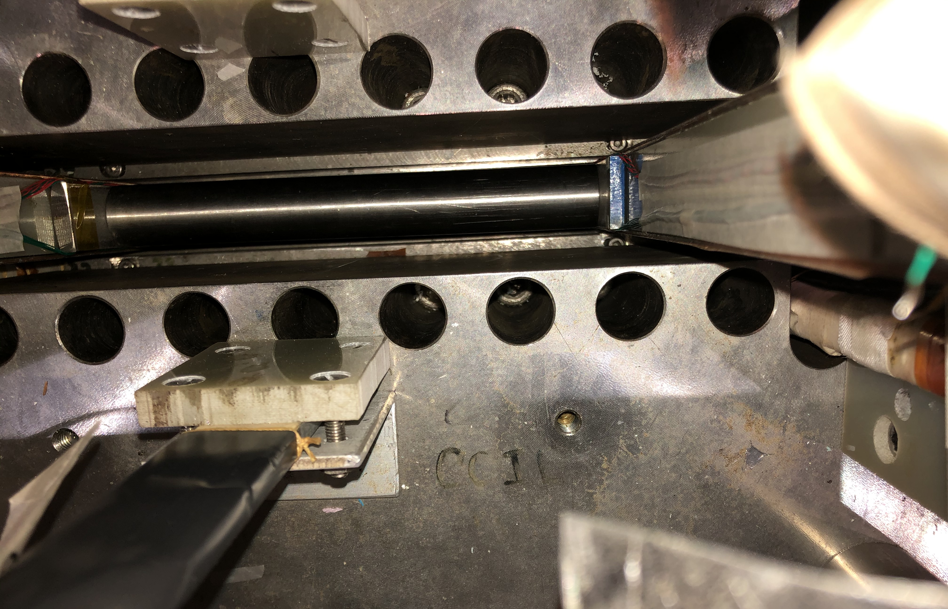
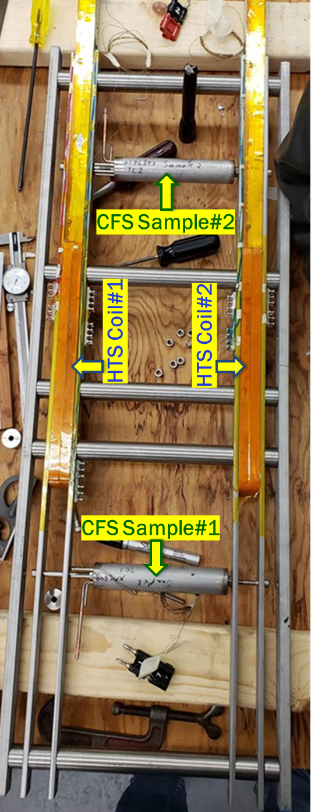
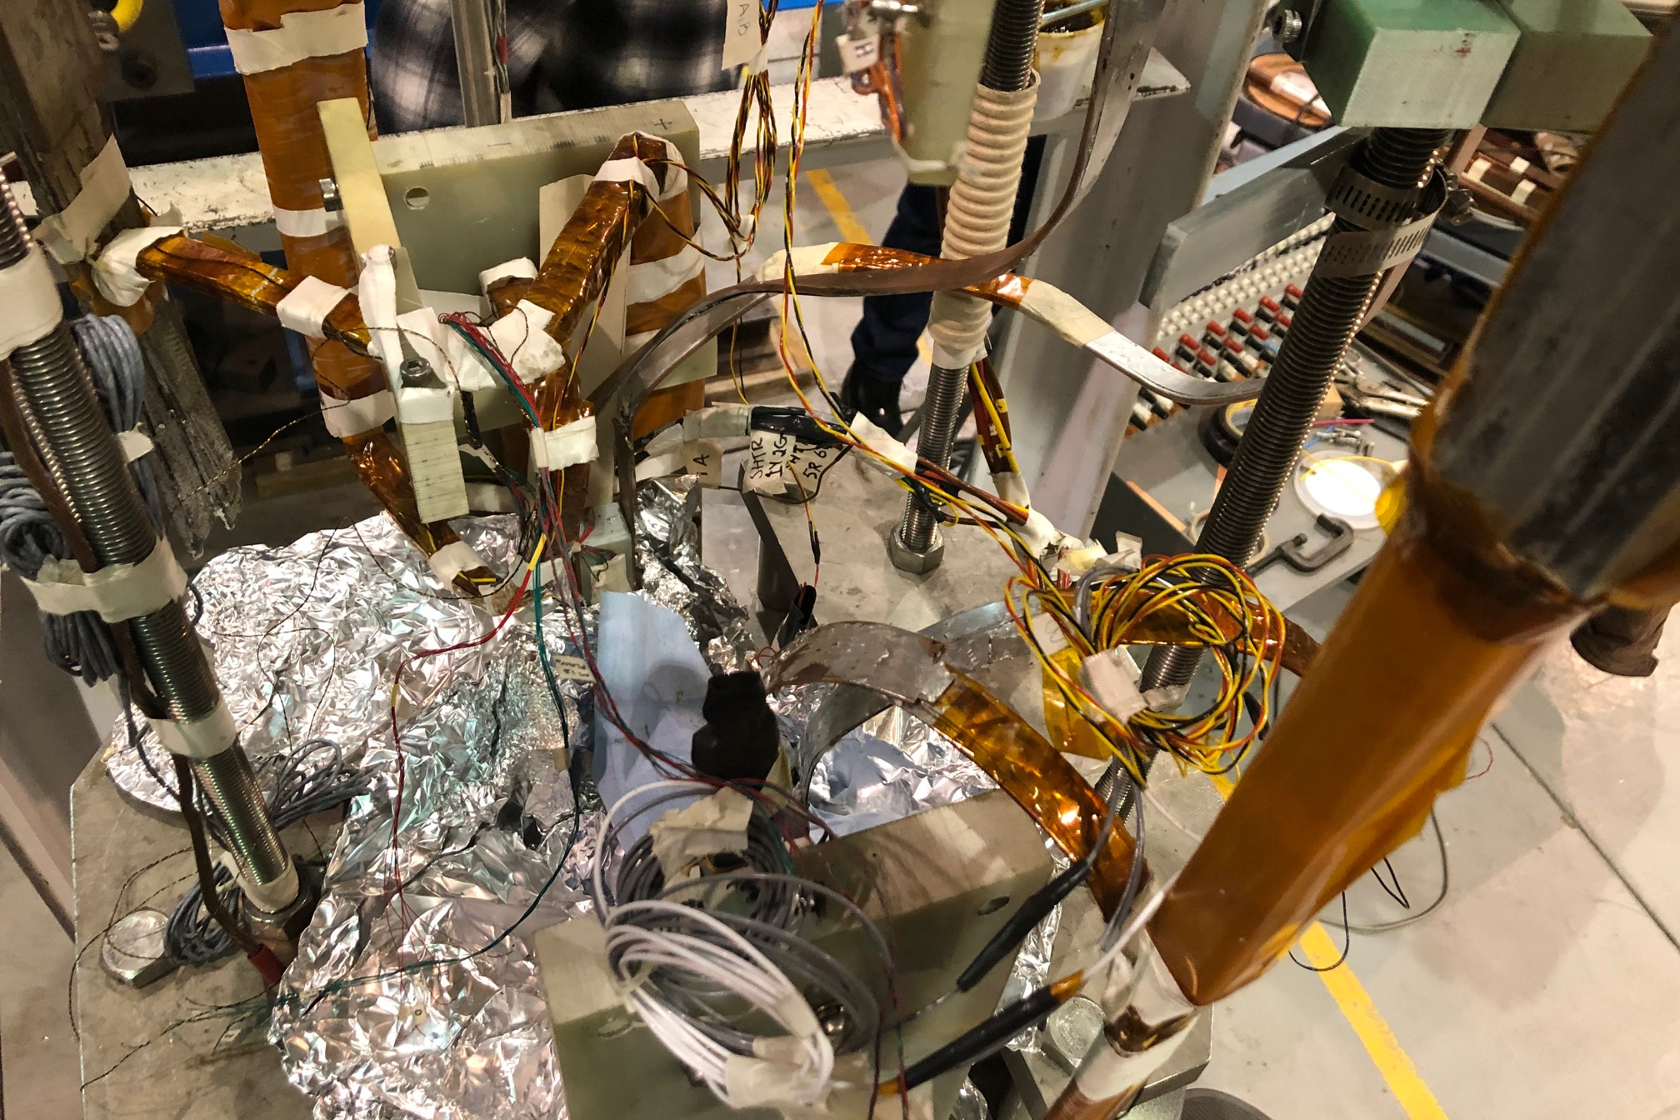
Fixture inside the magnet
HTS coils and samples inside
HTS/LTS Hybrid Dipole
Fixture inside the common coil dipole
Zoo of leads

Slide 10
Run Plan and Instrumentation

Slide 11
Run Plan for Magnetization Studies
(partly shown earlier and reviewed by BNL/LBL/OSU team)

Slide 12
Hall Probes for
Magnetization Measurements
Two Hall probes (redundancy) at the center and one at the edge (at the request of Mike Sumption) in the base coil with turn-to-turn insulation after the BNL/LBL/OSU test planning meeting
Note: planned test is magnetization studies in insulated coil only.
  Everything else is exploratory
  (extra at very small cost).
Two Hall probes (redundancy) at the center only in the No-insulation coil

Slide 13
Voltage-taps for HTS Quench Protection
A v-tap after every 10 turns in each of four pancake coil
Two “insulated pancake coils” with 16 v-taps and two “No-insulation pancake coils” with 10 v-taps
More v-taps at leads, etc.
LTS coils have the original v-taps

Slide 14
Magnetic and Mechanical Models
Maximum for magnetization test: 8 KA in Nb₃Sn coils and 800 A in HTS coils
The baseline models are for 10 kA in the Nb₃Sn coil and 1 kA in two HTS coils
Also examined HTS coils at 1.5 kA and 2 kA (just in case), for quench studies

Slide 15
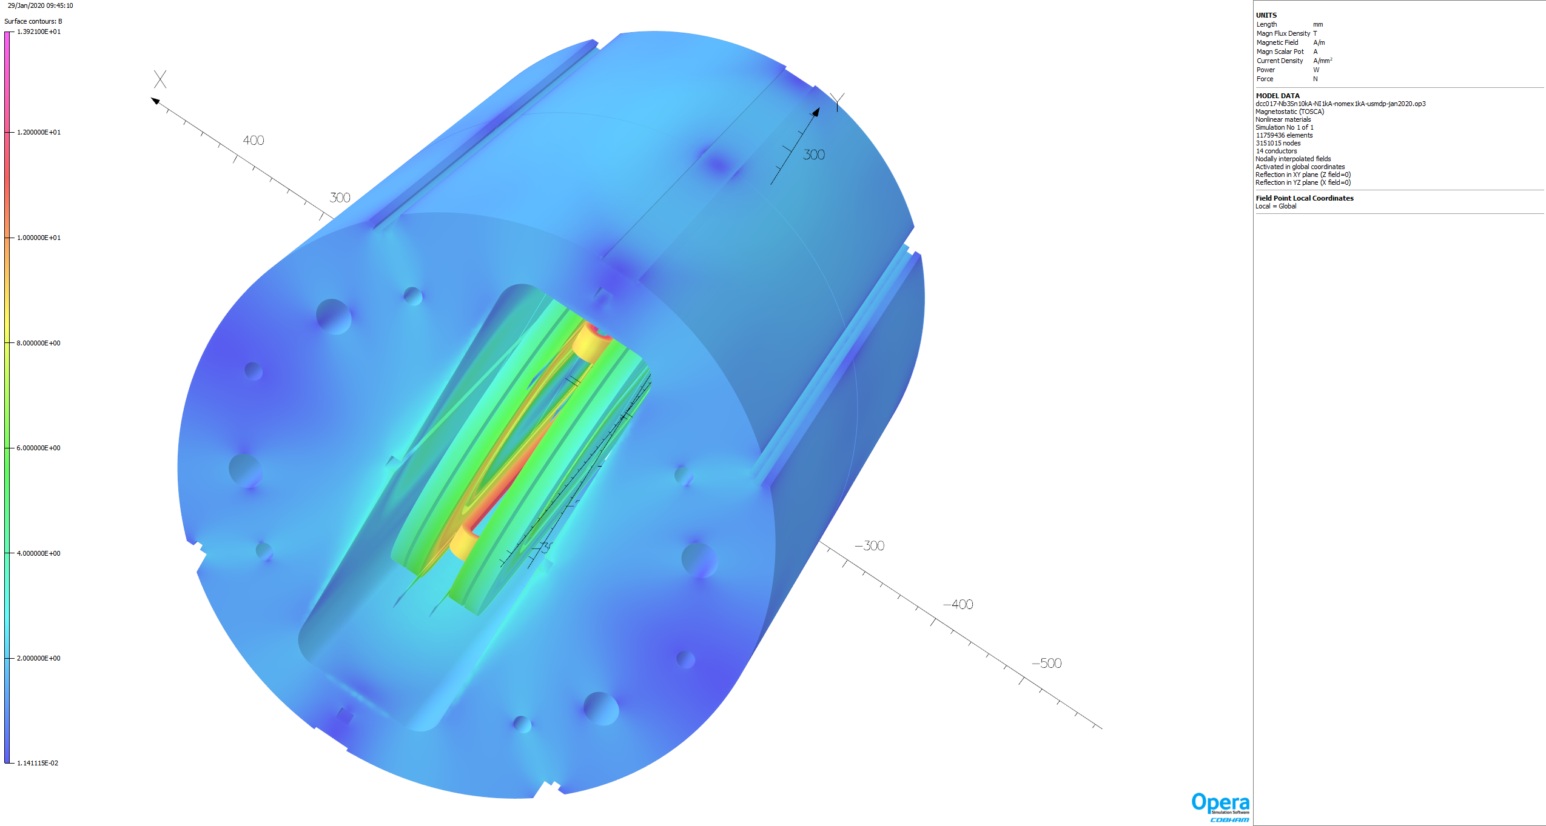
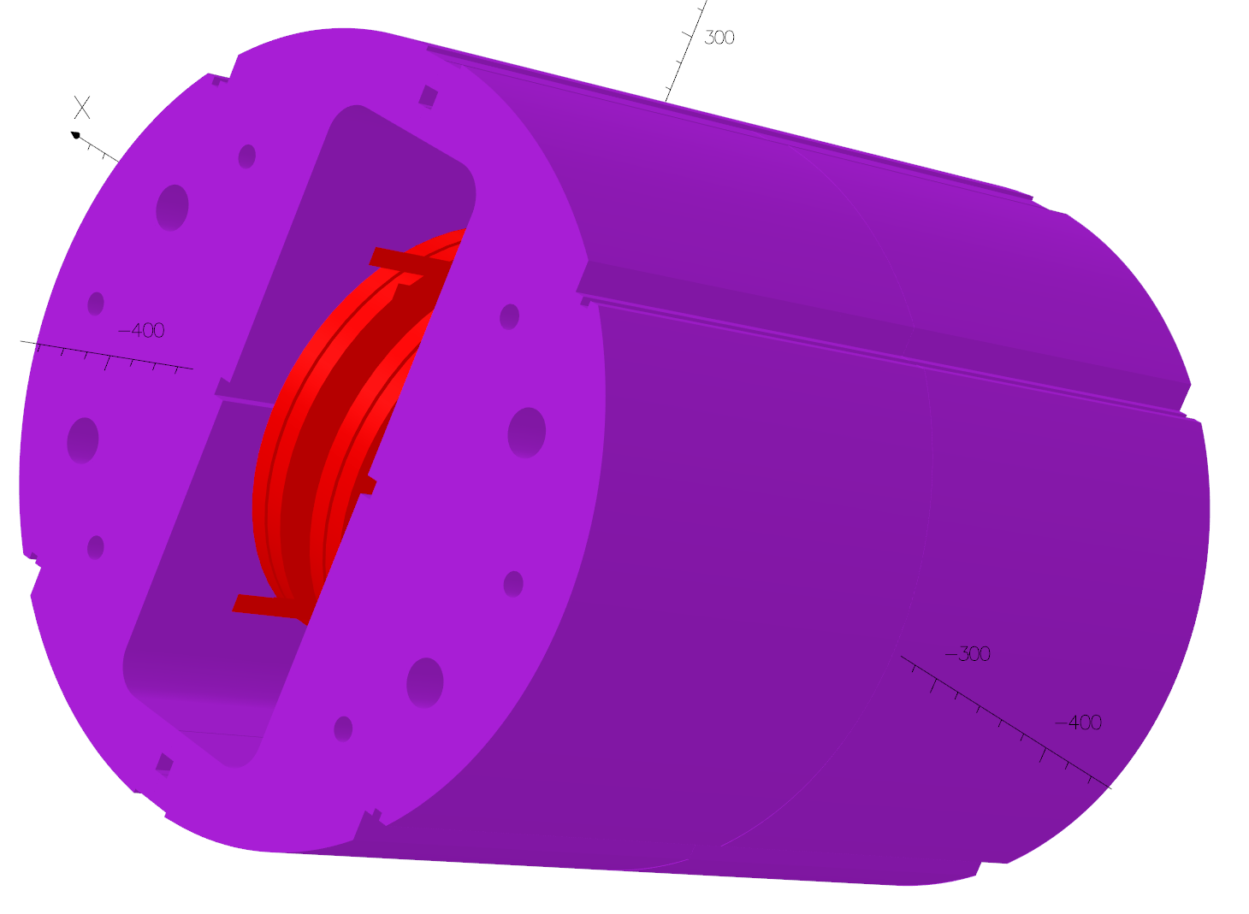
Magnetic Model
(Nb3Sn coils @10 kA, HTS coils @1kA)

Slide 16
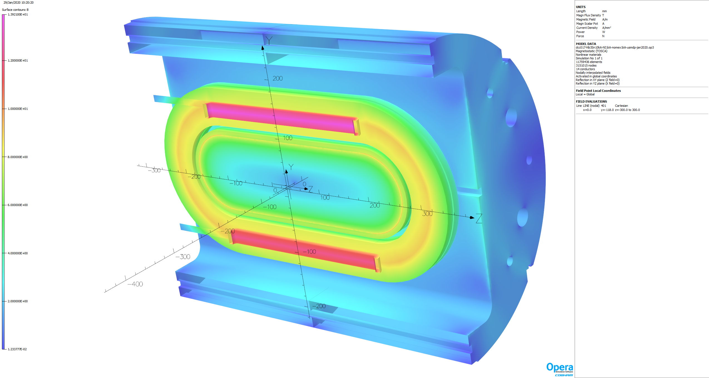
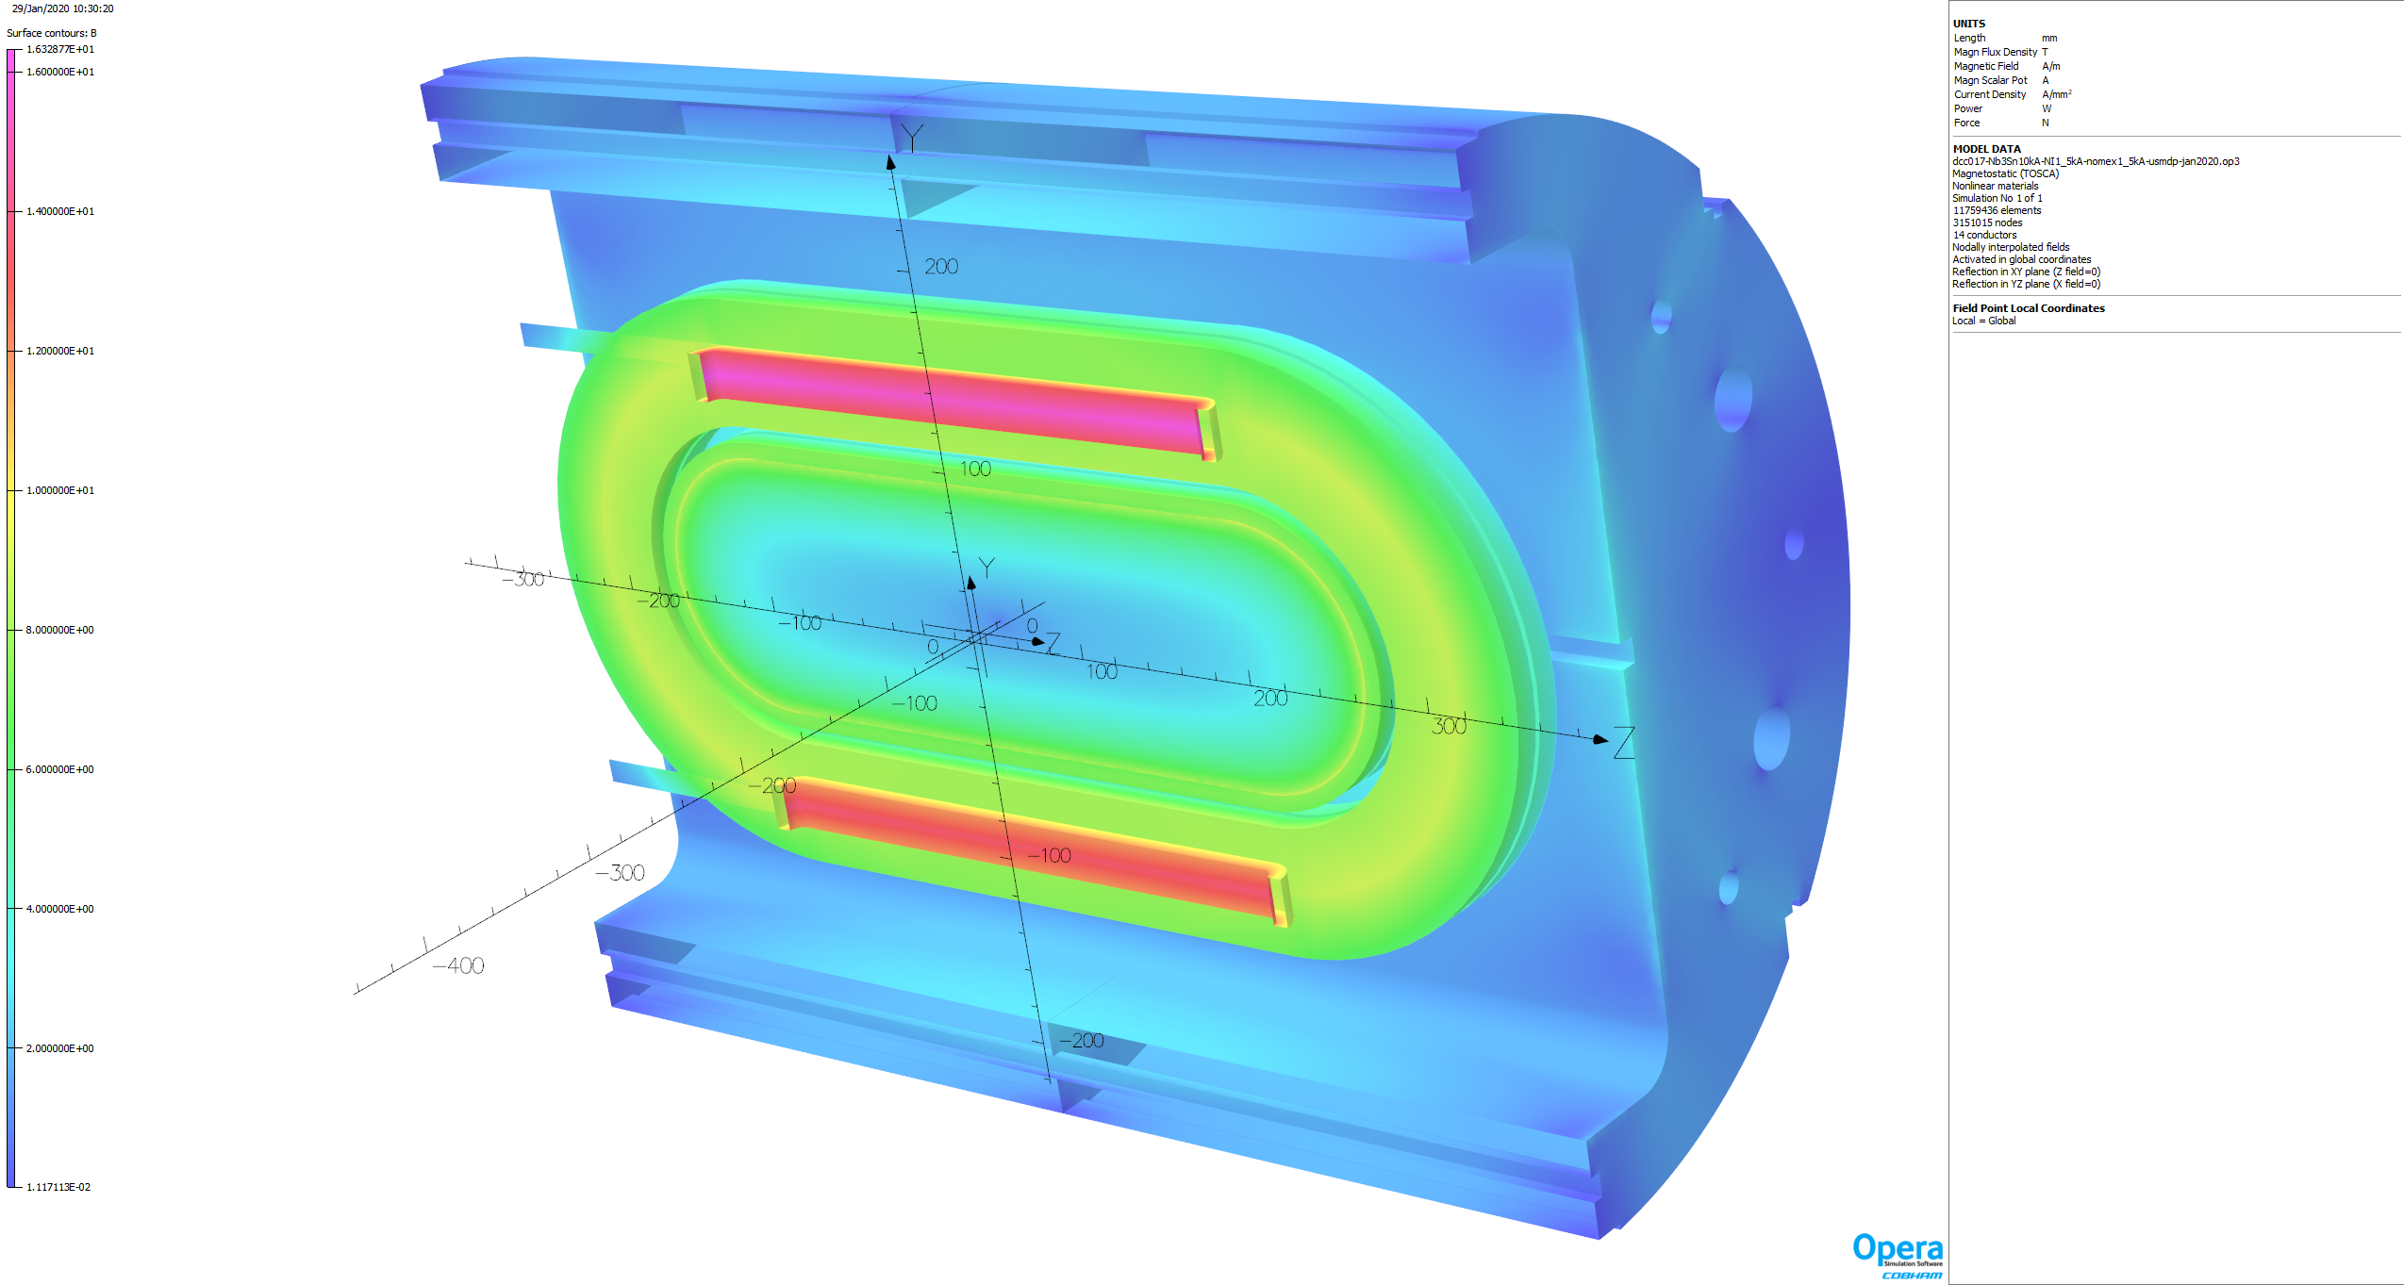
Cutout View for Nb₃Sn coils at 10 kA and HTS coils at 1 KA and 1.5 kA
13.9 T
16.3 T
HTS coils are installed with as low clearance as possible. Horizontal Lorentz forces will bring them in contact with the LTS coils

Slide 17
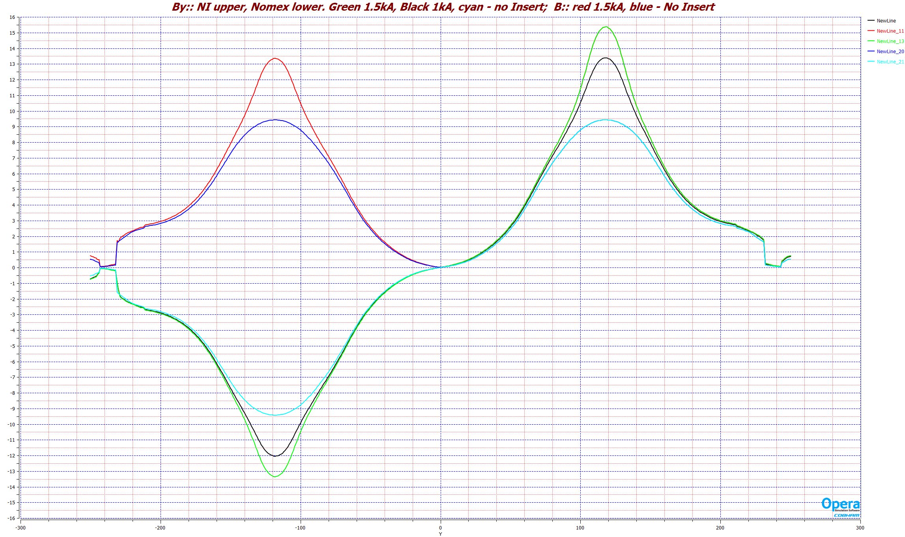
Field along vertical axis
HTS 1.5 KA
HTS 1 kA
NO HTS
B
By
Upper aperture
By
Lower aperture

Slide 18
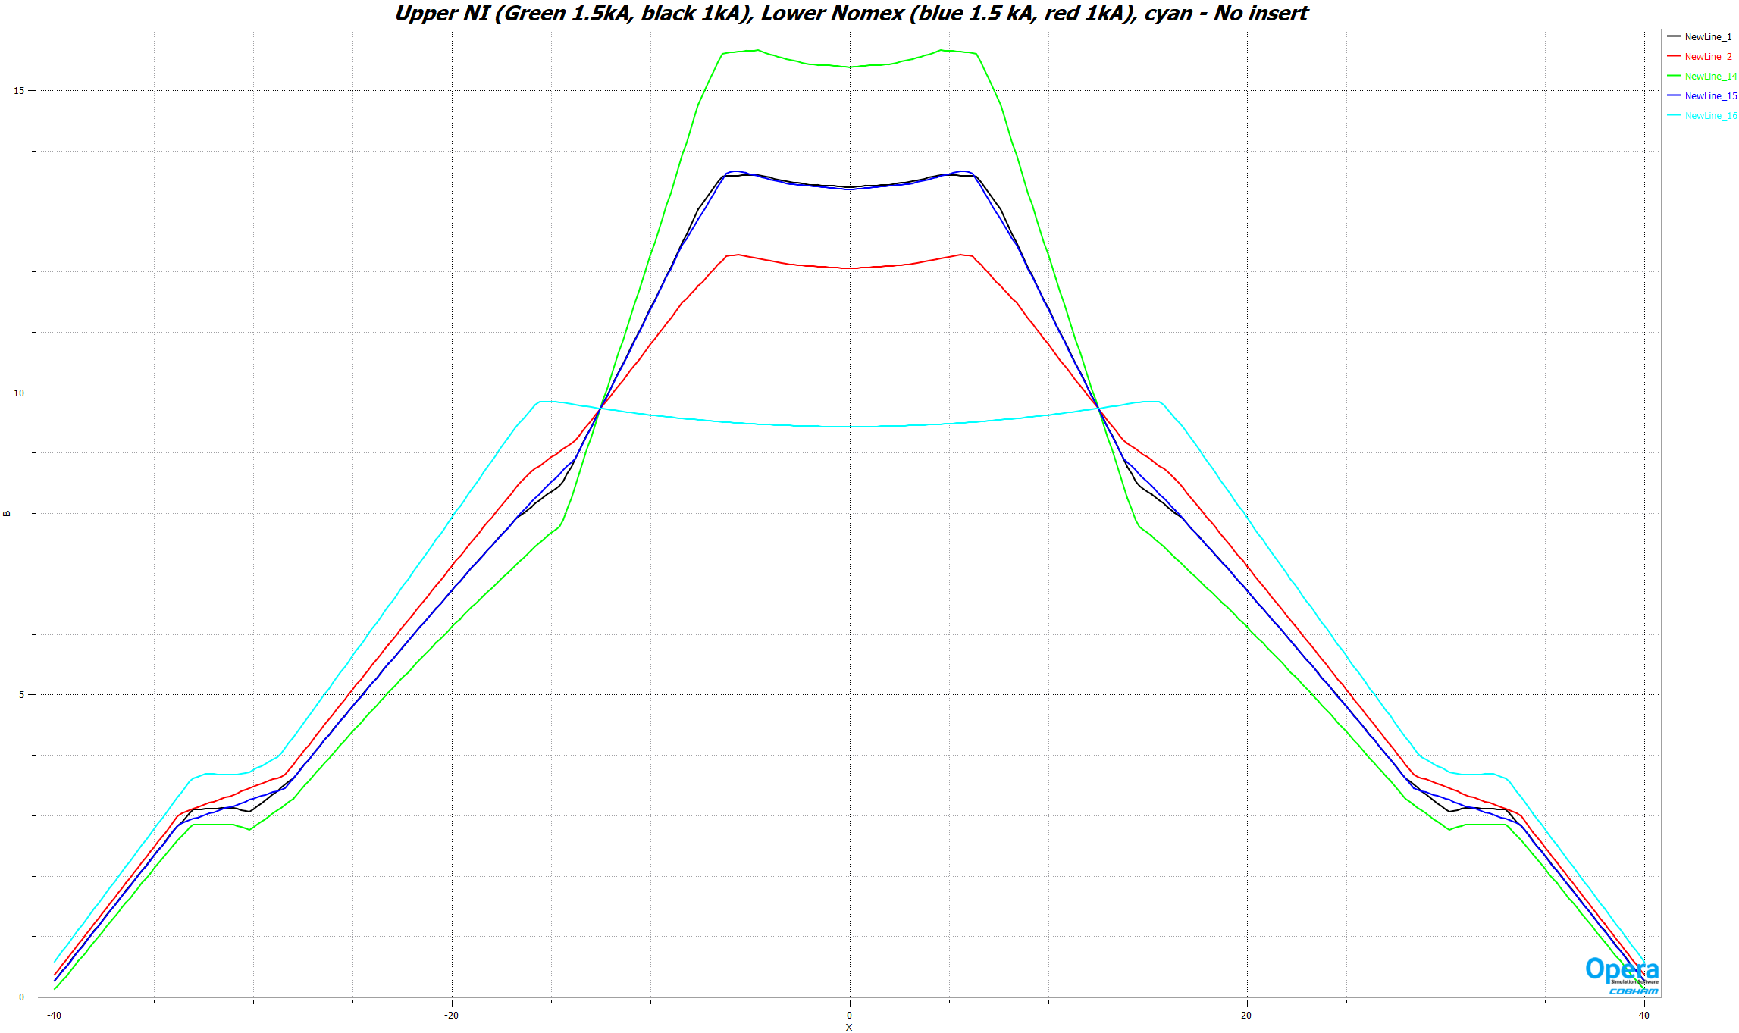
B along x-axis in the aperture
HTS 2 kA
HTS 1.5 kA
HTS 1 kA
No Insert

Slide 19
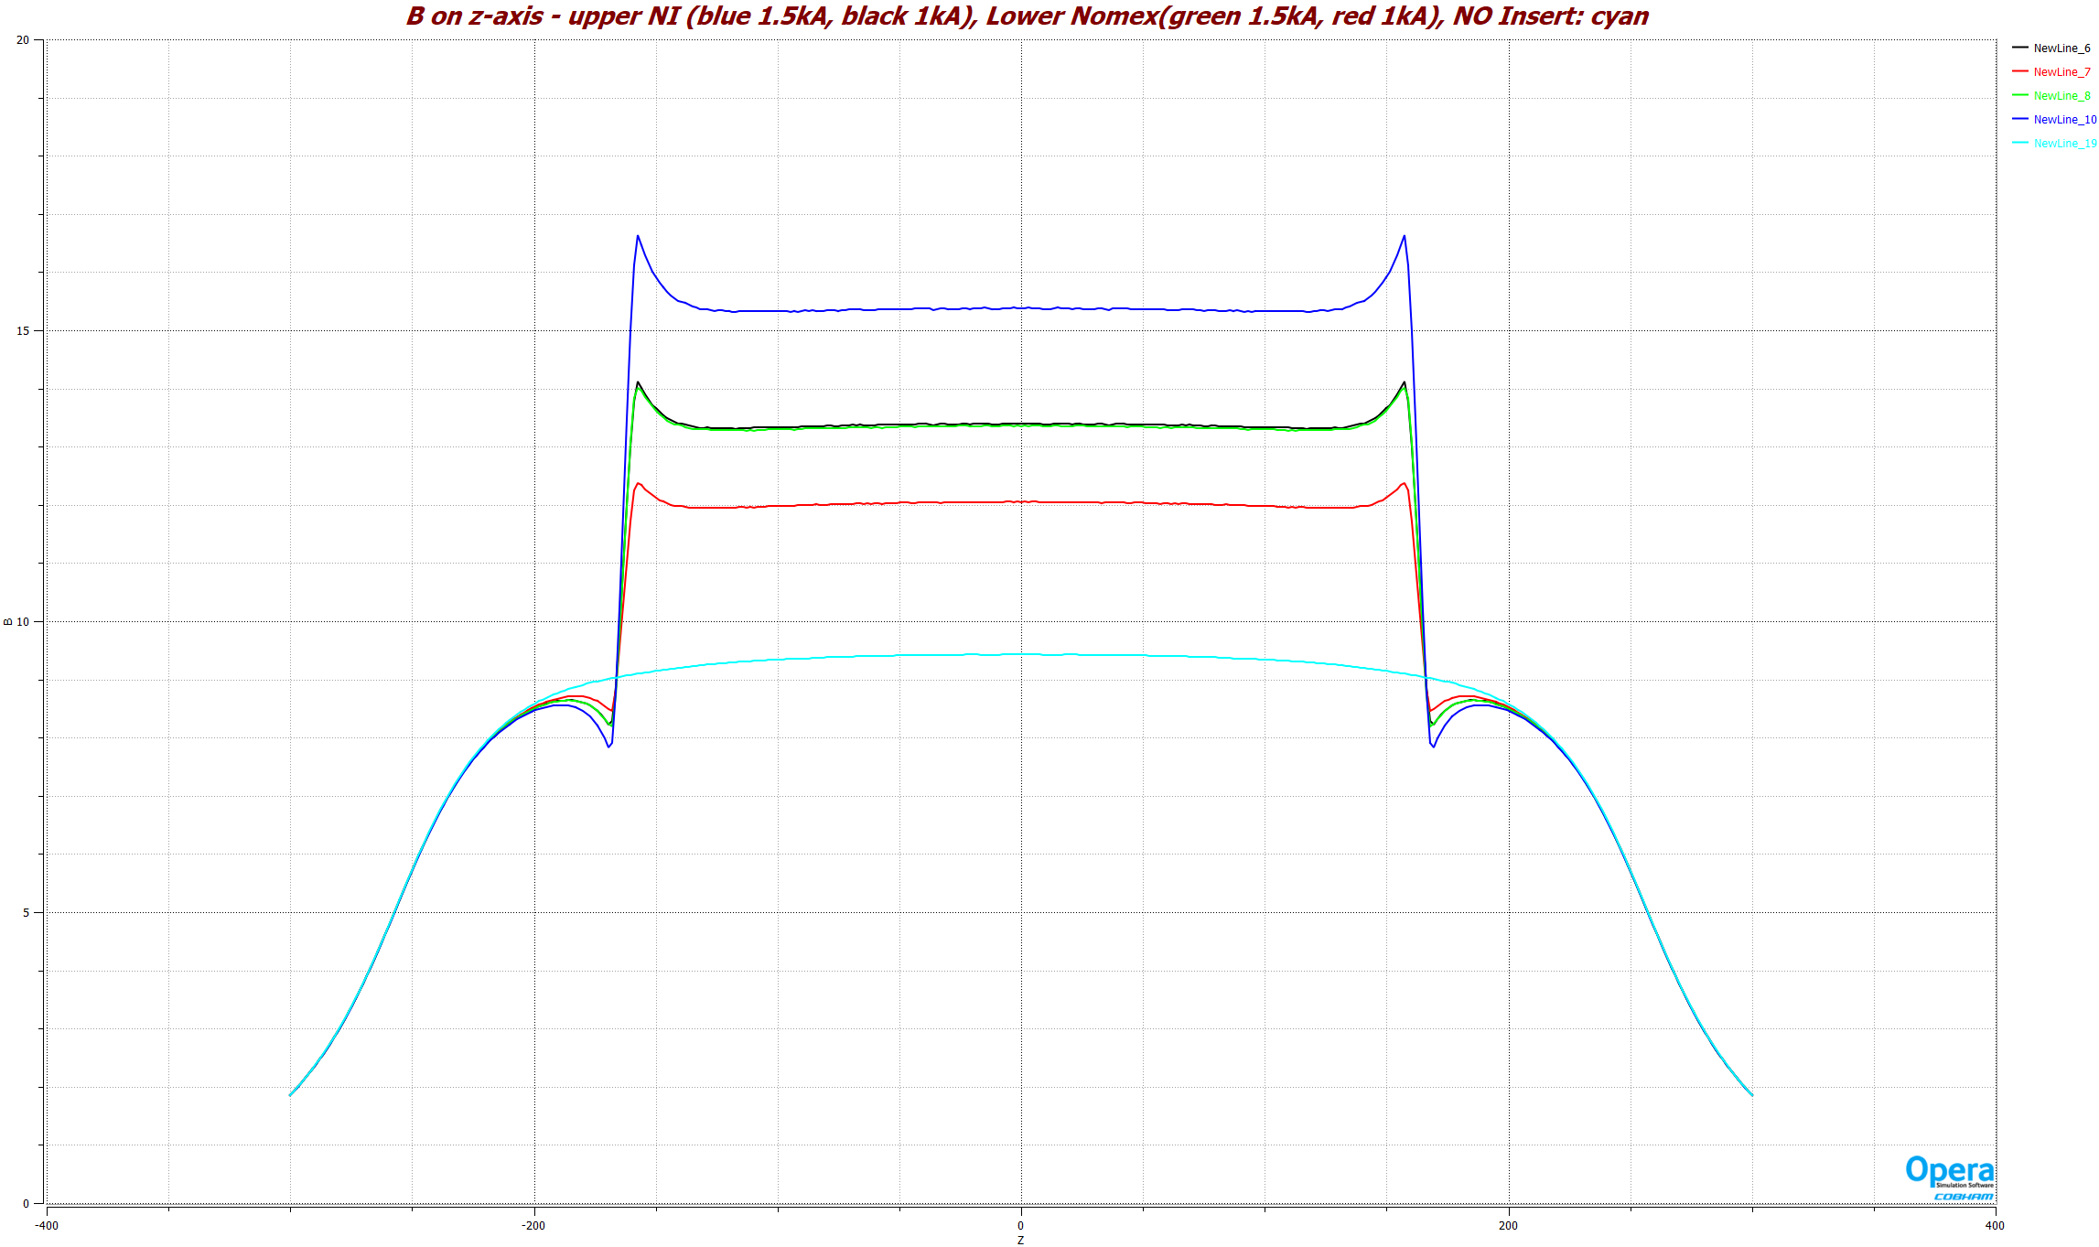
B along z-axis
HTS 2 kA
HTS 1.5 kA
HTS 1 kA
No Insert

Slide 20
Mechanical Models
The baseline models are for 10 kA in the Nb₃Sn coil and 1 kA in two HTS coils
Also examined HTS coils at 1.5 kA and 2 kA (just in case), for quench studies

Slide 21
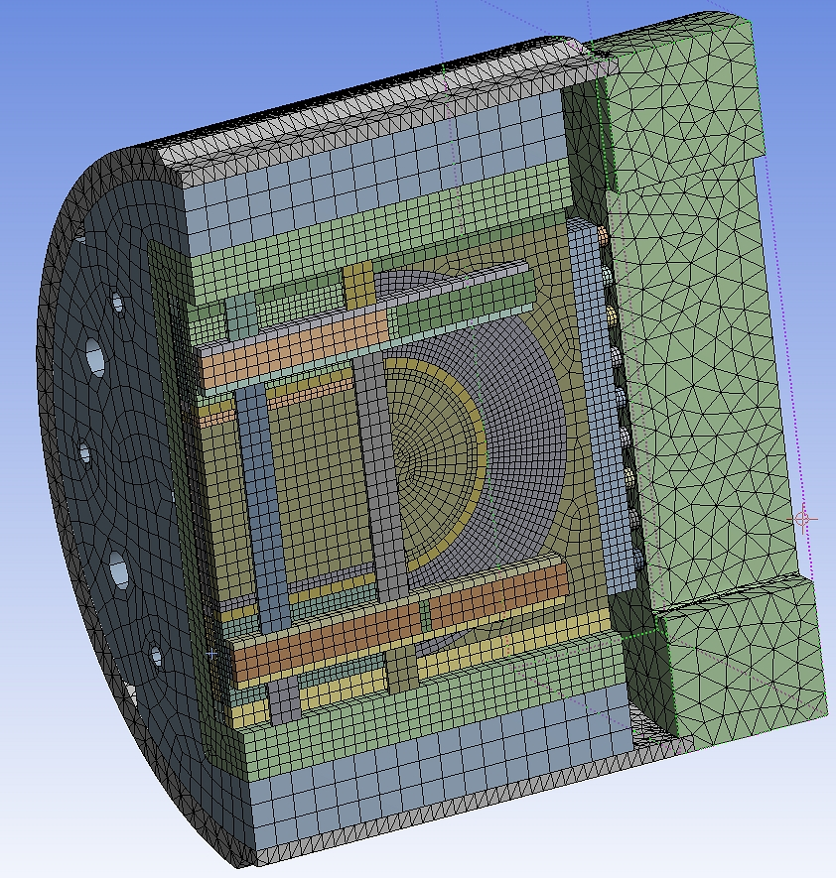
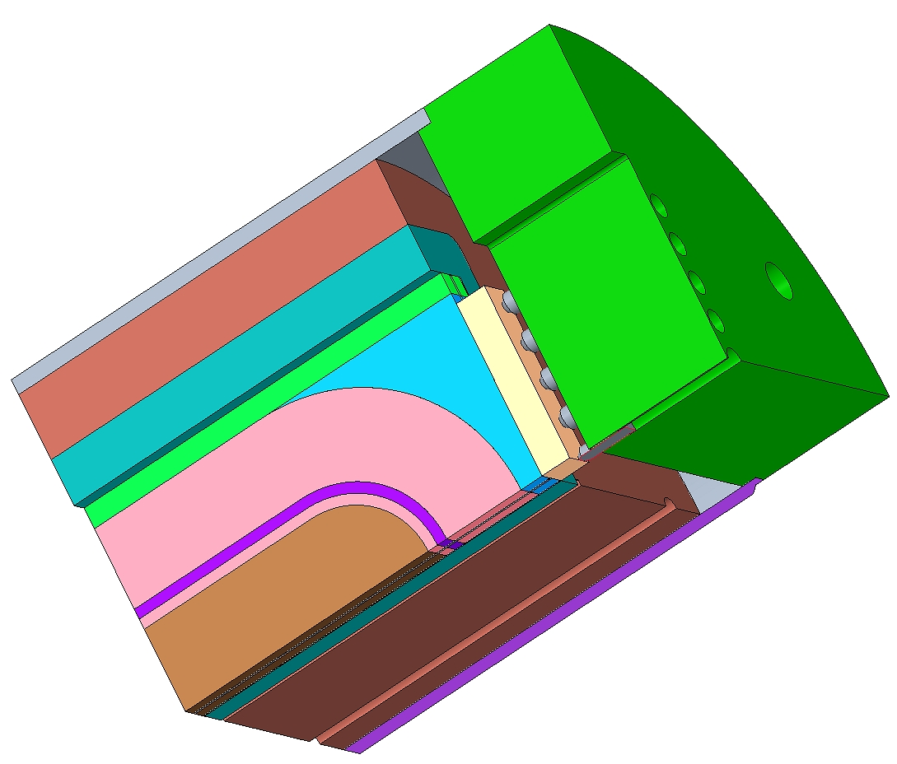
ANSYS Model
(Nb3Sn coil and Two different HTS coils)
Main Question
Can Nb3Sn coils and structure take the transverse Lorentz load (x-axis) coming from the HTS coils powered at high current

Slide 22
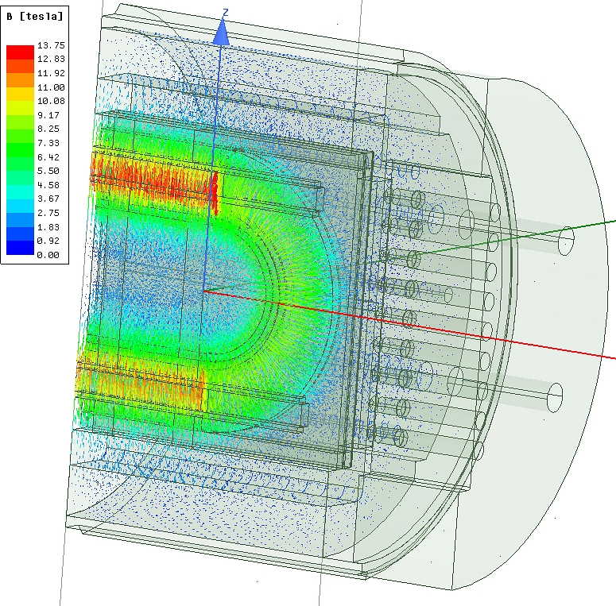
ANSYS Run Field from Nb₃Sn 10 kA, HTS 1 kA

Slide 23
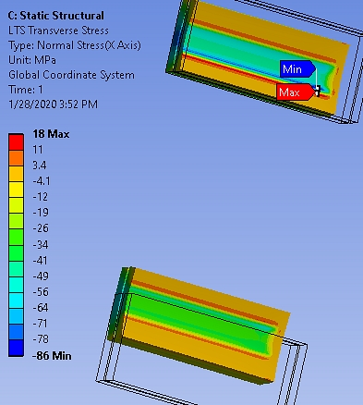
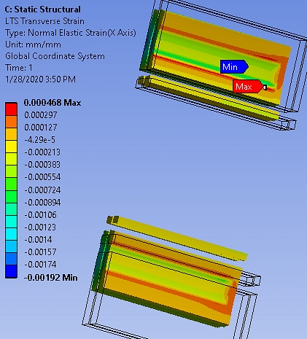
ANSYS Run Transverse Stress and Strain from Nb₃Sn 10 kA, HTS 1 kA
LTS Coils

Slide 24
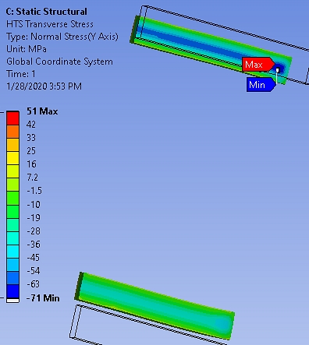
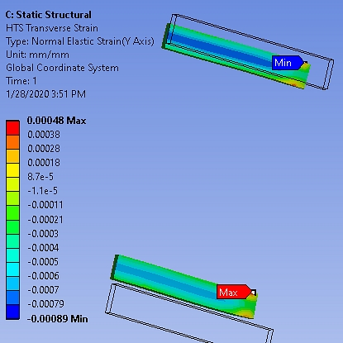
ANSYS Run Transverse Stress and Strain from Nb₃Sn 10 kA, HTS 1 kA
HTS Coils

Slide 25
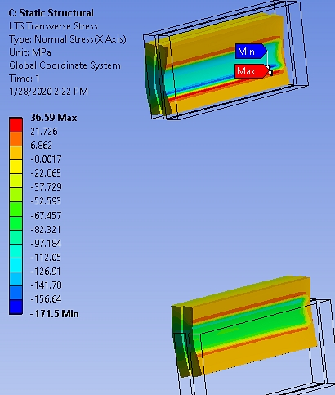
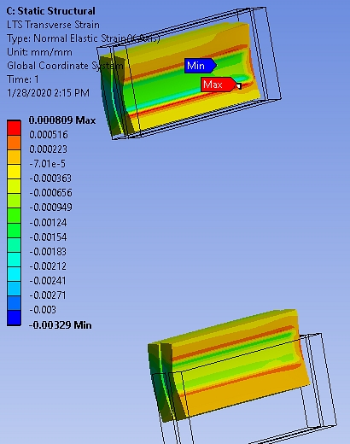
ANSYS Run Transverse Stress and Strain from Nb₃Sn 10 kA, HTS 2 kA
LTS Coils

Slide 26
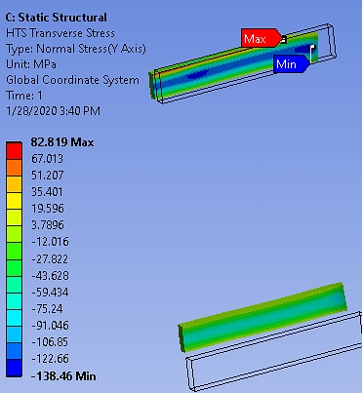
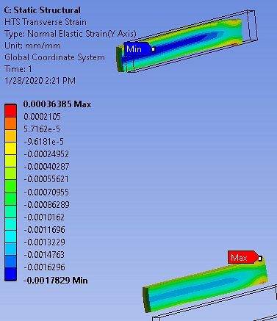
ANSYS Run Transverse Stress and Strain from Nb₃Sn 10 kA, HTS 2 kA
HTS Coils

Slide 27
Quench Protection of
HTS/LTS Hybrid Dipole

Slide 28
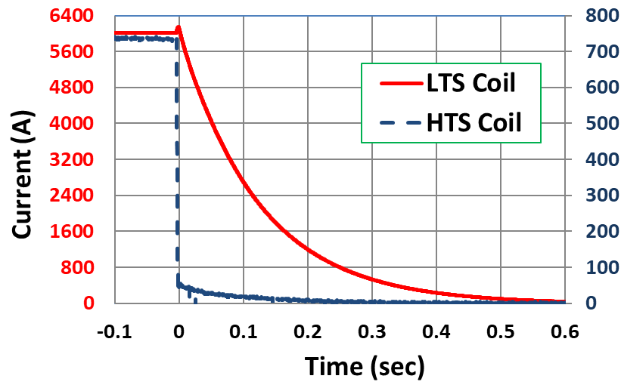
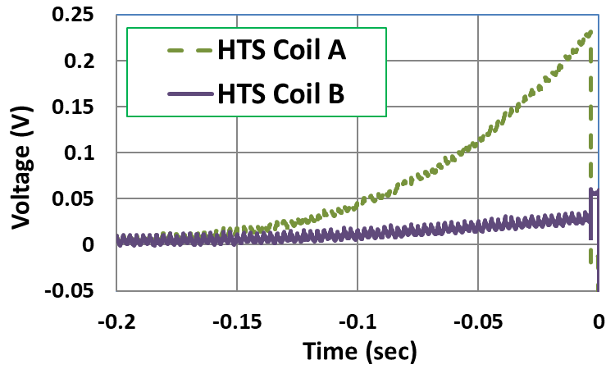
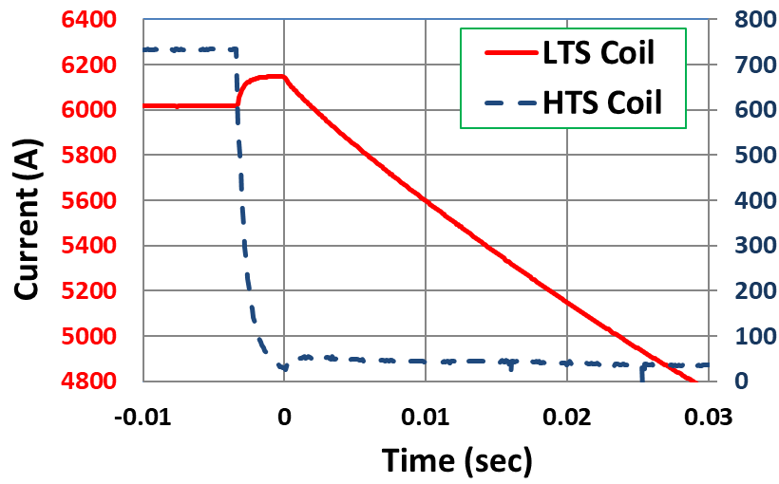
Feedback of Quenching of HTS Coils on LTS Coils in HTS/LTS Hybrid Magnet
HTS coils operated like HTS coils
Significant voltage in HTS coils
What happens when the energy of HTS coil increases?
Or what happens to HTS coils if LTS coil quenches?
Study of coupling between HTS & LTS coils can be a major part of MDP

Slide 29
From Piyush Joshi

Slide 30
Summary
The magnet has been assembled with HTS coils and CFS samples inserted in the common coil dipole DCC017.
We are on track for performing the test before the MDP collaboration meeting at Berkeley.
The main purpose of this test is to measure the magnetization on HTS coils with HTS tape primary in field parallel direction (earlier studies under SBIR program was for field perpendicular direction).
We will also study the performance HTS/LTS hybrid magnet at high fields (>10 T).
A unique BNL common coil structure allows four simultaneous tests – two HTS coils and two HTS samples. It should score well with the fusion community in terms of MDP/FES collaboration.

