Slide 1

${\text{CORC}}^{\text{®}}$ Cable Terminations with Integrated Hall Arrays for Quench Detection
Reed Teyber, Maxim Marchevsky, Soren Prestemon - LBNL
Jeremy Weiss, Danko van der Laan – ACT LLC

Slide 2
Motivation
Normal zone detection in HTS cables remains an active area of R&D
In Fusion reactors, coils can operate with fast ramp rates
  Detection problems exacerbated
Seek a non-invasive (outside of reactor), real-time quench detection system
  Supplement voltage measurements

Slide 3
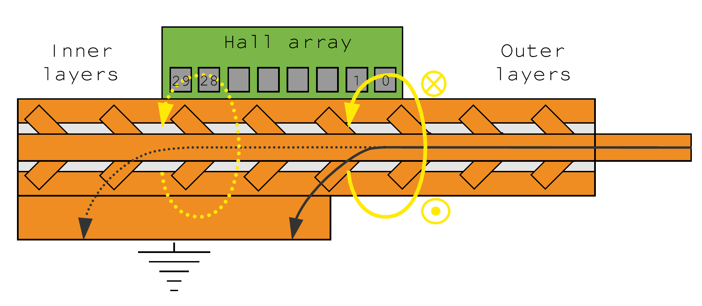
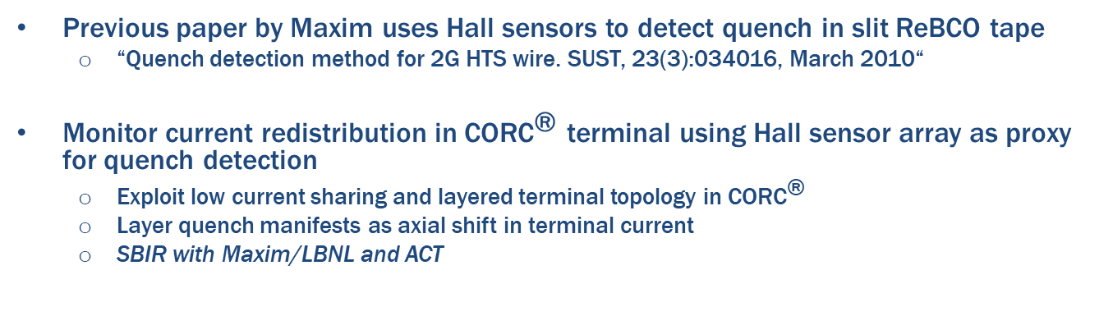
Motivation
Previous paper by Maxim uses Hall sensors to detect quench in slit ReBCO tape
  “Quench detection method for 2G HTS wire. SUST, 23(3):034016, March 2010“
Monitor current redistribution in ${\text{CORC}}^{\text{®}}$ terminal using Hall sensor array as proxy for quench detection
  Exploit low current sharing and layered terminal topology in ${\text{CORC}}^{\text{®}}$
  Layer quench manifests as axial shift in terminal current
  SBIR with Maxim/LBNL and ACT

Slide 4
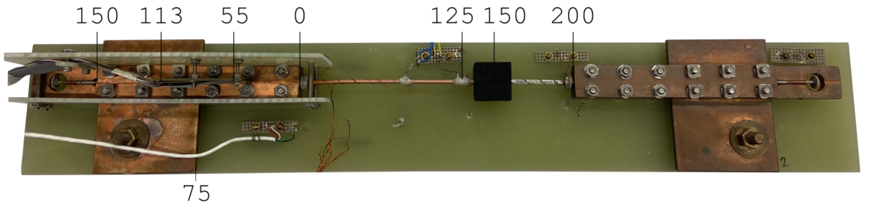
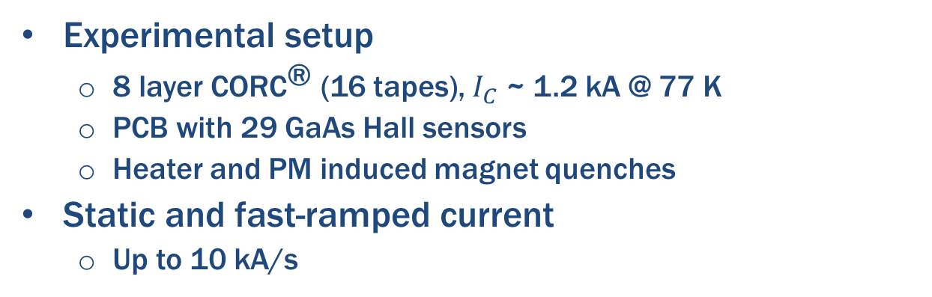
Methods
Experimental setup
  8 layer ${\text{CORC}}^{\text{®}}$ (16 tapes), $I_{C}$ ~ 1.2 kA @ 77 K
  PCB with 29 GaAs Hall sensors
  Heater and PM induced magnet quenches
Static and fast-ramped current
  Up to 10 kA/s

Slide 5
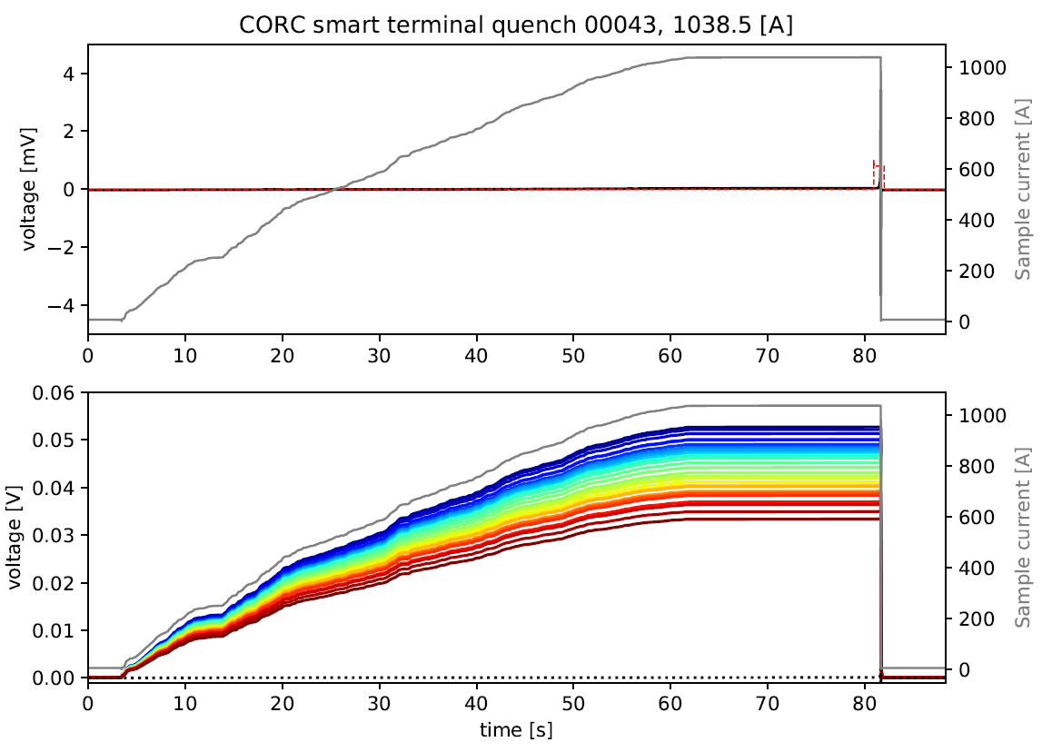
Methods
Experimental procedure
  Ramp current to desired value, turn on heater to induce quench
  Plot change in sensor value (subtract baseline measurement)
Heater
Current redistribution
Baseline
Blue: sensor 0 (inner terminal)
Red: sensor 29 (outer terminal)

Slide 6
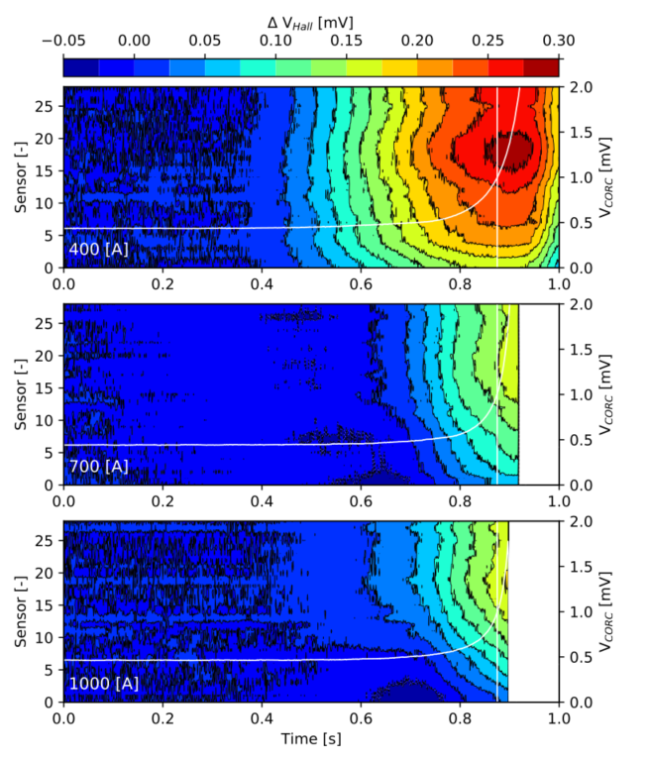
Static quenches
Static current, heater induced quench
  Contours show change in Hall sensor response
  Right y-axis shows sample voltage
Spatial frequencies to consider
  Layer to layer: ~10 sensors
  Twist-pitch: ~3 sensors
  Tape-to-tape: ~1 sensor
Response dominated by global increase in field
  Fits simple model on previous slide
  Periodic, wave-like normal zone propagation at 700 A
    Originating at terminal outside
    Not at helix twist-pitch length scales
  Smaller variations observed on layer-to-layer scale (~10 sensors), as observed at 1000 A
Outer term.
“CORC-side”

Slide 7
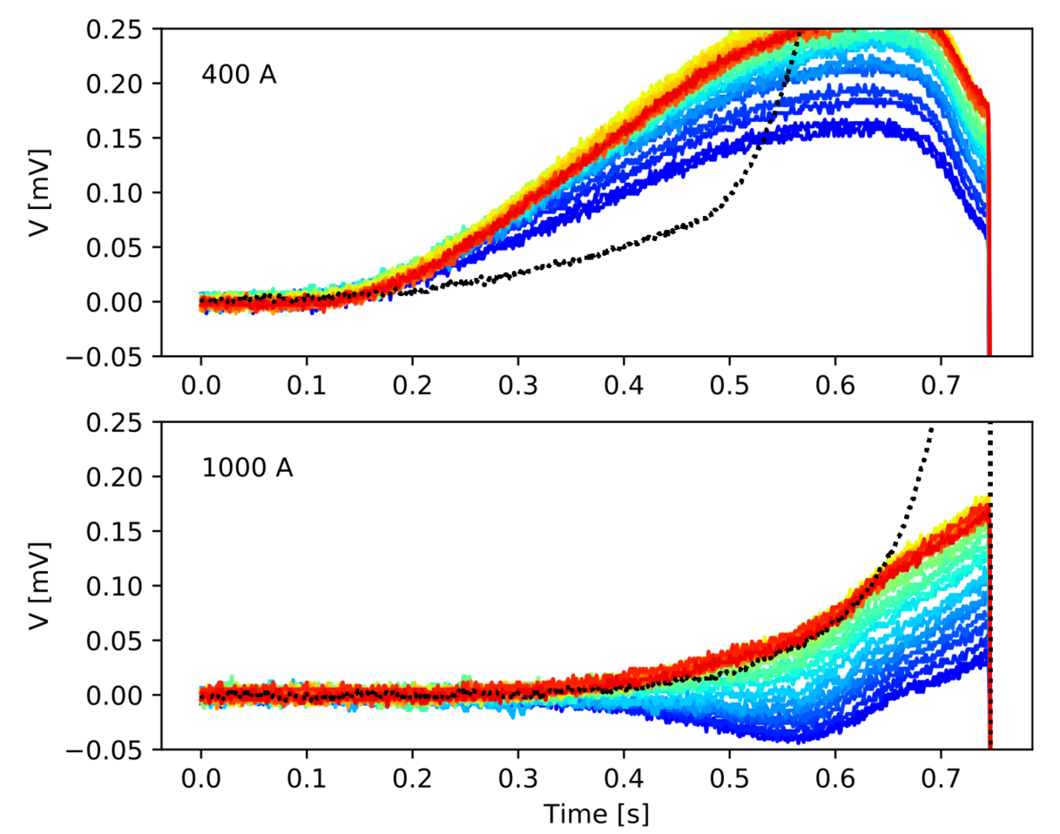
Static quenches
Terminal Hall sensors can be used for real-time quench detection
  Similar magnitude and temporal response as sample voltage

Slide 8
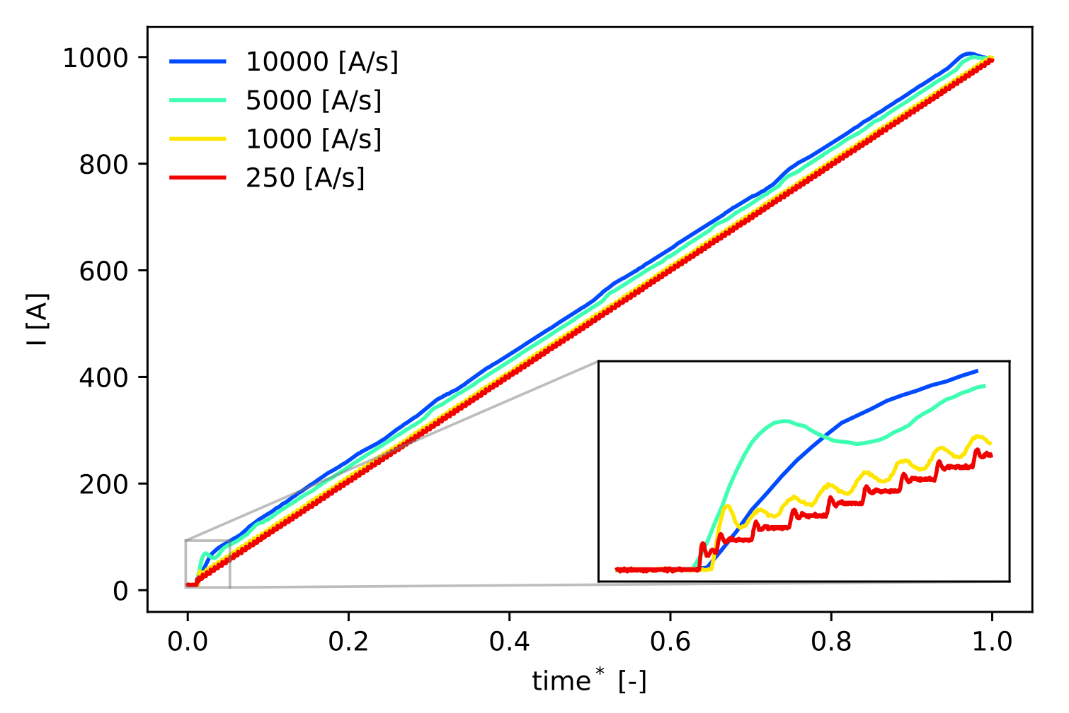
Dynamic quenches
Explore feasibility of terminal Hall sensor for quench detection in ramped Fusion magnets
  Ramp rates of 1 kA/s, 5 kA/s and 10 kA/s
  Sorenson SGA 10/1200 PSU programmed with PyVISA
  Magnet-induced (left) and heater-induced (right) results
With fast ramps (1-10 kA/s), small variations in tape inductances yield inductive voltage distribution
Non-dimensional time

Slide 9
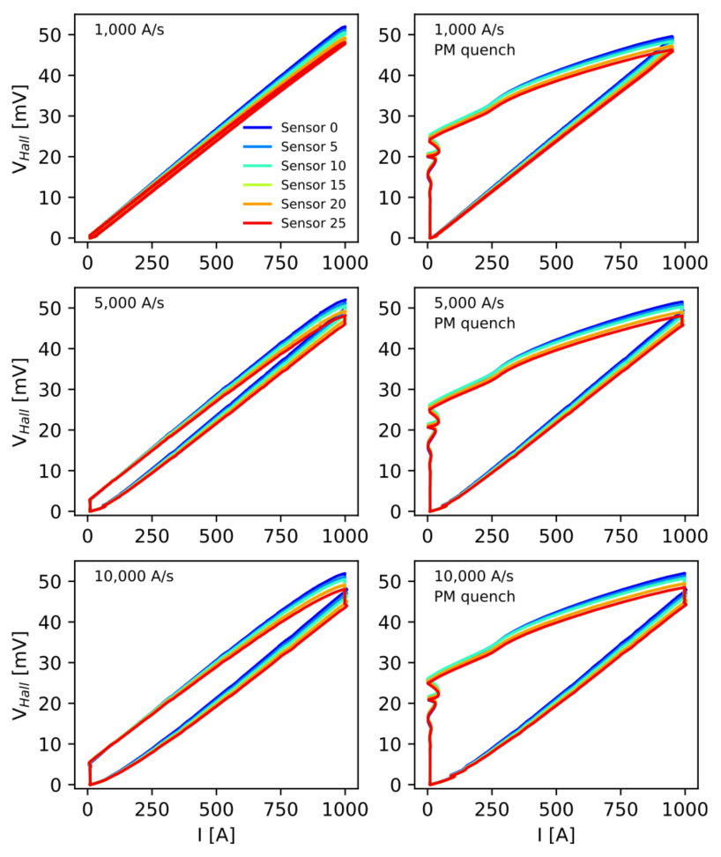
Dynamic quenches
Raw Hall sensor signals demonstrate hysteresis loop over current excursion
  Shielding currents induced in copper terminals
Contours show change in Hall sensor plot between no-quench experiment and quench experiment

Slide 10
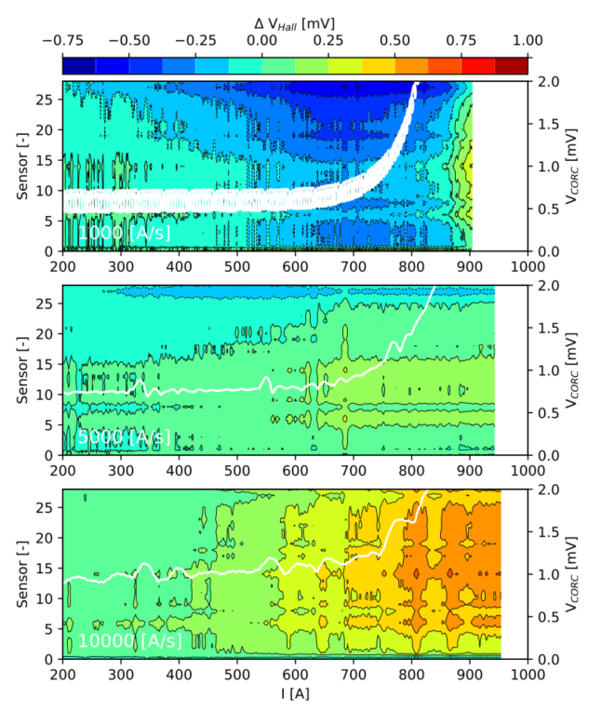
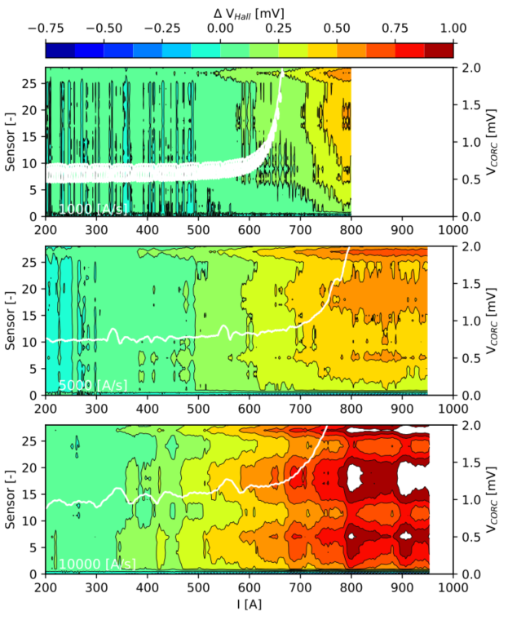
Dynamic quenches
Magnet induced
Heater induced
1 kA/s
5 kA/s
10 kA/s

Slide 11
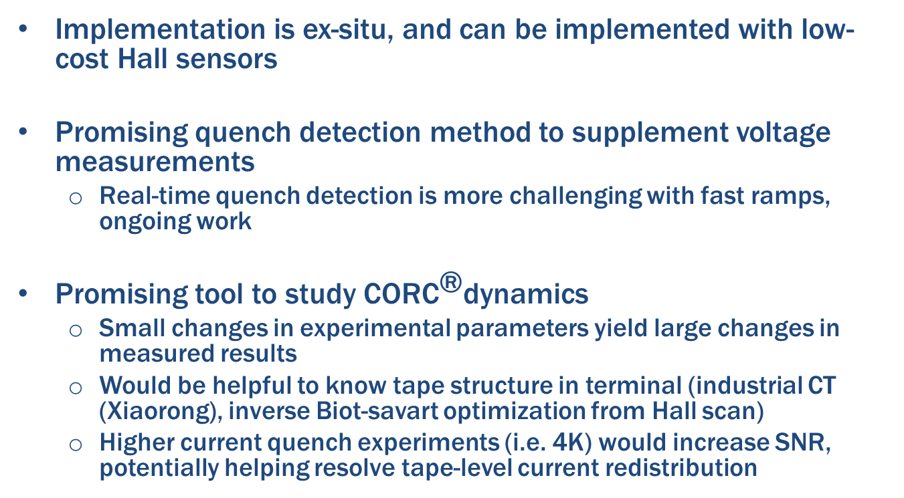
Discussion
Implementation is ex-situ, and can be implemented with low-cost Hall sensors
Promising quench detection method to supplement voltage measurements
  Real-time quench detection is more challenging with fast ramps, ongoing work
Promising tool to study ${\text{CORC}}^{\text{®}}$dynamics
  Small changes in experimental parameters yield large changes in measured results
  Would be helpful to know tape structure in terminal (industrial CT (Xiaorong), inverse Biot-savart optimization from Hall scan)
  Higher current quench experiments (i.e. 4K) would increase SNR, potentially helping resolve tape-level current redistribution

Slide 12
Extra Slides

Slide 13
Ramped Quench detection

Slide 14
