Slide 1
Preliminary Results of the HTS/LTS Hybrid Dipole Test
MDP Video meeting on February 19, 2020
Ramesh Gupta
For Superconducting Magnet Division
Brookhaven National Laboratory

Slide 2
Contributions from
Work presented here and the work being performed now is thanks to many individuals, including:
    Bill Sampson, Shresht Joshi, Anis Ben Yahia, Piyush Joshi, Bill McKeon, Sonny Dimaiuta, Denny Sullivan, Peter Galioto, Pat Doutney, Mike Anerella, John Cozzolino, Ray Ceruti, …

Slide 3
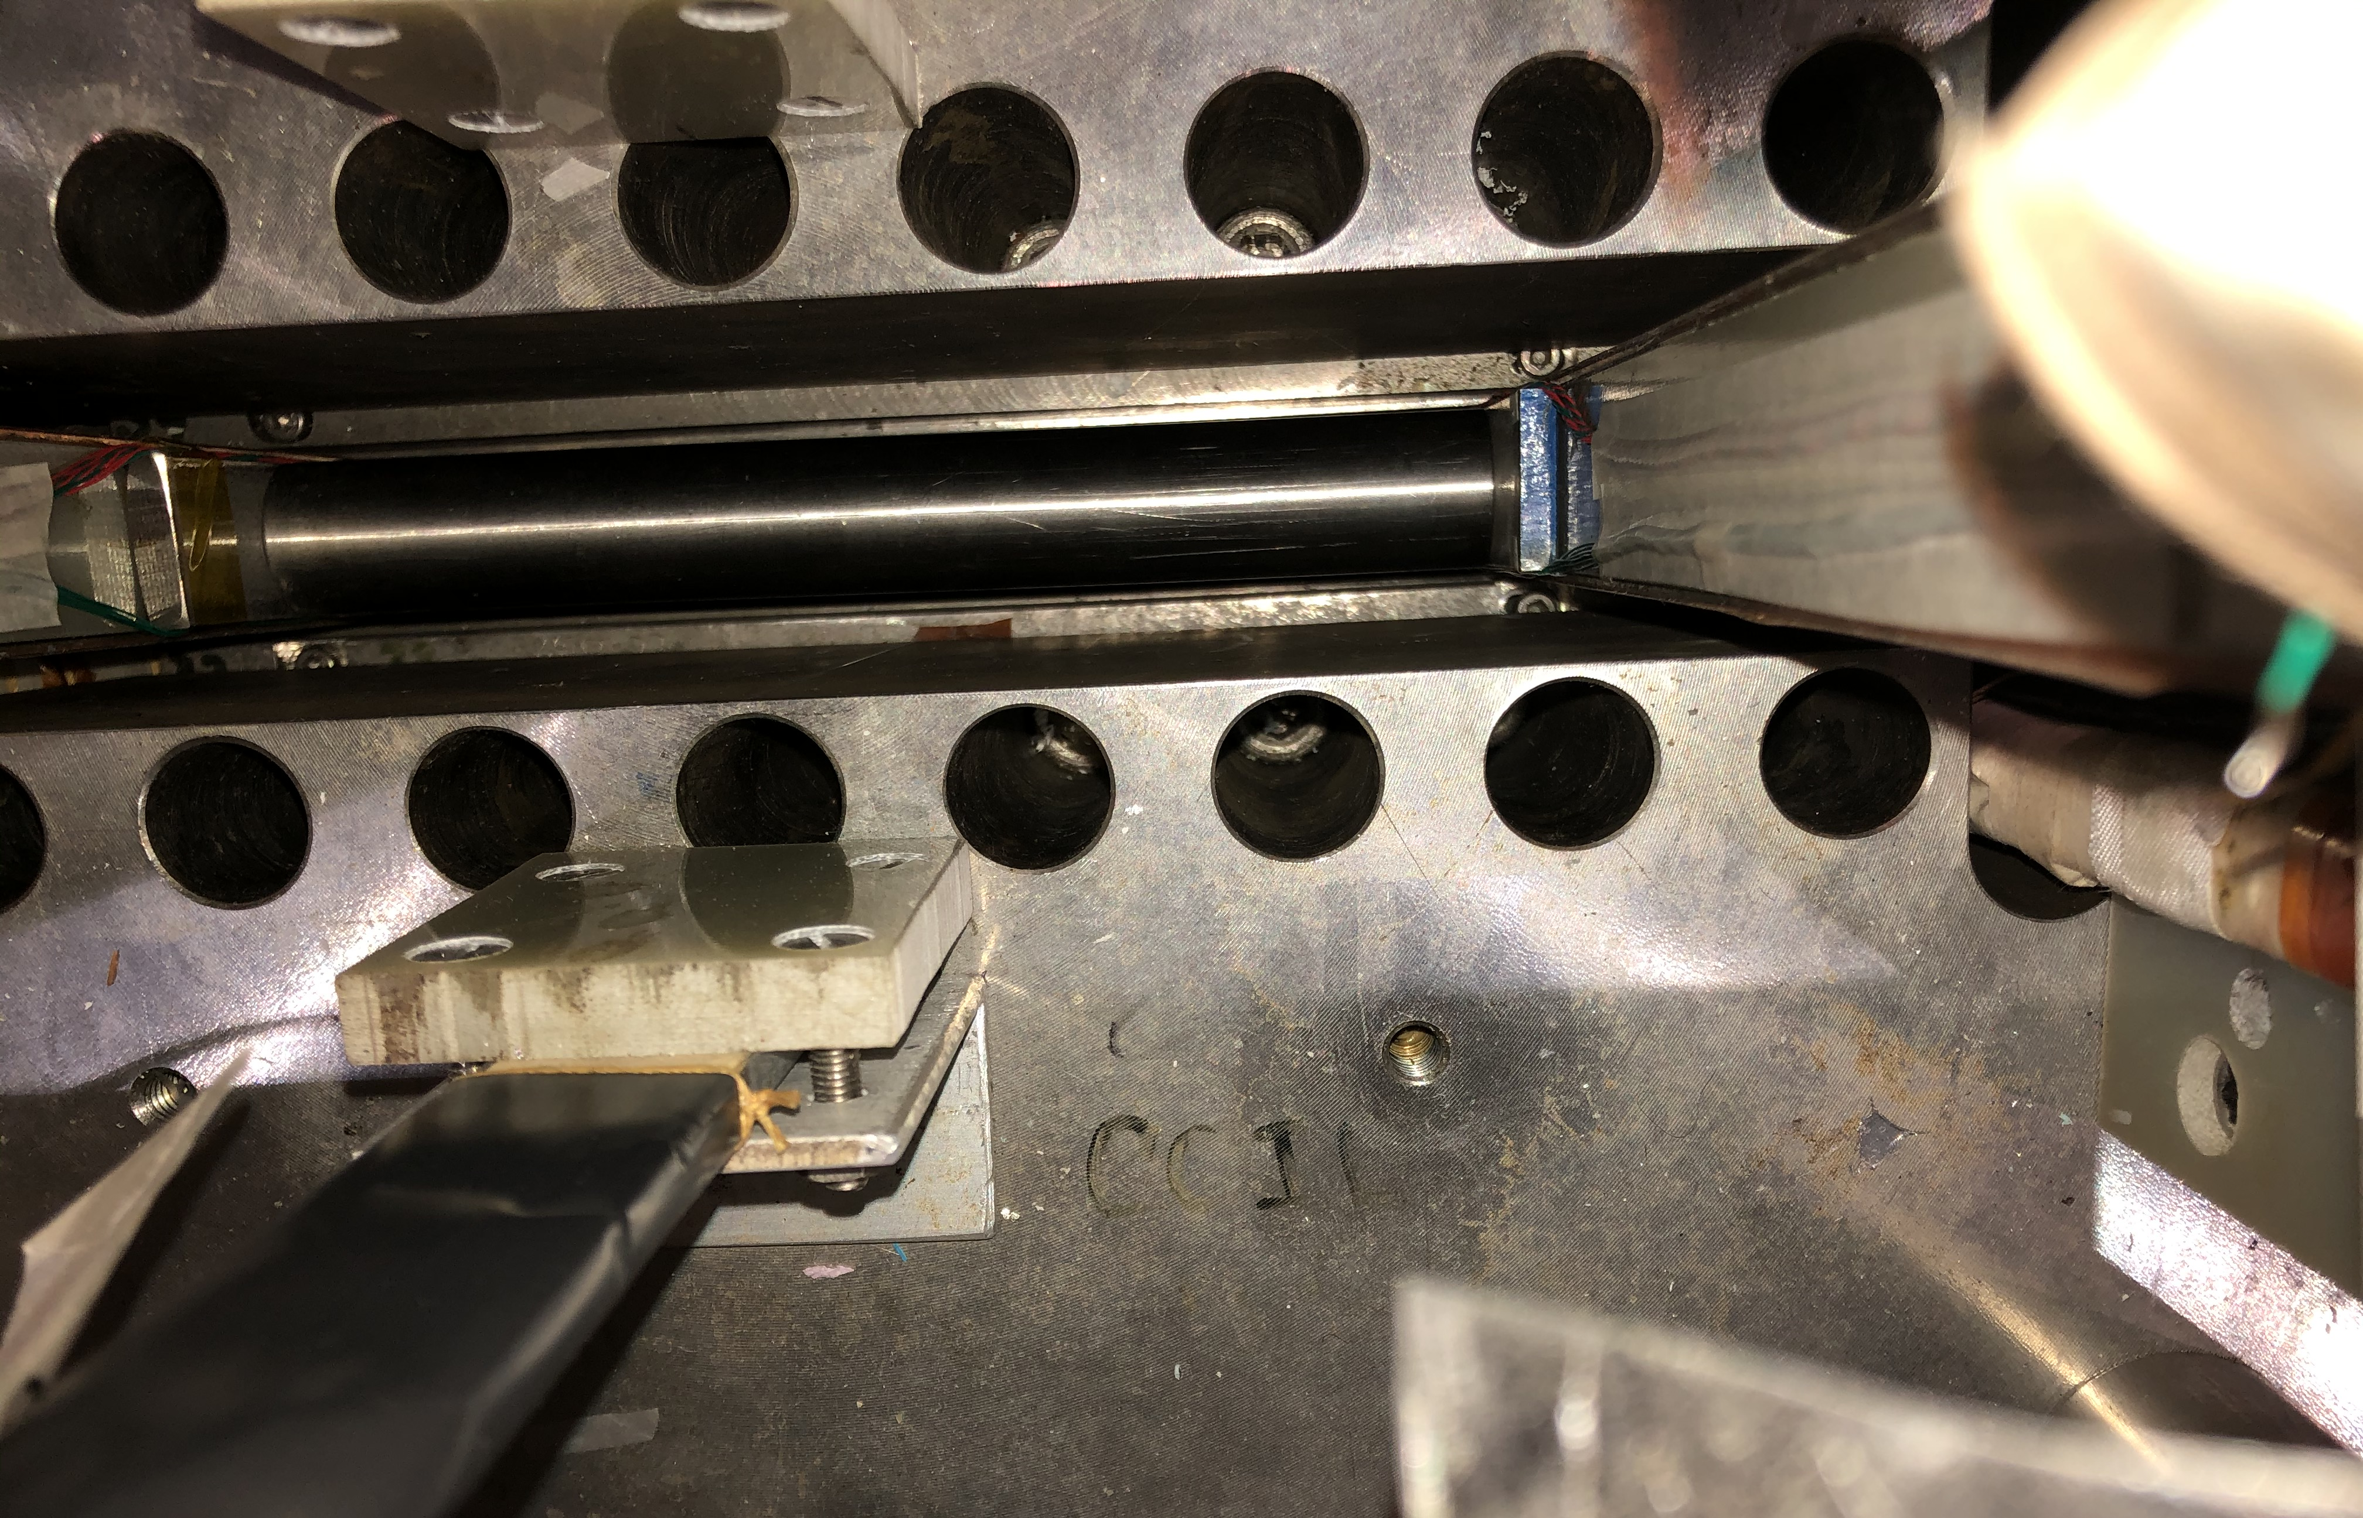
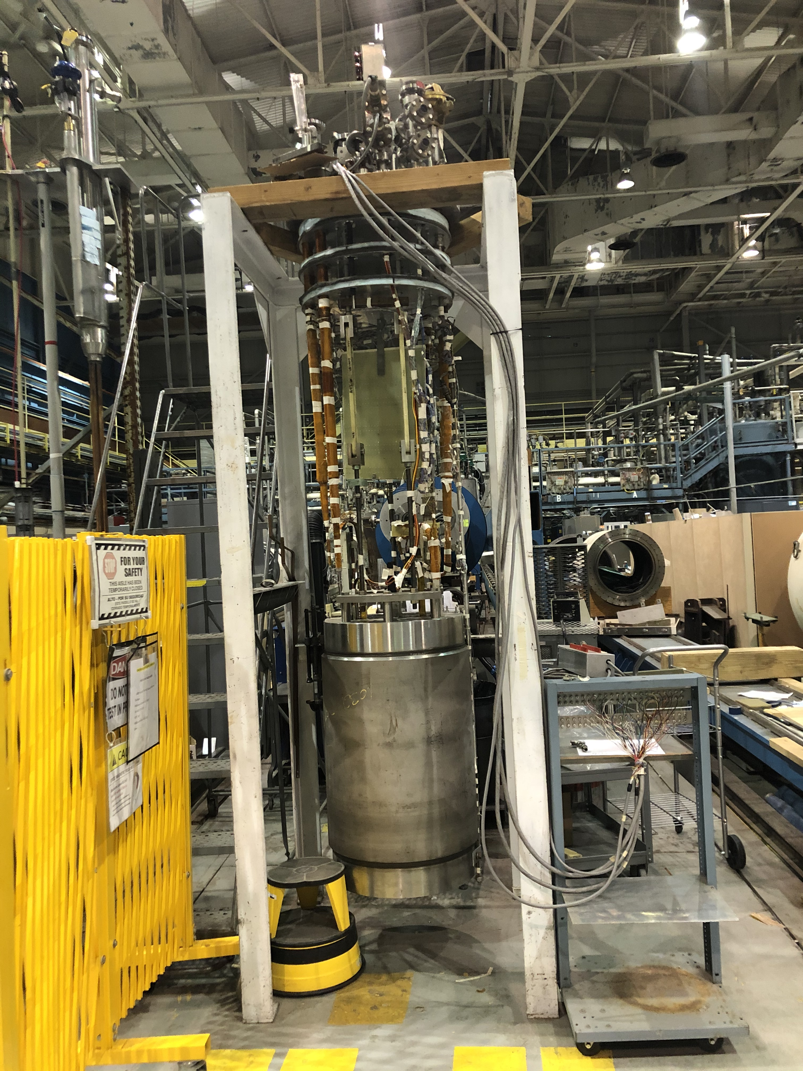
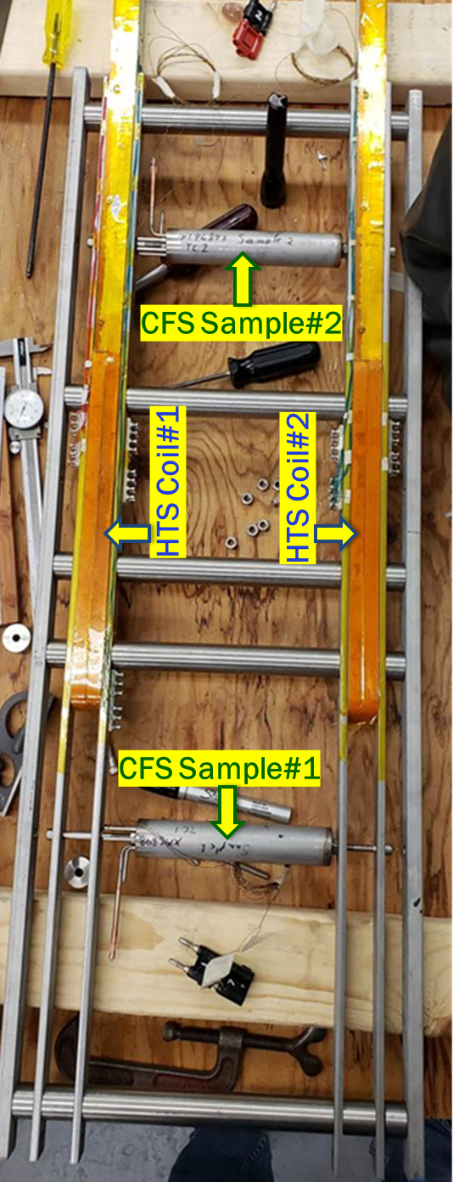
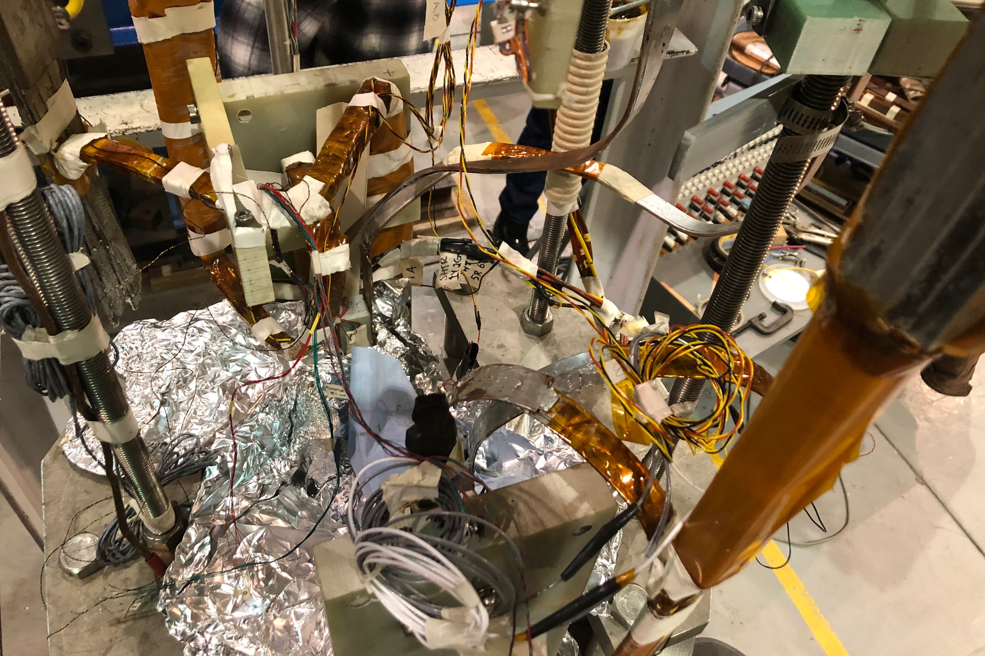
Fixture inside the magnet
HTS coils and samples inside
HTS/LTS Hybrid Dipole
Fixture inside the common coil dipole
Zoo of leads

Slide 4
Run Plan for Magnetization Studies
(almost everything planned in this slide done, perhaps not always be in the order planned)

Slide 5
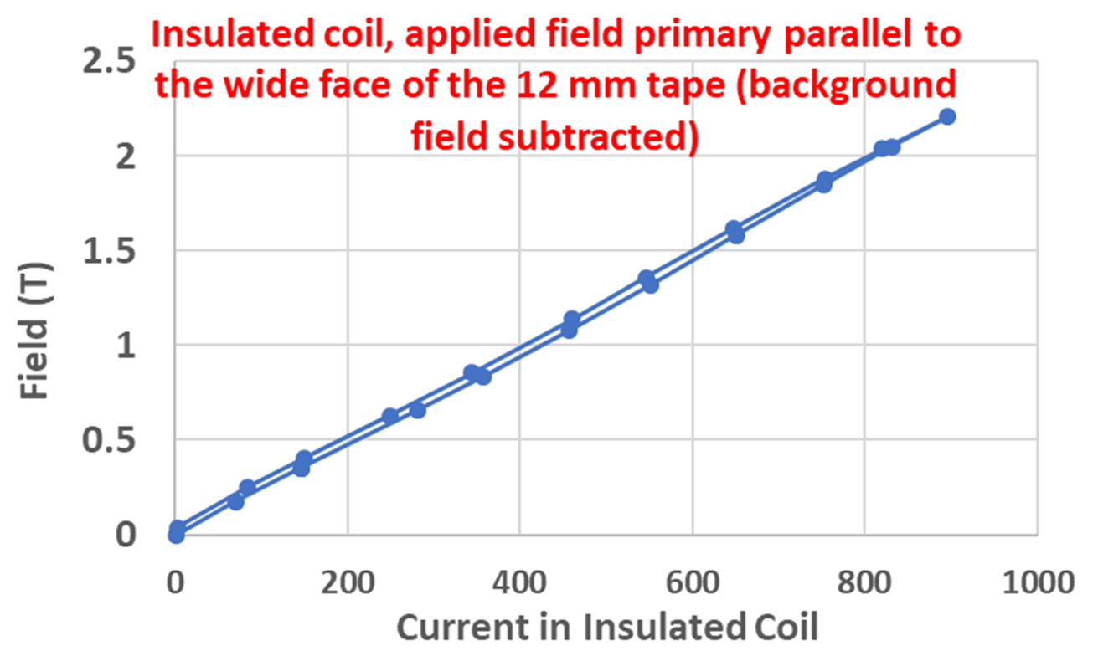
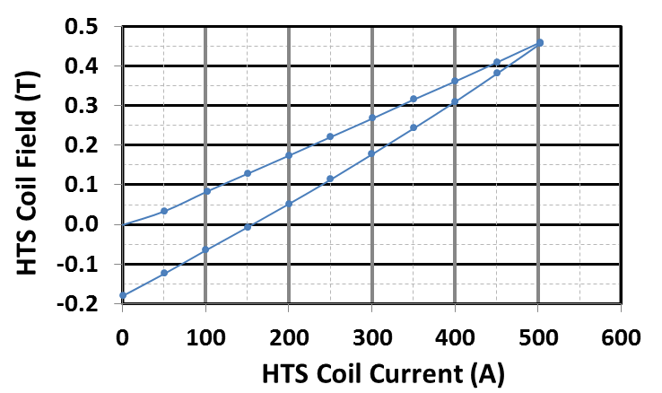
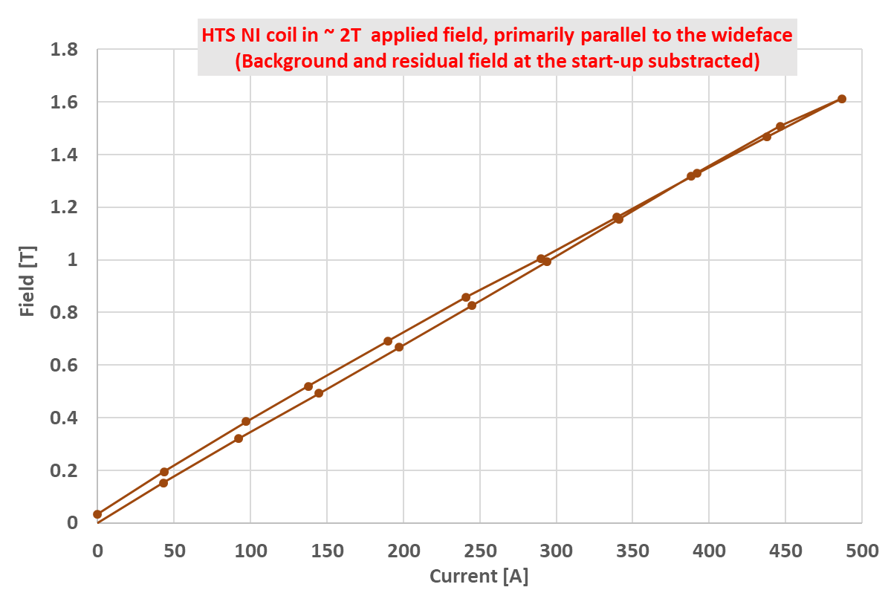
Test Run at 4 K in HTS/LTS Hybrid Dipole
(~2 T background field from Nb₃Sn coils)
Additional field from the HTS coils in up and down ramp
(offset to start from zero to start up-ramp)
Field perpendicular (2016 SBIR)
Field parallel (2019 MDP)
Field parallel (2019 MDP)
Significant reduction in magnetization from HTS coils when field is primarily parallel to the wide face when compared to primarily perpendicular

Slide 6
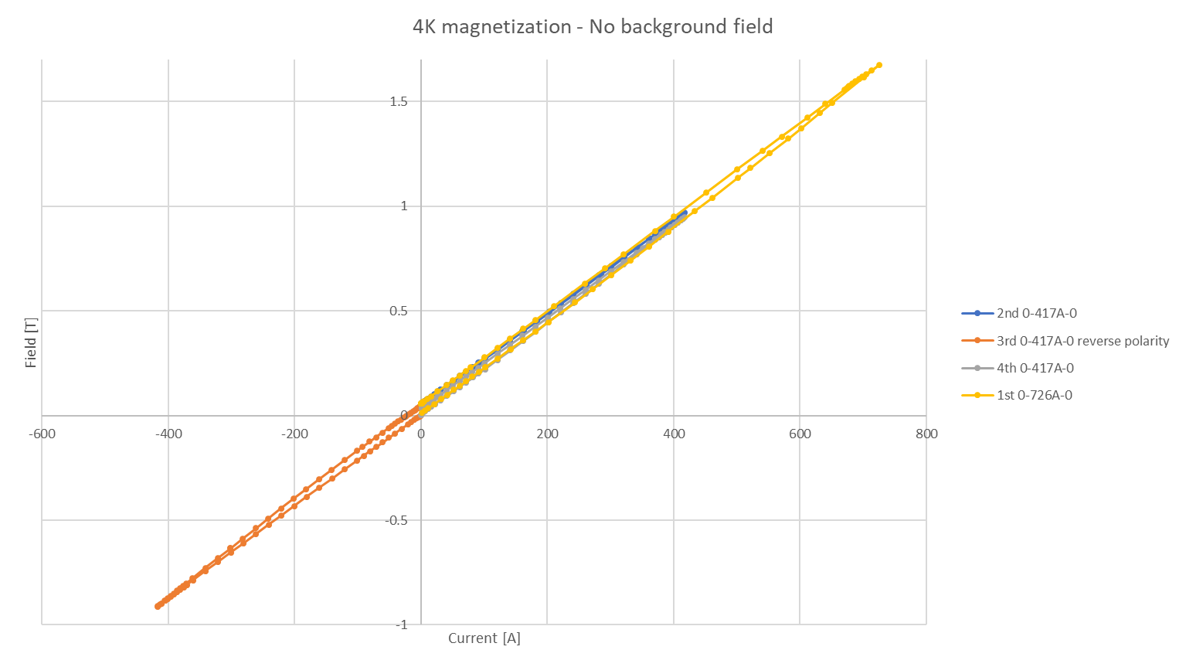
4 K run – No background field
Magnetization measurement were done prior to this test up current up to 500A at higher temperatures

Slide 7
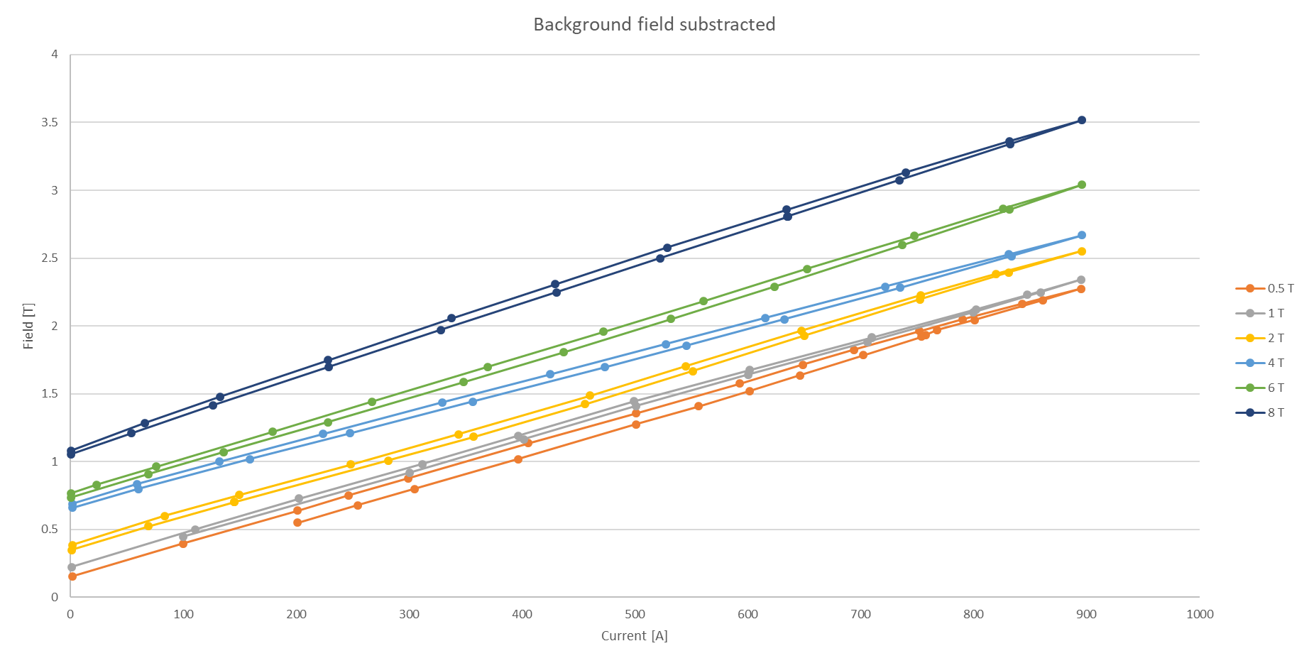
4 K Magnetization Run in Background Field
(background field subtracted)

Slide 8
Quench Protection of
HTS/LTS Hybrid Dipole

Slide 9
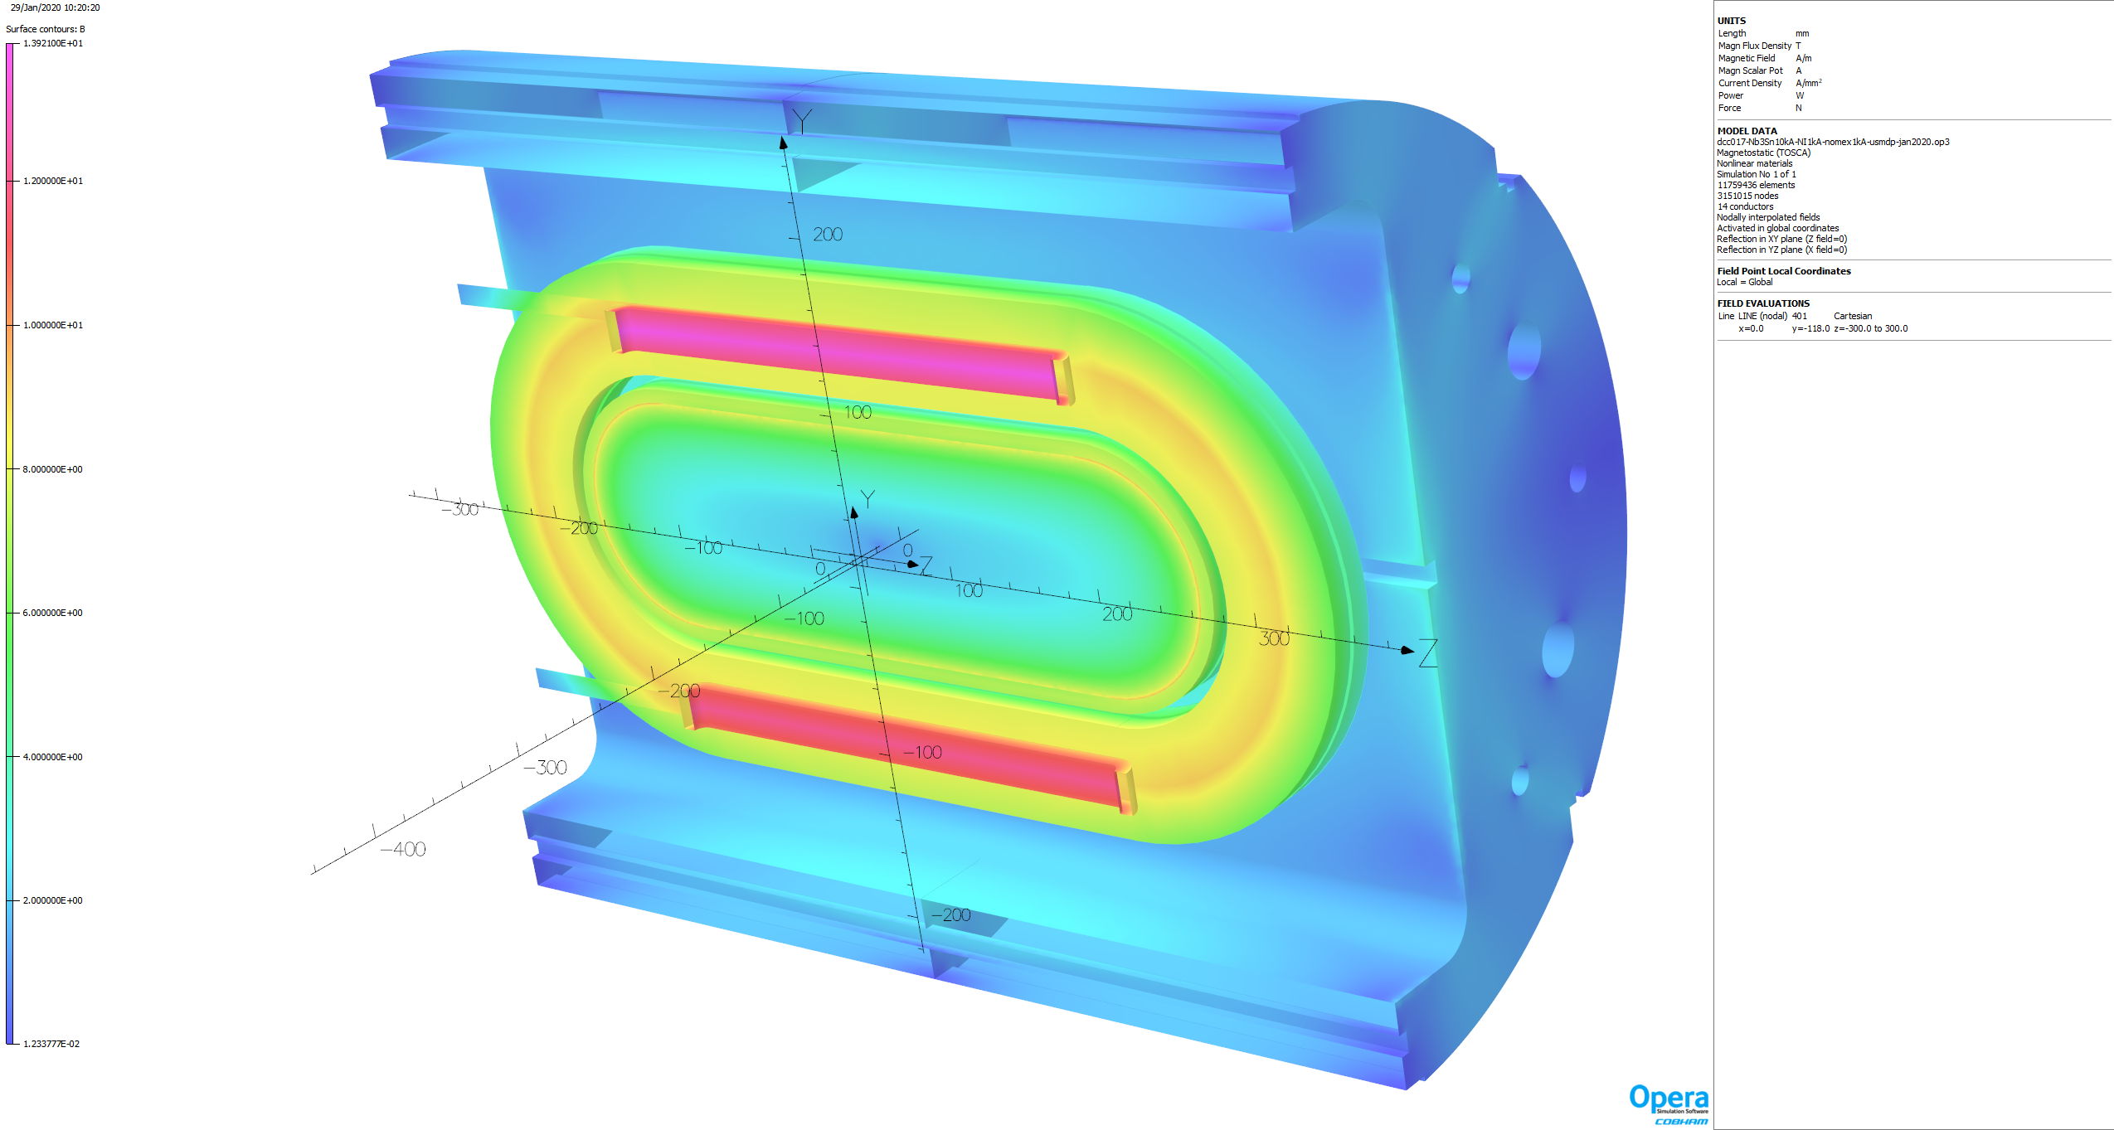
Cutout View for Nb₃Sn coils at 10 kA and HTS coils at 1 kA
(with Nomex insulation and No-insulation)
13.9 T
HTS coils are installed with as low clearances. Horizontal Lorentz forces brings them in contact with the LTS coils

Slide 10
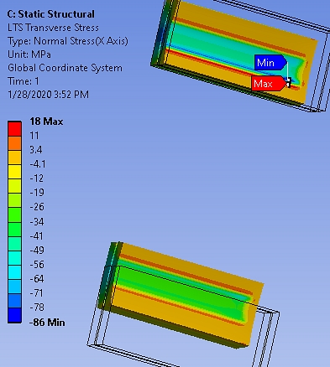
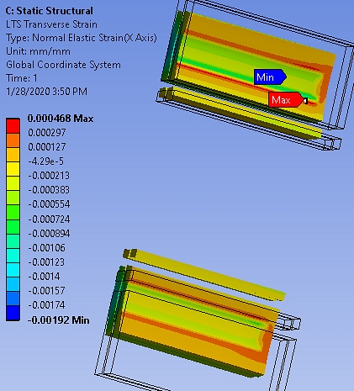
ANSYS Run Transverse Stress and Strain from Nb₃Sn 10 kA, HTS 1 kA
LTS Coils

Slide 11
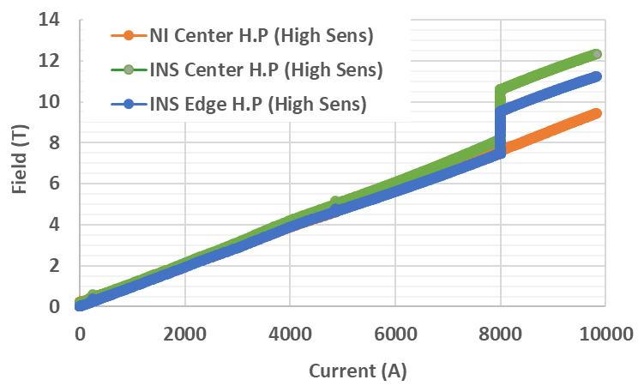
Insulated Coil Powered with the common coil
(field in NI coil: Nb3Sn field + trapped field)
Nb₃Sn coil quenched

Slide 12
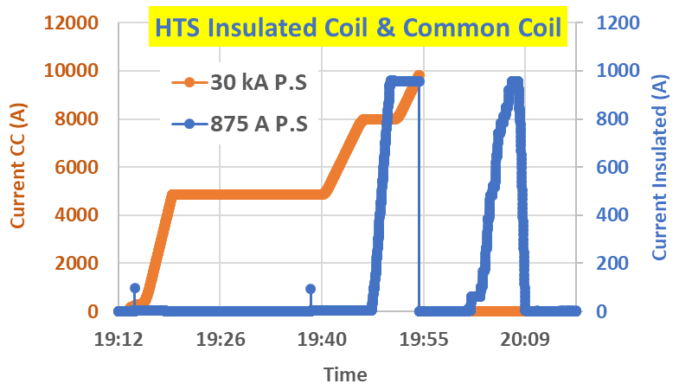
HTS Coil was ramped to the maximum of PS after the quench to check damage from the quench
Nb₃Sn coil quenched

Slide 13
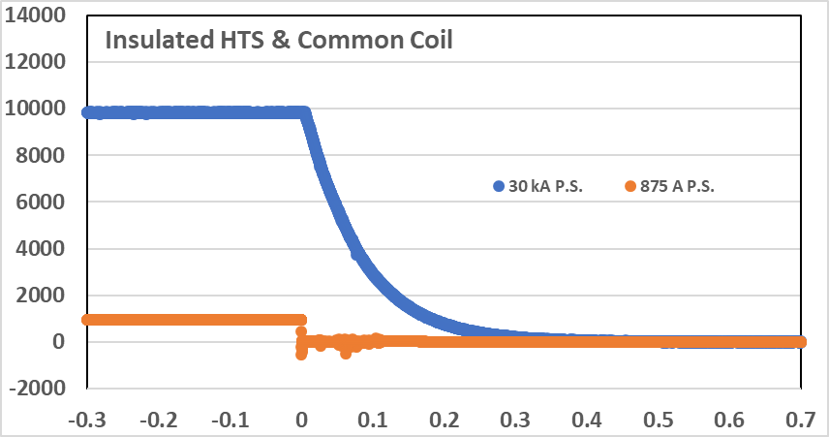
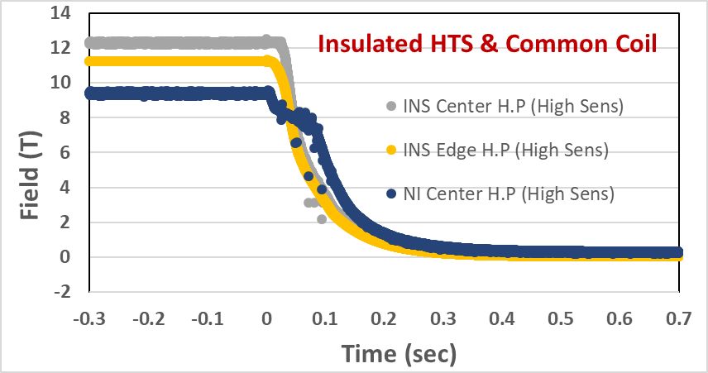
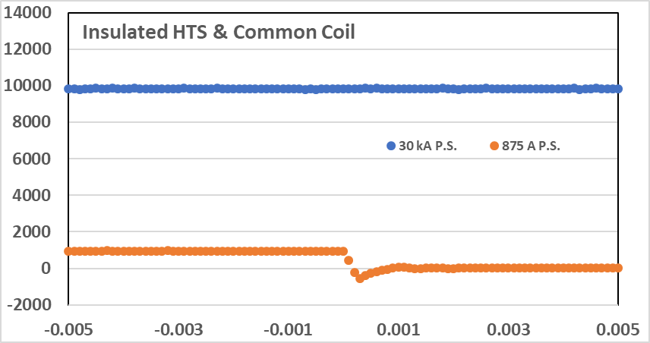
Field and Current Decay
(coupling studies)
Current Decay
Field Decay
(quench @ t=0)

Slide 14
Planned Quenches
All quenches in LTS coils.
HTS coils seems to tolerate quenches from Nb3Sn coils (large energy transfer)

Slide 15
Extra slides

Slide 16
HTS Coil in 2 T Field (primarily parallel to the wide face)
NI COIL

Slide 17
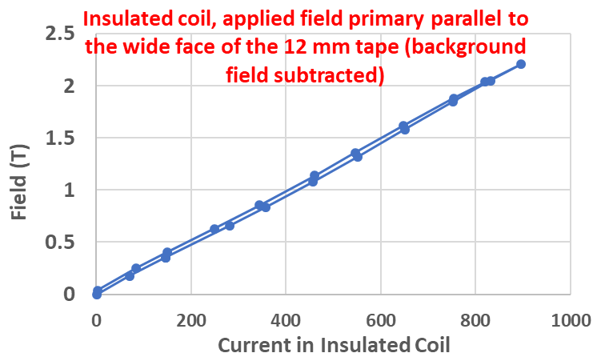
HTS Coil in 2 T Field (primarily parallel to the wide face)
INSULATED COIL

Slide 18
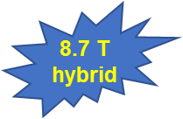
2016 Test (Field Perpendicular)
HTS coils with ASC tape
Field primarily perpendicular to the wide side of the tape
HTS coils were ramped to quench, just like LTS coils
No measurable degradation found
Test limited by the current leads of LTS coil

Slide 19
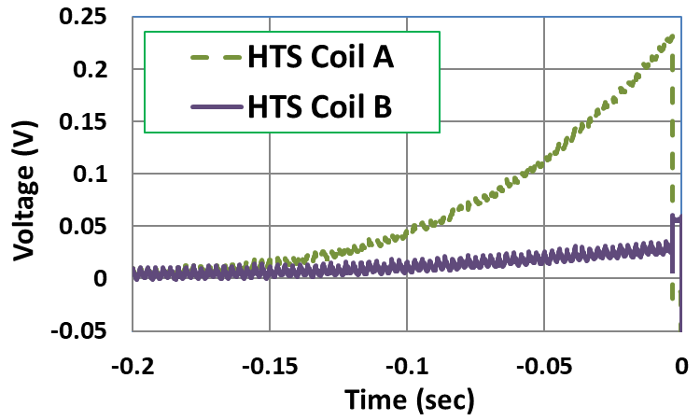
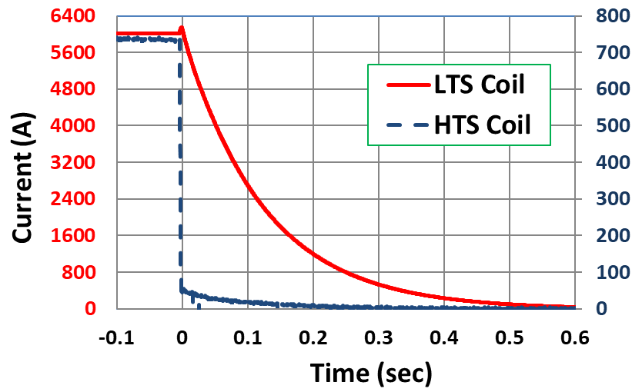
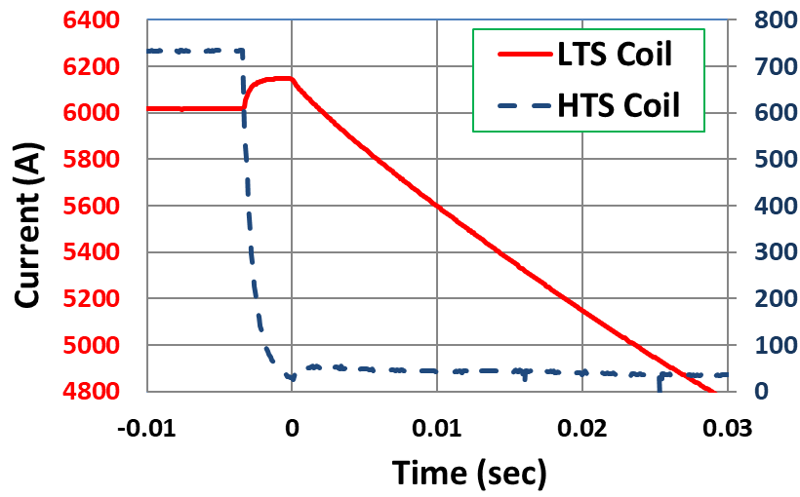
Feedback of Quenching of HTS Coils on LTS Coils in HTS/LTS Hybrid Magnet (2016)
Coupling between the HTS & LTS coils
What happens to HTS coils if LTS coil quench?

