Slide 1
Guidance for MDP after our 2020 Collaboration Meeting
Soren Prestemon
US Magnet Development Program
Lawrence Berkeley National Laboratory

Slide 2
Structure for meetings moving forward in 2020
Teams (a.k.a “Working Groups”, a.k.a. “Work Packages”, …) are asked to meet on a regular basis
Teams:
Area I: Nb₃Sn magnets arena
Leads: Sasha and Diego
Area II: HTS magnets
IIa: Bi2212 magnet arena
Tengming (coordinator), Ulf, Dan, Laura, Emanuela
IIb: REBCO magnet arena
Xiaorong (coordinator), Ernesto, Vadim, Ramesh, Vito
Area III: Technology
IIIa: Comparative analysis of magnet design concepts
Paolo (coordinator), Ramesh, Vadim, Sasha, Lance, Ambrosio
IIIb: Advanced modeling arena
Lucas (coordinator), Diego, Lance, Vittorio, Dan
IIIc: Magnet Materials
Steve K. (coordinator), Tengming, Ramesh
IIId: Novel Diagnostics
Maxim (coordinator), Reed, Stoyan, Maria, Piyush, Marcos
IIIe: Training Rate Enhancements
Stoyan (coordinator), Maxim, Emanuela
Area IV: Conductor Procurement and R&D
Lead Lance Cooley; team is composed of Lance’s advisory committee

Slide 3
Purpose and goals of team meetings
Focus on technical progress
Building on the recent planning process, what are the near-term priorities?
Who on the team can contribute, and how? Who else from MDP should be brought in?
What resources are needed, and when?
Force yourselves to meet on a regular basis (at least every two weeks, even if short)
Keep track of your meetings:
Have action items shared by the team
Be prepared to update the MDP at a General Meeting on a regular basis
We will target every ~2 months at a minimum
We intend to follow a more rigid structure with MDP General Meetings: Every 2 weeks, starting from today!
Exceptions may occur, but will be kept to a minimum
You are still welcome to make “ad-hoc” presentations to a General Meeting (as has been done to-date)

Slide 4
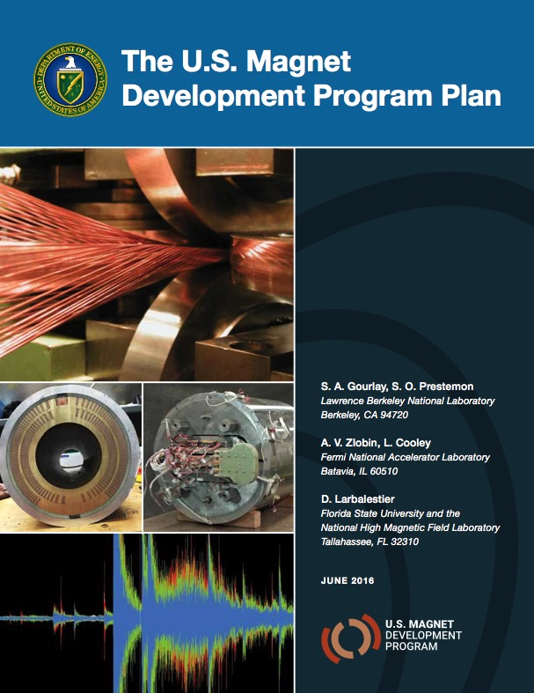
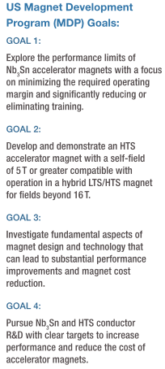
Evolution of the US Magnet Development Program – lets update the plan
The updated roadmaps provide the opportunity to draft and updated MDP Plan
Process:
SP/G7 will lay out the structure of the plan
We will ask the technical area teams to draft wording for the various areas
We will create versions of each team’s roadmaps in a common format
=>Lets target having a new document within the next ~3 months

Slide 5
US MDP vision remains the same, but our plan is refreshed
Maintain and strengthen US Leadership in high-field accelerator magnet technology for future colliders
Focus on the four primary goals identified in the the original MDP Plan
Explore the performance limits of Nb₃Sn accelerator magnets…
Develop and demonstrate an HTS accelerator magnet with a self-field of 5T or greater…
Investigate fundamental aspects of magnet design and technology…
Pursue Nb₃Sn and HTS conductor R&D …
Further develop and integrate the teams across the partner laboratories and Universities for maximum value and effectiveness to the program
Identify and nurture cross-cutting / synergistic activities with other programs to more rapidly advance progress towards our goals
Time for an update!
We are refreshing the Program Roadmaps this year,
but the vision and primary goals remains unchanged

