Slide 1
MDPCT1b ( “15 T”): test plan and status
MDP meeting
March 18, 2020
Stoyan Stoynev
US Magnet Development Program
Fermi National Accelerator Laboratory

Slide 2
Magnet test – main goals reminder
Study the effect of the increased pre-load and altered end-support on magnet training and training memory
Measure ramp rate and temperature dependences of magnet quench current
Measure field quality and effects from shims, more detailed studies on decay and snap-back effects
Check safety operation at the high field (stress, MIITs)
Study protection heater parameters (outer layer and middle layer)

Slide 3
Magnet Test Plan Reminder
Verify that all configuration files are uploaded to the production area and DAQ computers are rebooted
Room Temperature preparation
Electrical checkouts and Hi-pot
Hi-pot schedule: Coil to ground (with heaters grounded or floating) at 1000 V, PH to ground (with coils grounded or floating) at 1000 V.
Check the quench and slow scan data logging
Verify that the VMTF Overview Display is up and running
Initial RRR measurements: check CVT, FVT and Lead signals
Verify that all warm checkouts are completed
in the Test Readiness Verification Procedure document (TID-N-769)
Magnetic measurements (z-scan) in VMTF at room temperature
Cool down
Restricted cool down:
temperature difference between the magnet top and bottom should not exceed 50 K
Periodically check the SG data logging
System checks at 4.5 K with 60 mΩ dump resistor:
Cold Electrical Checkout and Hi-pot, Quench Detection Checkout
Verify that all cold verification steps are completed in the Test Readiness Verification Procedure (TID-N-769)
Connect the CPS3 power leads and proceed with the AQD/DQD balancing
Ramp to 1000 A, adjust Cu-I AQD balance and perform manual trip
Heater induced quenches at up to 5 kA
We are here

Slide 4
Magnet Test Plan Reminder (2)
At 1.9 K operation with 60 mΩ dump resistor:
Cold measurements after training may have to become part of the second thermal cycle!
It depends on test timing and schedule optimization.
The maximum current will be limited to 11 kA
Magnetic measurements at 5.0 kA– see the Magnetic measurements plan
Z-scan of the main field and field harmonics with both probes
Decay and Snap-back measurement with both probes at 760 A during current ramp up
Quench Training at 20/50 A/s to a plateau
Plateau is 5 quenches with no improvement above 50 A
More than one detraining (above 200 A) quench or multiple detraining quenches at above 50 A will urge a team review meeting
Flux-jump measurements
Strain gauge and acoustic signal measurement
Ramp rate studies (10/100/200/300/400 A/s)
Magnetic measurements in cycles up to Imax - 500 A – see the Magnetic measurements plan
Z-scan at different currents (1/5/9 kA) with both probes
Decay and Snap-back studies with both probes at currents 300 A and 750 A during current ramp up and down
Temperature dependence studies (2.1/2.7/3.4/4.0/4.5 K)
At 4.5 K operation with 60 mΩ dump resistor:
Inductance measurements at 50 and 300/200 A/s
(and up to 80% of the current reached in training)
Splice resistance measurements

Slide 5
Magnet Test Plan Reminder (3)
Warm up to 300 K
Cold RRR Measurements.
Periodically check the SG data logging
At 300 K after the test
Repeat RRR measurements at room temperature
Magnetic measurements (if needed)
Cool down to 1.9 K (second thermal cycle)
Cold measurements from the previous thermal cycle after training may have to become
part of this one (see above)! Then they will be preformed before the heater tests.
Check training memory
Training to plateau if necessary
Protection heater studies (if safe)
minimum power to quench vs current
time delay vs current
quench distribution and propagation (L2 PH are in between coils)
At 4.5 K operation
2 training quenches at 20/50 A/s
Warm up to 300 K

Slide 6
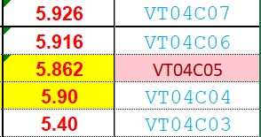
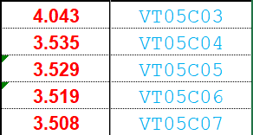
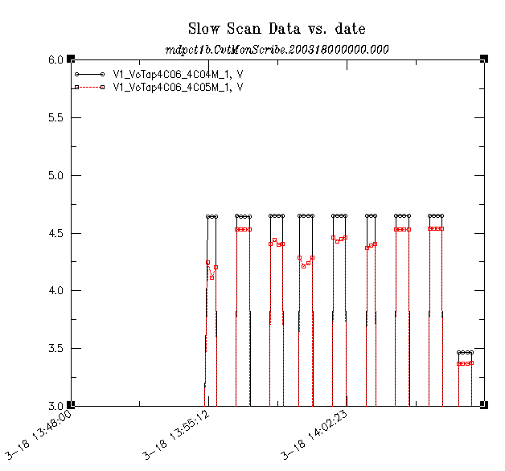
Latest check-out (in-dewar)
All VT detection and characterization channels were fine except:
D7
Coil 5, VT D3 is N/A –
not new, known issue, can’t be fixed;
VT to be skipped as before
D1
D2
D4
D3
Layer 4
D6
D5
C3
C7
Coil 4, VT C5 is flaky (sometimes N/A) –
C4
C6
Layer 3
C5
C1
C2
Coil 4, VS C6_C4
Coil 4, VS C5_C4
[V]
[V]
From warm
RRR data :
It suggests the VT “insert” is touching the next turn.
Coil 4, VT C5 is to be skipped in the readout.

Slide 7
Latest check-out (in-dewar) (2)
Hipot (1000 V) passed, but some readings were higher than usual (still within limits)
Coil-to-ground (heaters floating): 6.2 $$A (non-linear dependence with voltage)
Coil-to-ground (heaters grounded): 4.8 $$A (non-linear dependence with voltage)
The coil-to-ground resistance was measured (with ohm-meter) to be below 2 GΩ
Heater-to-ground readings were below 0.2 $$A
Earlier hipots on the magnet itself (no top header) showed < 0.2 $$A currents for all

Slide 8
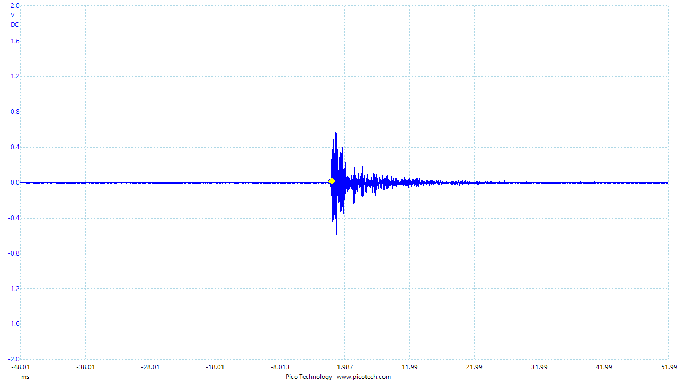
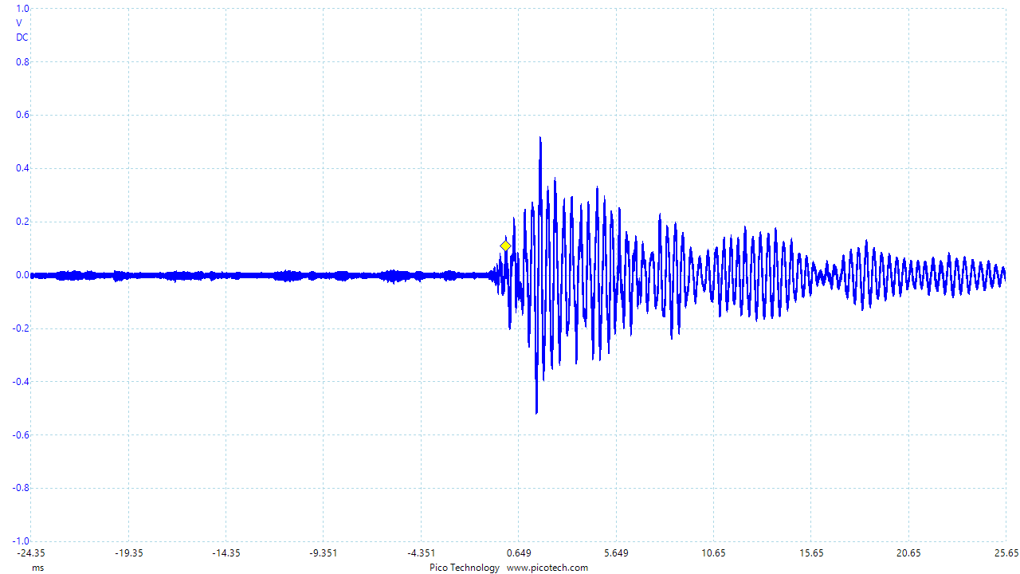
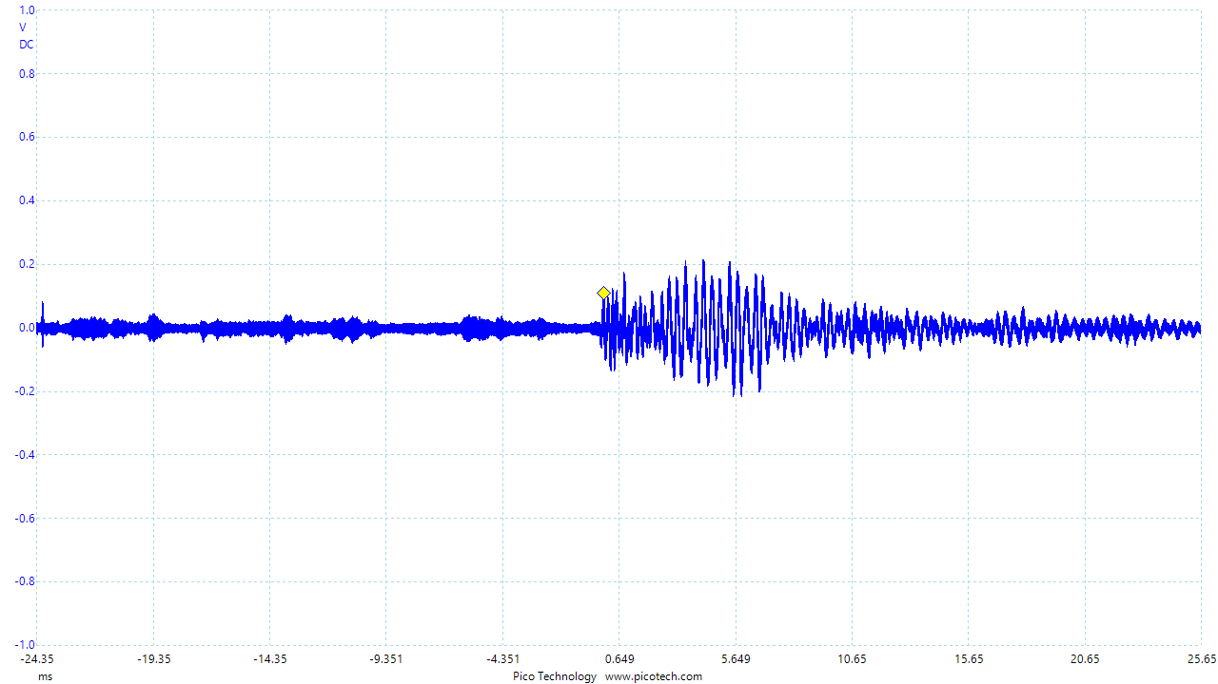
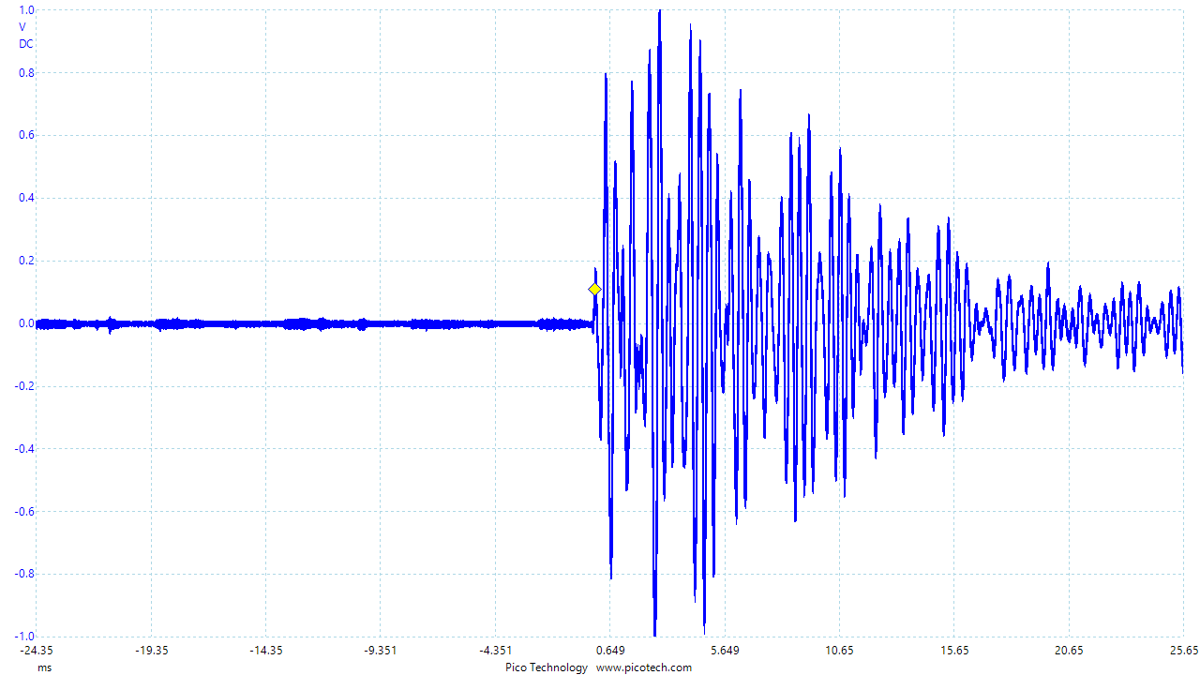
Latest check-out (top header)
SG: All Strain gauges are operational.
RTD: One of three temperature sensors on the shell failed – won’t be repaired (it is at the LE)
However, a repaired connection brought the bore temperature sensors back to two
QA: Flexible quench antenna (on the bore tube) channels – fine.
LBNL QA (external) to be deployed later
Acoustics: Four acoustic sensors (“old” style) operational.
(we constantly fail to get comparable results with the “new” type of acoustic devices;
we strongly think sensors should be bolted and not glued to surfaces)
Voltage readings (different scales) from acoustic sensors testing – magnet hanging over/in the pit
LE1
LE2
RE1
RE2

Slide 9
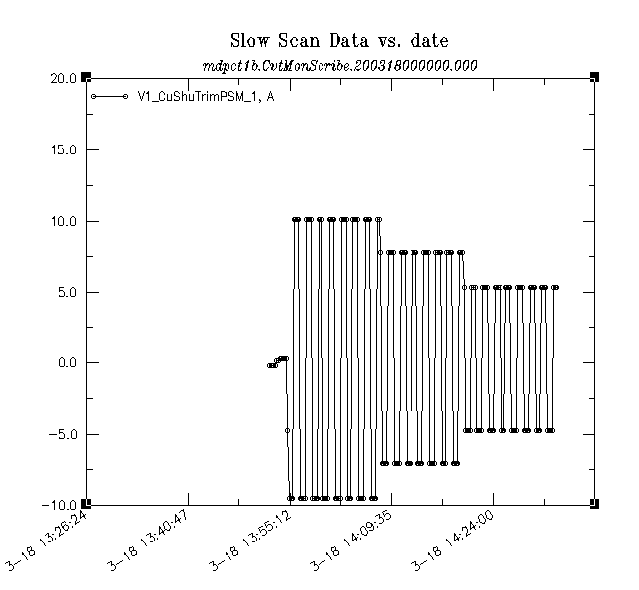
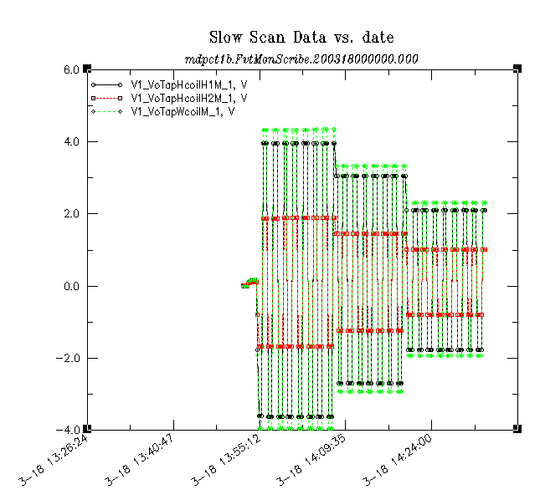
Warm RRR data and magnetic measurements
All CVT and FVT channels fine, some examples below
Current (10 A)
Whole/half coil signals
Warm magnetic measurements ongoing…

Slide 10
Next steps
Restricted ΔT<50 K cool-down over the weekend, possibly starting tomorrow
last time it took 76 hours (~ 3 days)
Cold check-outs on Monday
will likely take two days
Training as soon as Wednesday
It is reasonable to expect that there will be less people available for support in next weeks
and priorities shifted resulting in delays if not suspensions.
However:
We may be allowed to run the test within the minimal Lab operations being prepared
(and eventually invoked)

Slide 11
Summary
Following the developed run plan
No signifficant issues encountered, “warm” steps being finalized
Planning for
- restricted ΔT cool-down over the weekend (starting tomorrow?),
- cold check-outs on Monday and
- training later that week
We may be allowed to run the test within the minimal Lab operations being prepared
(and eventually invoked)

Slide 12
Back up

