Slide 1
MDP Meeting on
Comparative analysis of magnet design concepts
Paolo Ferracin, Giorgio Ambrosio, Lance Cooley, Ramesh Gupta, Vadim Kashikhin, Alexander Zlobin
US Magnet Development Program

Slide 2
Outline
What was presented at the collaboration meeting (in brief)
Three tasks
Status and plan

Slide 3
Proposed design studies roadmap
Title: Design studies of LTS/HTS hybrid magnets
Focus on design of
Outer (background) coils based on Nb3Sn superconductor
Inserts based on
Both with REBCO and Bi2212 superconductors
Hybrid magnets towards 20 T field level

Slide 4
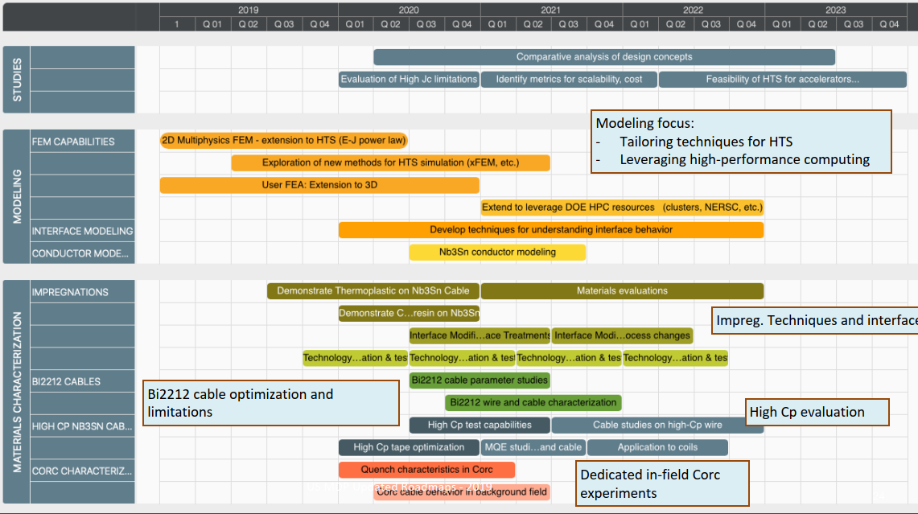
Proposed design studies roadmap
Time frame: 2020 – 2023
Methods
Modeling effort
“classical 2D/3D” mechanical, magnetic and QH simulations
Developing new modeling techniques is not part of this task
However, if new tool/analysis is required → feed-back to Technology area (III), modeling and simulations

Slide 5
Hybrid program and goals of the design studies (I)
Hybrid program
“Near term” (~2020-2022)
CCT5
8 T in 90 mm aperture
CCT Bi2212 BIN5 and/or some inner coils from the CCT REBCO C2
1-2 T field level
Target hybrid field: ~ 9 T
Goals of the design studies
Start analysis of challenges specifically of hybrid magnets
Integration of LTS/HTS, mechanics, protection, powering, diagnostics, test facility…..

Slide 6
Hybrid program and goals of the design studies (II)
Hybrid program
“Medium term” (~2022-2024)
CCT6 and/or SMCT
11-12 T in 120 mm aperture
CCT Bi2212 and/or SMCT Bi2212 and/or CCT REBCO and/or COMB REBCO
Towards 5 T field level
Target hybrid field: towards 14-15 T
Goals of the design studies
Evaluate different designs (both LTS and HTS)
Investigate alternatives (common-coil and blocks)
Perform a comparative analysis in view of a 20 T hybrid magnet, considering both modelling and experimental results
Margin, mechanics, field quality, quench protection strategies, fabrication-assembly-loading, performance of previous models, scalability, cost……
Basically, help converging on all the and/or
Continue the analysis of challenges specifically of hybrid magnets

Slide 7
Hybrid program and goals of the design studies (III)
Hybrid program
“Long term” (~2025 and beyond)
Target hybrid field: towards 20 T
Goals of the design studies
How much field from LTS and HTS respectively?
Which design? How a 20T hybrid may it look like?
Evaluation high Jc limitations in Nb₃Sn
We are working on very high Jc strands: can we afford it?
Yes from the stress point of view (CCT and SMCT), but what about QP?

Slide 8
Outline
What was presented at the collaboration meeting (in brief)
Three tasks
Status and plan

Slide 9
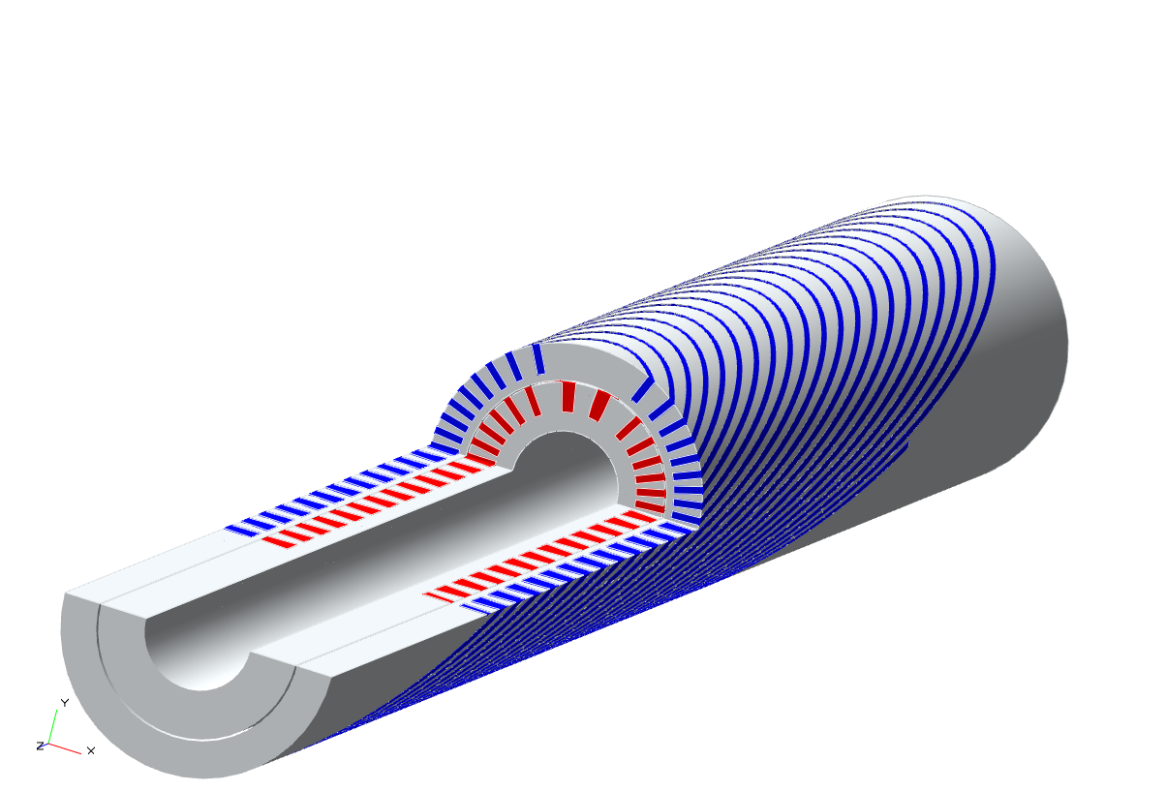
Status and plans task 1
Hybrid I
Bi2212 insert (1-2 T) in CCT5 (8-9 T)

Slide 10
Status and plans task 1
Hybrid I
Bi2212 insert (1-2 T) in CCT5 (8-9 T)
Weekly meeting on upgrade of LBNL test facility for hybrid testing
In that meeting, discussion on interface insert-CCT
CAD model of FRESCA2-feather received from CERN to check locking system
Work in progress
Weekly meeting on CCT activities
Initiated discussion on Bi2212 support structure
Al or SS shell thickness? Self-supported (most likely) ? Contact between layers and shells
Never tested before in a 8 T background field
2D analysis in progress

Slide 11
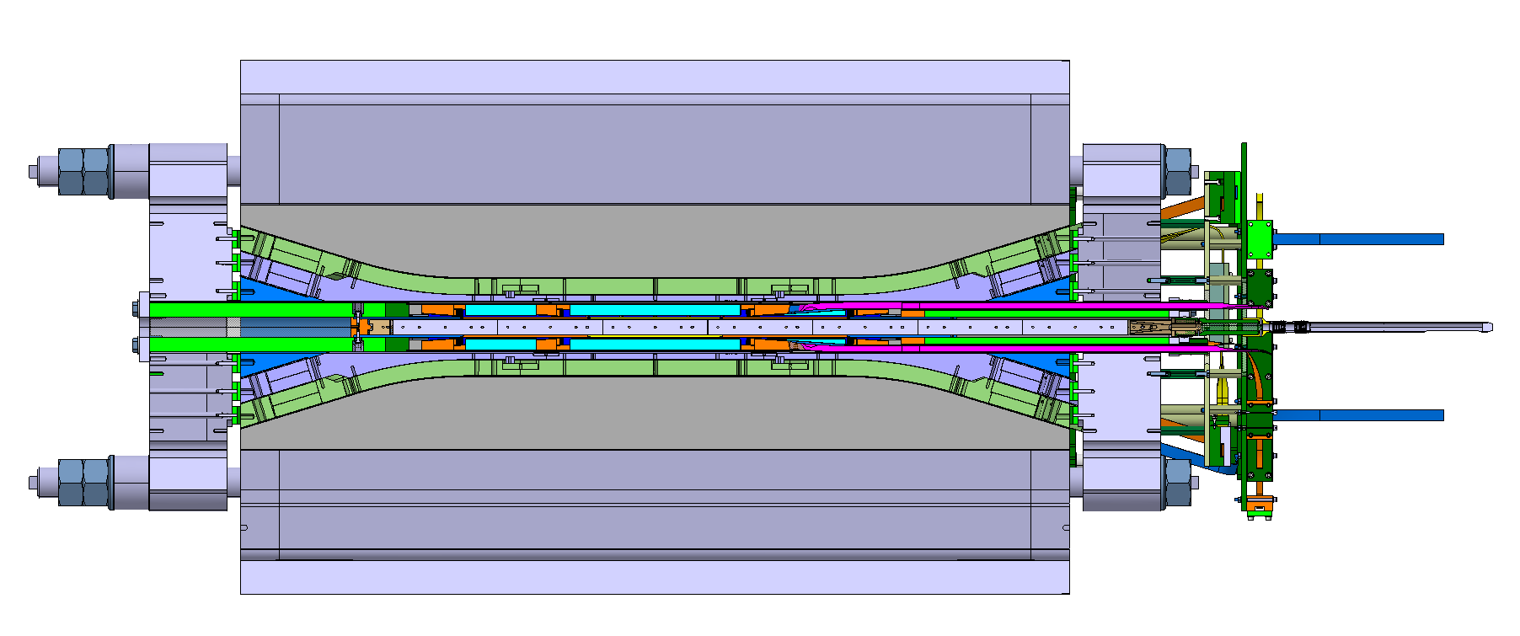
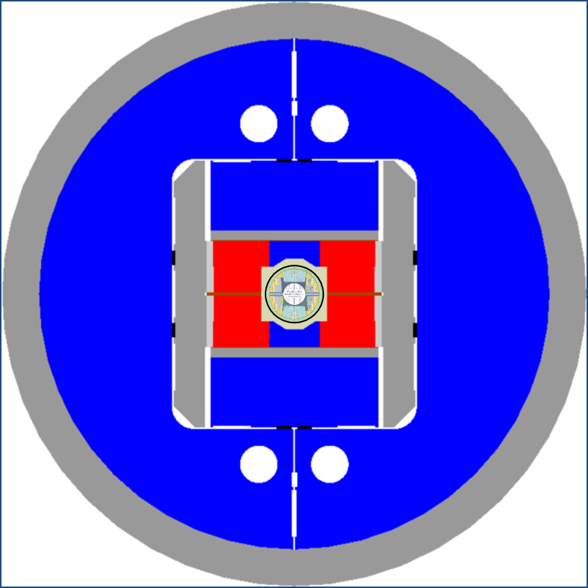
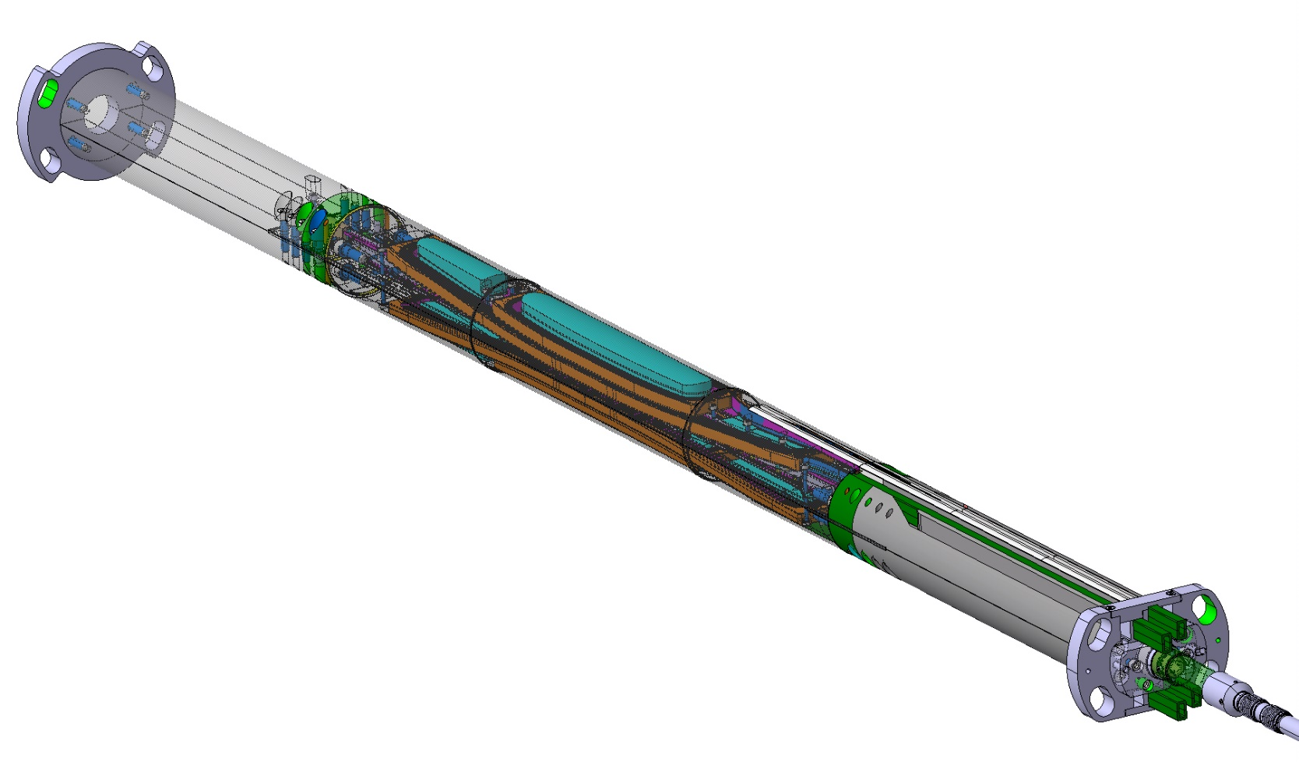
An example of the interface insert-outsert

Slide 12
Status and plans task 2
Hybrid II
Bi2212/REBCO insert (5 T) in Nb₃Sn outsert (~11 T) with 120 mm bore
Outsert currently under study
CCT6
SMCT

Slide 13
Hybrid II Bi2212/REBCO insert (5 T) in Nb₃Sn outsert (~11 T)
Weekly meeting on CCT activities
Initiated review of CCT6 design
Which strand/cable? Which spar and ribs (feedback from subscale coils)? Which support structure? Which pre-stress?
Modelling in progress

Slide 14
Hybrid II Bi2212/REBCO insert (5 T) in Nb₃Sn outsert (~11 T)
Comparative analysis
How a 11 T, 120 mm aperture design with cos-ϑ or block or common coils may look like?
Preliminary criteria for comparison

Slide 15
Hybrid II Bi2212/REBCO insert (5 T) in Nb₃Sn outsert (~11 T)
Some thoughts on cos-ϑ
From 60 mm (11T magnet) to 120 mm
Forces linearly increased with aperture
From 110 to 220 Mpa of Lorentz stresses → even higher peak stresses
Stress management required
However….

Slide 16
Hybrid II Bi2212/REBCO insert (5 T) in Nb₃Sn outsert (~11 T)
Some thoughts on cos-ϑ
Still interesting to check FCC design
Also in that case twice the forces as 11T magnet
Force quadratically increase with field
16 T to 11 T →
~ factor 2 reduction
60 to 120 mm →
~ factor 2 increase
Larger cable?

Slide 17
Hybrid II Bi2212/REBCO insert (5 T) in Nb₃Sn outsert (~11 T)
Some thoughts on cos-ϑ
In parallel, comparative analysis between CCT and SMCT

Slide 18
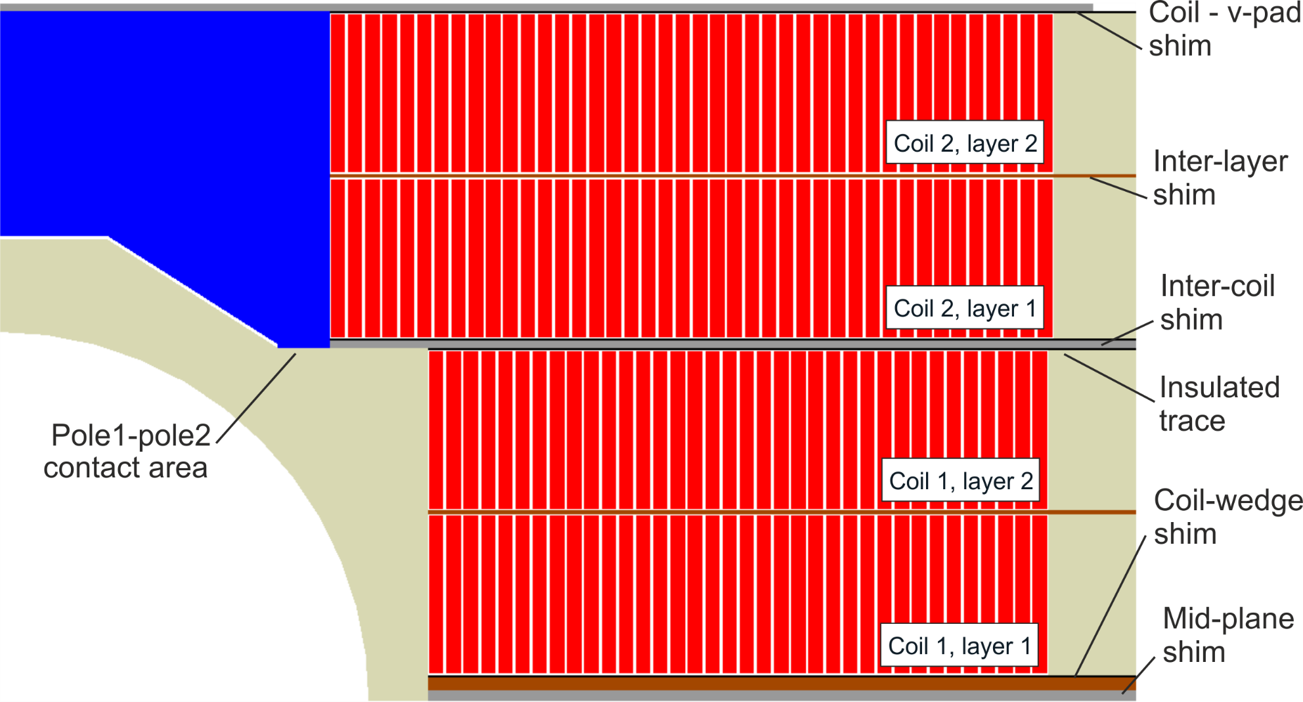
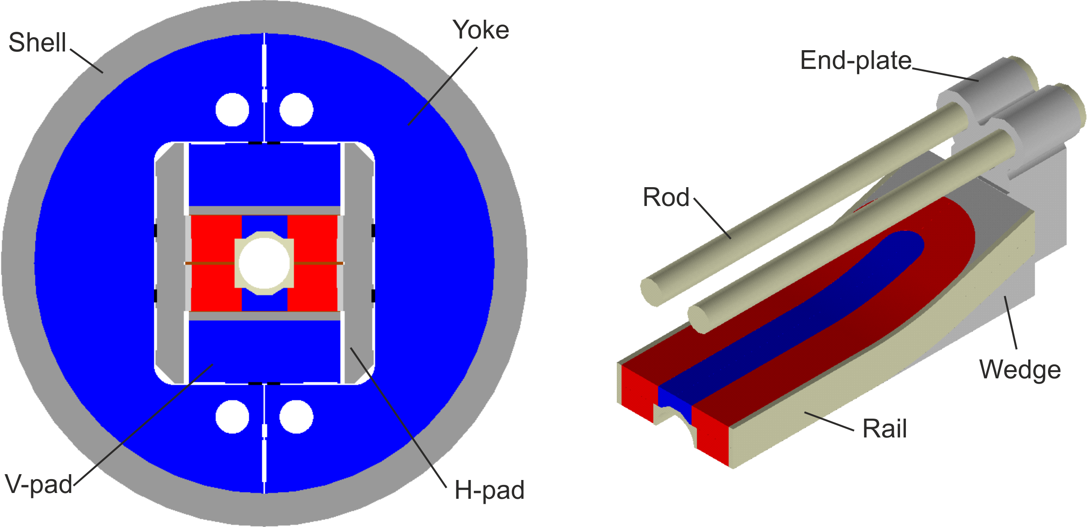
Hybrid II Bi2212/REBCO insert (5 T) in Nb₃Sn outsert (~11 T)
Some thoughts on block
FRESCA2 (reached 14.6 T)
13-15 T in 100 mm bore
1 mm strand, 40 strand cables
~21 mm cable
Is it conceivable a wider cable, for a 120 mm bore and an 11 T target field?

Slide 19
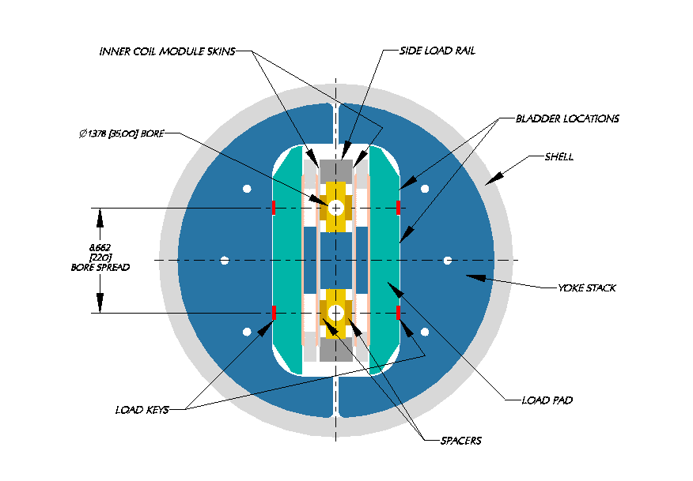
Hybrid II Bi2212/REBCO insert (5 T) in Nb₃Sn outsert (~11 T)
Some thoughts on common-coil
So far, apertures for accelerator magnets (small)
How a 120 mm aperture common coil magnet would look like?
Like the outsert of a 16 T magnet?

Slide 20
Hybrid II Bi2212/REBCO insert (5 T) in Nb₃Sn outsert (~11 T)
Preliminary criteria for comparison
Strand/cable design
Efficiency (quantity of conductor)
Coil parts
Coil ends
Winding
Coil fabrication tooling (W-C-R-I)
Lorentz stress / Peak stress
Assembly-loading
Support structure
Scale-up
Quench protection
Strong/easy
Medium
Weak/difficult

Slide 21
Also, later….
Hybrid II
Bi2212/REBCO insert (5 T) in Nb₃Sn outsert (~11 T)
Comparative analysis of insert design
Hybrid III
Hybrid magnets towards 20 T field level
Conceptual design
Review of CERN activities

Slide 22
Finally, if there is time…..

Slide 23
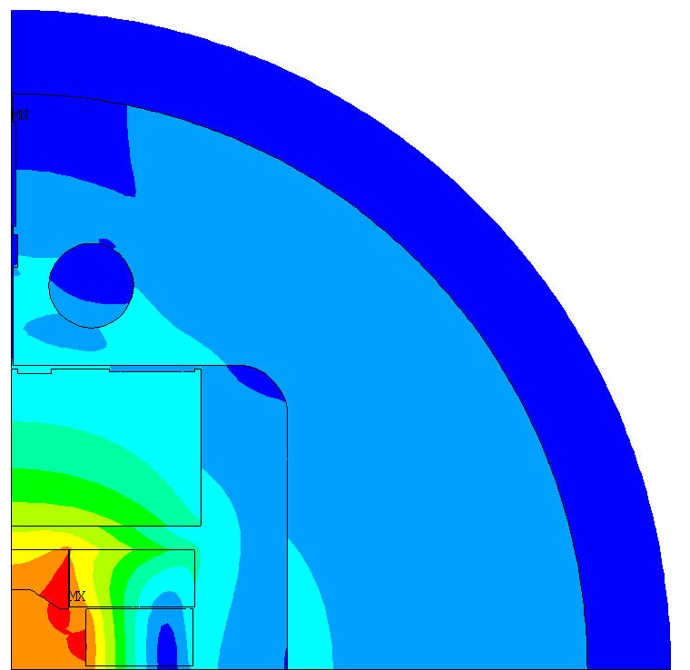
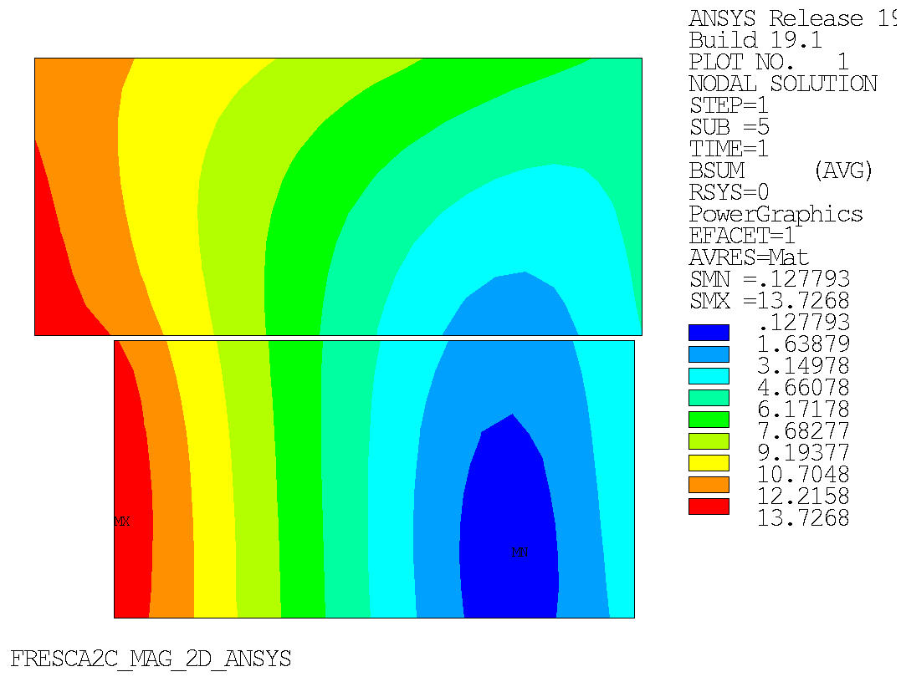
FRESCA2c magnetic model standalone
Electric current from the standalone testing perfomed in 2018 at 4.3 K
11.3 kA meaning an I/Iss ratio of 0.83
Bore field (B(0.0,0.0)) of 13.4 T
14/03/19 - D. Martins Araujo

Slide 24
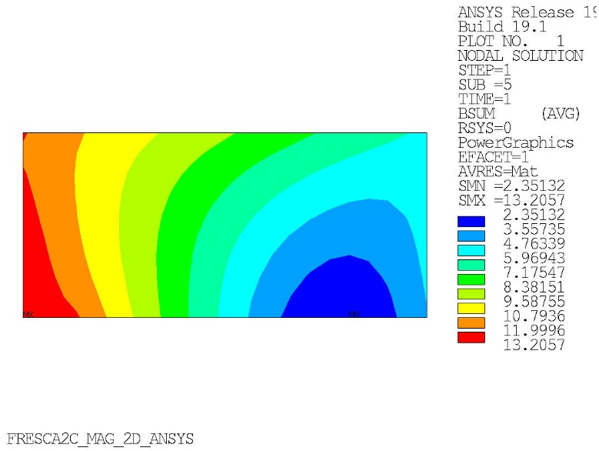
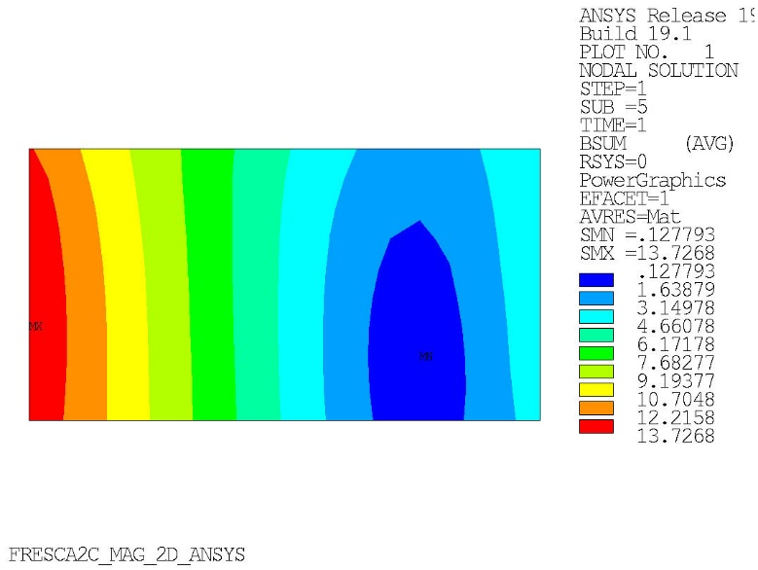
FRESCA2c magnetic model standalone
Max B field on coils
Outer coil: 13.21 T (80% SS)
Inner coil: 13.73 T (83%)
Outer
coil
Inner
coil
14/03/19 - D. Martins Araujo

Slide 25
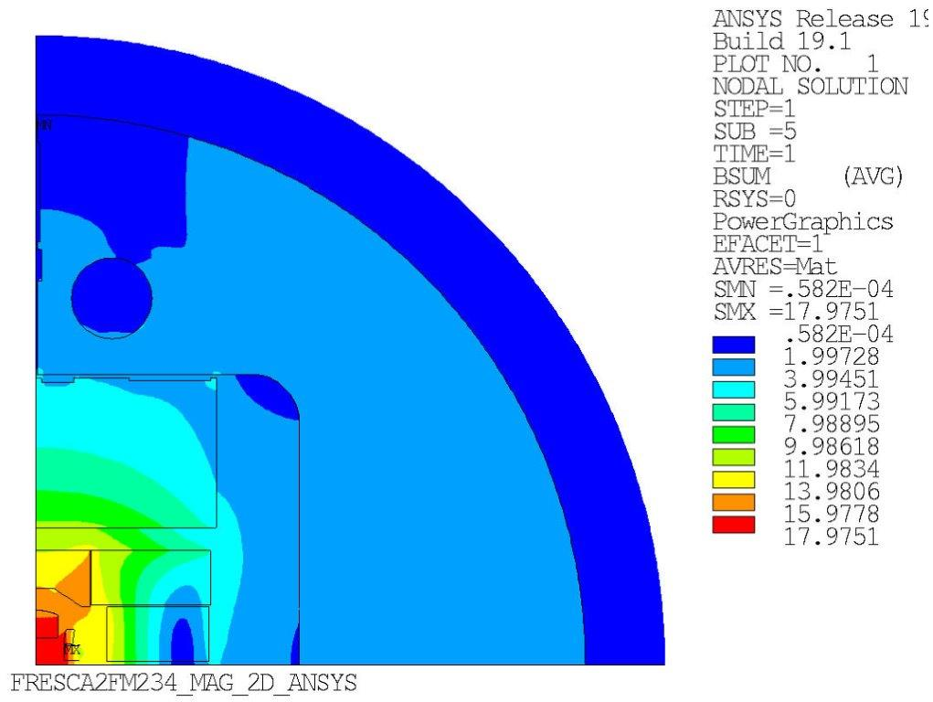
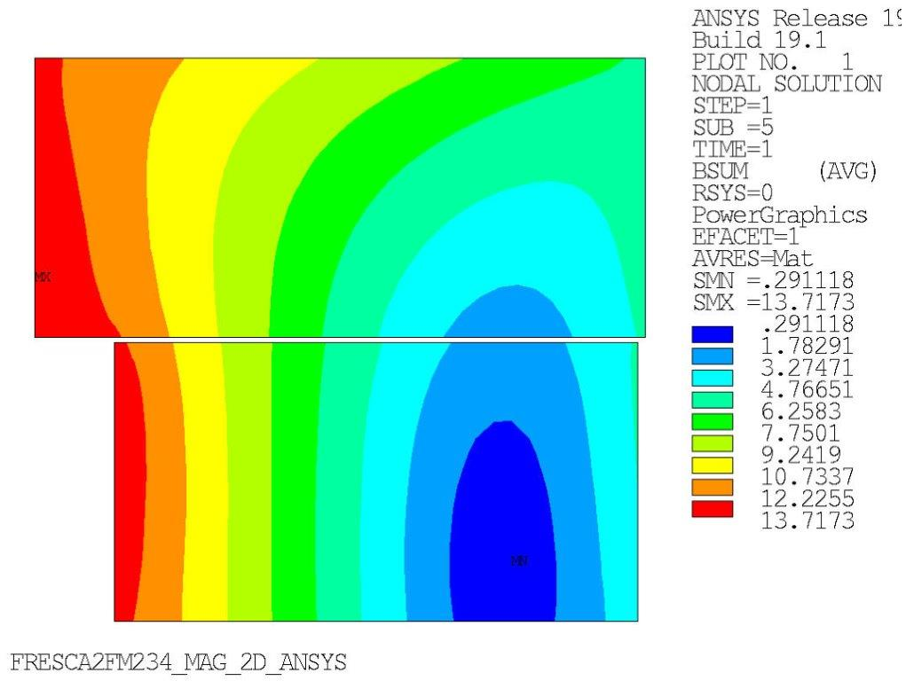
Case 1 of integration - magnetic model
Electric current of 11.7 kA on FRESCA to have I/Iss = 0.83 at 4.3 K considering 10 kA for FM2:
Bore field (B(0.0,0.0)) of 17.48 T
14/03/19 - D. Martins Araujo

Slide 26
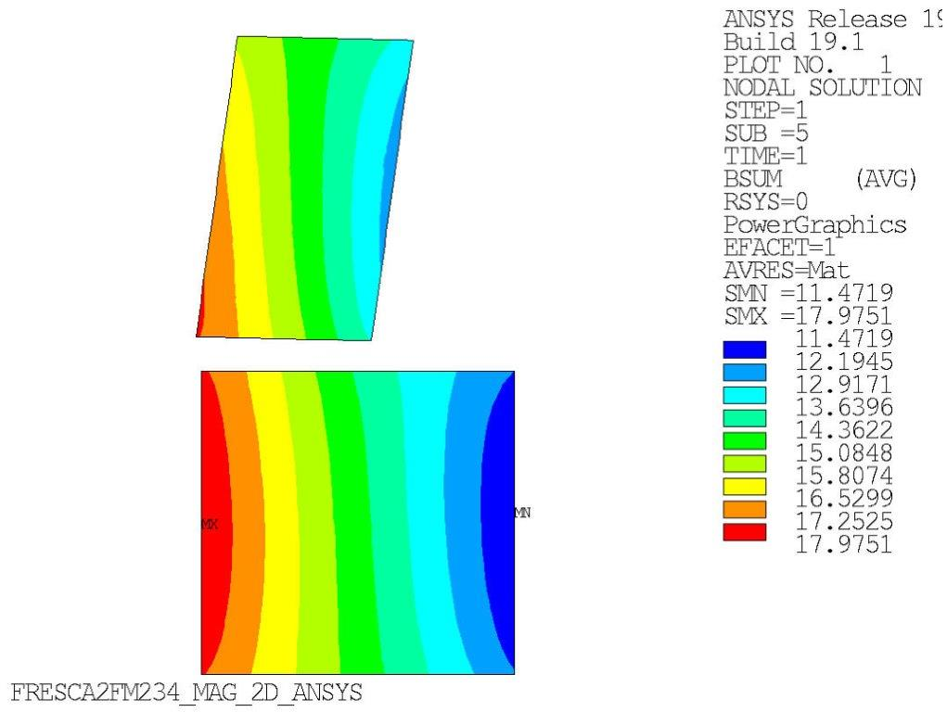
Case 1 of integration - magnetic model
Electric current of 11.7 kA on FRESCA to have I/Iss = 0.83 at 4.3 K considering 10 kA for FM2:
Bore field (B(0.0,0.0)) of 17.48 T
14/03/19 - D. Martins Araujo

Slide 27
Appendix

Slide 28
Hybrid program and goals of the design studies (II)
Then, some personal thoughts on the comparative analysis….
The goal should not be, or does not necessarily have to be
reaching a consensus on a particular design
….historically, as far as I know, this goas has never been achieved before…
Instead, more realistically, the working group could aim at
Discussing and reviewing the different designs and listing pluses and minuses or open issues….grounding on “objective” criteria
Providing inputs to the other areas (in particular area I and area II) to better define their roadmaps and overall directions, and avoid inconsistencies

Slide 29
An example of comparative analysis from FCC/Eurocircol
Magnets at the limits of Nb3Sn superconductor
Based simply on modelling, the selection is very difficult
Better if we rely also on experimental data

Slide 30
Resources needed and possible timeline
Resources
1.5 Post-Doc full time (0.5 per lab)
0.5 FTEy for supervision and biweekly meeting of the working group
Timeframes and goals
About 3-4 years in total
First six months (by Sept. 2020)
Review of work so far, by MDP and internationally (FCC/Eurocircol)
Nb₃Sn dipole magnets, HTS inserts, 15-20 T hybrid magnets
Definition of a list of criteria and preliminary evaluation of MDP designs and/or proposed alternatives, always from the hybrid perspective
Perform analysis in support of the test of the first hybrid magnet (9-10 T) with CCT5
First year (by March 2021)
Design study of second hybrid magnet (14-15 T)
Based on CCT, SMCT and HTS development results and first hybrid test with CCT5
Final goal
Design study of a 20 T hybrid

Slide 31
An example of the hybrid challenges
FRESCA2 and Feather2
13-14 T + 3-5 T
work in progress at CERN
Significant challenges in mechanical integration
Self supporting insert or in contact with LTS

Slide 32
An example of the hybrid challenges

Slide 33
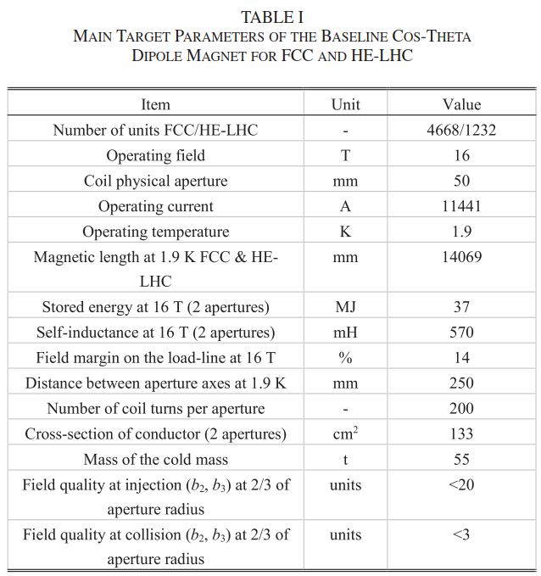
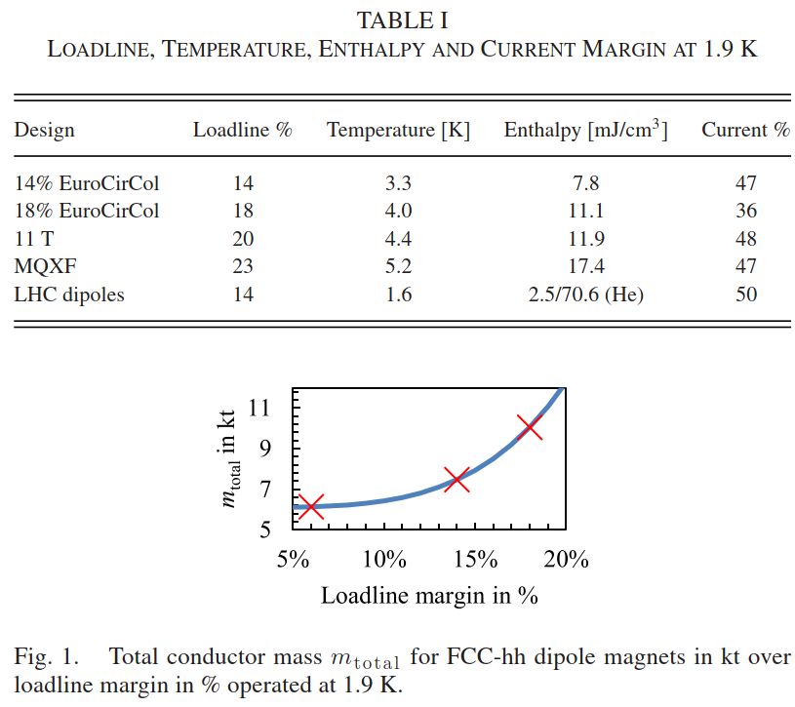
Show how the proposed roadmap builds off of MDP and international efforts to-date
Magnets at the limits of Nb3Sn superconductor
Eurocircol/FCC design studies: margin

Slide 34
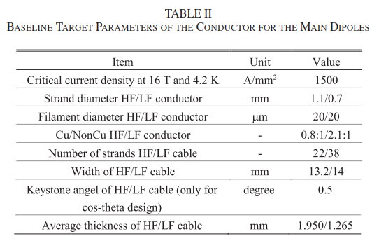
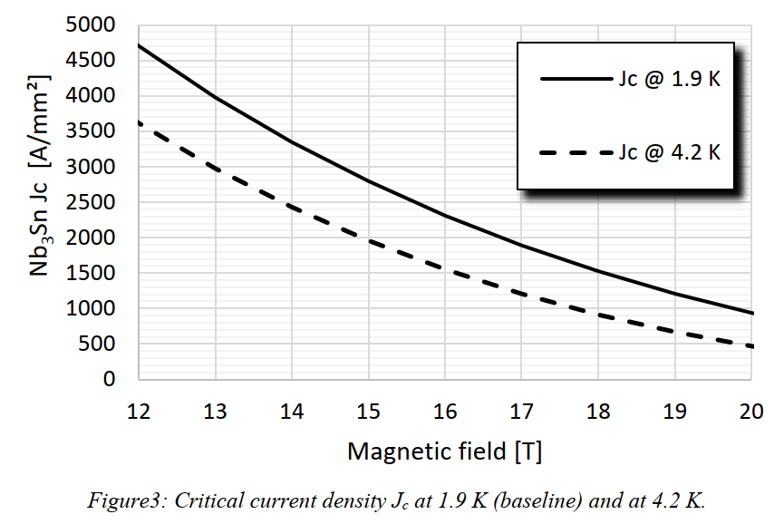
Show how the proposed roadmap builds off of MDP and international efforts to-date
Magnets at the limits of Nb3Sn superconductor
Eurocircle/FCC design studies: Jc

Slide 35
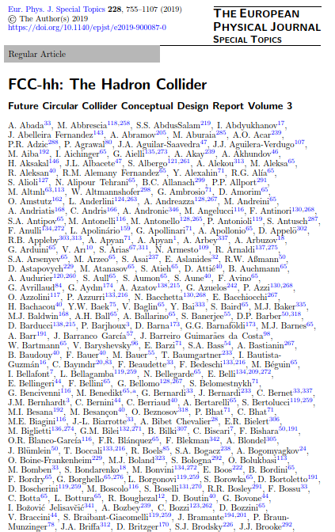
Show how the proposed roadmap builds off of MDP and international efforts to-date
Magnets at the limits of Nb3Sn superconductor
Eurocircle/FCC design studies: quantity of superconductor
No show-stoppers found in any particular design
Peak stress <150 MPa at warm and <200 MPa at cold
No final selection (although CT as baseline)final choice

