Slide 1
Area III: Technology
IIIa: Comparative analysis of magnet design concepts
Paolo Ferracin, Giorgio Ambrosio, Lance Cooley, Ramesh Gupta, Vadim Kashikhin, Alexander Zlobin
US Magnet Development Program

Slide 2
Proposed design studies roadmap
Title: Design studies of LTS/HTS hybrid magnets
Focus on design of
Outer (background) coils based on Nb3Sn superconductor
Inserts based on
Both with REBCO and Bi2212 superconductors
Hybrid magnets towards 20 T field level

Slide 3
Proposed design studies roadmap
Link with MDP areas and goals
Task will be part of area III, with links to area I and II
Area I → Nb₃Sn
Area II → HTS insert
Area III → technology
Modeling, diagnostics, instrumentation material
The objectives will be in line with goal 2
In particular the second part

Slide 4
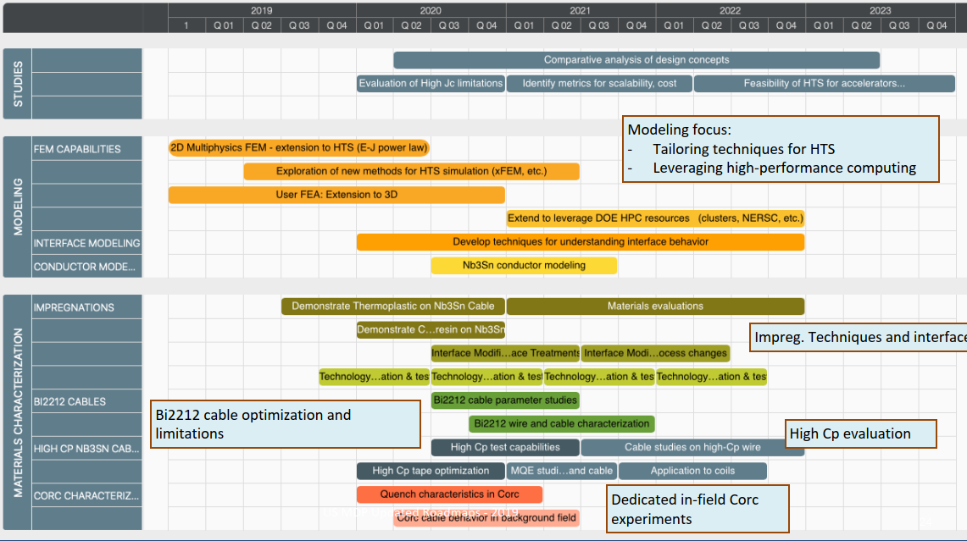
Proposed design studies roadmap
Time frame: 2020 – 2023
Methods
Modeling effort
“classical 2D/3D” mechanical, magnetic and QH simulations
Developing new modeling techniques is not part of this task
However, if new tool/analysis is required → feed-back to Technology area (III), modeling and simulations

Slide 5
The LTS and HST roadmaps (presented yesterday)

Slide 6
Hybrid program and goals of the design studies (I)
Hybrid program
“Near term” (~2020-2022)
CCT5
8 T in 90 mm aperture
CCT Bi2212 BIN5 and/or some inner coils from the CCT REBCO C2
1-2 T field level
Target hybrid field: ~ 9 T
Goals of the design studies
Start analysis of challenges specifically of hybrid magnets
Integration of LTS/HTS, mechanics, protection, powering, diagnostics, test facility…..

Slide 7
Hybrid program and goals of the design studies (II)
Hybrid program
“Medium term” (~2022-2024)
CCT6 and/or SMCT
11-12 T in 120 mm aperture
CCT Bi2212 and/or SMCT Bi2212 and/or CCT REBCO and/or COMB REBCO
Towards 5 T field level
Target hybrid field: towards 14-15 T
Goals of the design studies
Evaluate different designs (both LTS and HTS)
Investigate alternatives (common-coil and blocks)
Perform a comparative analysis in view of a 20 T hybrid magnet, considering both modelling and experimental results
Margin, mechanics, field quality, quench protection strategies, fabrication-assembly-loading, performance of previous models, scalability, cost……
Basically, help converging on all the and/or
Continue the analysis of challenges specifically of hybrid magnets

Slide 8
Hybrid program and goals of the design studies (III)
Hybrid program
“Long term” (~2025 and beyond)
Target hybrid field: towards 20 T
Goals of the design studies
How much field from LTS and HTS respectively?
Which design? How a 20T hybrid may it look like?
Evaluation high Jc limitations in Nb₃Sn
We are working on very high Jc strands: can we afford it?
Yes from the stress point of view (CCT and SMCT), but what about QP?

Slide 9
Hybrid program and goals of the design studies (II)
Then, some personal thoughts on the comparative analysis….
The goal should not be, or does not necessarily have to be
reaching a consensus on a particular design
….historically, as far as I know, this goas has never been achieved before…
Instead, more realistically, the working group could aim at
Discussing and reviewing the different designs and listing pluses and minuses or open issues….grounding on “objective” criteria
Providing inputs to the other areas (in particular area I and area II) to better define their roadmaps and overall directions, and avoid inconsistencies

Slide 10
An example of comparative analysis from FCC/Eurocircol
Magnets at the limits of Nb3Sn superconductor
Based simply on modelling, the selection is very difficult
Better if we rely also on experimental data

Slide 11
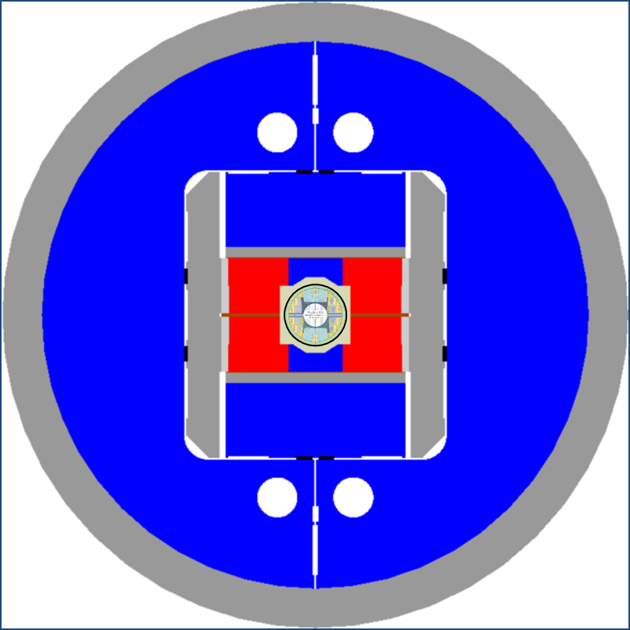
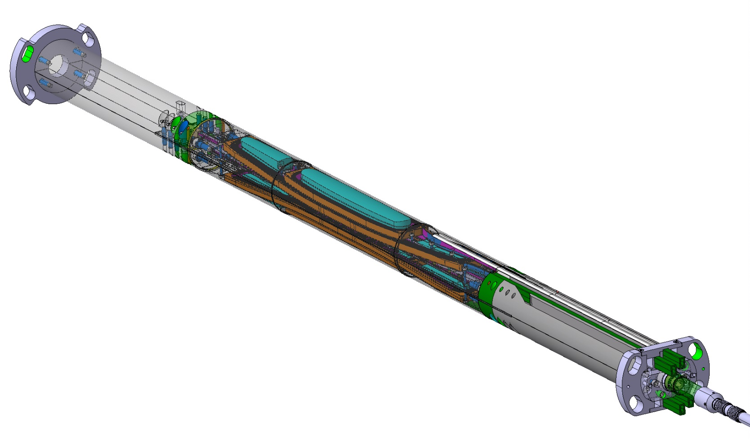
An example of the hybrid challenges
FRESCA2 and Feather2
13-14 T + 3-5 T
work in progress at CERN
Significant challenges in mechanical integration
Self supporting insert or in contact with LTS

Slide 12
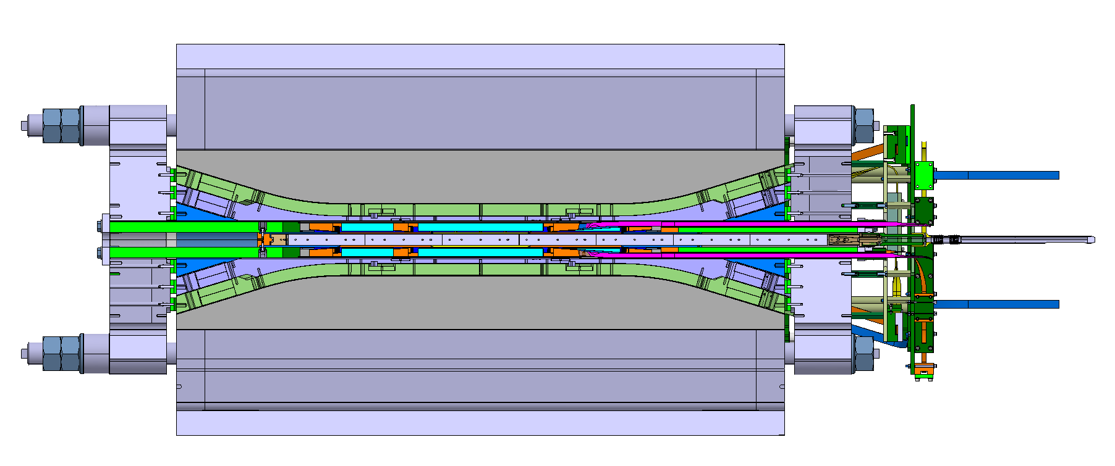
An example of the hybrid challenges

Slide 13
Resources needed and possible timeline
Resources
1.5 Post-Doc full time (0.5 per lab)
0.5 FTEy for supervision and biweekly meeting of the working group
Timeframes and goals
About 3-4 years in total
First six months (by Sept. 2020)
Review of work so far, by MDP and internationally (FCC/Eurocircol)
Nb₃Sn dipole magnets, HTS inserts, 15-20 T hybrid magnets
Definition of a list of criteria and preliminary evaluation of MDP designs and/or proposed alternatives, always from the hybrid perspective
Perform analysis in support of the test of the first hybrid magnet (9-10 T) with CCT5
First year (by March 2021)
Design study of second hybrid magnet (14-15 T)
Based on CCT, SMCT and HTS development results and first hybrid test with CCT5
Final goal
Design study of a 20 T hybrid

Slide 14
Appendix

Slide 15
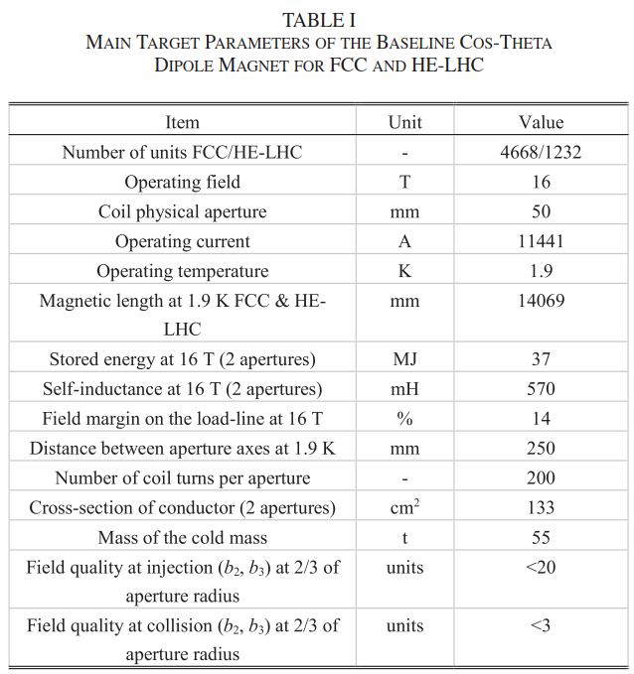
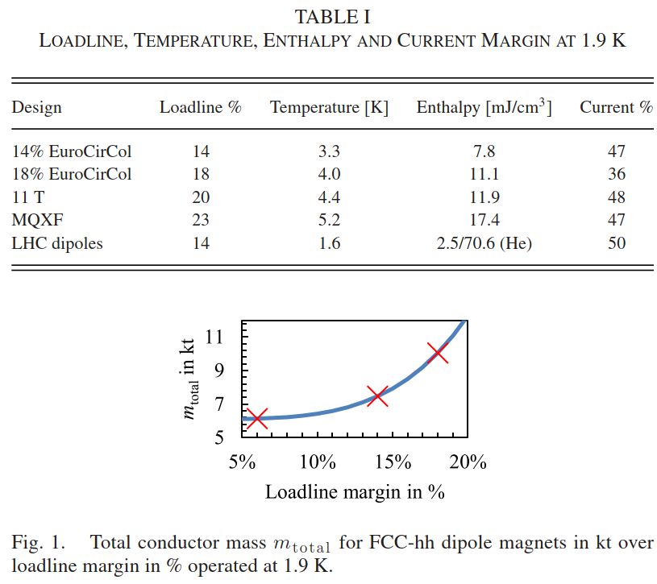
Show how the proposed roadmap builds off of MDP and international efforts to-date
Magnets at the limits of Nb3Sn superconductor
Eurocircol/FCC design studies: margin

Slide 16
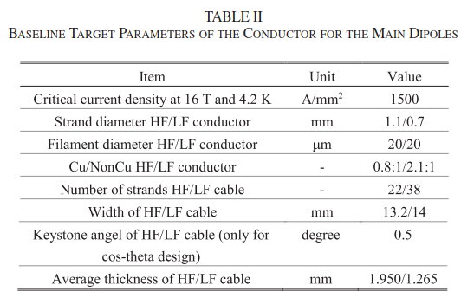
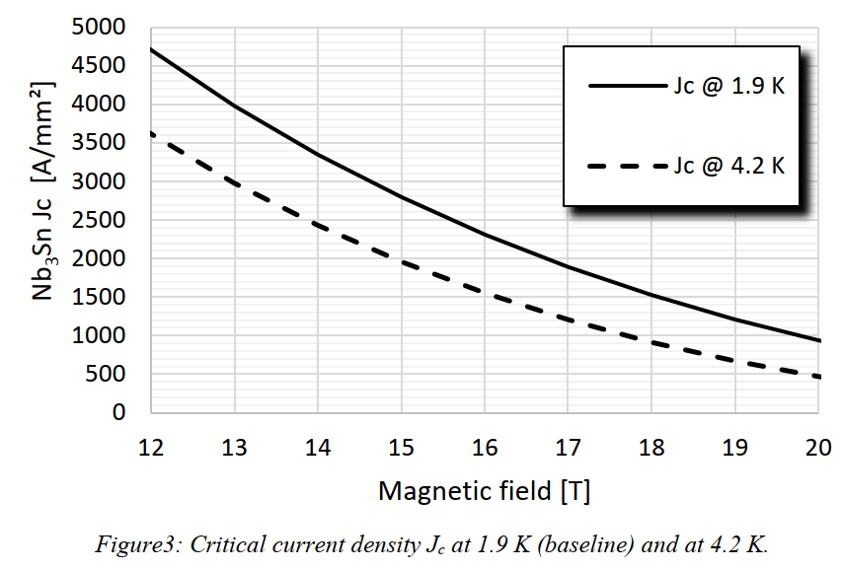
Show how the proposed roadmap builds off of MDP and international efforts to-date
Magnets at the limits of Nb3Sn superconductor
Eurocircle/FCC design studies: Jc

Slide 17
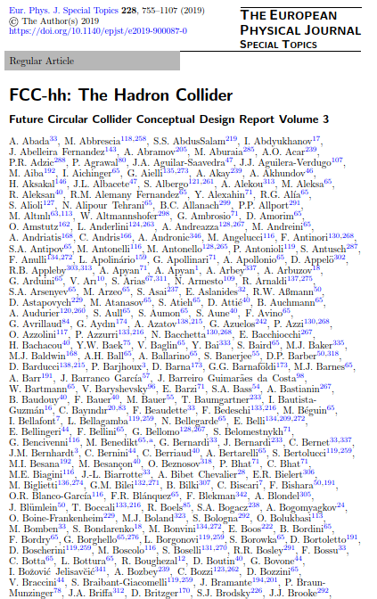
Show how the proposed roadmap builds off of MDP and international efforts to-date
Magnets at the limits of Nb3Sn superconductor
Eurocircle/FCC design studies: quantity of superconductor
No show-stoppers found in any particular design
Peak stress <150 MPa at warm and <200 MPa at cold
No final selection (although CT as baseline)final choice

