Slide 1
Quench Studies CORC® Cable Coil
at 10⁺ T in HTS/LTS Hybrid Dipole
MDP Videoconference on April 15, 2020
Ramesh Gupta
for Magnet Division at BNL

Slide 2
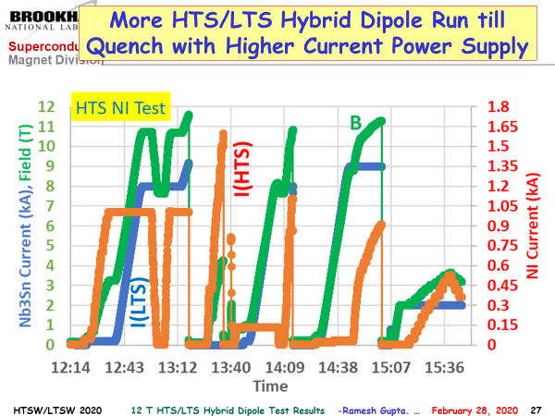
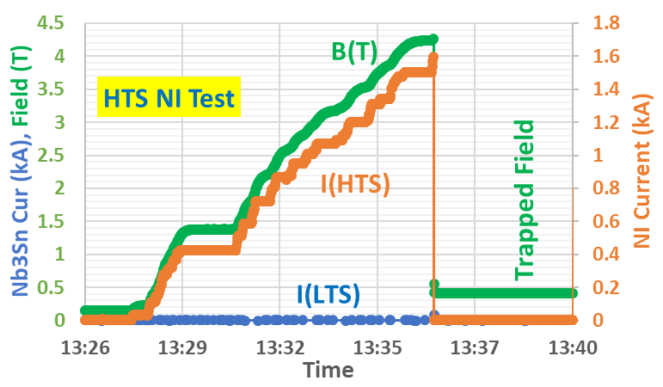
HTS/LTS Hybrid Test and HTS Standalone Test (Feb 2020)
Presented at LTSW2020 (one of several test runs)
Standalone HTS coil field reached : ~4.2 T
(limited by PS current; interrupted by PS trip)
(hybrid field limited by pinching strain on Nb₃Sn coils from HTS coils due to lack of structure on them; all CORC coil designs have structure)

Slide 3
Overview
Common coil dipole DCC017 is being used as a test facility magnet to perform rapid-turn-around, lower cost R&D.
The purpose of the ACT/BNL STTR is to design, built & test high current (>10 kA) CORC® coil and to operate it in series with LTS coil to demonstrate an accelerator type high field HTS/LTS hybrid configuration. Current plan to have a total of 28 (8+6+6+8) turns
The purpose of MDP program is to perform scientific studies on CORC® coil, in particular related to the quench detection, quench propagation and quench protection. Current plan to have 8 (4 + 4) turns
This presentation will give status and seek input for planning and guidance to get maximum scientific data out of the MDP test

Slide 4
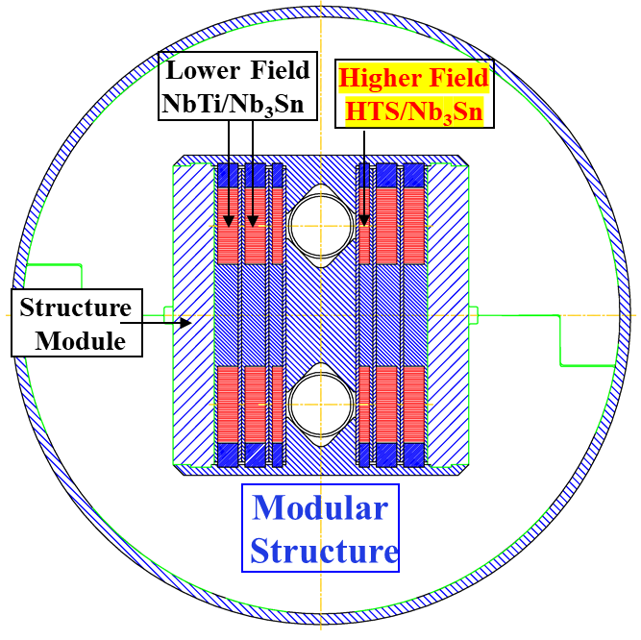
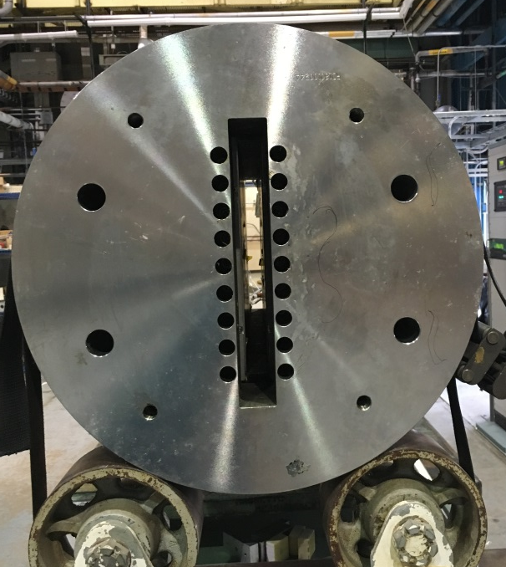
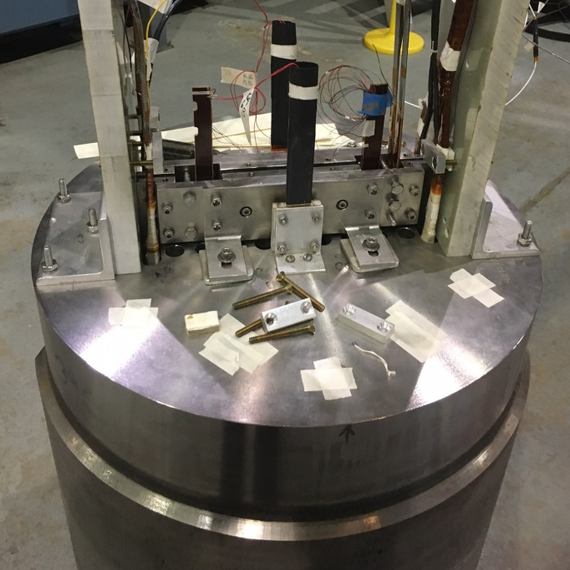
Test Modules in DCC017 for MDP and STTR using CORC® Cable
MDP test will have a single cassette with ~15 mm space for instrumentations between two four-turn coils
STTR test will have minimum space for maximum field with 2-4 cassettes (depending on the details of the design)
Insert coils in Empty Space
Empty Space
Modular Design
(insert coils as test cassettes)
Nb₃Sn common coil dipole DCC017 without insert coils
HTS coils inside Nb₃Sn dipole making HTS/LTS hybrid dipole

Slide 5
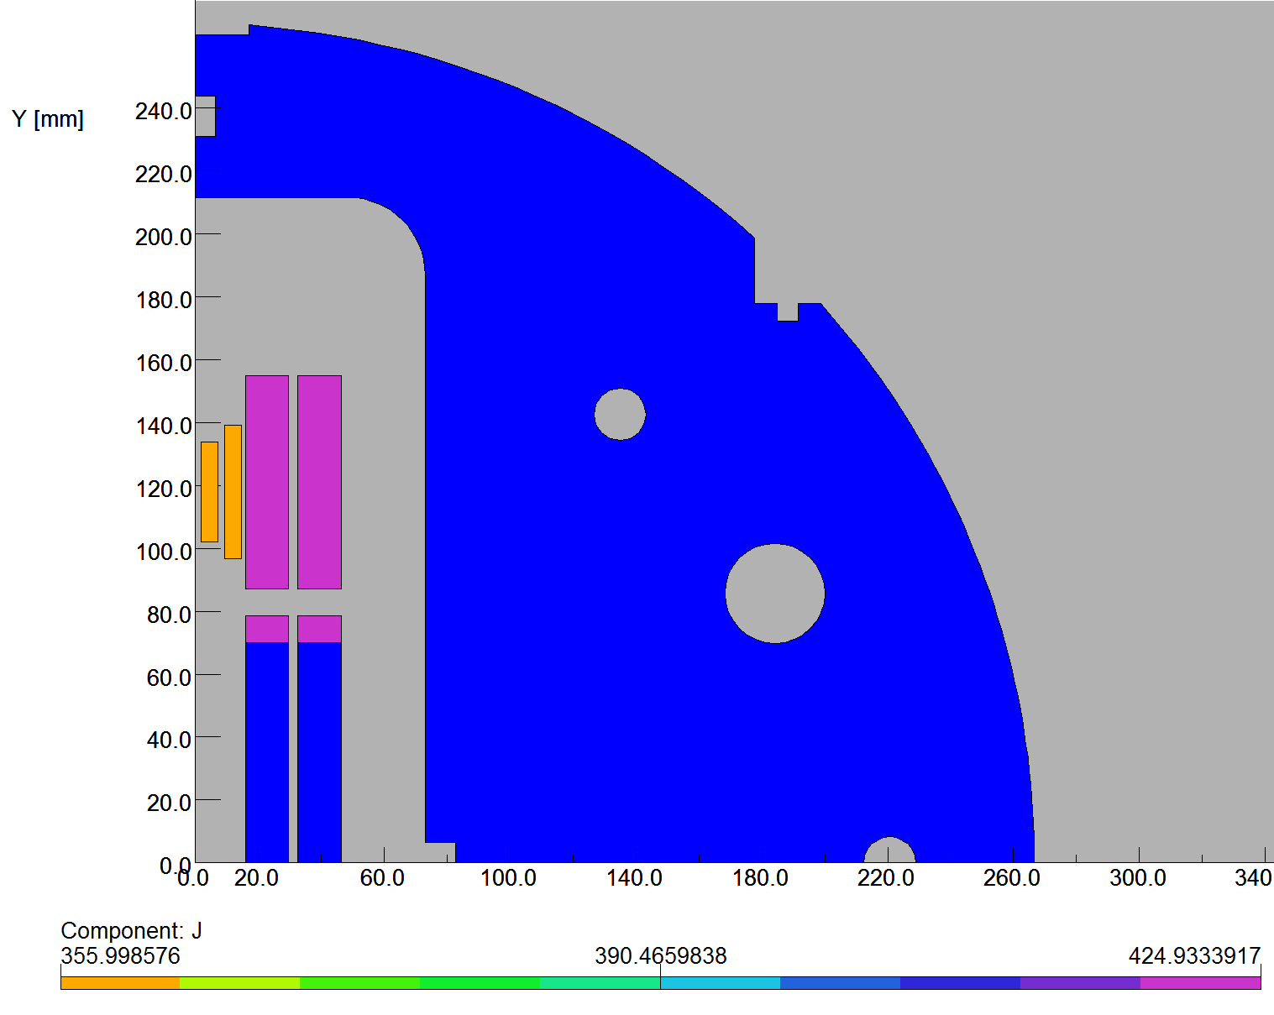
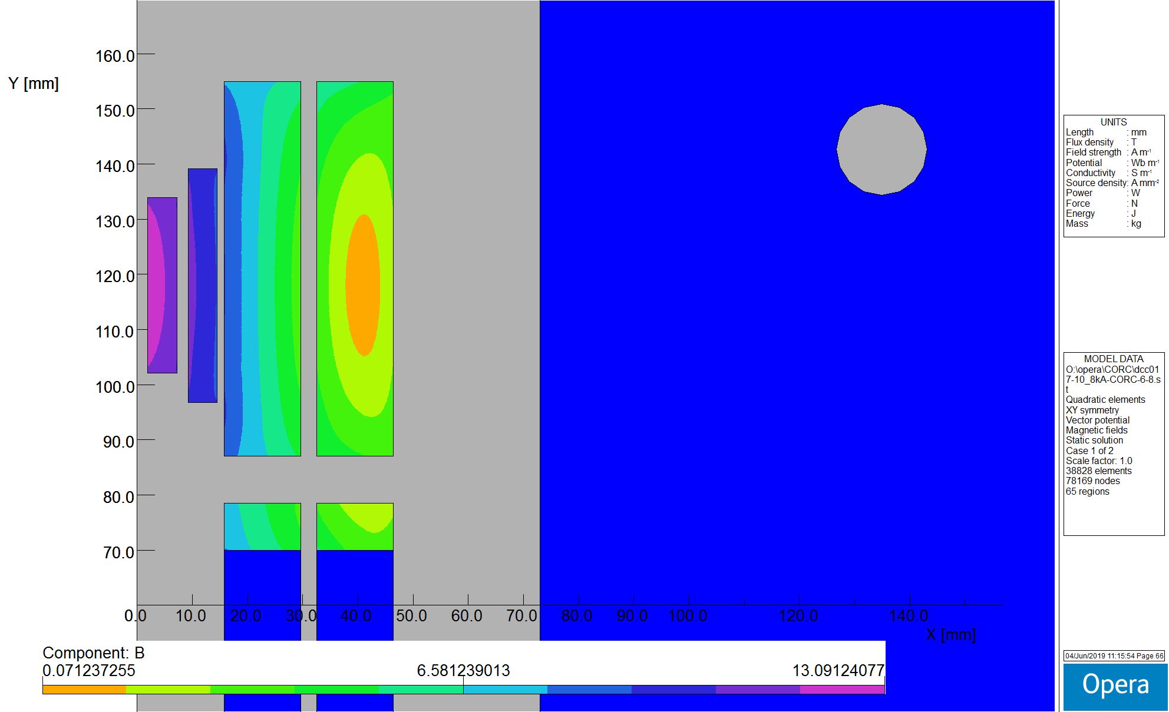
CORC Coils in the STTR Program
CORC STTR coils:
6 & 8 turns, in series with Nb₃Sn coils
Hybrid field: 13.1 T @10 kA
(peak field in Nb₃Sn coils reduced by CORC coils)
2-d model
Nb₃Sn Coils
CORC Coils

Slide 6
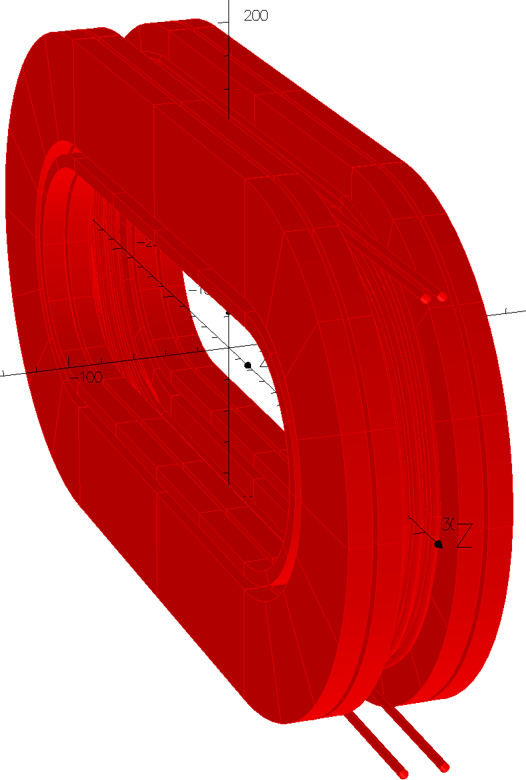
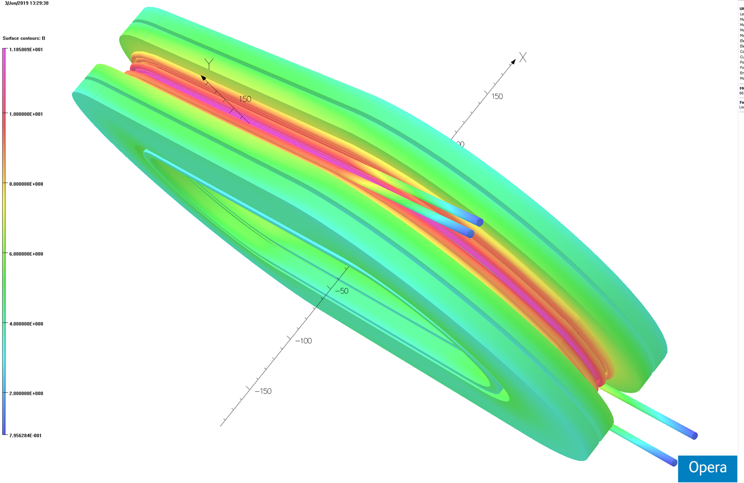
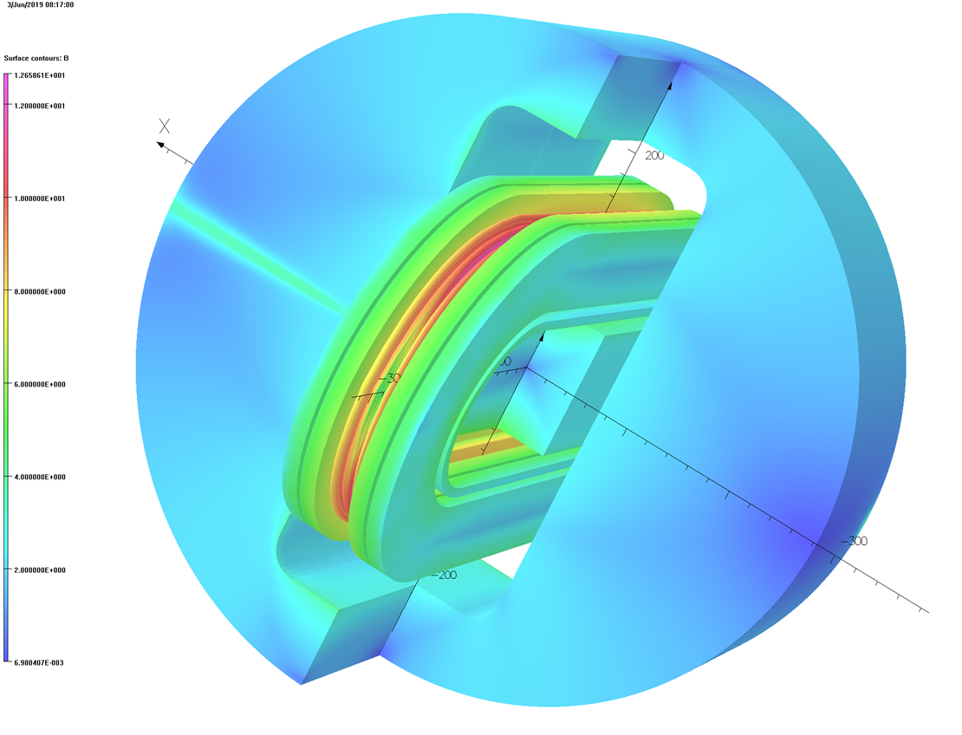
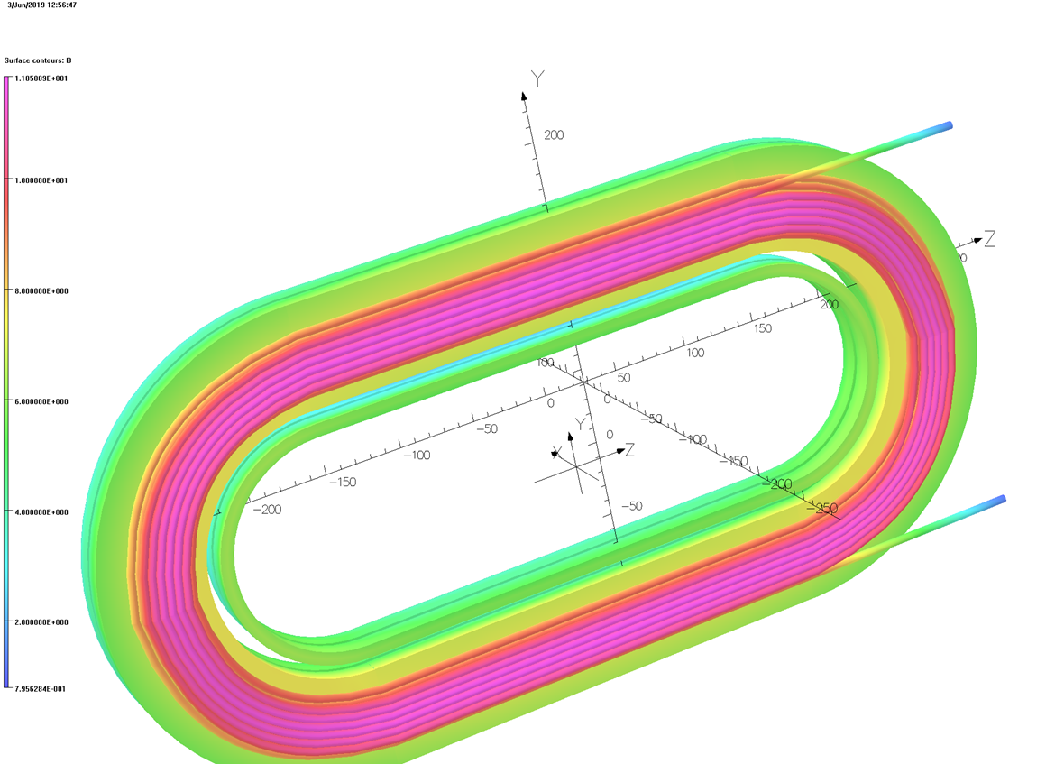
CORC Coils (with 6 and 8 turns) inside the Nb₃Sn coils in DCC017

Slide 7
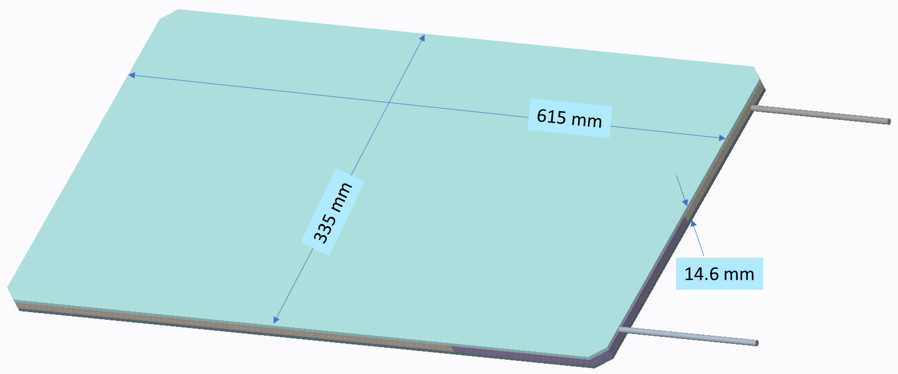
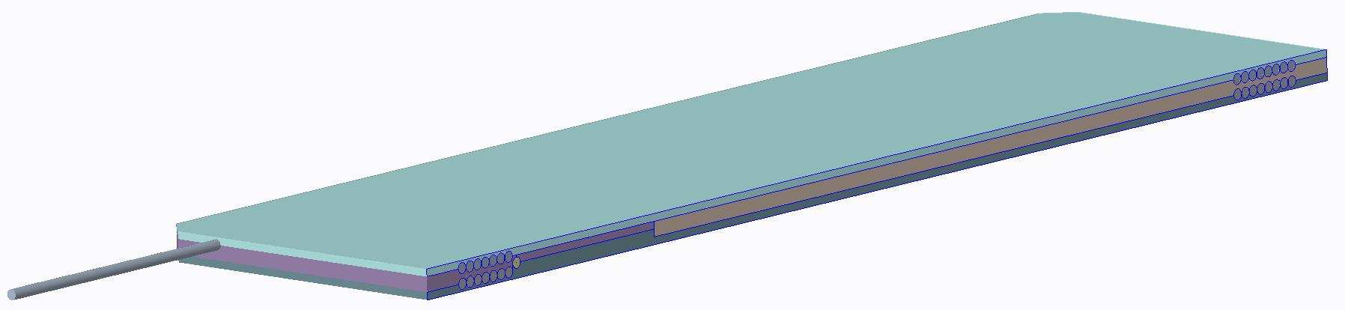
Double Pancake Module (or Cassette) for STTR
Horizontal Gap: 31 mm
Space for Hall Probe, etc.
: ~1 mm
Two such packages will be inserted inside the common coil dipole DCC017

Slide 8
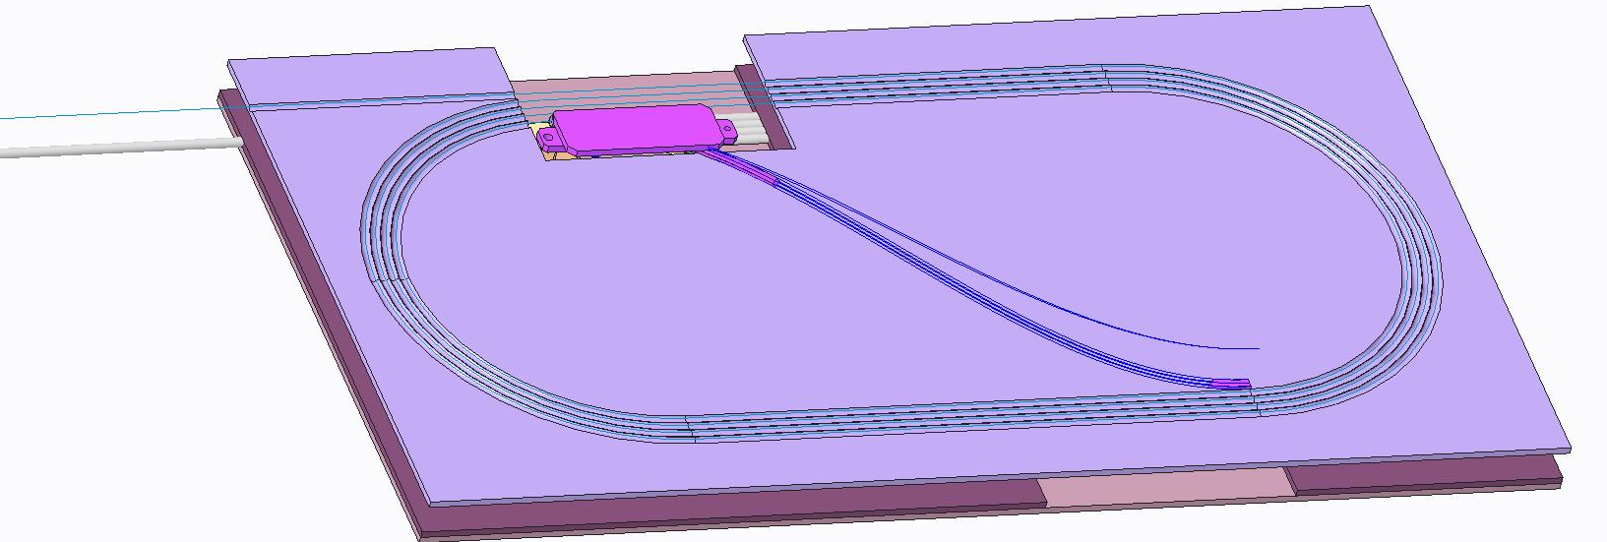
CORC Coil for MDP
CORC coil for MDP will have a total 8 turns (4 + 4), instead of 28 in the STTR coil.
Two 4 turns form a double pancake with S-transition to reverse the direction of current with ~15 mm gap for instrumentation.
A significant amount of cable (~13 meters) for quench studies.

Slide 9
What do we want to learn from the MDP Test?

Slide 10
Initial Discussions (1) (Last year, minutes from Xiaorong)
Powering scheme
Baseline: the CORC® coil will be connected in series with the power supply for the Nb₃Sn magnet up to 10 kA.
BNL is working to set up a 17 kA power supply to power the CORC® coil separately.
Driving questions for the quench experiments
Can we study the transition behavior of the coil with the series-powering scheme? [see required information below] If yes, how does the coil transition in 10 T background field? Is the transition smooth with the capability to ramp the current up and down along the transition?
Considering the margin of the CORC® coil at various fields, can we induce a quench with a heater? What is the total power generated by the heater to induce a quench at various background fields? Does the normal zone propagate during a quench at various background fields? Can we measure the propagation velocity?
How does current distribute between tapes at the front of growing normal zone?
Can we detect the local temperature rise due to the heater with different instrumentations such as acoustic and fiber-optic sensors? How does different instrumentations compare with each other?

Slide 11
Initial Discussions (2) (Notes from last year)
With the fiber-optic sensor, can we tell if the coil starts the transition in the peak field region?
Does the transition current of the CORC® coil depend on the number of ramping? Any impact of the current/Lorentz force cycling? Similarly, does the quench energy reduce after cycling? Does the normal zone propagates faster after cycling? Does the current sharing behavior change after cycling? Does the transition current of the CORC® coil depend on the ramp rate?
Can we probe the MIITs limit for the CORC® coil at 10 T? This can potentially degrade the CORC® coil and should be performed toward the end of the test campaign.
Information needed to design the experiments and plan the required instrumentation:
Coil design or dimensions to determine locations of potential instrumentation
Predicted short-sample performance for the CORC® coil at 4.2 K, different fields up to 10 T. The peak field region in the CORC® coil and the fields at other specific locations. This information can help to optimize the location(s) of the spot heater(s).

Slide 12
Initial Discussions (3) (Notes from last year)
Desired instrumentation:
Acoustic sensors to detect temperature rise and quench (coordinate with Maxim)
Hall sensor array to detect local current sharing between tapes and propagation of normal zone (Maxim)
Fiber optic sensor to measure temperature profile along the conductor (coordinate with Justin)
Voltage taps in the conductor terminal (installed by ACT or during coil fabrication)
From such general group meeting, we can get input for high level planning in terms of what is technically important, what can be done with the resources we have, what space is needed to do various experiments, who will do what, etc. etc., etc.,…
For detailed planning and implementation, we have started a separate smaller group working meeting.

Slide 13
Current Plan and Status
While overall design and cable parameters remain the same for both STTR and MDP coils, initially we considered of investigating two variations of the detailed designs for the two programs.
However, the current plan is to make two designs as similar as possible for direct applicability and to apply lessons learnt from one to another.
ACT is budgeted and responsible for the STTR coil. BNL will work with that initial design and adapt it for MDP, of course, BNL will provide its feedback for both. BNL is budgeted and responsible for the MDP coil.
ACT is likely to wind both coils but BNL may also do one or both. ACT recently successfully wound and tested its solenoidal coil in the background field at Florida. However, unlike the solenoid coil, the dipole coil will have a structure between the turns to deal with large stresses.

Slide 14
Extra Slides

Slide 15
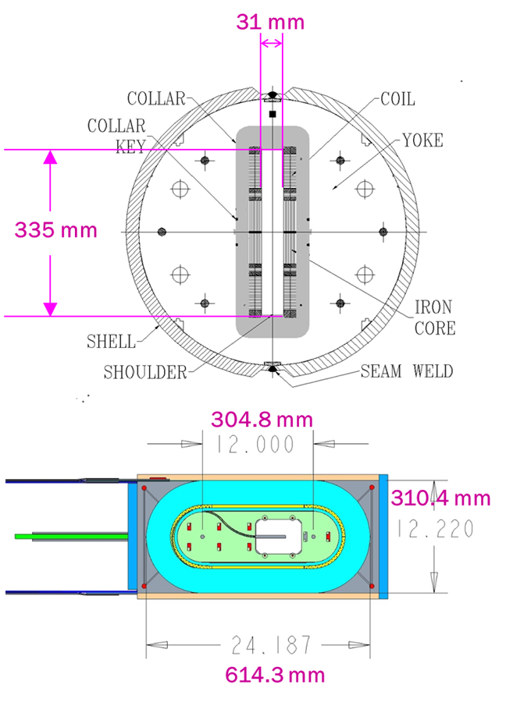
Parameters of BNL Dipole DCC017
Two layer, 2-in-1 common coil design
10.2 T bore field, 10.7 T peak field at 10.8 kA short sample current
31 mm horizontal aperture
335 mm vertical aperture
A unique feature for insert coil or cable testing
0.8 mm, 30 strand Rutherford cable
70 mm minimum bend radius
85 mm coil height
614 mm coil length
One spacer in body and one in ends
Iron over ends
Iron bobbin
Stored Energy@Quench ~0.2 MJ

Slide 16
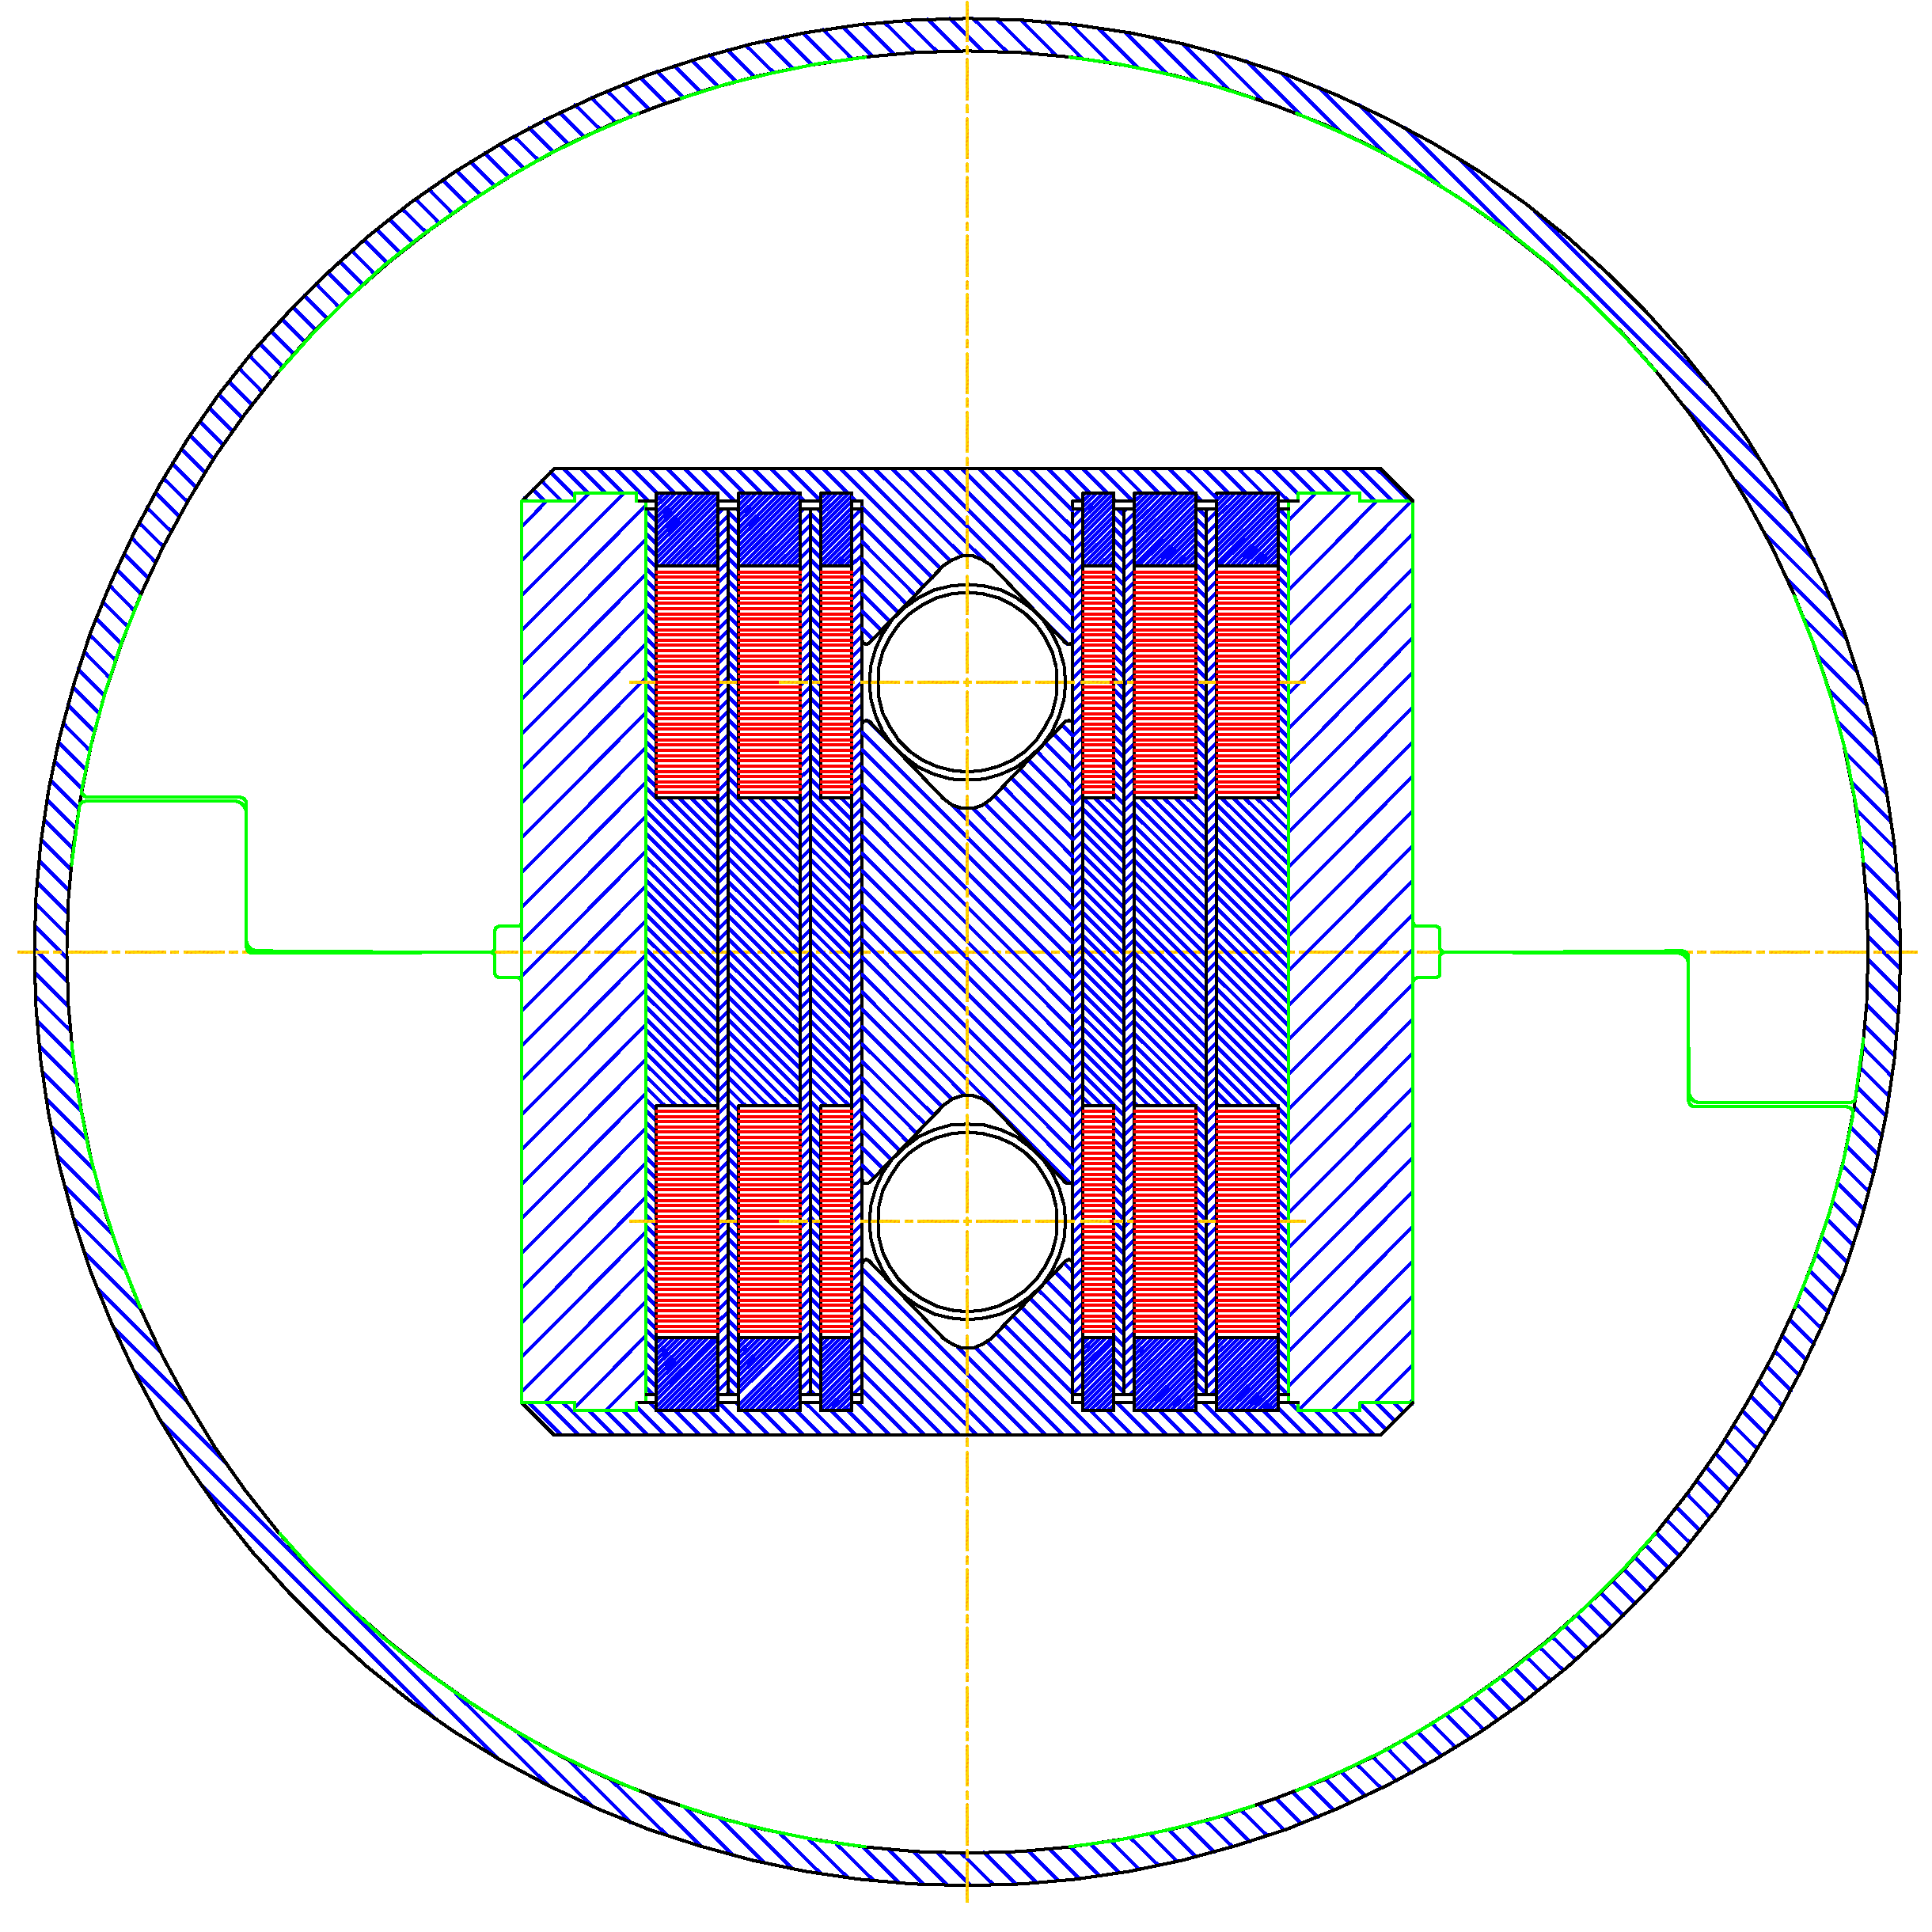
Lower Field
NbTi/Nb₃Sn
Higher Field
HTS/Nb₃Sn
Structure
Module
Modular
Structure
Notes:
Spend some time on this slide
Explain above picture
Emphasize modular R&D
Critical to objectively understanding technology
Advancing technology in a realistic time frame
Two slide projectors

