Slide 1
Plans for COMB magnet technology development with CORC cables
Vadim Kashikhin, Vito Lombardo
April 15, 2020

Slide 2
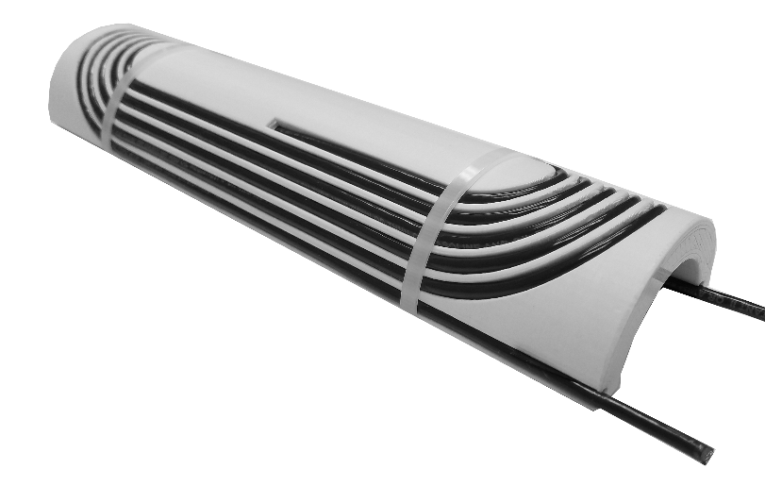
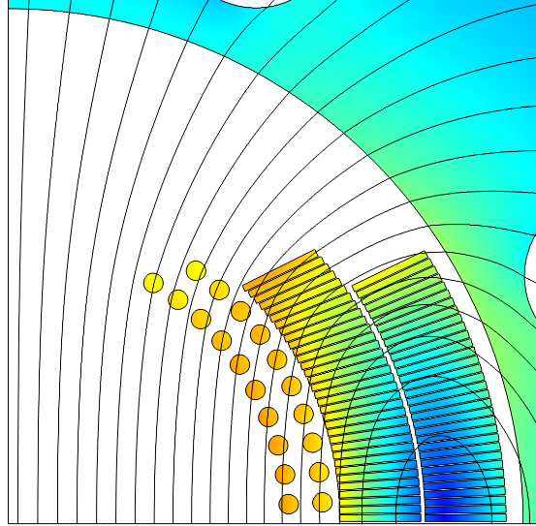

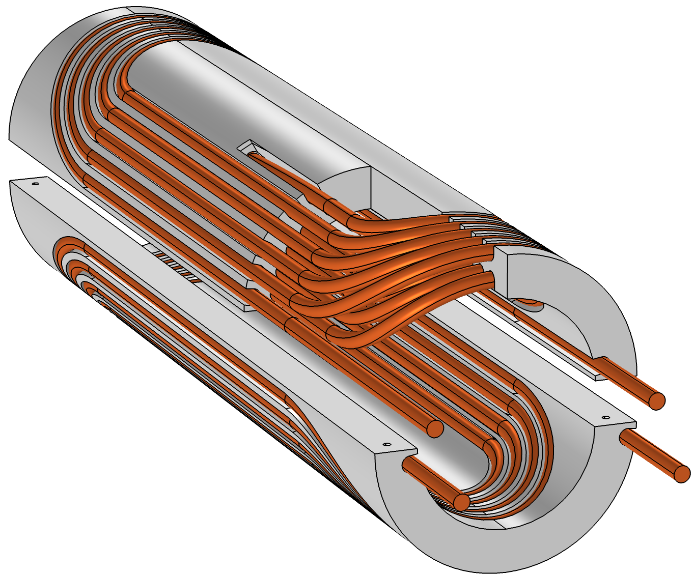
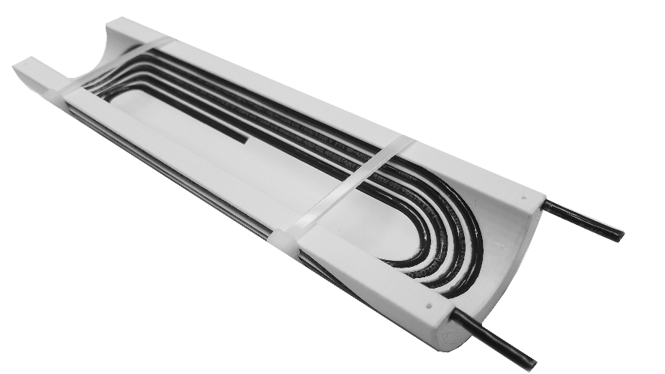
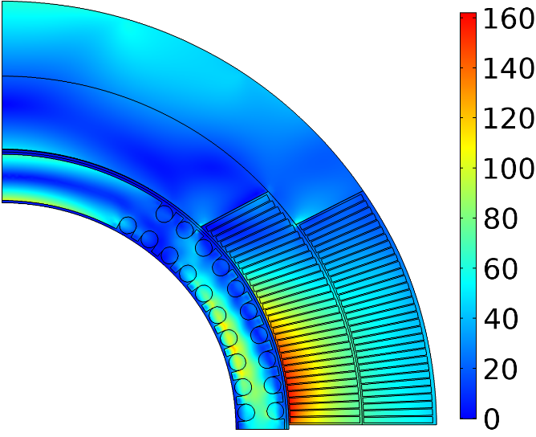
Conductor On Molded Barrel (COMB) magnet technology
Magnetic field (T)
Nb₃Sn coil
HTS coil
+1.25 T in Nb₃Sn 4.4 T standalone
Equivalent stress (MPa)
110 MPa
Mock-up coil built to demonstrate manufacturability
160 MPa
Double-COMB
support structure
Within safe limits

Slide 3
HTS/COMB development
The COMB magnet development goes along two paths:
  Technology demonstration:
    Procurement of CORC cable based on the presently available REBCO tapes (with the I_{c} spec at 77 K and self-field to have a quick turn-around). 2x10 m of the CORC cable with 29 tapes was delivered to FNAL – enough for 2 dipole half-coils.
    Winding experiments on short pieces of CORC wire (provided by LBL) and tests at 77 K to assess the bending degradation.
    Fabrication of two dipole half-coils and tests in a standalone condition at 1.9 K – 77 K. Expected field is ~4 T in 100 mm bore.
    Assembly of the COMB coils with the outer Nb₃Sn coils from the 15 T dipole and testing them in series at 1.9 K – 4.2 K.
  Performance demonstration:
    Procurement of the CORC cable based on the next generation of REBCO tapes with a thinner substrate and the I_{c} spec at 6 T, 4.2 K.
    Fabrication of two dipole half-coils and tests in a standalone condition at 1.9 K – 77 K. Expected field is >5 T in 100 mm bore.
    Assembly of the COMB coils with the outer Nb₃Sn coils from the 15 T dipole and testing them powered separately (up to ~12 T background field) at 1.9 K – 4.2 K.
The 4-year goal is to fabricate and test two complete COMB dipole coils with the CORC conductors to demonstrate 4-5 T self field in 100 mm bore and the HTS/LTS hybrid magnet operation with 100 mm bore and accelerator field quality.
Current stage
Stimulus funding

Slide 4
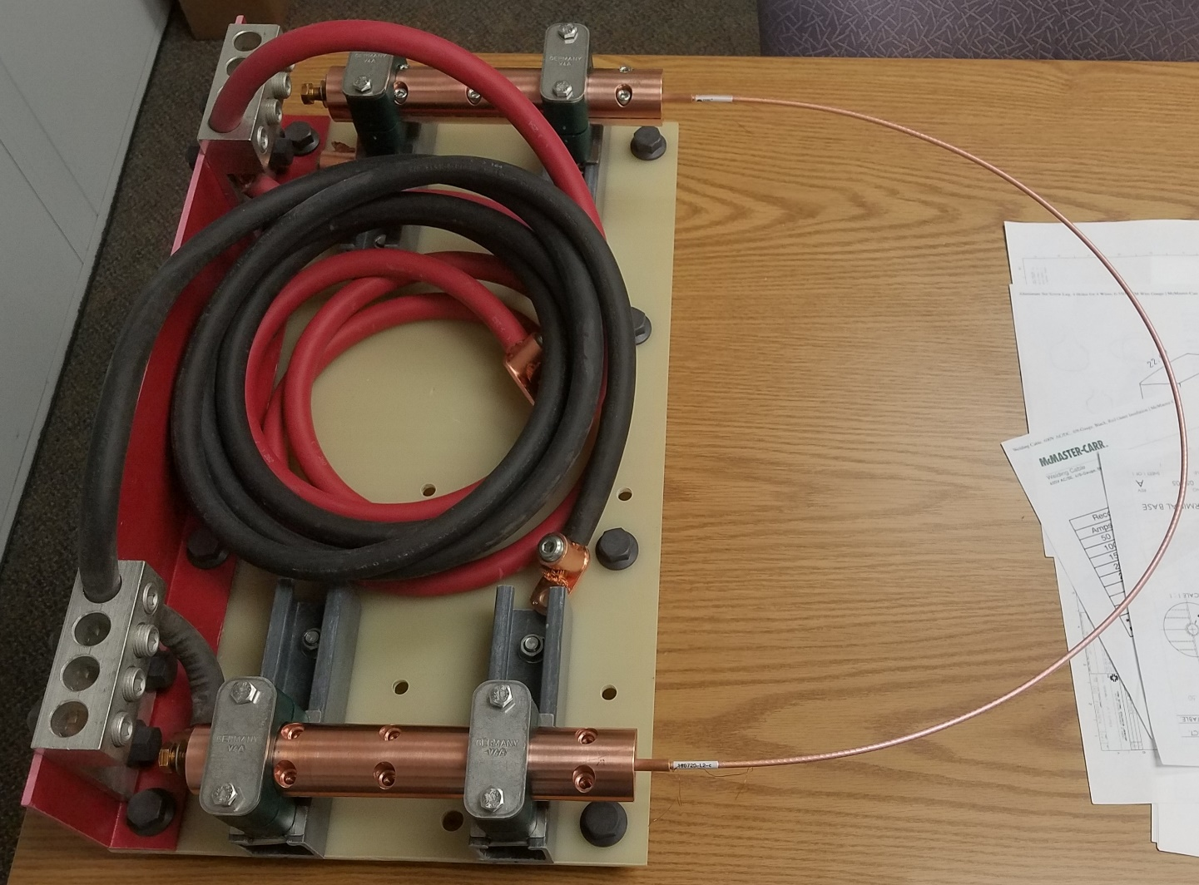
LN₂ test setup
Short-term plans: use 2.5 m of CORC cable provided by LBL to assess the bending degradation.
  The wire was split into two pieces for redundancy.
  Each piece will be first tested in a large U-shape (~0.5 m bending diameter) to measure the undisturbed wire performance.
  Then ~2.5 turns will be wound into the pole groves of the COMB structure (~52 mm minimum bending diameter) and retested.
If the bending degradation is acceptable, we will proceed with the full coil fabrication.
Otherwise, the coil will have to be redesigned with a larger bending diameter (may no longer fit into the 123 mm bore of the available Nb₃Sn magnet).
LBL cable sample
Copper adapters and wire terminals provided by ACT

