Slide 1
REBCO status update
REBCO Working Group
E. Bosque, A. Ben Yahia, R. Gupta, V. Kashikhin, V. Lombardo, X. Wang
MDP weekly meeting, 4/15/2020

Slide 2
Outline
Recap of the proposed MDP/REBCO roadmap
We have a working WG
Goal (overall and near-term), status and next steps for each front:
  Subscale CORC common coil
  COMB
  C3 and proposed stress test at FSU

Slide 3
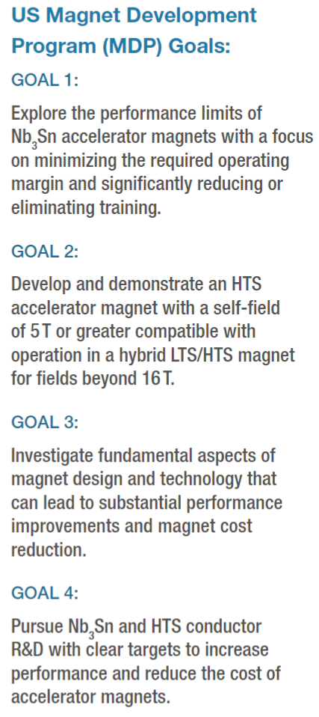
The REBCO roadmap contributes to two overarching goals of MDP
Goal 2: Develop and demonstrate an HTS accelerator magnet with a self-field of 5 T or greater compatible with operation in a hybrid LTS/HTS magnet for fields beyond 16 T
  Demonstrate 5 T, march towards 8 – 10 T regime
  Investigate COMB concept
  Test HTS insert in hybrid configuration
Goal 4: Pursue Nb₃Sn and HTS conductor R&D with clear targets to increase performance and reduce the cost of accelerator magnets
  Make magnets and use magnet results to provide feedback to HTS conductor R&D

Slide 4
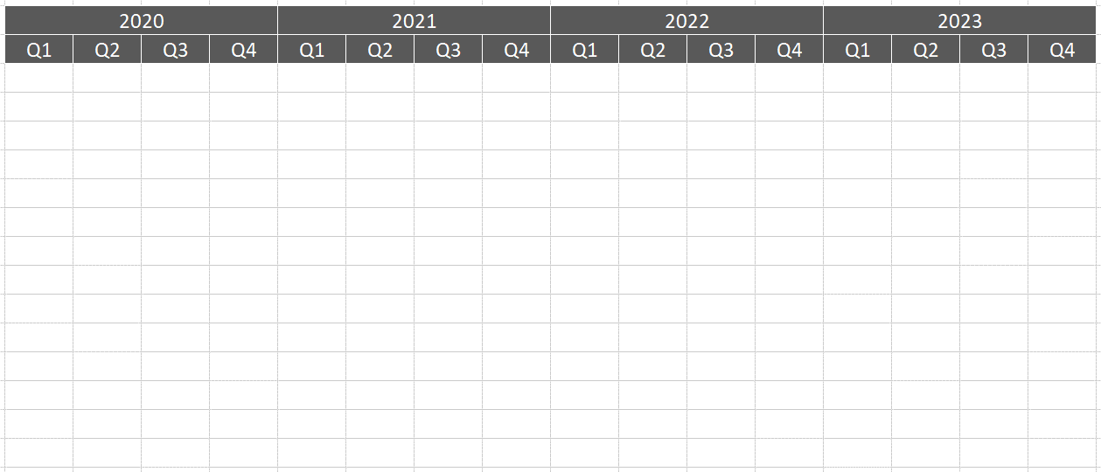
REBCO roadmap 2020 – 2023
5 T stand-alone CCT
8 - 10 T stand-alone
10 – 20+ T…
Develop test platform
CCT insert test (1 T @ 8 T)
CCT insert test (2 - 5 T @ 12 T)
Develop COMB
COMB test
COMB insert test
Procure next-gen CORC®
Develop adv. COMB
Stand-alone test
COMB test @ 12 T
Quench characteristics in CORC®
CORC® behavior in background fields
Characterize of conductor in background fields

Slide 5
Near-term key results assuming planned support
Subscale CORC® common coil quench study with the BNL 10 T common coil magnet
  December 2020
Demonstrate first COMB technology
  December 2020
5 T dipole field
  December 2020 → September 2021
Probe impact of transverse stress on CORC® conductor with the 14 T solenoid magnet at FSU
  December 2020

Slide 6
Let’s start working together
Build team for collaborative learning
  Monthly working group meeting
  Ad-hoc discussion
  Participate magnet fabrication and test at collaborating labs
  Review test results
Examples of collaboration areas
  Tape characterization: currently led by ASC. FNAL can help too
  Cable characterization and study
  Magnet design and analysis
  Magnet fabrication and test

Slide 7
The REBCO WG is up working
Testing the Indico webpage as a way to share notes/data
Provide input to the MDP/CPRD “ARRA” type conductor inventory
Prepare for the subscale CORC® common coil
  BNL: Discuss with ACT on the design and possible development procedure for the subscale CORC® common coil test. Ramesh will inform the WG when it is ready to present at the WG meeting. The WG will provide input on the concept and next steps regarding the development on the subscale common coil.
  WG: By September 2020: provide input to the BNL team on the instrumentation and experimental design for the subscale CORC® common coil test such that we can maximize the return for the MDP REBCO effort.
Set up a second lab to characterize REBCO tapes
  Ernesto: discuss with Dima to present on the REBCO tape transport measurement at Meeting #4 (May 7th). Purpose: to start discussing possible round-robin test of REBCO tapes such that additional labs can help take some of the characterization load in the future for the REBCO effort.
……

Slide 8
Update on the subscale CORC® common coil
See Ramesh’s slides

Slide 9
Update on COMB development
See Vadim and Vito’s slides

Slide 10
The CORC® CCT C3 will attempt to address several key questions for high-field applications
Conductor
  What is the optimal wire architecture to improve the I_{c} retention? How does the minimum I_{c} specification work? What is the wire performance?
Magnet fabrication
  Do we need full-depth radial groove? Is it feasible to wind with the full-depth radial groove? How to vacuum impregnate the magnet? How to arrange the joints?
Magnet performance
  Can we reach the 5 T dipole field? What is the transition behavior when the conductors are impregnated? What is the mechanical behavior of the magnet as we approach 5 T? How can we pin point the normal zones and understand the causes? What is the field quality?

Slide 11
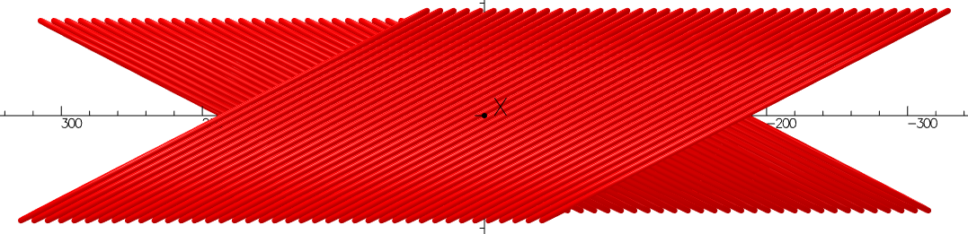
The baseline design is a 6-layer CORC® CCT
Magnet ID is 70 mm
OD approaching 160 mm
Angle (degree) |  |  | TF
Pair 1 | Pair 2 | Pair 3 | T/kA
50 | 35 | 27 | 0.72

Slide 12
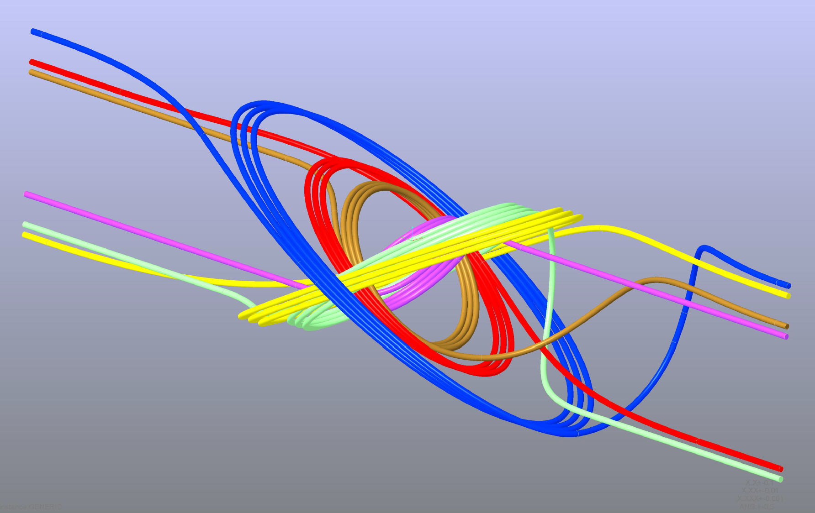
We will start with a 3-turn subscale magnet to gain experience with the conductor, magnet fabrication and test

Slide 13
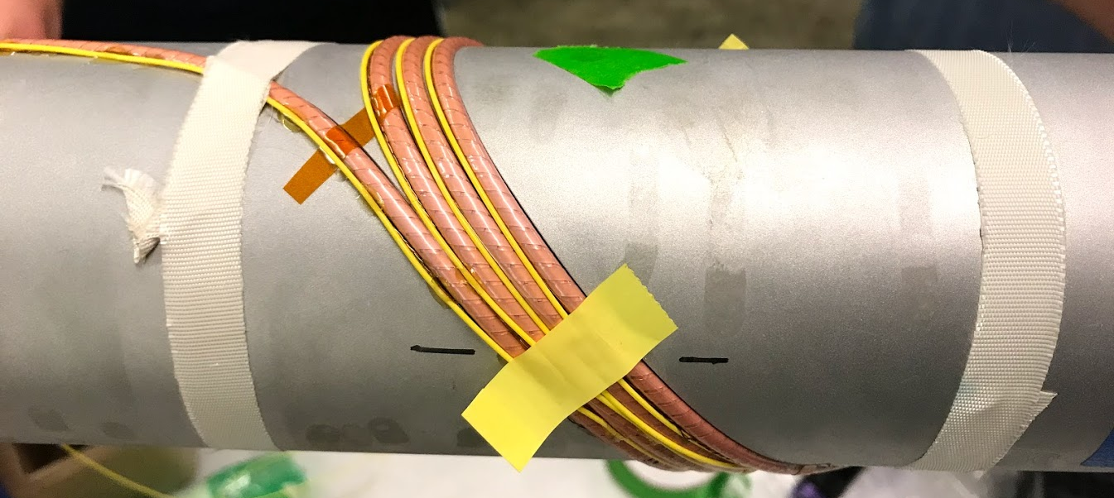
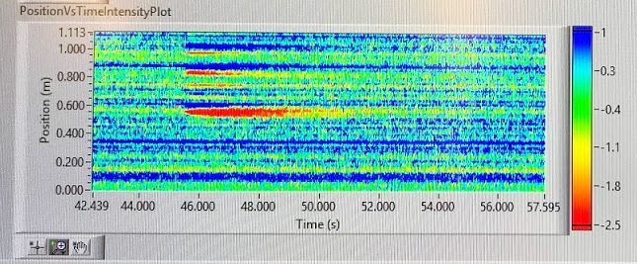
Preliminary test of the fiber-optic sensor in a CORC® CCT subscale coil showed that the measurement sensitivity needs significant improvement
Optical fiber co-wound with the CORC® wire
Impregnate the coil with Stycast
Test at 77 K and monitor the optic-fiber signal by ramping the current
Multiple normal zones in the coil showed up at 150 W heating power. Interesting but not sensitive enough
Tested two configurations:
Bare fiber (more sensitive)
Fiber in a tube (minimize the impact from mechanical strain)
In collaboration with Penn State

Slide 14
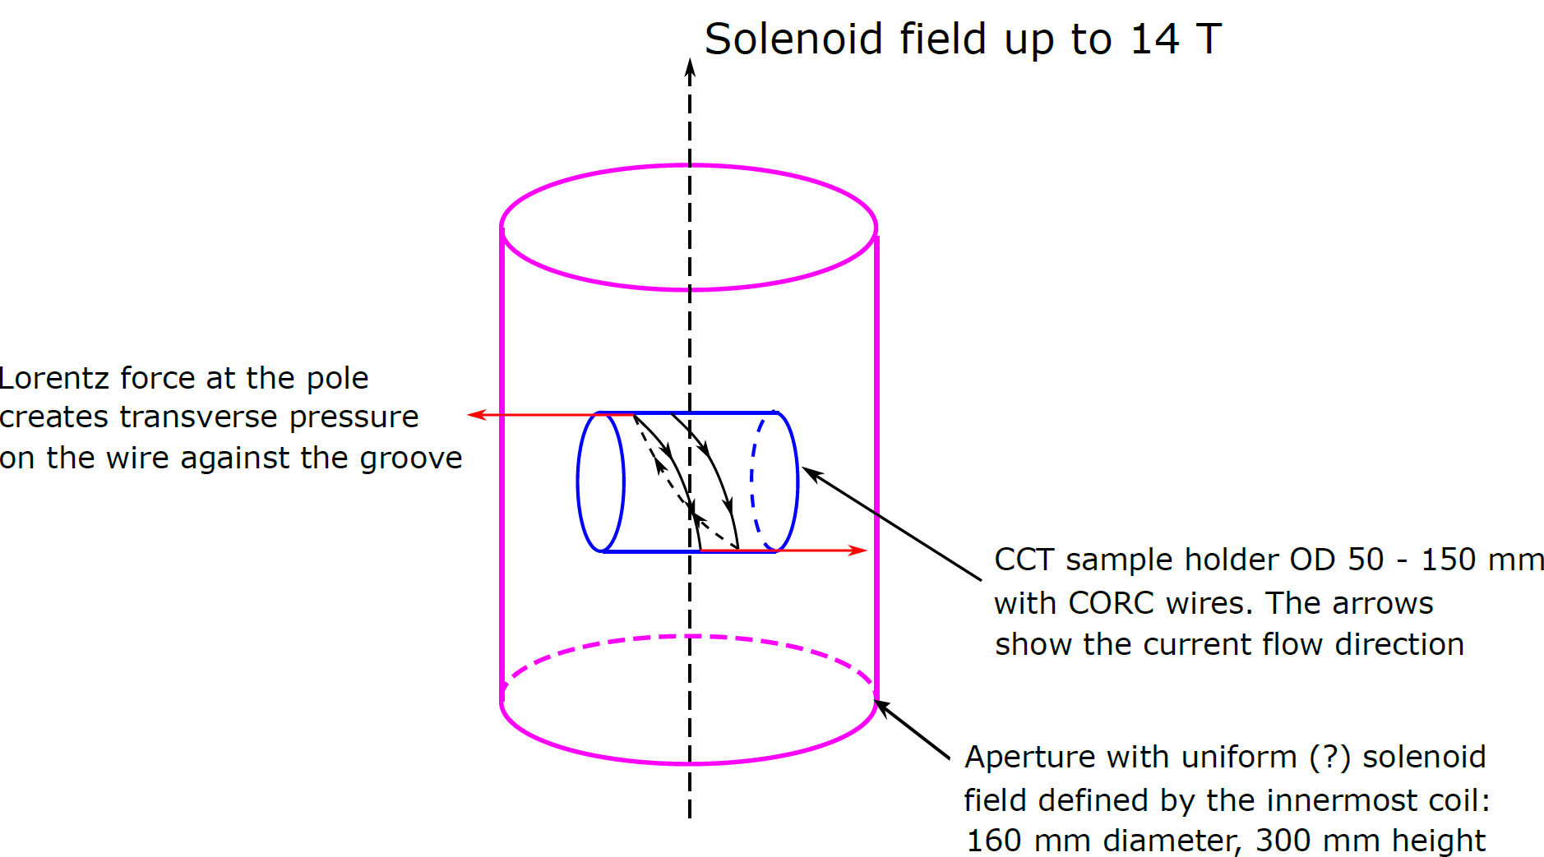

Can we probe the impact of transverse stress on CORC® wires using the 160-mm aperture solenoid magnet?

Slide 15
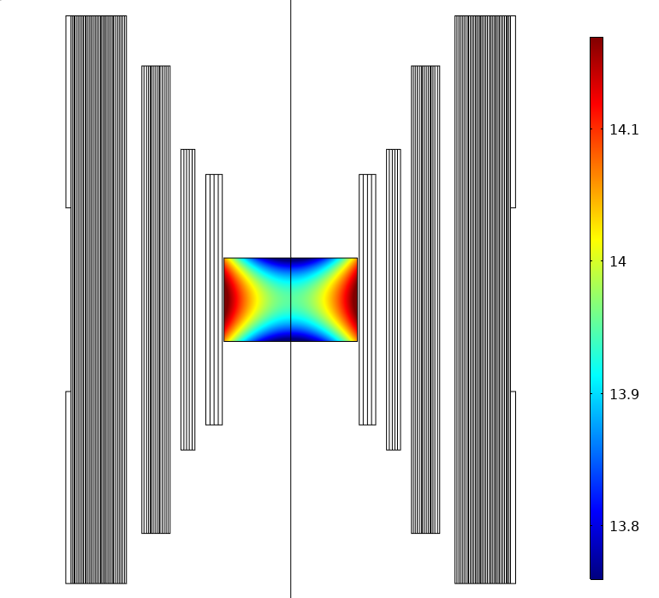
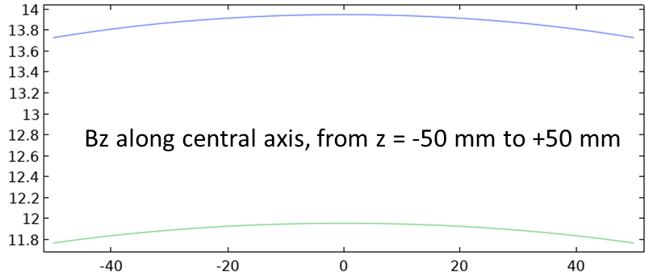
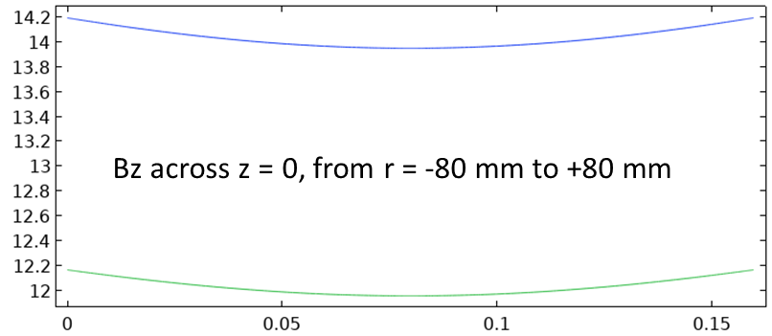
The background solenoidal field is good approximate to a dipole field
Depicted is the available insert:
160 mm diameter, 100 mm tall
inside the Cryogenic 14T testbed.
Bz along central axis, from z = -50 mm to 50 mm
Outsert running at 14 T (blue) and 12 T (red)
-50 50
z [mm]
Bz along z = 0, from r = -80 mm to 80 mm
Outsert running at 14 T (blue) and 12 T (red)
-80 80
r [mm]

Slide 16
The REBCO effort is moving along the new roadmap
A WG is up running to facilitate the collaboration across labs to develop the REBCO accelerator magnet technology
We expect to have new results this year along several fronts to push the REBCO accelerator magnet technology
  Test a subscale CORC® common coil in a background field
  Develop and demonstrate COMB technology
  Develop subscale C3 magnet

