Slide 1
Update from the US-MDP Modeling Working Group
Compiled by: Diego Arbelaez, Emanuela Barzi, Lucas Brouwer, Lance Cooley, Daniel Davis, Vittorio Marinozzi, Giorgio Vallone
5/13/2020

Slide 2
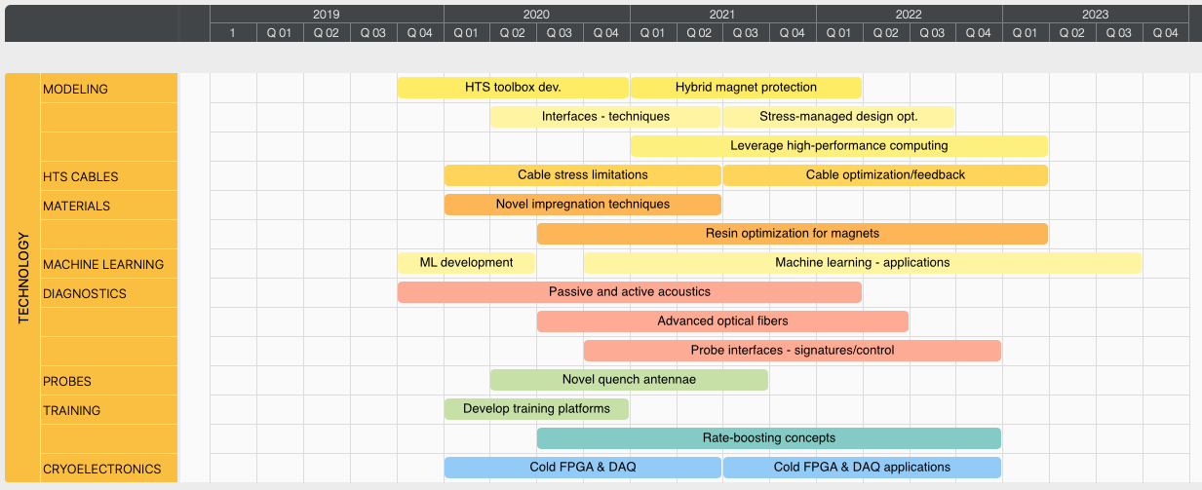
Key Questions to Answer in the MDP Modeling Roadmap
How do we best protect LTS/HTS hybrid magnets and interpret results?
How does interface behavior in stress managed designs impact training?
Can we better understand and improve LTS/HTS conductor and cable?

Slide 3
Connection to MDP Goals and Roadmaps
Interface Modeling
explores performance limits of Nb₃Sn and HTS in stress managed designs
guides technology development in epoxies and impregnation techniques
Hybrid Magnet Design and Quench Protection
new LTS/HTS roadmaps quickly converge with hybrid testing becoming a key priority for MDP
LTS/HTS Conductor and Cable Modeling
guides the design of new Nb₃Sn strand for training reduction (high Cp)
refines strain limits of Nb₃Sn and HTS magnets
optimization of LTS/HTS cable for accelerator applications

Slide 4
We now have a dedicated, open, monthly meeting of the modeling working group
Goals/Purpose:
detailed discussion of modeling techniques (opportunity to go “into the weeds” and learn from each other)
coordinating and working together towards MDP roadmap milestones
form the basis of future updates to the general MDP (in summary / conclusions)
April 21st, 2020 (kickoff)
discussion of working group goals and purpose/format for future meetings
selection of initial topics for upcoming meetings
We plan to announce meeting topics ahead of time so anyone interested from MDP can join – email lnbrouwer@lbl.gov to be placed on mailing list

Slide 5
Topics for the next several months are set
April 21st, 2020 (kickoff)
discussion of working group goals and purpose/format for future meetings
selection of initial topics for upcoming meetings
May 19th, 2020 (multi-scale modeling of conductor and strain limits – 1)
Diego Arbelaez, “multi-scale modeling of conductor and magnets”
Giorgio Vallone, “a methodology to compute the critical current limit in Nb₃Sn magnets”
June 16th, 2020 (multi-scale modeling of conductor and strain limits – 2)
Emanuela Barzi, “overview of sub-modelling at FNAL and in the broader community”
July 21st, 2020 (review of multi-physics tools for quench protection studies)
TBD: (pos. Dan Davis and/or Vittorio Marinozzi), “overview of STEAM/LEDET for quench protection”
Lucas Brouwer, “ANSYS user elements for hybrid magnet protection studies”
Future topics: advanced techniques for interface modeling, simulation tools for HTS, current sharing in HTS cables, …..

Slide 6
Summary
MDP modeling effort supports general R&D roadmap: interfaces in stress managed coils, conductor development, magnet protection for hybrids, + more …..
a standing monthly meeting is established for review of existing work and development of new modeling techniques relevant to the MDP program plan
meetings are open with upcoming topics advertised to the larger MDP group

Slide 7
Extra

Slide 8
Interface Modeling Roadmap Elements and Milestones
2020
Q1 | Q2 | Q3 | Q4
2021
Q1 | Q2 | Q3 | Q4
Identify/develop FEM interface techniques
Cross-connection: feedback from CCT subscale testing
technique developed
Interface Modeling
Integration of these techniques into existing CCT/CMCT mechanical models
Detailed study of current magnet interface behavior and identification of desired interface behavior
techniques integrated
report on existing design behavior
identification of desired behavior and design changes
Cross-connection to resin and impregnation technology development
input on baseline + range of interface properties in existing designs (bond strength etc.)
development of new materials or techniques as desired interface becomes clear

Slide 9
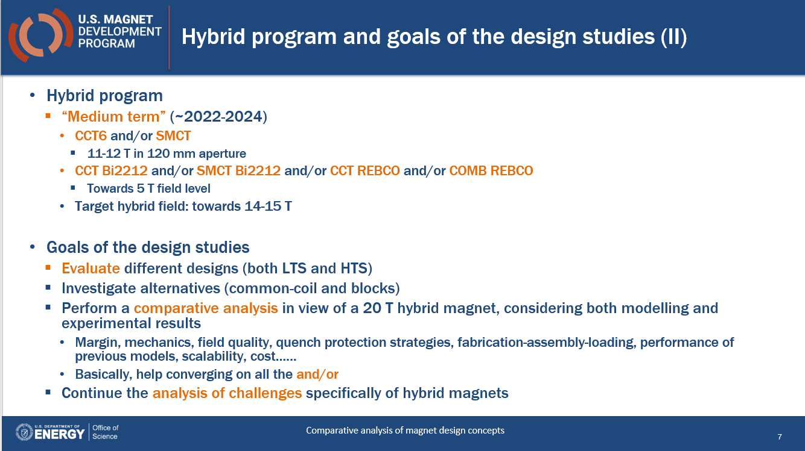
Hybrid Modeling Roadmap Elements and Milestones
2020
Q1 | Q2 | Q3 | Q4
2021
Q1 | Q2 | Q3 | Q4
Review hybrid quench protection
identify critical capabilities missing in LTS codes (likely HTS specific behavior)
Hybrid Modeling
Develop techniques and add them to existing codes (ANSYS, STEAM, LEDET)
Benchmarking with existing hybrid test data
techniques integrated
Codes benchmarked
Enables study of hybrid designs in comparative roadmap (see Paolo’s talk)

Slide 10
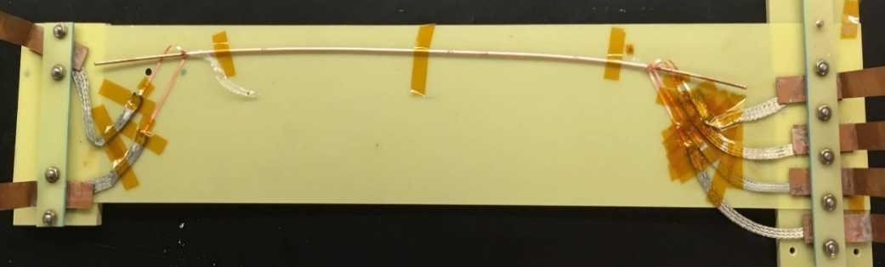
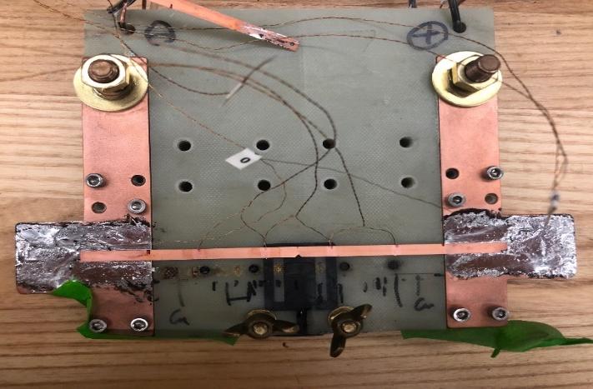
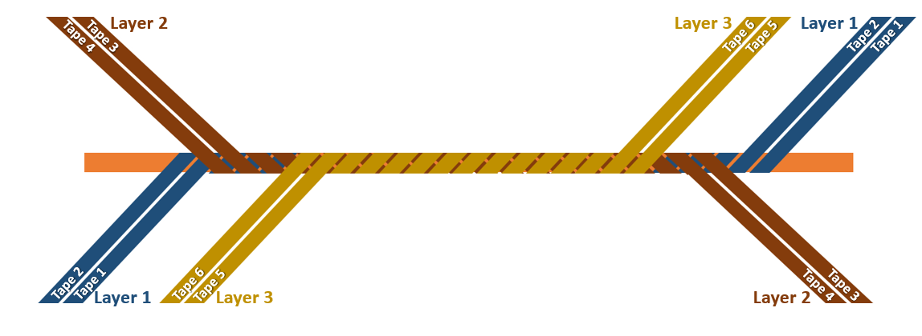
Conductor Modeling Roadmap Elements and Milestones
2020
Q1 | Q2 | Q3 | Q4
2021
Q1 | Q2 | Q3 | Q4
Equivalent circuit models
continued feedback on cable parameters: contact res., length, lubricant, etc.
HTS
Extension of FEM techniques for HTS cables
FEM for HTS cables in ANSYS uel, or other codes
Exploration/development of new techniques – high risk (xFEM etc.)
parallelization/clusters
new techniques
efficient HPC for HTS FEM
Feedback/ benchmarking from controlled experiments
development of new experiments with input from modeling
High Cp: timeline and effort is captured by “training rate enhancement” roadmap

