Slide 1
Acoustics for Nb₃Sn Composite R&D
15 May 2020
Steven Krave
US Magnet Development Program
Fermi National Accelerator Laboratory

Slide 2
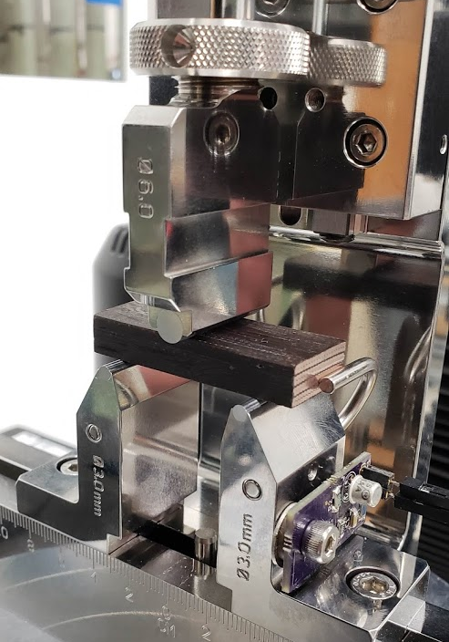

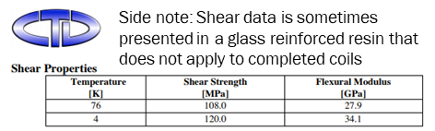
Why Short Beam Shear Testing
An appropriate test to quantify any changes in mechanical performance
Compressive behavior is dominated by cable properties
Tensile just wont work
Shear
  Binder is likely to affect interface behavior, therefore shear properties
  Generally shear samples are complicated geometry that can not be realized with cable
  Short Beam strength uses a symmetric beam with a span to thickness ration of ~4.
    This is do-able

Slide 3
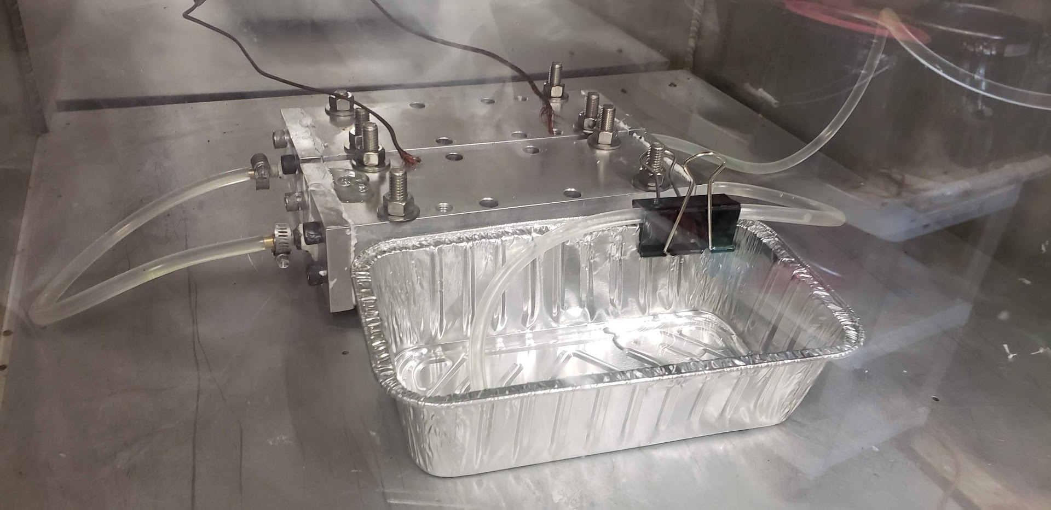
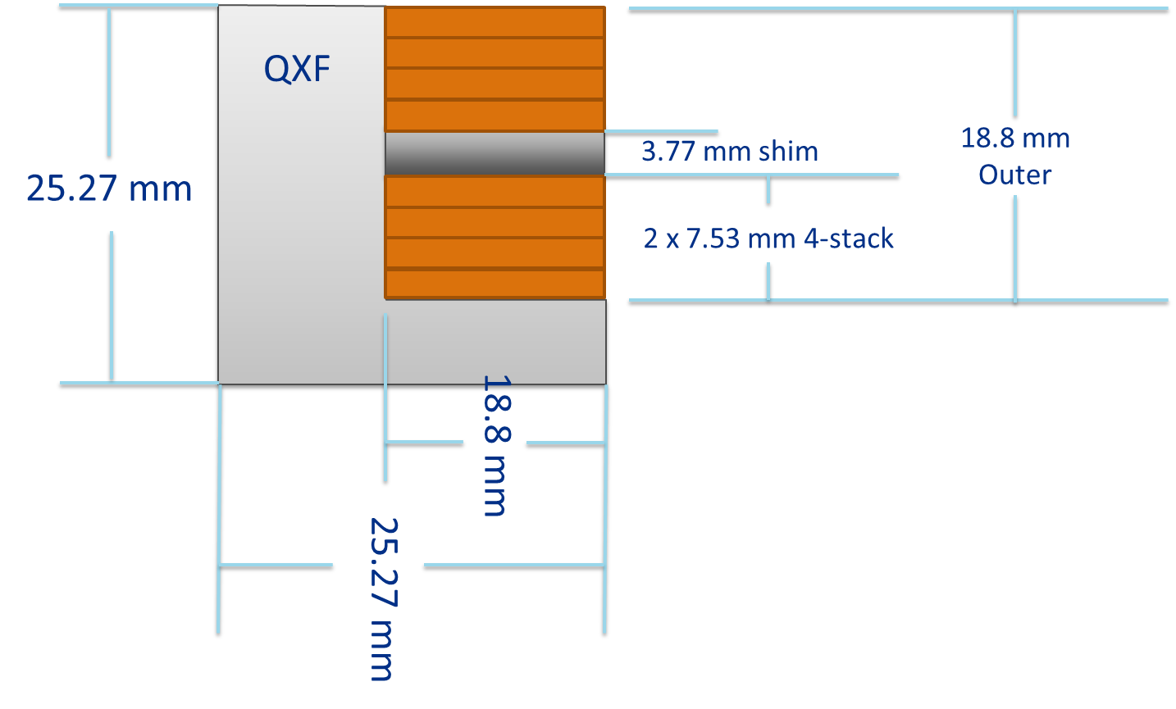
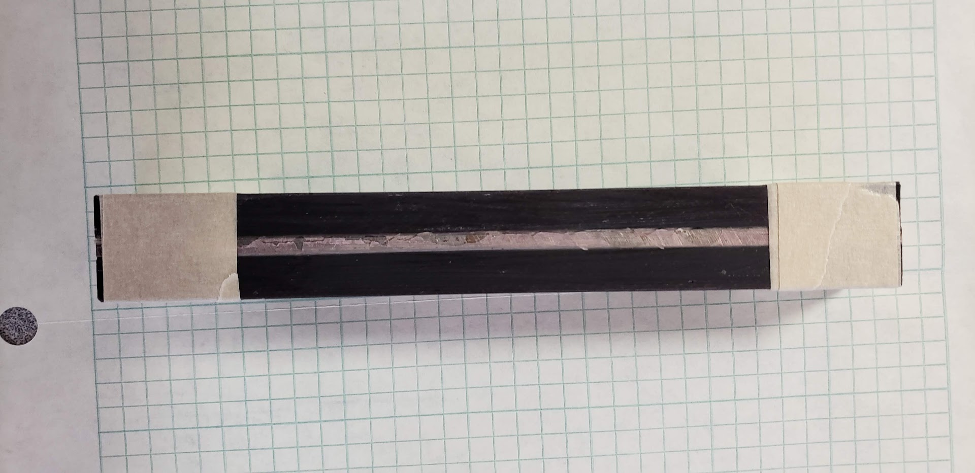
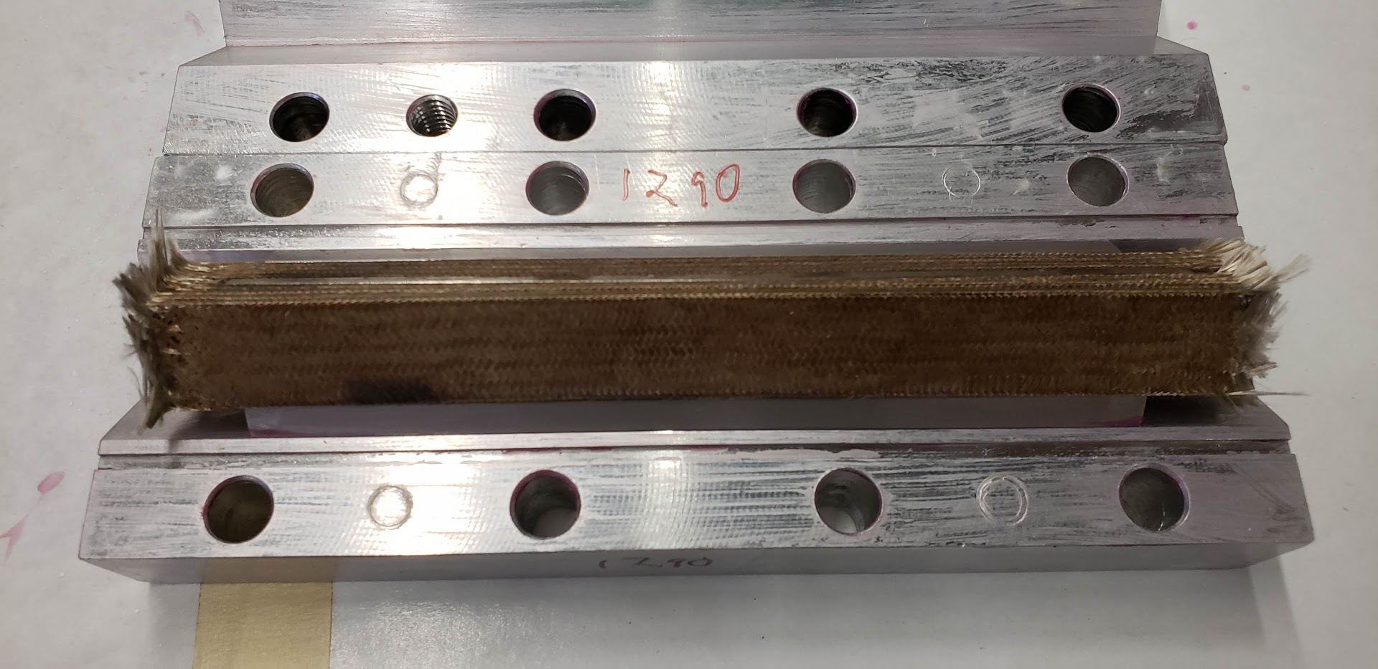
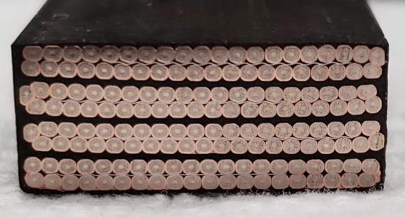
Sample Preparation
Samples were:
Cut and Fused
Insulated (by leftover sleeve removed previously)
Cured to nominal size
Reacted
Impregnated
Sectioned

Slide 4
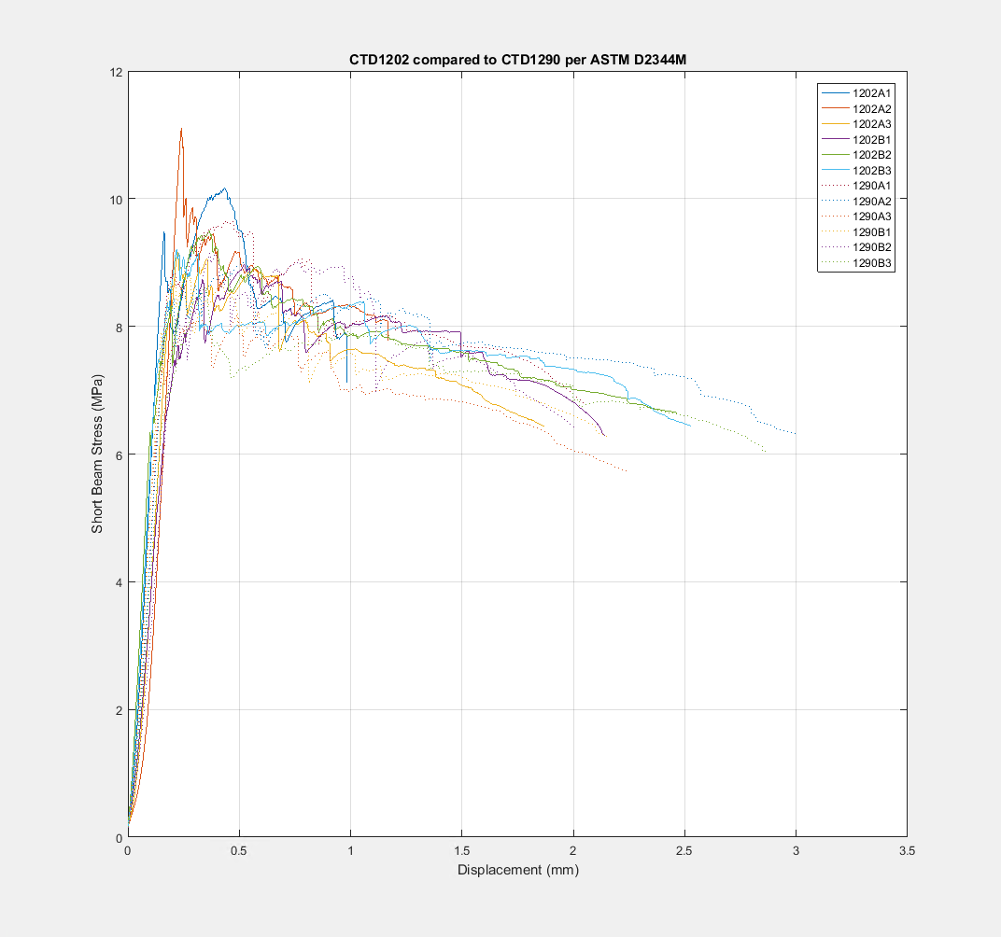
Test Data
Samples all behaved in a similar fashion.
Minimum of ~7 Mpa short beam stress
Audible cracking present during testing

Slide 5
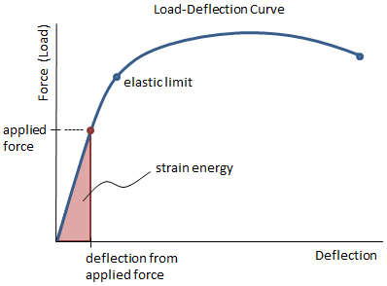
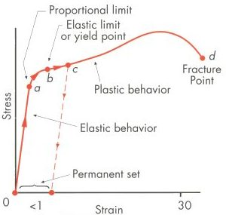
Energy.
During testing, a force is applied over a displacement.
  Work is done
In the elastic regime, this energy is stored as strain energy and is recoverable.
In the plastic regime work is done to deform the sample.
  A small(negligible?) amount is stored in structure defects
  A majority is dissipated as heat
Cable stacks do not behave in an ideal plastic fashion.

Slide 6
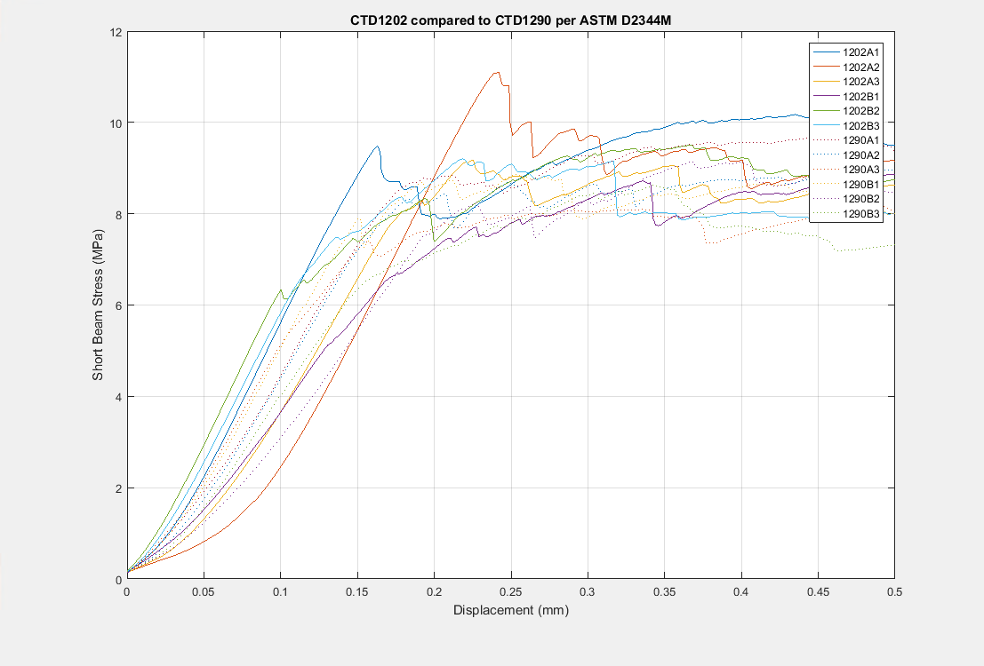
Interface Failure During Testing
Cable stacks fail gradually in reasonably large fast changes in energy
These changes have measurable magnitude over adjacent data points
This can be calculated by assuming a plastic like behavior with constant modulus, leading to an offset value of initial location
∝ Energy Release

Slide 7
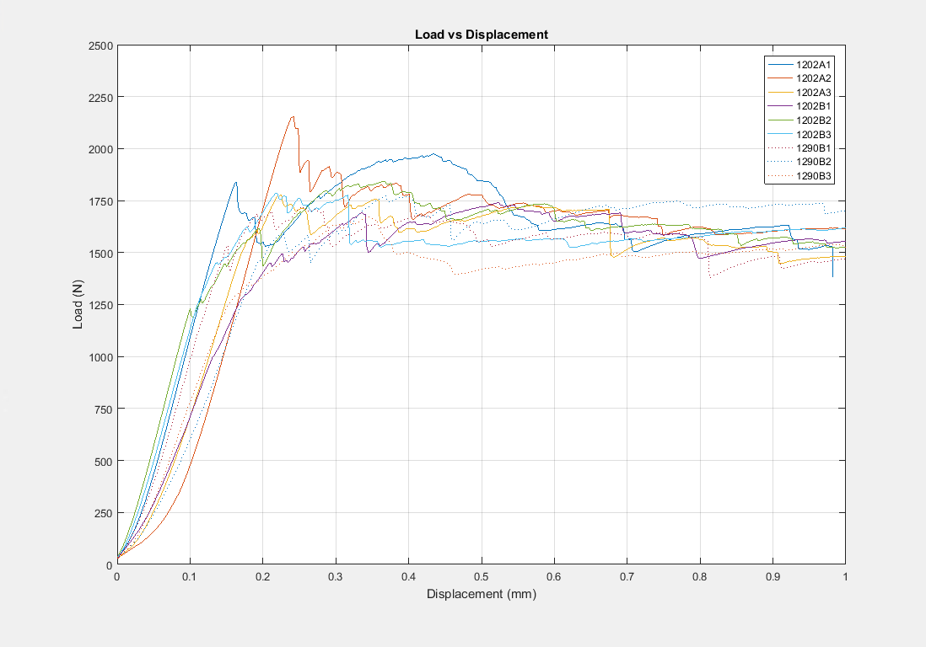
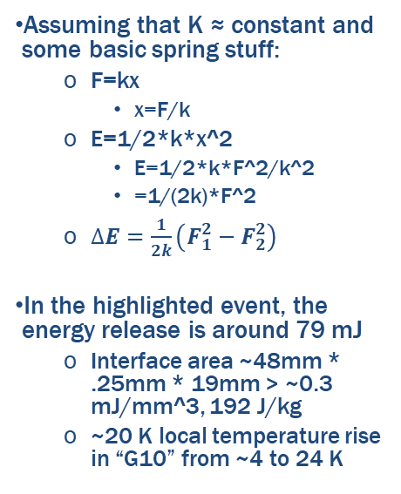
What is the scale of energy release?
Assuming that K ≈ constant and some basic spring stuff:
  F=kx
    x=F/k
  E=1/2*k*x^2
    E=1/2*k*F^2/k^2
    =1/(2k)*F^2
  $∆E=\frac{1}{2k}\left(F_{1}^{2}−F_{2}^{2}\right)$
In the highlighted event, the energy release is around 79 mJ
  Interface area ~48mm * .25mm * 19mm > ~0.3 mJ/mm^3, 192 J/kg
  ~20 K local temperature rise in “G10” from ~4 to 24 K
dN of ~250N
K=12.5MN/m

Slide 8
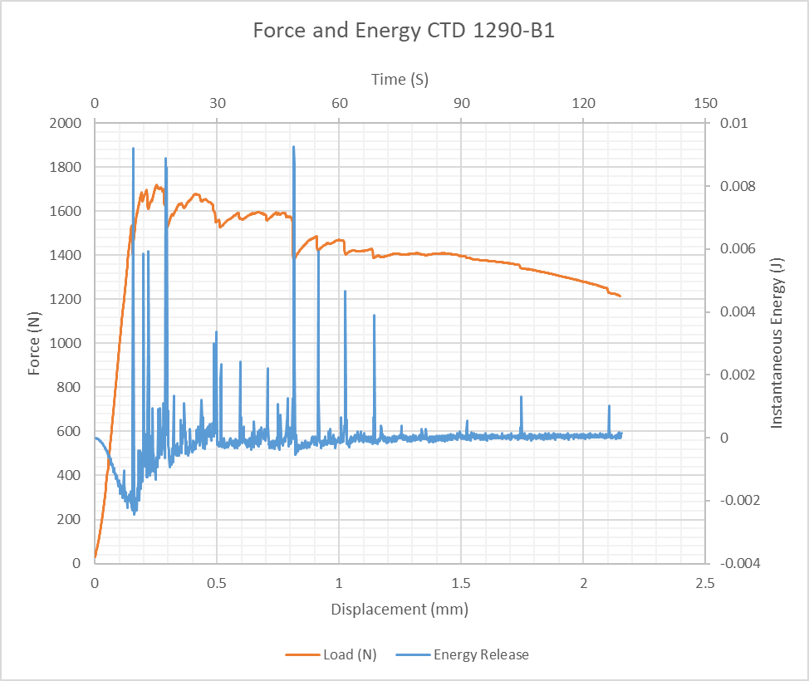
How about more events?
Several events between 1 and 10 mJ
Acoustic data from earlier shows that many of the events that span
The sample below shows at least 13 events above 2mJ
This is mostly failure along a single interface 48mm long

Slide 9
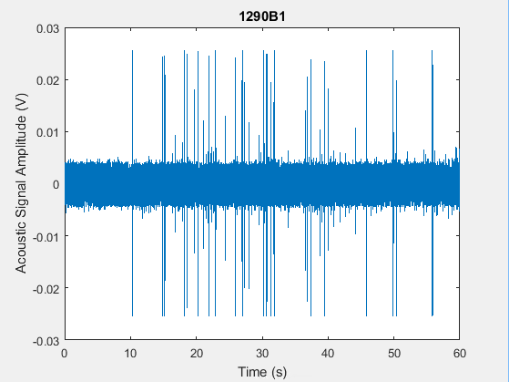

And the Acoustic Data
Should be able to correlate acoustic emissions with the above changes in load.
Might be able to characterize energy levels of acoustic events through
Other magical signal processing? Working to Meet MDP goal of fingerprinting quench Mechanisms

Slide 10
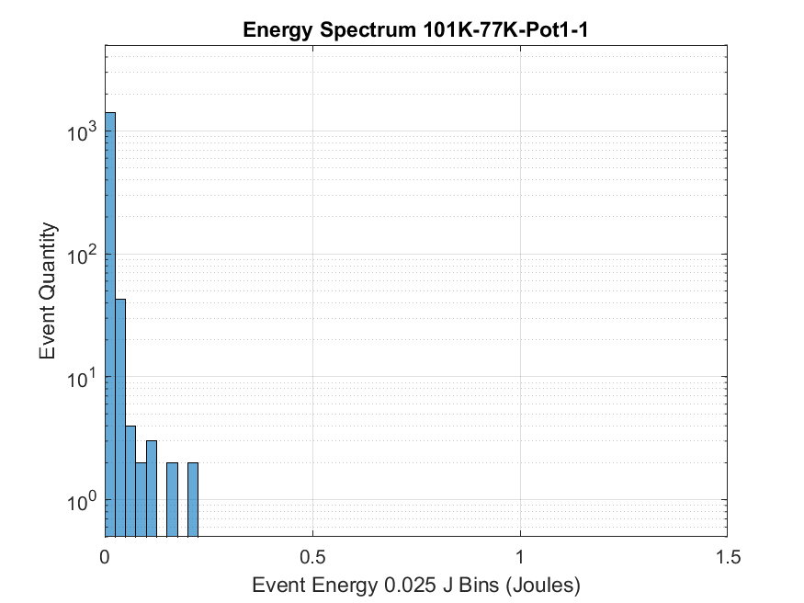
Event Comparison
Acoustic Amplitude Histogram for 1st ~90 seconds
Load Energy Histogram Same Sample
Acoustic signals and load events line up and amplitudes are correlated. The histograms above roughly illustrate this feature

Slide 11
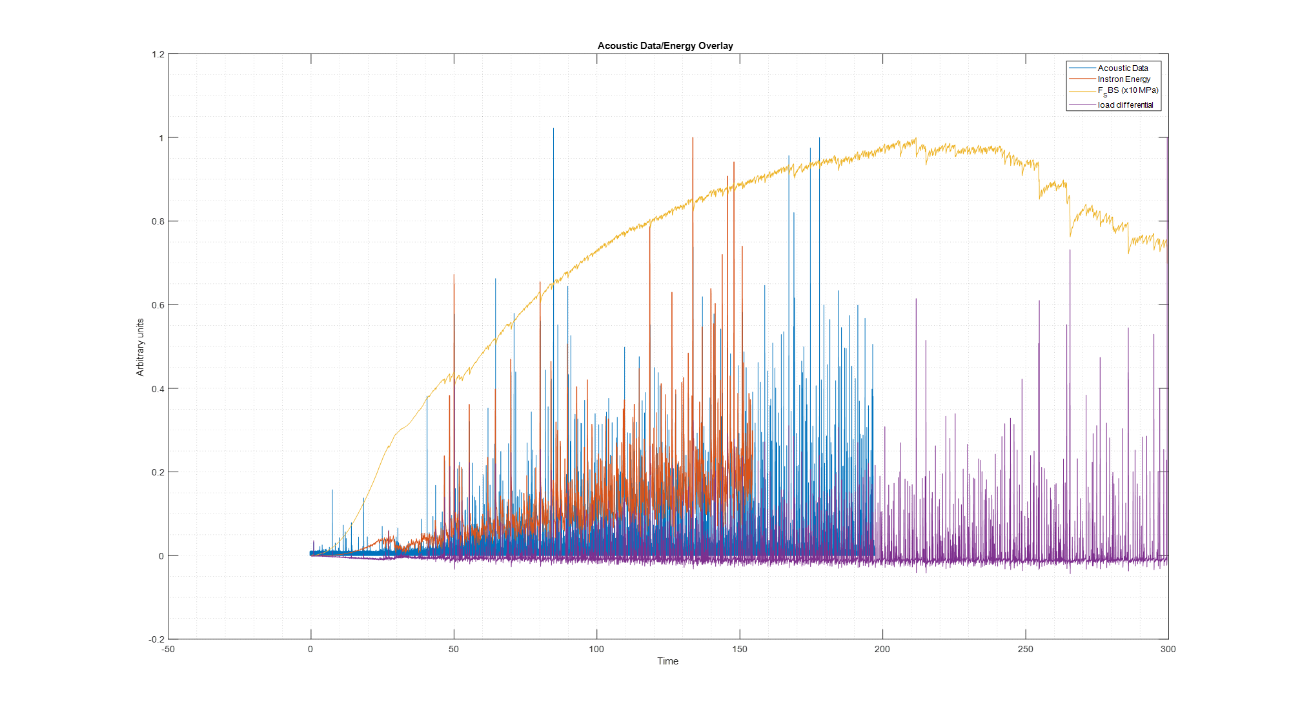
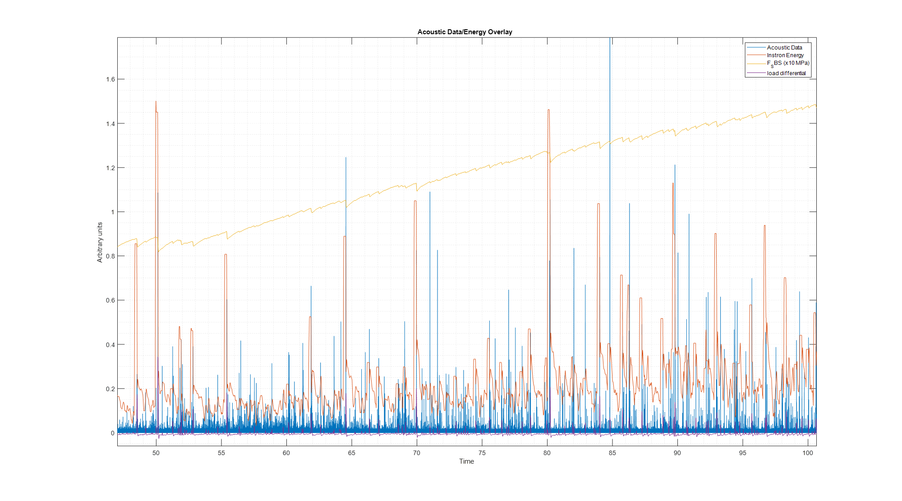
We can look at timing of acoustic events and see correlation with load change events on the instron
  Louder events are generally higher energy events
  Most events are rather small
Correlation of microfracture events with acoustic data and energy scale (noisy resin shown)

Slide 12
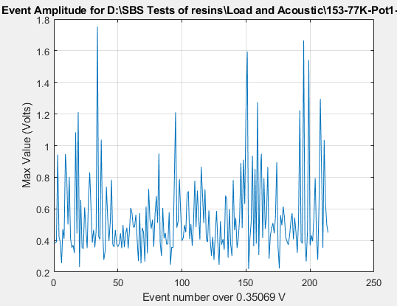
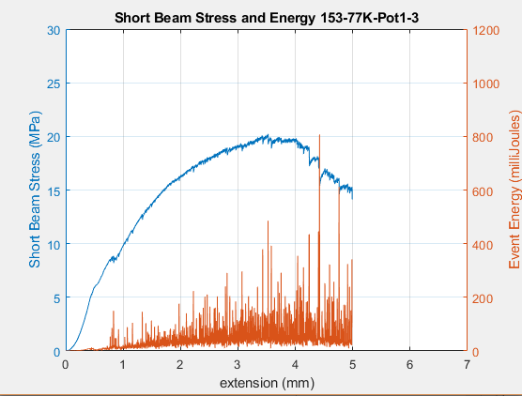
Progression of event amplitude through loading
Most resins seem to show random event amplitude after onset of cracking
So we are likely subject to the energy histogram above
  Perhaps no precursor to event with sufficient energy to quench magnet
  Other loading conditions may vary
  Event rate increases as load curve flattens
    Makes sense from energy conservation interpretation.
    Leads to appearance of increasing amplitude
From Fracture toughness, the cracking behavior is a function of strain energy, fracture toughness, initiating factors, crack initiators etc
  Linear magnet behavior will lead to passing through all strain energy states at any rate that is “slow”
    Where dynamic effects are negligible

Slide 13
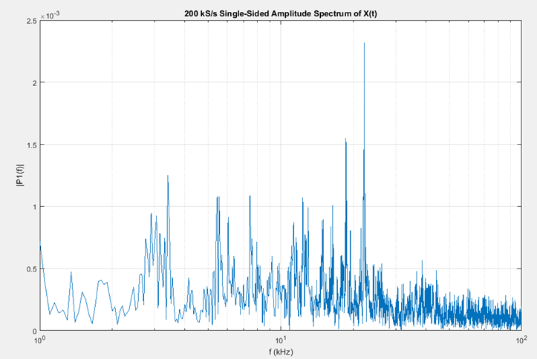
FFT of SBS sample at 200 kS/s
200 kS/s catches some properties of the system but there is still headroom for more data at higher frequencies
Several main components
  How much is characteristic to the system and how much to the failure mode
  Largest peak at 22khz
Still bandwidth for something…

Slide 14
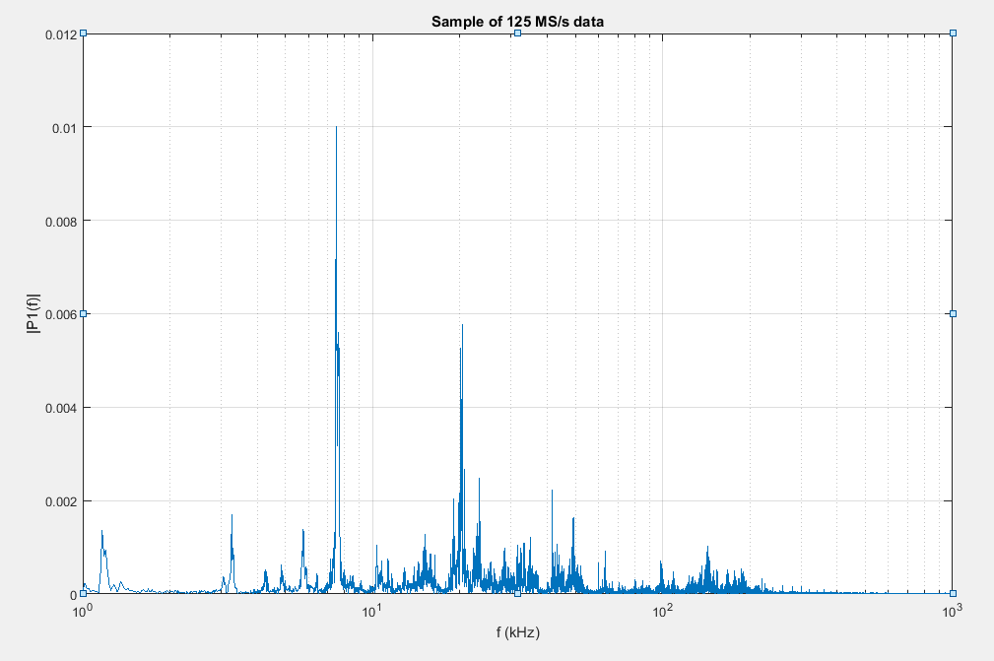
FFT of similar signal at 125 MS/S
Much better
Peaks at 7.8 kHz and 20 kHz
  Likely resonance of instron and beam
    Beam resonance would be in ballpark of ~20kHz
  There is not too much going on past 100 khz, but the extra headroom is nice
  This is based on Maxim’s 1st generation sensor and has somewhat limited bandwidth

Slide 15
Example event (typical)
'D:\SBS Tests of resins\Load and Acoustic\153-77K-Pot1-3.mat'
plot(Volts(4.521e7:4.523e7))

Slide 16
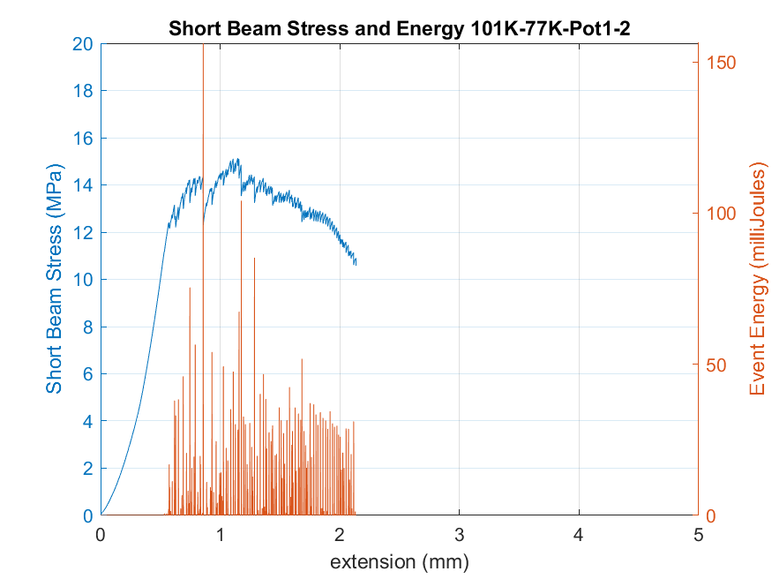
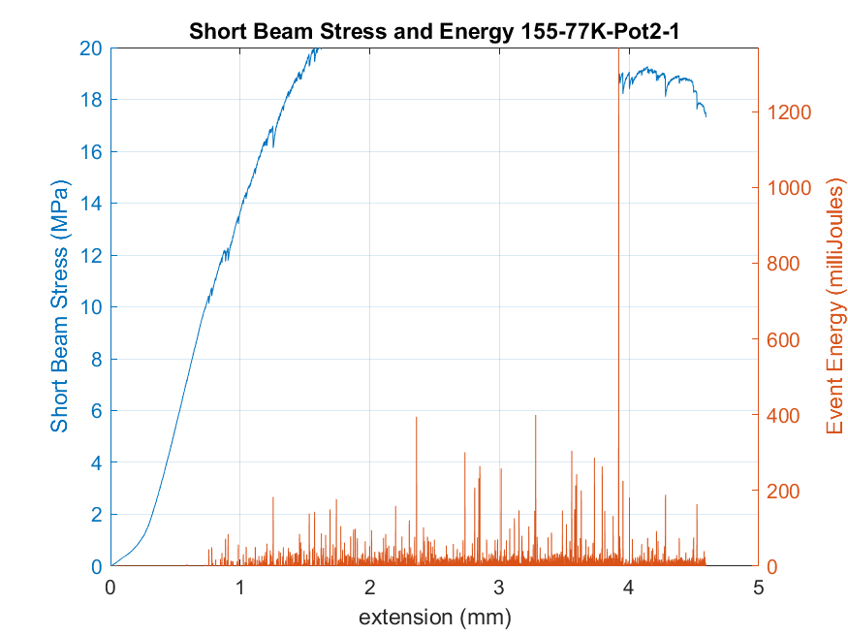
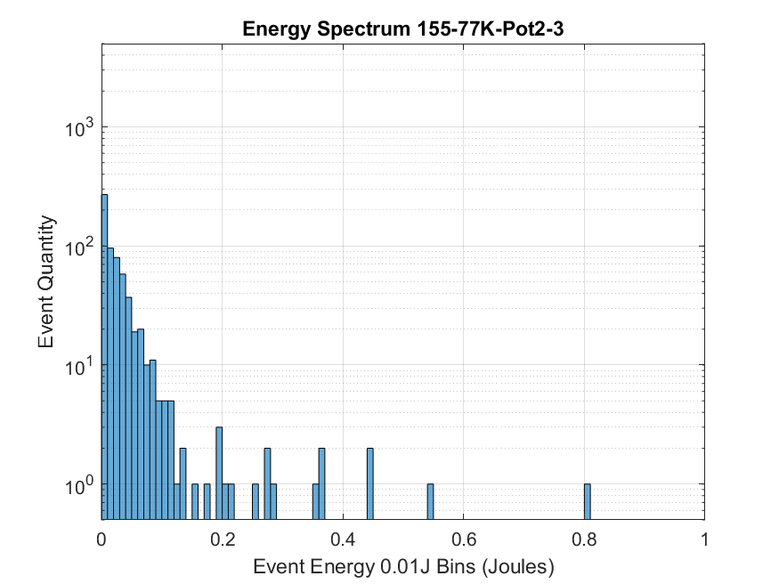
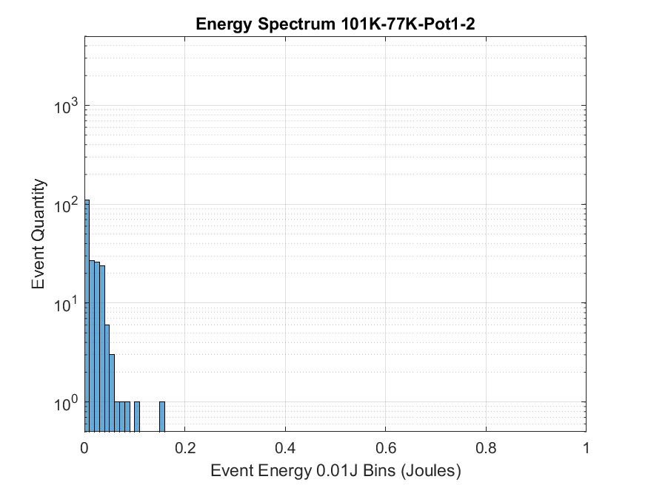
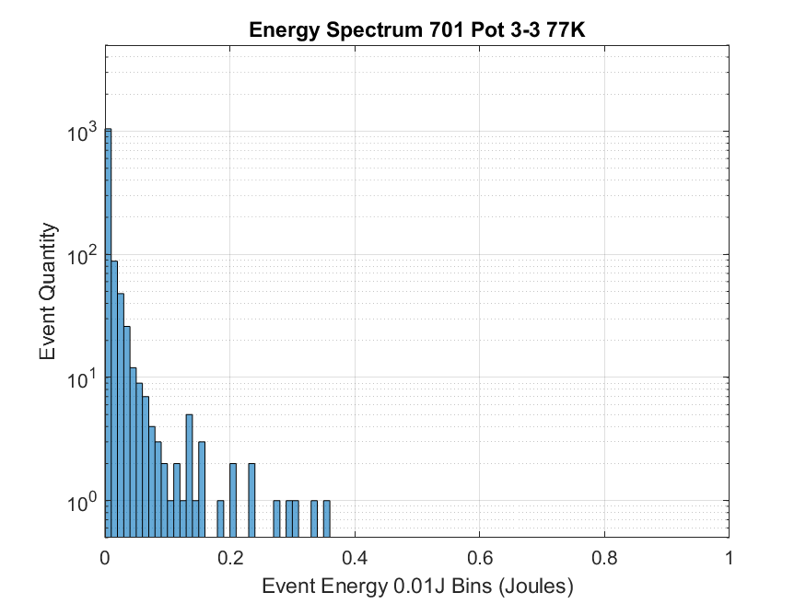
More Plots…

Slide 17
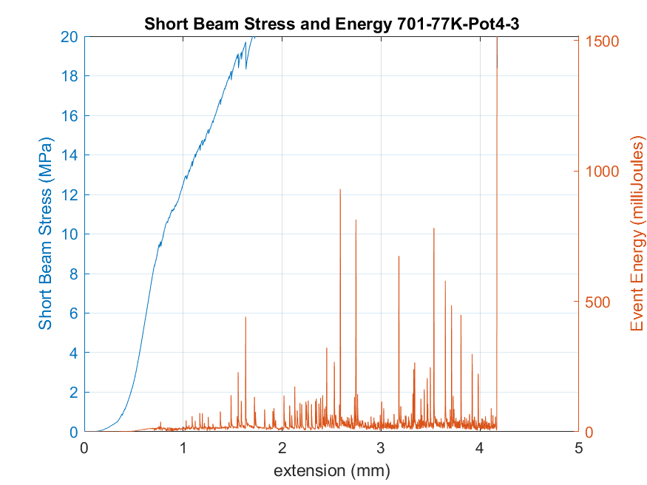
CTD-701X: Something promising
I broke this part
We can compare resins by how quiet they are.
This resin is exceptionally quiet and still reaches high shear stresses ~2-3X 101K
We can see good behavior in the load data, and the matching acoustic data
Or you can just listen
  I have 101k below, but I need to configure the file handling of the 701.
Many fewer events than other resins
Except some small ones during initial loading
Working on re-plotting as samples tested out of expected range

Slide 18
Continuing work on Ten stacks and subscale samples with acoustic sensors
The end goal of the acoustic instrumentation is to build collect a sizable dataset of acoustic data for specific loading modes
Different tests can be tailored to produce different failure modes
  Short beam test causes shear failure
    We can investigate specific interfaces
      Cable to cable
      Metal to insulation to metal
      Composite interlaminar
  Compression test leads to compression failure
    Epoxy cracking in compression
    Barreling
    Plastic deformation and degradation of superconductor
      Side note: you can hear cracking during bending of an individual strand of reacted conductor as filaments are fracturing or stick-slipping inside the copper matrix as you approach 1% bending strain
Utilizing high resolution loading data in controlled conditions can allow correlation to forces and stresses required in different failure modes
More samples are being fabricated for more measurements

Slide 19
Backup

Slide 20
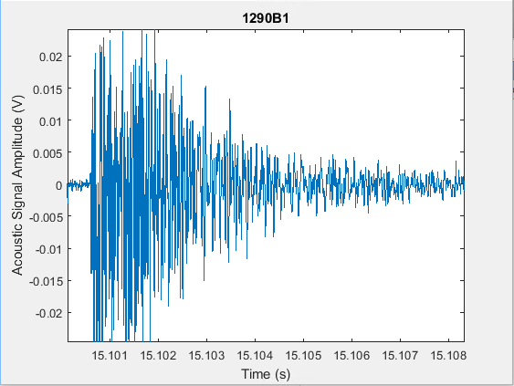
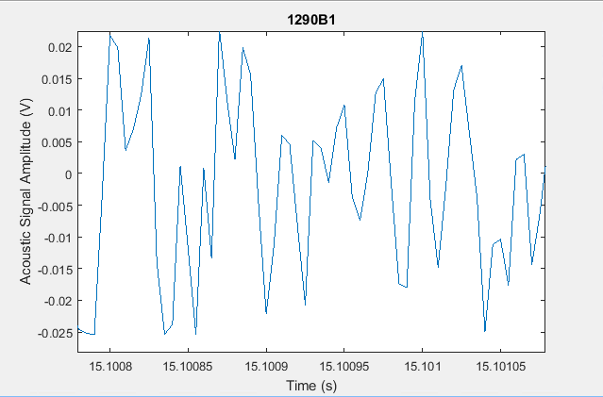
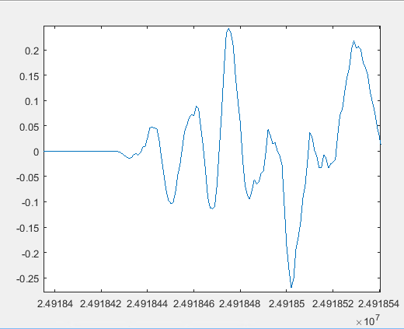
Improving Aquisition
Original Sample data 12 Mpts, 8 bit 200 khz by basic DSO
New DAQ hardware on hand, some data available, but not yet examined
12 bit, 80MS/s 256Mpt buffer
200 kHz is probably not enough…
But 20 MHz is sufficiently overkill

Slide 21
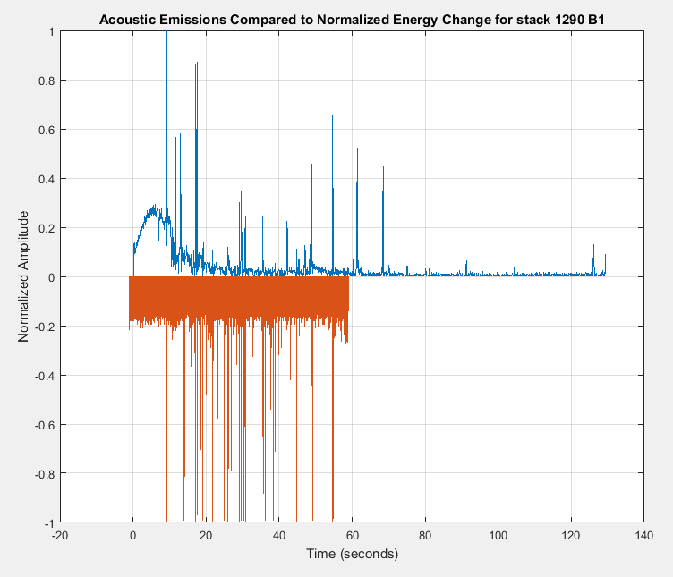
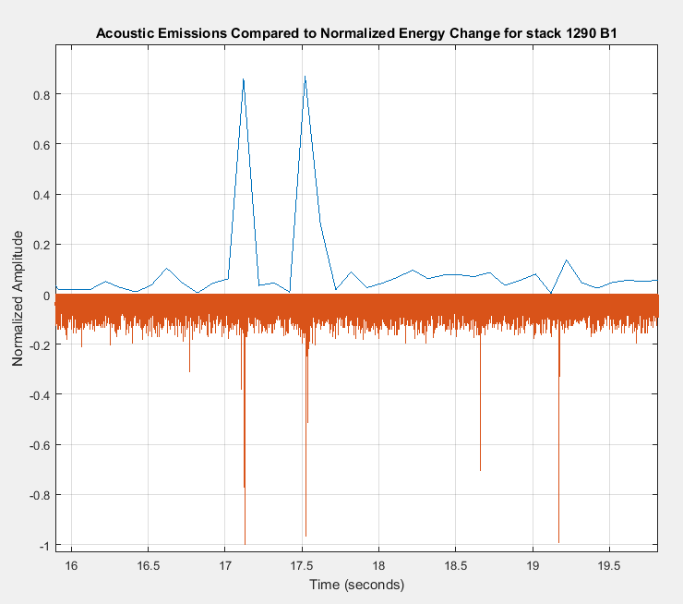
Look, they do line up!
Acoustic events do line up with energy change events
Manually aligned to 1 event between datasets as the Instron does not provide a sync signal
All other events followed
Events have substantial acoustic power
  Most easily seen force events saturate the acoustic DAQ
  Small events in the noise of the force signal still have substantial acoustic signals
    Huge dynamic range!
Note example shown has substantial noise, noise floor reduced by 10 dB with better shielding on cable (Aluminum foil)
Intuitively, noise is the result of an energy release.
Load
Acoustic Amplitude

Slide 22
Short Beam Strength per ASTM D2344
QXF Cable with replaced braided on 933 sized S-glass insulation after curing and reaction in argon at room temperature.
Short Beam Strength (Mpa) | A1 | A2 | A3 | B1 | B2 | B3
1202 | 10.172 | 11.0995 | 9.1679 | 8.9705 | 9.4933 | 9.2027
1290 | 9.662 | 9.0029 | 8.1725 | 8.8717 | 9.1438 | 8.6172
 | Average | σ | CV
1202 | 9.68 MPa | 0.811 MPa | 8.37%
1290 | 8.91 MPa | 0.502 MPa | 5.18%

Slide 23
Comparison between S and E-glass
E-glass has a lower softening temperature than S glass and appears to be degraded further during the reaction process. A comparison between 0.003” E and S-glass tape is in progress with Shear and compressive tests
Tests are ongoing
High sample rate acoustic data is being recorded
Higher load data rate will be used for future tests (100 Hz - 1kHz)

Slide 24
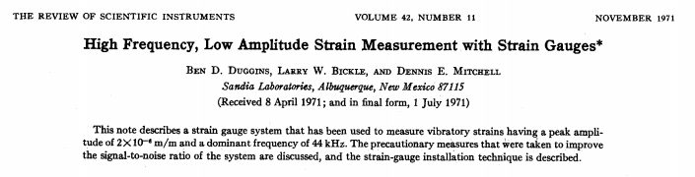
Slightly related content: High Speed Strain data for acousticish data
Since sound is just a pressure wave, we can measure it with sensitive instruments that measure pressure or compression (strain).
Strain gages are measure strain in 1 direction so they can be used in some interesting ways if desired.
  Be certain that the length of the measurement element is substantially shorter than the wavelength of interest
  Speed of sound in steel is ~5800m/s at room temperature
  At 20 khz in steel, λ≈290 mm
    Our 1/4” strain gages should be reasonable even 200khz should be detectable
    Our strain gage system only goes to 19 kHz so lets see

Slide 25
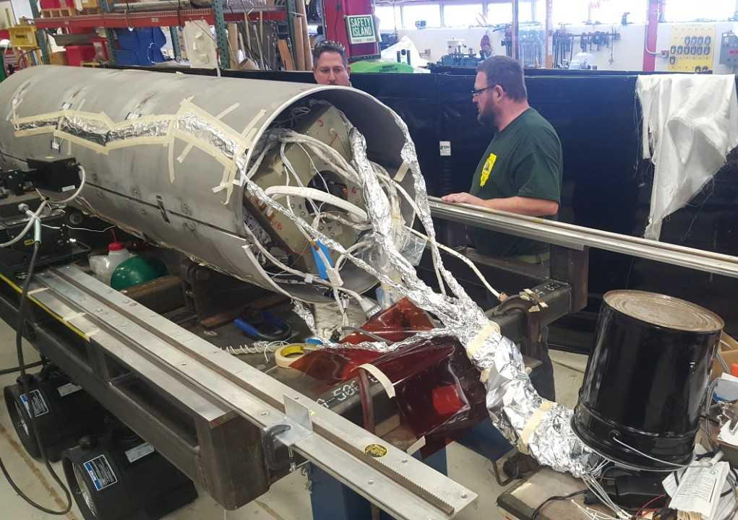
MQXF preparing for skin welding.
Note the aluminum foil octopus
Since it was on the bench we decided to give it a shot and see if we could see anything in the acoustic regime

Slide 26
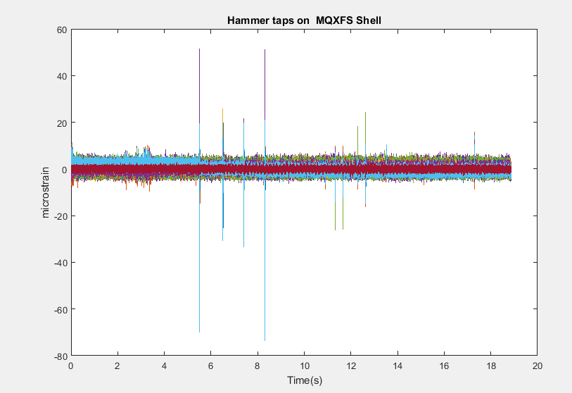
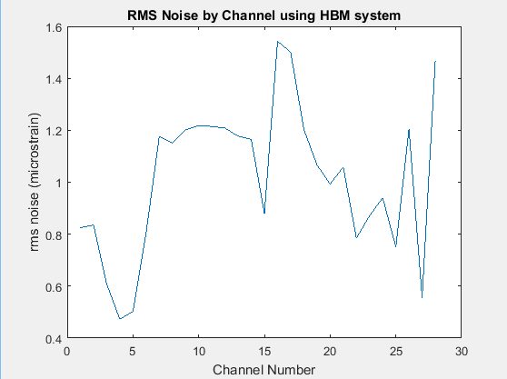
We hit it with a hammer (not Stoyans hammer though)

Slide 27
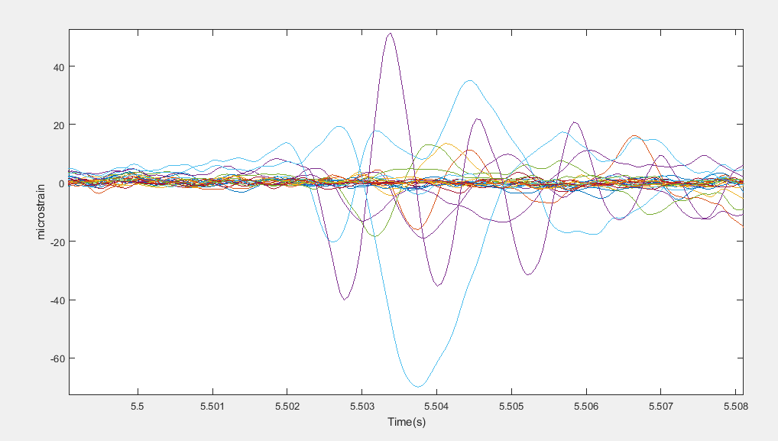
Time shift between wave arrivals is clearly visible, and resolvable at 20 kHz, indicated difference from measured gages of ~900mm
Some gages are substantially less sensitive
Polarity
Distance
Separation
We may (probably) have additional bandwidth limitations from the DAQ hardware
Conclusions on this topic
  I’m not really sure, but we can see things.
  We may not be able to see things during a quench, but maybe we can it shouldn’t be hard to take this data and see if it is detectable magnitude

Slide 28
General Conclusions
Ten Stack and other subscale testing for general material property measurements can be leveraged to gather additional data
  This data can be used to train neural networks to better characterize quench and other events
  Acoustic and mechanical behavior can indicate performance of a cable composite system aside from providing input for magnet modeling
High frequency strain data might be able to be used for better understanding of magnet performance.
  Not sure how much value is here, but we could take a peek

