Slide 1
AE analysis and event clustering
M. Marchevsky
L. Stephey, M. Mustafa LBNL

Slide 2
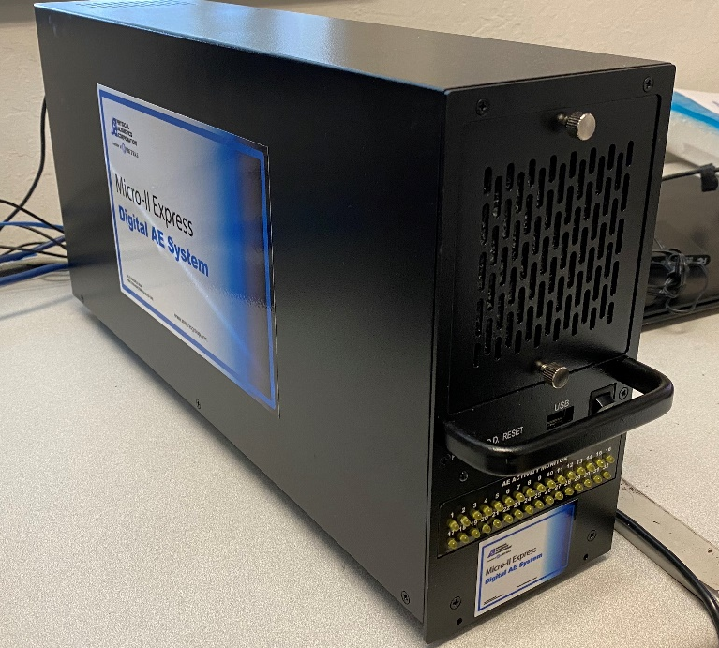
New hardware development
Commercial AE system from Physical Acoustics
Self-calibrating acoustic hardware
New variation of the “old style” two-wire sensor design that used compact SMD components and is modified to enable pulsing the piezo for cross-calibration purposes
An FPGA-based system that can stream 8 (and up to 32 after upgrade) channels at 10 Ms/s and simultaneously stream important metadata such as count, energy, frequency, etc. in real time.

Slide 3
Selecting acoustic events by thresholding
Threshold
U
U
t
0
N - number of zero crossings
HDT
HLT
(hit definition time)
(hit lockout time)
T
t
- Event absolute time
0
2
U – Event amplitude
E = U
rms
- Event energy
T – Event duration
N - Number of zero crossings
F = N/T - Frequency

Slide 4
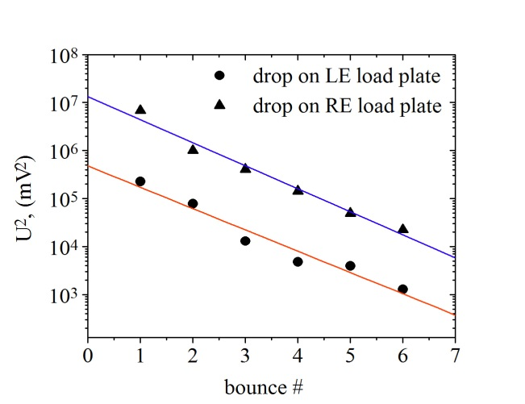
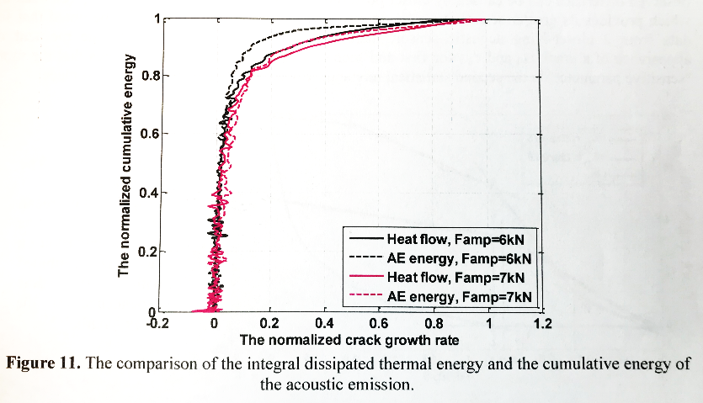
Connecting AE amplitude, energy release and temperature rise
1. AE voltage in a square in known to be proportional to the energy released in the transient event. This can be verified in a simple experiment
A metal ball dropped on the magnet surface, each time reaching progressively lower height h_{n}, until all its energy has been transferred to the structure. Same energy fraction is transferred to the magnet structure at every bounce and E_{n} for the n-th bounce can be expressed as $E_{n}$=$E_{0}α^{n}$
M. Marchevsky et al., Cryogenics, 69, pp 50-57, 2015
https://doi.org/10.1016/j.cryogenics.2015.03.005.
2. Attenuation of the acoustic wave in the material follows a universal behavior: $A\left(x\right)=A_{0}e^{−βx}$
Using two sensors at the opposite ends of the magnet one can estimate energy release as $E_{AE}=γU_{i}U_{j},$where $γ$ is a universal scaling and $U_{i}$ and $U_{j}$ are the acoustic sensor voltages
3. In a number of papers it was demonstrated that integral thermal dissipation is proportional to the cumulative energy of acoustic emission for crack propagation
Specific heat of the conductor at low temperature c(T)∼αT, hence:
$E_{AE}=γU_{i}U_{j}$ = $γU_{AE}^{2}$~ $\int_{T_{0}}^{T_{1}}{αTdT}$ = ½($T_{1}^{2}$-$T_{0}^{2}$)
IOP Conf. Series: Material Science and Engineering 208, 012012 (2017)

Slide 5
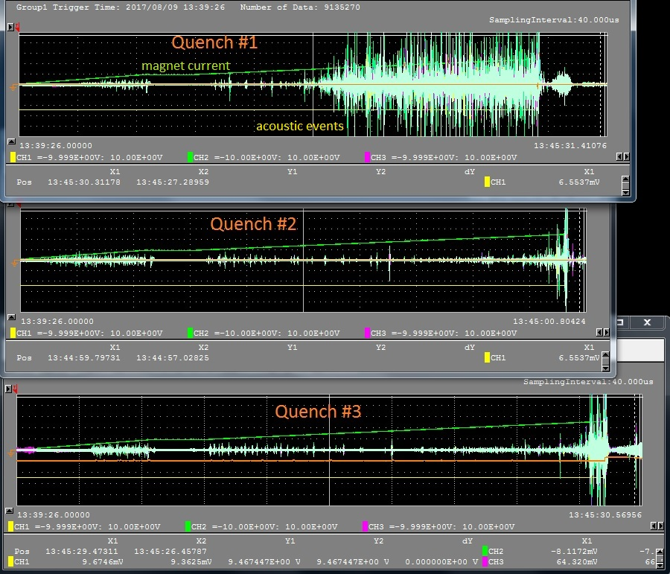
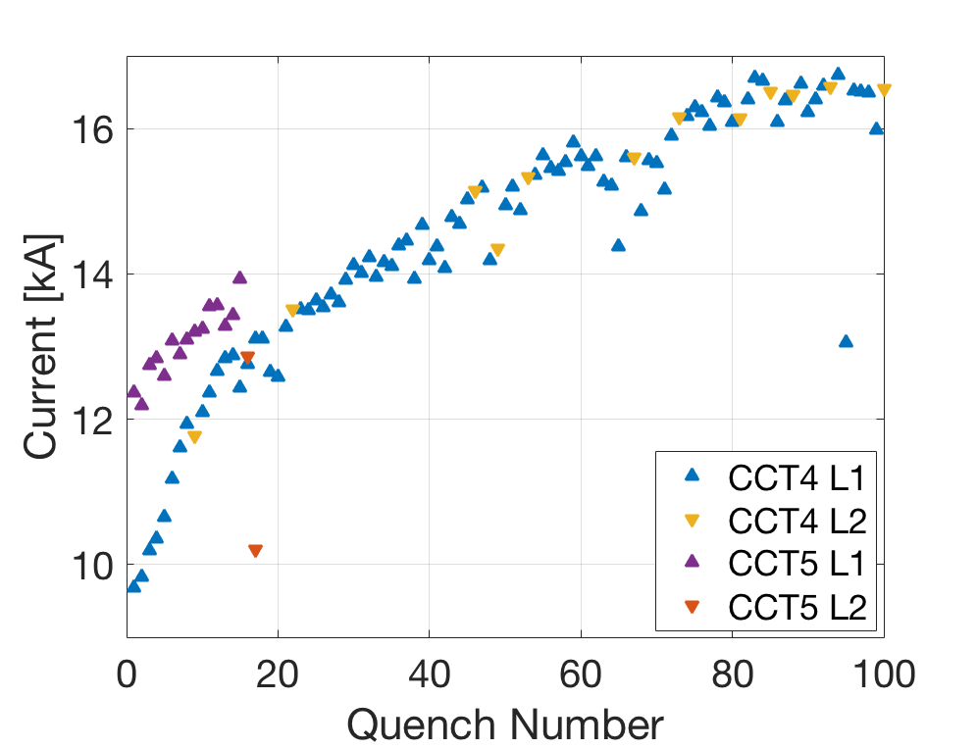
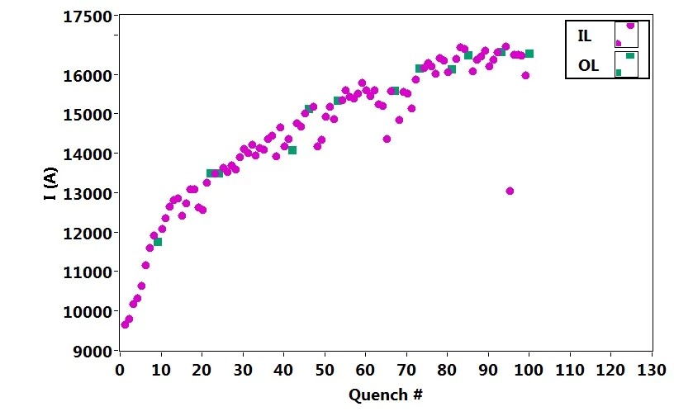
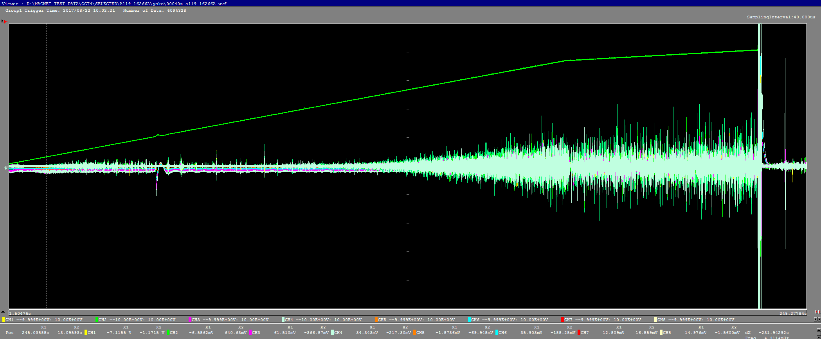
Magnet memory and two distinct training regimes
Quench #1
Regime I
Quench #2
“kink” in the training
dependence
Regime II
Quench #3
CCT5: new non-cracking epoxy was used => Regime I portion of the training curve is eliminated!
Quench #90
Possible physical mechanism:
Cracks in epoxy develop and percolate
=> slip-stick between grains and parts
Quench #90
Mechanical memory in the initial quenches (Kaiser effect)
As training progressed, the memory effect is erased

Slide 6
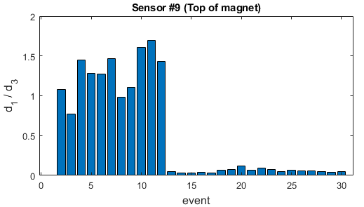
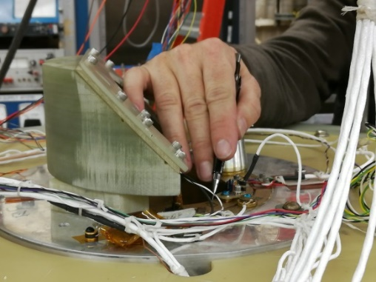
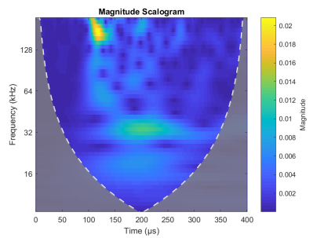
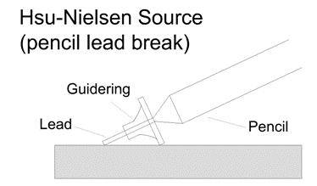
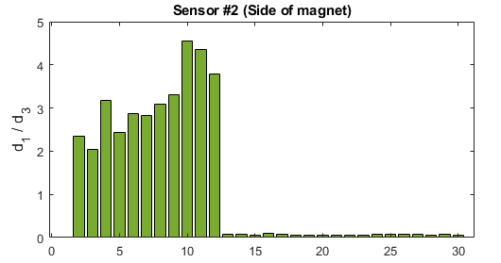
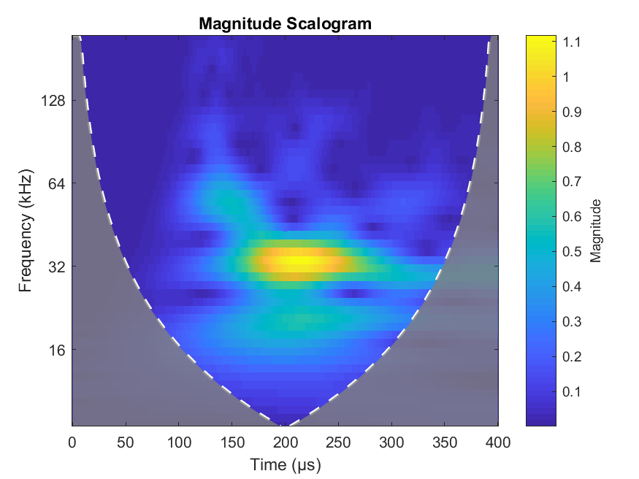
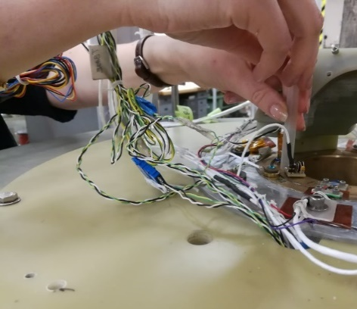
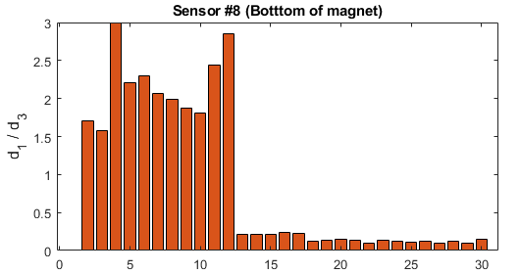
Mechanical events can be reliably identified using acoustics
Pencil break
When ratio of d₁/d₃ , where d_{n} is the n^{th} scale of discrete wavelet decomposition is used as an identification criterion, an order of magnitude difference between pencil lead break (events 2-12) and ball drop (event 13-30) is detected on all eight sensors around the magnet (even those that are far away from source)
Ball drop
by E. Nilsson
1 g ball dropped from 7.5 cm height.

Slide 7
Simple event classification approach
Select two fingerprint files: from Quench #1 ramp – label them as “1”, and from Quench #103 ramp – label them as “2”
Q1 ramp: 4711 events of type “1” Q103 ramp: 2860 events of type “2”.
Randomized and took 2860 of each type => 5720 events total in the dataset
Split the resulting data into two randomly-selected sub-sets of equal size (2860 pts)
Normalize wavelet scale-specific amplitudes for every event
 | Actual type
 |  | 0 | 1
 | 0 | 1152 | 321
 | 1 | 185 | 1202
Train the Random Forest classifier in Python on the first sub-set against event “type”, then validate its prediction accuracy using the second sub-set
Predicted type
Apply trained and validated algorithm to the ramp data is has never seen to find out how many events of each type were detected

Slide 8
Identifying fraction of “cracking” events in training ramps
Type “1” event fraction
“kink” in the training
dependence
Ramp to quench #
Trained Random Forest model reveals a kink in the event fraction dependence that coincides with the transition from “cracking” regime in the training curve

Slide 9
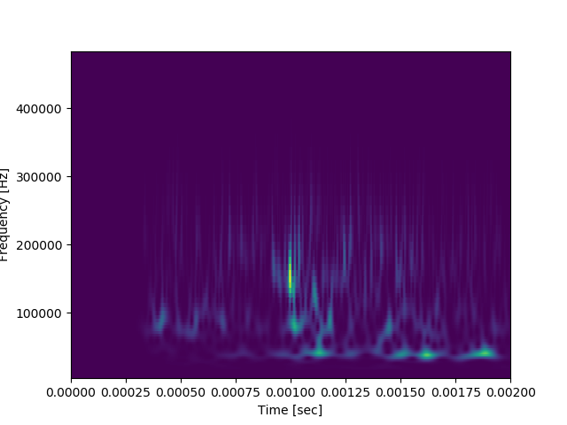
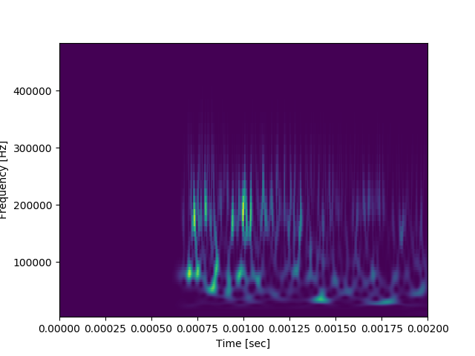
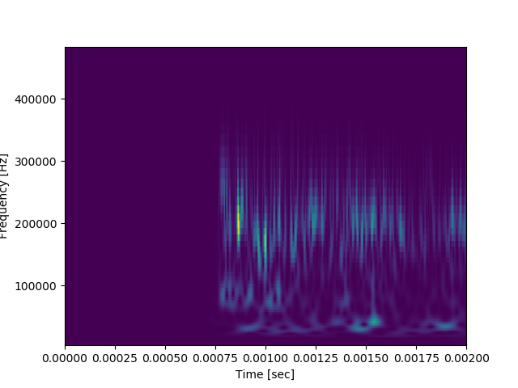
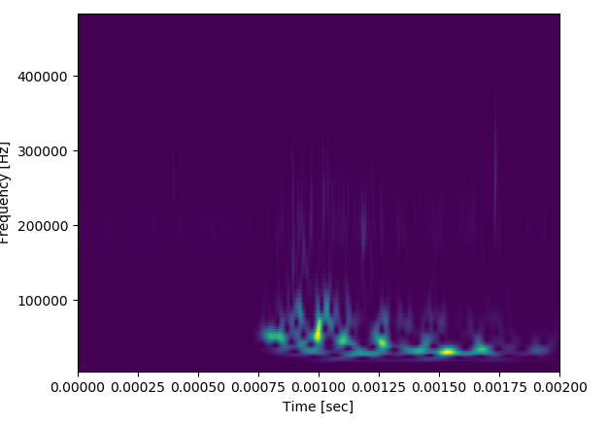
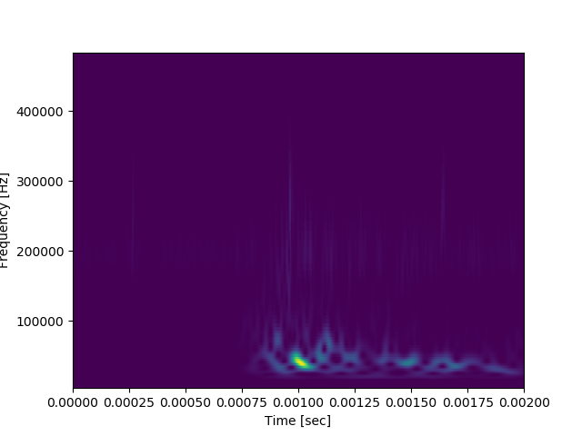
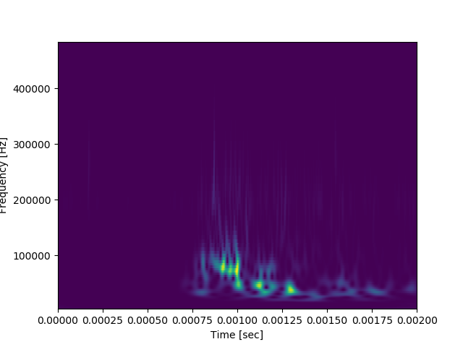
Looking at “fingerprints” using spectrograms
Q1
“True ”Regime I”?
Q103
“True ”Regime II”?

Slide 10
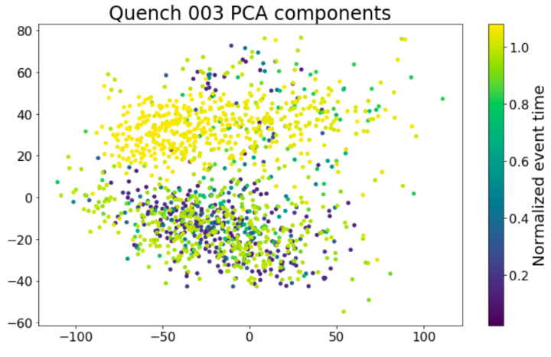
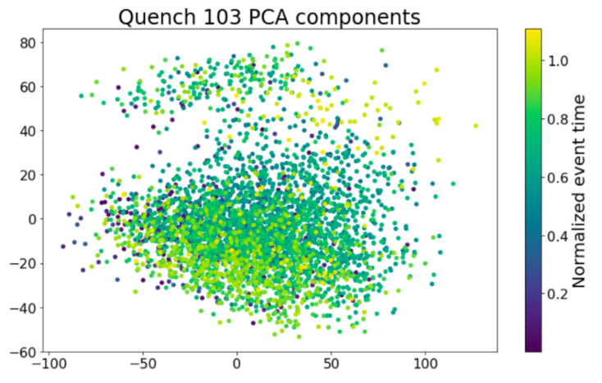
Acoustic event type clustering and sound database
In collaboration with NERSC
Encoder
Latent
Decoder
First encouraging unsupervised clustering results using deep learning
Reconstructed spectrograms

Slide 11
How different AE events really are in the beginning of training vs end of training?
CCT4 Quench #3
CCT4 Quench #103
We still need a robust physical validation of our clustering results

Slide 12
Mechanical relaxation after the quench in CCT4
~ 2.5 s
current
Cracking
regime
CTD-101 (4.2 K)
9677 A
acoustic
“Mix-61” (4.2 K)
Un-sintering of a Nb₃Sn
Rutherford cable (RT)
current
10197 A
acoustic
All slowed down to ∼17% of the original sampling rate of 1 MHz
current
16266 A
Slip-stick
regime
acoustic
We are building a “sound database” that can be latter used for supervised learning models
Post-quench slip-stick “aftershocks” – we will apply those to verify clustering and potentially also for supervised training

