Slide 1
Multi-Scale Modeling of Superconducting Magnets
D. Arbelaez
MDP Modeling Group Meeting
05/19/2020

Slide 2
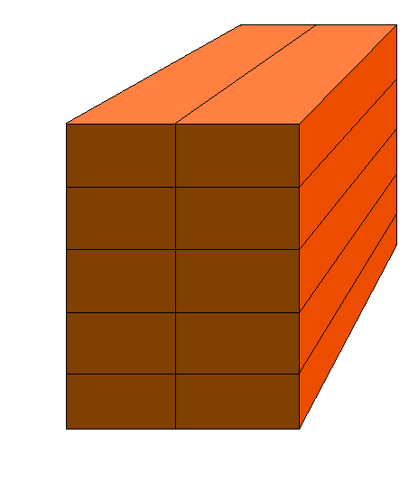
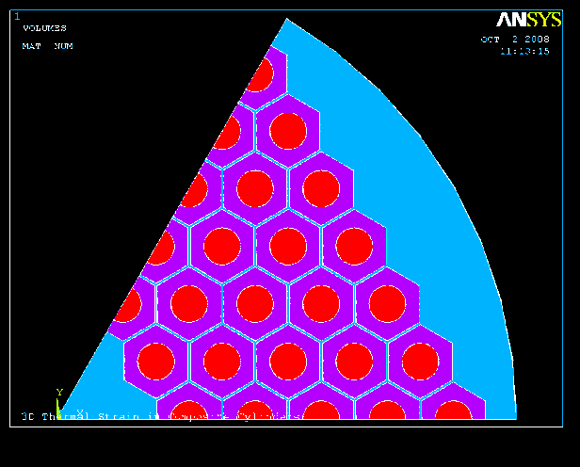
Multi-Scale Model Overview
Obtain the 3D strain state at the filaments for applied macro-scale loads
Determine effective material properties at different length scales
Models range from the cable to strand sub-element scale
Coil
Cable
Strand
RRP Filament

Slide 3
Available Tools
Several tools were developed and are available for use
Cable Models (use regular mesh)
Cable deformation model
Stress/Strain analysis on cable
Effective property calculation (including epoxy in gaps between strands and insulation around cable)
Periodic sub-element model
Stress/Strain analysis on sub-element
Effective property calculation

Slide 4
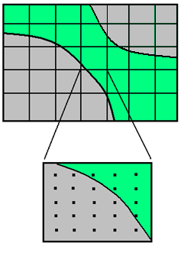
Cable Compaction Model
Large plastic deformation finite element two phase model
Elasto-plastic homogeneous phase (strand)
Non-linear elastic fictitious material phase (void)
Avoids complications with meshing and contact elements
Fictitious void material is modeled with a highly compressible “soft” material
Regular unaligned mesh
Three types of elements
Strand element (elasto-plastic)
Void element (non-linear elastic)
Interface element
Treated as a void element when the volume of the element is greater than the strand volume inside that element
Treated as a strand element when the volume of the element is less than the strand volume inside that element
Unaligned Mesh
Void Space
Strand

Slide 5
Material Properties
Elasto-plastic strand
Power law hardening curve
Properties for Copper are assumed
Fictitious void material
Defined by strain energy function
Volumetric part is a function of J (ratio of final to initial volume)
Highly compressible (small stiffness) for moderate values of J
Stiffens quickly as J approaches zero

Slide 6
Initial Cable Configuration
Initial cable model
Number of strands (N)
Strand diameter (d)
Initial pitch angle (φ₀)
Smallest repeating unit cell in the axial direction with length
End strand geometry
Remains in contact with at least on strand throughout unit cell
Initial angle φ₀ and final angle -φ₀ with respect to the cable axis
One possible solution for the axis of the end strand is the intersection of two angled cylinders
Intersection defines the end strand axis

Slide 7
Deformed Cable Shape
Final cable parameters
Width of the cable (w)
Thickness of the cable (t)
Pitch length (L_{p})
Packing factor
Boundary conditions
Periodic in the axial direction
Normal displacement is constrained on the side faces
Parameters for Deformed Cable Example

Slide 8
von Mises Stress Example

Slide 9
Sample Cross-Sections

Slide 10
Homogenization of the “Coil Material”
“Coil Material” microstructure
Cable
Interstitial binder (epoxy)
Insulation layer (S-glass composite)
Homogenized strand properties are used for the cable
Periodicity is assumed in all directions (infinite material)
Consider only linear elastic behavior
Effective properties are extracted by applying six different periodic loading conditions
Insulation
Epoxy
Strand

Slide 11
Calculated Orthotropic “Coil Material” Properties
Individual Material Properties
Epoxy (E = 5 GPa, ν = 0.3)
Insulation (E₁ = 14.9 GPa, E_{t} = 6.7 GPa)
Strand properties varied (E = 126 GPa determined from homogenization of the strand with E = 135 GPa for Nb₃Sn)

Slide 12
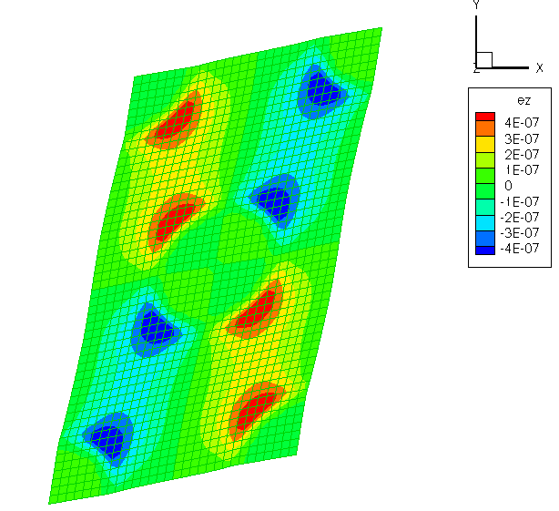
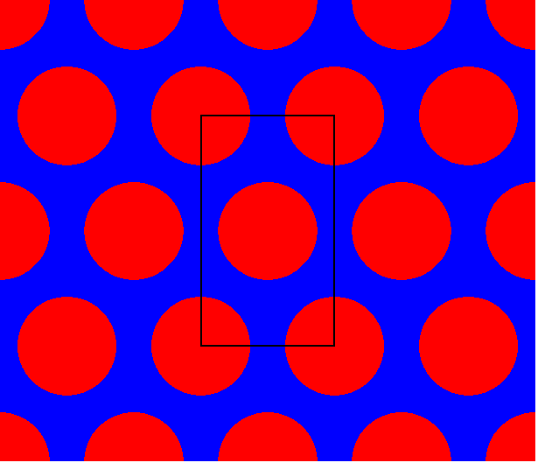
Model at the Strand/Filament Scale
Homogenization of a periodic microstructure to determine effective properties
Periodic assumption is valid only if there is a large number of sub-elements
Geometry may not be periodic due to deformations
Periodic Microstructure
Periodic Boundary Conditions

Slide 13
Coupling Between Different Scales
Coupling is for only linear elastic properties
Trivial coupling between scales since properties are independent of deformation
Coupling from coil to cable scale and from cable to RRP sub-element/filament scale
Loads are transferred by applying the strain in the larger scale as the average strain over a unit cell in the smaller scale

Slide 14
Conclusions
Work did not continue on this subject after initial progress but some useful tools were developed
Cable deformation code
Effective property calculation code
Framework is in place for multi-scale analysis
If there is interest these tools can be made available for broader use
In current form they are not made for outside users and would need some work to make them user friendly

