Slide 1
A Methodology to Compute the Critical Current Limit in Nb₃Sn Magnets
G. Vallone¹, E. Anderssen¹, B. Bordini², P. Ferracin², J. F. Troitino², S. Prestemon¹
¹Lawrence Berkeley National Laboratory, ²CERN
Modeling Working Group
05/19/2020

Slide 2
Outline
Introduction
Cable Stacks Under Transversal Pressure
Application to Superconducting Magnets
Conclusion

Slide 3
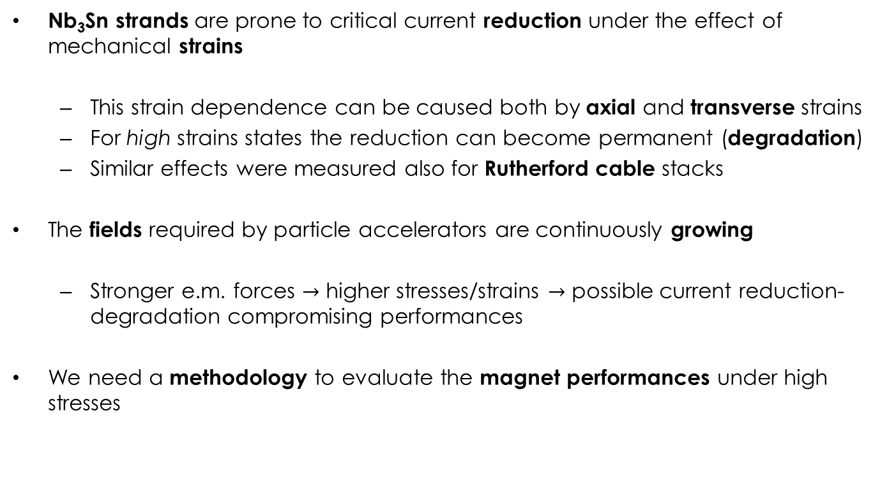
Introduction
Nb₃Sn strands are prone to critical current reduction under the effect of mechanical strains
  This strain dependence can be caused both by axial and transverse strains
  For high strains states the reduction can become permanent (degradation)
  Similar effects were measured also for Rutherford cable stacks
The fields required by particle accelerators are continuously growing
  Stronger e.m. forces $→$ higher stresses/strains $→$ possible current reduction-degradation compromising performances
We need a methodology to evaluate the magnet performances under high stresses

Slide 4
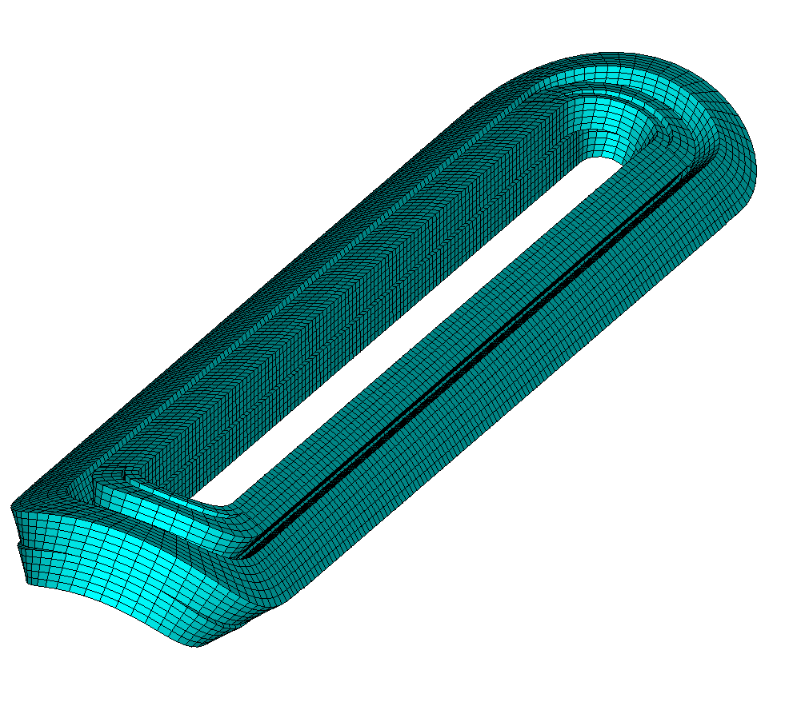
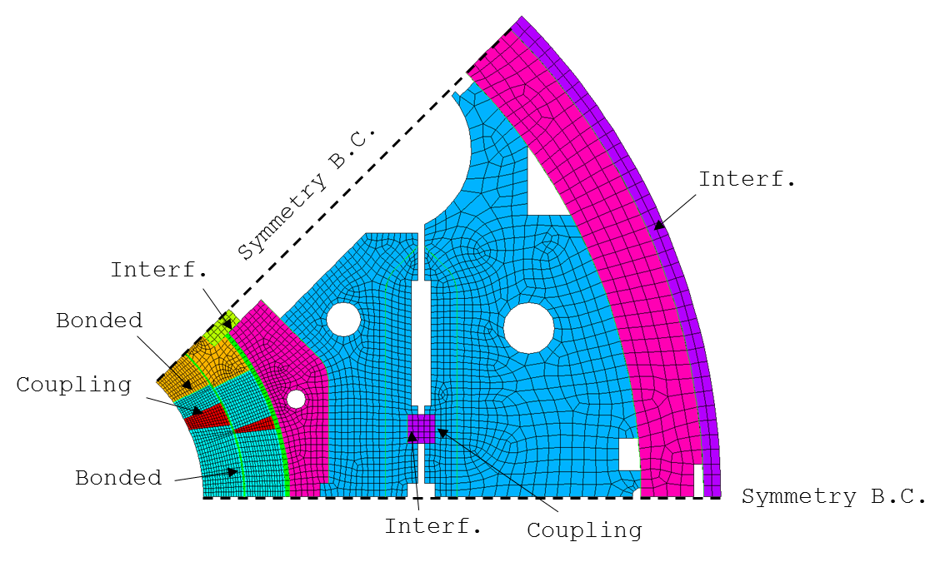
Coils Mechanical Limits
Currently, we use an empiric limit of 150-200 MPa on the coil equivalent stress†
We cannot measure directly the strain on the coil
  This limit is verified against numerical model results (eventually validated with indirect measurements)
  In these models the coil is considered a block with uniform elastic properties, measured on cable stacks
†H. Felice et al., IEEE TAS, 2011

Slide 5
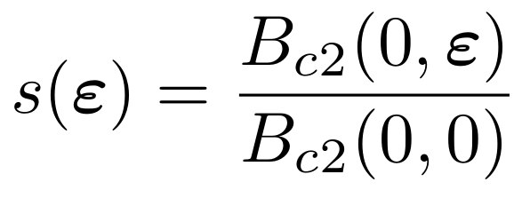
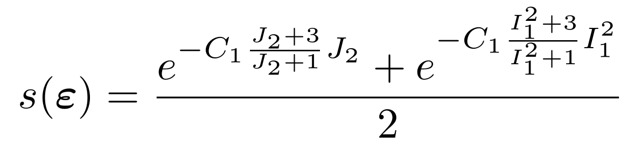
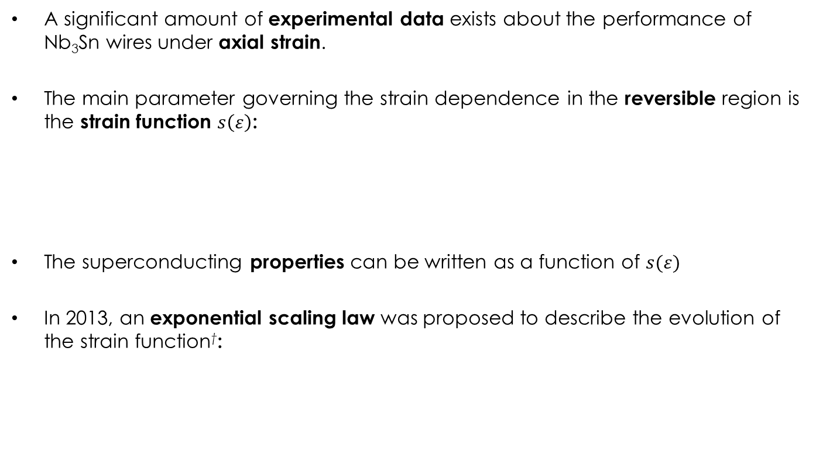
Critical Current Strain Dependence
A significant amount of experimental data exists about the performance of Nb₃Sn wires under axial strain.
The main parameter governing the strain dependence in the reversible region is the strain function $s\left(ε\right)$:
The superconducting properties can be written as a function of $s(ε)$
In 2013, an exponential scaling law was proposed to describe the evolution of the strain function†:
†B. Bordini et al., SuST, 2013

Slide 6
Outline
Introduction
Cable Stacks Under Transversal Pressure
Application to Superconducting Magnets
Conclusion

Slide 7
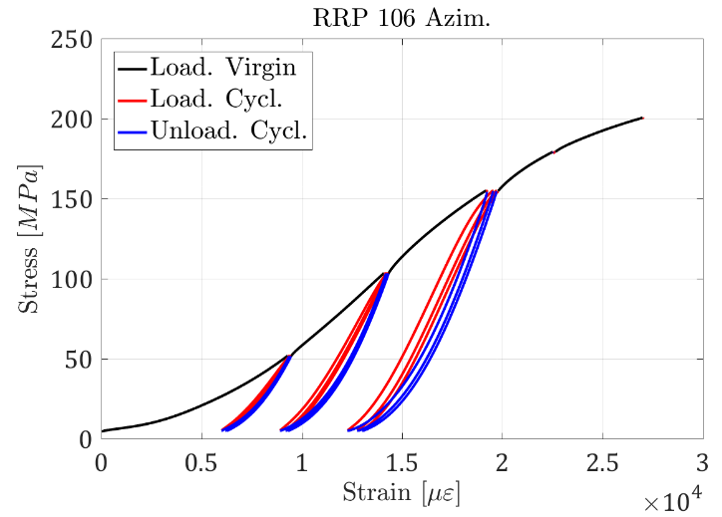
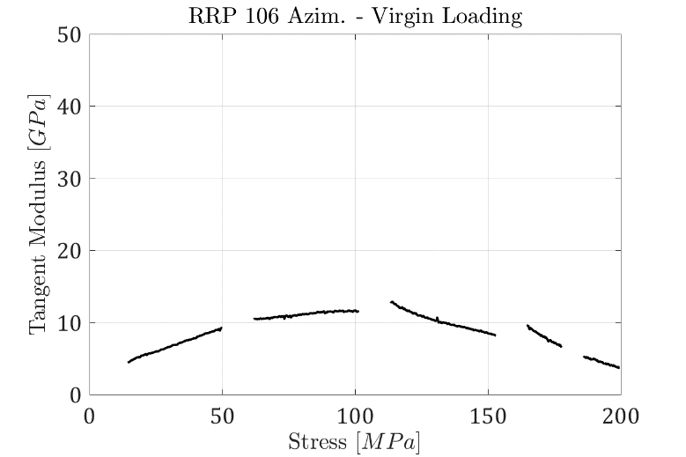
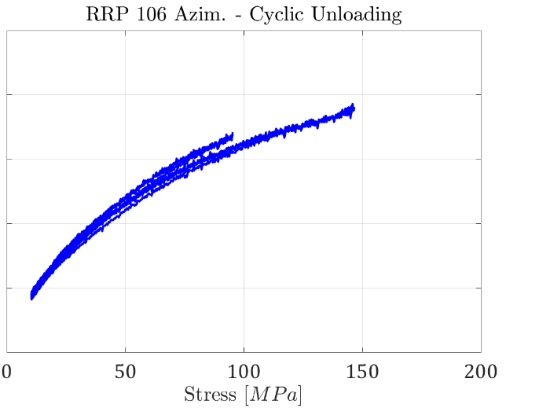
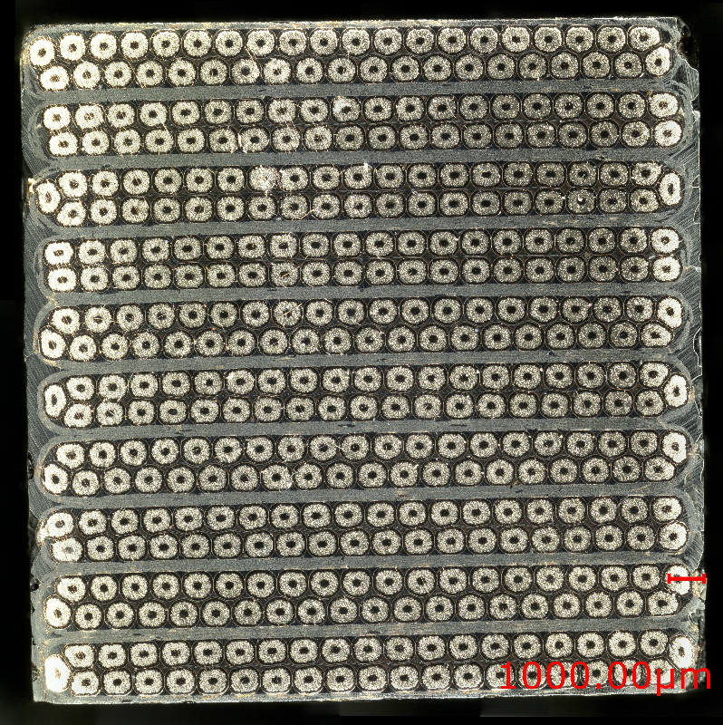
Cable Stacks – Transversal Pressure
Measurements on stacks of impregnated cables:
  Very different behaviour in the three phases
  The chord and tangent modulus† vary continuously during the test
Probably difficult to condensate the coil elastic properties in a single number (elastic modulus)
Non-linear stress-strain relationship
  Unreliable stress from strain measurements on coil
† ASTM - E111 - 04

Slide 8
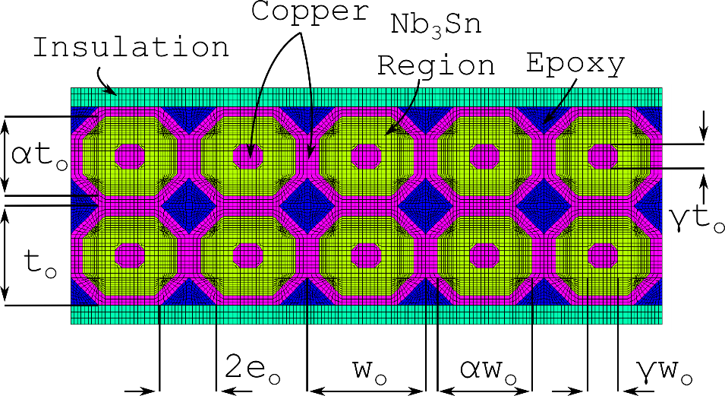
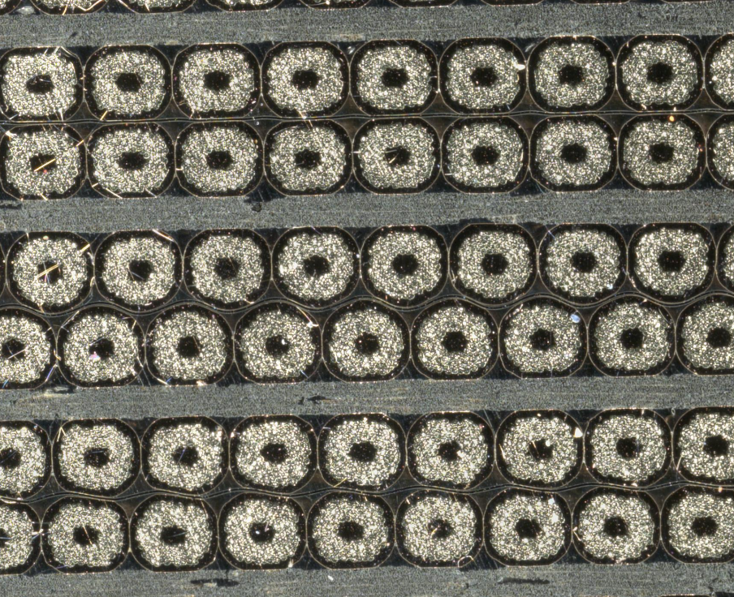
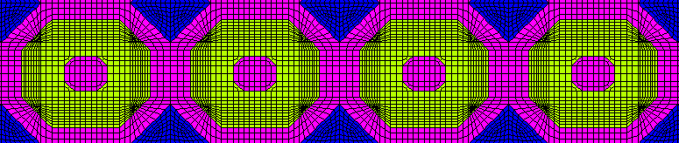
Cable Stacks – FE Model (1)
2D FE model of a Rutherford cable stack
Material properties from literature
Geometry from a mix of image analysis and simple geometric formulas to match the filling factor, copper-non copper etc.
Stiffness validated against measurements on impregnated 10 stacks

Slide 9
Cable Stacks – FE Model (2)
Virgin/cyclic behaviour explained by copper plasticization
FE slope reasonably good especially considering that no model calibration was performed
Initial phase may be due to compaction
Model successfully predicts the higher stiffness (20%) of 11T cables

Slide 10
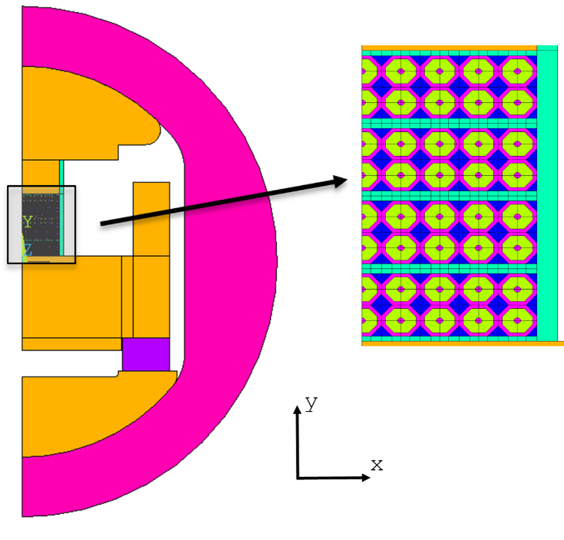
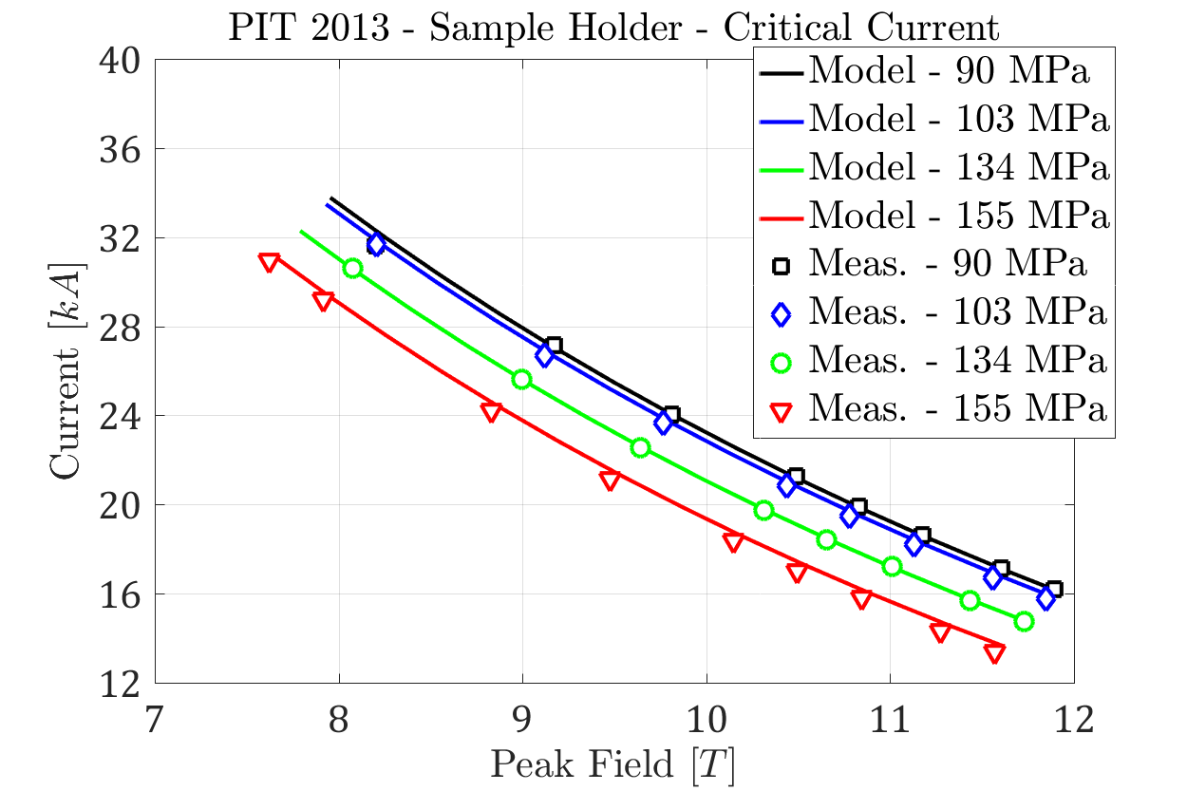
Cable Stacks - Critical Current
2D mechanical and electro-magnetic model of the sample holder
Cable stack modelled with the mechanical approach validated from 10-stack measurements
Quench currents are matched reasonably well. Notice that:
  On the last loading there was a small irreversible degradation
  The quenches at 90 MPa were at short sample limit. The model correctly predicts the same strain function at 0 MPa

Slide 11
Outline
Introduction
Cable Stacks Under Transversal Pressure
Application to Superconducting Magnets
Conclusion

Slide 12
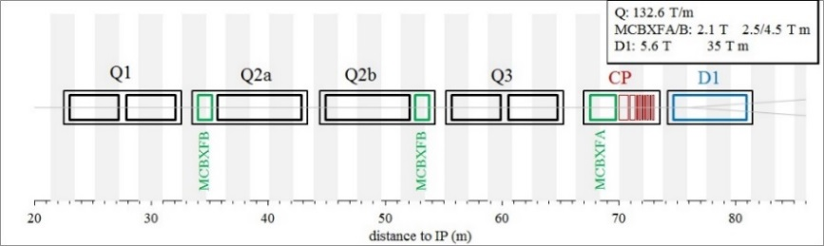
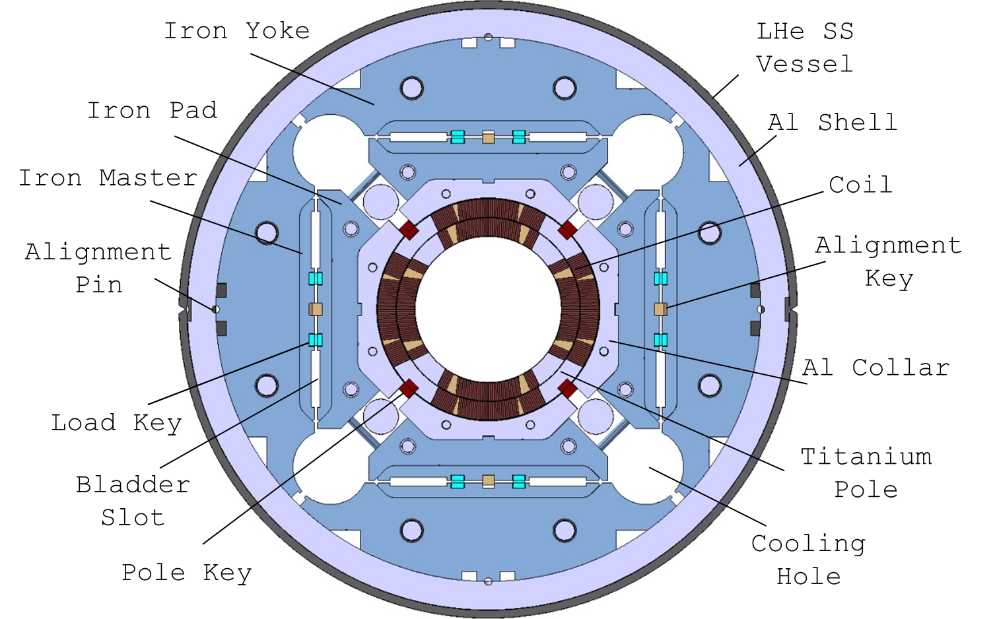
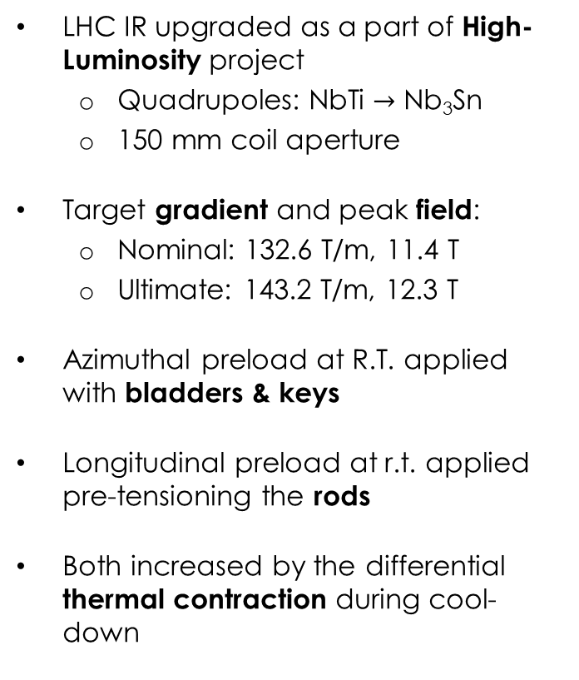
MQXF Design
LHC IR upgraded as a part of High-Luminosity project
  Quadrupoles: NbTi $→$ Nb₃Sn
  150 mm coil aperture
Target gradient and peak field:
  Nominal: 132.6 T/m, 11.4 T
  Ultimate: 143.2 T/m, 12.3 T
Azimuthal preload at R.T. applied with bladders & keys
Longitudinal preload at r.t. applied pre-tensioning the rods
Both increased by the differential thermal contraction during cool-down

Slide 13
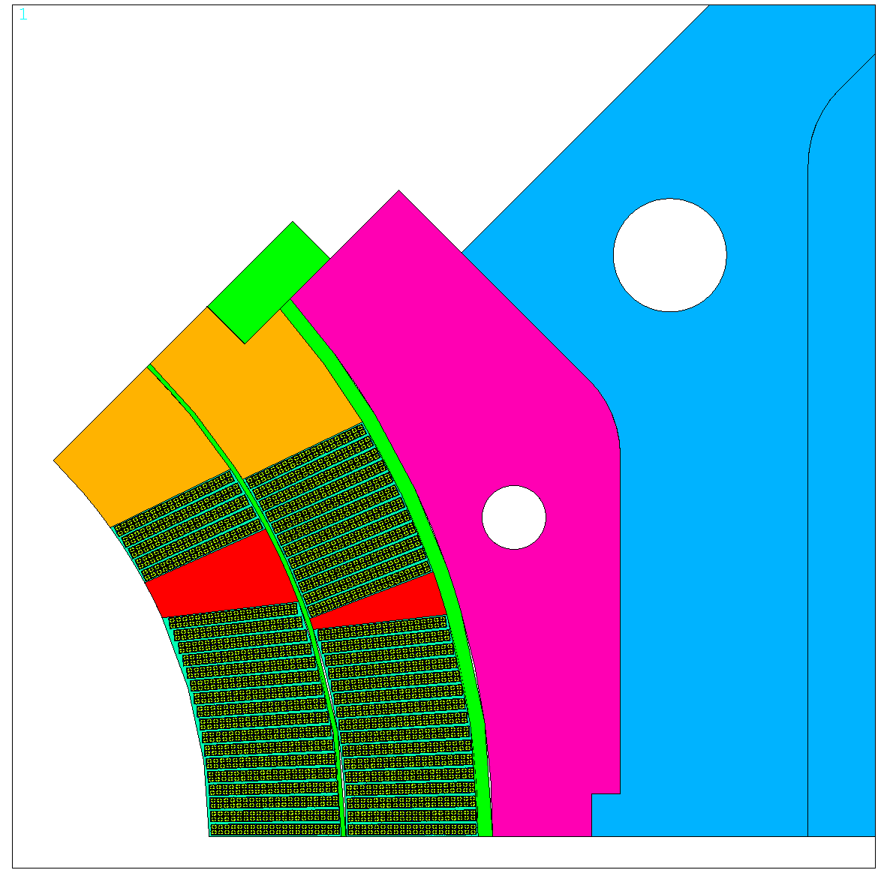

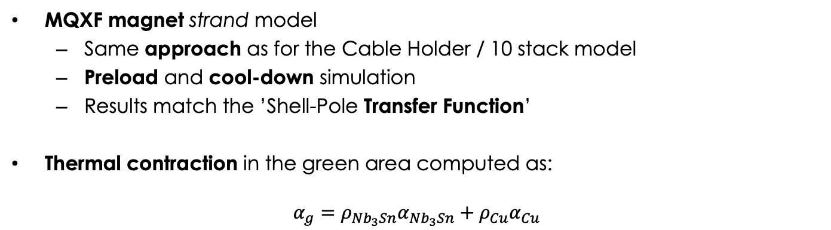
MQXF - Mechanical Model (1)
MQXF magnet strand model
  Same approach as for the Cable Holder / 10 stack model
  Preload and cool-down simulation
  Results match the ’Shell-Pole Transfer Function’
Thermal contraction in the green area computed as:
$$α_{g}={ρ_{Nb_{3}Sn}α}_{Nb_{3}Sn}+ρ_{Cu}α_{Cu}$$

Slide 14
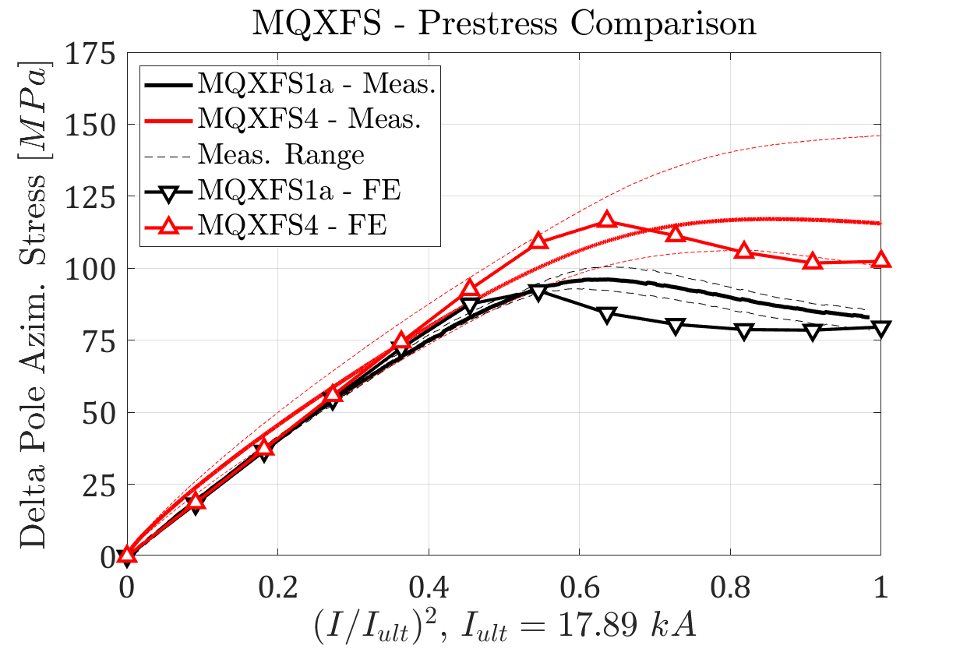
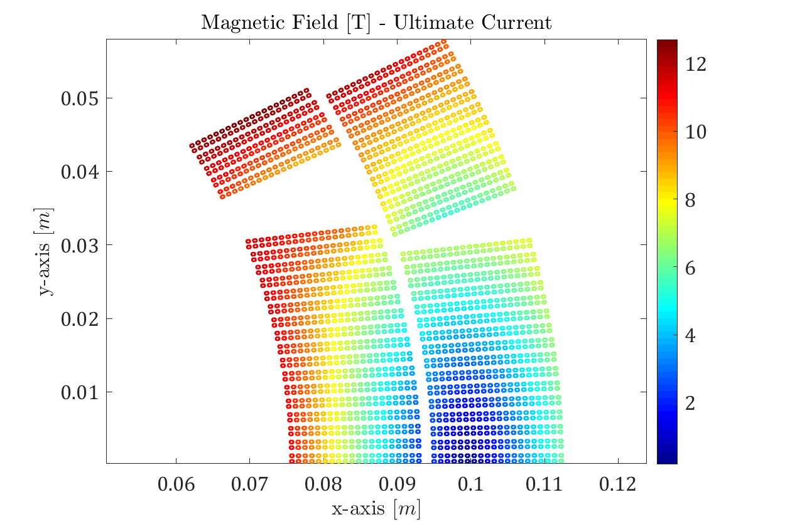
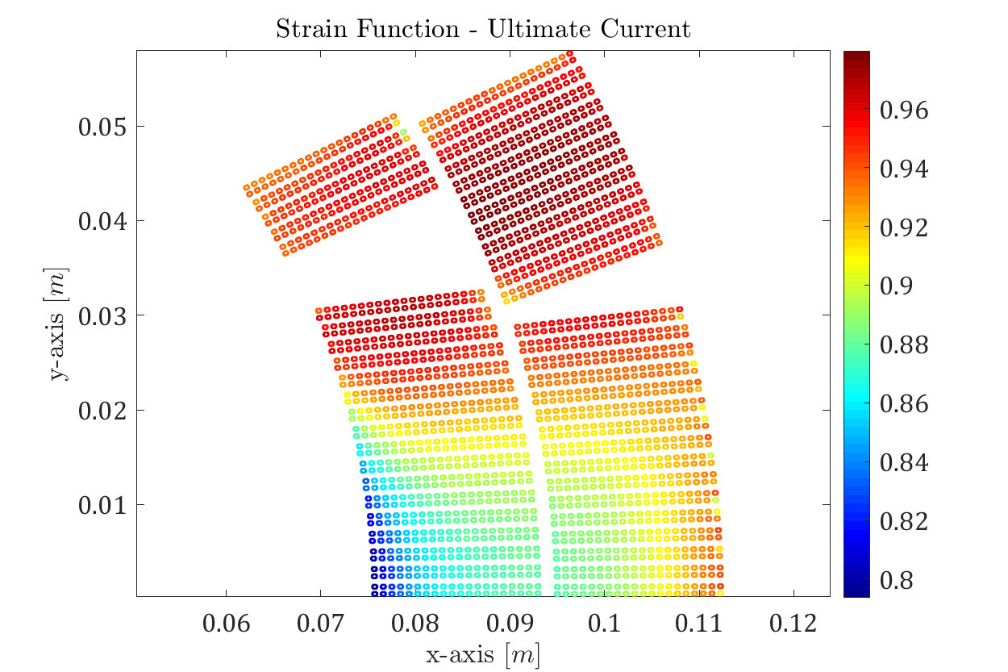
MQXF - Mechanical Model (2)
Powering simulation:
  Mechanics simulation during powering refined in the past †
  The strand model during unloading is slightly stiffer than expected from the measurements
Strain Function at ultimate current > 0.8
† G. Vallone and P. Ferracin, IEEE TAS, 2017

Slide 15
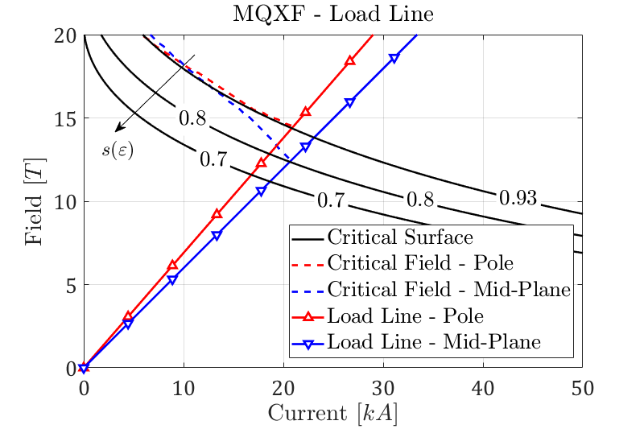
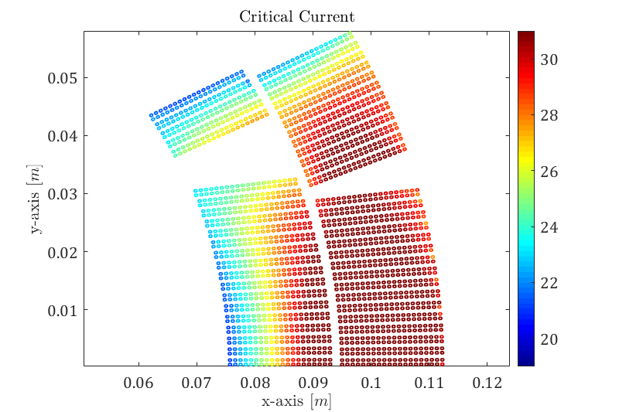
MQXF – Critical Current
Powering results:
  Critical strands near the mid-plane, 20.7 kA (SSL, pole, 21 kA)
  Inner layer, 2nd turn: the e.m. forces and the outer layer pole corner create a stress concentration, reducing the available margin
    The impact of local strain spikes is difficult to evaluate in block models
  Critical current is almost the same on the mid-plane and on the pole
    This is probably due to the empirical approach from past results

Slide 16
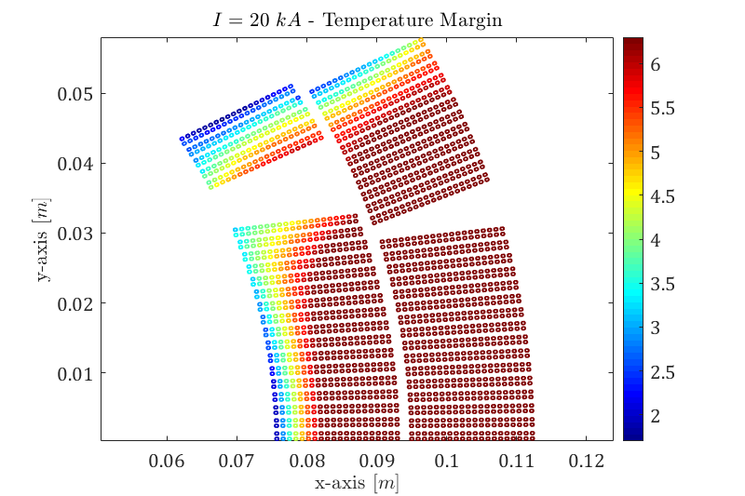
MQXF – Temperature Margin
Temperature margin:
  The critical surface movement caused by the strain can reduce the available margin against sudden energy depositions, potentially decreasing the magnet performances
  The temperature margin reduction is:
    0.7 K at ultimate current
    2.5 K at the limit current

Slide 17
Outline
Introduction
Cable Stacks Under Transversal Pressure
Application to Superconducting Magnets
Conclusion

Slide 18
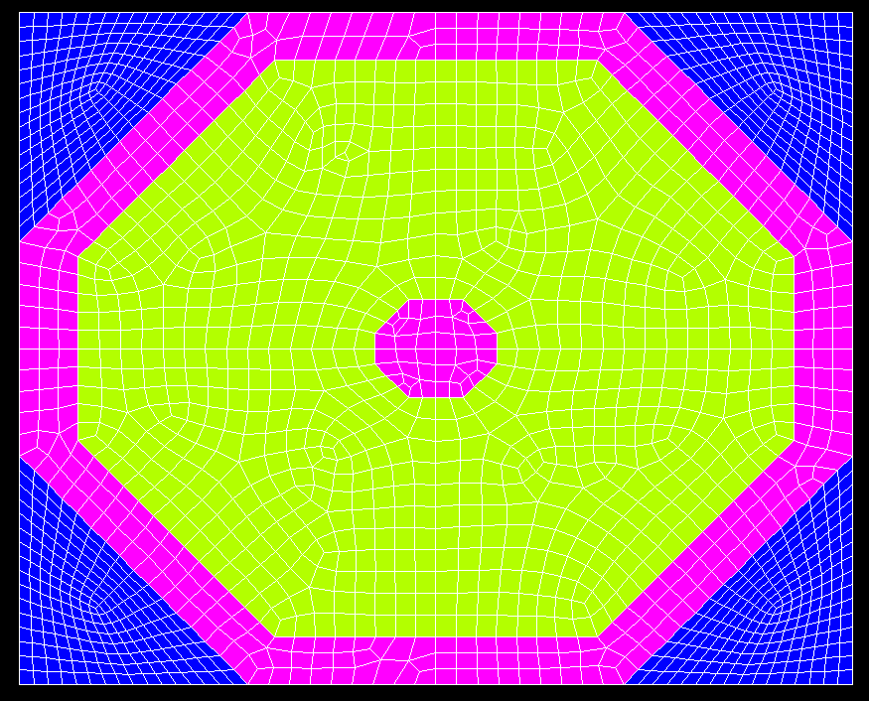
Conclusion
Impregnated cable stacks under transversal pressure:
  Stiffness is continuously varying
  Comparison with FE model shows that the copper plasticization may explain part of this behaviour
Cable stack critical current model results suggest that:
  The critical current reduction can be reproduced using a law developed on axial tests
  It seems that we do not need to model the filaments
The methodology was applied to a superconducting magnet:
  Reasonable agreement between the measurements and computations
  The results provide:
    A more accurate critical current and load margin computation
    Location of potential critical regions in the magnet (e.g. pole corners)
    Reduced temperature margin

Slide 19
Questions?

Slide 20
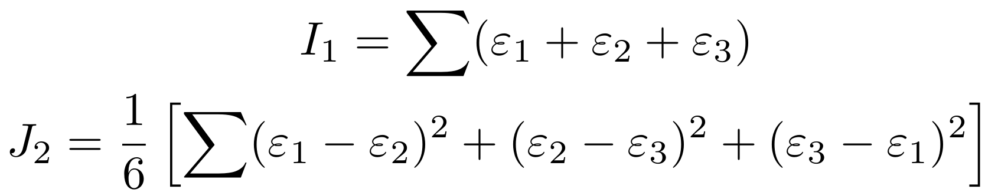
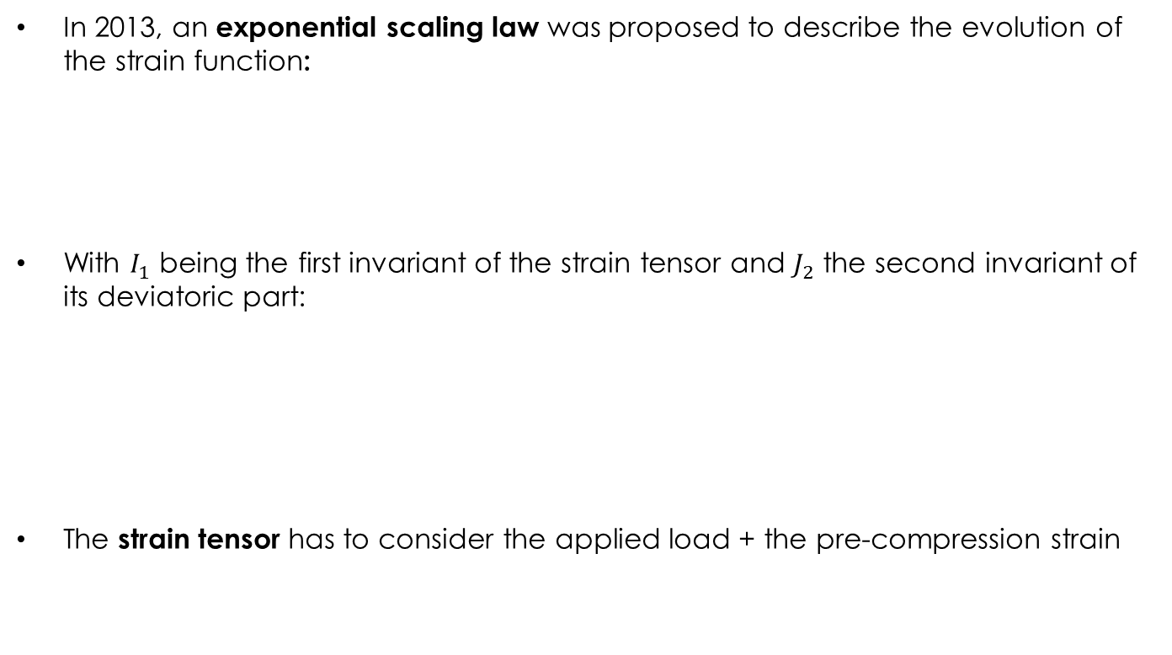
The Exponential Strain Function (1)
In 2013, an exponential scaling law was proposed to describe the evolution of the strain function:
With $I_{1}$ being the first invariant of the strain tensor and $J_{2}$ the second invariant of its deviatoric part:
The strain tensor has to consider the applied load + the pre-compression strain
B. Bordini et al., SuST, 2013

Slide 21
Cable Stacks – Hysteresis
Hysteresis behaviour test:
  ~35 cycles, sample used also to study creep
  Need to repeat also at lower load levels
The width of the curve (~energy dissipation) converges
The residual strain keeps increasing
Energy dissipation ~ 100/150 mJ/cm³

Slide 22
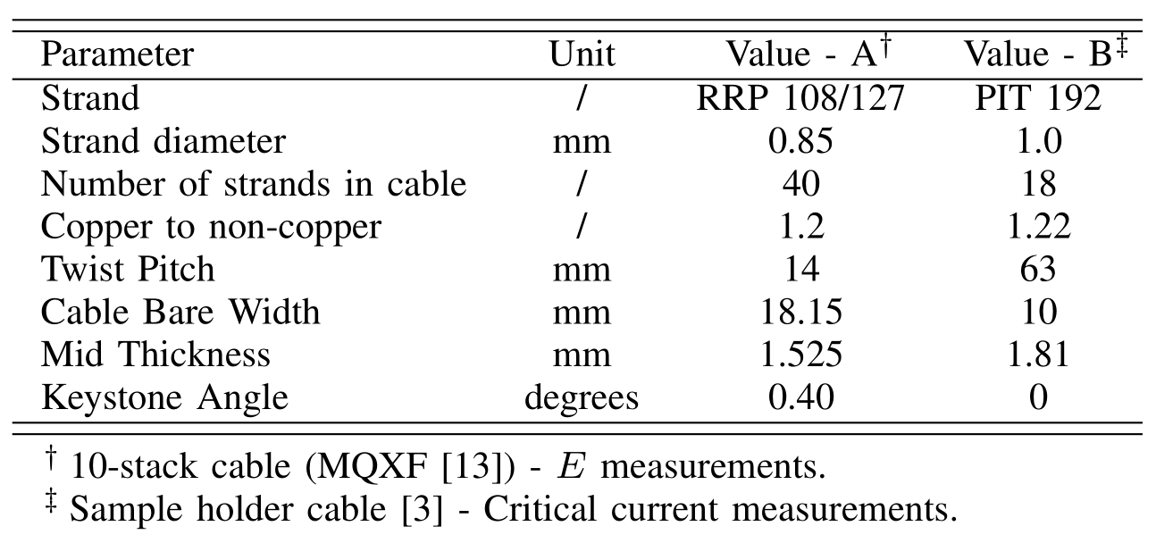
FRESCA Sample Holder
2D mechanical and electro-magnetic model of the sample holder
Cable stack represented with the mechanical approach validated from 10-stack measurements
  Same methodology but different strand/cable parameters

Slide 23
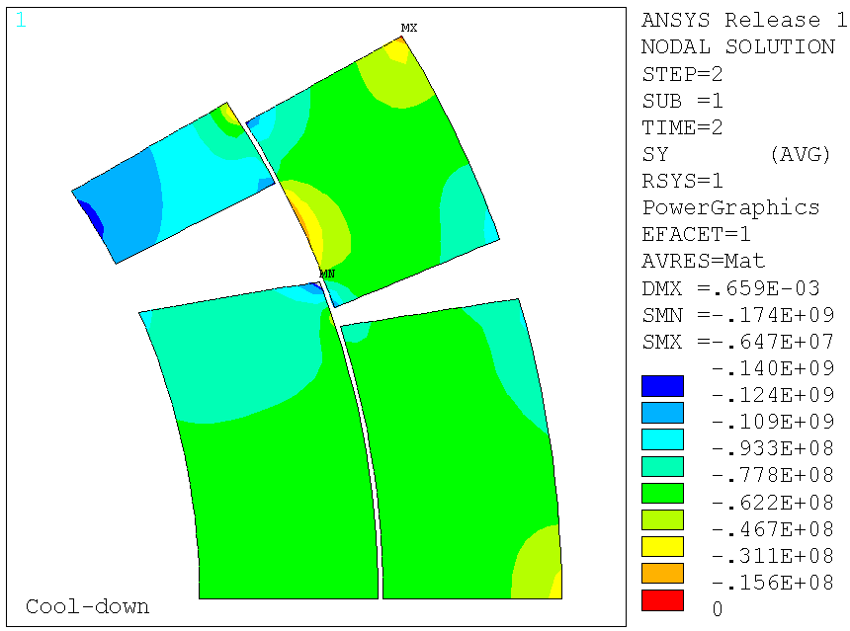
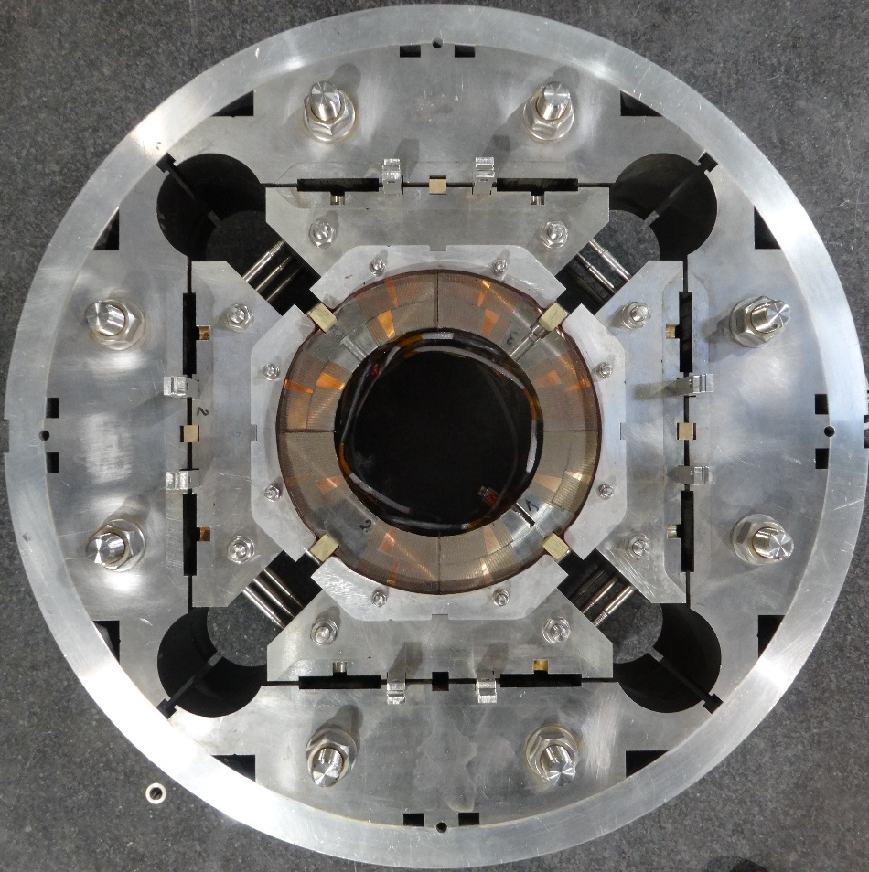
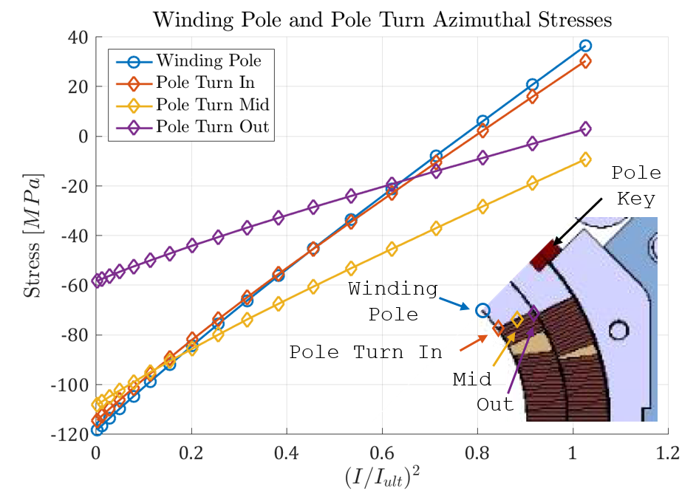
Strain Gauge Locations
Shell
Pole

Slide 24
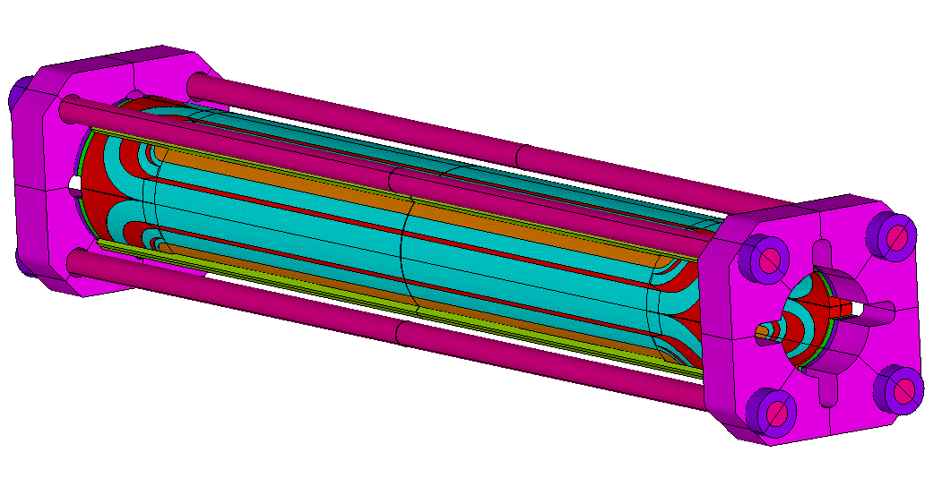
MQXF Prestress
Azimuthal preload at R.T. applied with bladders & keys
  Al shell compresses the coils. Part of the force is absorbed by the pole key
Longitudinal preload at r.t. applied pre-tensioning the rods
Both increased by the differential thermal contraction during cool-down

Slide 25
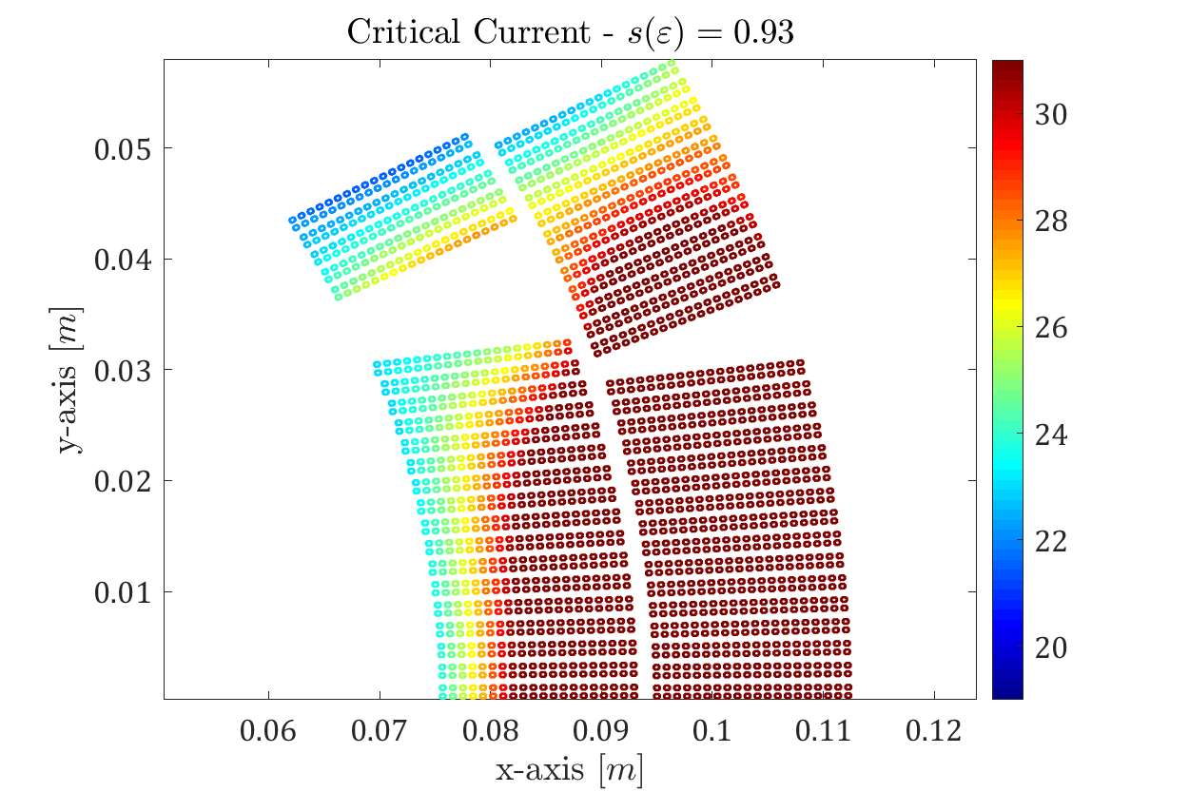
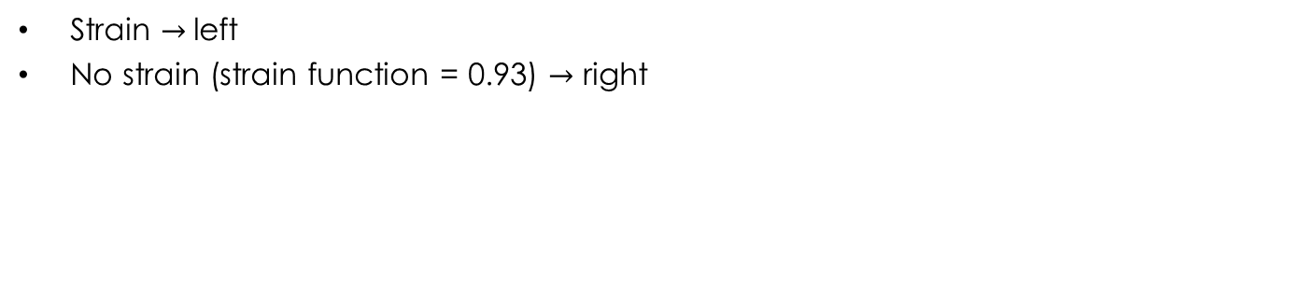
Strain $→$left
No strain (strain function = 0.93) $→$ right

Slide 26
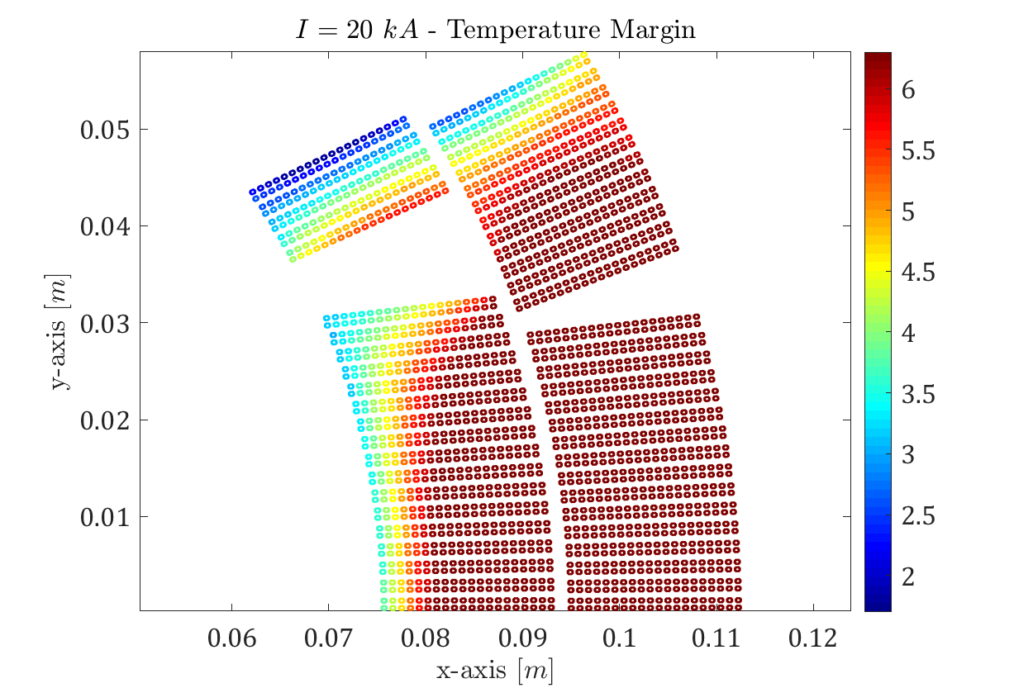
Strain $→$left
No strain (strain function = 0.93) $→$ right

