Slide 1
Bi-2212 strain data in literature
June 2, 2020
Emanuela Barzi
US Magnet Development Program

Slide 2
Questions
Determine reversible transverse pressure strain for Bi-2212 magnet design.
Understand whether it improves when using 50 bar heat treatments.
In literature there are many more data on I_{c} sensitivity of Bi-2212 wires to axial strain (tensile and compressive). Therefore it would be useful to find an appropriate equivalent strain correlation for transverse pressure cases.

Slide 3
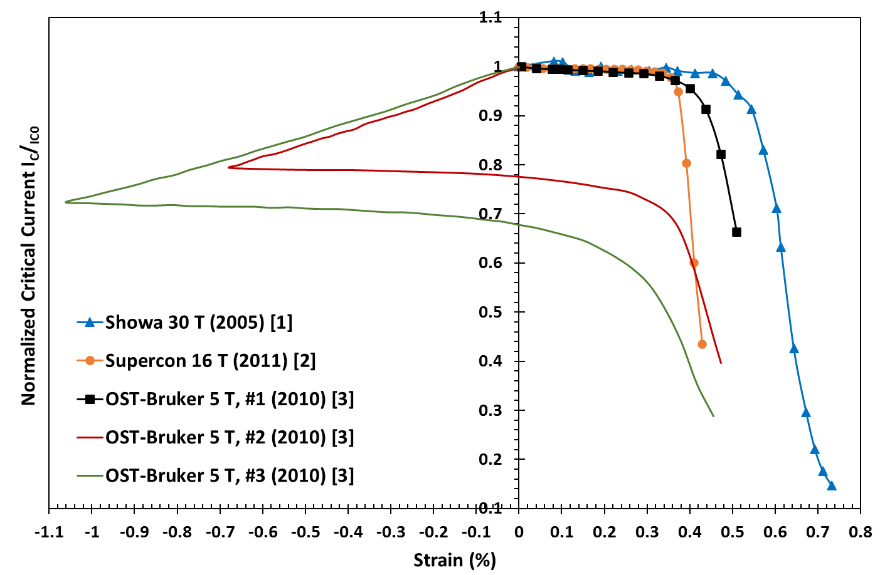
Bi-2212 I_{c} Sensitivity on Axial Strain
COMPRESSIVE
TENSILE
All Bi-2212 wires are Powder-in-Tube. However, strain sensitivity appears to depend on the specific manufacturing technology used by each manufacturer.

Slide 4
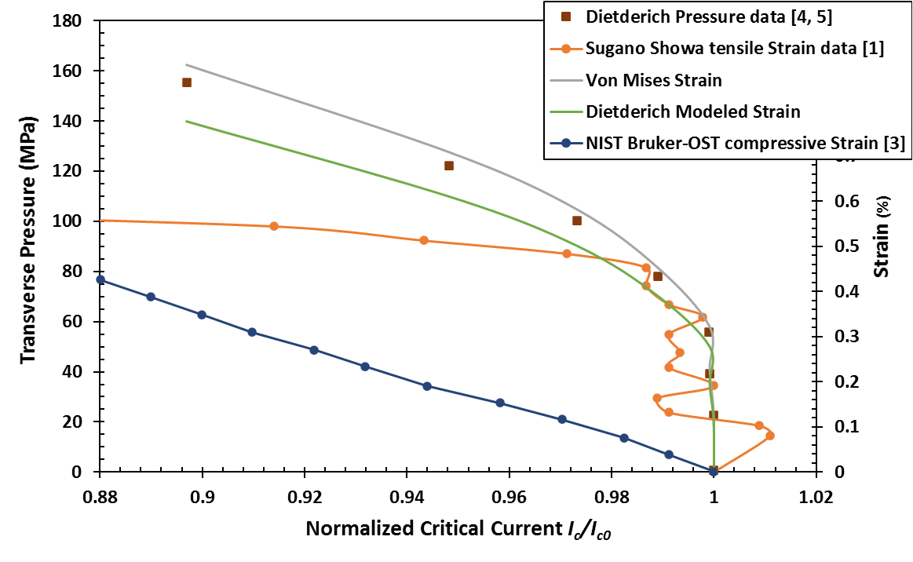
Axial vs. Transverse Strain
Using Von Mises strain correlation seems to represent quite well transverse pressure data up to the knee seen in axial strain data. Then compressive strain behavior guides I_{c} reduction.

Slide 5
References
[1] M. Sugano, K. Itoh, and T. Kiyoshi, “Strain Dependence of Critical Current in Bi2212
W & R Wires Under Magnetic Field Up to 30 T”, IEEE TRANSACTIONS ON APPLIED SUPERCONDUCTIVITY, VOL. 16, NO. 2, JUNE 2006.
[2] X. F. Lu, L. F. Goodrich, D. C. van der Laan, J. D. Splett, N. Cheggour, T. G. Holesinger, and F. J. Baca, “Correlation Between Pressure Dependence of Critical Temperature and the Reversible Strain Effect on the Critical Current and Pinning Force in Bi₂Sr₂CaCu₂O_{8+x} Wires”, IEEE TRANSACTIONS ON APPLIED SUPERCONDUCTIVITY, VOL. 22, NO. 1, FEBRUARY 2012 8400307.
[3] X. F. Lu, N. Cheggour, T. C. Stauffer, C. C. Clickner, L. F. Goodrich, U. Trociewitz, D. Myers, and T. G. Holesinger, “Electromechanical Characterization of Bi-2212 Strands”, IEEE TRANSACTIONS ON APPLIED SUPERCONDUCTIVITY, VOL. 21, NO. 3, JUNE 2011.
[4] D.R. Dietderich et al., “Critical current variation of Rutherford cable of Bi-2212 in high magnetic fields with transverse stress,” Physica C 341, 2599-2600 (2000).
[5] Daniel R. Dietderich, Ronald M. Scanlan, Takayo Hasegawa, Yuji Aoki, Robert S. Sokolowski, and Leszck R. Motowidlo, “Critical Current Variation as a Function of Transverse Stress of Bi-2212 Rutherford Cables”, IEEE TRANSACTIONS ON APPLIED SUPERCONDUCTIVITY, VOL. I I, NO. 1, MARCH 2001.

