Slide 1
Assemble and test of three-turn C2 subscale magnet at 77 and 4.2 K
X. Wang, H. Higley, T. Bogdanof and B. Ghiorso

Slide 2
Driving questions
What’s the transport performance at 77 and 4.2 K? How much current is reduced after assembly of four layers? What’s the field generation?
How do we arrange the splices? What’s the joint performance?
How do we strain relieve the magnet with the splices? How do we attach to the header?
Can we detect the quench without damaging the magnet?
What can we learn for C2?

Slide 3
Time line of c2b assembly
12/18/2018, assembled four layers into c2b and mounted it to the G10 strong-back. Attached to the header to determine the routing of NbTi leads and positioning of inter-layer joints. Decided to use Hall sensor to measure the dipole field at the aperture center
12/19/2018, started making inter-layer joints with Cu blocks
12/20/2018, attached to the header to determine the routing of NbTi leads
1/7/2019, started installing inter-layer joints with Cu blocks
1/8/2019, installed the Hall sensor board
1/10/2019, installed and verified voltage taps on each layer
1/11/2019, attached to the header, soldered the leads
1/12 – 1/13/2019, soldered voltage taps to the connector panel
1/14/2019, tested at 77 K at SSTF
2/7/2019, 77 K test at MTF
2/8/2019, 4.2 K test at MTF

Slide 4
C2b used design version A (the first iteration) and the development revealed a few issues that were addressed for the 40-turn C2
Issues
Layers 2, 3, 4 have compound bends
Need to fix the wire in the compound bend through e.g., stycast before winding → increases wire handling and complicates winding procedures
Design version B avoids the reverse bend
Implemented in the 40-turn design
Reverse bend: cannot apply tension and wire tends to come out of the groove

Slide 5
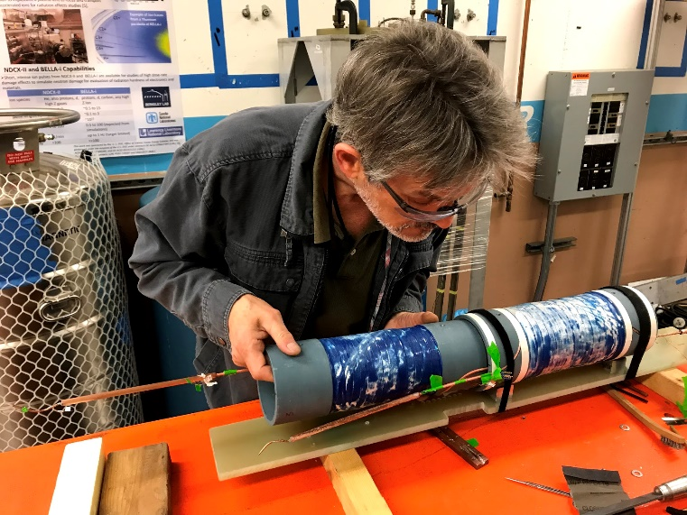
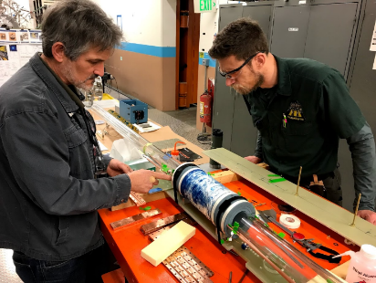
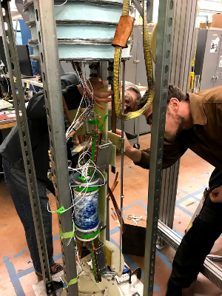
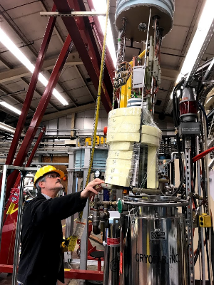
Assembly of four layers

Slide 6
C2b has three inter-layer joints and two leads
Layer 3/4 joint
Layer 1
Layer 4
Layer 1/2 joint
Layer 2/3 joint

Slide 7
Voltage tap and joint configuration

Slide 8
Stycast showed negligible impact on wire performance
Systematic tests on 3-turn coils showed less than 3% I_{c} reduction due to Stycast
Data wrt I_{c} before winding. 20 µV, 77 K, self-field
 | After winding | After stycast | Change
BS-Layer 1 | n/a | -29%
BS-Layer 2 | -29% | -31% | -2%
BS-Layer 3 | -32% | -35% | -3%
BS-Layer 4 | -31% | n/a
AB-Layer 1 | -19% | -21% | -2%
AB-Layer 3 | -25% | -26% | -1%

Slide 9
The magnet was cooled down to 77 K at a rate less than 2 K/min
Voltage across V2 segment of each layer at 100 mA
Layer 4 (outer most) went through the transition about 334 s earlier than Layer 1 (inner most)
Need to measure all four layers for future cooldown

Slide 10
We performed systematical tests at 77 K to probe coil behavior and assess fabrication procedure
After assembly
I_{c} reduction due to higher fields
77 K
Before assembly
Changed the design in layers 2, 3, 4 to minimize conductor handling
Notes:
- Lose 50% of Ic after winding and assembly

Slide 11
16% - 19% reduction in I_{c} due to higher field on the conductor after assembly
Data wrt I_{c} before winding. 20 µV, 77 K, self-field
 | After winding | After stycast | After assembly
BS-Layer 1 | n/a | -29% | -46%
BS-Layer 2 | -29% | -31% | -47%
BS-Layer 3 | -32% | -35% | -54%
BS-Layer 4 | -31% | n/a | -45%

Slide 12
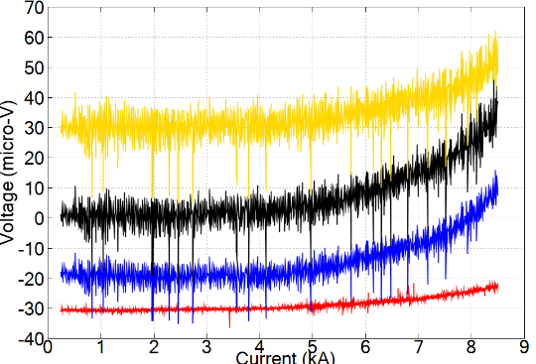
The 3-turn magnet reached 8.5 kA at 4.2 K, a factor of 10 increase from 77 K at 10 µV level
4.2 K
4
750 A/mm² at 8.5 kA
Layer 2/3 had the lowest performance
Low joint resistance: 5 – 21 nΩ
Low n value: 4 – 8
Partial co-winding lead to different inductive noise levels
3
2
L1
0.94 T dipole field in the aperture
Validated the calculation

Slide 13
Noise level on the 1 kHz SCXI data, scaling with the averaged data shown in the previous slide
34 µV
500 µV
700 µV
810 µV

Slide 14
A factor of 10 increase in transport performance from 77 to 4.2 K
I_{c} and n-value defined at 20 µV voltage criterion
Layer | Before winding | After assembly | 4.2 K | Ratio
1 | 1777 (10.0) | 958 (5.5) | 10897 (4.6) | 11.4
2 | 1671 (12.0) | 878 (6.5) | 7996 (4.9) | 9.1
3 | 1671 (5.6) | 774 (4.2) | 7997 (5.4) | 10.3
4 | 1669 (10.0) | 911 (4.2) | 8274 (4.0) | 9.1

Slide 15
Inter-layer joint resistance ranged from 3.6 to 20 nΩ at 4.2 K
R(J12) = 20 nΩ
R(J23) = 3.6 nΩ
R(J34) = 7.1 nΩ

Slide 16
Driving questions
What’s the transport performance at 77 and 4.2 K? How much current is reduced after assembly of four layers? What’s the field generation?
A factor of 10 increase in the transport current from 77 to 4.2 K
On average 17% reduction in I_{c} after assembly due to higher magnetic fields
How do we arrange the splices? What’s the joint performance?
4 – 20 nΩ
How do we strain relieve the magnet with the splices? How do we attach to the header?
Can we detect the quench without damaging the magnet?
Yes.
What can we learn for C2?
Remove the reverse bends. Co-wind the instrumentation wire completely with the conductor

