Slide 1
Training Rate Enhancements
MDP Meeting
June 10, 2020
Stoyan Stoynev¹, Emanuela Barzi¹, Maxim Marchevsky² , Xingchen Xu¹
US Magnet Development Program
¹Fermi National Accelerator Laboratory
²Lawrence Berkeley National Laboratory

Slide 2
Training Rate Enhancement Roadmap (as of February 2020)
 |  |  |  |  |  |  |  |  |  |  |  |  |  |  |  |  | High-Cp R&D
 |  |  |  |  |  |  |  |  |  |  |  |  |  |  |  |  | Cable/stack training R&D
 |  |  |  |  |  |  |  |  |  |  |  |  |  |  |  |  | QCD R&D
 |  |  |  |  |  |  |  |  |  |  |  |  |  |  |  |  | Vibrational R&D
2019
2020
2021
2022
2023
Q4
Q1 Q2 Q3 Q4
Q1 Q2 Q3 Q4
Q1 Q2 Q3 Q4
Q1 Q2 Q3 Q4
High-Cp wire concept development
Cable studies on
high-Cp wire
High-Cp applications
to coils
High-Cp cable
development and tests
High-Cp wire and tape optimization
Strand and cable
FEM simulations
Cable device and
sample development
Device fabrication and sample testing
Quench Current-boosting Device (QCD) development and tests on small models
QCD larger magnet
studies and tests
CCT magnet tests
Ultrasonic pulsing
Vibrational tests development

Slide 3
Site access still limited
Most of the work severely affected by limited site access
Some work performed but remote possibilities exhausted
High-Cp wire: no new update since the MDP/LTSW 2020
High-Cp cable: No additional results since LTSW presentation
QCD (Quench Current-boosting Device) designed, parts ordered, partial assembly, VMTF integration group created and plans approved; mirror magnet disassembled, parts assessed, work coordination and planning was on-going
Ultrasonic pulsing plans on-hold due to overall magnet testing schedule rearrangements (still unknowns)

Slide 4
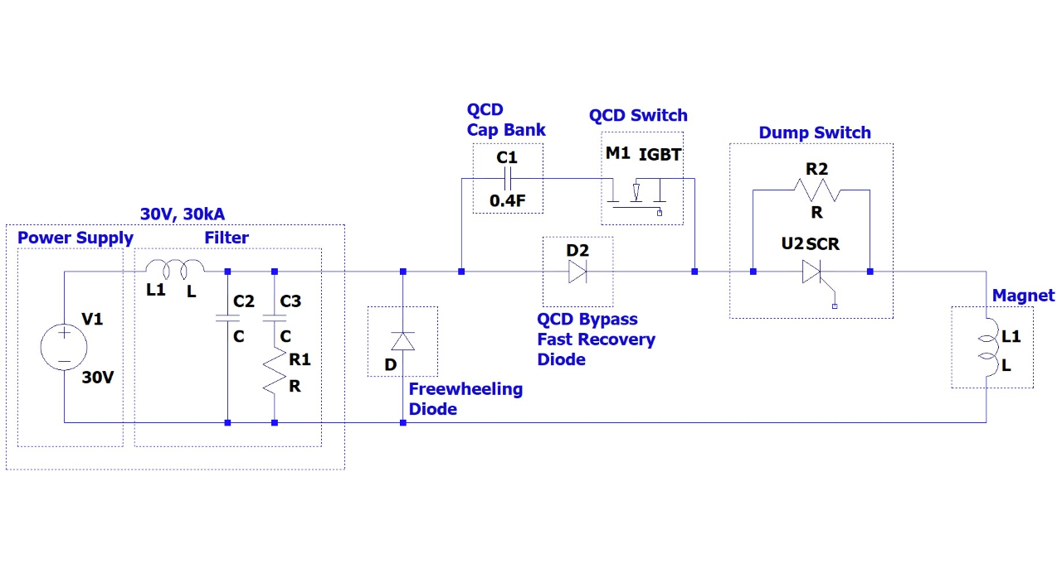
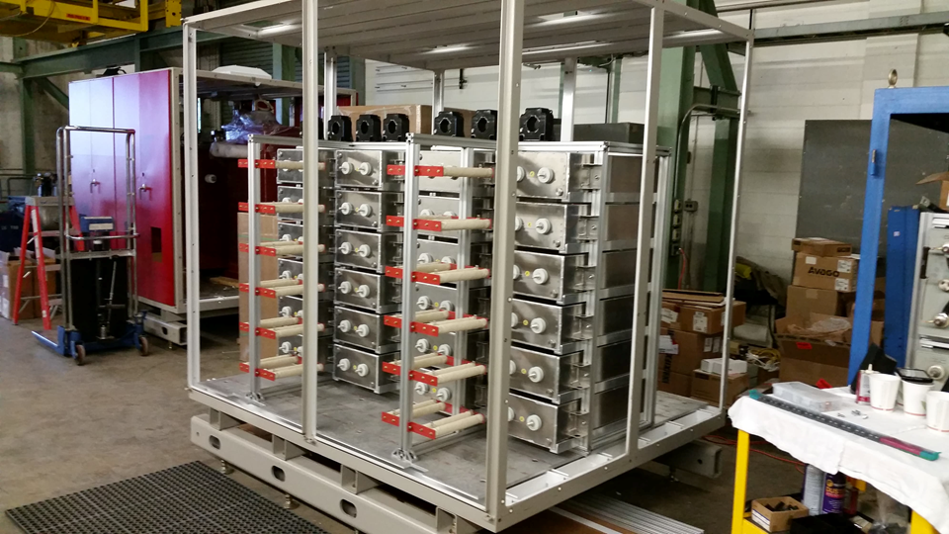
QCD
Simplified version
of the circuit
Design finalized
Most of the hardware components ordered and received
(remaining some “interface” components)
Partial assembly
Some components of the QCD
were assembled but even partial
commissioning is still far away

Slide 5
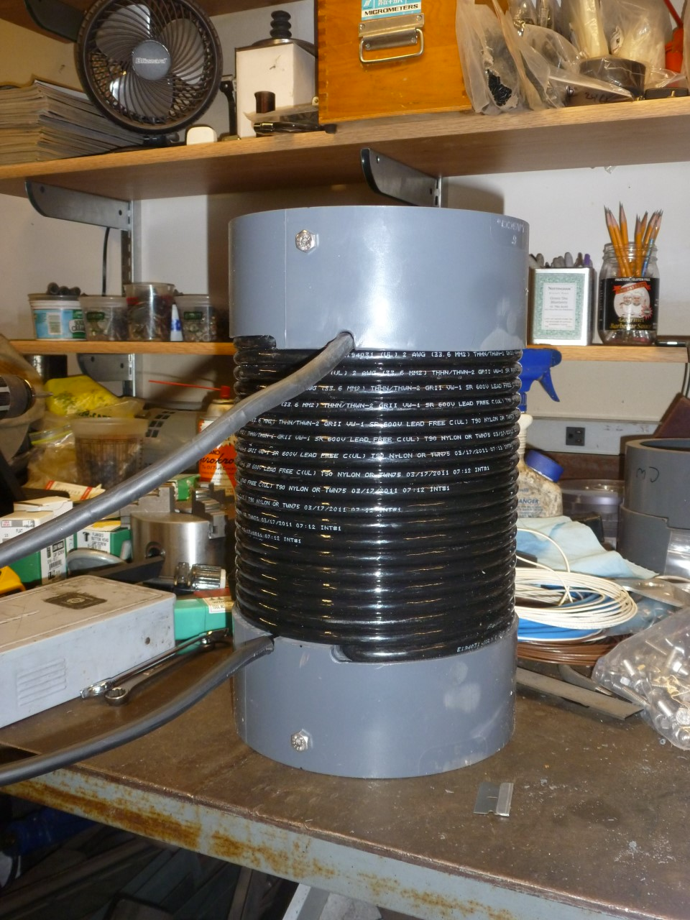
QCD (2)
Both engineering (controls, wiring list, integration to existing infrastructure) and technical
(hardware ordering, technical drawings, actual work on components as some
technicians can work at home) aspects were covered.
One of four chokes that are needed to limit the di/dt in the switching devices of the QCD were assembled “in-house” (of technicians)
Work on CONTROLS:
- figuring out the controls needed for the
QCD (experience with other devices; options).
- putting together a wiring list on how these boards would be
interconnected.
- Designing the PLC panel and ordering control power
components needed for the controls.
- Drawing for the overall controls diagram.

Slide 6
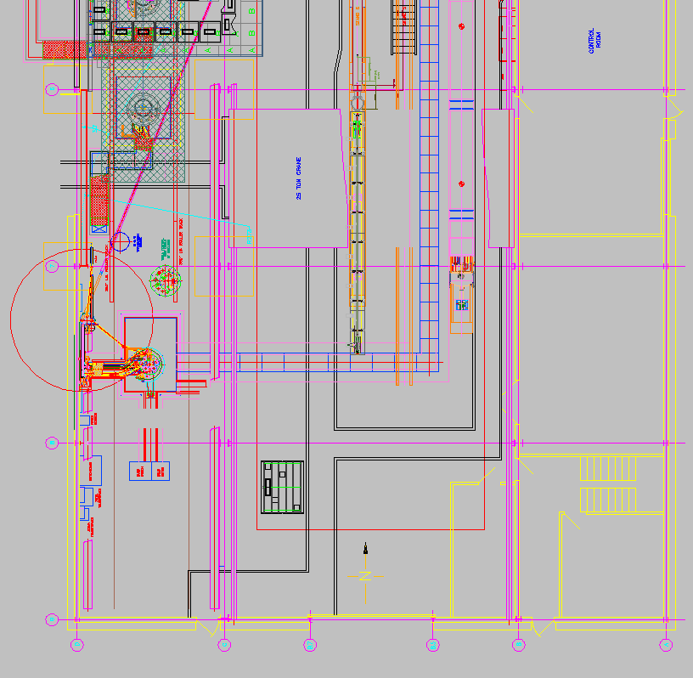
QCD integration
IB1 floor plan
The QCD will be integrated to the
CPS3 power system in IB1 at FNAL
Control room area
Test Stand 4 (horizontal testing)
VMTF
QCD
CPS3 power area

Slide 7
QCD integration (2)
Plan created, each of the sub-tasks below has responsible identified,
coordination meetings held
Specification & Design Review
Procurement
Installation of Busbar/Diode assembly
Installation of other mechanical structures
Final Inspection & Testing
Documentation Review and Approval
Floor layout review
Mobilization
Floor installation
Updating floor layout drawing
Documentation Review and Approval
Safety documents including LOTO procedures
System integration test Procedures
Safety Interlock checkouts (triggered by PLC modification)
System Integration checkouts and tuning
ORC review and walkthrough
Project coordination within T&I
QCD impact to quench systems
QCD impact to power system hardware
QCD impact to safety systems
Specification, Design, & Review
PLC interface (ladder logic and iFix coding, wiring, testing)
ETS interface
Electrical power interface
QLM interface and modification (if necessary)
Summation Unit interface
Dump modification (if necessary)
Grounding modification (if necessary)
Procurement
Documentation Review and Approval

Slide 8
QCD - near term plans (to end of FY)
Preparatory integration work (that is, without the QCD itself) will be concluded
This work is covered by Department support money
The rest of the work will likely* resume in the new FY
Funding limits for the FY exhausted
Engineers almost certainly busy with shut-down work throughout the Summer
* There is a chance we will be allowed to use money from next FY on credit

