Slide 1
Some thoughts on the all-silicon tracker and the choice of solenoid magnets for the EIC
James Symons 3/9/2021

Slide 2
Outline
What to do next for the All-Silicon Tracker ?
Yellow Report / Complementarity
Examples of Complementarity at HERA and LHC
Resolution and Cost Scaling for Solenoids
Impact of an All Silicon Tracker on ECCE and on Reference Detector
Proposal Call is out : What to do next?
Wait for an offer
ECCE
Reference Detector
Propose something “More Complementary”

Slide 3
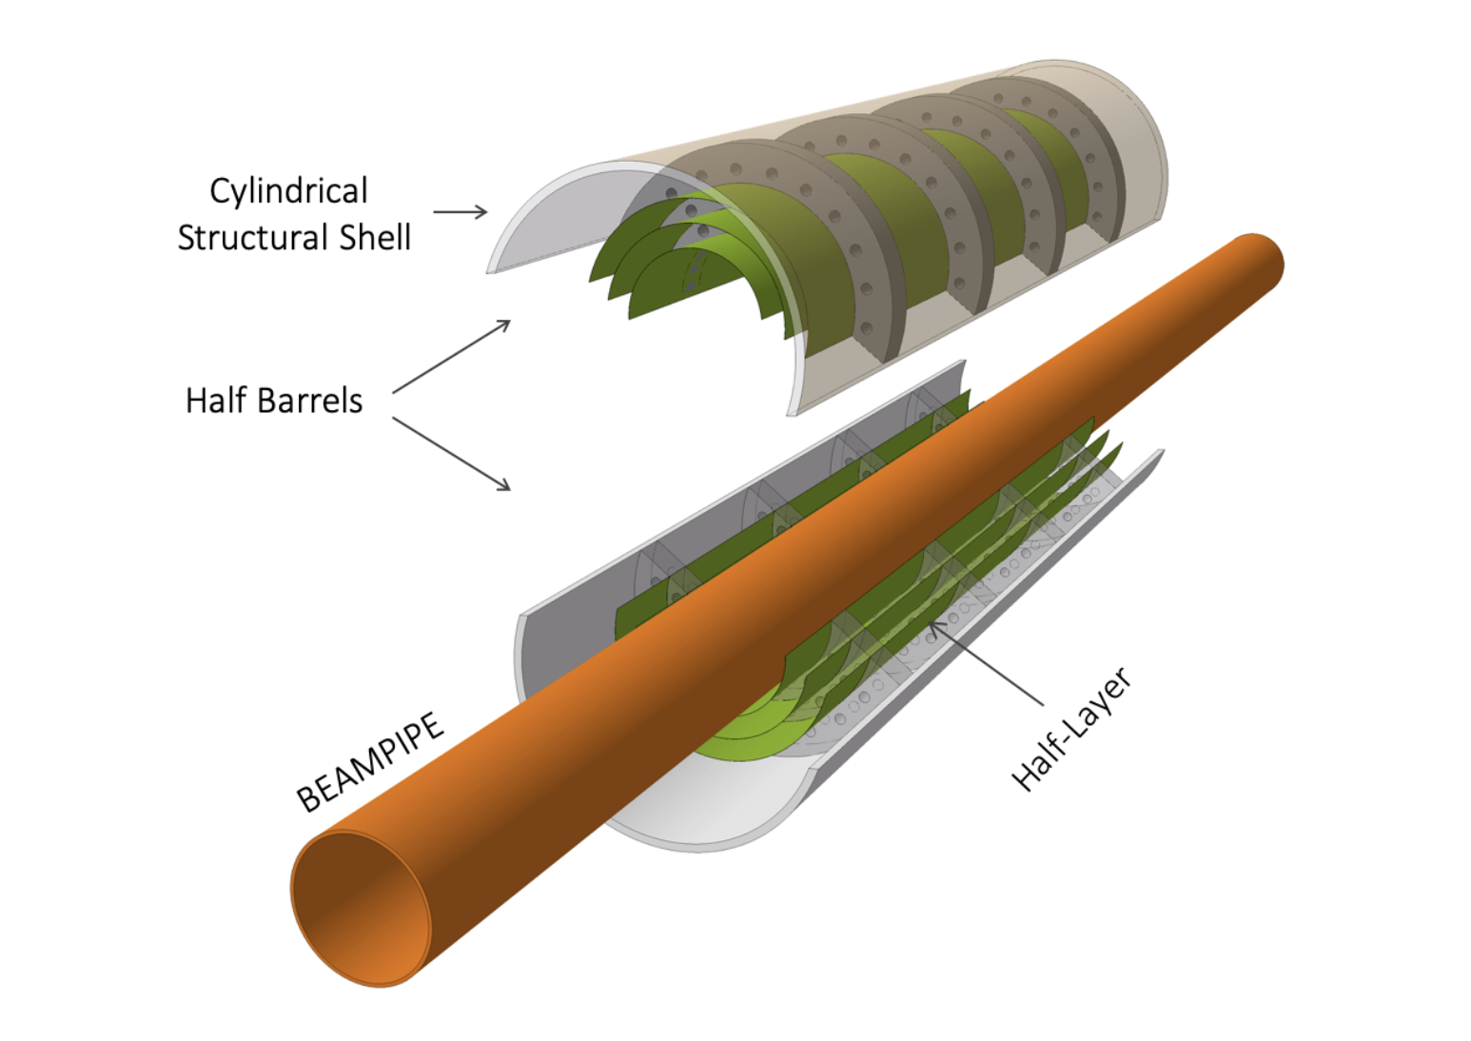
Complementarity
The Yellow Report (just published yesterday) devotes a whole chapter to discussing the advantages of two complementary general-purpose detectors:
Chapter 12 includes this sentence:
“An alternative concept that has been put forward during the Yellow Report discussions is to instrument the central region with an all-silicon tracker, based on CMOS Monalithic Active Pixel Sensors (MAPS). The corresponding device would be significantly more compact (outer radius of 45 cm as compared with 80 cm) and would slightly improve transverse momentum measurements and vertexing at the expense of particle identification performance.”
Allows a smaller magnet

Slide 4
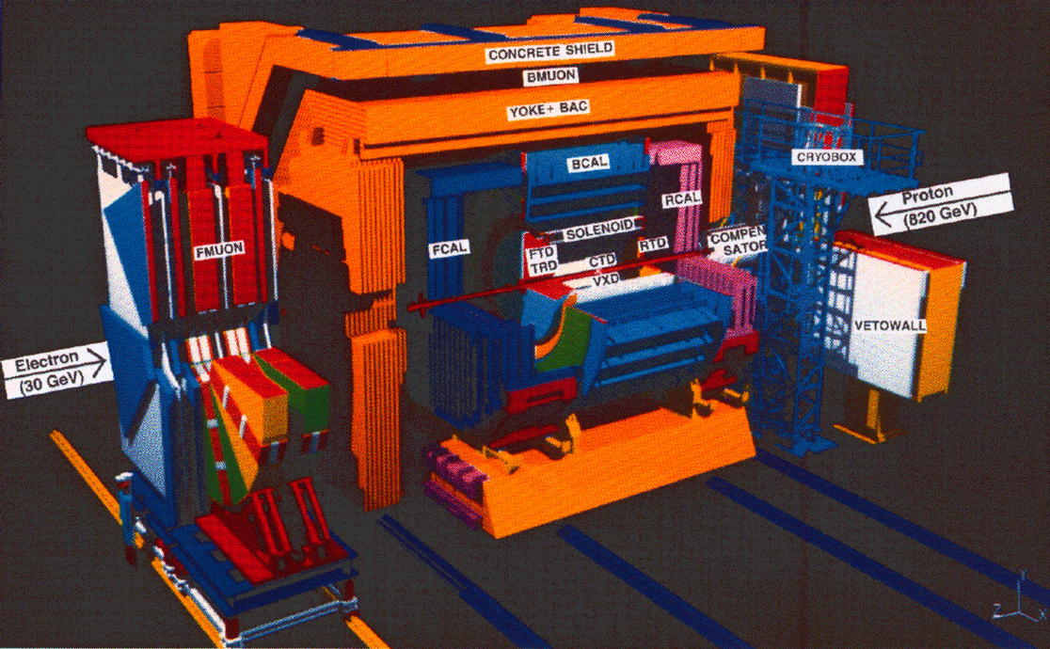
The HERA Detectors – ZEUS and H1
Solenoid Coil
LArEM and Hadronic Calorimeters
Tracking
LArEM and Hadronic Calorimeters
Solenoid Coil
ZEUS Coil radius 1.5m, B=1.8, X .9
Stored Energy 11MJ
H1 Coil radius 3m, B=1.15 T
Stored Energy 120MJ

Slide 5
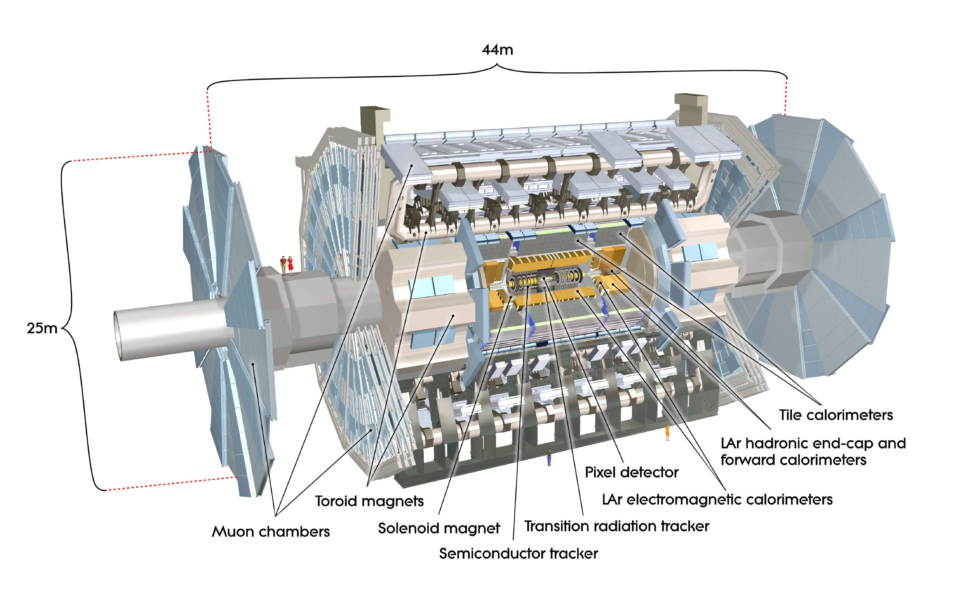
Another Example of complementary detectors – ATLAS and CMS
ATLAS Central Solenoid Radius 2m, Field 2T
Stored Energy 38MJ
CMS Solenoid Radius 6m, Field 4T
Stored Energy 2600 MJ

Slide 6
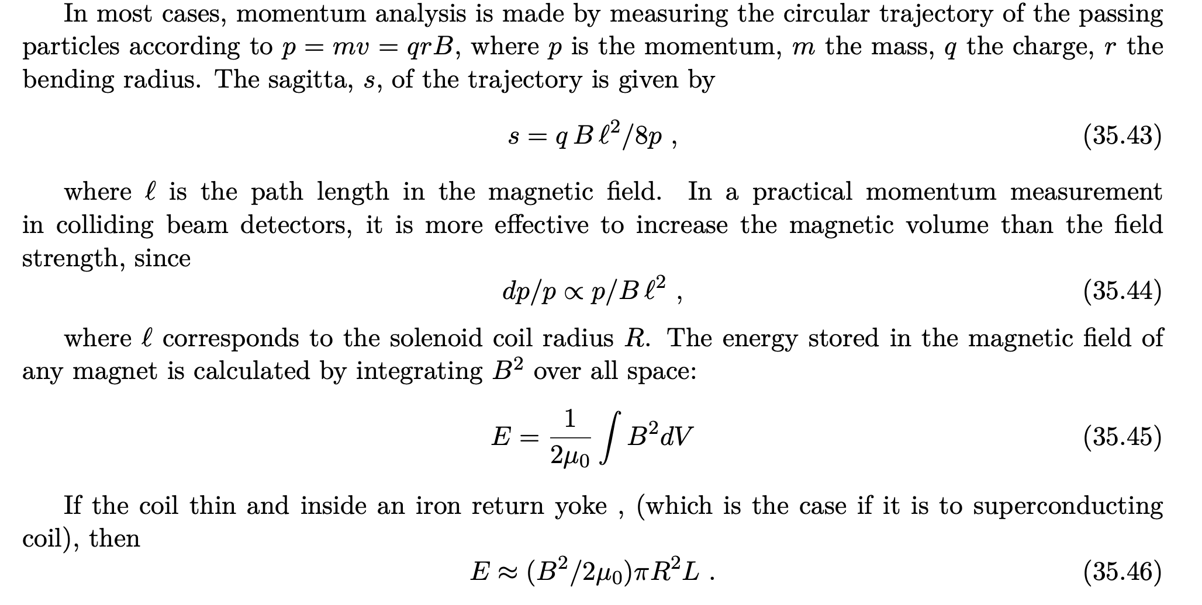
Resolution and Cost Scaling for Solenoids

Slide 7
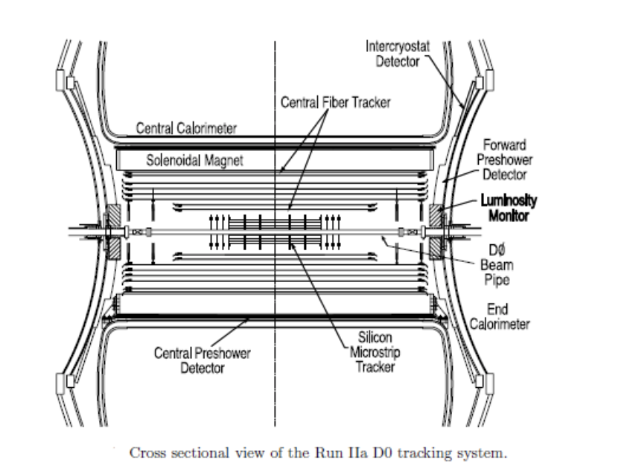
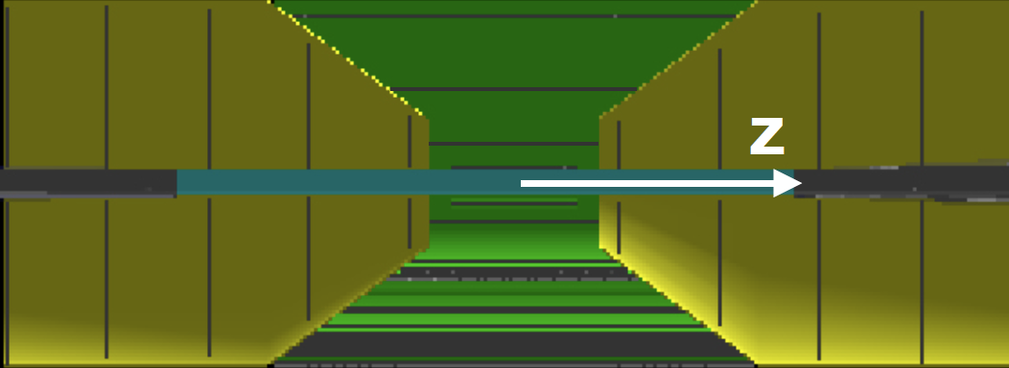
Thin-coil spectrometers have to make very efficient use of the field.
CDF, ZEUS, ATLAS, etc. use thin coils with as little radiation length as possible leading to mechanical challenges. X increases with radius
Typically Packed with tracking

Slide 8
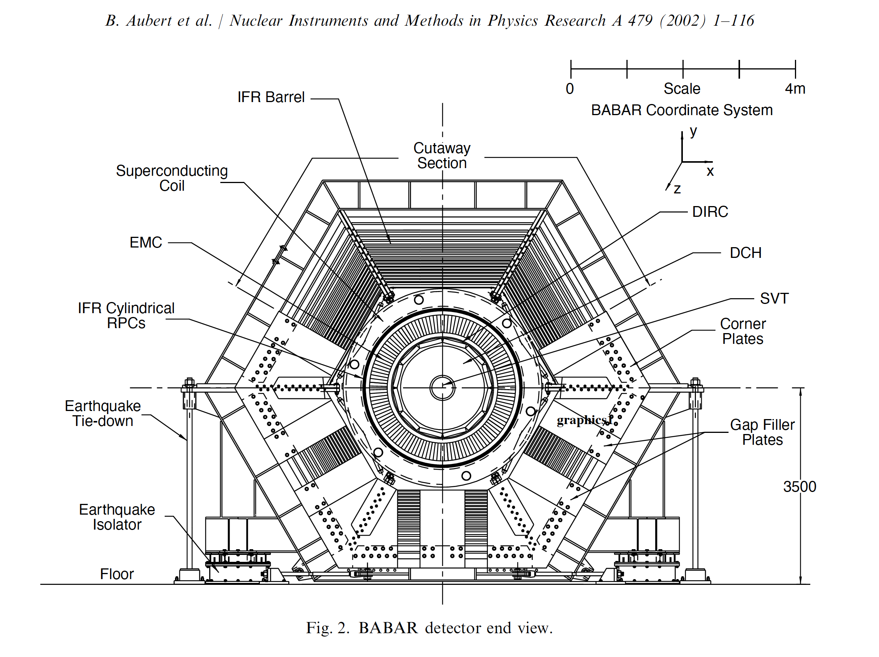
The BaBar experiment placed the DIRC and EMCal inside the solenoid coil, reducing the radiation length in front of the calorimeter, making less efficient use of the magnetic field.

Slide 9
Examples of thick and thin coil solenoids
Experiment | Bore Radius | Field | Radius of Tracking | % of Field Volume Used | FOM | Stored Energy | Column1
STAR | 2.3 | 0.5 | 2 | 76% | 2.00 | 7
BABAR | 1.375 | 1.5 | 0.81 | 35% | 0.98 | 40
CMS | 6 | 4 | 1.2 | 4% | 5.76 | 2600 | * Field needed for muons which are tracked outside
EIC Reference | 1.6 | 3 | 1 | 39% | 3.00
EIC REF All Si | 1.6 | 3 | 0.43 | 7% | 0.55 |  | * Field needed for high eta
RTuned all si | 1.1 | 3 | 0.43 | 15% | 0.55
Experiment | Bore Radius | Field | Radiation Length
CDF | 1.5 | 1.5 | 0.84
D0 | 0.533 | 2 | 0.9
ZEUS | 1.5 | 1.8 | 0.9
ATLAS | 1.25 | 2 | 0.66

Slide 10
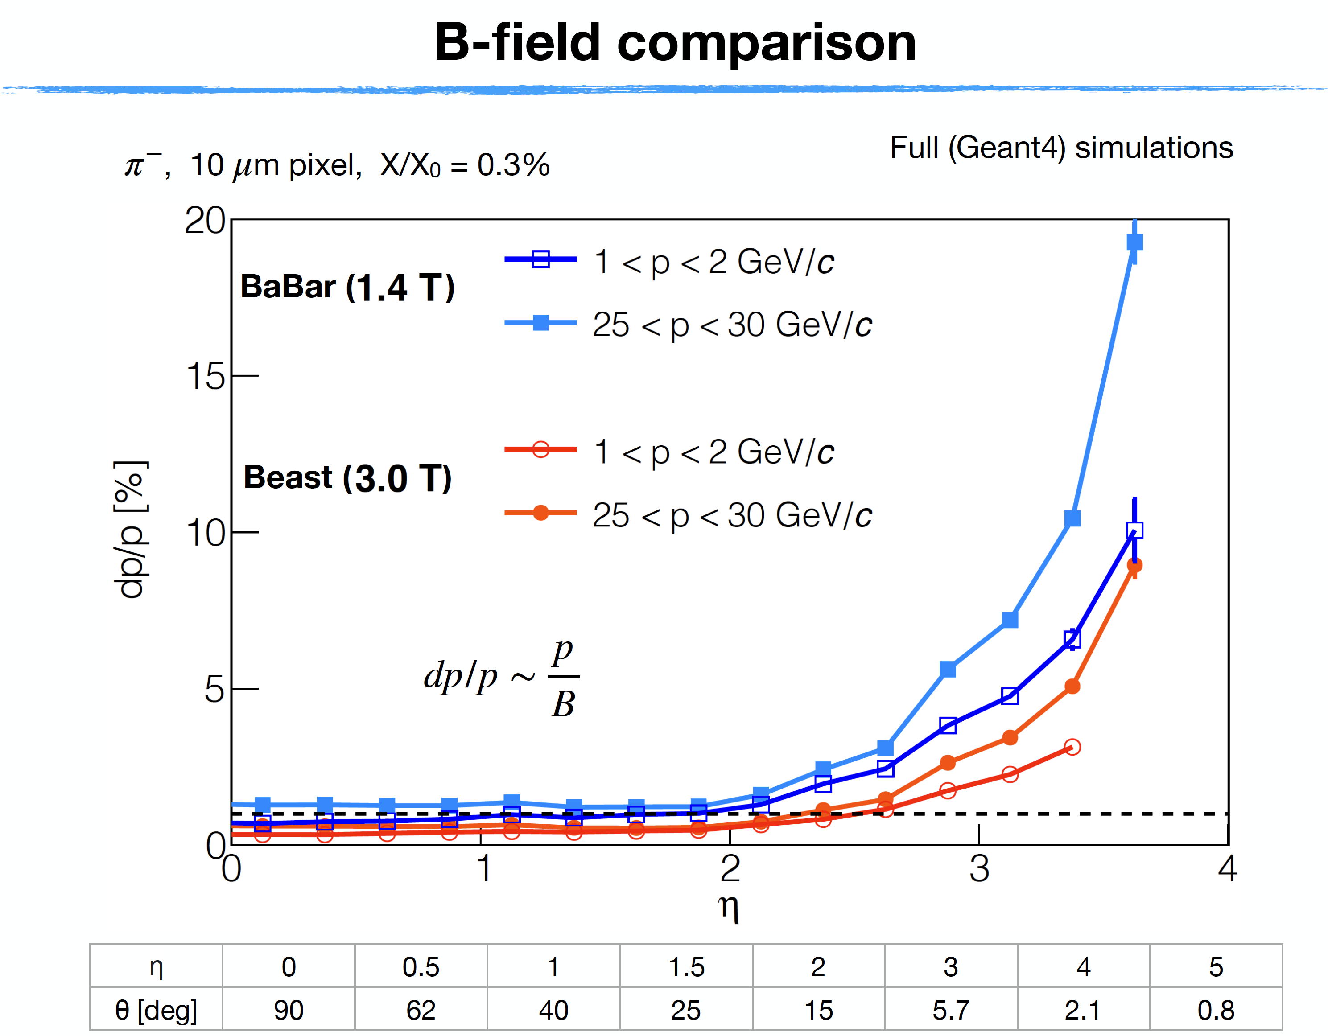
R. Cruz at ECCE Workshop

Slide 11
Impact of all-silicon on ECCE and Reference Detector
ECCE
Not Much
They have a magnet and a TPC
However, they will need state of the art silicon for vertex and forward tracking
Reference Detector
Could still have an impact on the magnet since it hasn’t been built
Could replace the TPC since that hasn’t been built.
Sneaking feeling that the high eta, hadron side has not yet been optimized

Slide 12
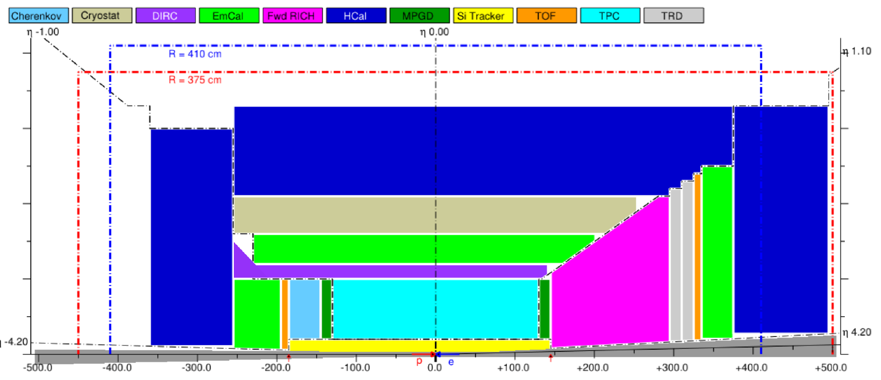
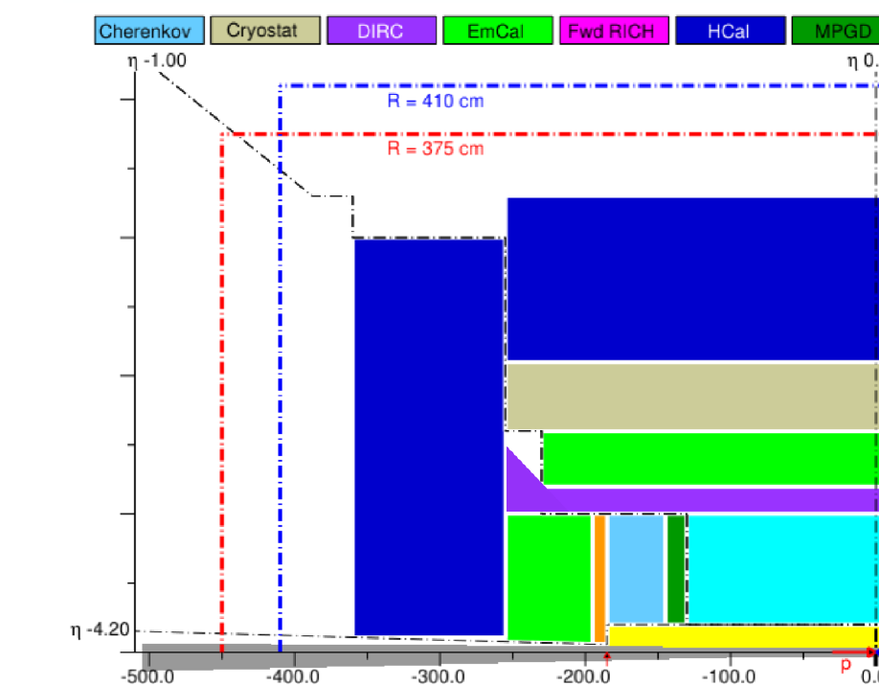
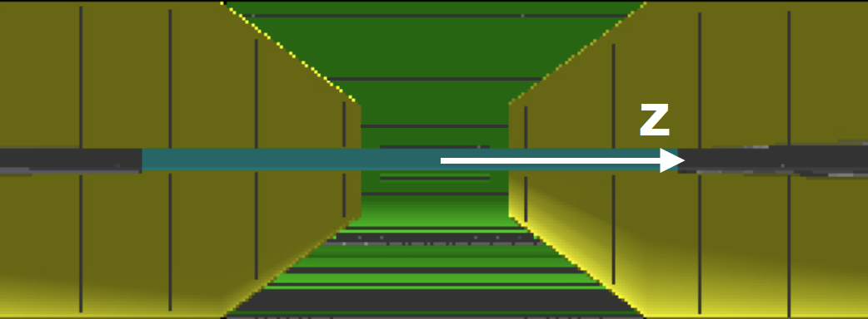
Impacct of all Silicon on Reference Detector

Slide 13
What would the impact be of the smaller Solenoid
Radius 1.6m -> 1.1m
Length 5.4m -> 4.6m
Volume reduced by 60%
Significant reduction in cost

Slide 14
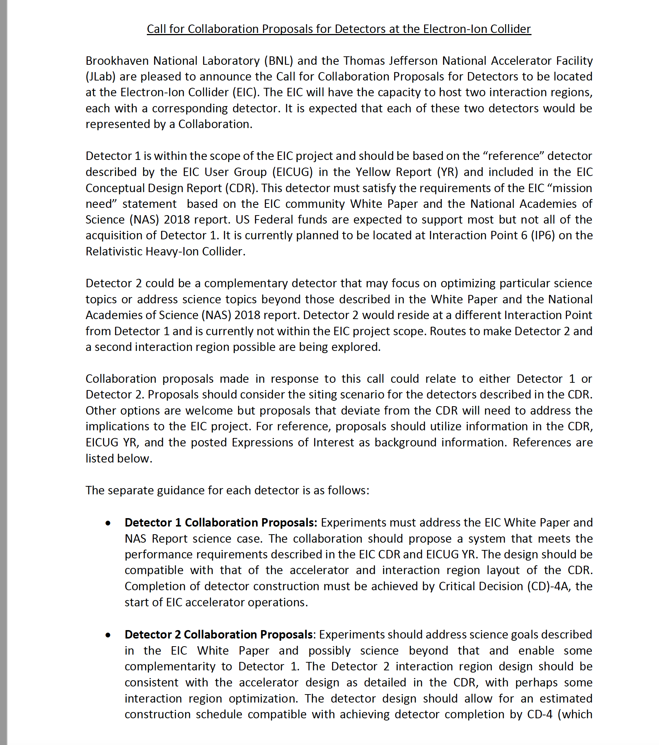
The Train has left the station (Maybe)

Slide 15
Number of Interesting questions
Strong support for Yellow Report Reference Detector
Will ECCE compete for detector 1?
If the New Magnet is chosen for Detector 1, is ECCE sufficiently complementary for Detector 2?
Is there still room for a more complementary idea?

Slide 16
STAR was originally planned to have a thin superconducting coil
CDR was updated:
The major change that has taken place in the solenoidal magnet system has been to adopt a warm coil approach rather than the superconducting approach documented in the CDR. This change was driven by the recognition that the relatively low magnetic field (0.5 T) required for the detector permitted a choice of coil approach and that a warm coil would improve the physics capability of the detector by permitting the barrel electromagnetic calorimeter to be placed radially inside of a warm coil. This results in a significant reduction (by about a factor of three) of the material between the collision vertex and the calorimeter, resulting in improved performance, especially for the low energy particles that are typical of the kind of heavy ion collisions that are the primary focus of RHIC. A warm coil also requires less capital cost and could be fabricated more rapidly than a cryogenic coil. In addition, the technical risk inherent in a thin, cryogenic coil is greater than that for a warm coil with no special constraints on the coil thickness. On the other hand, a warm coil requires a significant increase is the supporting utilities that must be provided by RHIC to support operations of the STAR detector. The RHIC management has agreed that BNL/RHIC would provide the additional installed capabilities required (e.g. power, cooling tower, heat exchangers, etc.) and that the additional power load of a warm coil would be accommodated within the power allocation and the operating budget for RHIC.

Slide 17
What next for this group?
Wait for an offer
All silicon collaboration has a dowry called the Silicon Consortium and MAPS
Work with ECCE and Reference Detector
Change name of tracker to All MAPS
Reference Detector magnet optimization
Propose something “More Complementary”
Anyone for a thin solenoid with a forward dipole to solve the high eta tracking problem?

