Slide 1
Reminders

Slide 2
PMP Deadlines
Monday, June 22 | Employee Self-Assessments are due
Tuesday, July 14 | Supervisor completes draft of the performance review by Tuesday, July 14 and submits to one-up reviewer. Supervisor enters the proposed rating at pmp.lbl.gov
Tuesday, July 14 - Wednesday, July 29 | One-up Reviewer completes commenting/suggested edits by Wednesday, July 29
Wednesday, July 29 - Wednesday, August 5 | Supervisor incorporates comments/edits by Wednesday, August 5 All Supervisor Reviews are due for Division review, do not “Finalize” the document at this stage.
Wednesday, August 5 – Friday, August 14 | Division Review Process. Supervisors will receive Division approval to “Finalize” the document during this time period.
Friday, August 14 – Friday, August 28 | After Division approval is received, Supervisors conduct performance review meeting with the employee and obtain employee’s electronic signature using “HelloSign.”
Friday, August 28 | All annual performance reviews completed, signed electronically by employee and supervisor. This is a hard deadline and we need 100% Completion.

Slide 4
We encourage you to participate!
Early Career Researchers,
The deadline to submit your intent to participate in the 2020 SLAM is this Friday, June 19. To be eligible, you must have received your Ph.D. from 2013-2019 and be an active employee through the live competition on September 17, 2020. The SLAM provides a great opportunity to hone your elevator pitch and compete for a chance at a $3,000 First prize! If you are considering participating, the sign-up is simple and will only take a minute. Once the submission period is closed, you will receive an email confirming your eligibility and next steps in the competition. The next deadline will be to submit your video on July 17th. There will be multiple opportunities provided to help with your SLAM preparation. Please reach out to the Career Pathways Office at pathways@lbl.gov with any questions.

Slide 5
Division Updates

Slide 6
Acknowledge a unique situation
We have been away from the lab since the middle of March
We have been adapting to a new environment of remote work
We have been adapting our lives to social distancing

Slide 7
Recognize that this is not an ideal environment for job transitions
It is not an ideal time to conduct interviews
New hires do not get in-person introductions, an office with the group, or in-person training
And retiring staff do not have the ability to receive the in-person recognition for their years of service

Slide 8
Jane McCall
Started at the lab in 1992 and has been with the Nuclear Science Division since 2006
Spent most of that time providing support to the Nuclear Theory program
Currently supports the Nuclear Theory and Neutrino Programs as well as the RIKEN iThems collaboration
Worked in procurement, at the ALS, and EHS Waste Management

Slide 9
We thank Jane for
her dedication and support over the years

Slide 10
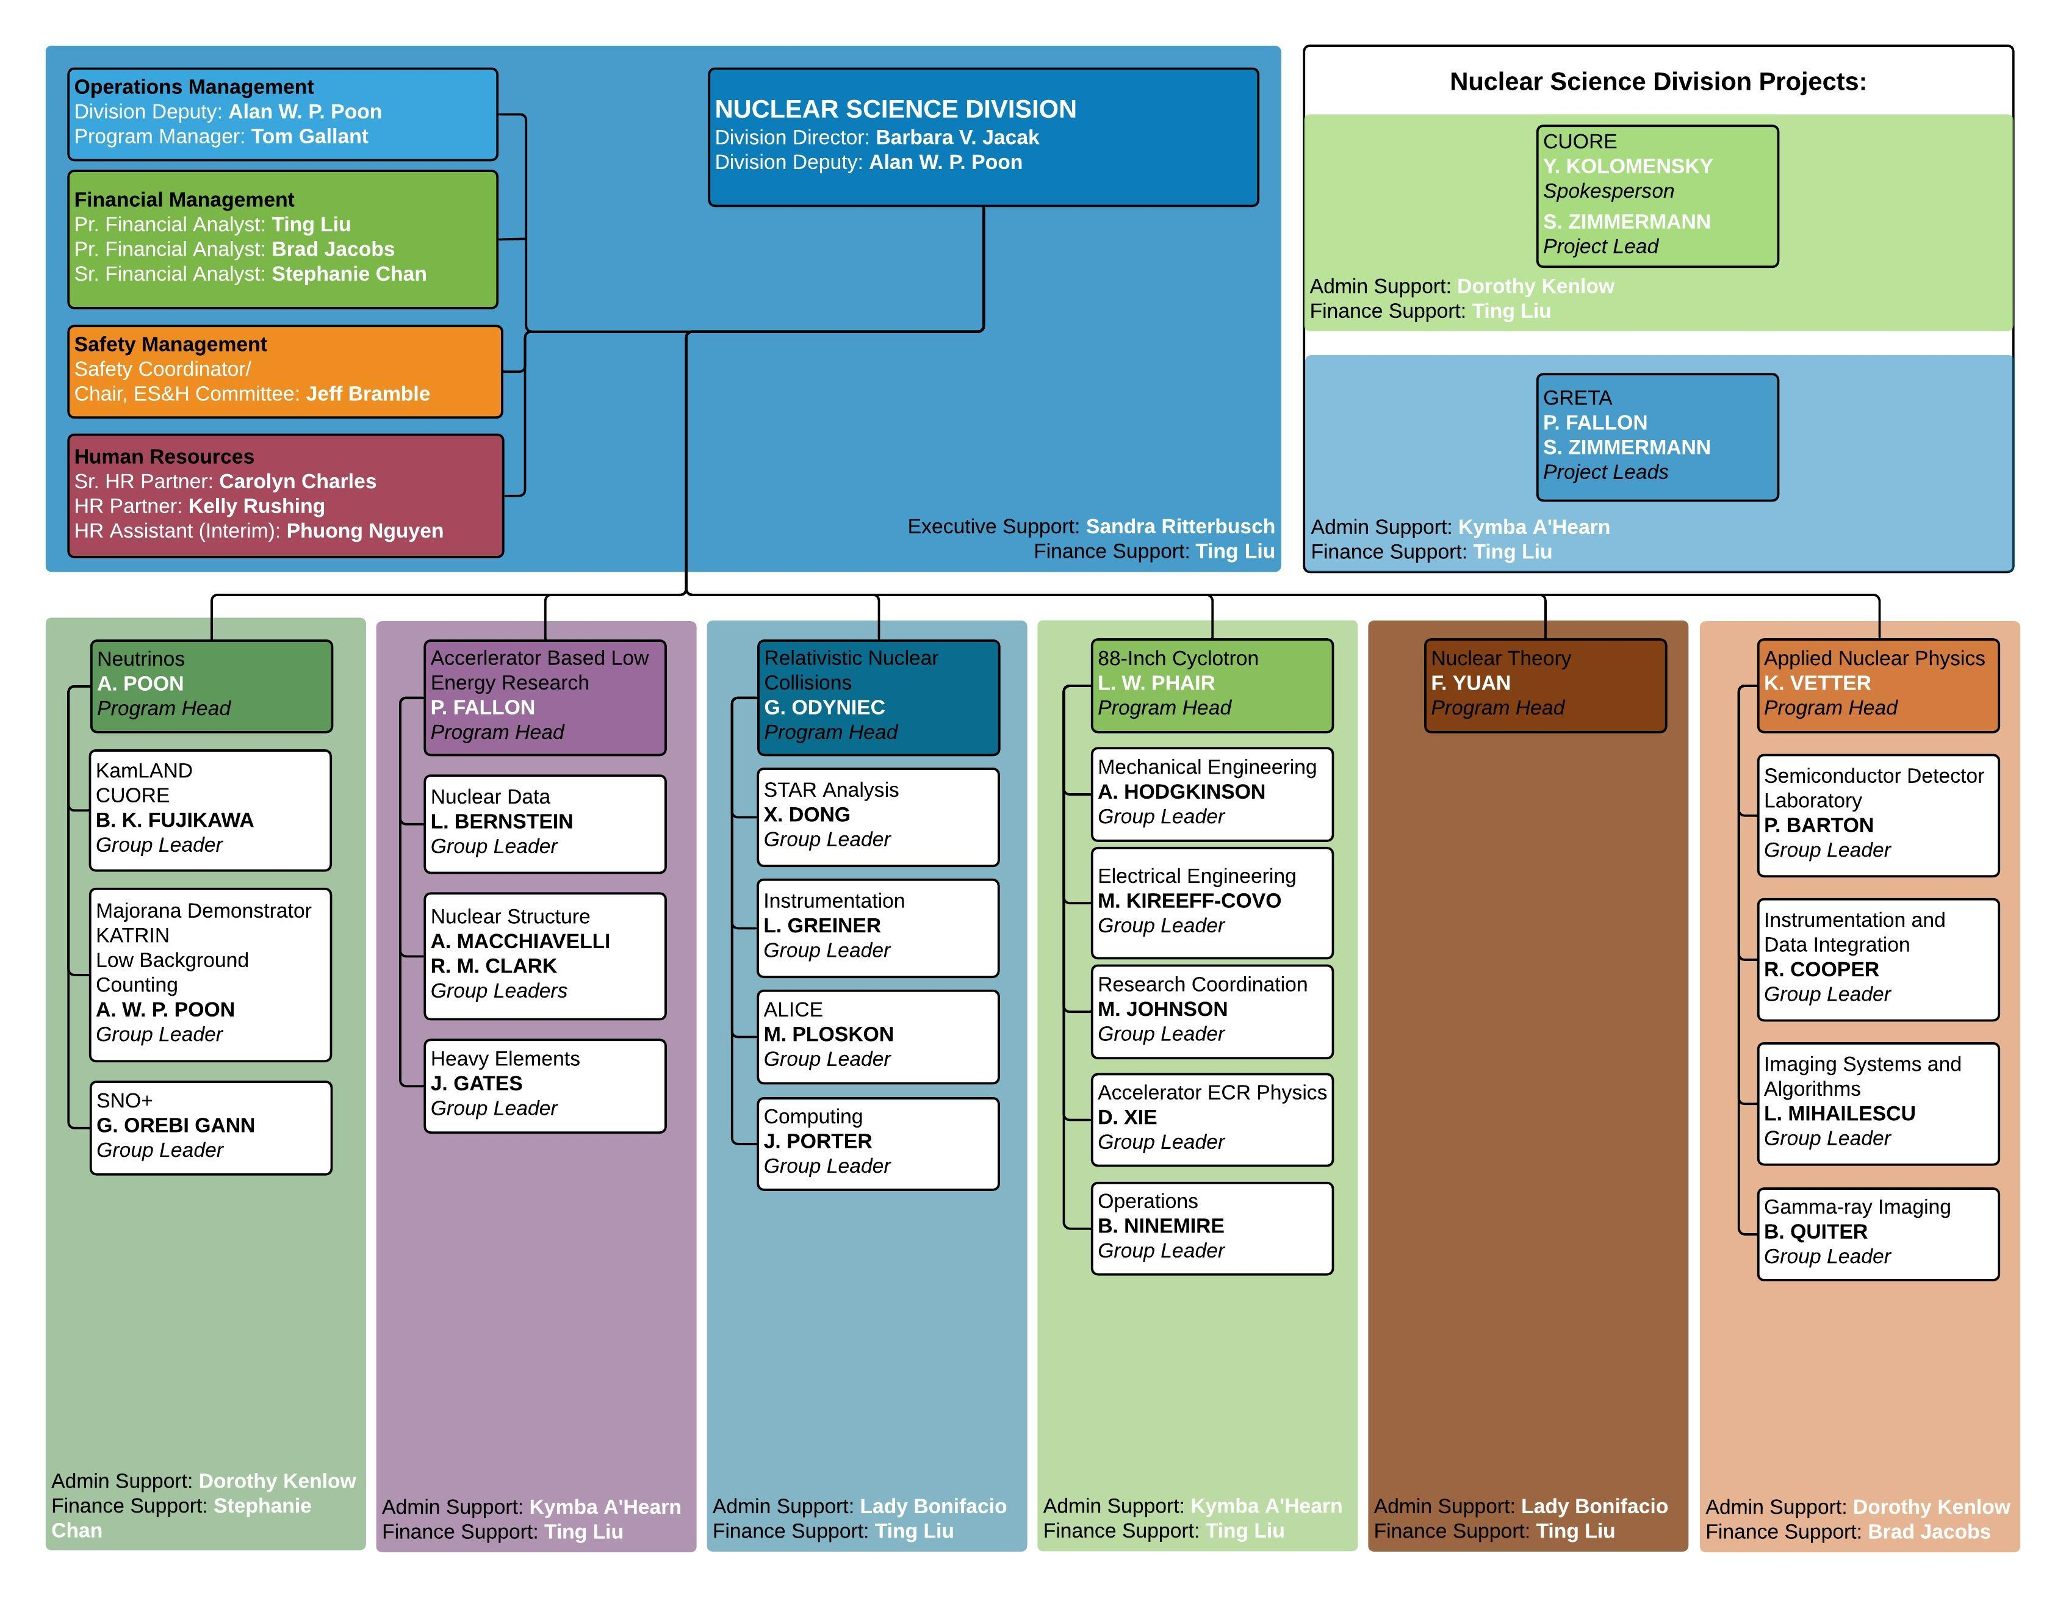
Many thanks to the entire ops team in assisting with this transition

Slide 11
Area Updates

Slide 12
Glenda Fish
Started at the lab in 1984
Glenda served in the Nuclear Science Division from June 2005 to March 2006, and April 2007 to January 2008
Over the course of her career, Glenda has served in the AFRD (now ATAP), Nuclear Science, Engineering, and Physics Divisions
She has also worked on the SSC and ALS projects, Laboratory Directorate and currently serves in the Physical Sciences Area office.

Slide 13
James Symons
James stepping down as ALD June 30, 2020
James came to the Lab in 1977 as a post-doctoral researcher from Oxford University
Served as the Nuclear Science Division Director from 1985 to 1995
During 1995 to 2002 he was involved in planning for RHIC and served as the NSAC Chair
Again served as the Nuclear Science Division Director from 2002 to 2012
He has been the Associate Laboratory Director for Physical Sciences (then General Sciences) since 2011

Slide 14
Phase 2 Activities

Slide 15
Nuclear Science Division
+2 for RNC: testing of MVTX power boards in building 70 (Leo Greiner's lab)
+1 for ion source group (Dan Xie): develop Ti and V beams for the 88
+2 for 88-inch cyclotron operations
+2 for 88-inch cyclotron experimenters
+2 shared between 88 operations & experiment
+3 for ANP: shared among various projects, coordinated by ANP
+2 for SHE group: develop control systems, detector box for E120 search
+2 for Fundamental Symmetries group: expand LEGEND and CUPID R&D
+2 for theory group: allow postdoc & student opportunities to discuss with senior theorists using white boards in theory break room (common room)
+2 for management oversight & on-site admin work
Proposed increase of 20 badge-ins
for Pilot 2

