Slide 1
MDP Technical Meeting #7
20 T hybrid magnet and comparative analysis
P. Ferracin, G. Ambrosio, E. Barzi, L. Cooley, R. Gupta, V. Kashikhin, V. Marinozzi, I. Novitski, B. Yahia, A. Zlobin
US Magnet Development Program

Slide 2
Outline
Some preliminary estimates of radiuses and dimensions
Appendix
  Design criteria for a 20 T hybrid magnet
  Definition of the goals of the working group
  Overview of current hybrid work
  Action items

Slide 3
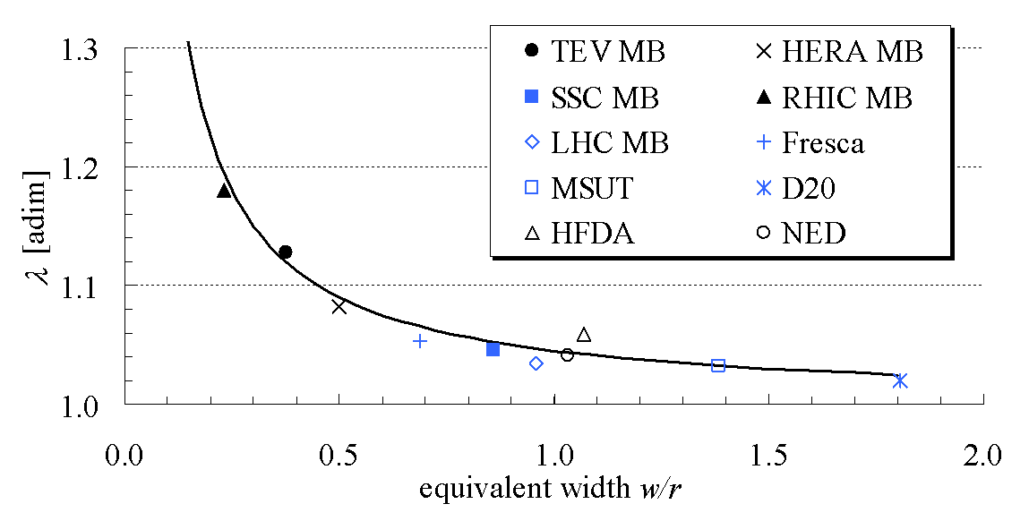
Field in at 20 T dipole
B_{bore_op} = 20 T
B_{peak_op} = B_{bore_op} · 1.04 = 20.8 T
B_{bore_ss} = B_{bore_op} / 0.85 = 23.5 T
B_{peak_ss} = B_{bore_ss} · 1.04 = 24.4 T

Slide 4
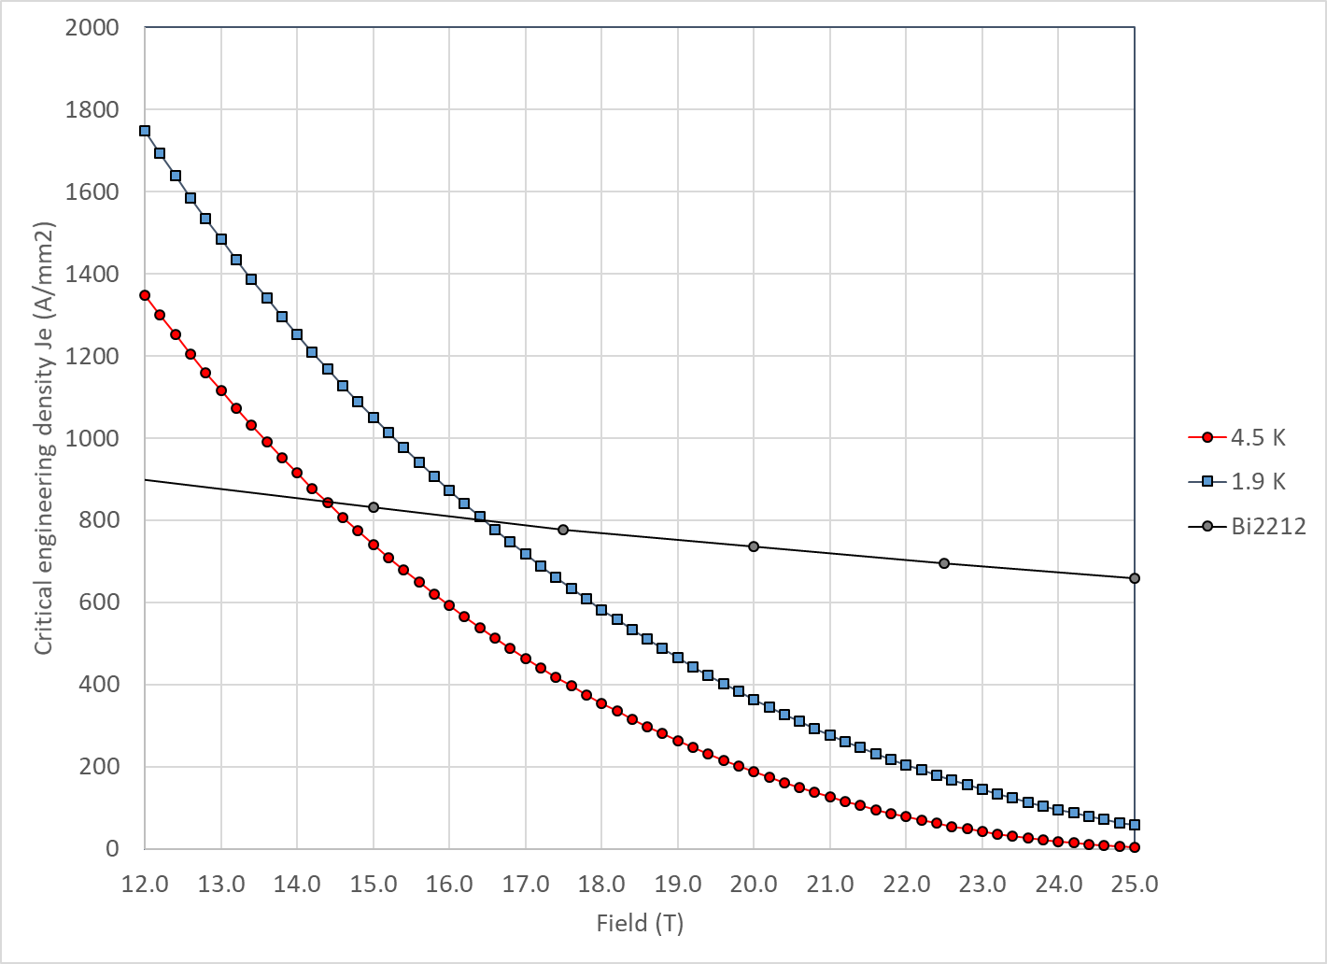
Nb₃Sn vs Bi2212
With properties describe above Nb₃Sn and Bi2212 cross at 14.5 T at 4.2 K and 16.5 T at 1.9 K

Slide 5

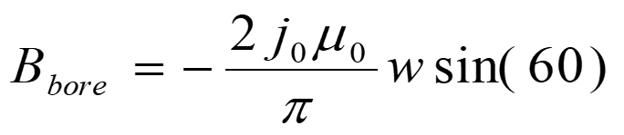
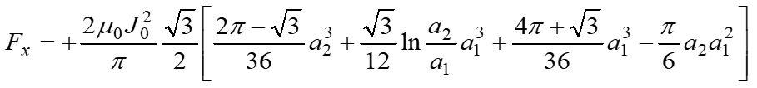
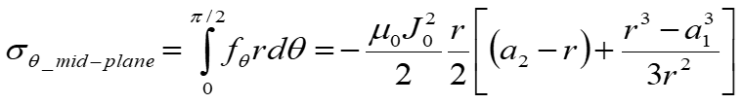
Sector coil
Sector coil (60°) with J = J₀ distribution
  No iron
  Constant Jo
Je = Jc * 0.48
Jo = Je * 0.67
Jo = Jc * 0.32

Slide 6
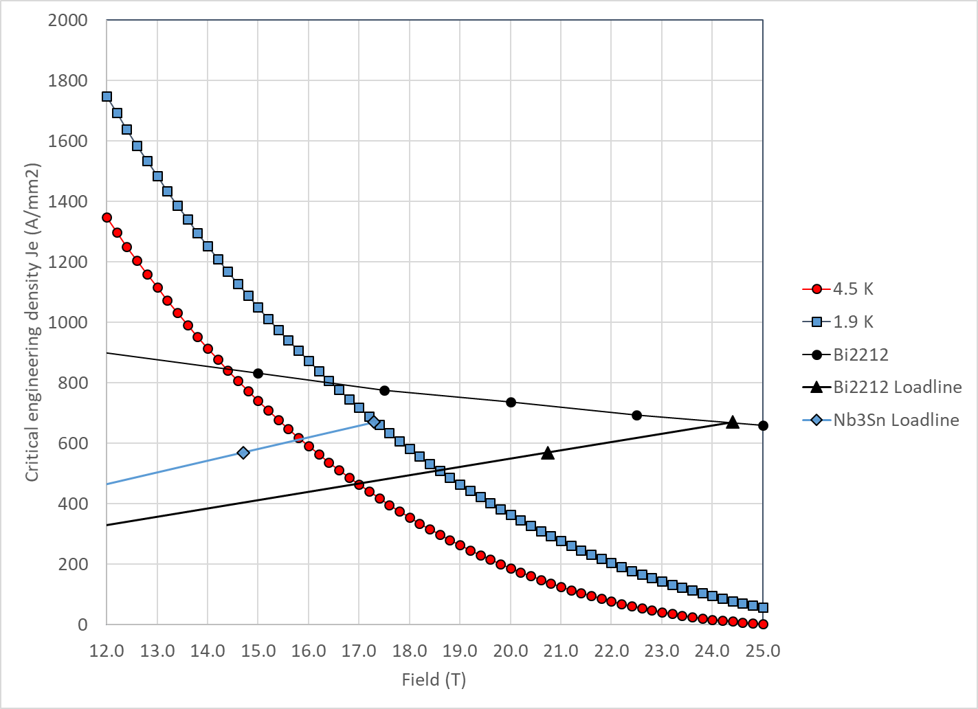
20 T Bi2212-Nb3Sn hybrid
Bi2212
  At short sample
    B_{p_ss} = 24.4 T
    J_{e_ss} = 670 A/mm2
    J_{o_ss} = 450 A/mm²
  So, at 85% of short sample
    B_{p_op} = 20.8 T
    J_{e_op} = 570 A/mm2
    J_{o_op} = 382 A/mm²

Slide 7
20 T Bi2212-Nb3Sn hybrid
Bi2212
  At short sample
    B_{p_ss} = 17.3 T
    J_{e_ss} = 670 A/mm2
    J_{o_ss} = 450 A/mm²
  So, at 85% of short sample
    B_{p_op} = 14.7 T
    J_{e_op} = 570 A/mm2
    J_{o_op} = 382 A/mm²

Slide 8
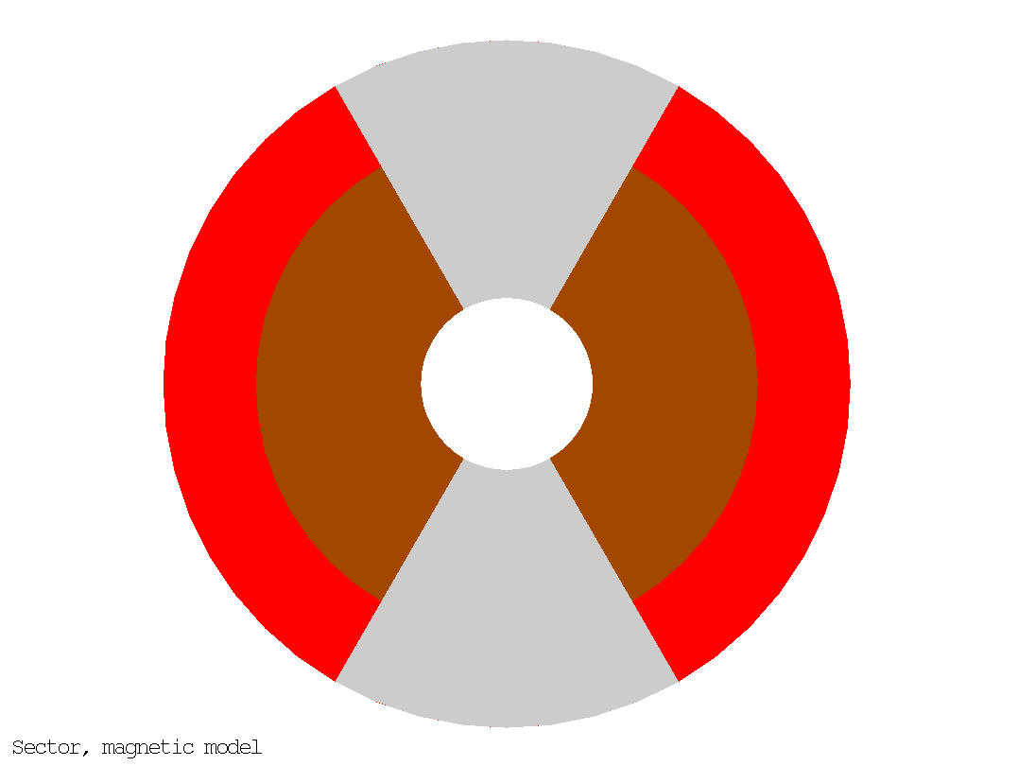
20 T Bi2212-Nb3Sn hybrid
50 mm aperture
Under the previous assumption (sector coil, constant Jo everywhere, no stress management, no iron)
  ID Nb₃Sn = 146 mm
  OD Nb₃Sn = 200 mm
  76 m total coil thickness
    48 mm thick Bi2212 coil
    28 mm thick Nb₃Sn coil
  Area Bi2212: 2460 mm² (1 quadrant)
  Area Nb₃Sn: 2550 mm² (1 quadrant)
  Stored energy: 2.86 MJ/m (4 quadrants)
Nb₃Sn
Bi2212

Slide 9
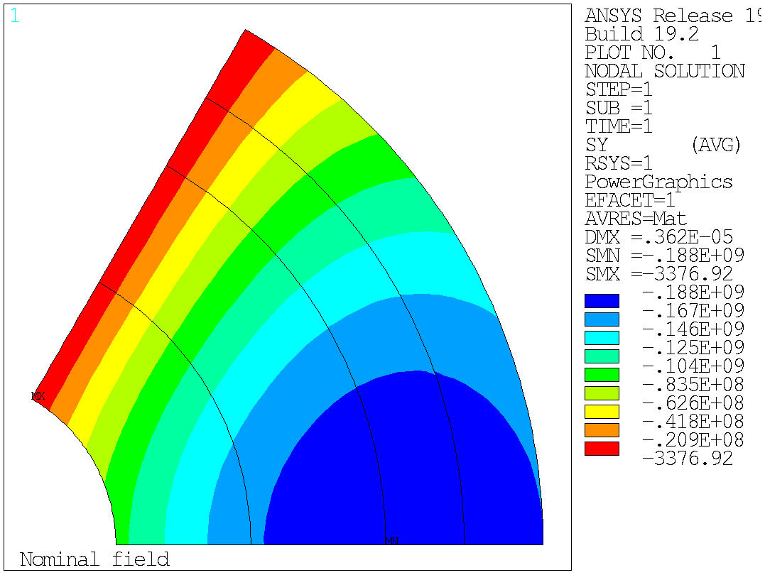
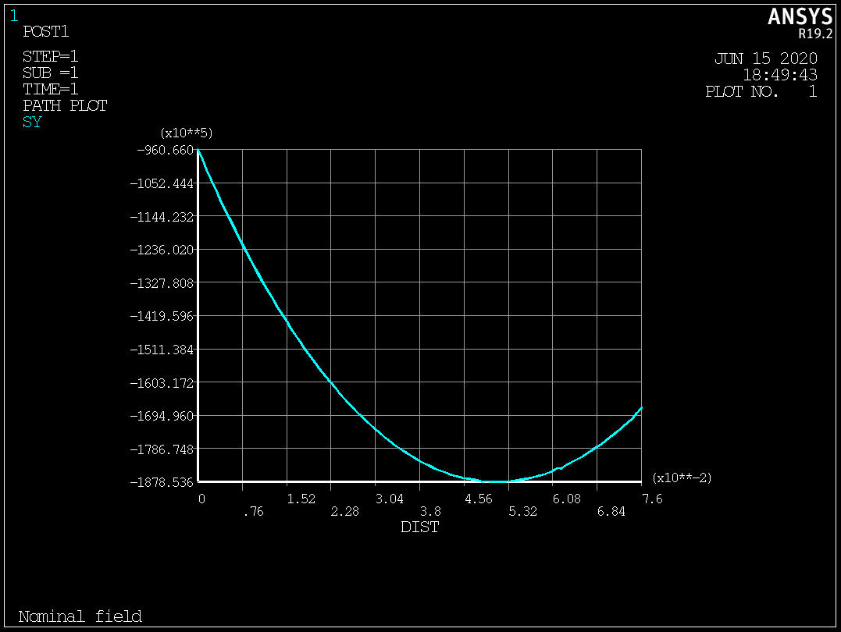
20 T Bi2212-Nb3Sn hybrid
Accumulated stress on the mid-plane → Max: 190 MPa
  No shear, no bending….

Slide 10
20 T Bi2212-Nb3Sn hybrid
Test separately the Nb3Sn and the Bi2212 coils
ID: 50 mm
OD: 200 mm
W: 76 mm
ID: 50 mm
OD: 146 mm
W: 48 mm
ID: 146 mm
OD: 200 mm
W: 27 mm
Nb₃Sn
Nb₃Sn
Nb₃Sn
Bi2212
Bi2212
Bi2212

Slide 11
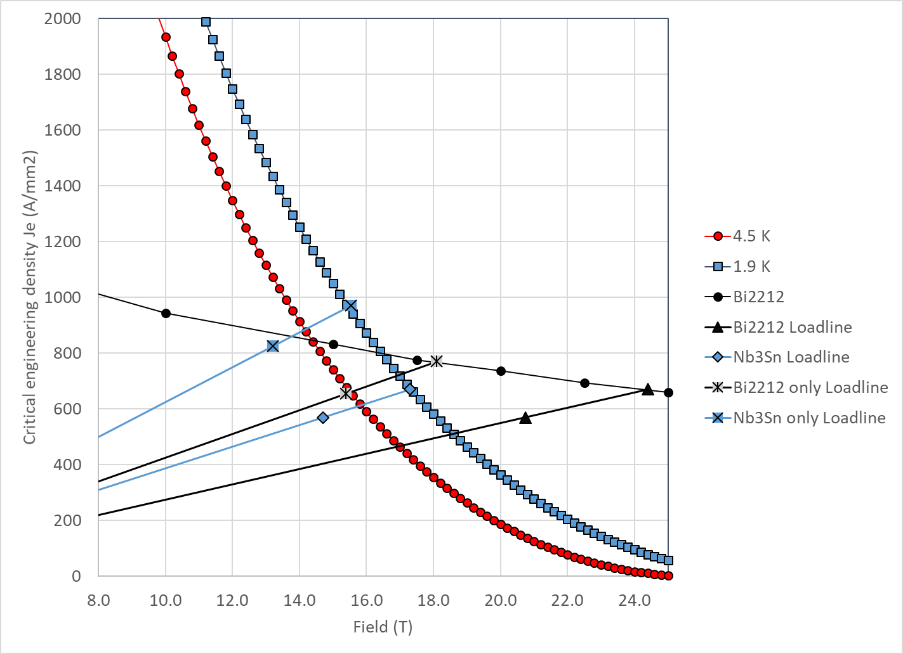
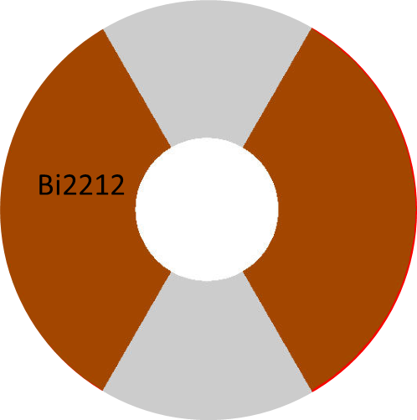
20 T Bi2212-Nb3Sn hybrid
Bi2212 “only”
Bi2212
  At short sample
    B_{p_ss} = 18.1 T
    B_{bore_ss} = 17.0 T
    J_{e_ss} = 770 A/mm2
    J_{o_ss} = 516 A/mm²
  So, at 85% of short sample
    B_{p_op} = 15.4 T
    B_{bore_op} = 14.5 T
    J_{e_op} = 655 A/mm2
    J_{o_op} = 439 A/mm²

Slide 12
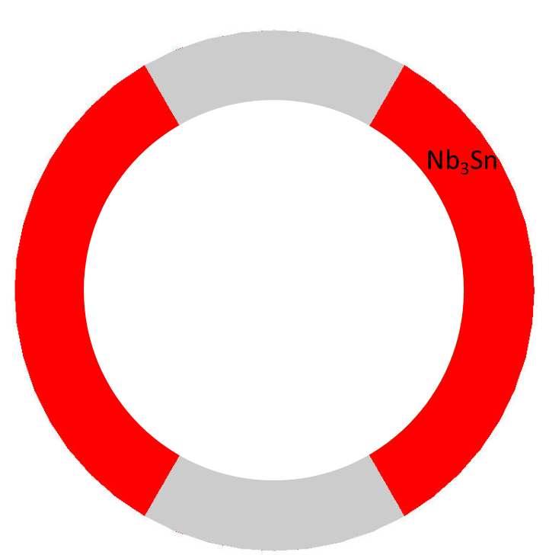
20 T Bi2212-Nb3Sn hybrid
Nb3Sn “only”
Nb3Sn
  At short sample
    B_{p_ss} = 15.5 T
    B_{bore_ss} = 12.4 T
    J_{e_ss} = 970 A/mm2
    J_{o_ss} = 650 A/mm²
  So, at 85% of short sample
    B_{p_op} = 13.2 T
    B_{bore_op} = 10.5 T
    J_{e_op} = 825 A/mm2
    J_{o_op} = 553 A/mm²

Slide 13
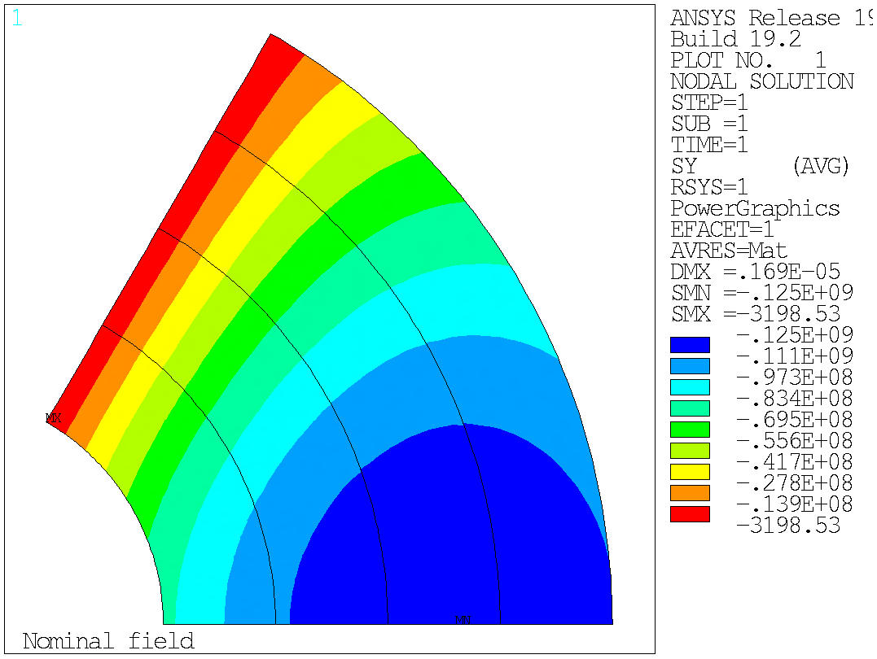
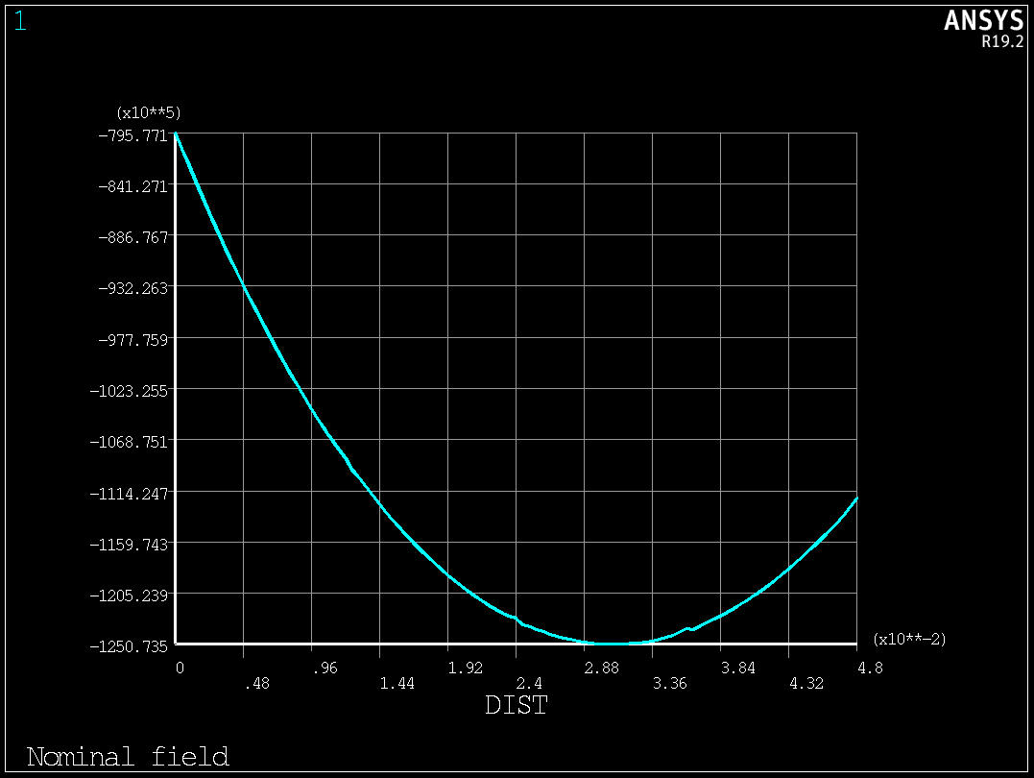
20 T Bi2212-Nb3Sn hybrid
Bi2212 “only”
Accumulated stress on the mid-plane → Max: 125 MPa
  No shear, no bending….

Slide 14
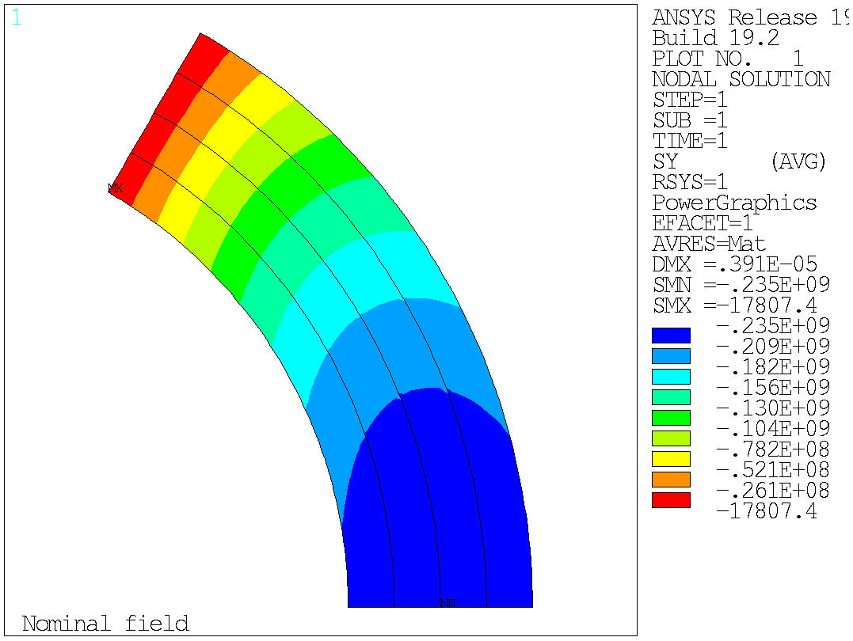
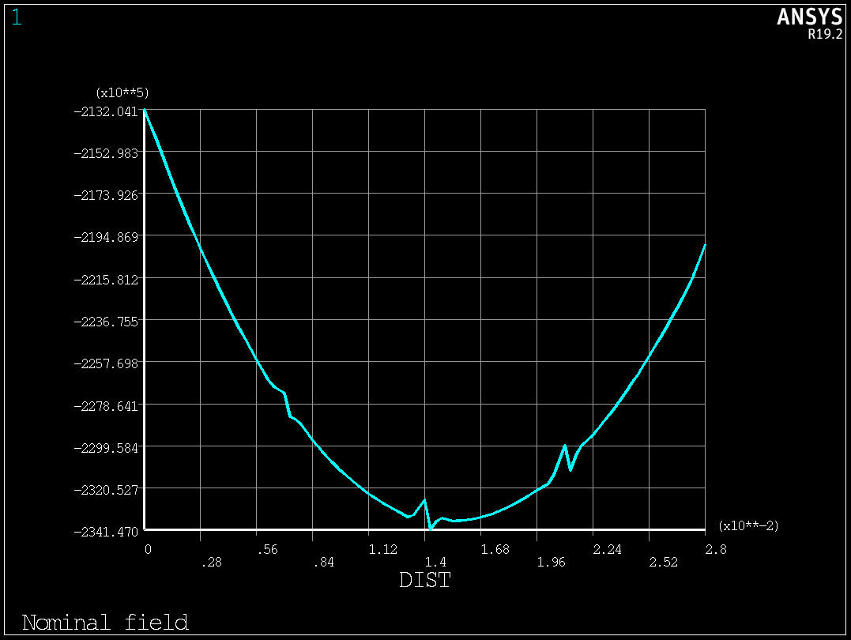
20 T Bi2212-Nb3Sn hybrid
Nb3Sn “only”
Accumulated stress on the mid-plane → Max: 235 MPa
  No shear, no bending….

Slide 15
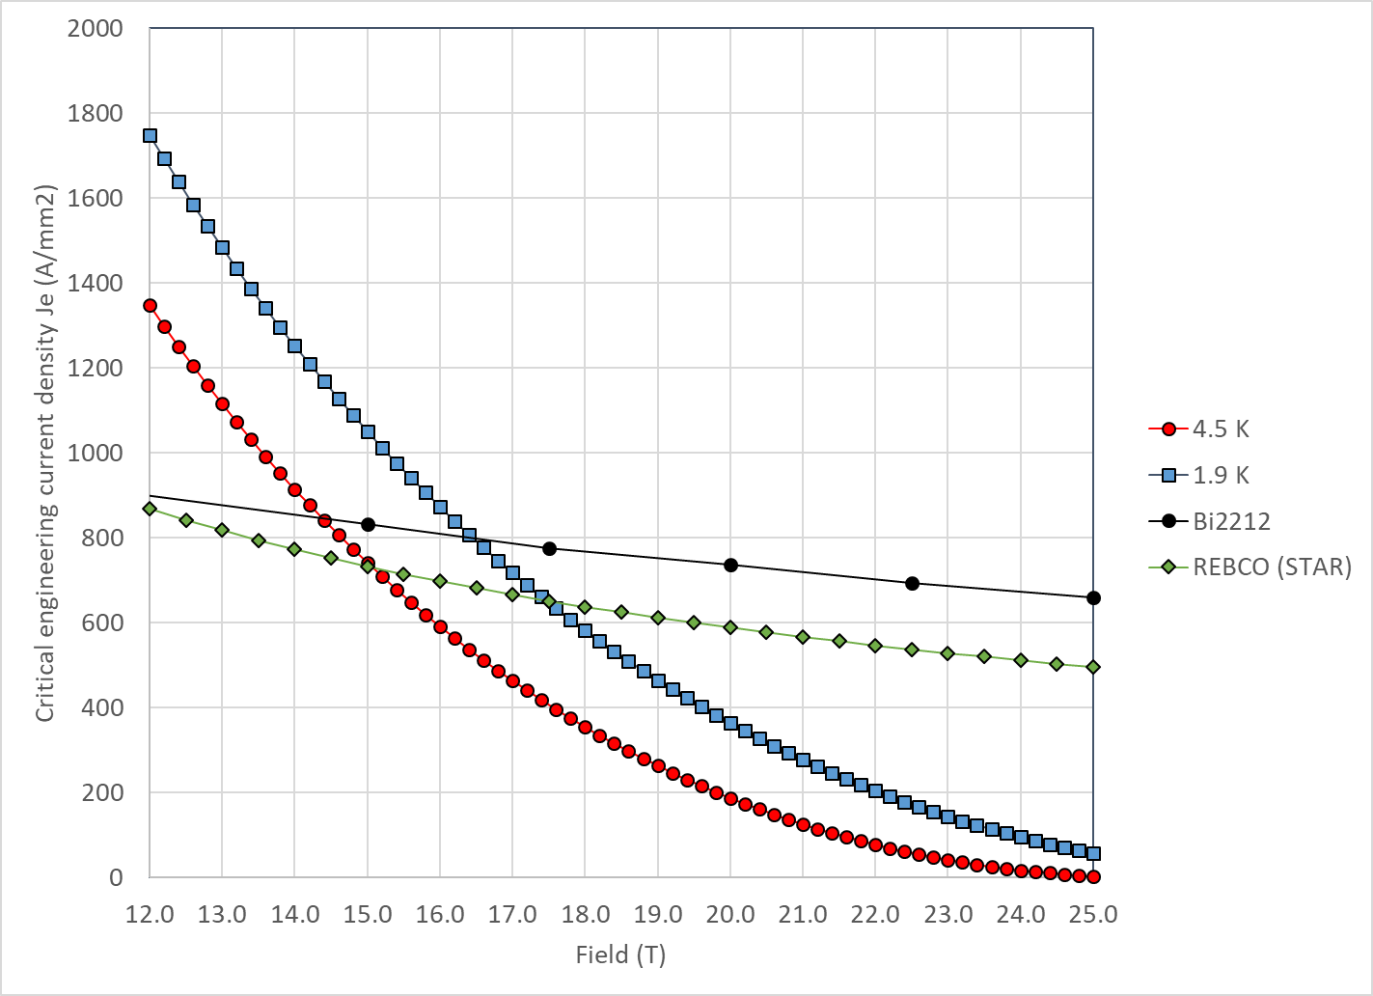
20 T REBCO-Nb3Sn hybrid (work in progress…)
With properties describe above
  Nb₃Sn and Bi2212 cross at
    14.5 T at 4.2 K
    16.5 T at 1.9 K
  Nb₃Sn and REBCO cross at
    15.0 T at 4.2 K
    17.5 T at 1.9 K

Slide 16
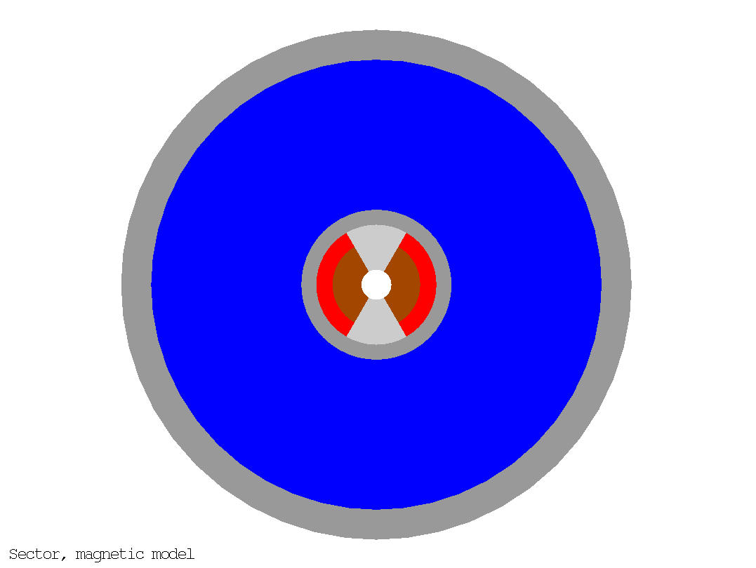
Very…very…preliminary magnet size
20 mm collar
250 mm thick yoke
  However, for a single short model, higher stray field could be accepted
50 mm thick shell
  F_{x}/t = 200 MPa
OD: 850 mm

Slide 17
Appendix

Slide 18
Design criteria for a 20 T hybrid magnet
Previous work within MDP on a 16 T dipole magnet
  GianLuca Sabbi, Alexander Zlobin, MDP General meeting – May 17, 2017
https://conferences.lbl.gov/event/82/

Slide 19
Design criteria for a 20 T hybrid magnet
Geometrical
  Number of apertures 1
  Free coil aperture 50 mm
Comments
  The common coils will naturally provide 2 apertures
    This will be taken into account on the comparison
  No “strong” constraints on
    Magnet total length (<2 m)
    Magnet straight section (>200 mm)
    Maximum magnet OD
      Reference numbers: 620 mm (FNAL/1.9K), 660 mm (BNL/1.9K), 914 mm (LBNL/4.5K)

Slide 20
Design criteria for a 20 T hybrid magnet
Operational
  Reference temperature 1.9 K
    4.5 K option can be considered: it would impact the ratio of HTS vs LTS
  Operational bore field 20 T
  Margin on the load-line @ 1.9K >= 15 %
    With respect to round strand I_{c} including self field and 5% cabling degradation
  Short sample bore field 23.5 T
  Geometrical harmonics at R_{ref}=17 mm and 20 T: b_{n}<5 for n<10
    Magnet straight section
  Target design field 20 T

Slide 21
Design criteria for a 20 T hybrid magnet
Operational
  Maximum Nb₃Sn coil stress >180 (<150) MPa at 1.9 (293) K
  Conditions of coil-pole or rib interfaces at 20 T
    If bonded 20 MPa max. tension
      ‘Corner spikes’ (~1 contact element, 1 mm) neglected
    If separation allowed: Half cable width in contact or < 50 µm max gap
      Conditions may be different depending on the design

Slide 22
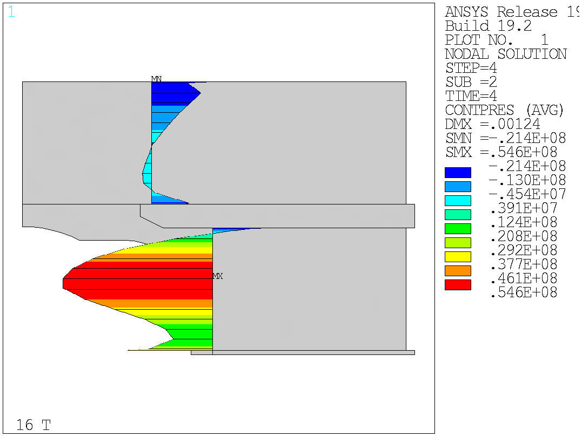
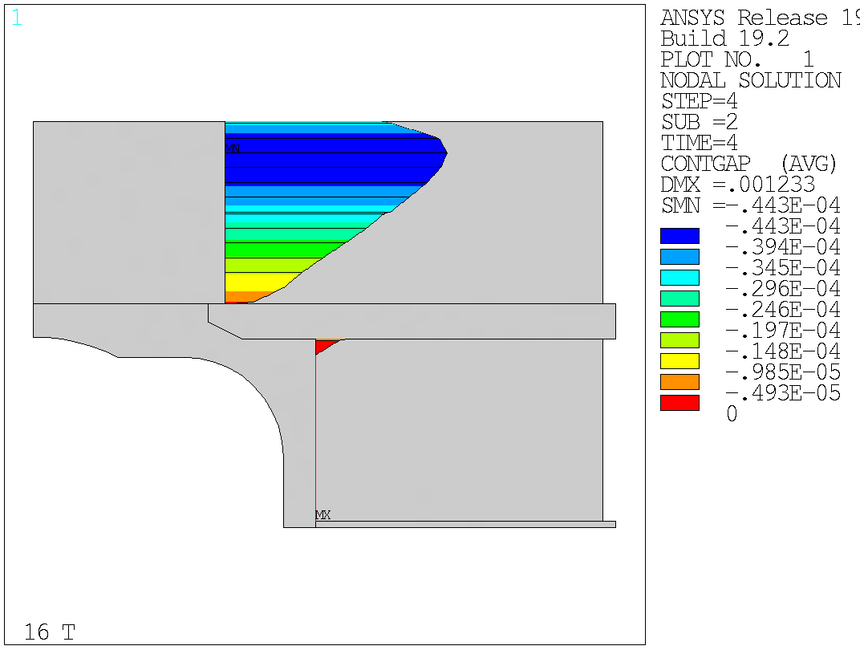
Design criteria for a 20 T hybrid magnet
Bonded vs separation-allowed
  Test Facility Dipole (by G. Vallone)

Slide 23
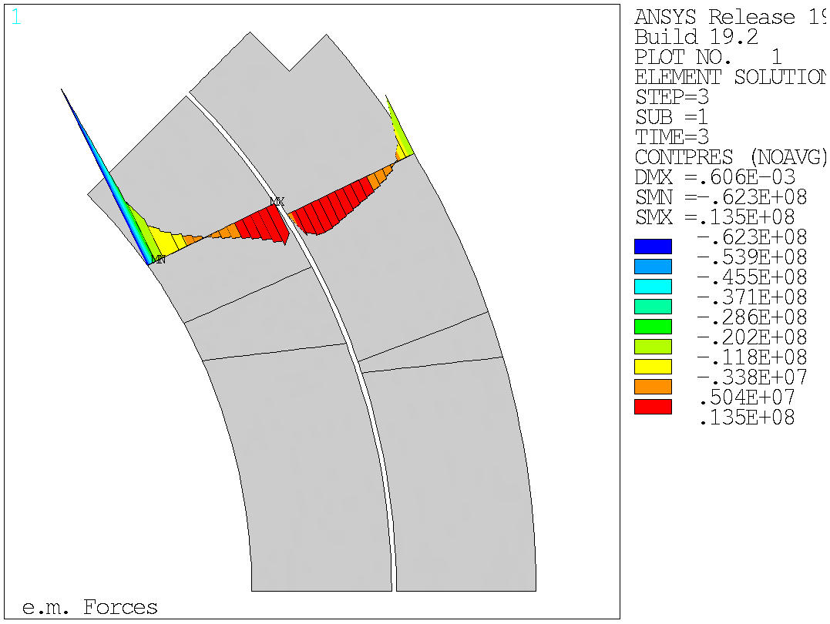
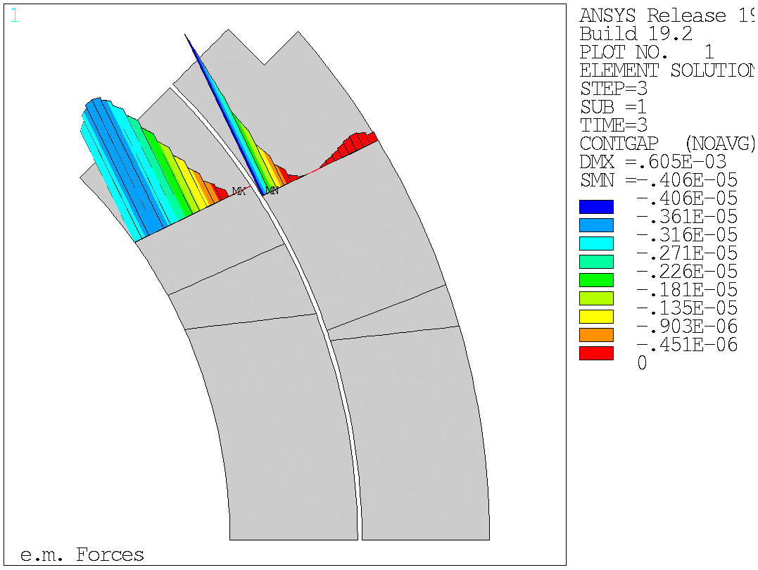
Design criteria for a 20 T hybrid magnet
Bonded vs separation-allowed
  MQXF (by G. Vallone)

Slide 24
Material limits
(by Giorgio Vallone)

Slide 25
Design criteria for a 20 T hybrid magnet
Nb₃Sn Conductor and cable
  Strand diameter 0.7-1.2 mm
  Cu:non-Cu ratio 0.8-2.0
  Non-Cu J_{c} round strand with self-field
    12 T, 4.2 K 2980 A/mm2
    15 T, 4.2 K 1640 A/mm2
    16 T, 4.2 K 1250 A/mm2
      See next slide for reference fit
  RRR (after cabling) >50
  I_{c} degradation due to cabling 5%
  Maximum number of strands in cable 60
  Cable Insulation thickness 0.150 mm

Slide 26
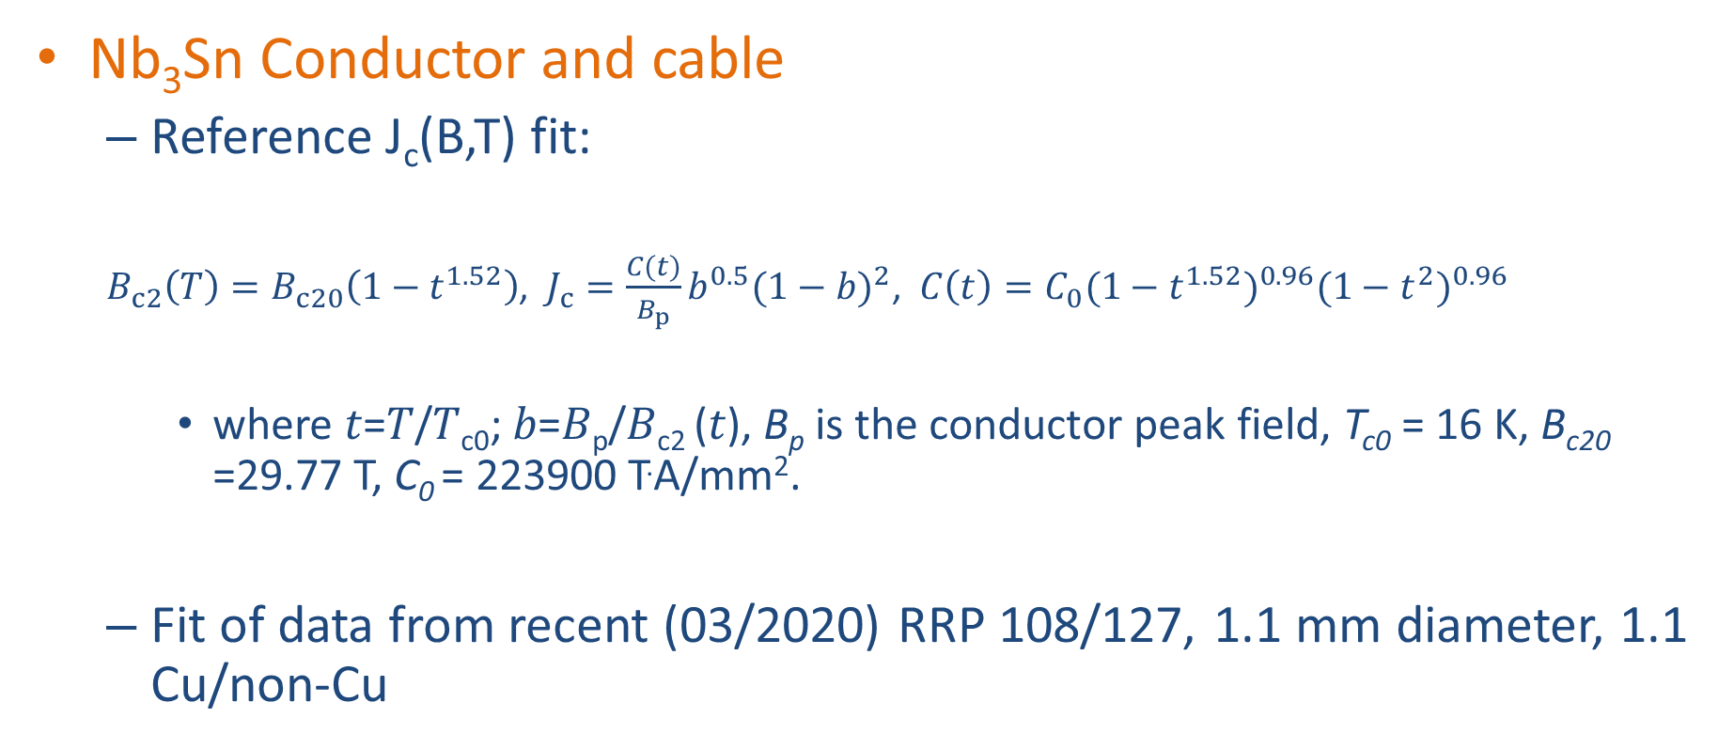
Design criteria for a 20 T hybrid magnet
Nb₃Sn Conductor and cable
  Reference J_{c}(B,T) fit:
  $B_{c2}\left(T\right)=B_{c20}\left(1−t^{1.52}\right)$, $J_{c}=\frac{C(t)}{B_{p}}b^{0.5}{(1−b)}^{2}$, $C\left(t\right)=C_{0}{(1−t^{1.52})}^{0.96}{(1−t^{2})}^{0.96}$
    where 𝑡=𝑇/𝑇_{c0}; 𝑏=𝐵_{p}/𝐵_{c2} (𝑡), B_{p} is the conductor peak field, T_{c0} = 16 K, B_{c20} =29.77 T, C₀ = 223900 T.A/mm².
  Fit of data from recent (03/2020) RRP 108/127, 1.1 mm diameter, 1.1 Cu/non-Cu

Slide 27
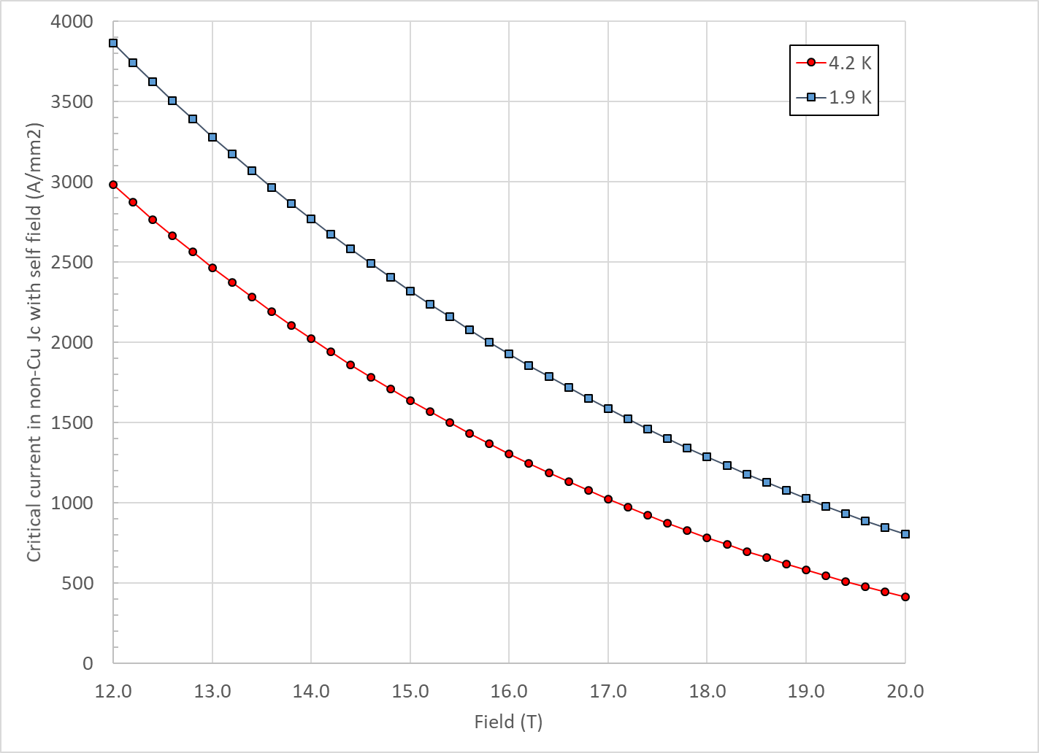
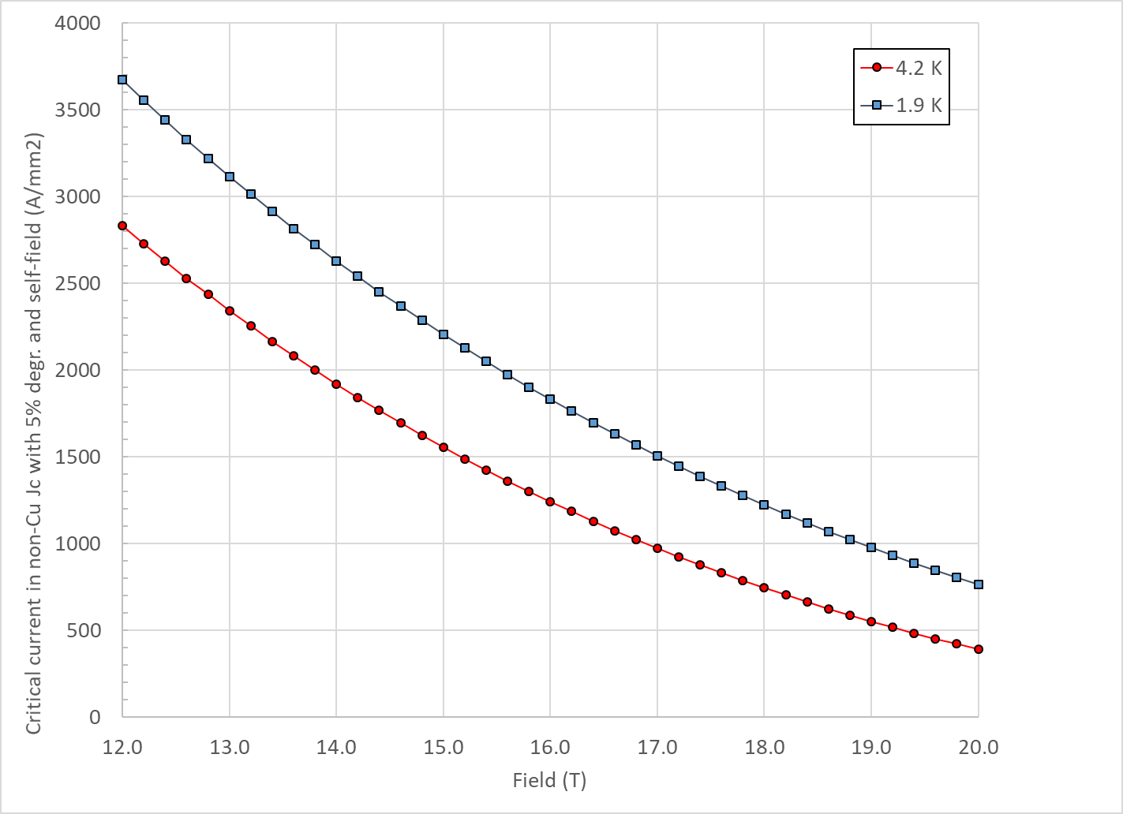
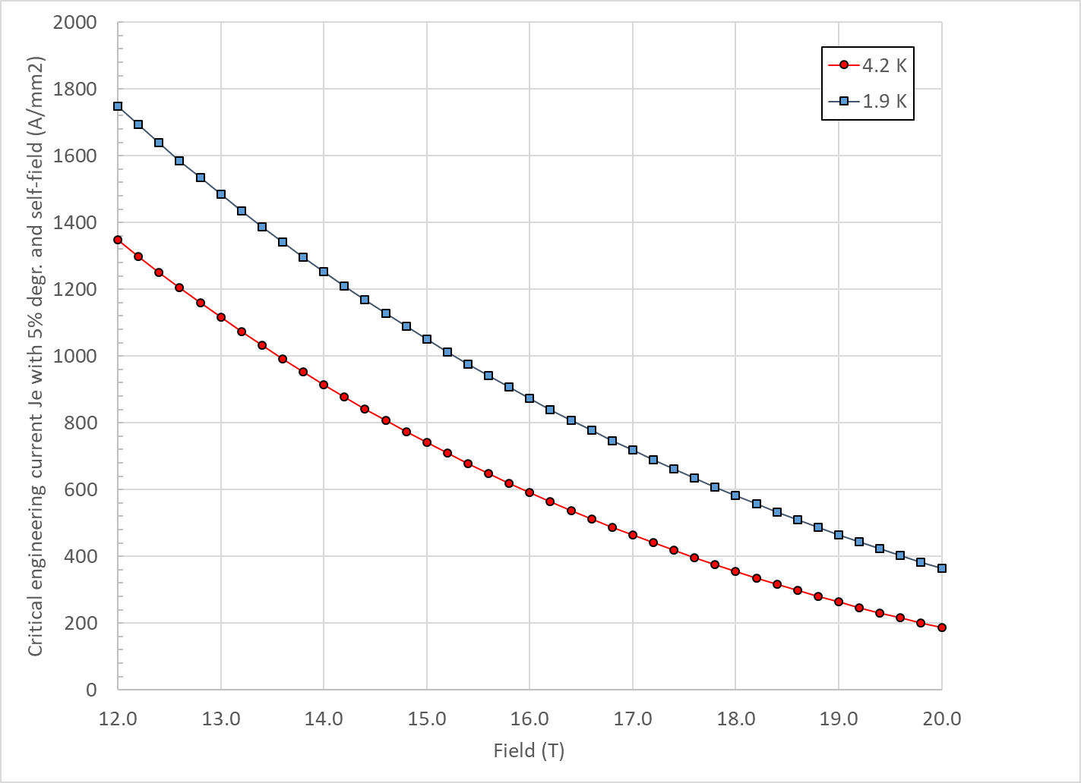
Design criteria for a 20 T hybrid magnet
Nb₃Sn Conductor and cable
  “3000” A/mm² kind of conductor, round, with self field
J_{c} round
J_{c} , 5% deg.
J_{e} , 5% deg.

Slide 28
Design criteria for a 20 T hybrid magnet
Nb₃Sn Conductor and cable
  In general, it would be better to stay within already tested parameters (min, max)
Dimension before reaction; In MQXF, assumed expansion during reaction is 4.5 % (th), 1.2 % (w)

Slide 29
Design criteria for a 20 T hybrid magnet
Bi2212 Conductor and cable (input from T. Shen and L. Garcia Fajardo)
  The wire diameter:
    from 0.6 mm to 1.5 mm
  Cable width: basically same possibilities as with Nb₃Sn cables

Slide 30
Design criteria for a 20 T hybrid magnet
Bi2212 Conductor and cable (input from T. Shen and L. Garcia Fajardo)
  Record performance strand RC5/6 about 20% higher than what is currently “comfortably” produced.

Slide 31
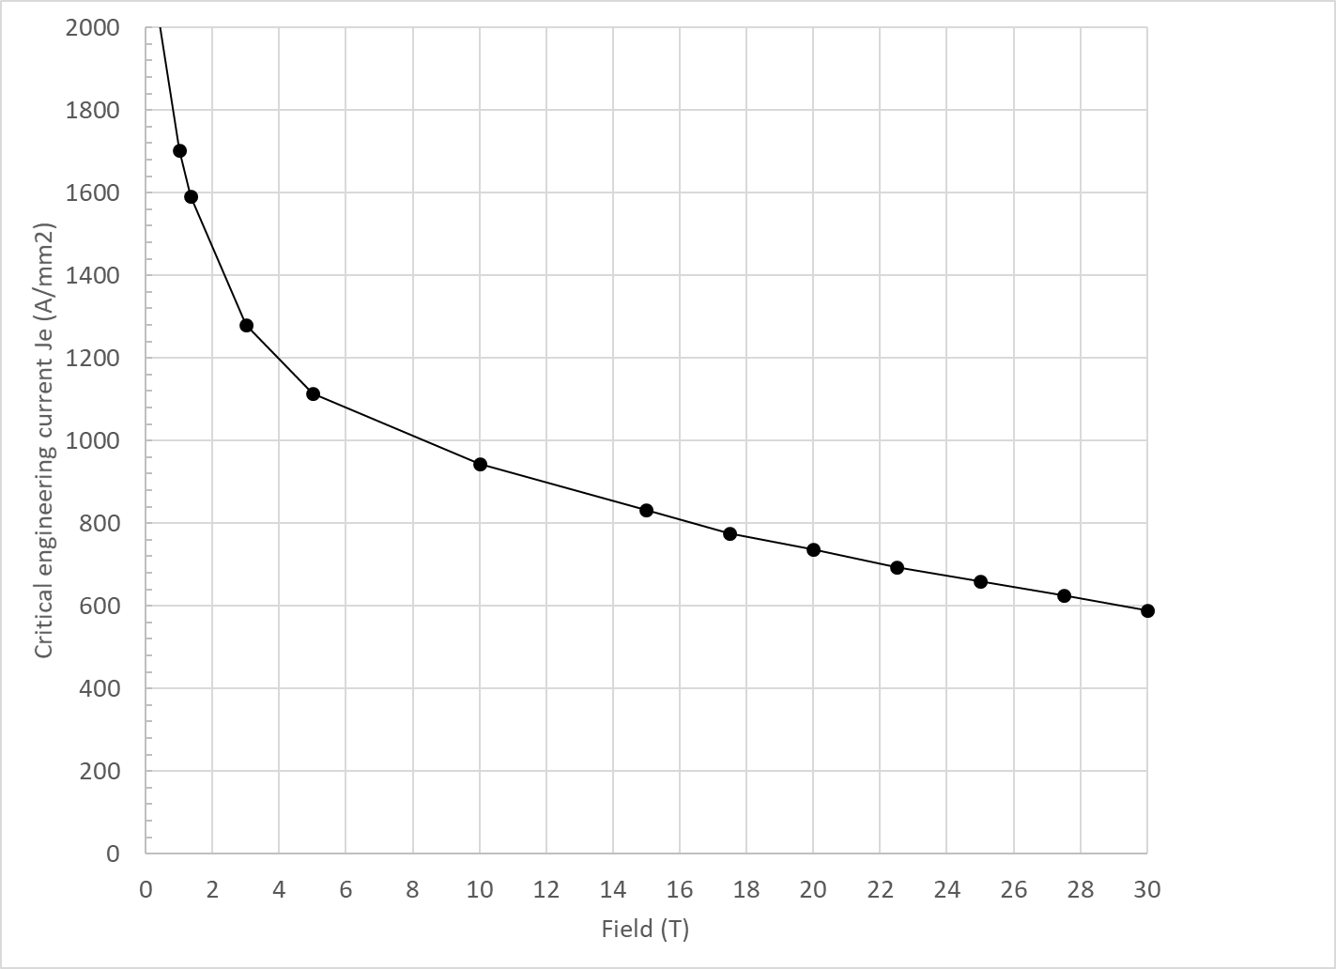
Design criteria for a 20 T hybrid magnet
Bi2212 Conductor and cable (input from T. Shen and L. Garcia Fajardo)

Slide 32
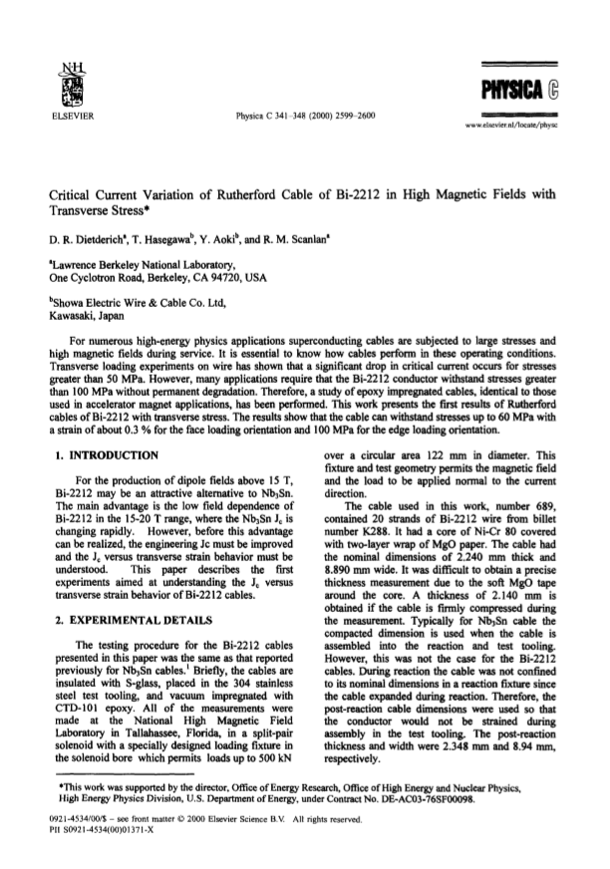
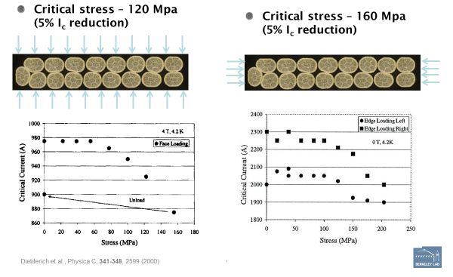
Design criteria for a 20 T hybrid magnet
Bi2212 Conductor and cable
  Maximum Nb₃Sn coil stress: <120 MPa (293) K

Slide 33
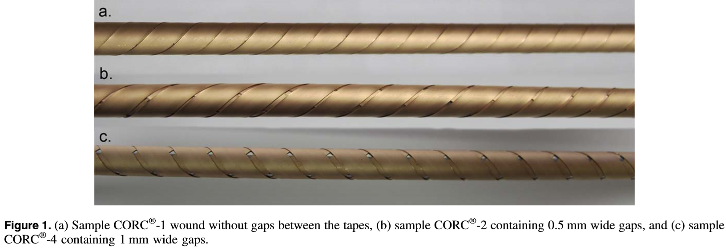
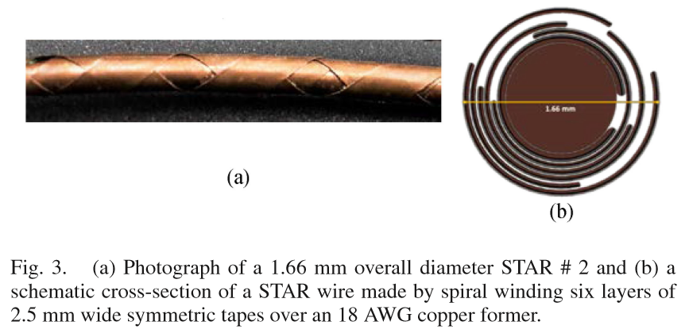
Design criteria for a 20 T hybrid magnet
REBCO Conductor
  CORC cable
    3.42mm diameter including 30 micron thick insulation.
  STAR cable
    1.3 mm diameter without insulation (#3)
    2.04 mm diameter without insulation (#4)

Slide 34
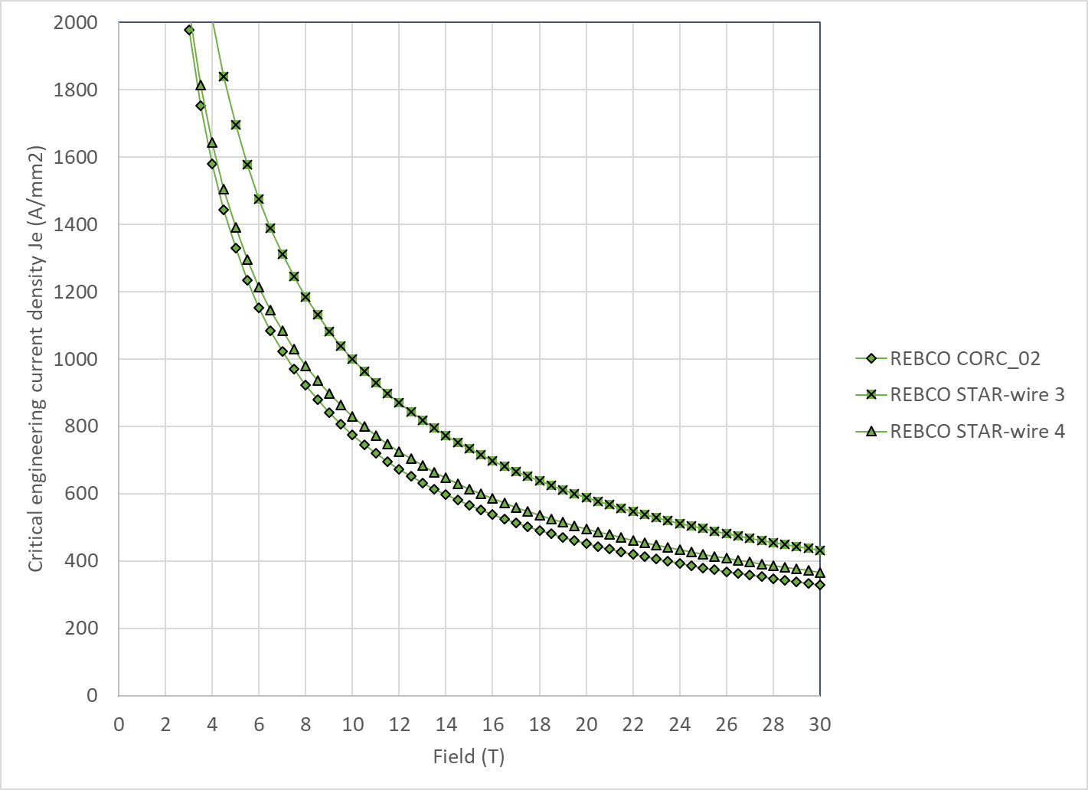
Design criteria for a 20 T hybrid magnet
REBCO Conductor
  We use the following parameterization
    Ic(B, 4.2 K) = 10^( α*log(B)+c)
  Where

Slide 35
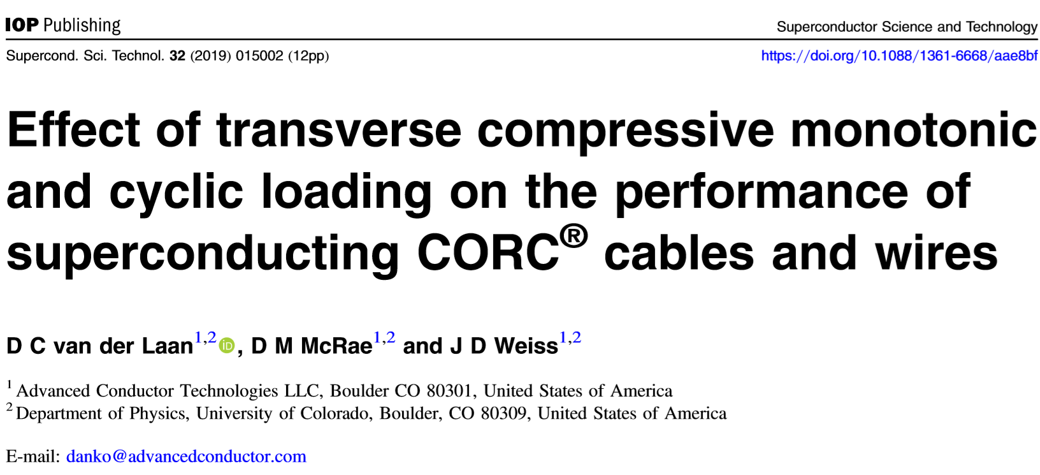
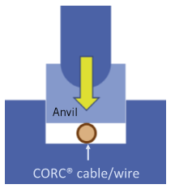
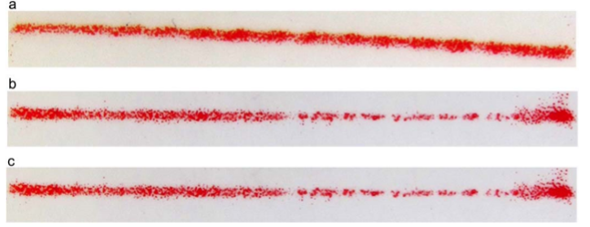
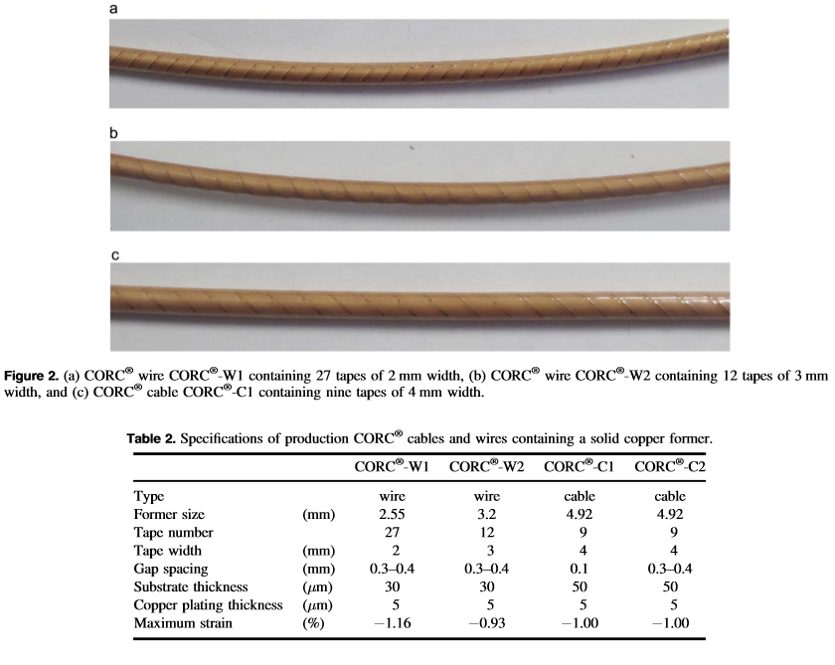
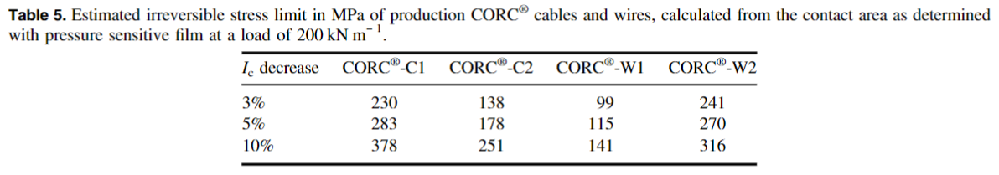
Design criteria for a 20 T hybrid magnet
REBCO Conductor
  Stress degradation

Slide 36
Design criteria for a 20 T hybrid magnet
With properties describe above
  Nb₃Sn and Bi2212 cross at
    14.5 T at 4.2 K
    16.5 T at 1.9 K
  Nb₃Sn and REBCO cross at
    15.0 T at 4.2 K
    17.5 T at 1.9 K

Slide 37
Design criteria for a 20 T hybrid magnet
Quench protection
  Nb₃Sn
    Maximum hot spot temperature 350 K
    Total time delay 40 ms
    Maximum J in the Cu 1350 A/mm²
    Maximum voltage to ground @ quench 1.0 kV
    Ground insulation design voltage >5 kV
  Bi2212 and REBCO
    See next slides
  Powering in series

Slide 38
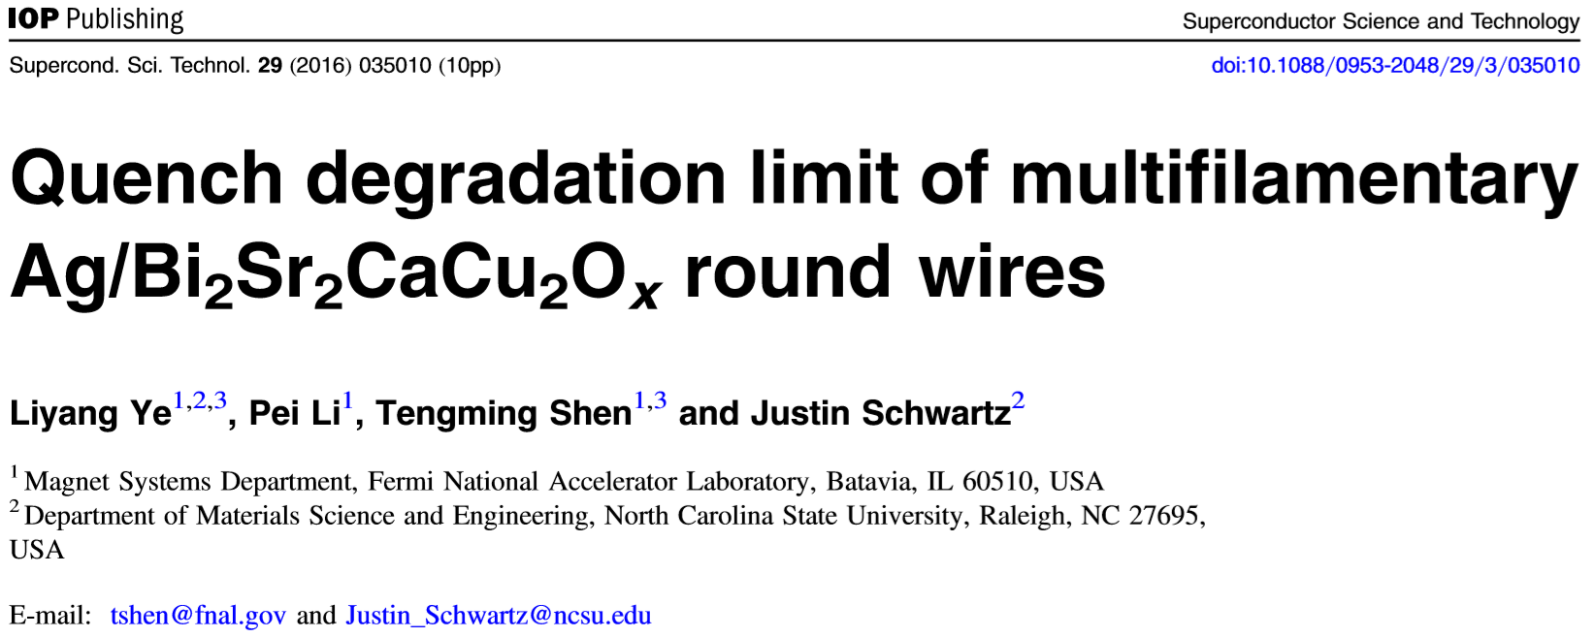
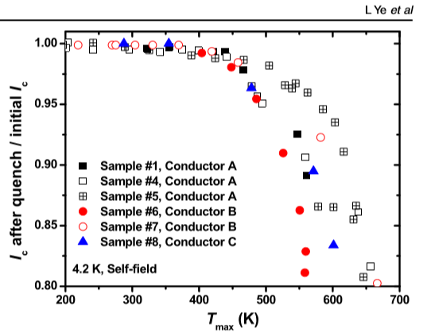
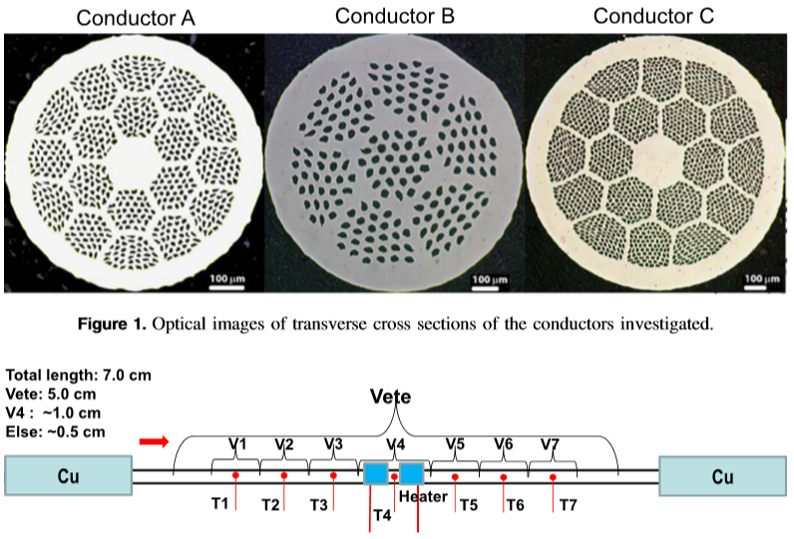
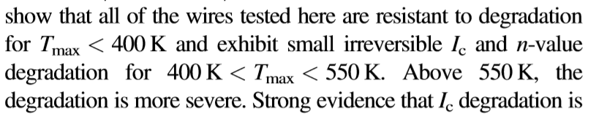
Design criteria for a 20 T hybrid magnet
Quench protection
  Bi2212: T_{max}= 400-450 K

Slide 39
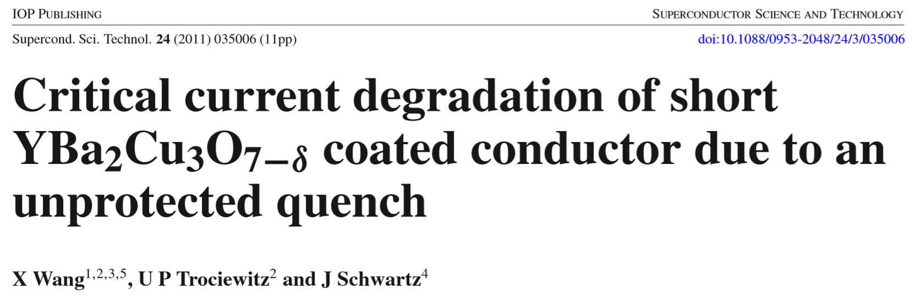
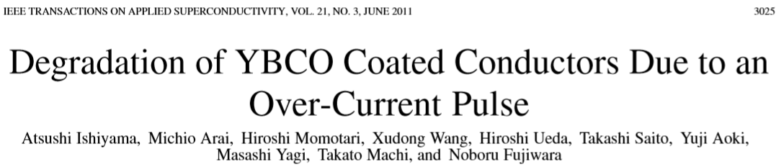
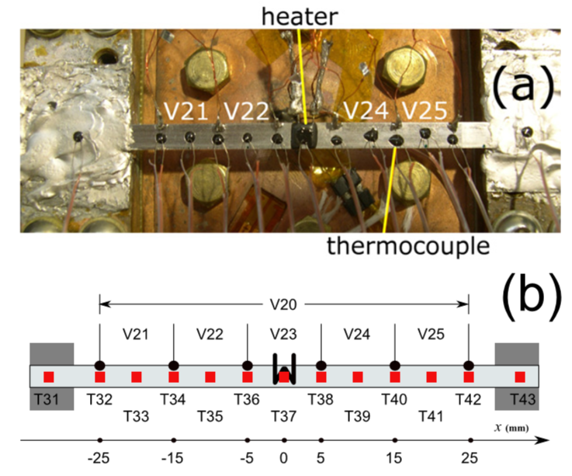
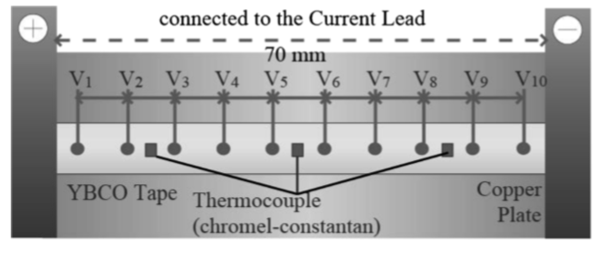
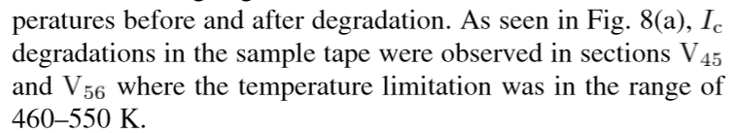
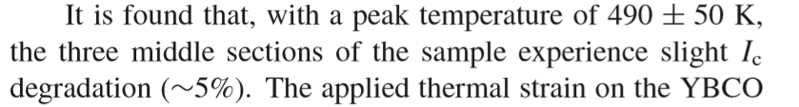
Design criteria for a 20 T hybrid magnet
Quench protection
  REBCO

Slide 40
Design criteria for a 20 T hybrid magnet
Summary on Hot spot temperature
  For all 3 materials, 350 K maximum hot spot temperature appears to be a reasonable value

Slide 41
1st goal of the working group
Conceptual design of a 20 T hybrid HTS-LTS magnet
  Comparative analysis of different design options for a 20 T hybrid
    Cosϑ design and its stress-management options
      “Traditional” Cosϑ
      Canted Cosϑ (CCT)
      Stress management Cosϑ (SMCT)
    Block-type coil design (block with flared ends)
    Common-coil design (block with racetrack coil)
  Definition of general design criteria: aperture, field, margin…..
  Analysis of challenges specifically of hybrid magnets
    Integration of LTS/HTS, mechanics, protection, powering, diagnostics, test facility…..

Slide 42
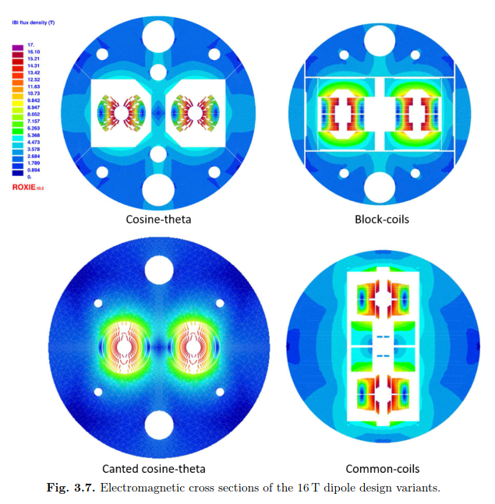
1st goal of the working group
An example: 16 T dipole magnets for FCC
Ideally the goal should be to carried out the full 2D design and analysis of a 20 T hybrid for all the design options considered
    Cosϑ design and its stress-management options, Block-type design, Common-coil design
In addition, 3D considerations will be included in the comparison

Slide 43
1st goal of the working group
The goal of the comparison should not be, or does not necessarily have to be
  reaching a consensus on a particular design
Instead, more realistically, the working group could aim at
  Discussing and reviewing the different designs and listing pluses and minuses or open issues….grounding on “objective” criteria
  Providing inputs to the other areas (in particular area I and area II) to better define their roadmaps and overall directions, and avoid inconsistencies

Slide 44
2nd goal of the working group
Review and follow-up of current work on hybrid magnets
This current work can be divided based on the field level
  9-10 T
  11-12 T
  13-14 T
  Beyond 15 T
The goal is to collect and organize information from these programs (responsibility of area I and area II) to provide inputs for 20 T hybrid design

Slide 45
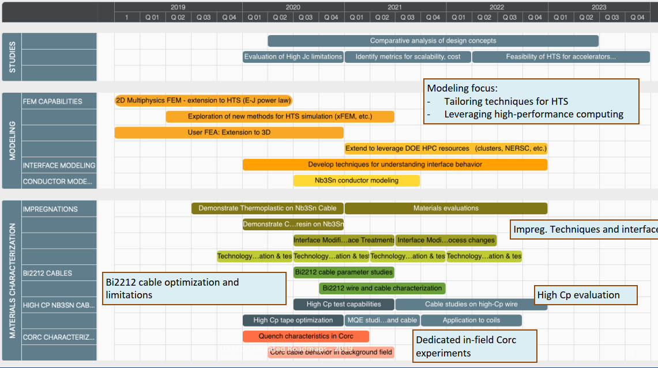
1st goal of the working group
Time frame: 2020 – 2023
Methods
  Modeling effort
    “classical 2D/3D” mechanical, magnetic and QH simulations
      Developing new modeling techniques is not part of this task
      However, if new tool/analysis is required → feed-back to Technology area (III), modeling and simulations

Slide 46
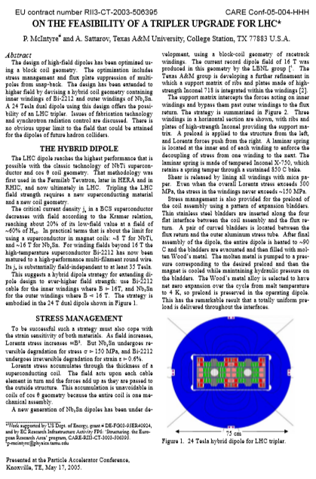





First some references (20 T B_{op})

Slide 47





First some references (“towards” 20 T)

Slide 48



First some references (“towards” 20 T)
Analytical model from Lucas Brouwer
  Thick shell with cosϑ distribution
4 CCT winding layers,
  2 of Bi2212 and 2 of Nb₃Sn
    Field in Nb₃Sn is given by self field + stray field from Bi2212 insert
Results: 150-160 mm interface D for B=23.5 T

Slide 49


Size comparison
LHC MQXF FRESCA2 ????

Slide 50

Peak stress
Stress due to accumulated e.m. forces on the mid-plane
  No shear, no bending….

Slide 51
Analysis of coil radius and thickness

Slide 52




The 9-10 T field level
LBNL
  Bi2212 insert Bin5c_2 (2-3 T stand alone) in CCT5 (8-9 T)
    Test planned in 2021

Slide 53

The 9-10 T field level
BNL
  Coils wound with REBCO tape inside DCC017 common coil Nb₃Sn dipole

Slide 54




The 11-12 T field level
BNL
  Coils wound with REBCO tape or CORC (1-3 T) inside DCC017 common coil Nb₃Sn dipole (10.2 T)
Tape perpendicular to field
Tape parallel to field
CORC

Slide 55




The 13-14 T field level (I)
LBNL
  Bi2212 or REBCO (CCT or COMB) inserts (5-6 T stand alone) in CCT6 (2 or 4 layers, 11 T)

Slide 56

The 13-14 T field level (II)
FNAL
  Bi2212 or REBCO (CCT or COMB) inserts (5-6 T stand alone) in SMCT (2 layers, ~11 T)

Slide 57

The 13-14 T field level (III)
BNL
  CORC Coils in DCC017 as part of the STTR Program

Slide 58


The 13-14 T field level (III) and beyond 15 T
FNAL
  Bi2212 insert SMCT (4-5 T stand alone) in 11T dipole coil and then in SMCT coil

Slide 59
Conclusions and action items
The goals of the working group have been defined
  Comparison linked to 20T hybrid design
General criteria for the conceptual design defined, especially for Nb₃Sn
  Less “rigid” than in previous comparison work
  Many open question on HTS (quench protection, stress) → feedback from Area II and III needed
Preliminary analytical analysis seems to provide “reasonable” general dimensions
Some general comments
  The topics (20 T B_{op}) seems still rather “unexplored”, or not too crowded
  With Area I and II, MDP has a nice R&D path towards it
Next steps
  Work on REBCO specs and Je
  Define “comparison” criteria
  Continue aperture/thickness/dimension analysis
    Iron, grading
  Move progressively from analytical models to simplified FEM of CT, CCT, SMCT, block and CC designs
  Continue the follow-up of current hybrid program

