Slide 1
Superallowed Alpha Decay
Rod Clark
Notes:
Covering operations and some accelerator R&D
VENUS: plasma chamber, Leak on He injection line.

Slide 2
Wave Mechanics and Radioactive Disintegration
R. W. Gurney and E.U. Condon, Nature (London) 122, 439 (1928)
 |  | E_{α} (MeV) | T_{1/2}
Radium C’ | ²¹⁴Po | 7.7 | 160 μs
Radium A | ²¹⁸Po | 6.0 | 3 mins
Uranium | ²³⁸U | 4.2 | 4.5 GYrs
Zur Quantentheorie des Atomkernes
G. Gamow, Z. Phys. 51, 204 (1928)
Quantitative description of
Geiger-Nuttall Rule:
log(T_{1/2}) = a + bQ_{α}^{−1/2}
H.Geiger and J.M.Nuttall, Phil. Mag. 22 613 (1911)

Slide 3

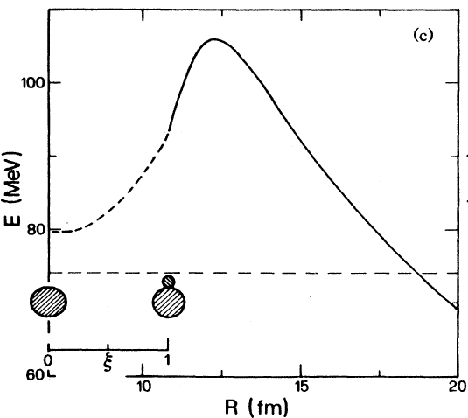
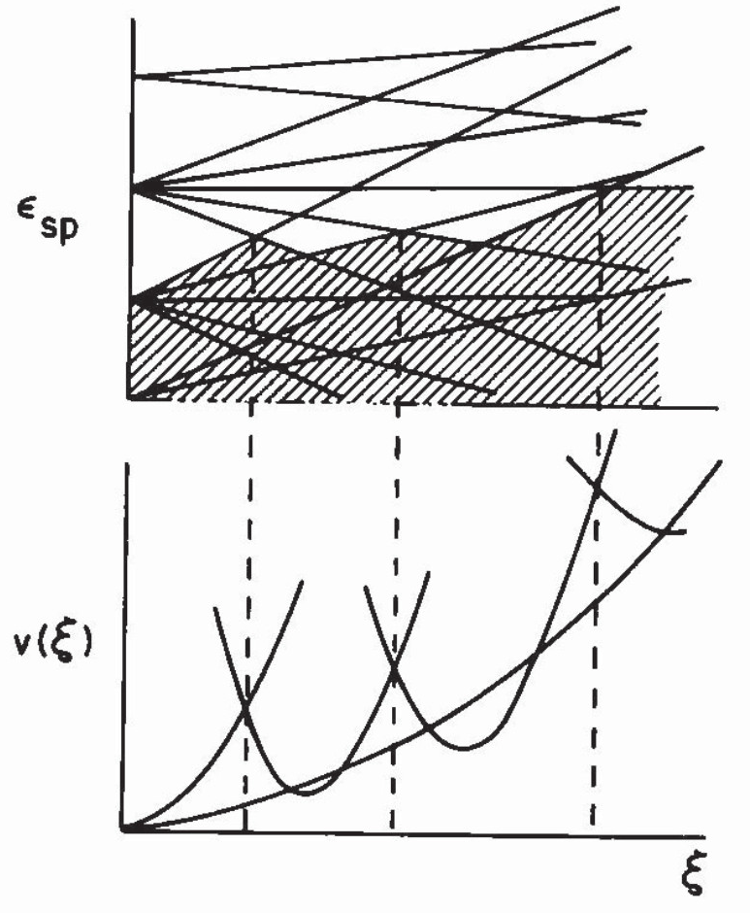
Superfluid Tunneling Model (STM)
The Schrödinger equation describing
the model is:
= generalized deformation variable
Calculation of decay constant:
= P . f . T
P= preformation of decay configuration
f = frequency of hitting barrier
T = transmission coefficient through barrier
“Nuclear Superfluidity: Pairing in Finite Systems”
David M. Brink and Ricardo A. Broglia
Cambridge University Press, 2005
F. Barranco, G.F. Bertsch, R.A.Broglia, E.Vigezzi,
NPA 512 253 (1990)

Slide 4

Decay Constant
λ = P f T
Alpha-particle formation probability,
Potential parameter, C,
is dependent on Q-value
Knocking frequency,
Inertial mass parameter, D,
depends on pairing gap, Δ.
Transmission through barrier,
➔ Investigate dependencies on Δ, Q, L

Slide 5

Superheavy Nuclei
Nature 565,
553 (2019).

Slide 6
Alpha Decay of Even-Even Isotopes: Fm to Og
× = experiment
• = STM
R.M. Clark and D. Rudolph, PRC 97 02433 (2018)

Slide 7
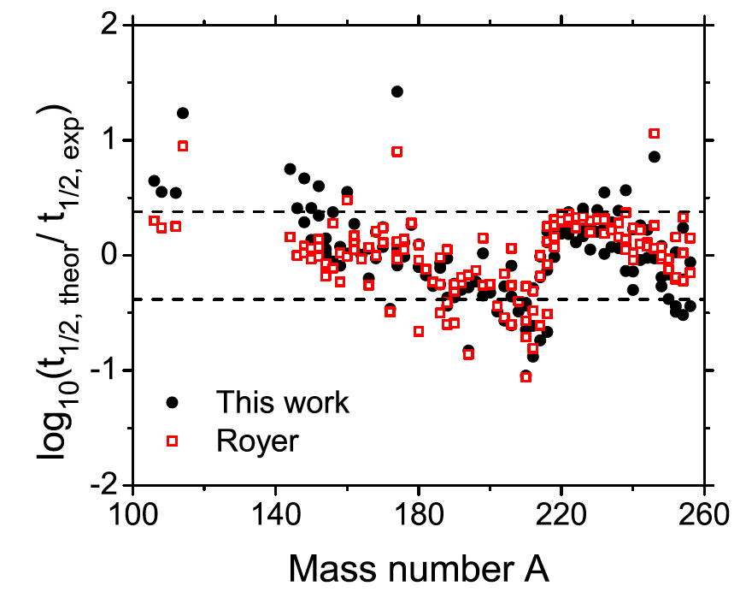
Modern “Geiger-Nuttall” Formula
STM
NPA 848 (2010) 279
even-odd
odd-even
odd-odd
even-even
×4

Slide 8
Superallowed Alpha Decay
K. Auranen et al., Phys. Lett. B 792 (2019) 187

Slide 9
Experiment vs. Models
R.M. Clark et al., Phys. Rev. C 101 034313 (2020)

Slide 10
STM Pair Gaps vs. Expectation
The pair gap extracted to reproduce
T_{1/2}(α) agrees with the expected variation
with A and Z.
No hint of additional neutron-proton
correlations playing a part.
¹¹⁴Ba
¹¹²Xe
¹¹⁰Xe
¹¹⁰Te
¹⁰⁸Te
¹⁰⁶Te
²¹²Po
.
P. Vogel, B. Jonson, and P.G. Hansen, Phys. Lett. B 139, 227 (1984).

Slide 11
Extracted Alpha-Particle-Formation Probabilities, P
Constant N
Constant Z
a)
b)
P (×10⁻²)
P (×10⁻²)
✕
✕
¹¹⁴Ba
¹¹²Xe
¹¹⁰Te
²¹²Po
¹⁰⁶Te
¹⁰⁸Te
¹¹⁰Te
²¹²Po
However, the “expected” variation of the pairing does lead to an increase in
the formation probability of the alpha particle, P, as one approaches N=Z.
R.M. Clark et al., Phys. Rev. C 101 034313 (2020)

Slide 12
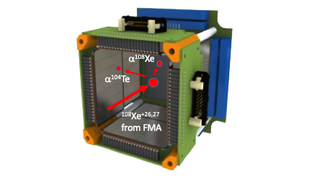
Alpha Decay Chain ¹⁰⁸Xe➔¹⁰⁴Te➔¹⁰⁰Sn
If extra proton-neutron correlations then the effect is likely to be biggest at N=Z.
They would show up in unrealistically large values for the fitted pairing gaps.
Two events (!) with the average
properties:

Slide 13
Exclusion Plot for Pairing Gaps
(BCS Limit)
Δ(¹⁰⁸Xe)=Δ(¹⁰⁴Te)
Δ(¹⁰⁸Xe)=1.32×Δ(¹⁰⁴Te)
(Single j-shell limit)
∑E_{α} =9.4 MeV
Δ_{VJH}
R.M. Clark et al., Phys. Rev. C 101 034313 (2020)

Slide 14
Summary
Superfluid Tunneling Model
Able to reproduce known data on alpha decay
All ingredients (Q_{α}, L, Δ) essential to understanding
In the ¹⁰⁰Sn region
Alpha preformation is larger near ¹⁰⁰Sn than ²⁰⁸Pb
Expected due to variation of pair gap
Current data on N=Z nuclei ¹⁰⁴Te and ¹⁰⁸Xe still leave open possibility of
superallowed alpha decay

Slide 15

Future Experiments at FRIB
 | ¹⁰⁸Xe |  | ¹¹²Ba
FRIB Phase | Day 1 | Max | Day 1 | Max
Primary Beam | ¹²⁴Xe | ¹²⁴Xe | ²³⁸U | ²³⁸U
Rate | 7.6×10⁻⁴ | 3.0×10⁻² | 1.0×10⁻⁶ | 3.0×10⁻³
Per Day | 65 | 2600 | 0.1 | 260
¹⁰⁸Xe should be feasible on Day One, ¹¹²Ba comes into reach later

Slide 16
Thanks!

Slide 17
Extra Slides

Slide 18
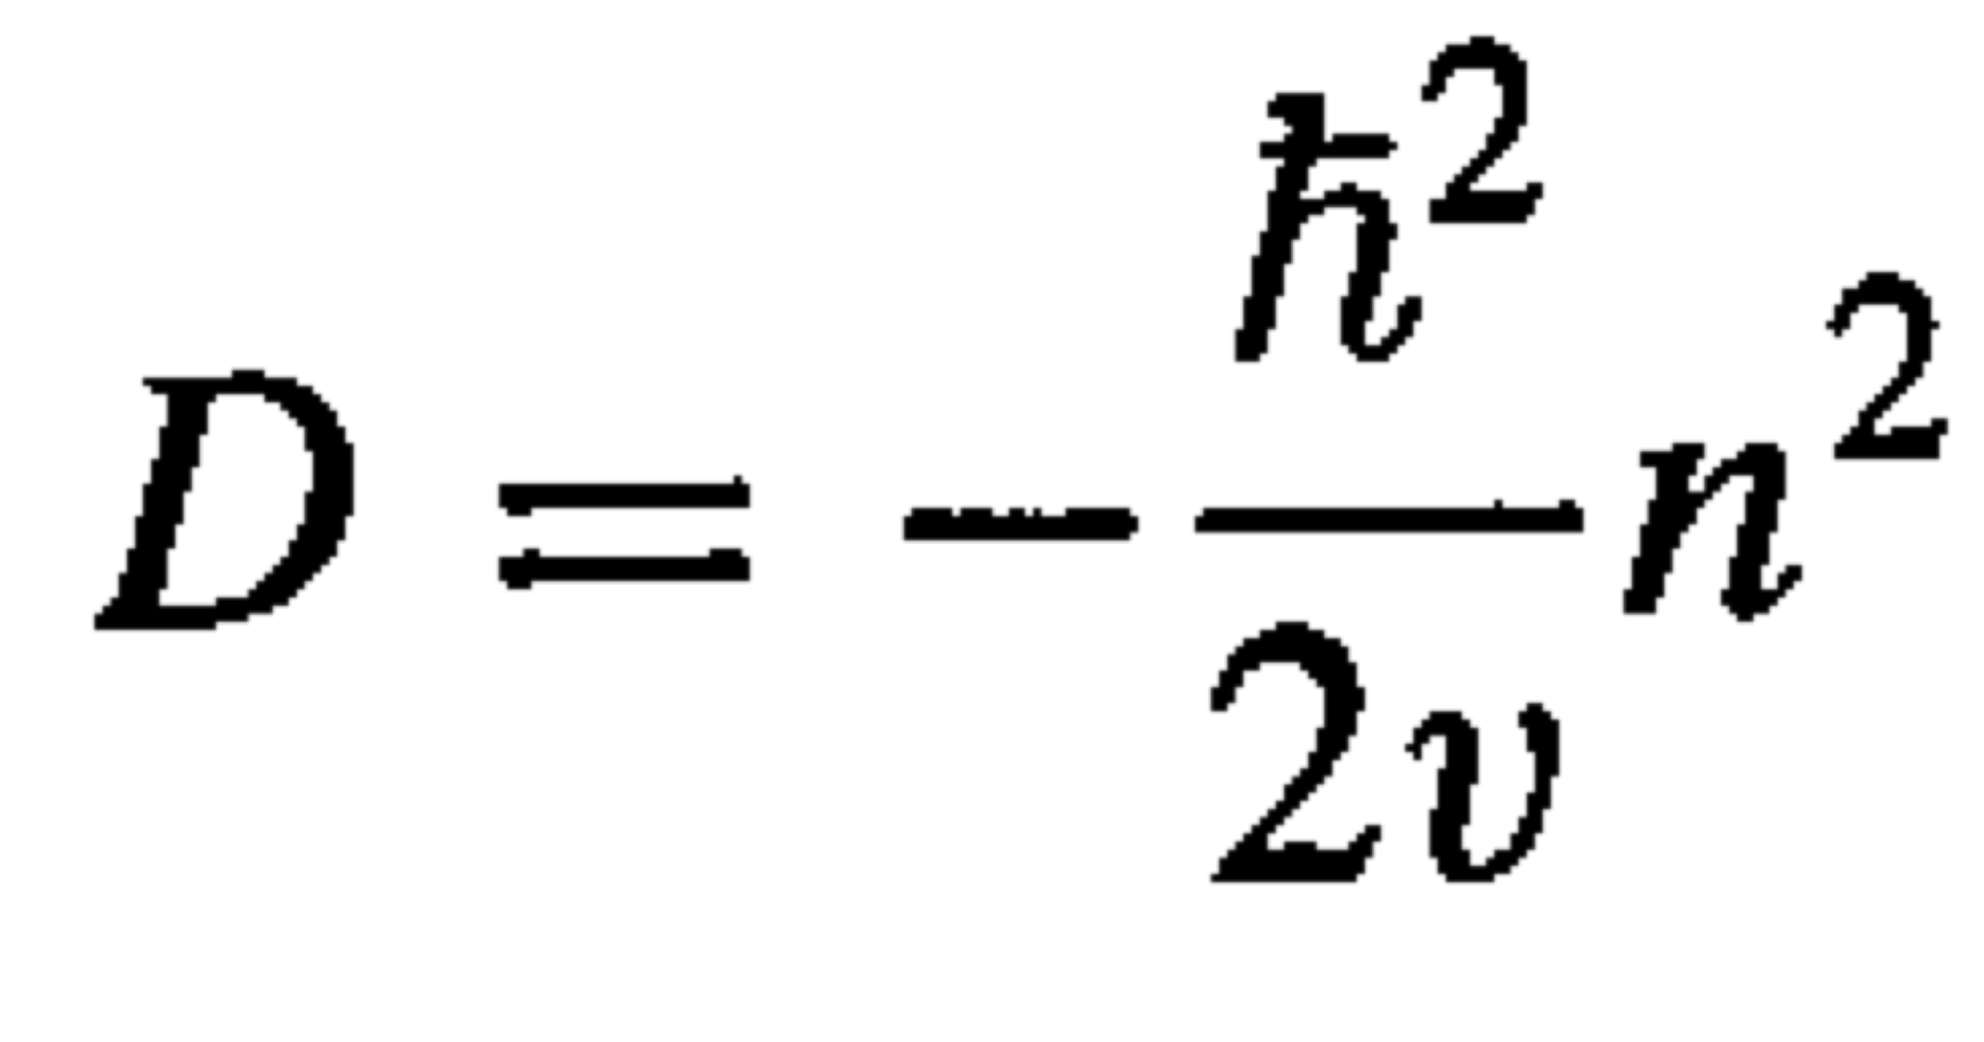
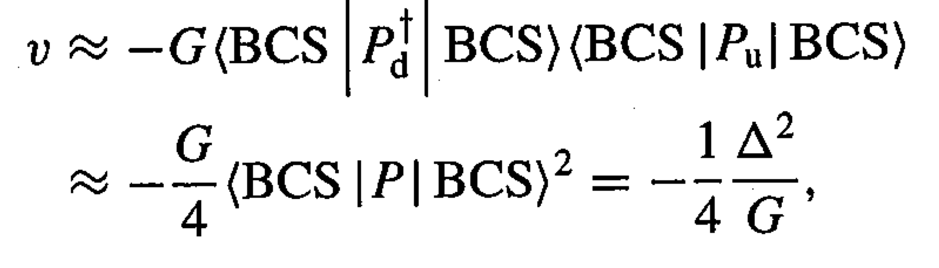
Inertia
Inertial mass parameter,
n is the number of level crossings in rearrangement (n=4)
v is the interaction matrix element,
Inertial mass parameter, D, is dependent on pairing gap, Δ.

Slide 19
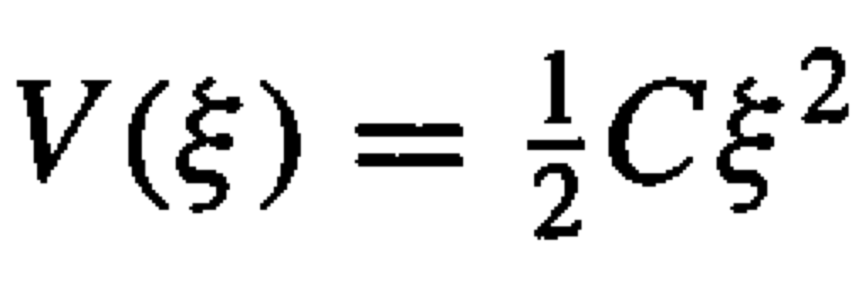
Potential Energy
V(ξ=1) = V_{n} + V_{c} – Q = C/2
Potential energy parameter, C, is dependent on Q-value

Slide 20
Dependence on Pairing Gap, Δ=xΔ₀
T/10⁻¹³
f/10²⁰
P/10⁻²
★
t_{1/2}/10⁻⁵

Slide 21
Even-Z, Odd-N SHN
2

Slide 22
Using the STM: Variation of Δ with A and Z
First hint that nothing unusual
about “superallowed” decay?
Bohr and Mottelson:
Vogel, Jonson, Hansen:
a=7.2 MeV and b =44MeV
A. Bohr and B. Mottelson, Nuclear Structure (Benjamin, New York, 1975), Vol. 1.
P. Vogel, B. Jonson, and P.G. Hansen, Phys. Lett. B 139, 227 (1984).

Slide 23
STM vs. Experiment
¹¹⁴Ba
¹¹²Xe
¹¹⁰Xe
¹⁰⁸Xe
¹¹⁰Te
¹⁰⁸Te
¹⁰⁶Te
¹⁰⁴Te
²¹²Po

Slide 24
Extracted Values of Δ
¹¹⁴Ba
¹¹²Xe
¹¹⁰Xe
¹¹⁰Te
¹⁰⁸Te
¹⁰⁶Te
²¹²Po

Slide 25
What About N=Z?
If extra proton-neutron correlations are contributing then the effect is likely to be
biggest with the N=Z chain ¹⁰⁸Xe➔¹⁰⁴Te➔¹⁰⁰Sn.
They would show up in unrealistically large values for the fitted pairing gaps.

Slide 26
Exclusion Plot for Pairing Gaps
E_{α}(¹⁰⁸Xe)
4.5 MeV
Δ(¹⁰⁸Xe)=Δ(¹⁰⁴Te)
Δ(¹⁰⁸Xe)=1.32×Δ(¹⁰⁴Te)
4.4 MeV
4.3 MeV
4.2 MeV
∑E_{α} =9.4 MeV
Δ_{VJH}

Slide 27
New Results from JAEA
Search for α decay of 104 Te with a novel recoil-decay scintillation detector
Phys. Rev. C, Y. Xiao et al., Accepted16 August 2019
ABSTRACT
A search for super-allowed α decay of N=Z nuclei104Te and 108Xe was carried out using novel recoil-decay scintillator detector
at the tandem accelerator facility at Japan Atomic Energy Agency (JAEA). Inorganic crystal scintillation material of YAP:Ce
(Yttrium Aluminium Perowskite) coupled to position-sensitive photo-multiplier tube (PSPMT) was implemented for the first time in radioactive decay experiment. Residues from the fusion-evaporation reaction 58Ni+54Fe→ 112Xe∗ were separated by the JAEA Recoil Mass Separator (RMS) and implanted into the YAP:Ce crystal. α decays of neutron-deficient tellurium isotopes were
identified and proton-emission of 109I was observed. The α decay chain 109Xe →105Te → 101Sn was recorded with time interval
of 960 ns between two αpulses. Position localization in the crystal for decays and ions in the energy range from hundreds keV to 60 MeV was achieved with the accuracy of 0.67 mm, proving that this detector is capable of making temporal and spatial correlations
for fast decay events. No conclusive evidence was found for the decay chain 108Xe → 104Te → 100Sn within 3 days experiment. However, two events were observed with properties consistent with the reported observation at Fragment Mass Analyzer (FMA)
but with the separation between signals less than 4 ns. The cross section limit of 130 pb was obtained for production of two events
of 108Xe, about an order of magnitude below the expectation based on earlier cross section measurements and HIVAP fusion-evaporation code.
T_{1/2}(¹⁰⁴Te)<4ns?

Slide 28
Exclusion Plot for Pairing Gaps
E_{α}(¹⁰⁸Xe)
4.5 MeV
Δ(¹⁰⁸Xe)=Δ(¹⁰⁴Te)
Δ(¹⁰⁸Xe)=1.32×Δ(¹⁰⁴Te)
4.4 MeV
✖
4.3 MeV
4.2 MeV
∑E_{α} =9.4 MeV
Δ_{VJH}

