Slide 1
C2 magnet: fabrication and test results
X. Wang
REBCO WGM #7, 6/18/2020

Slide 2
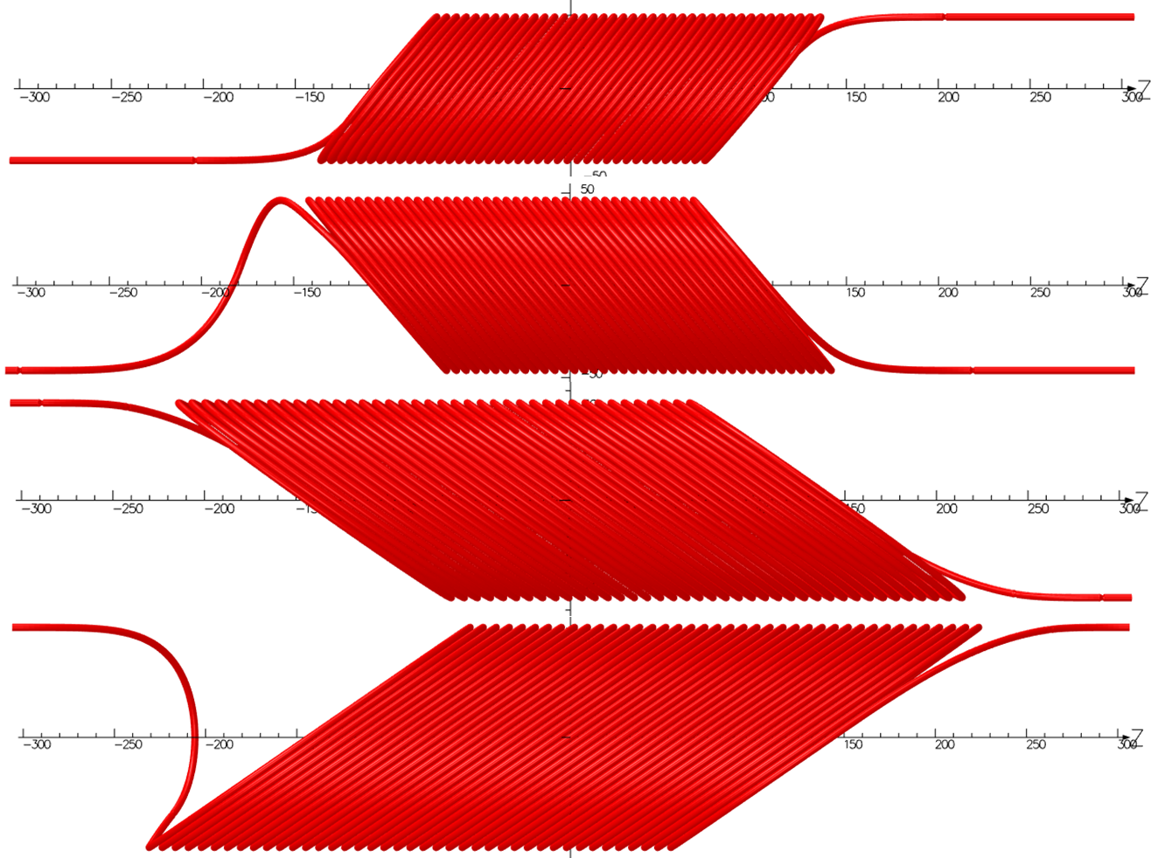
C2 aims to generate 3 T with longer conductors, metal mandrels and Stycast to constrain the conductors
Layer 1
Parameters | value
Tilt angle, L1/2 | 50°
Tilt angle, L3/4 | 35°
Min. bending radius | 30 mm
Transfer function | 0.47 T/kA
Target dipole field | 3 T
2
3
4

Slide 3
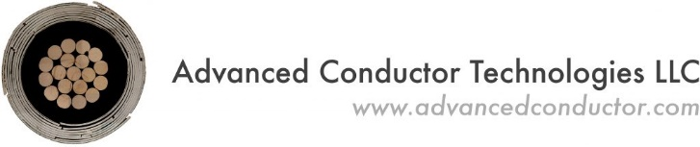

C2 used the state-of-art 30-tape CORC® wire to boost the magnet current
SuperPower tapes: 2 mm wide, 30 µm substrate, 5 µm surrounded Cu stabilizer
Layer 4 wire contains high- and low-pinning tapes – conductor grading
Measurements at ASC/FSU detected deviation from expected tape performance, allowing the quick feedback to SuperPower and wire design at ACT
Wire ID | Length (m) | Wire OD (mm) | Average tape Ic (A) 77 K, SF | Peak field on wire (T) | Min bend radius (mm)
C2-L1 | 18 | 3.80 | 70 | 3.6 | 30
C2-L2 | 20 | 3.80 | 70 | 3.6 | 35
C2-L3 | 24 | 3.77 | 69 | 3.2 | 30
C2-L4 | 28 | 3.67 | 57 | 2.8 | 35

Slide 4
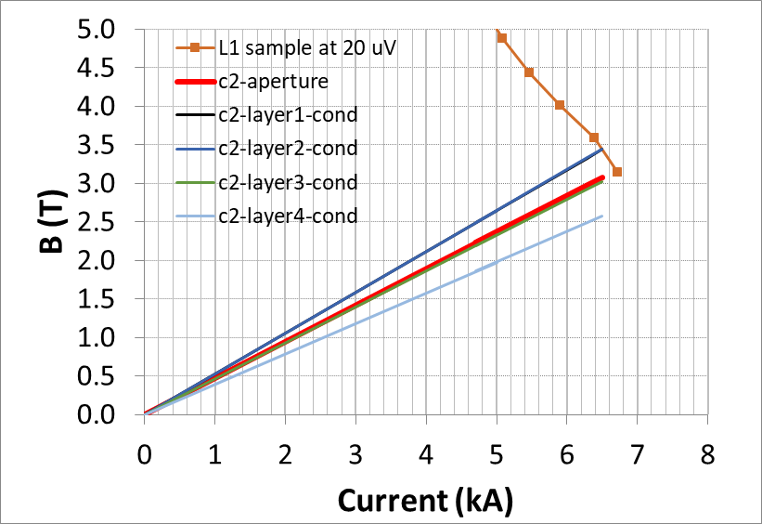
We expect C2 to reach 3 T at 4.2 K based on the in-field performance data of a Layer 1 sample
V(I) transition of a Layer 1 sample measured by ACT at different background fields
Bending radius close to C2
Jeremy Weiss and Danko van der Laan

Slide 5
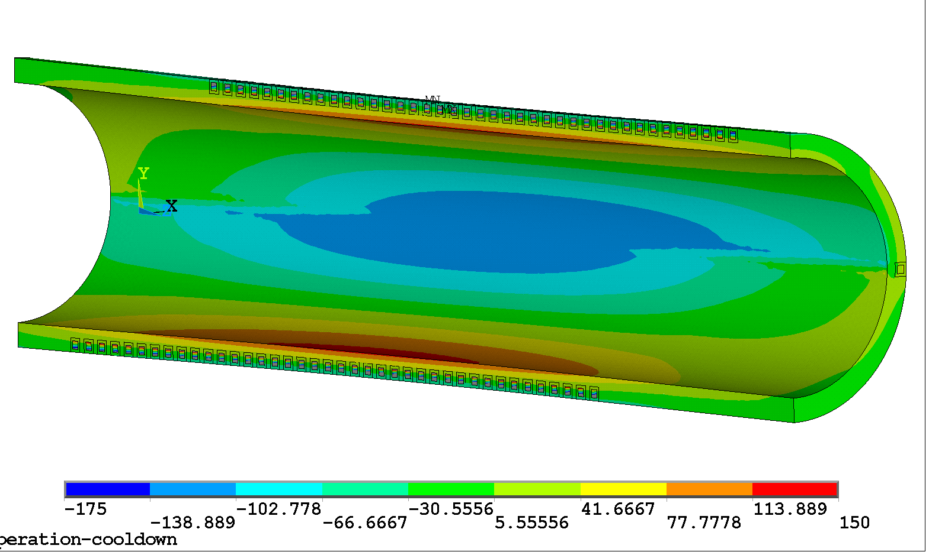
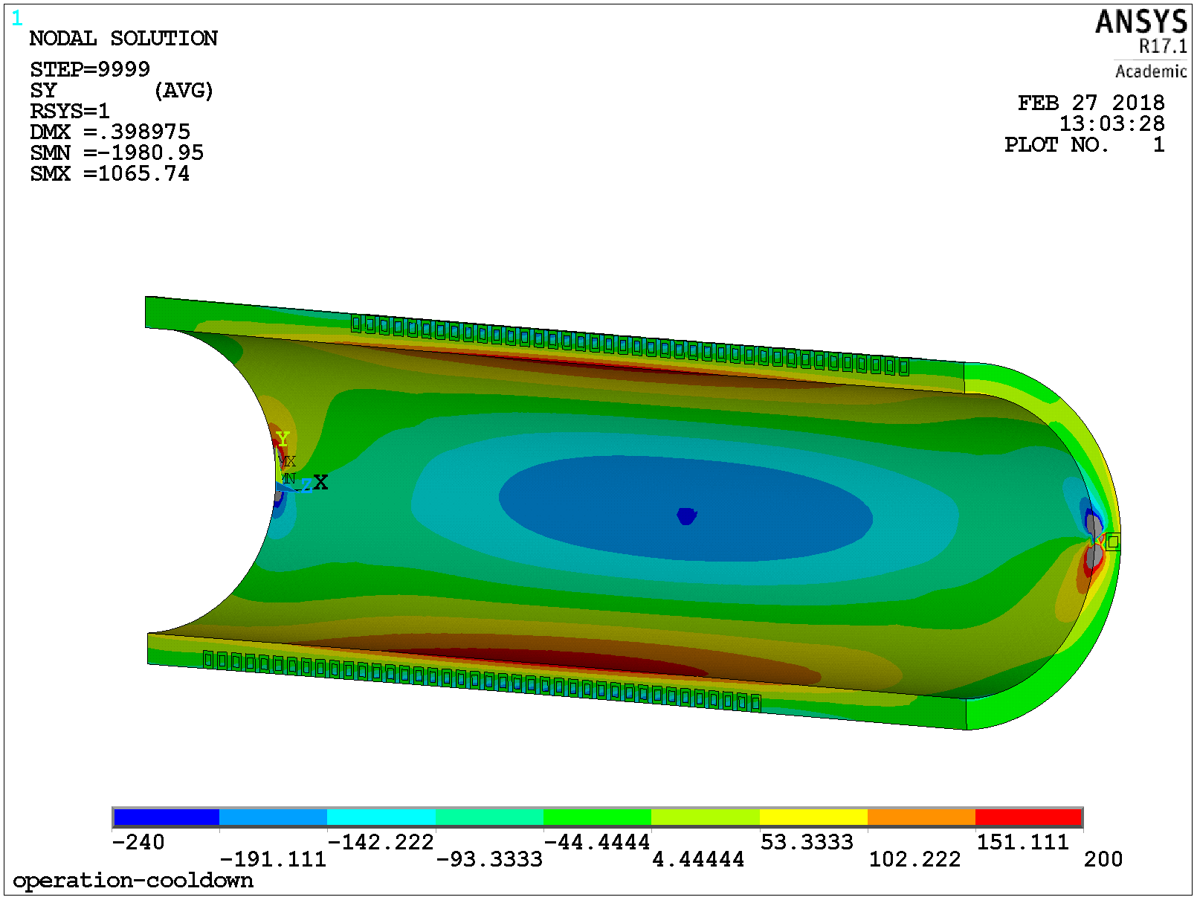
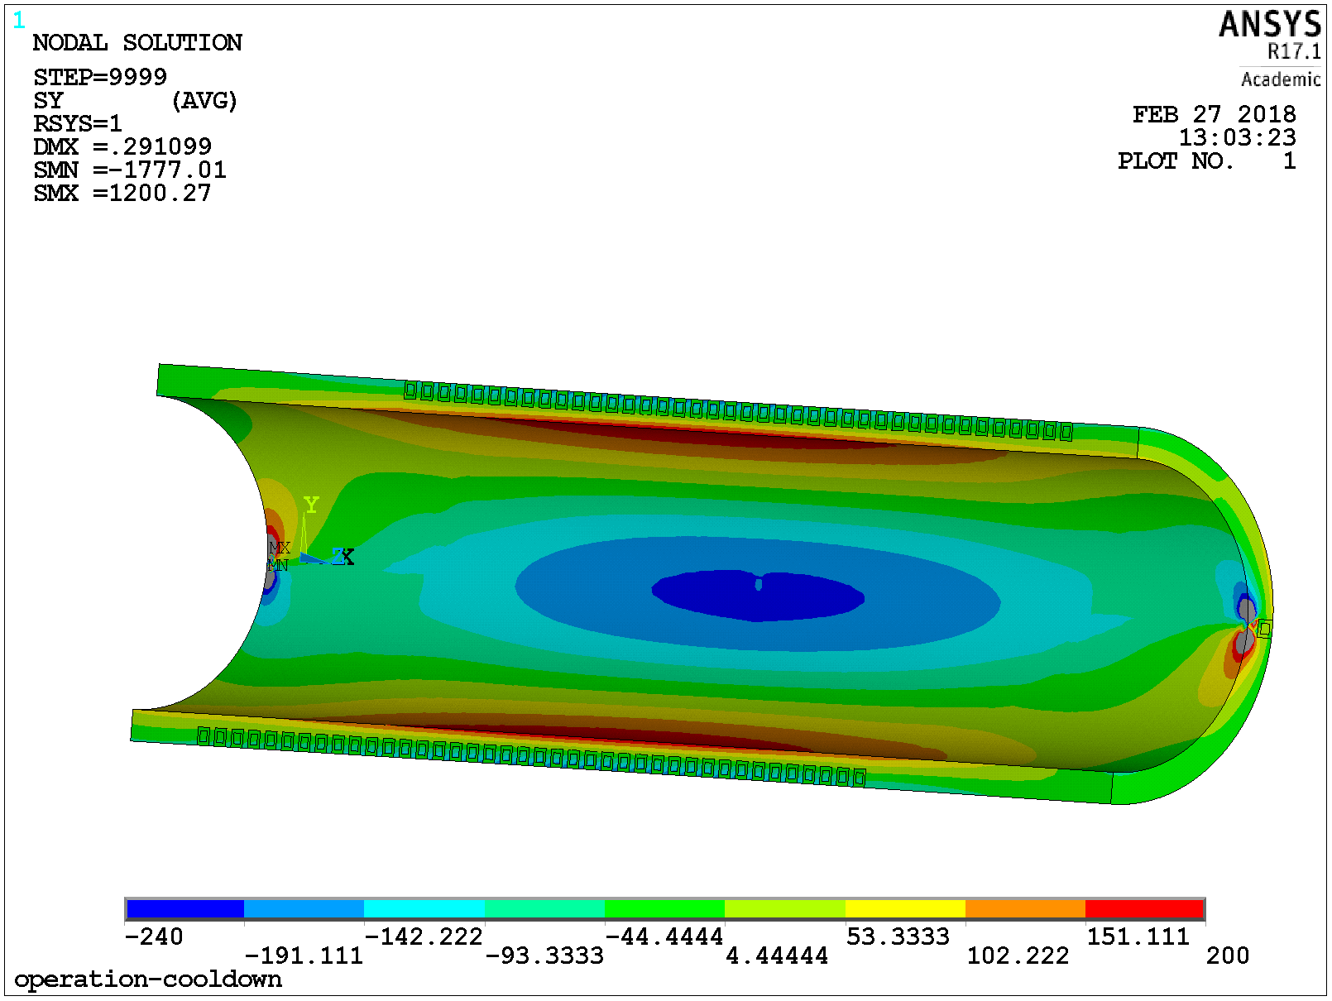
Mechanical analyses confirm that
C2 and beyond needs a metal mandrel
Mandrel stresses of 150-200 MPa is too high for 3D printed Bluestone that was used for C1 mandrel
Lucas Brouwer
Bluestone
Aluminum
Aluminum Bronze
C2 mandrel used Aluminum Bronze to leverage the experience of the CCT program at LBNL [D. Arbelaez, Thur-Af-Or24-05]
Notes:
- Cooldown to 4.5 K minus Lorentz Force

Slide 6
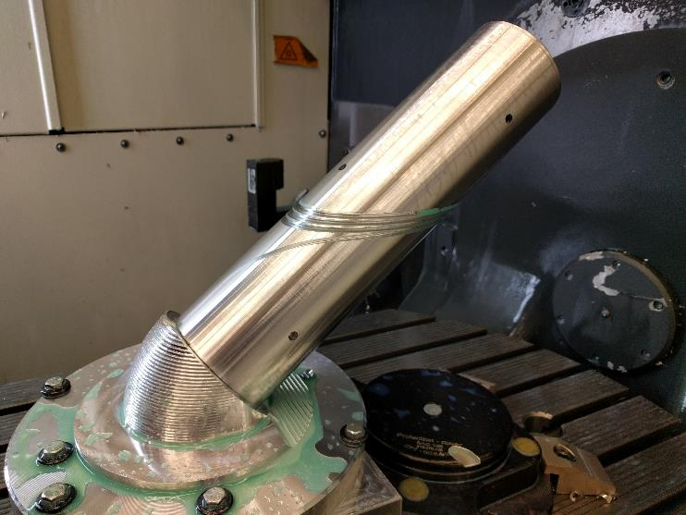
It may not be straightforward to machine the tilted groove in a metal mandrel
We tried with an in-house 5-axis CNC machine
Mandrel length is limited to about 300 mm

Slide 7
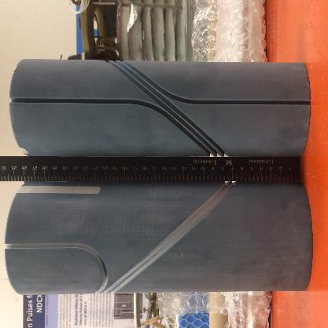
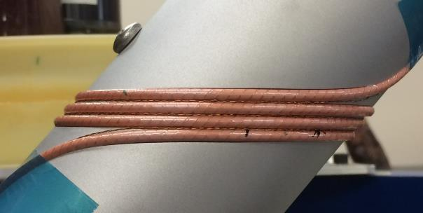
We reduced groove depth on mandrels as an interim solution to continue the magnet development
Laura Garcia Fajardo
Bill Ghiorso, Hugh Higley
Full-depth radial groove: Straightforward to machine but challenge to wind with tension
We will continue investigating this
Meanwhile, we used half-depth groove to help with winding

Slide 8
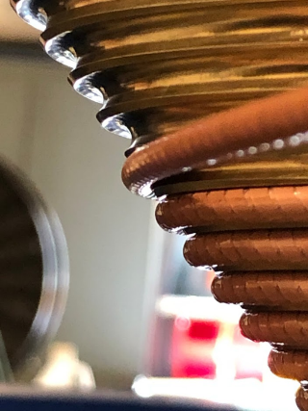
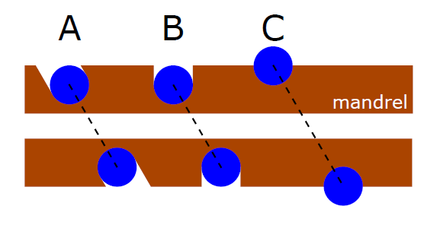
We chose the half-depth groove design for C2 magnet
Tilted
Half-depth radial groove
Full-depth radial groove

Slide 9
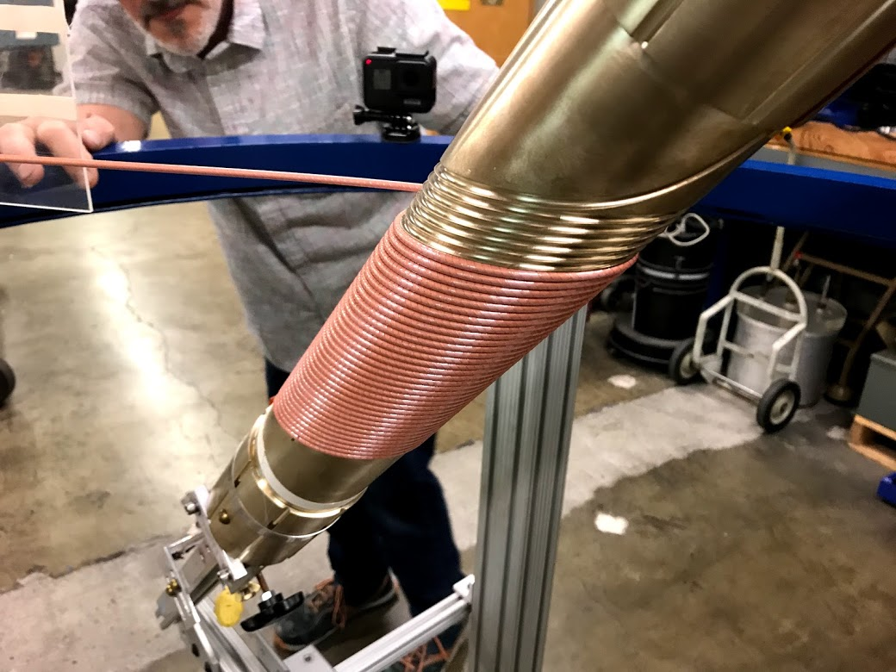
So we started
Winding with Hugh’s winding table
Mandrel designed by Bill Ghiorso and machined by Maxwell Maruszewski

Slide 10
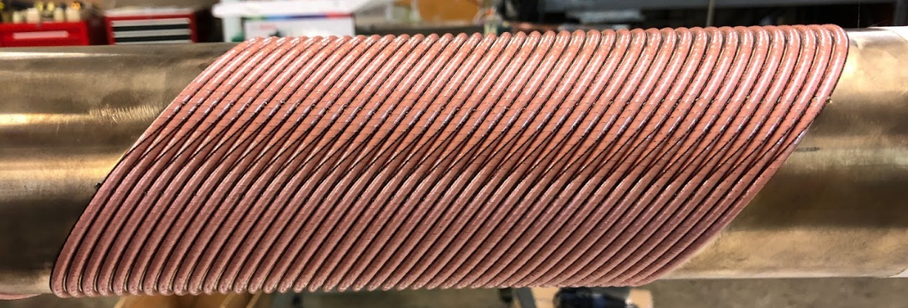
Co-wound voltage-tap wires with the conductor to reduce the inductive pickup during tests
Voltage tape wires

Slide 11
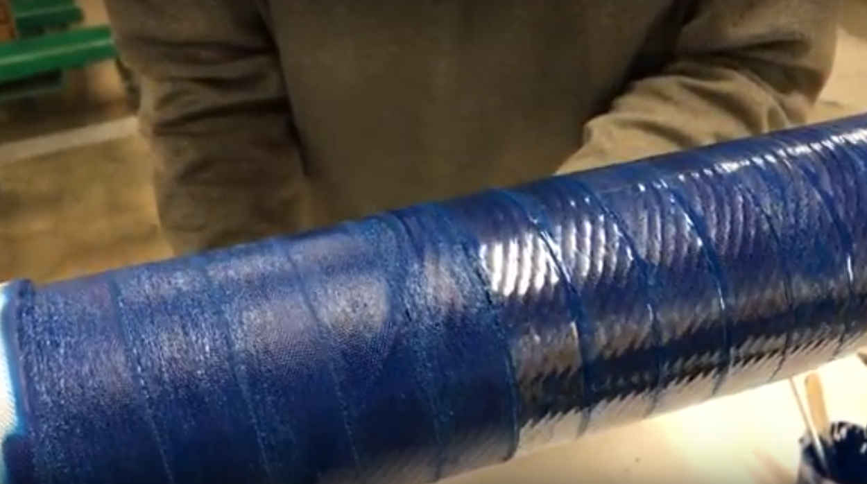
Painted Stycast 2850MT after winding to constrain the conductors
Hugh Higley
Wrapped fiber cloth on top of conductor
Wrapped and heated heat shrink tapes around coil before Stycast cured

Slide 12
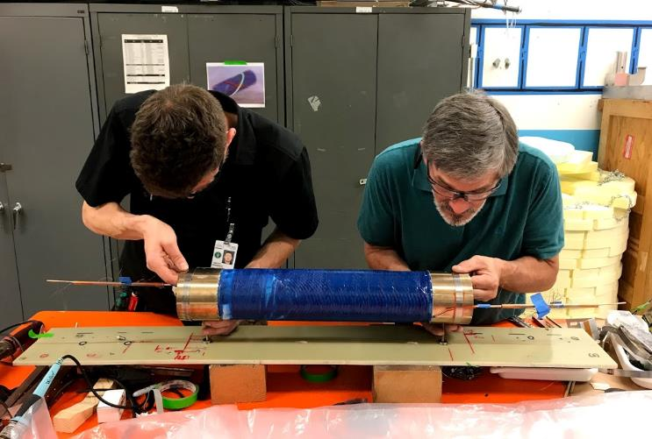
We measured the transport performance of each layer at 77 K before making the next layer
Hugh Higley and Timothy Bogdanof

Slide 13
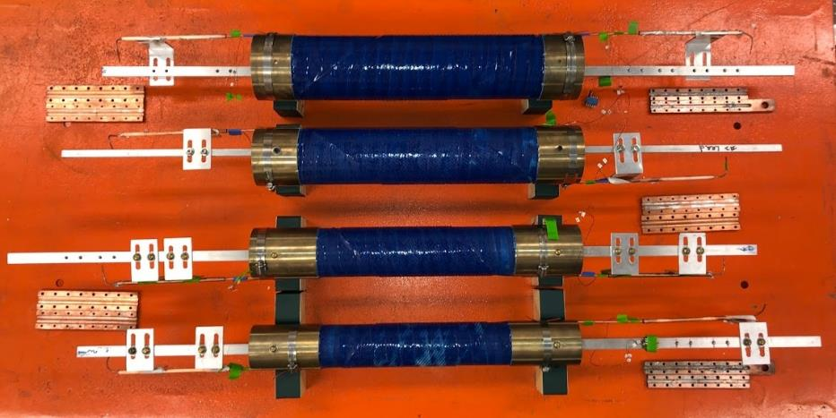
Few months layer, four layers of C2 oriented for a dipole configuration
Terminals
Aluminum Bronze mandrel
Cu blocks covering terminals
Layer 4
3
2
1

Slide 14
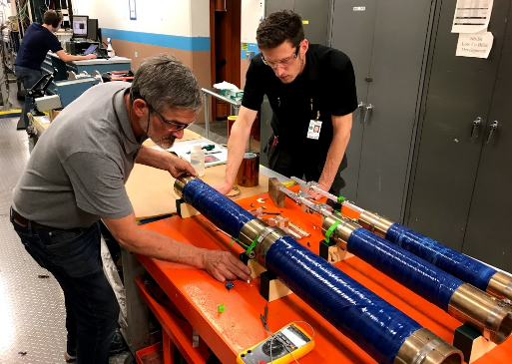
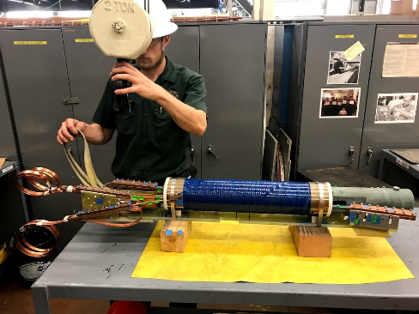
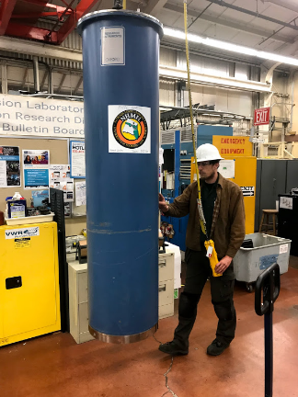
Assembly and insert into the cryostat

Slide 15
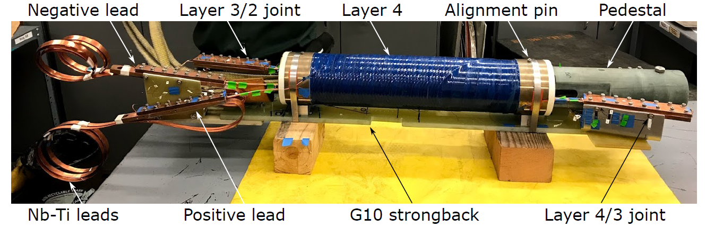

Slide 16
We used a systematic and progressive approach to develop and understand the fabrication technology for C2
3-turn
Test at 77 K
Wind
Test at 77 K
Apply Stycast
Test at 77 K
Assembly
Test at 77 K
Test at 4.2 K
40-turn
Layer 1
Wind
Test at 77 K
Apply Stycast
Test at 77 K
Layers 2 – 4
Wind
Apply Stycast
Test at 77 K
Assembly
Test at 77 K
Test at 4.2 K

Slide 17
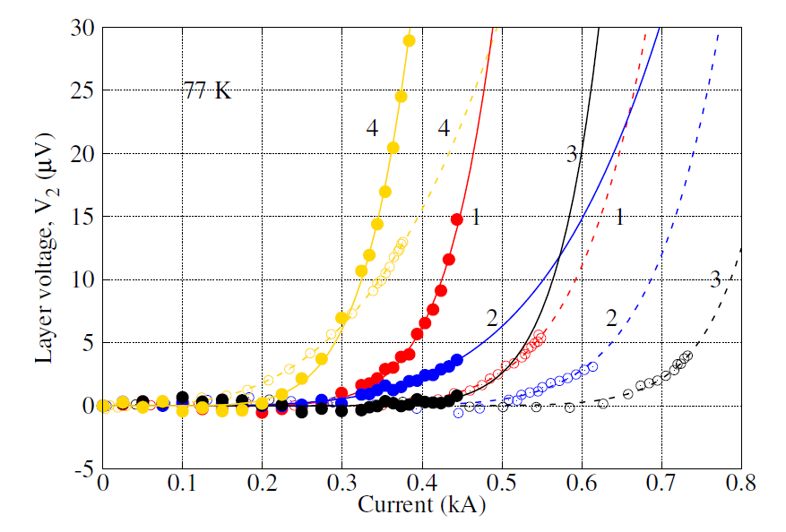
Layer 4 showed lower performance than the other three layers at 77 K but get closer to Layer 1 after assembly
~ 30% I_{c} reduction due to higher fields
There is potential to perform at 4.2 K as the voltages across Layers 1 and 2 start rising

Slide 18
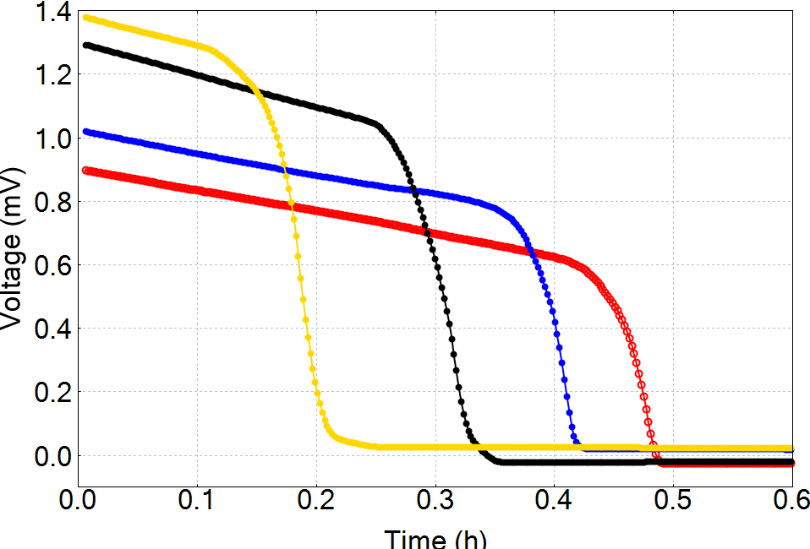
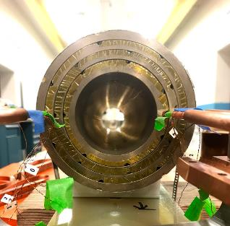
Layers became superconducting in sequence, indicating cooling from outer to inner layers
Layer 4
Cool down from 100 to ~ 90 K
3
2
1

Slide 19
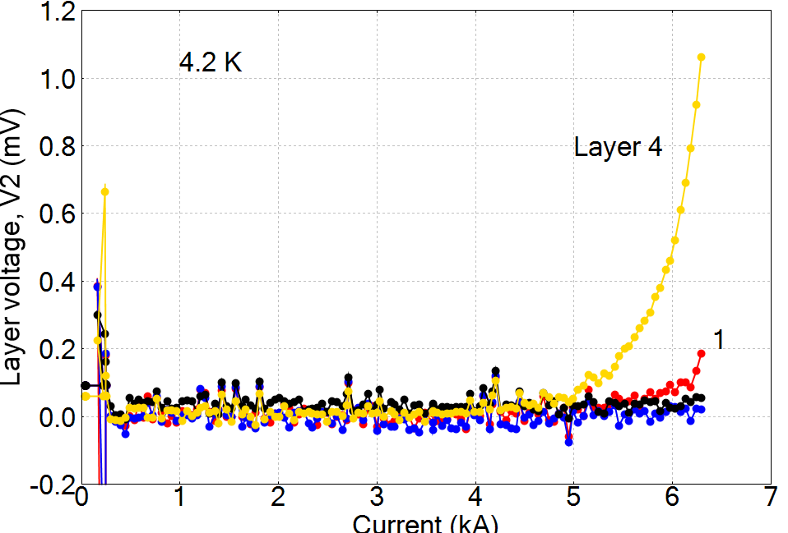
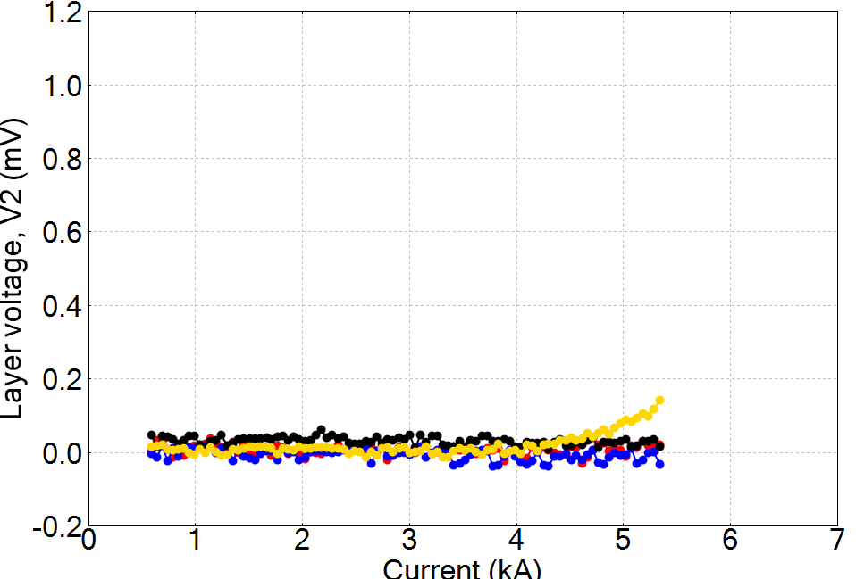
A controlled increase in the maximum current allowed us to probe the true performance of C2
Increasing the threshold for quench detection
Ramp 4

Slide 20
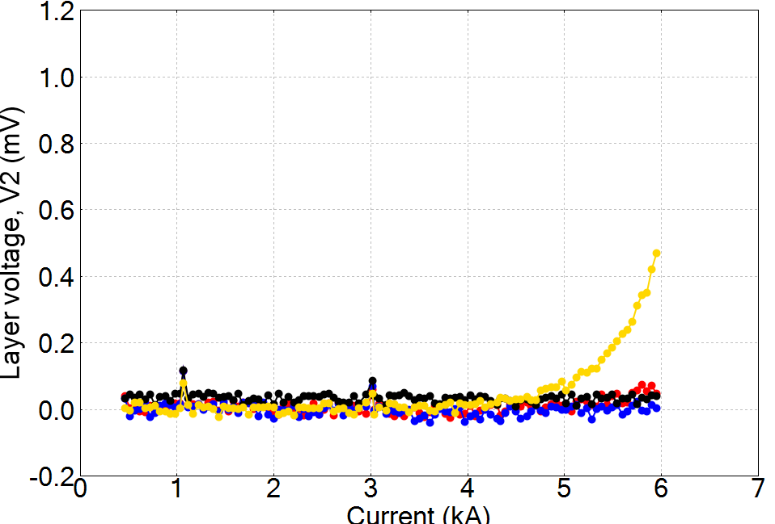
A controlled increase in the maximum current allowed us to probe the true performance of C2
Increasing the threshold for quench detection
Ramp 11

Slide 21
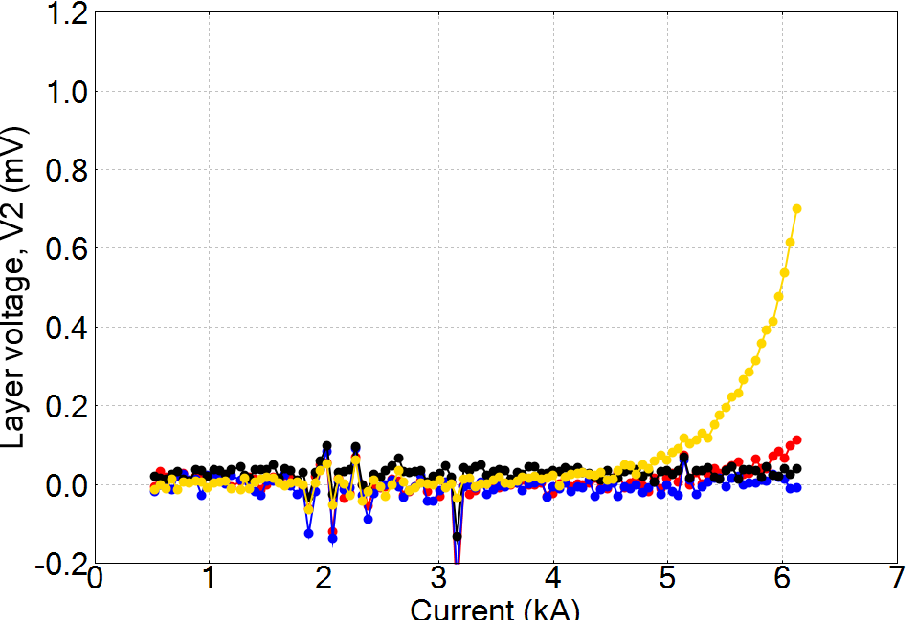
A controlled increase in the maximum current allowed us to probe the true performance of C2
Increasing the threshold for quench detection
Ramp 13

Slide 22
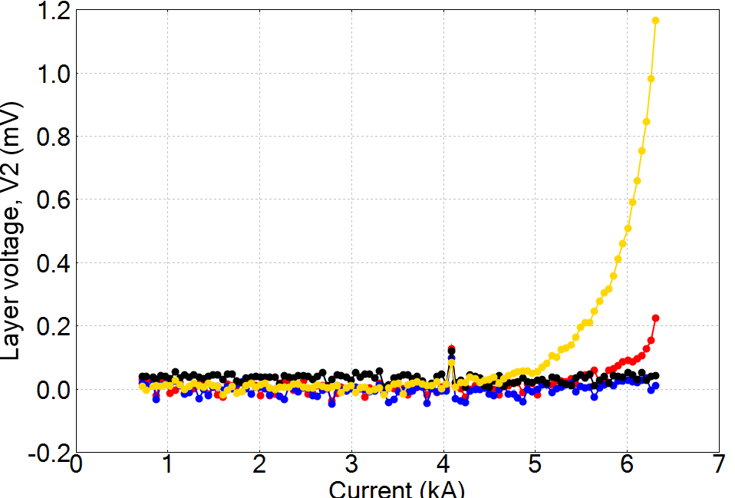
A controlled increase in the maximum current allowed us to probe the true performance of C2
Increasing the threshold for quench detection
Reproducible V(I) transition between ramps
  n = 13.1 for Layer 4
  n = 6.8 for Layer 1, consistent with the behavior of short sample measured at ACT
Wire J_{e} = 595 A/mm² at 6.3 kA
Ramp 15

Slide 23
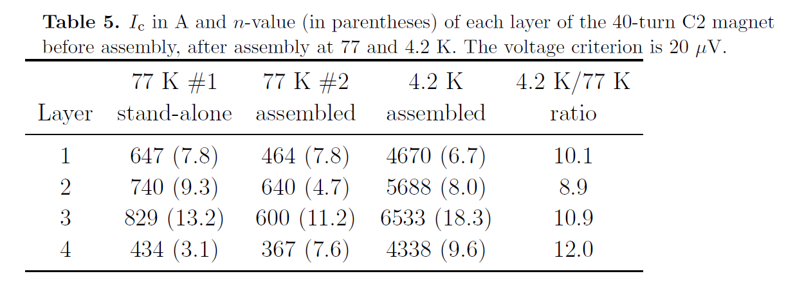
The current-carrying capability increases by a factor of ~ 10 from 77 to 4.2 K

Slide 24
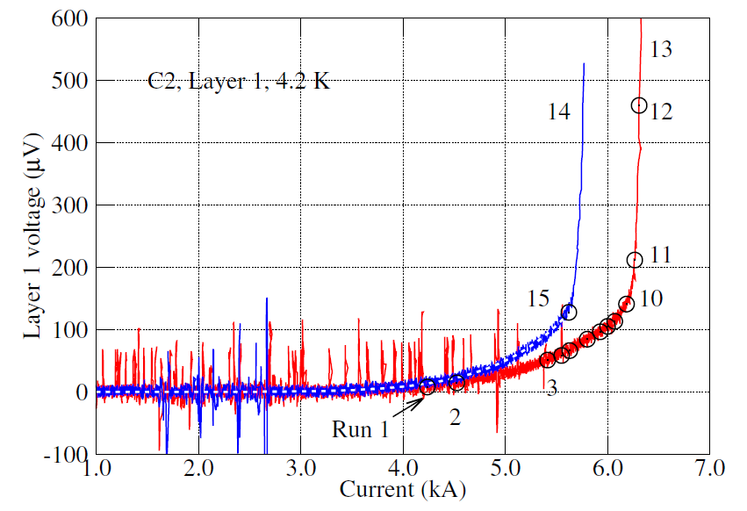
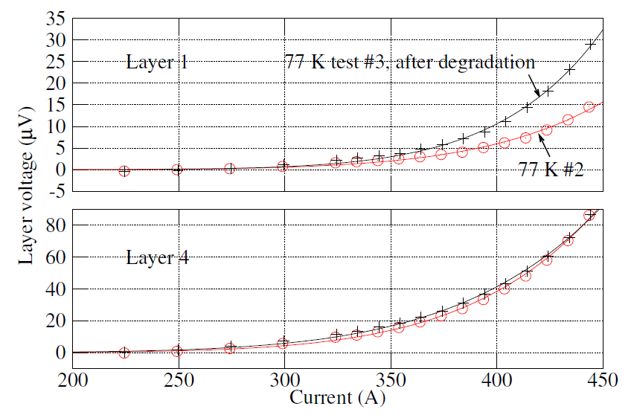
Layer 1 I_{c} degraded by 5% at 4.2 K after the thermal runaway

Slide 25
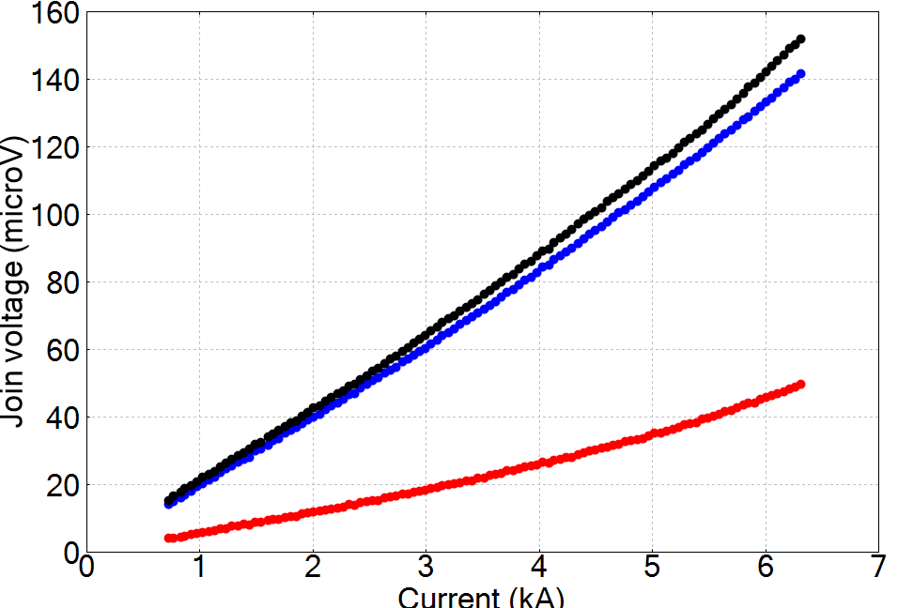
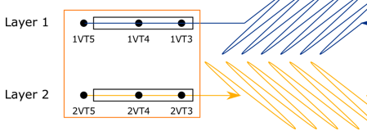
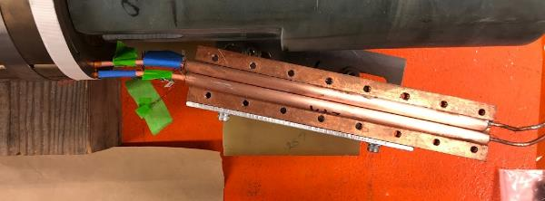
Inter-layer joint resistance ranges from 8 to 24 nΩ at 4.2 K - room for improvement
Joint voltage is measured across the voltage taps in each layer
Layer 3/4
2/3
Layer 1/2

Slide 26
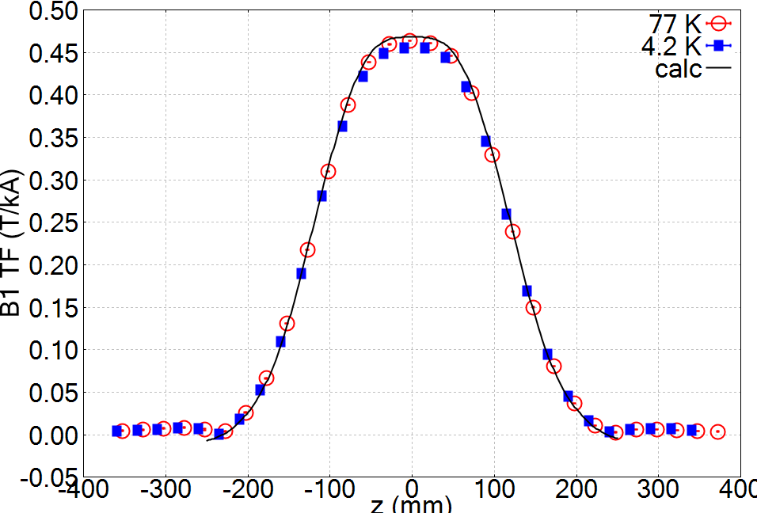
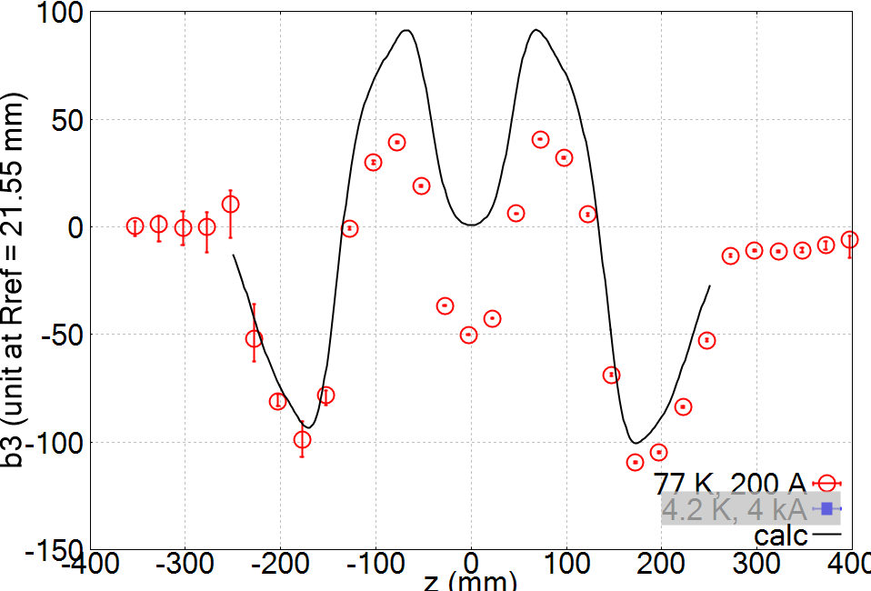
We measured the field quality of C2 and observed strong persistent-current effects at the magnet center
Measurement with a 100 mm long rotating coil developed by J. DiMarco at FNAL
B₁
b₃

Slide 27
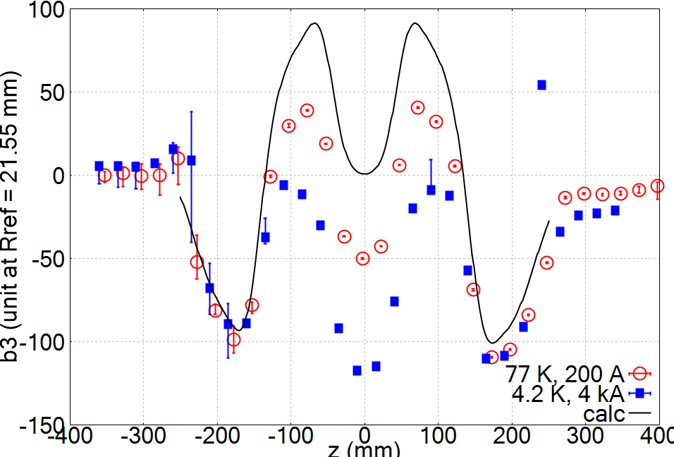

Stronger effects at 4.2 K – 30 tapes with large J_{c}
Cory Myers from OSU will present detailed field quality study, Thu-Mo-Po4.07-05
B₁
b₃

Slide 28
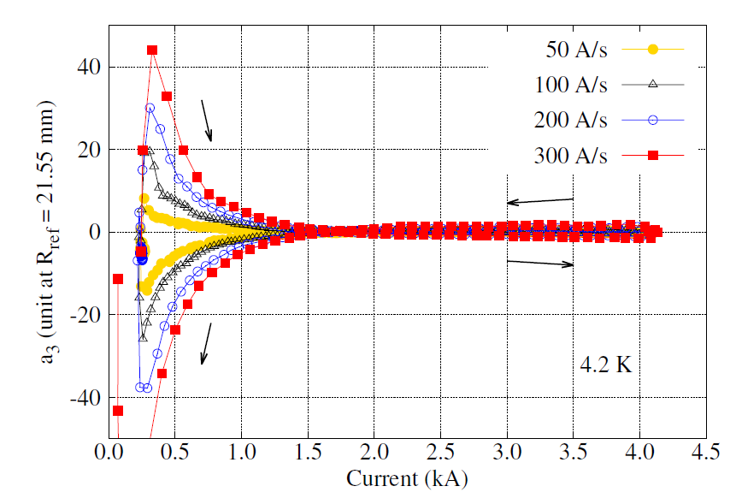
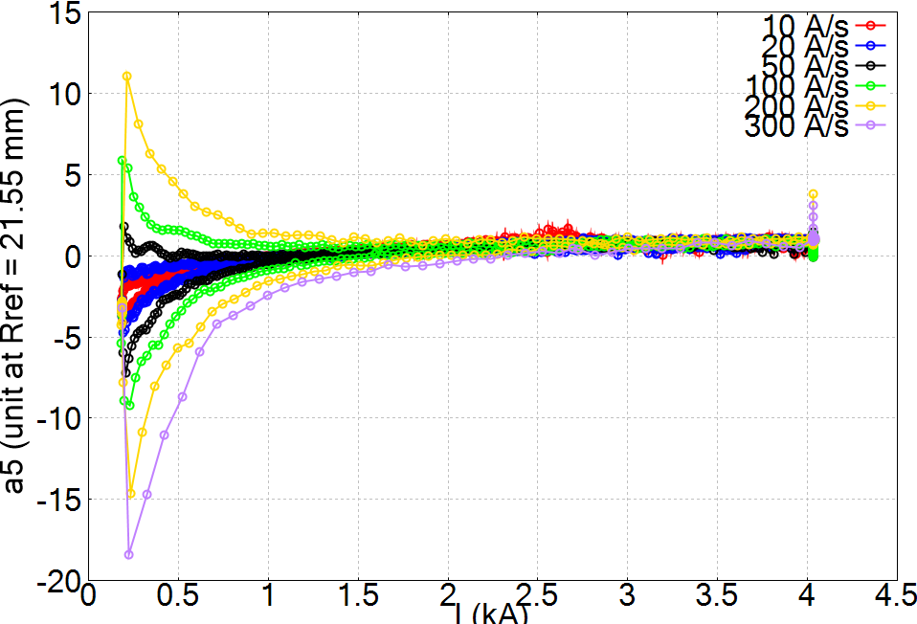
A ramp-rate dependence was observed in non-allowed skew terms. A similar behavior was seen in C1 with the plastic printed mandrel
C2 on aluminum bronze mandrel
C1 on bluestone mandrel
Inter-tape coupling currents?

Slide 29
We close the chapter on C2 with a good result with more questions arise
“A good result and more questions. That’s what we need.” – S. Gourlay
C2 reached 2.9 T, 98% of the expected value
Layer 1 started transitioning at 4.8 kA, 73% of the short-sample prediction. Why?
What caused the low performance of Layer 4?
Where is the heat/voltage generated?
How can we improve for the next magnet?

