Slide 1
Diagnostics roadmap and progress overview
M. Marchevsky (LBNL) and Diagnostics Workgroup

Slide 2
What are the key topics to address with diagnostics right now?
Performance limits: quench and quench precursors locations in high-field Nb₃Sn dipoles (15 T and CCT)
Training mechanisms: micro-mechanics, mechanical memory, event classifications
HTS degradation and quench origins: localization of hot spots in HTS magnets

Slide 3
Technical objectives (MDP Collaboration Meeting)
1. Resolving magnet disturbance spectra and understanding mechanical memory mechanisms
Acoustic emission
Distributed heater arrays
2. Conduct spot heater studies to improve voltage-based diagnostics and address “silent” quenches
3 .Characterize training-like behavior in different impregnation materials under load using a Transverse Pressure Insert (TPI) measurement system
3. Mitigating magnet training by remote probing and manipulation of weak interfaces and cracks
Time-reversal acoustics
4. Developing robust quench detection and localization
Standalone active acoustic QD
Multi-element and flexible quench antennas
Linear quench localization sensors
“Change in impedance” method
5. Fiber-optic based instrumentation for distributed mapping of strain variations during training and quench
6. New diagnostics to probe stress-driven degradation in ReBCO-based high-field HTS magnets
7. Understanding current sharing and stability margins in HTS coils and cables
8. Novel non-rotating probes for magnetic measurements
9. Cryogenic electronics, FPGAs and quantum sensors
Training
Quench
HTS
Enabling technology

Slide 4
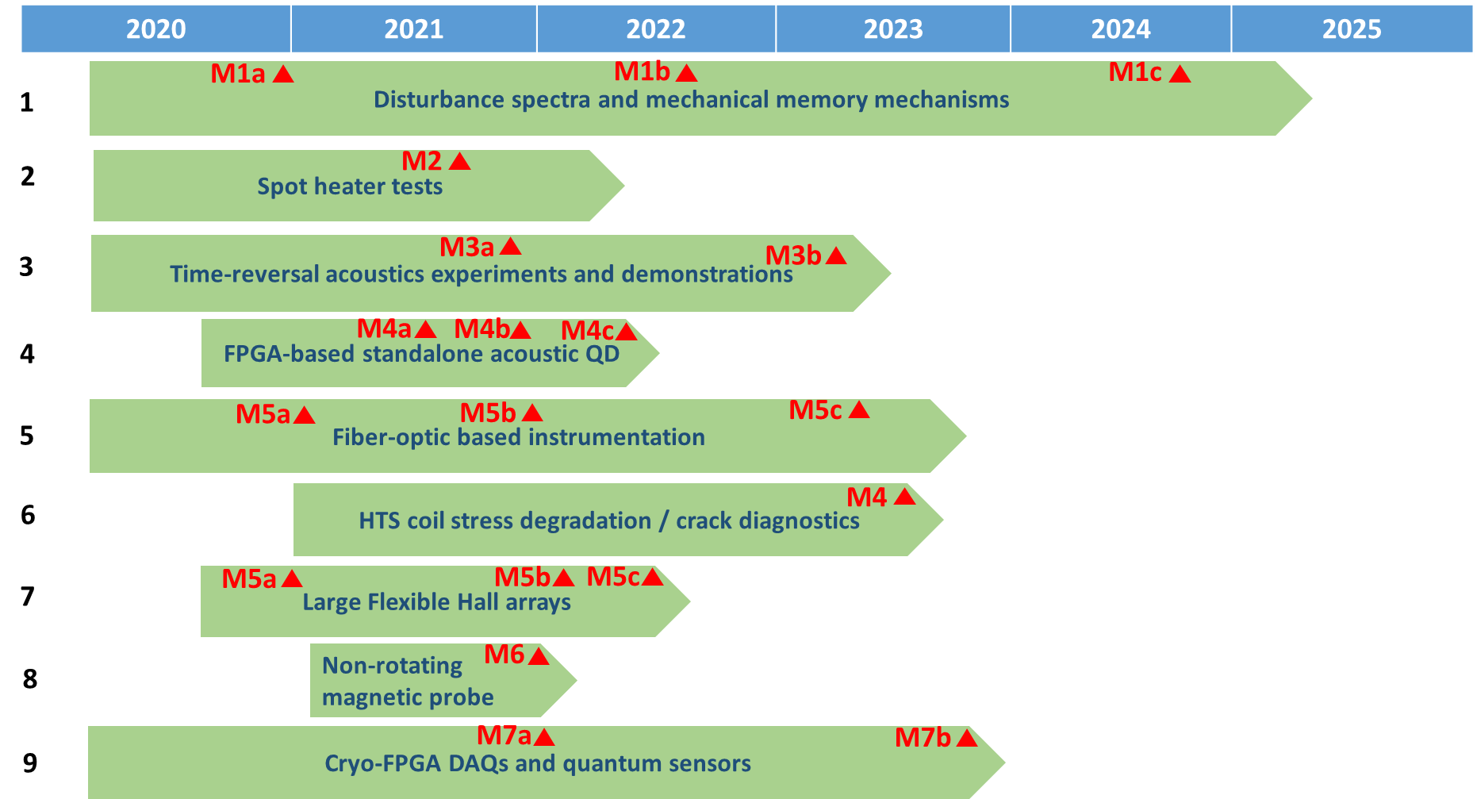
Roadmap update
LBNL/FNAL
FNAL
LBNL
Localization &
LBNL, BNL
FNAL/BNL
LBNL/NHMFL
LBNL
LBNL/FNAL, BNL
LBNL/FNAL, BNL

Slide 5
Latest progress summary
Acoustics & training
New acoustic system has been successfully tested at LBNL in CCT subscale test yielding some useful event localization data
Interesting data obtained by FNAL on cable 10-stacks is presently being analyzed
Two summer students are working at FNAL to develop ML models for the 15T acoustic data
LBNL is working on the paper with NERSC on training and event clustering in CCT4 test
Fiber-optics
Let us discuss progress on training in a dedicated meeting!
New FBG interrogator has been acquired by FNAL and a another model is being considered by BNL. The immediate plan is to set up a cryogenic testbed for fiber-optic technology qualification and share experience and potentially equipment between the labs – to be discussed today
Quench antennas
FNAL has developed flexible multi-element quench antennas that is to be used in the CCTs, and is working on a software aimed at simulating antenna signals for precise event localization - to be discussed today
Hall arrays
LBNL has built several 60-sensor Hall arrays and they are available for HTS studies
Cryo-electronics
LBNL is processing results of recent series of cryogenic FPGA tests and working on a paper – to be discussed today

Slide 6
Diagnostics WG meetings
# | Topic | Link
1 | Roadmap and general planning | -
2 | Fiber-optic instrumentation | https://conferences.lbl.gov/event/337/
3 | Quench antenna | https://conferences.lbl.gov/event/354/
4 | Acoustic diagnostics and machine learning | https://conferences.lbl.gov/event/345/
5 | Cold electronics and FPGAs | https://conferences.lbl.gov/event/403/
Bi-weekly, on Fridays at 12.00PM/2PM/3PM (LBNL/FNAL/BNL)

