Slide 1
OverPass/UnderPass (Clover-leaf)
End Design for Block Coil Dipoles
MDP 20 T Design Study Meeting on June 30, 2020
Ramesh Gupta
for PBL/BNL Collaboration

Slide 2
Contents
Alternate End Design for Block Coil Dipoles
Why
What
Progress and Plans
Proof-of-Principle test with dual goals
Challenges

Slide 3
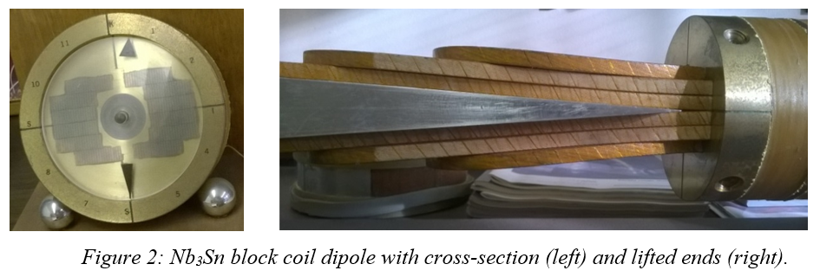
Introduction
Block coil designs have many attractive features in the cross section due to their simplicity, easy to segment coils in hybrid dipoles and structure to manage the Lorentz forces in high field magnets
The ends of certain coil blocks, however, don’t remain simple (some had reverse bends as well). They also get longer. Moreover, the ends + transition regions have often limited the magnet performance

Slide 4
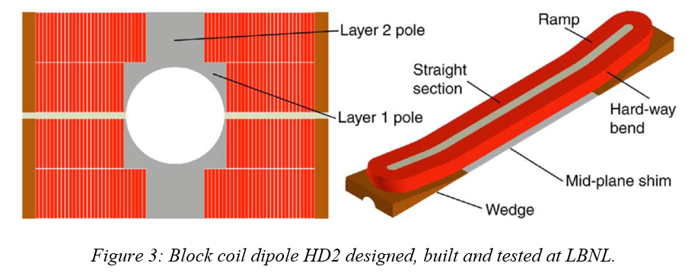
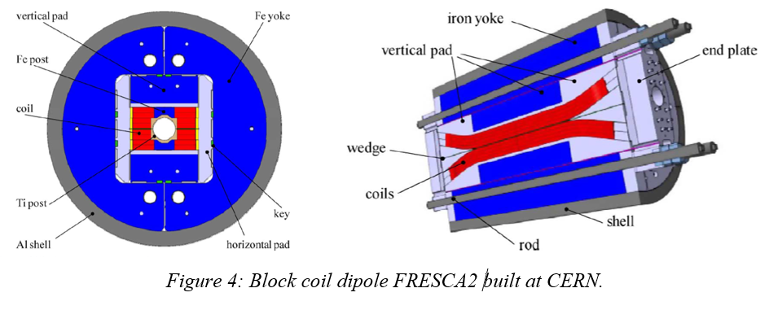
Single Aperture Dipoles (lifted ends to clear the beam tube)

Slide 5
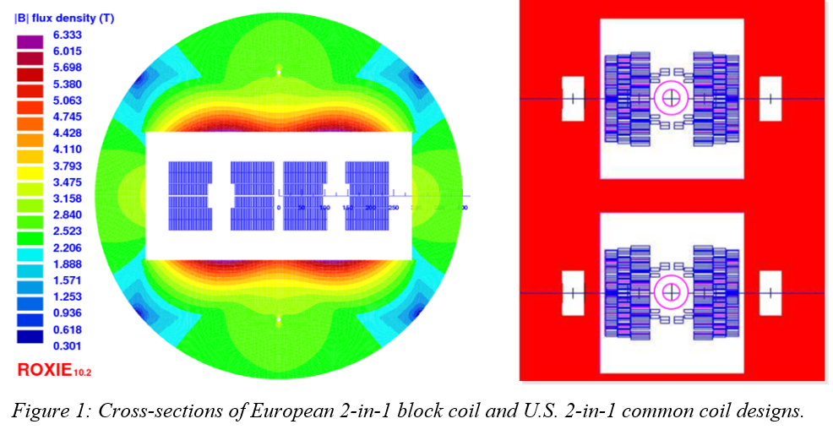
Dipoles for Colliders (some blocks must still be lifted in hard direction to clear the bore)

Slide 6
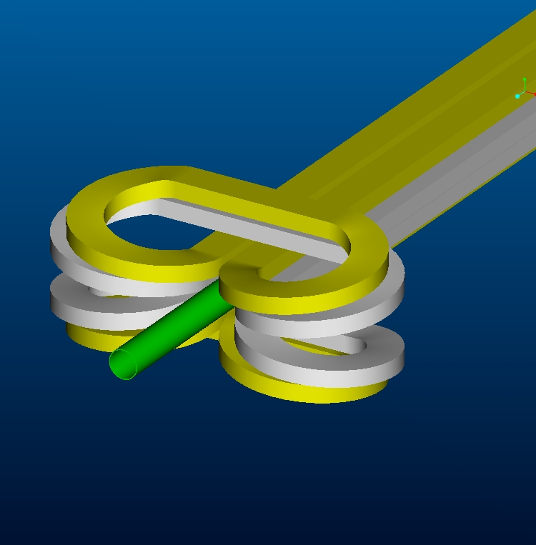
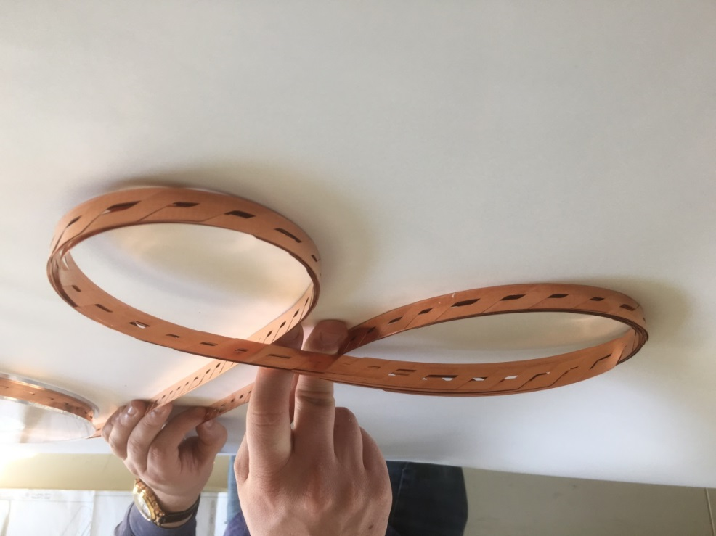
Overpass/UnderPass End Design
ASC2002
To visualize, imagine driving on a highway when you have to go back
No reverse or hard way bend
Conductor friendly design – less strain (primarily tilt)
Less axial length of ends
Useful for block coil designs
Roebel
Courtesy:
Glyn Kirby, CERN
Rutherford Cable

Slide 7
Freeway Overpass/UnderPass (or clover-leaf) End Design
ASC2002
Presented at ASC 2002
Design attractive for the HTS and for the block coil dipoles
SBIR Phase I with e2P in 2015
HTS test coil wound in Phase I and produced good technical results
CERN picked it up, made large invested and made significant progress - part of the 20 T design
STTR Phase I with PBL in 2020
Proof-of-principle Nb₃Sn demo in Phase II with common coil dipole
BNL
ASC2018
CERN

Slide 8
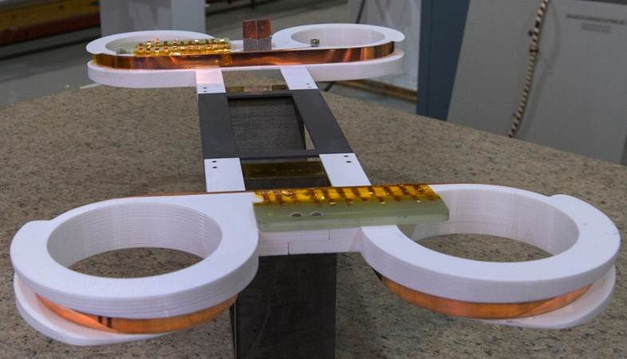
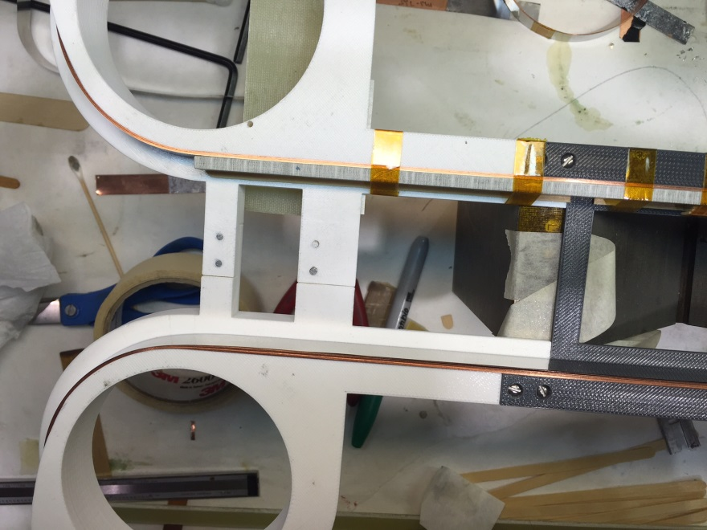
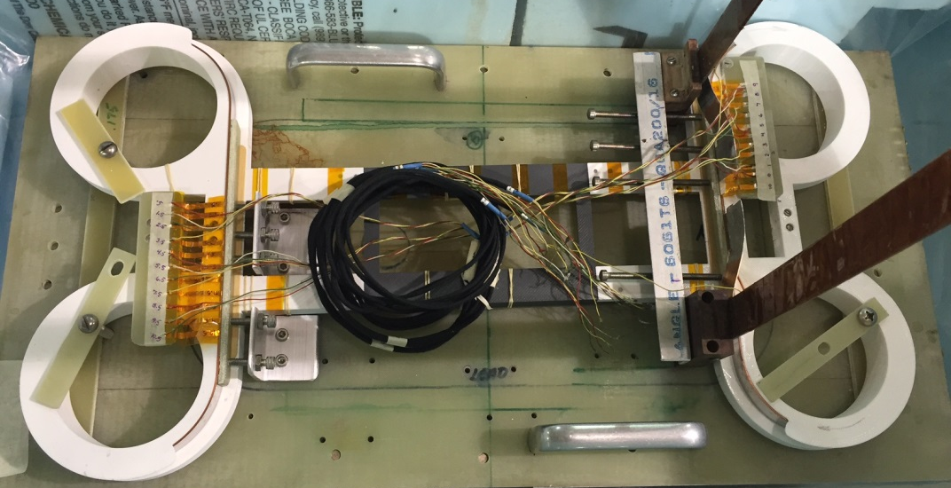
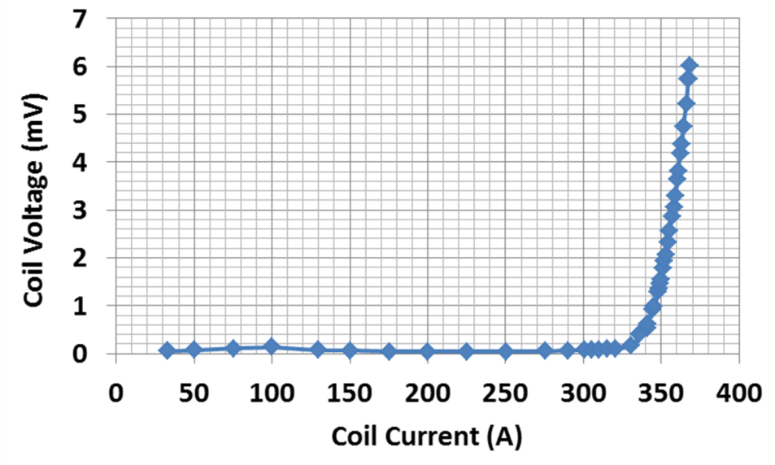
Demonstrations of the HTS Coils with Overpass/Underpass Design with SBIR
12 mm wide tape @BNL
No degradation
4 mm tape (3 e2P coils)
Courtesy 3d printer
77 K Test Results

Slide 9
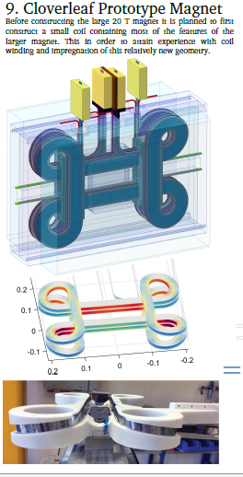
Overpass/underpass clover-leaf design
Another significant contribution of the US SBIR Program to the world wide high field magnet R&D
Similar design by wolf about a decade earlier – independent work

Slide 10
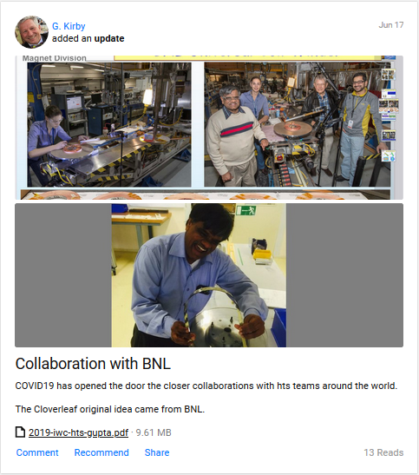
Collaboration with CERN
Roebel
Courtesy:
Glyn Kirby, CERN

Slide 11
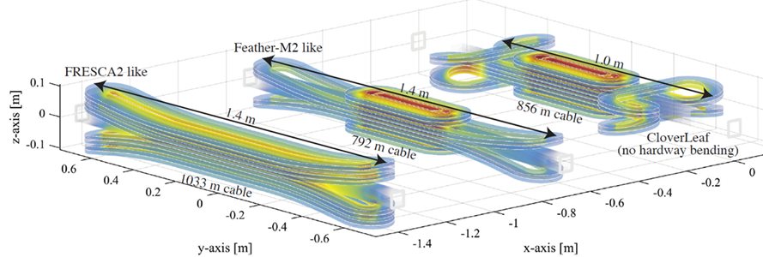
Work at CERN (1)
A comparison of the length of the ends in a coil with lifted ends (left) and a coil with overpass/underpass ends (right) to clear the bore tube
J. van Nugteren, G. Kirby, J. Murtomaki, G. de Rijk, L. Rossi and A. Stenvall, “Towards REBCO 20+ T Dipoles for Accelerators,” presented at the European Conference on Applied Superconductivity (EUCAS 2017), September 2017

Slide 12
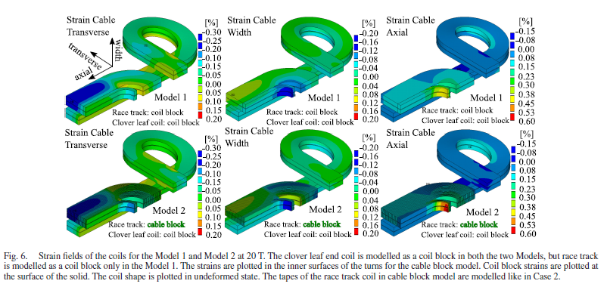
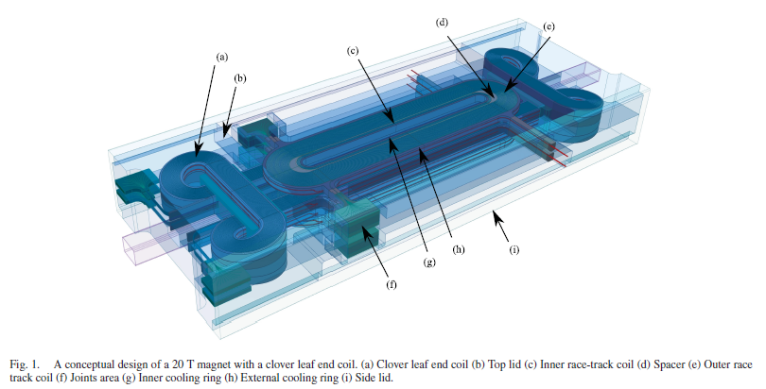
Work at CERN (2)

Slide 13
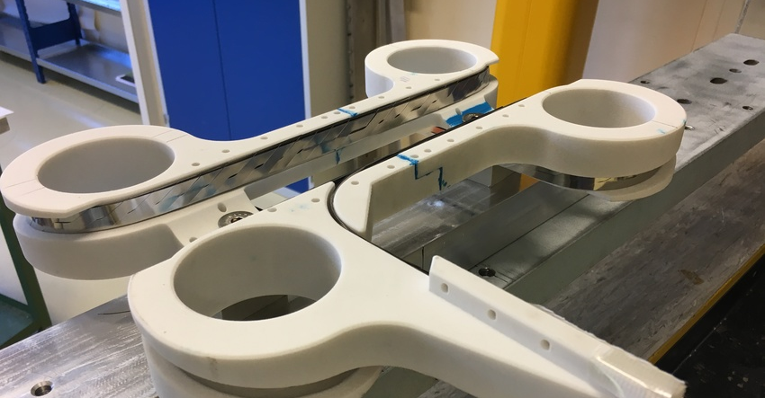
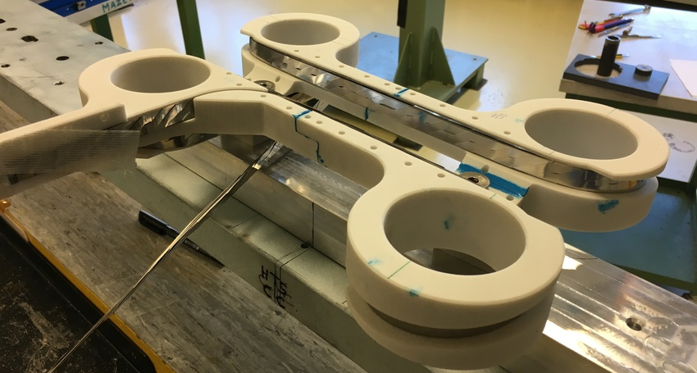
Test Coil Winding at CERN
https://www.researchgate.net/project/Dipole-HTS-Magnets-at-CERN

Slide 14
Recently Funded PBL/BNL STTR
(work to start soon)

Slide 15
PBL Team
Current staff of Particle Beam Lasers, Inc. (PBL)
James Kolonko (President)
Delbert Larson (Vice President)
Steve Kahn (Senior Engineer, BNL retiree)
Ron Scanlan (Senior Scientist, LBNL retiree)
Bob Weggel (Senior Engineer, MIT retiree)
Erich Willen (Senior Scientist, BNL retiree)
Previous participants
Bob Palmer (BNL)
David Cline (UCLA)
Harold Kirk (BNL)
Al Garren (LBL)
Shailendra Chouhan (FRIB)
PBL/BNL team has worked on several SBIRs/STTRs and has made important contributions in areas such as high field HTS solenoid, common coil dipole, hybrid dipole, open midplane dipole, etc.

Slide 16
TASKLIST
Perform 2-d and 3-d magnetic design for the proof-of-principle Nb₃Sn dipole
Perform 2-d and 3-d mechanical design for the proof-of-principle Nb₃Sn dipole
Perform coil winding test
Perform mockup assembly test
Selection of conductor and cable for the proof-of-principle magnet
Plan for proof-of-principle tests in Phase II
Develop a conceptual design for the assembly and test of the overpass/underpass coils in the proof-of-principle dipole
Develop a conceptual design of a 16 T, 50 mm aperture dipole for a future proton collider and a background field test facility magnet for HEP and FES
Phase I Final Report and identify the key components for a Phase II proposal
(PBL welcomes participation and collaboration with all USMDP partners)

Slide 17
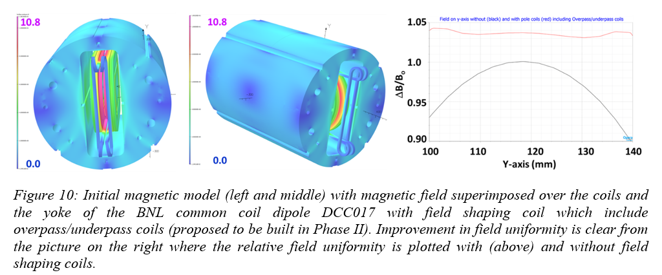
Goal of Phase II, if funded (1)
Insert coil test in BNL DCC017 for a “Proof-of-Principle” demonstration of (a) overpass underpass end design (b) Field quality common coil design

Slide 18
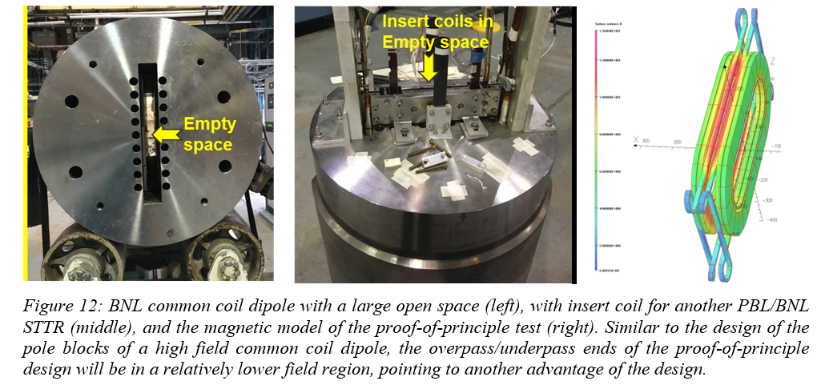
Goal of Phase II, if funded (2)
Insert coil test in BNL DCC017 for a “Proof-of-Principle” demonstration of (a) overpass underpass end design (b) Field quality common coil design

Slide 19
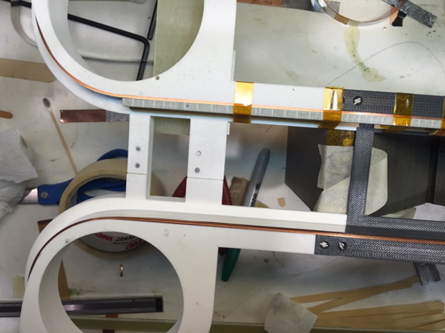
Challenges (incomplete list)
New Design – any new design, until demonstrated, has potential issues not fully appreciated initially
Coil winding – coils are wound outside in, with no clear path, regular winding techniques don’t work
Mechanical design and analysis of the new end design

Slide 20
Summary
A new conductor friendly end design for block coils dipoles to reduce strain and length of the end region
Relevant to Nb3Sn and HTS and therefore relevant to high field 20 T design study
Magnet ends and body to end transition region has often limited the performance of block coil dipoles. This new design has a potential of improving that performance.
New designs typically comes with new challenges. All are invited to collaborate/participate in this PBL/BNL STTR.

