Slide 1
MDP General Meeting MDPCT1b test plan and quench performance studies
M. Baldini, S. Krave, S. Stoynev
US Magnet Development Program

Slide 2
Outline
MDPCT1b test goals and plan
Training quenches and locations
Ramp rate dependence study
Quench current temperature dependence study
Summary

Slide 3
MDPCT1b test goals
Study the effect of the increased pre-load and altered end-support on magnet quench performance
Measure ramp rate and temperature dependences of magnet quench current
Magnetic measurements
Obtain strain data and MIITs at the high field
Study protection heater
First thermocycle

Slide 4
Test plan: test cycle I
Room Temperature preparation
Electrical checkouts and Hi-pot
System checks at 4.5 K with 60 mΩ dump resistor:
Cold Electrical Checkout and Hi-pot, Quench Detection Checkout
1.9 K operations with 60 mΩ dump resistor
Quench Training at 20 A/s to a plateau (maximum current will be limited to 11kA and <15 MIITs)
Flux-jump measurements
Strain gauge and acoustic signal measurements
Ramp rate studies (10/100/200 A/s)
Temperature dependence studies
Magnetic measurements near the plateau (~ -500 A) – see the Magnetic measurements plan
4.5 K operations with 60 mΩ dump resistor
Inductance measurements at 50 and 300 or 200 A/s
Splice resistance measurements
Warm up to 300 K
Cold RRR Measurements
At 300 K after the test
Repeat RRR measurements at room temperature

Slide 5
VMTF test facility and instrumentations
Strain gauges on magnet skin, Al clamps, coils and bullets
Two quench antennas on the warm finger,
Acoustic sensors attached to the magnet end plate
Voltage taps

Slide 6
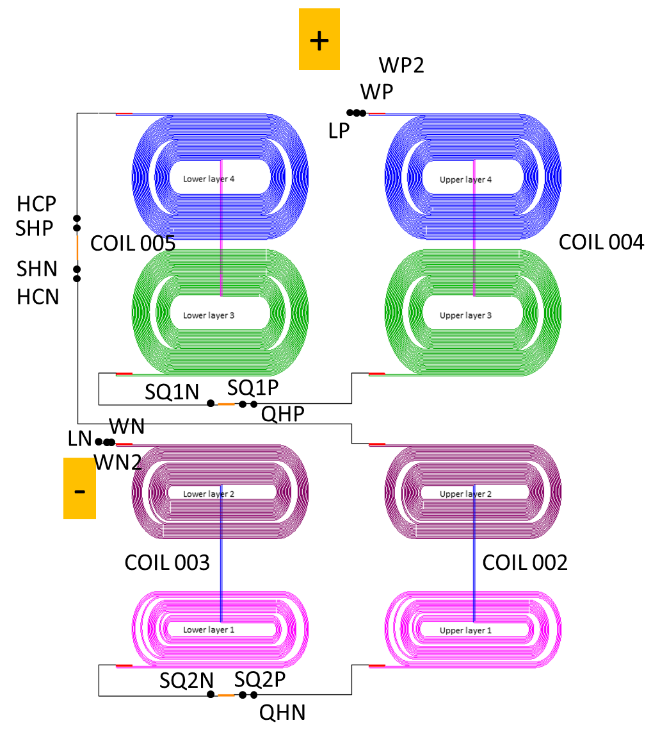
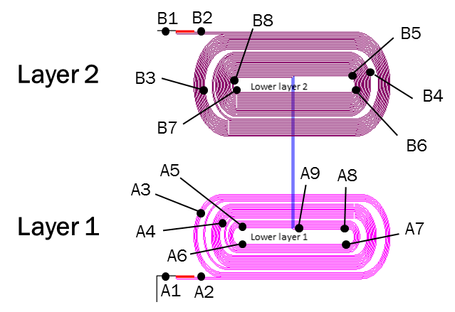
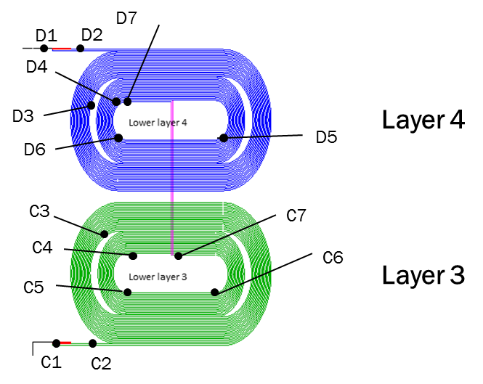
Coil connections and voltage taps
Inner coils
Outer coils

Slide 7
Training history
Training is slower than in MDPCT1
Signs of detraining after quench #61
96.7% of magnet design limit
79.4% of magnet short sample limit (driven by inner coil 3) in 61 quenches
86.1 % of magnetic field short sample limit
to be updated

Slide 8
Training history by coils
Two IL quenches in coil 2 in MDPTC1 test
This test: all quenches were in the outer coils
No quenches in the inner coils even with increased pre-load and altered end-support
Training of coil 4 is more consistent with previous test behavior
Coil 5 is the limiting coil

Slide 9
Training quench layer locations
Most of the quenches are in coil 5 layer 3 (inner layer)
Note that coil 5 cable was already cured and unwounded from a previous coil

Slide 10
Training quench locations
Quenches are in coil 5 layer 3 move from lead end pole turn to straight section pole turn.
The straight section quenches are the one limiting the magnet performances.

Slide 11
Training quench locations (2)
78% of quenches are in coil 5 are in layer 3
64% of training quenches are in the lead end pole turn section
60% of the quenches in coil 4 are in layer 3

Slide 12
Ramp rate dependence
Tested: 10, 20, 50, 100 and 200 A/s
All quenches in coil 5 layer 3
Quenches move from the strain section to the return end
5c6_c7 segment locations for quenches at ramp rate above 50 A/s
5c5_c6 segment locations for quenches at ramp rate below 50 A/s

Slide 13
Temperature dependence
coil 5 short sample limit
All quenches in coil 5 layer 3
Quenches move back to the straight section
5c5_c6 segment locations for quenches below T= 2.2 K
5c6_c7 segment locations for quenches above T= 2.2 K
Clear indication of conductor degradation
Ramp Rate and Iq(T) data show that the magnet has been trained to its conductor limit determined by RE pole turn of coil 5

Slide 14
RRR data
Cold resistance data were collected during magnet warm up
Warm resistance data were taken at the beginning of the test
RRR were calculated for each voltage tap segment
Outer coil RRRs are lower than inner coil RRRs

Slide 15
Summary
All training quenches took places in the outer coils: no inner coil quenches
Highest training quench is at 10008 A which corresponds to a bore field of 14.5 T
The training limiting coil is coil 5: RR and Iq(T) data show that the magnet has been trained to its conductor limit determined by RE pole turn of coil 5.
Test Cycle I has been completed. Splice resistance and inductance measurements were not performed and will be done during test cycle 2 together with protection studies.

