Slide 1
MDPCT1b quench locations, quench propagation and links to performance
MDP Meeting, July 22, 2020
Stoyan Stoynev for the team
US Magnet Development Program
Fermi National Accelerator Laboratory

Slide 2
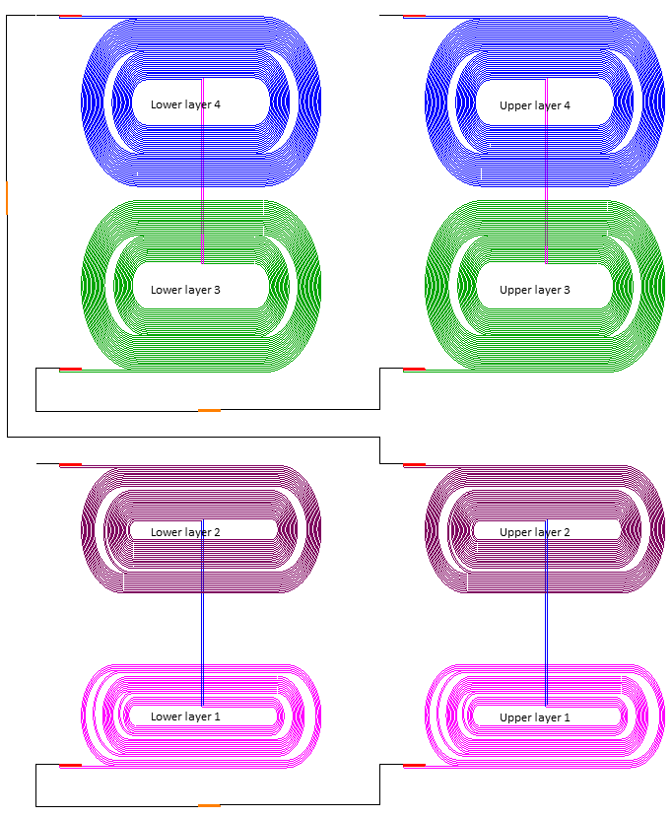
“15 T” Coil connections
+
COIL 005
COIL 004
-
COIL 002
COIL 003

Slide 3
“15 T” voltage taps
Coil instrumentation (seen from “above”)
D7
D1
D2
B1
B2
B8
D4
B5
Layer 2
D3
Layer 4
B3
D6
D5
B4
B7
B6
C3
C7
A5
A9
A8
A3
C4
C6
Layer 1
Layer 3
A4
A7
C5
A6
A1
A2
C1
C2

Slide 4
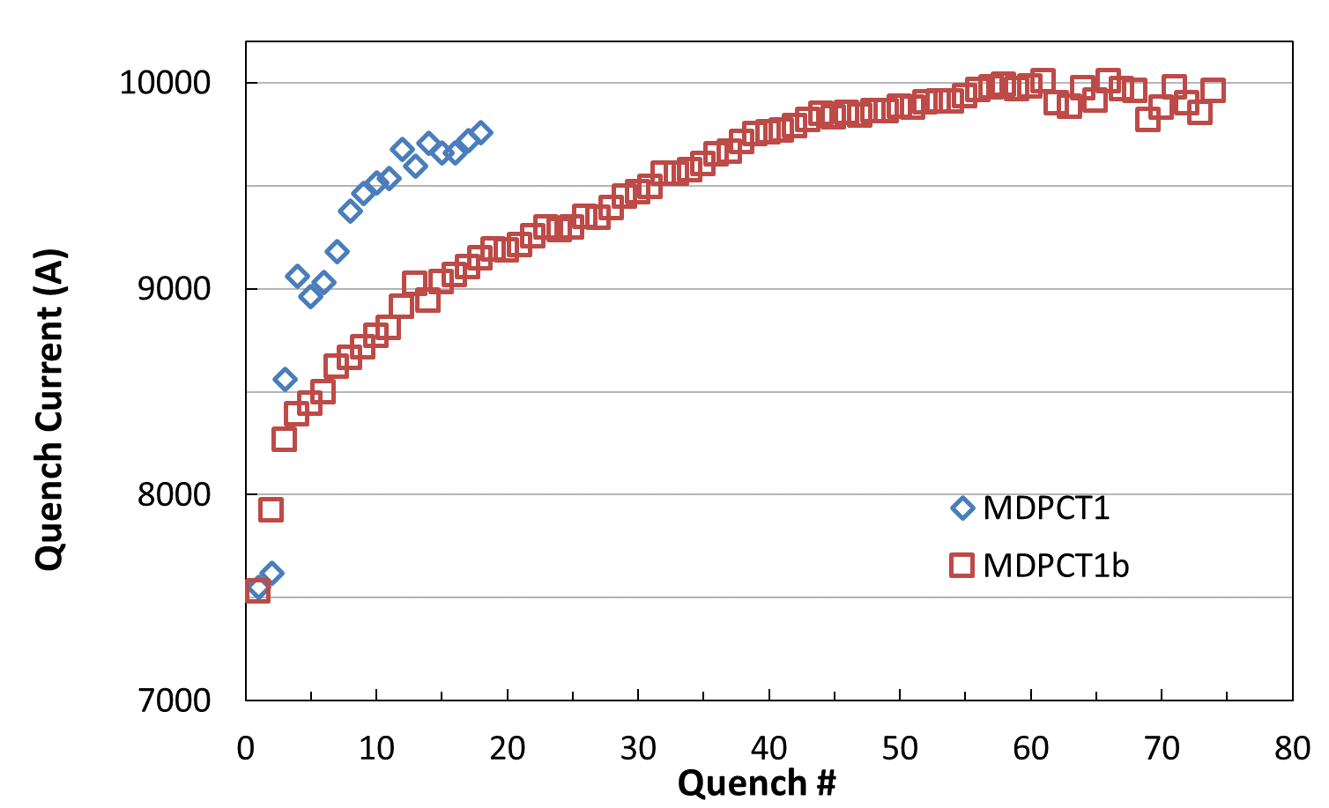
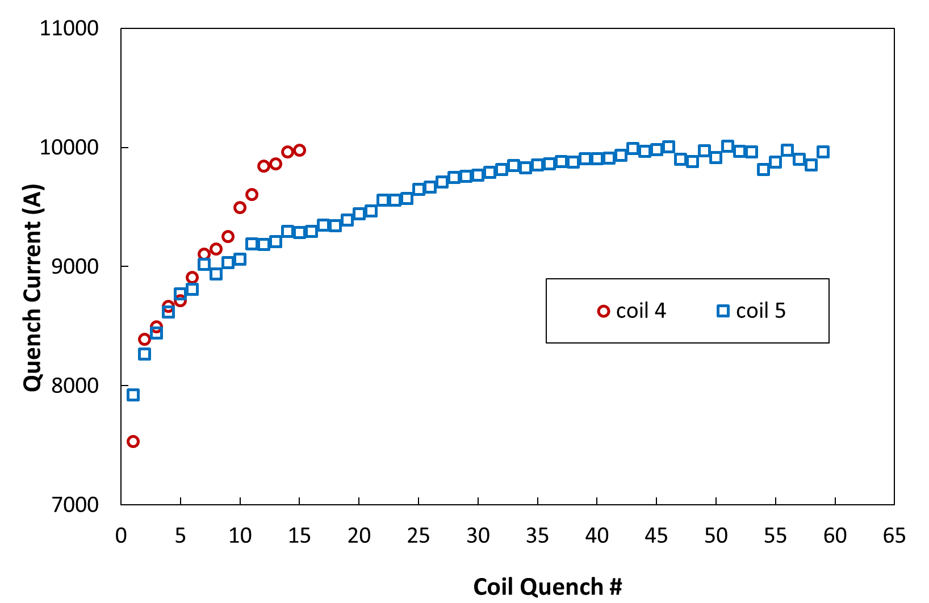
MDPCT1b Training
Ramp #s
62
Ramp #58
61
Ramp #75
Ramp #45
63
Ramp #13
(it is possible that
degradation goes on)
Ramp #6
Ramp #14
Ramp #2
Ramp #1

Slide 5
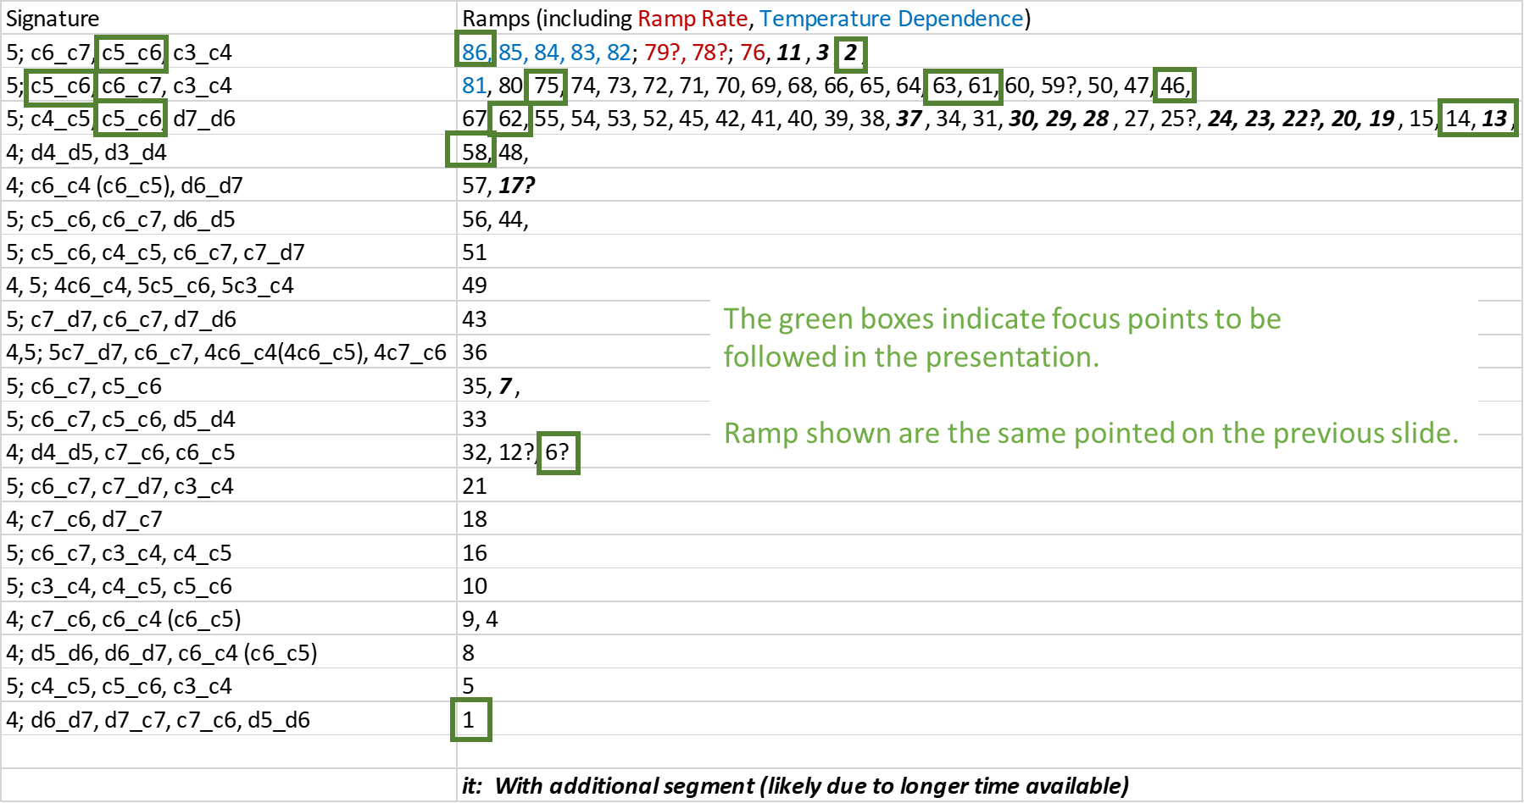
Quench patterns

Slide 6
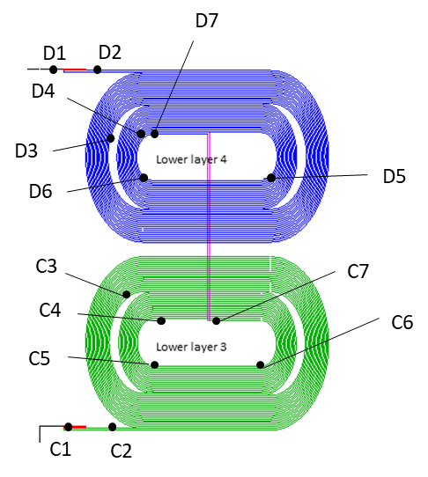
Quench locations at a glimpse .
2
3
28
2
2
Those colors indicate
quenches in different
non-adjacent segments
(often in different layers/coils)
COIL 005
COIL 004
20?
The only
non-pole
location
This color indicates fairly
well known location
11*
2
3
2
28
2
20
2
This color indicates not so
well known location
20?
Both colors (and only them) can
have associated numbers which are
the numbers of similar quenches
*7 of them are RR and TD quenches

Slide 7
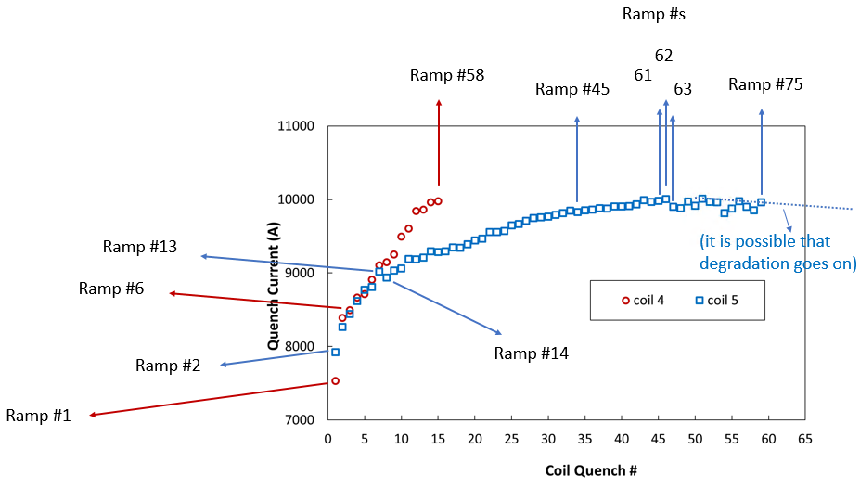
Quenches
Coil 4 only quenches
Looking at beginning-middle-end of training curve

Slide 8
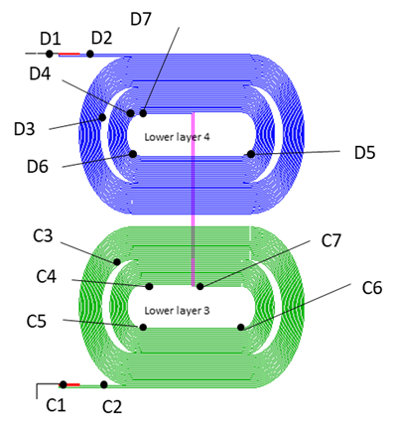
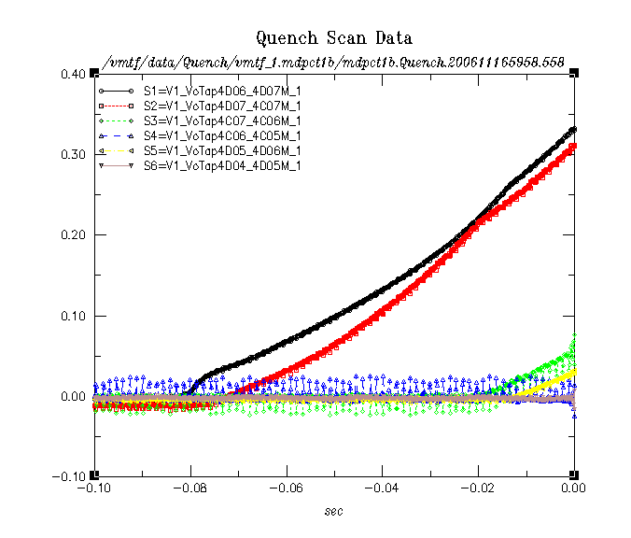
4; d6_d7, d7_c7, c7_c6, d5_d6
Ramp 1
(7530 A)
COIL 005
COIL 004
Propagation through d7_c7 (27 cm): 57 ms
Propagation through d6_d7 (27 cm): 9+71 ms
Known
Quench propagation V: 5 m/s and 3 m/s, respectively

Slide 9
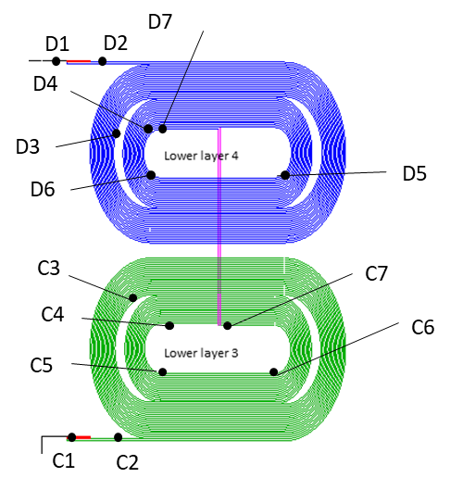
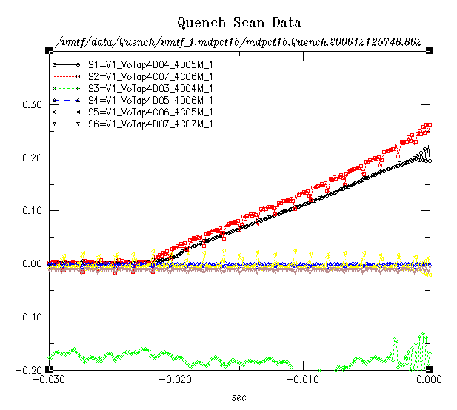
4; c7_c6, d4_d5
Ramp 6
(8497 A)
COIL 005
COIL 004
9.5 V/s
Most of the quenches don’t give
enough information to determine
the propagation velocity but
one can compare voltage rise
patterns in the same segment(s)
Less known

Slide 10
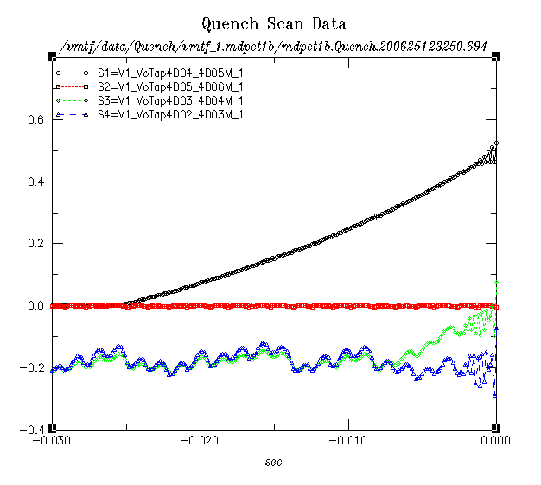
4; d4_d5, d3_d4
Ramp 58
(8978 A)
COIL 005
COIL 004
14.6 V/s
No significant differences in
propagation pattern toward the
end of the training curve;
faster propagation at higher current
(factor of ~2).
~Known

Slide 11
Quenches
Coil 5
Three main patterns identified, points of interest on the training curve investigated

Slide 12
Quenches
Coil 5
Pattern 1
(beginning of training, ramp rate
and temp. dependence quenches)

Slide 13
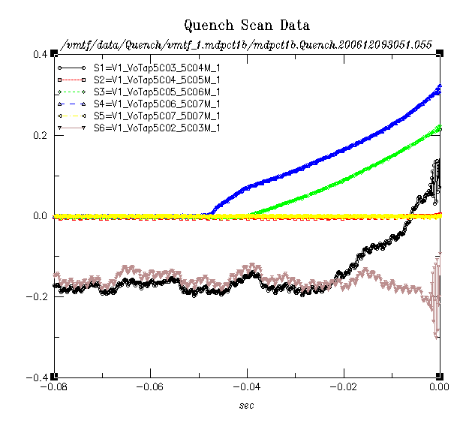
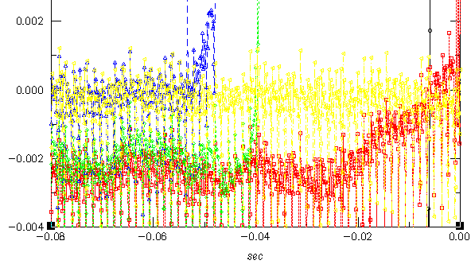
Ramps
Pattern
5; c6_c7, c5_c6, c3_c4
Ramp 2
(7924 A)
COIL 005
COIL 004
C5_c6
6.6 V/s
4.4 V/s
Propagation through c5_c6 ( 54 cm): 16 ms
Known
Quench propagation V: 34 m/s (?)
(more likely C3_C4 is quenching
independently, see later)
Less known

Slide 14
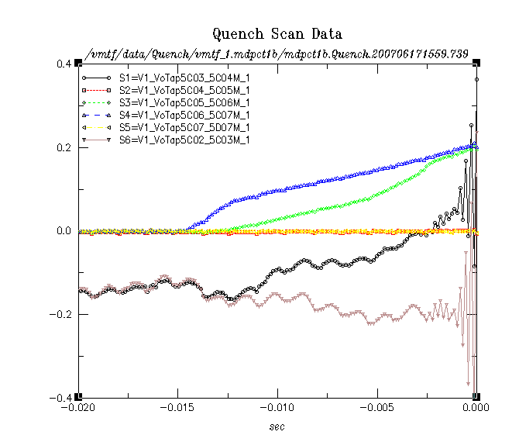
5; c6_c7, c5_c6, c3_c4
Ramp 86
(8886 A; 4.5 K)
COIL 005
COIL 004
Could be
resolved
by
acoustic
measurements
?
8.6 V/s
?
No significant differences in
propagation pattern between early
training at 1.9 K and RR/TD quenches;
faster propagation (factor of ~2); second quench location initiates earlier.
~Known
Less known

Slide 15
Quenches
Coil 5
Pattern 2
(with the two highest currents)

Slide 16
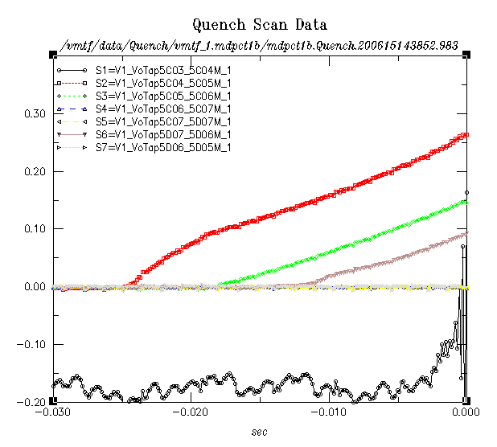
5; c4_c5, c5_c6, d7_d6
Ramp 13
(9021 A)
COIL 005
COIL 004
8.0 V/s
C5_c6
15 V/s
7.6 V/s
Propagation through c4_c5 ( 30 cm): 6.4 +23.0 ms
Known
Quench propagation V: 10 m/s
Less known

Slide 17
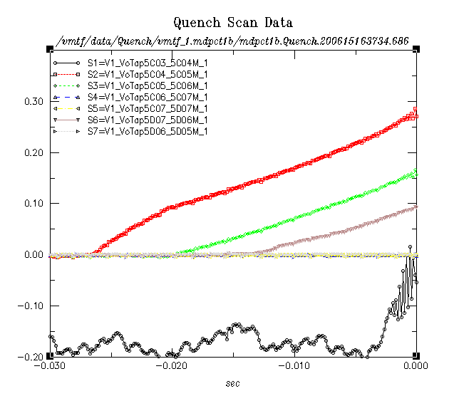
5; c4_c5, c5_c6, d7_d6
Ramp 14
(8940 A)
COIL 005
COIL 004
8.0 V/s
C5_c6
15 V/s
Similar to ramp #13
Note that the dV/dt decreases by a
factor of two when the adjacent segment
becomes resistive – consistent with
quench propagating in the remaining
segment direction
Known
Less known

Slide 18
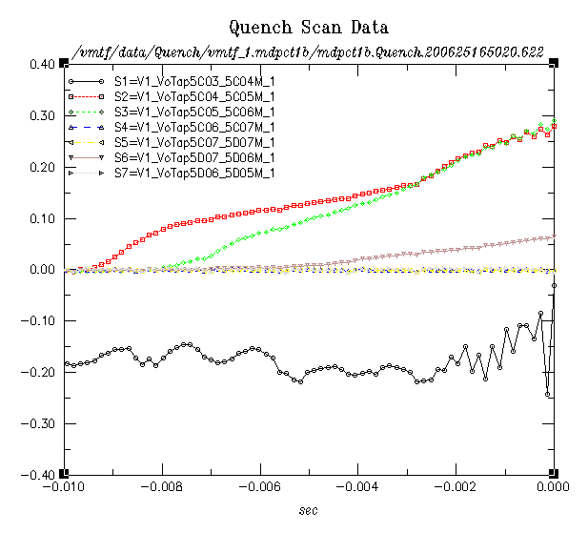
5; c4_c5, c5_c6, d7_d6
Ramp 62
(10007 A)
COIL 005
COIL 004
16 V/s
C5_c6
73 V/s
28 V/s
Propagation through c4_c5 ( 30 cm): 1.4 +6.9 ms
Quench propagation V: 36 m/s
Known
Much higher initial expansion,
faster propagation later (factor of ~2+).
C5_C6 dV/dt factor of 3+ higher!
Less known

Slide 19
Quenches
Coil 5
Pattern 3
(with limiting quenches)

Slide 20
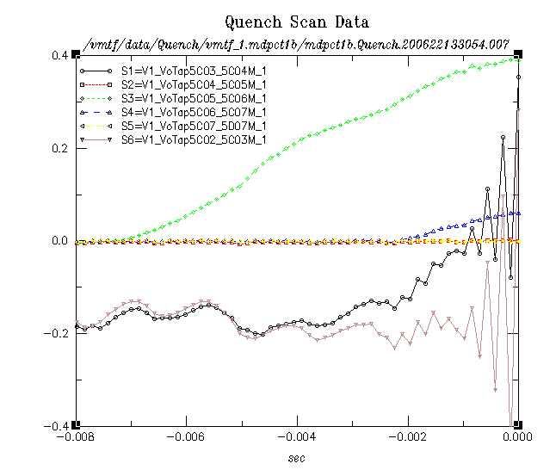
5; c5_c6, c6_c7, c3_c4
Ramp 46
(9831 A)
COIL 005
COIL 004
C5_c6
40 V/s
?
62 V/s
?
In this case the quench starts in
the “green” segment and it propagates in
both directions
(two-directional 62 V/s is consistent also
with the one-directional 28 V/s from the
previous slide)
Known
Less known

Slide 21
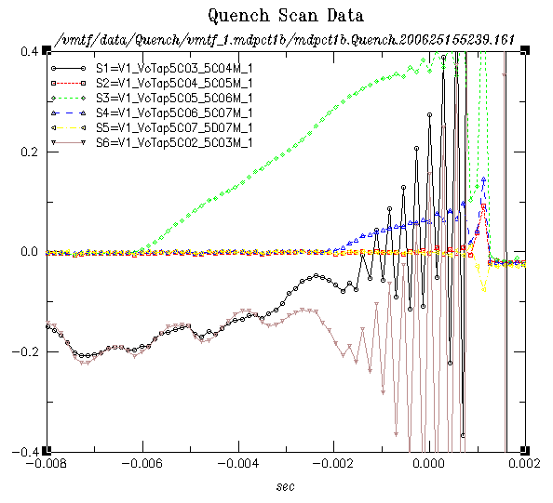
5; c5_c6, c6_c7, c3_c4
Ramp 61
(9980 A)
COIL 005
COIL 004
C5_c6
36 V/s
?
61 V/s
?
Known
Less known

Slide 22
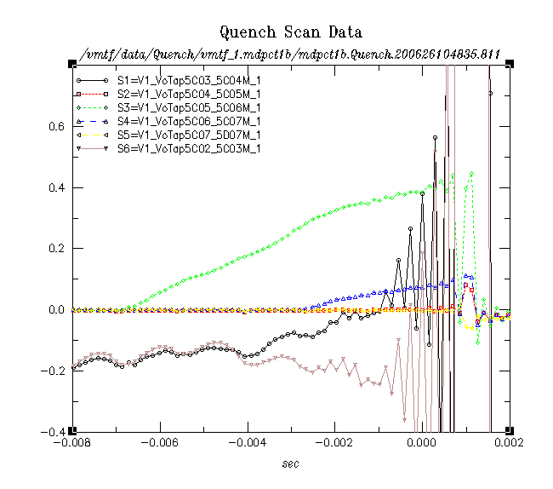
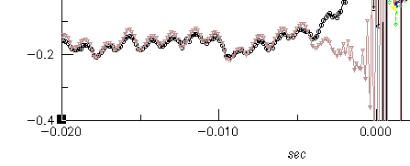
5; c5_c6, c6_c7, c3_c4
Ramp 63
(9900 A)
COIL 005
COIL 004
34 V/s
?
C5_c6
62 V/s
?
Known
Less known

Slide 23
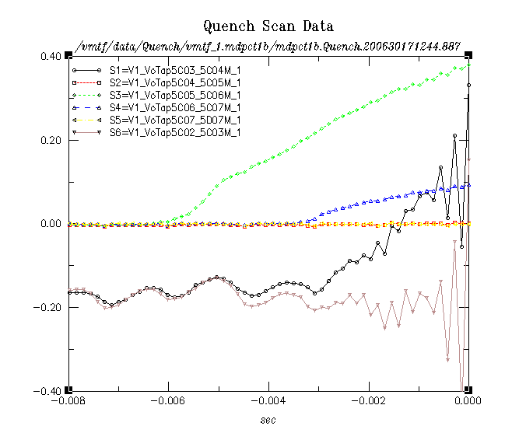
5; c5_c6, c6_c7, c3_c4
Ramp 75
(9961 A)
COIL 005
COIL 004
C5_c6
?
60 V/s
104 V/s
?
Known
Faster initial quench propagation
in later ramps? Could indicate
locally damaged conductor.
Segment boundary not so cleanly visible anymore in dV/dt.
Less known

Slide 24
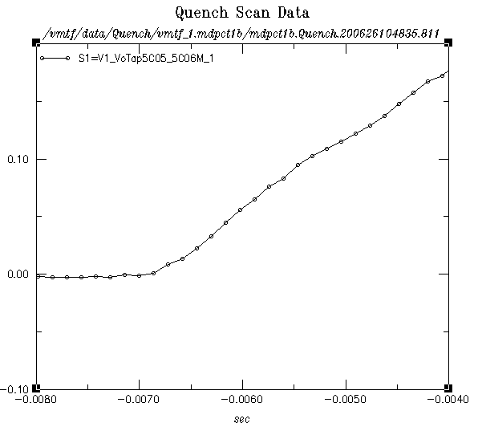
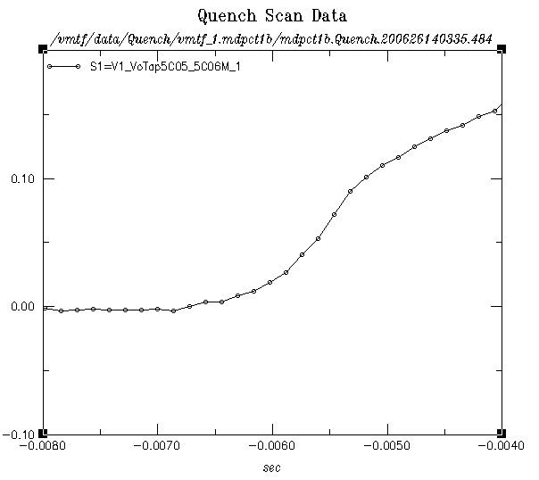
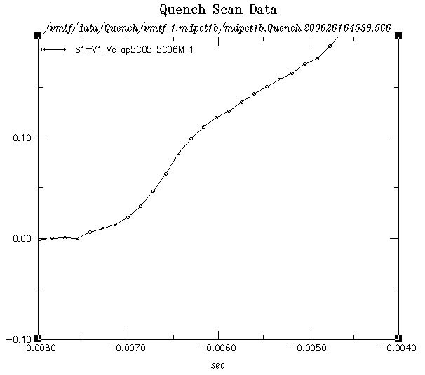
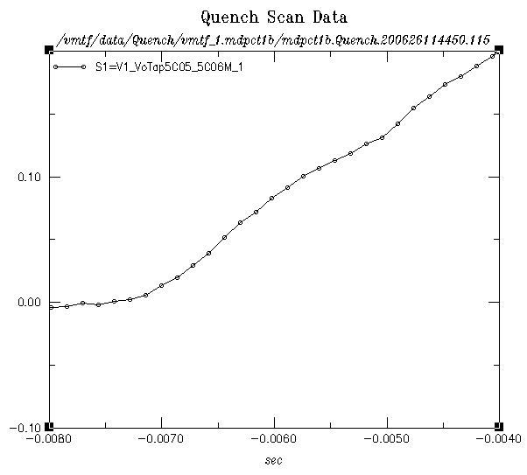
5; c5_c6, c6_c7, c3_c4
Ramp 63
(9900 A)
Ramp 66
(9913 A)
Ramp 68
(9969 A)
C5_c6
C5_c6
C5_c6
Ramp 64
(9883 A)
Those are all same scales.
From Ramp 66 on the profile changed,
a non-linear initial expansion is visible.
It suggests much higher quench propagation than in other quenches in the
same segment (but different location, see ramp 62 which is also similar to 67).

Slide 25
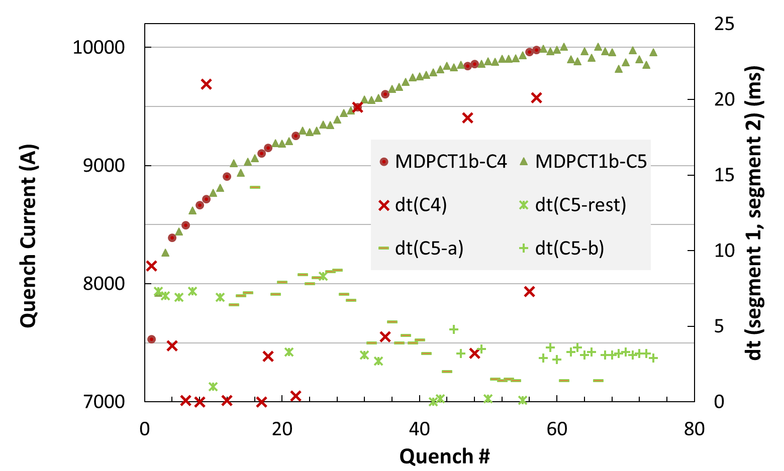
Time between first two segments quenching
Coil 5 times (on the right vertical axis)
are grouped in the main two “patterns”
(denoted C5-a and C5-b) with remaining
ones under another group (C5-rest).
Time ~0 usually indicates quenches in two
non-adjacent segments (often in different layers or coils)
The time difference relates to “patterns” discussed. It is seen however that for one of the main pattern Δt changes significantly (after ~ quench #30). The other main pattern (where the limiting quenches are)
shows consistent nearly constant times despite the short non-linear quench/voltage expansion discussed.

Slide 26
Summary
Quench velocities can only be determined in small part of the quenches
and they increase at higher currents (as expected)
Voltage rising (dV/dt) patterns are useful to monitor change in behavior
While the propagation speed clearly increases toward high currents,
non-linear/large initial expansions are seen in multiple quenches
toward the end of the training curve (coil 5)
may indicate degradation “initiation”
beyond the first milli-second dV/dt are consistent for large part of the
training curve in the segment we can monitor (5C5_C6)
Ramp rate and temperate dependence quenches
are similar to some early training quenches at 1.9 K

