Slide 1
A First Look at MDPCT1b Acoustics 22 July 2020
S. Krave, S. Stoynev
US Magnet Development Program
Fermi National Accelerator Laboratory

Slide 2
Background
Acoustic sensors were used on MQXFS1d at FNAL several years ago, we are just getting into this analysis
Sensors were installed on the 1st test of the 15T dipole with technical issues leading to no real data
We installed the old style sensors on this test of 15T and took data!
Motivations:
Acoustics can help locate longitudinal location of quench initiating events (We have a student working on this)
Some behavior about event types may be obtained through deep learning or signal analysis techniques (we have a student working on this as well)
We may be able to better classify the disturbance spectrum, as well as provide statistical measures of magnet stability
S. Krave | First look at MDPCT1b Acoustics

Slide 3
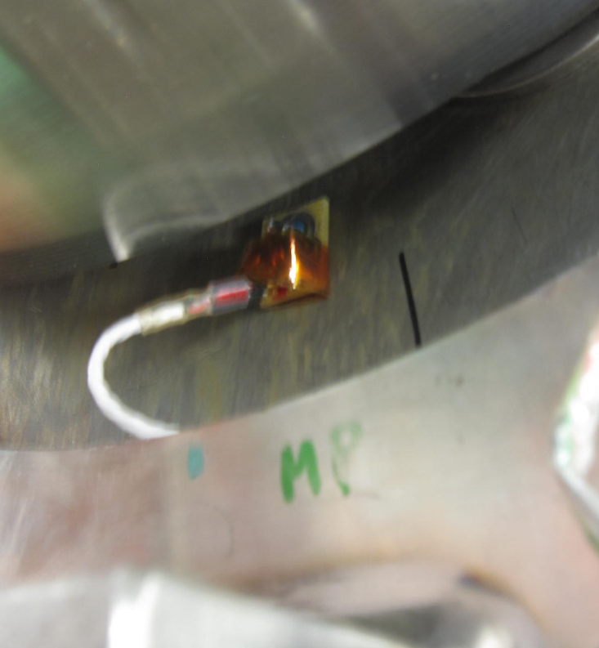
Sensor Locations
2 sensors on each end near MP
1+2 on LE, 3 and 4 on RE
Only 3 DAQ channels available
1st day (sensor to DAQ channel)
1 to 1, 2 to 2, 3 to 3, 4 unused
Later Days
1 to 1, 4 to 2, 3 to 3
S. Krave | First look at MDPCT1b Acoustics

Slide 4
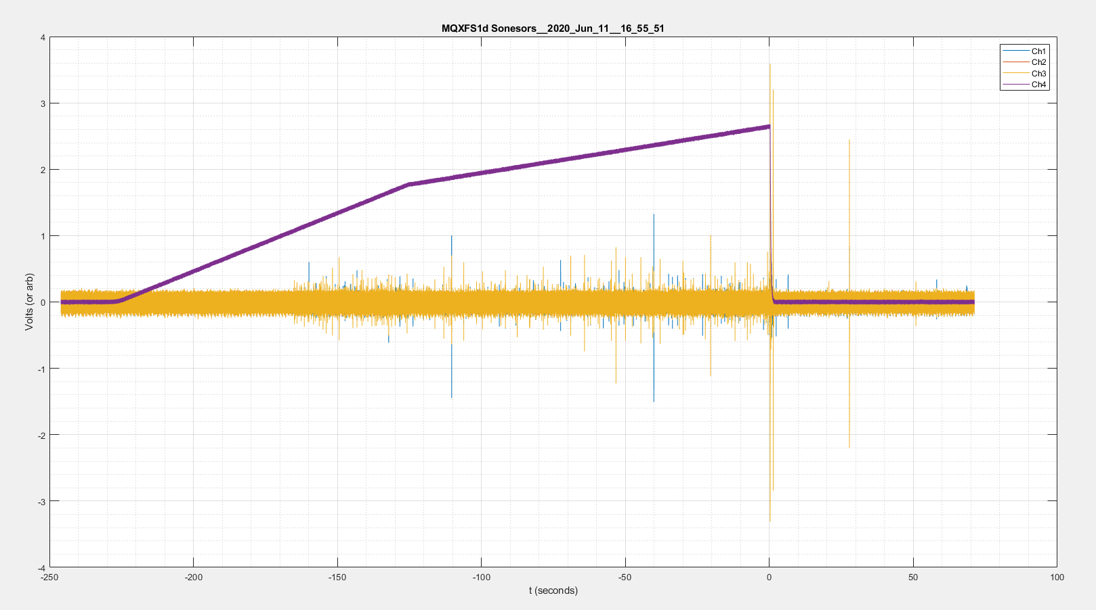
Initial Observations
A quick comparison at high level of an early ramp and a later ramp.
We will look at Ramp 1, and 81
Ramp 1
Ramp 81

Slide 5
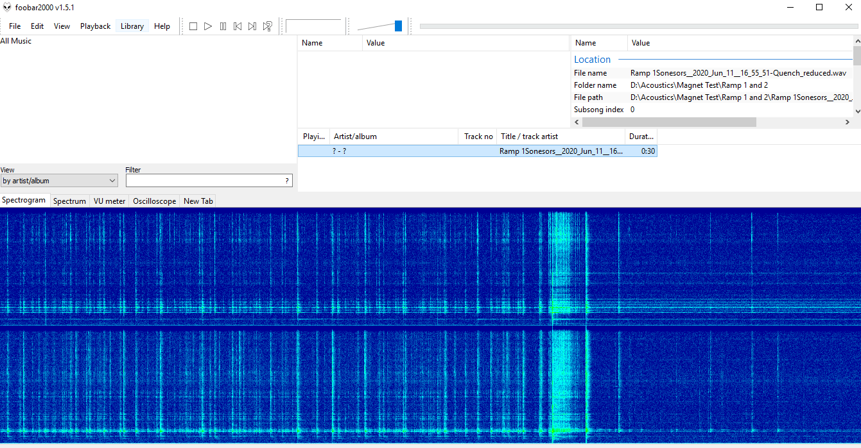
Ramp 1
Several Visible AE’s over noise floor of ~0.2V Amplitude leading to quench
Dead sensor 2
Large AE’s at quench and after, as a result of structural motion I assume
Notes
Spectrograms need some rescaling to better show data
Filtering will improve event identification

Slide 6
Ramp 81
Substantially Quieter
Still events occurring, but 10’s of times less powerful
You can’t really see them in the conditions graphed
RAMP 81
S. Krave | First look at MDPCT1b Acoustics

Slide 7
Visual Validation of TOF between sensors
Clear evidence of time delay between active sensors on opposite sides of magnet.
This event appears to happen nearer LE of magnet
Time delay between signals may be used to approximate event location
Lots of scattering and interfaces in this magnet so precision may not be excellent
S. Krave | First look at MDPCT1b Acoustics

Slide 8
Applying lowpass filtering
No Filtering
50 kHz lowpass

Slide 9
Ongoing Work and Conclusions
We have collected acoustic data semi-successfully
252 gigs of it
We are able to identify acoustic events and a change in behavior from early to late quenches
We have excellent students eager to get their hands on the data after initial post-processing
They have started with some preliminary data to get codes functioning and to compare with MQXFS1d
We see how the systems are behaving and expect to be able to significantly improve data quality, and sensor implementation in the future
S. Krave | First look at MDPCT1b Acoustics

Slide 10
Backup Slides
System Details
etc
S. Krave | First look at MDPCT1b Acoustics

Slide 11
MQXFS1d Ramp 4 reference
Similar amplitude signals, but less electrical noise
Similar event behavior
Generally “louder”

Slide 12
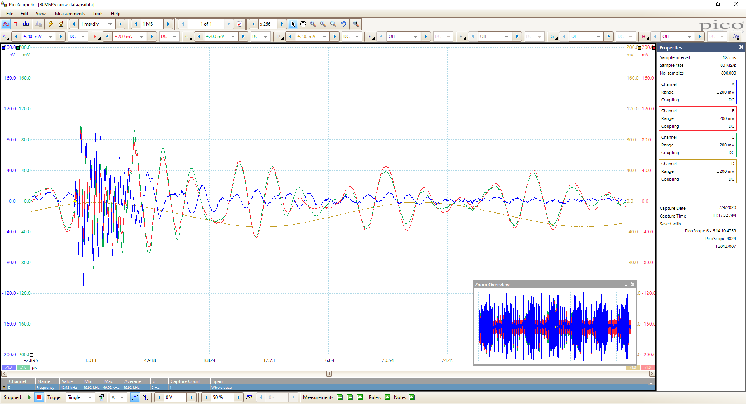
Noise once in the Test Stand
Somewhere near the acoustic sensors is a dirty switching power supply spewing noise.
Can be fixed in future with 250-500kHz lowpass filter
Signal is aliased onto 1MSPS data

Slide 13
General Sensor Info
See Maxim’s paper:
Acoustic emission during quench training of superconducting magnets
S. Krave | First look at MDPCT1b Acoustics

Slide 14
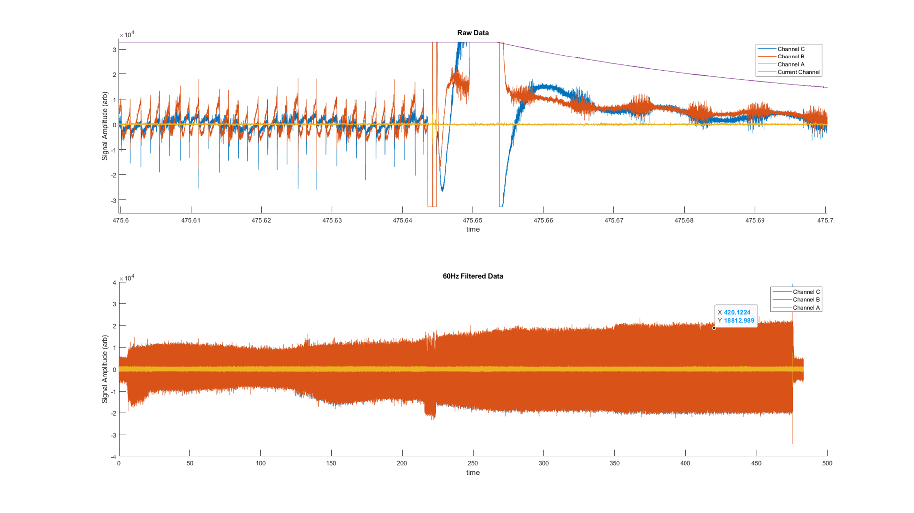
Test 1 Background:
On the last two magnets, acoustic Sensors were installed
MQFSM2: “New Style” sensors
15T Dipole: new “Old Style” sensors
There were some acquisition and noise issues
In both cases
The in house developed scope software provided strange outputs and some limitations

Slide 15
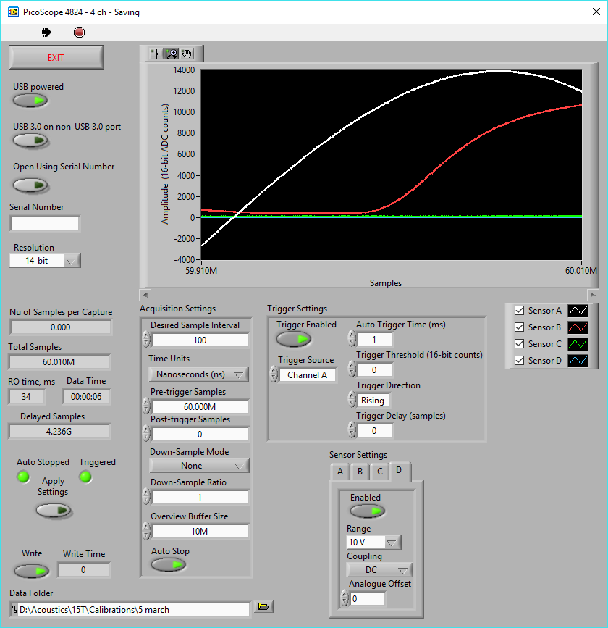
System Checkout: Not very interesting graph shows good behavior
System now functioning at 2MSps on 4 channels for several minutes with no dropped data
It also ran well up to 10 MSps
Data indicates we should be able to have full test data with no signal drops at 1MHz for all 8 channels
Though software limits us to 4 at the moment

Slide 16
System Checkout: Making sure the sensors work on the magnet
With the DAQ functioning well, we also checked the sensor installation on the magnet.
Tap different locations with a hammer and look for acoustic response
All sensors should respond and time delays should appear as expected
S. Krave | First look at MDPCT1b Acoustics

Slide 17
Test Acoustic Data +
Waveforms match well and sensors on same end of magnet have similar time delay
Sensors on opposite end have significant lag
There is a strange voltage spike before vibrations are detected by the sensor which makes me nervous
Possible ground loop indication?
Maxim said he uses a non-metallic hammer to tap and test acoustic sensors to avoid this spike
Sensor 2
Sensor 1
Sensor 3
Voltage Spike?!?!
Sensor 4
S. Krave | First look at MDPCT1b Acoustics

Slide 18
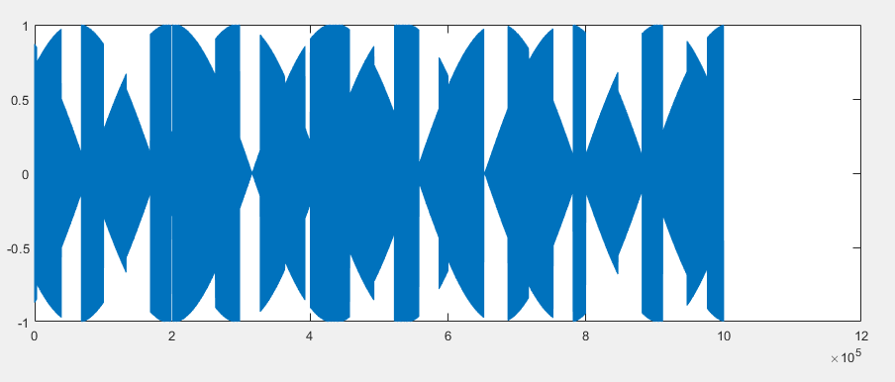
Handling Large streams of data
Data stream is written to disk in chunks and the graph on the computer is updated each chunk.
We found some problems here
Total bandwidth used by acoustic sensors is not large by modern standards
Most mechanical hard drives can sustain 1Gbps, solid state can exceed 12 Gbps.
Our data is neither timestamped or quantified
Data is recorded as bitstream and we hope that we don’t have dropouts
16 bit values reported
±2^15 (±32768)
Bits | Sample Rate | Channels | Bandwidth (Mbps)
16 | 100000 | 4 | 6.4
16 | 200000 | 4 | 12.8
16 | 500000 | 4 | 32
16 | 1.00E+06 | 4 | 64
16 | 2.00E+06 | 4 | 128
16 | 4.00E+06 | 4 | 256

Slide 19
Validation of signal integrity
Since we want to check very large files sizes for errors, validation gets a bit difficult
Aliasing to the rescue
Feed the scope a signal from the function generator and under-sample (Fs<N_{y})
Sample rate at either 2X signal rate or signal rate
Dropped data will result in a shift of the apparent waveform, appearing as a step function
Aliasing: From Wikipedia
S. Krave | First look at MDPCT1b Acoustics

Slide 20
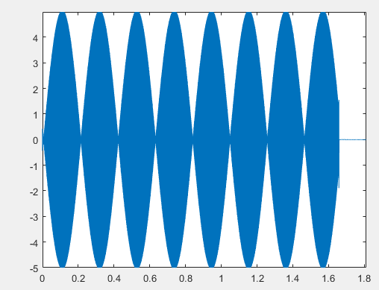
Experimenting with Parameters
We worked through a few optimizations in exploring available parameters
Program defaults led to dropout at even very low samples rates for low sample counts
It turned out that the short plot window buffer was causing too many operations and data delays
Bummer…
1mhz@1mhz with dropouts
500khz recorded at 1mhz. Notice discontinuities
500kHz recorded at 1mhz. Notice beating pattern of waveform with no interruptions. This indicated good system performance.
S. Krave | First look at MDPCT1b Acoustics

