Slide 1

ANSYS User Elements for Multiphysics Simulation of Superconducting Magnets
July 21st 2020
MDP Modeling Working Group Meeting
Lucas Brouwer
US Magnet Development Program
Lawrence Berkeley National Laboratory

Slide 2
Overview
Motivation: user defined elements in ANSYS keep all meshing, solving, and post-processing capabilities, while adding
interfilament coupling current losses
quench behavior
internal material property fits (T, B, quench state)
enables simulation of coupled quench back protection schemes (like CLIQ)
How to create a user element
How to compile and use the elements we have developed
What elements we have, and examples of what they can do
CLIQ simulation for a block dipole
Quench back in Nb₃Sn Undulators
Initial RRP sub-strand models for magnetization and quench
3D quench propagation in Nb-Ti CCT gantry
Bulk HTS magnetization

Slide 3
Commercial FEM codes only capture pieces of the many effects needed for simulating SC magnet behavior
SC Specific Behavior
current sharing and quench
interfilament coupling currents
filament magnetization
Cryogenic Material Properties
strong temp, field dependence
Jc(T,B) fits NbTi, Nb₃Sn, HTS
magnetic materials
Motivates development of a new FEM approach for consistent, coupled simulation of SC magnets
Transient Magnetic
eddy currents in structural materials
inductive and resistive coupling to circuit
Behavior of Magnet in Circuit
quench protection system
active systems (CLIQ)
Transient Thermal
quench propagation
heat transfer and cooling
recovery of superconductivity

Slide 4
ANSYS is used as a “black box” for our own elements
Keep all features of standard ANSYS…
  modeler, mesher, post-processor
  transient electromagnetic and thermal solvers
  eddy currents in structure
  external circuit coupling
  yoke saturation
New elements created by
writing code which generates FEM matrices
compiling a custom version of ANSYS
  SC specific magnetization (IFCC, +)
  current sharing + quench propagation
  coupling to thermal model with full (T,B) mat. prop.
... and add what is missing with user elements

Slide 5
Creating an ANSYS user element requires programming two Fortran files which determine element properties and matrix generation
Existing ANSYS installation (precompiled libraries, etc.)
uel.f
creates element matrices (stiff, load, damping)
user defined shape functions, material properties, FEM formulation
Visual Studio +
Intel Fortran Compiler
ANSYS.exe
You program
uec.f
user defined element properties, # nodes, # DOF, etc.

Slide 6
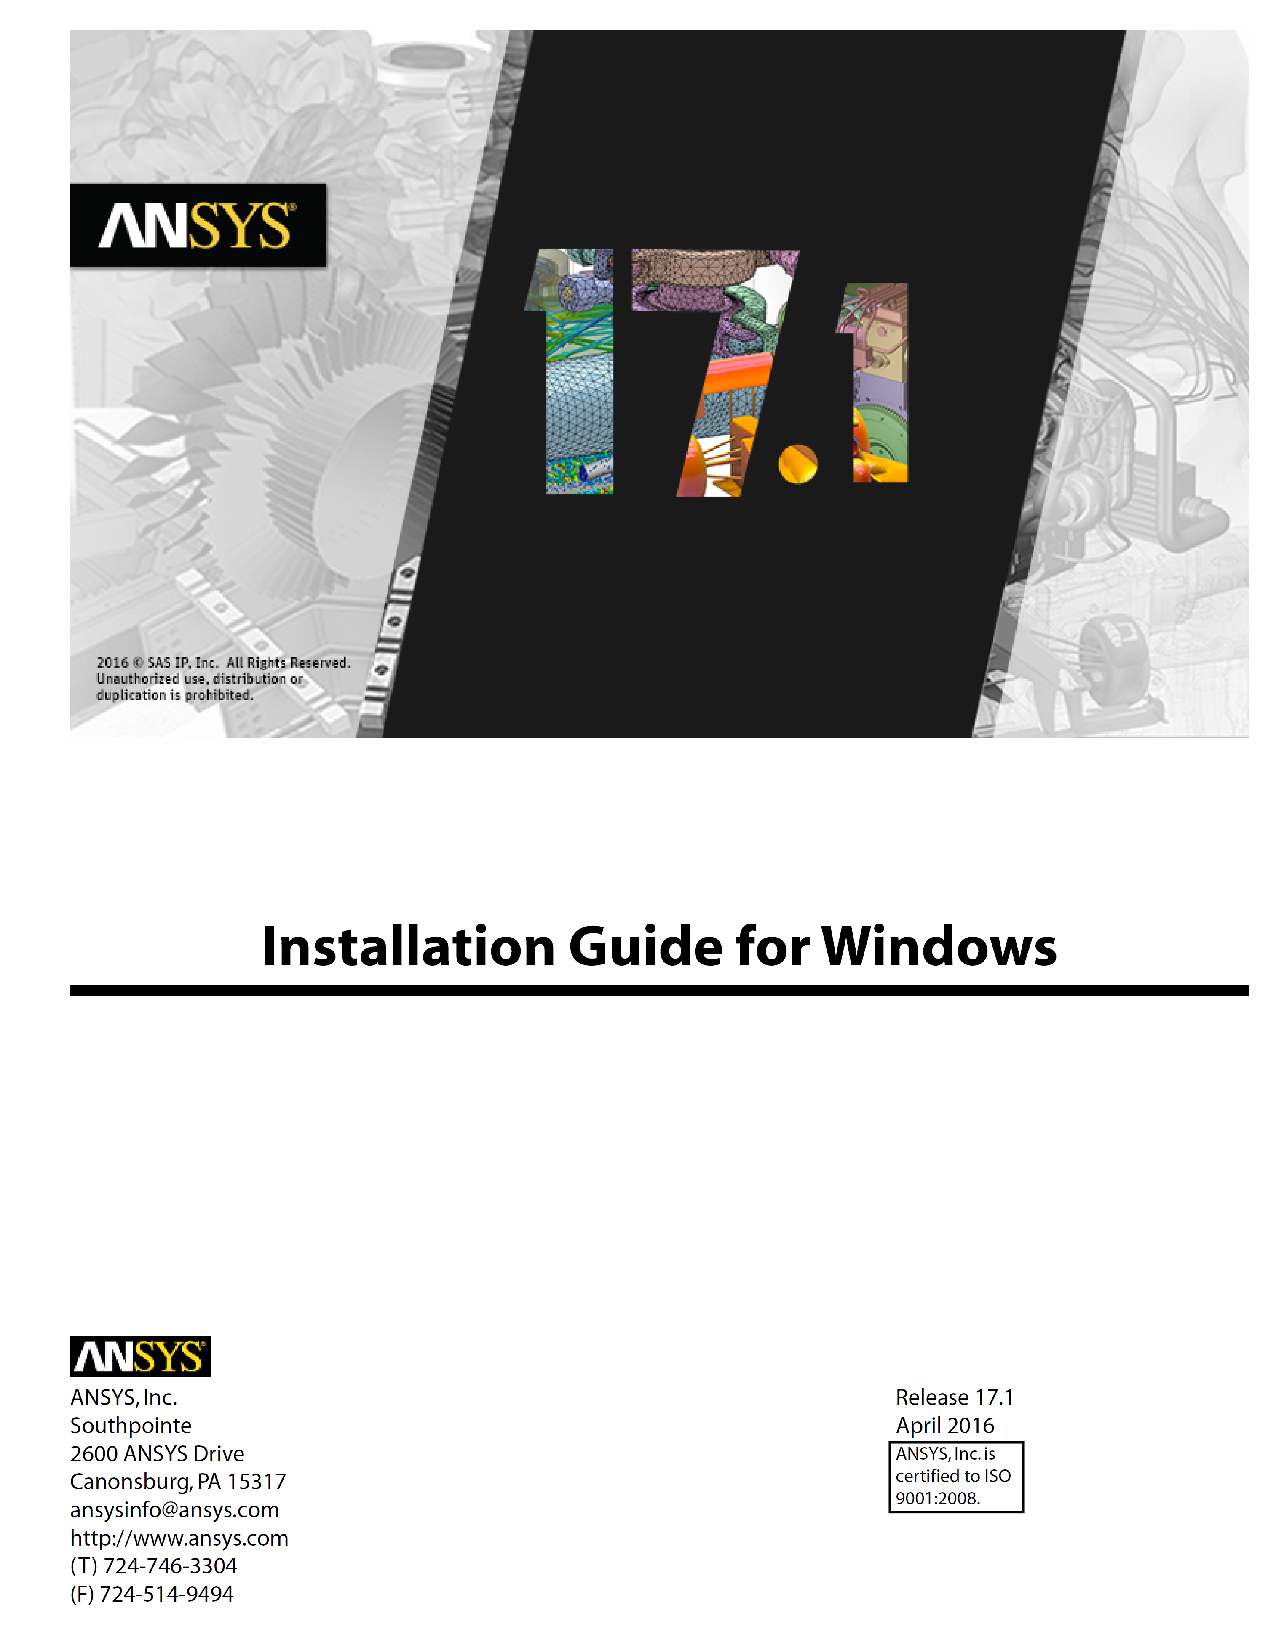
Software Requirements: Visual Studio and the Intel Fortran Compiler
It is important to use same version of Visual Studio + Intel Fortran Compiler as ANSYS did for their released version (check installation guide)

Slide 7
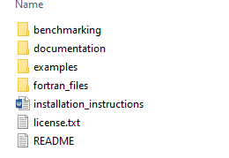
Tutorial: I will quickly compile the user elements and run an example
1. Download open source package (code + installation instructions + examples)
https://github.com/lnbrouwer/ANSYS_UEL
3. Run example of single strand in changing background
2. Follow steps to compile

Slide 8
The user elements can be included in simulations by selecting the element type and setting the real constants
These lines are the only deviation from a default ANSYS simulation using plane53
choose USER102 for conductor
set keyopts (IFCC_flag, mat. prop fit. etc)
set real constants (RRR, Lp, etc.)
No modification to re-run existing models, very little new knowledge required beyond default ANSYS

Slide 9
User Elements Developed at LBNL
Type
DOF
Applied Loads
Uses
1D: thermal
temp
Magnetic field, initial quench
1D Quench propagation
2D: thermal (uncoupled)
temp
Magnetic field , initial quench
2D Quench propagation
2D: thermal (coupled)
temp
Quench and IFCC heating from 2D mag
Coupled quench back (CLIQ, IFFC from dump resistor, etc.)
2D: mag (stranded)
Az
Applied current density
Static mag, Trans with IFCC
2D: mag (power law)
Az, volt
External field change, other
Bulk SC magnetization, flux penetration studies
2D: mag (circu coupled)
Az, curr, emf
Circuit element driven
Coupled quench back (CLIQ, IFFC from dump resistor, etc.)
3D: thermal
temp
Magnetic field
3D Quench propagation
3D: magnetic (power law)
Ax, Ay, Az
External field change, other
Bulk SC magnetization, flux penetration studies
*2D plane and axisymmetric

Slide 10
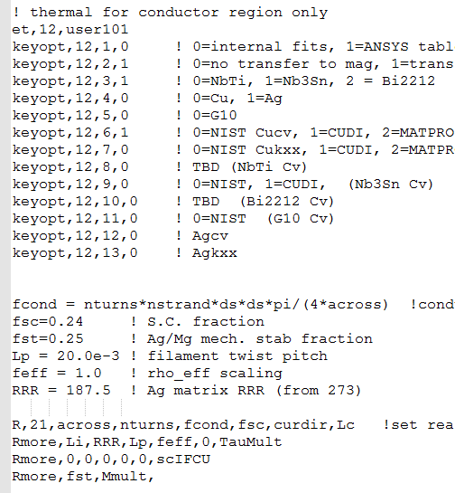
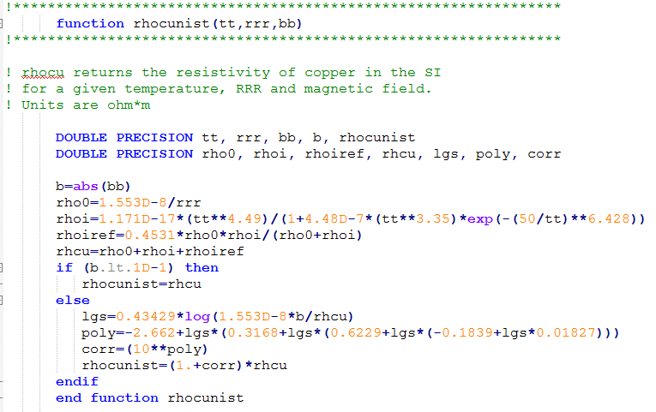
Material Property Fits are Internally Programmed for Simulations with Nb-Ti, Nb₃Sn, and Bi2212
User chooses materials and fits using element key options and real const.
Example format: NIST rhocu(T, RRR, B)*
Heat capacity, resistivity, thermal conductivity, critical current, etc.
*”Review of ROXIE’s material property database for quench simulation”,
G. Manfreda, CERN EDMS Nr: 1178007, 2011.

Slide 11
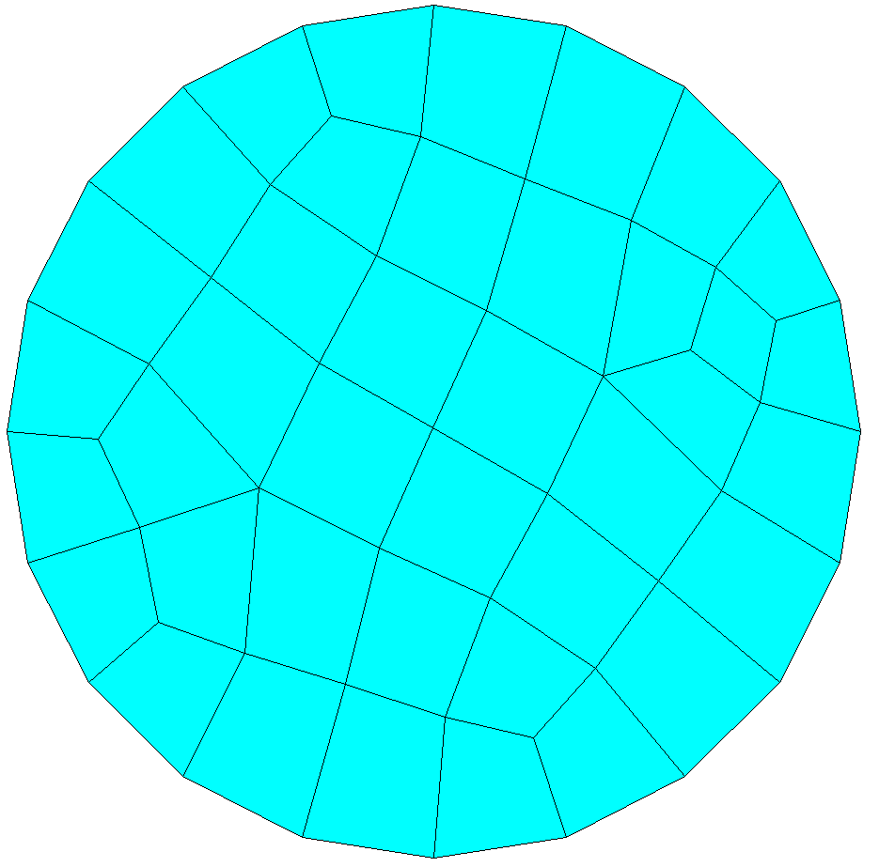
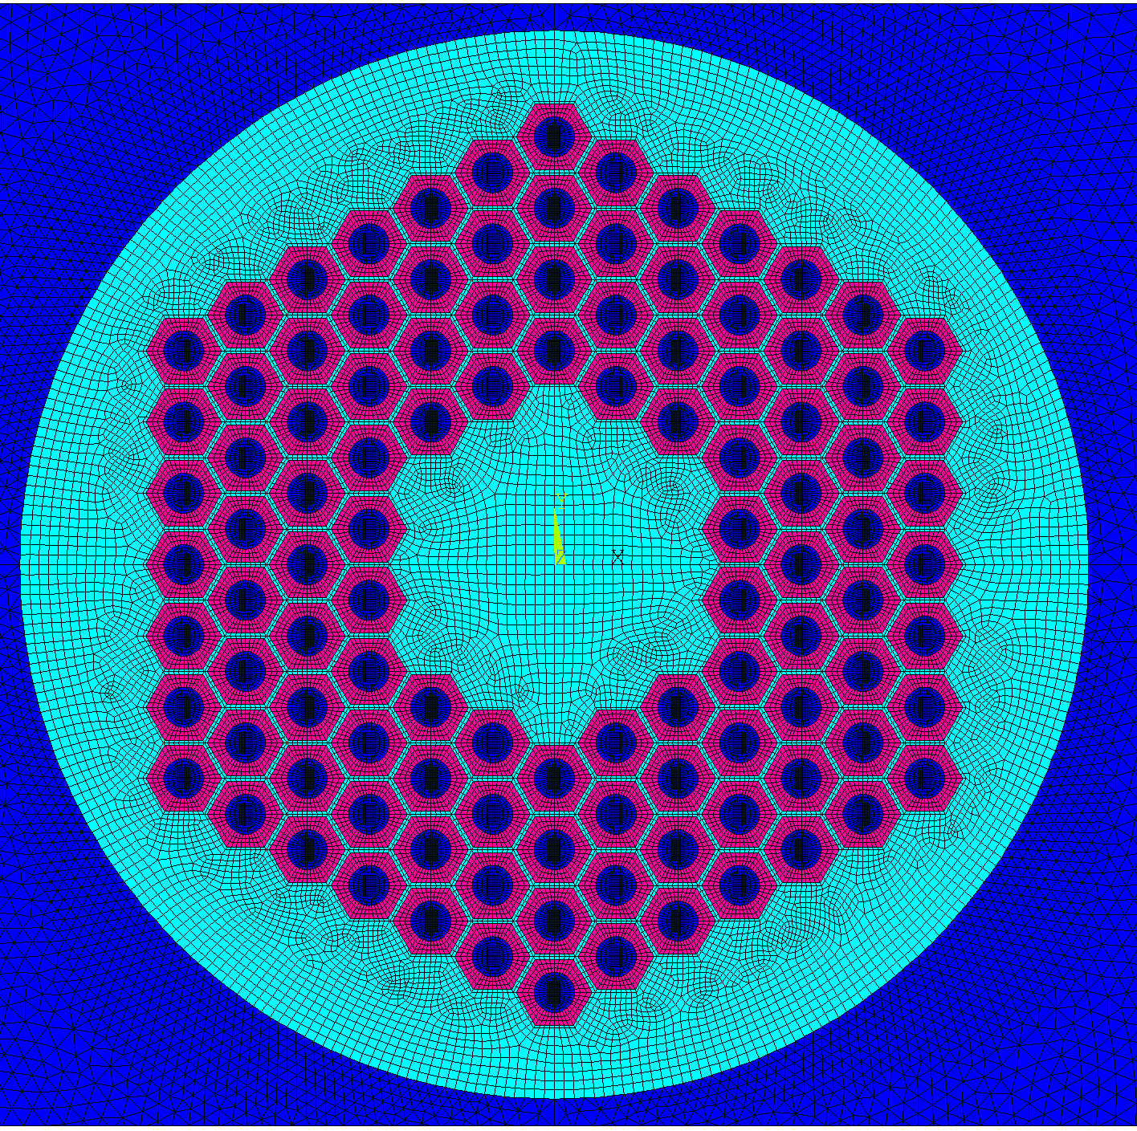
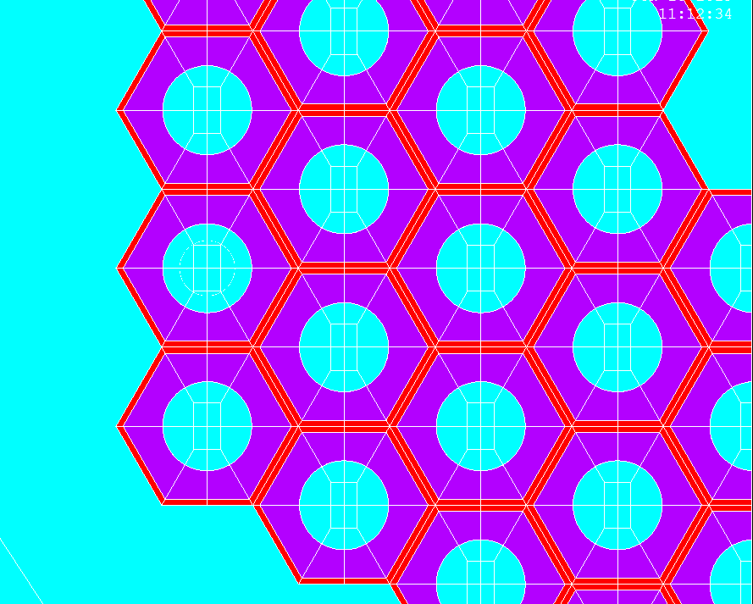
We have two approaches in ANSYS based on uniform (stranded) or computed current density (power law)
A-curr-emf (stranded)
A-V formulation with E-J power law
use for bulk devices, filament magnetization, etc.
use for conductor regions of NbTi, Nb3Sn magnet models
quench and current sharing is implemented with loss term based on Jc(T,B)
equivalent magnetization used for coupling currents (a priori current path)
optional resistive/inductive coupling to external circuit
conductive paths resolved by mesh
current distribution follows from DOF solution

Slide 12
Quench and Current Sharing are added at the point of element matrix generation
Current sharing form is set as desired (ex: linear from Tcs to TcB)
At every iteration, for each element, the current, field, and temp is checked vs. the Jc fit
heat generation is set based on quench state
contribution to total coil resistance is set for circuit coupling

Slide 13
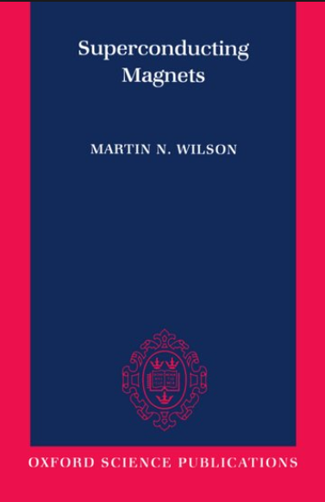
Interfilament coupling currents (IFCC) can be modeled using an equivalent magnetization formulation
Instead of modeling currents themselves (A-V), assume the induced current path is known and use an equivalent magnetization
For a transverse field (2D magnet) this leads to (from Wilson, etc.)
Heat deposition (which can drive coil to quench)
mechanism for CLIQ*
*E. Ravaioli. CLIQ: A New Protection Technology for Superconducting Magnets, PhD Thesis, Univ. Twente

Slide 14
Interfilament coupling currents (IFCC) can be modeled using an equivalent magnetization formulation
added to the ANSYS user element to model IFCC
Advantages of this approach
single DOF (vector potential)
IFCC is implemented without resolving currents themselves, which would require an impractically small (µm and 3D) mesh
Disadvantages
does not account for “real” Jc dependent behavior within strand (filament layer saturation)
our experience shows increasing overestimation of time to quench at high rates of field change and I/Ic

Slide 15
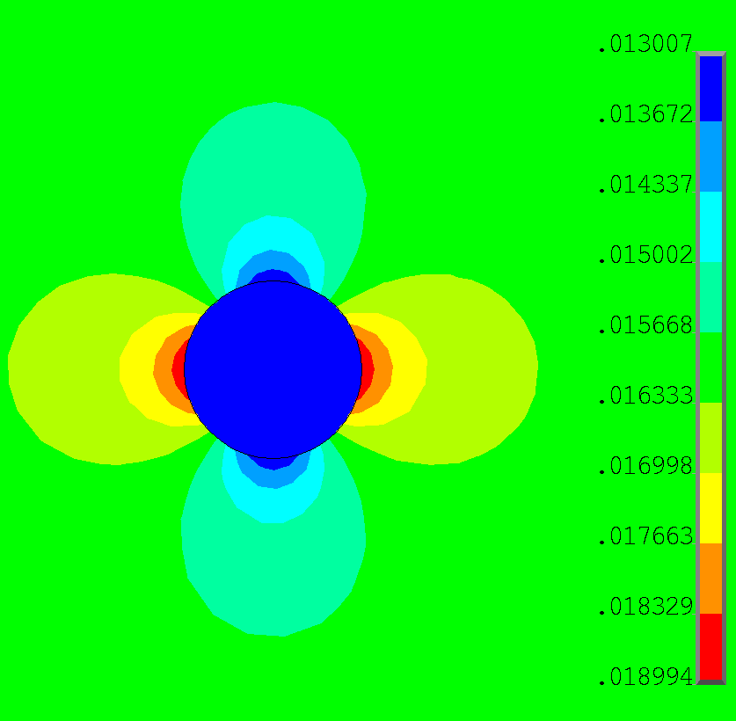
The simplest example: magnetization of a single strand in a changing background field
strand meshed with user elements
B.C. on edges of air used to apply constant ramp of background field, set IFCC time constant as constant 1.5 ms
Magnetic field inside the strand
Heating inside the strand
validated with analytic
validated with analytic

Slide 16
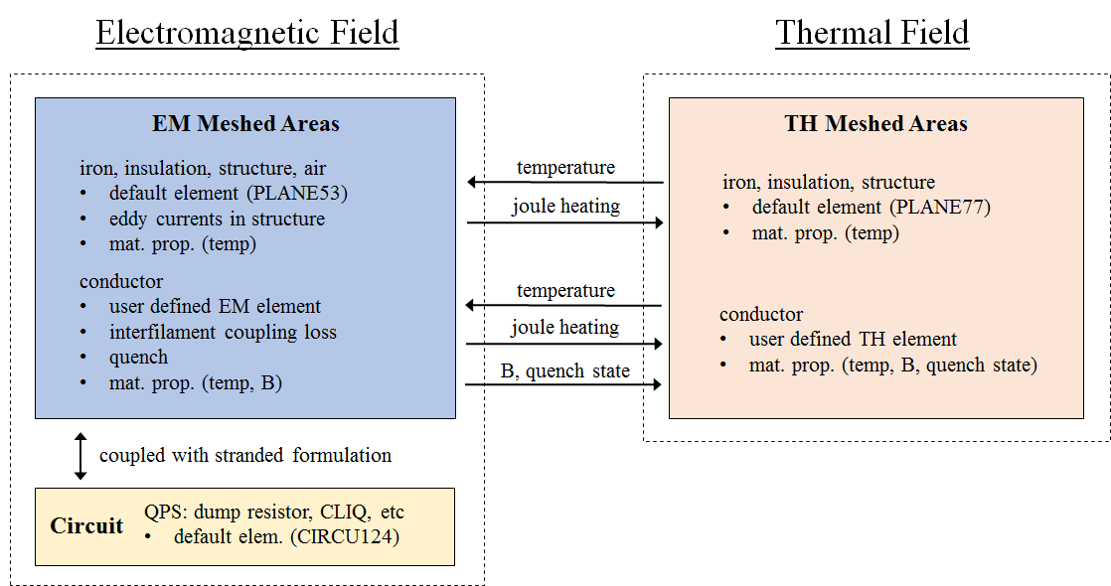
A fully coupled magnet simulation uses independently meshed electromagnetic and thermal domains, each with their own user element
Inductive and voltage coupling with quench resistance included (two additional DOF)

Slide 17
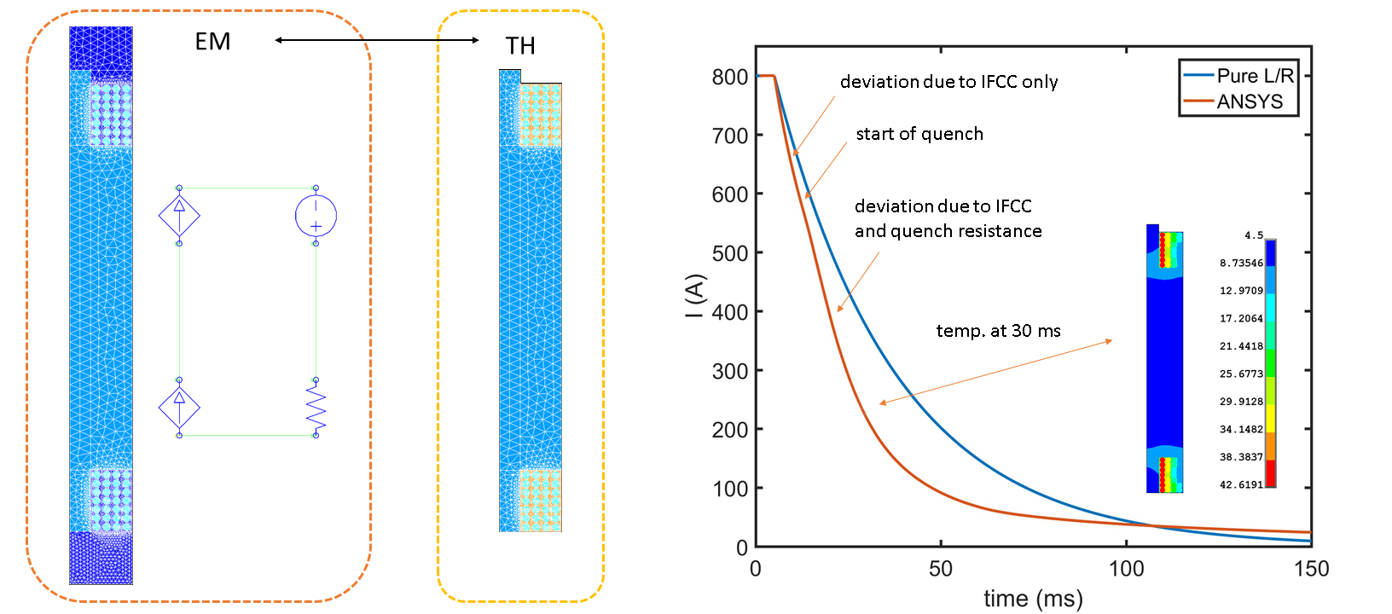
Iterative coupling across domains is achieved using the multi-field solver
Total time is broken up into “stagger” loops which iterate until loads converge
Advantage: different time steps can be used in magnetic (slower) and thermal (faster)

Slide 18
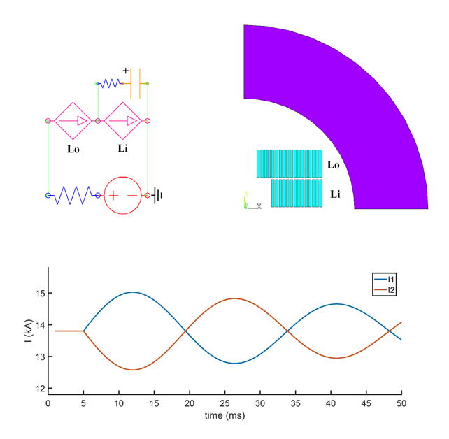
Example 1: Long benchmarking and verification study complete with CERN/STEAM: L. Bortot, B. Auchmann, E. Stubberud
Includes CLIQ comparison for a Nb₃Sn block dipole

Slide 19
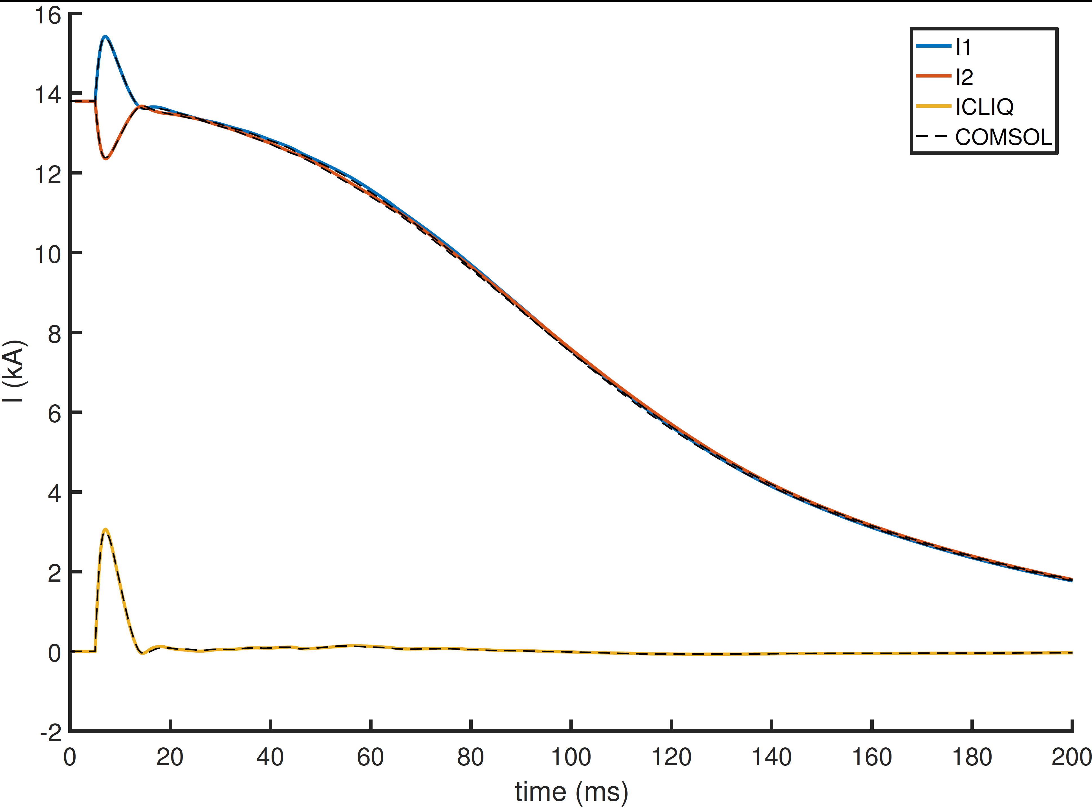
Comparison of coil and CLIQ currents to COMSOL (w/CERN) shows agreement

Slide 20
Comparison of coil resistance and hotspot temperature for CLIQ simulation to COMSOL (w/CERN) shows agreement

Slide 21
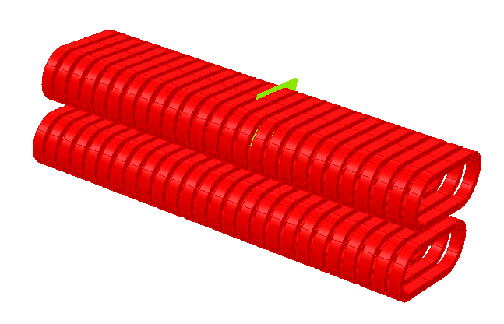
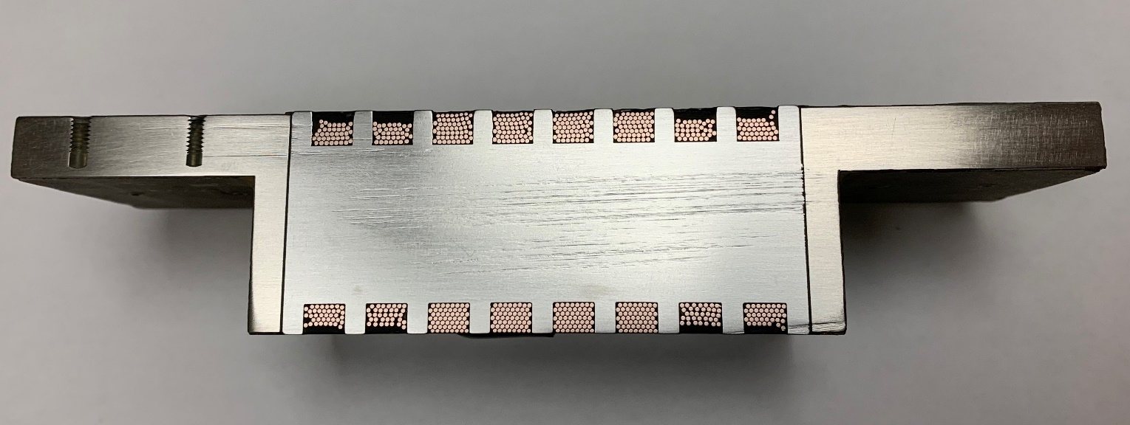
Example 2: Superconducting Nb₃Sn Undulators for Free Electron Lasers
Interaction of electron beam with alternating fields produces light in a FEL
Fe core
e⁻
B
-
+
-
+
4-5 T field on the conductor field
+
-
+
-
Single Nb₃Sn wire winding is ideal for benchmarking IFCC induced quenchback because no cable coupling currents

Slide 22
Undulator Models in ANSYS Protected with a Fast Switch + Dump Resistor

Slide 23
Example of a fully coupled quench back simulation of a Nb₃Sn undulator in a dump resistor circuit
Extreme current densities require advanced quench protection + modeling (Nb₃Sn at low field)
5100 A/mm^2 in Cu post quench -> energy has to be extracted quickly to avoid burning
accurate prediction of peak temperatures and current decay are critical

Slide 24
Benchmarking vs. data for two different undulators magnets tested at LBNL and ANL
Preliminary data representing general observed trend of better agreement at low current (I/Ic)

Slide 25
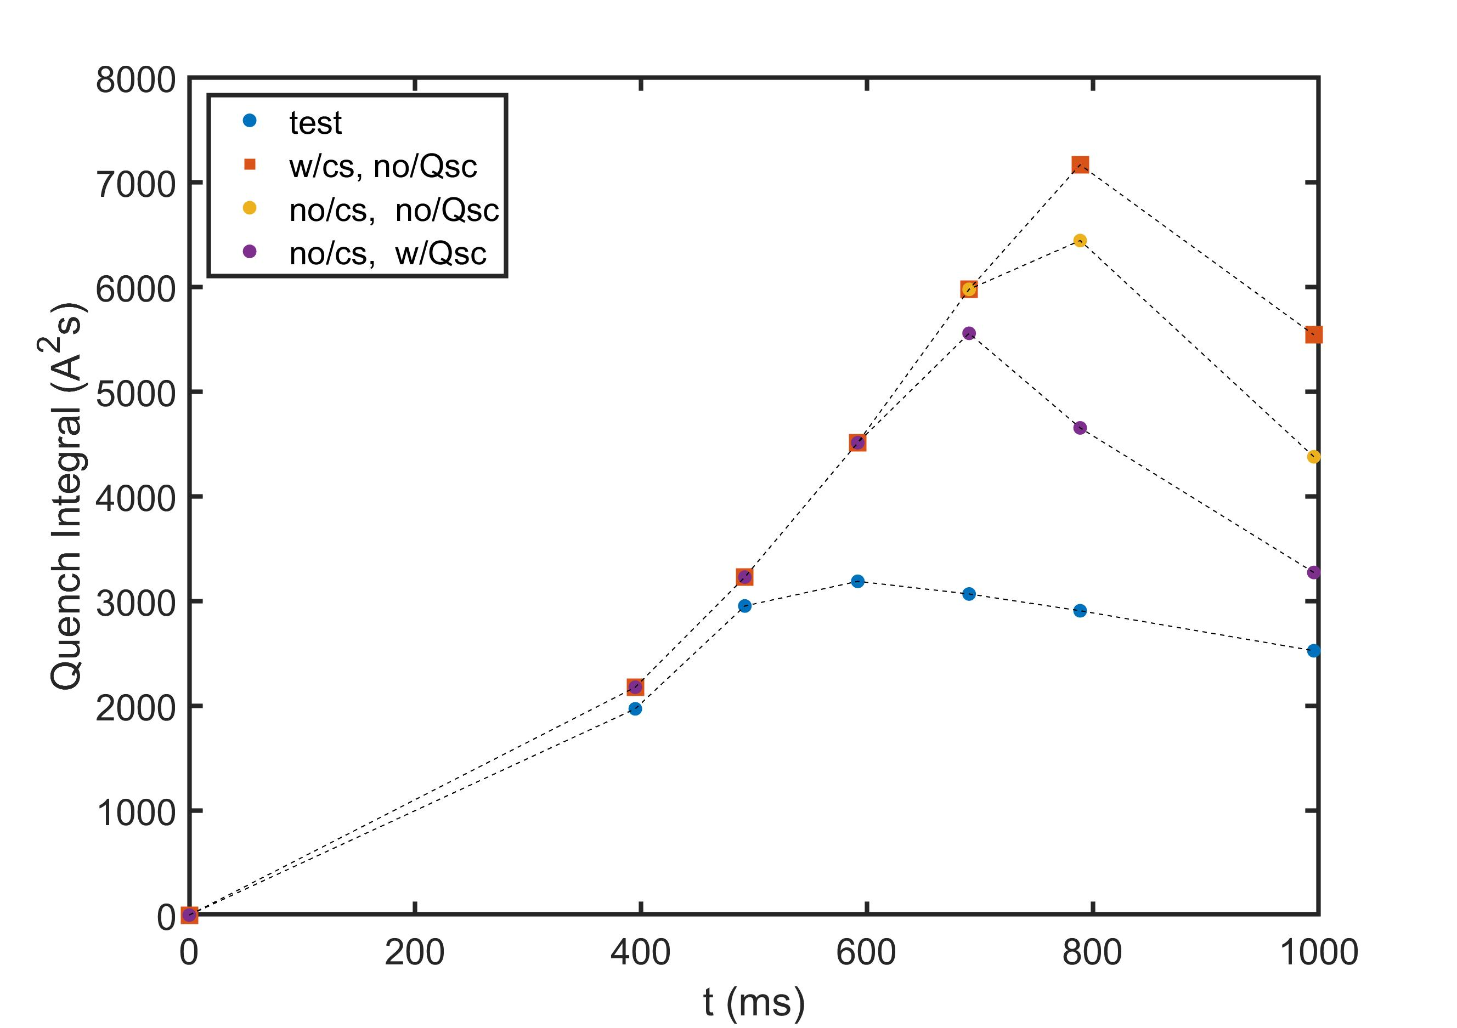
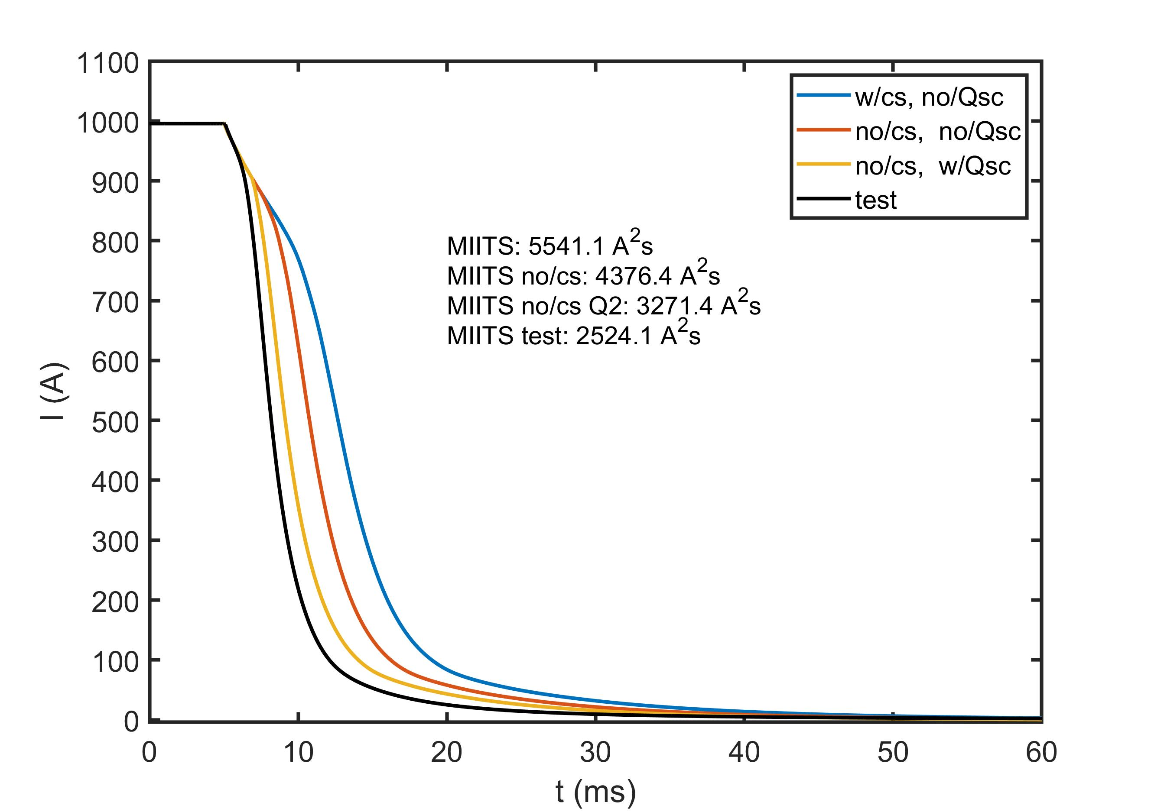
Simulation Results from SCU Overestimate Time to Quench at a High Fraction of I/Ic
We are working to understand this behavior and look for improved models

Slide 26
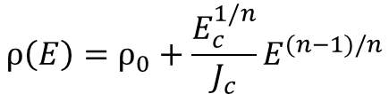
We have two approaches in ANSYS based on uniform (stranded) or computed current density (power law)
A-curr-emf (stranded)
A-V formulation with E-J power law
use for bulk devices, filament magnetization, etc.
use for conductor regions of NbTi, Nb3Sn magnet models
quench and current sharing is implemented with loss term based on Jc(T,B)
equivalent magnetization used for coupling currents (a priori current path)
optional resistive/inductive coupling to external circuit
$$ρ\left(E\right)=ρ_{0}+\frac{E_{c}^{1/n}}{J_{c}}E^{(n−1)/n}$$
conductive paths resolved by mesh
current distribution follows from DOF solution

Slide 27
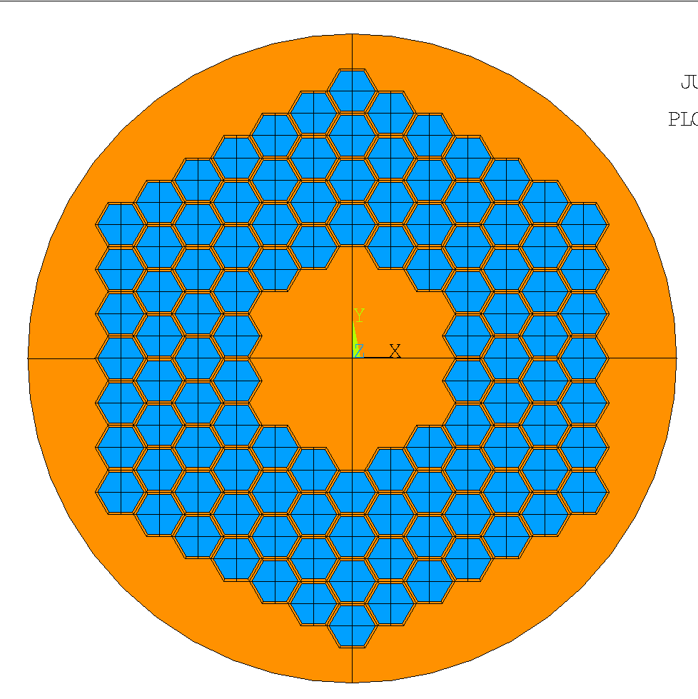
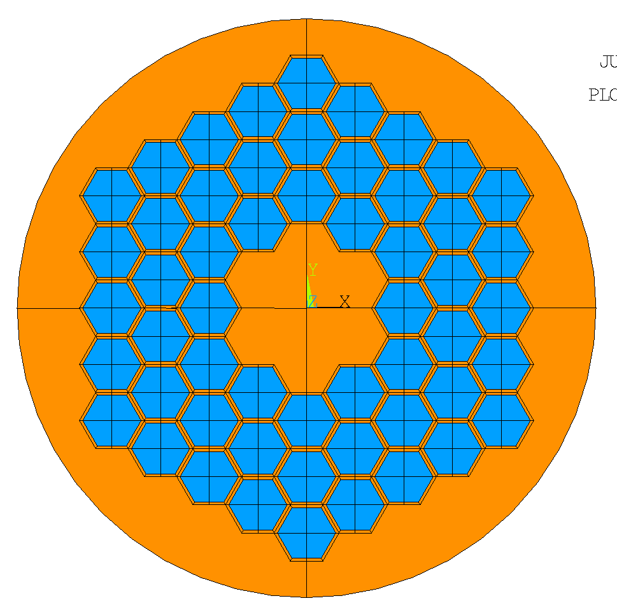
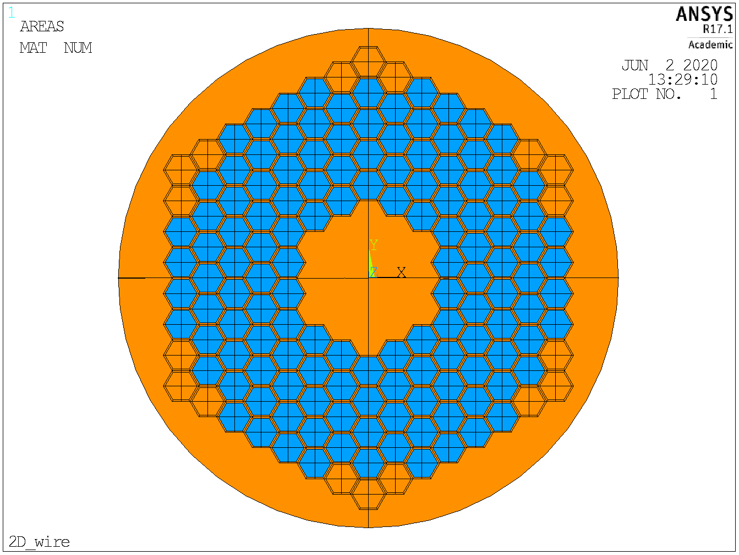
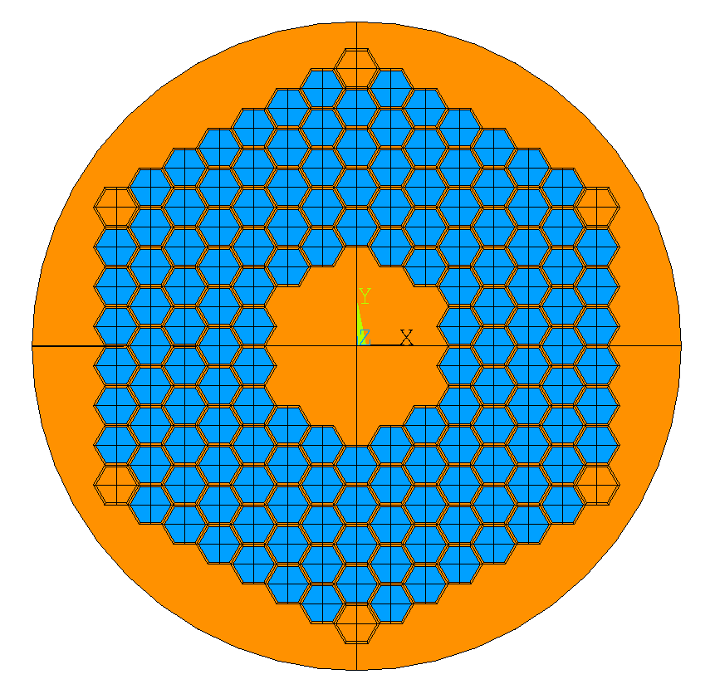
2D/3D sub-strand RRP models are under development to help study this discrepancy
Parametric Wire Geometry Generation
strand level inputs: diameter, stack (i.e. 54/61), non-cu fraction
non-cu subelement size is calculated to match strand non-cu fraction with the number of non-cu hexes
54/61, CCT3-4
108/127, CCT5-MQXF
169 stack, SCU, with corner subelements all copper
132/169, LBNL SCU
144/169, ANL SCU
3 Cu sublements per corner
1 Cu sublement per corner

Slide 28
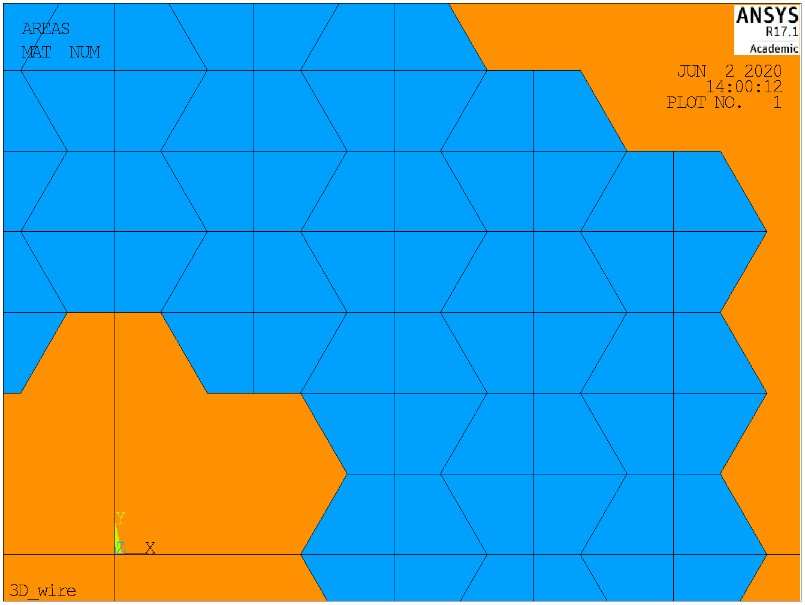
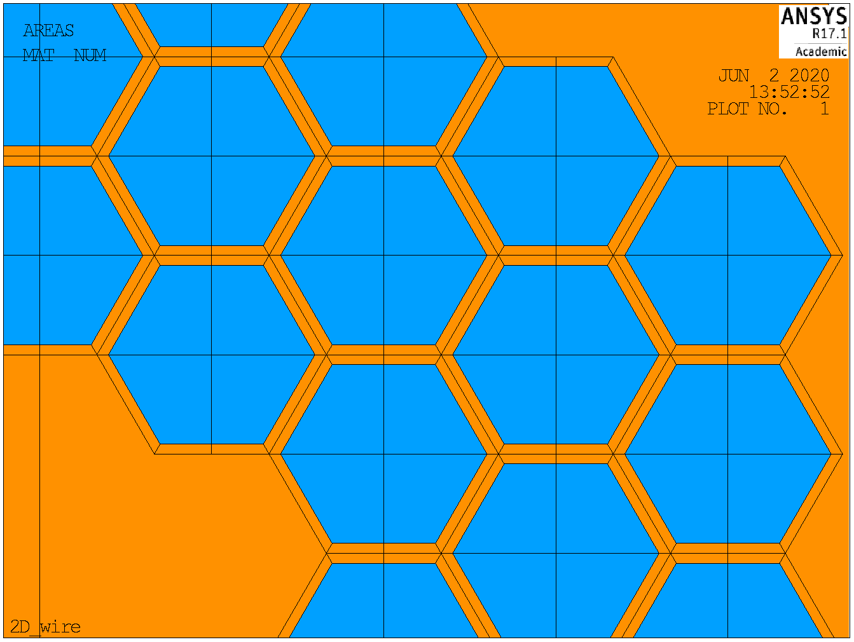
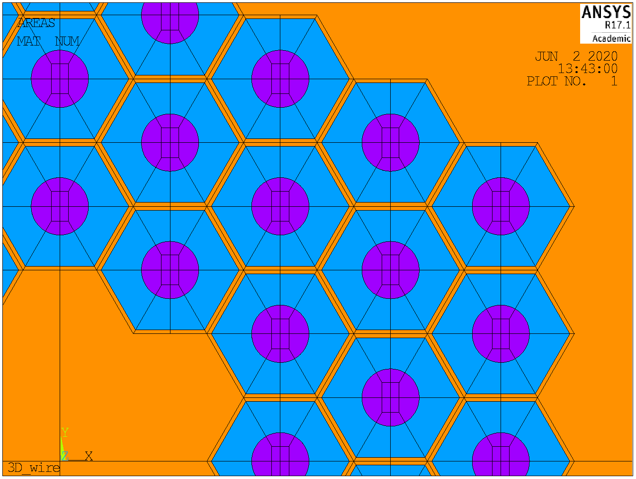
Optional level of subelement detail
Option #1: SC only
Option #2: SC + CU boundaries
Option #3: SC + CU + internal SN
increasing mesh dens, all three can be mapped mesh for 3D extrusion

Slide 29
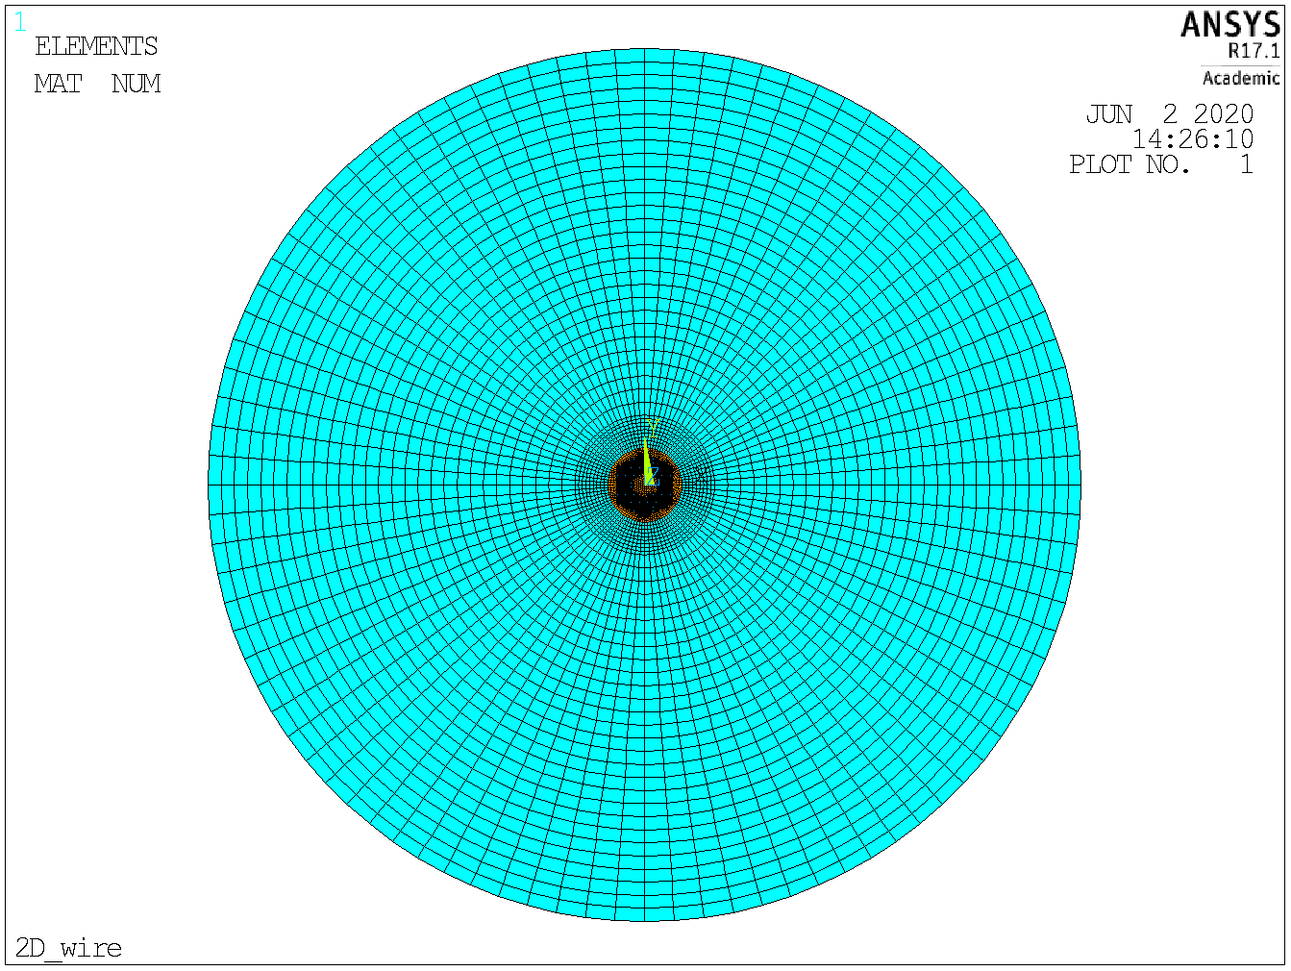
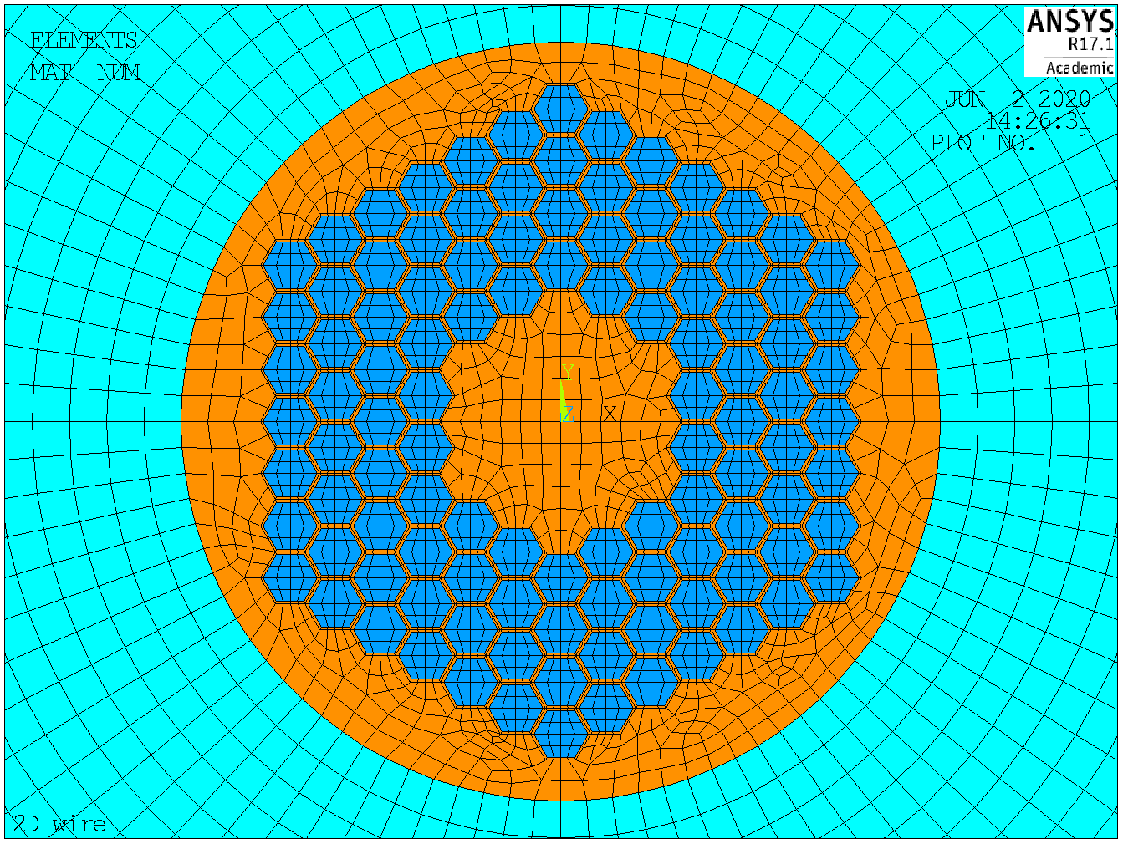
Loading with and without transport current
Background field is applied by specifying potential on the far field boundary
Constraint on total current through the wire face

Slide 30
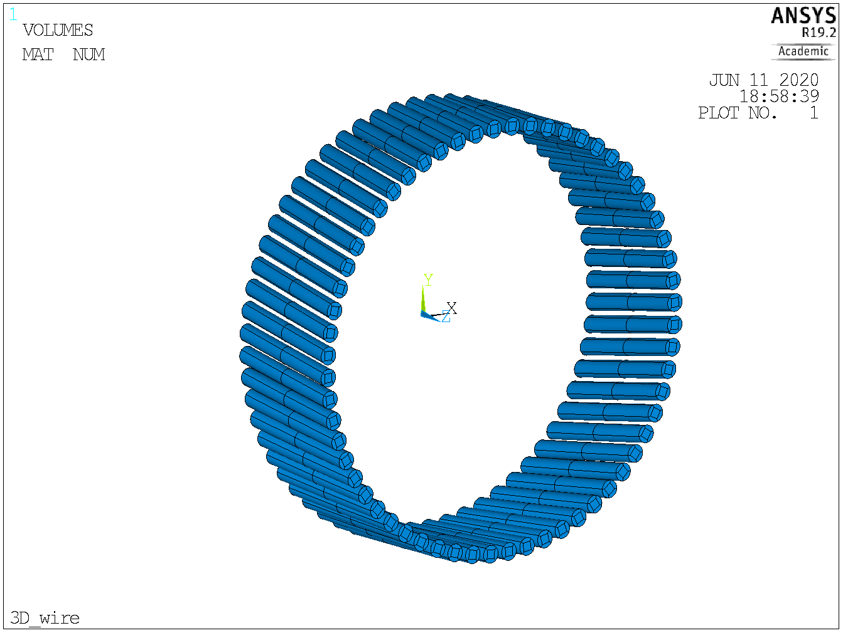
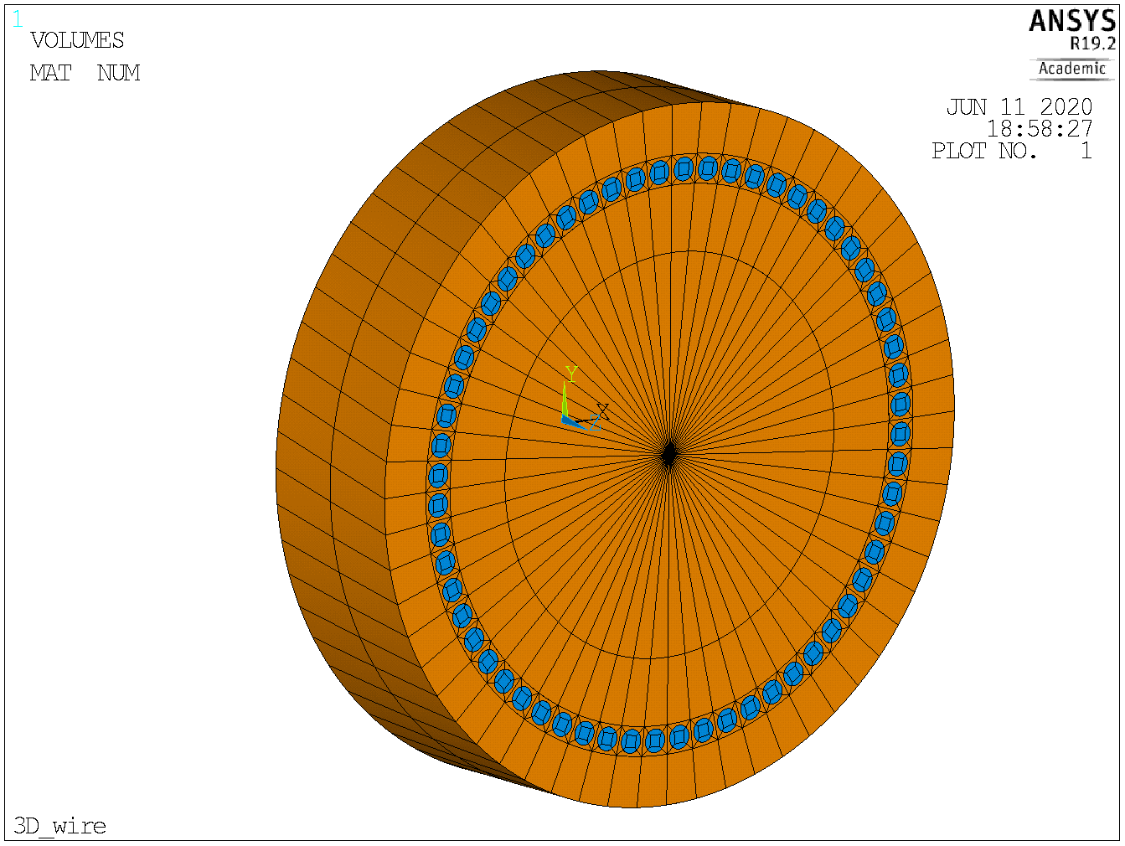
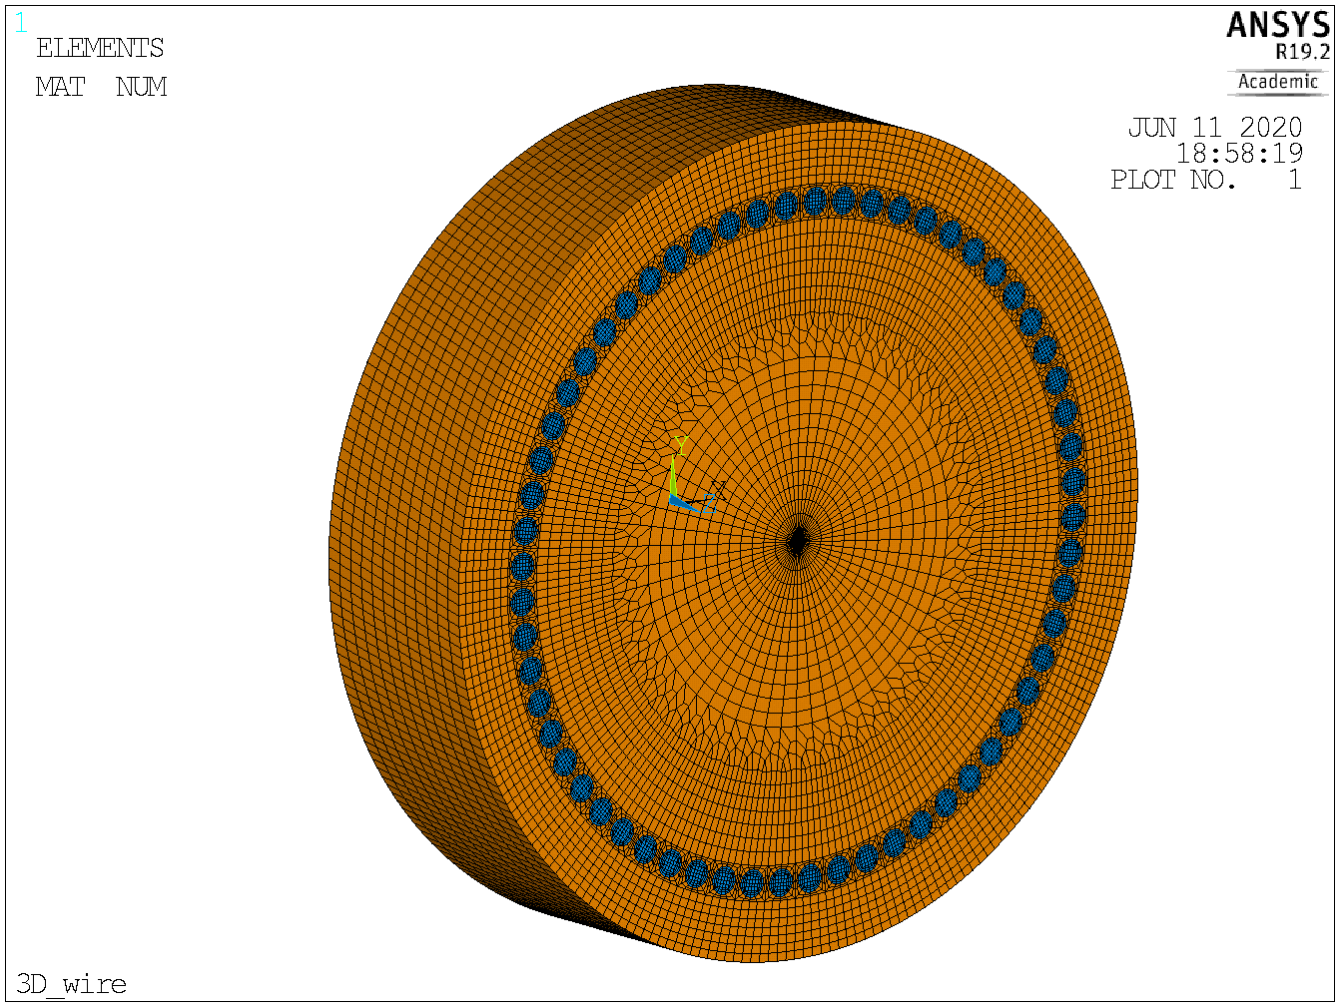
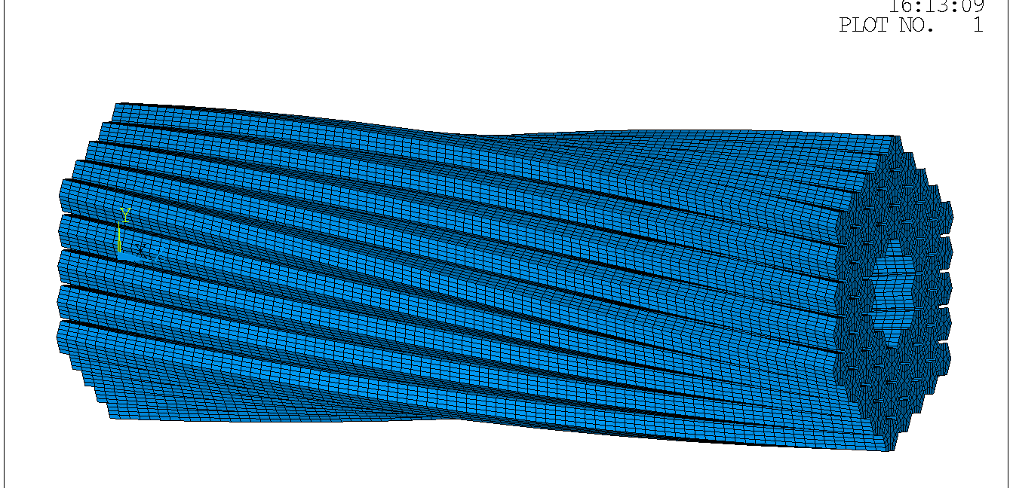
In 3D, you can use a minimum periodic symmetry extrusion with a twist
Minimum symmetry in 3D for round barrier is 360 deg / #fil
Minimum symmetry in 3D for RRP type wire is based on hex (60 deg)

Slide 31
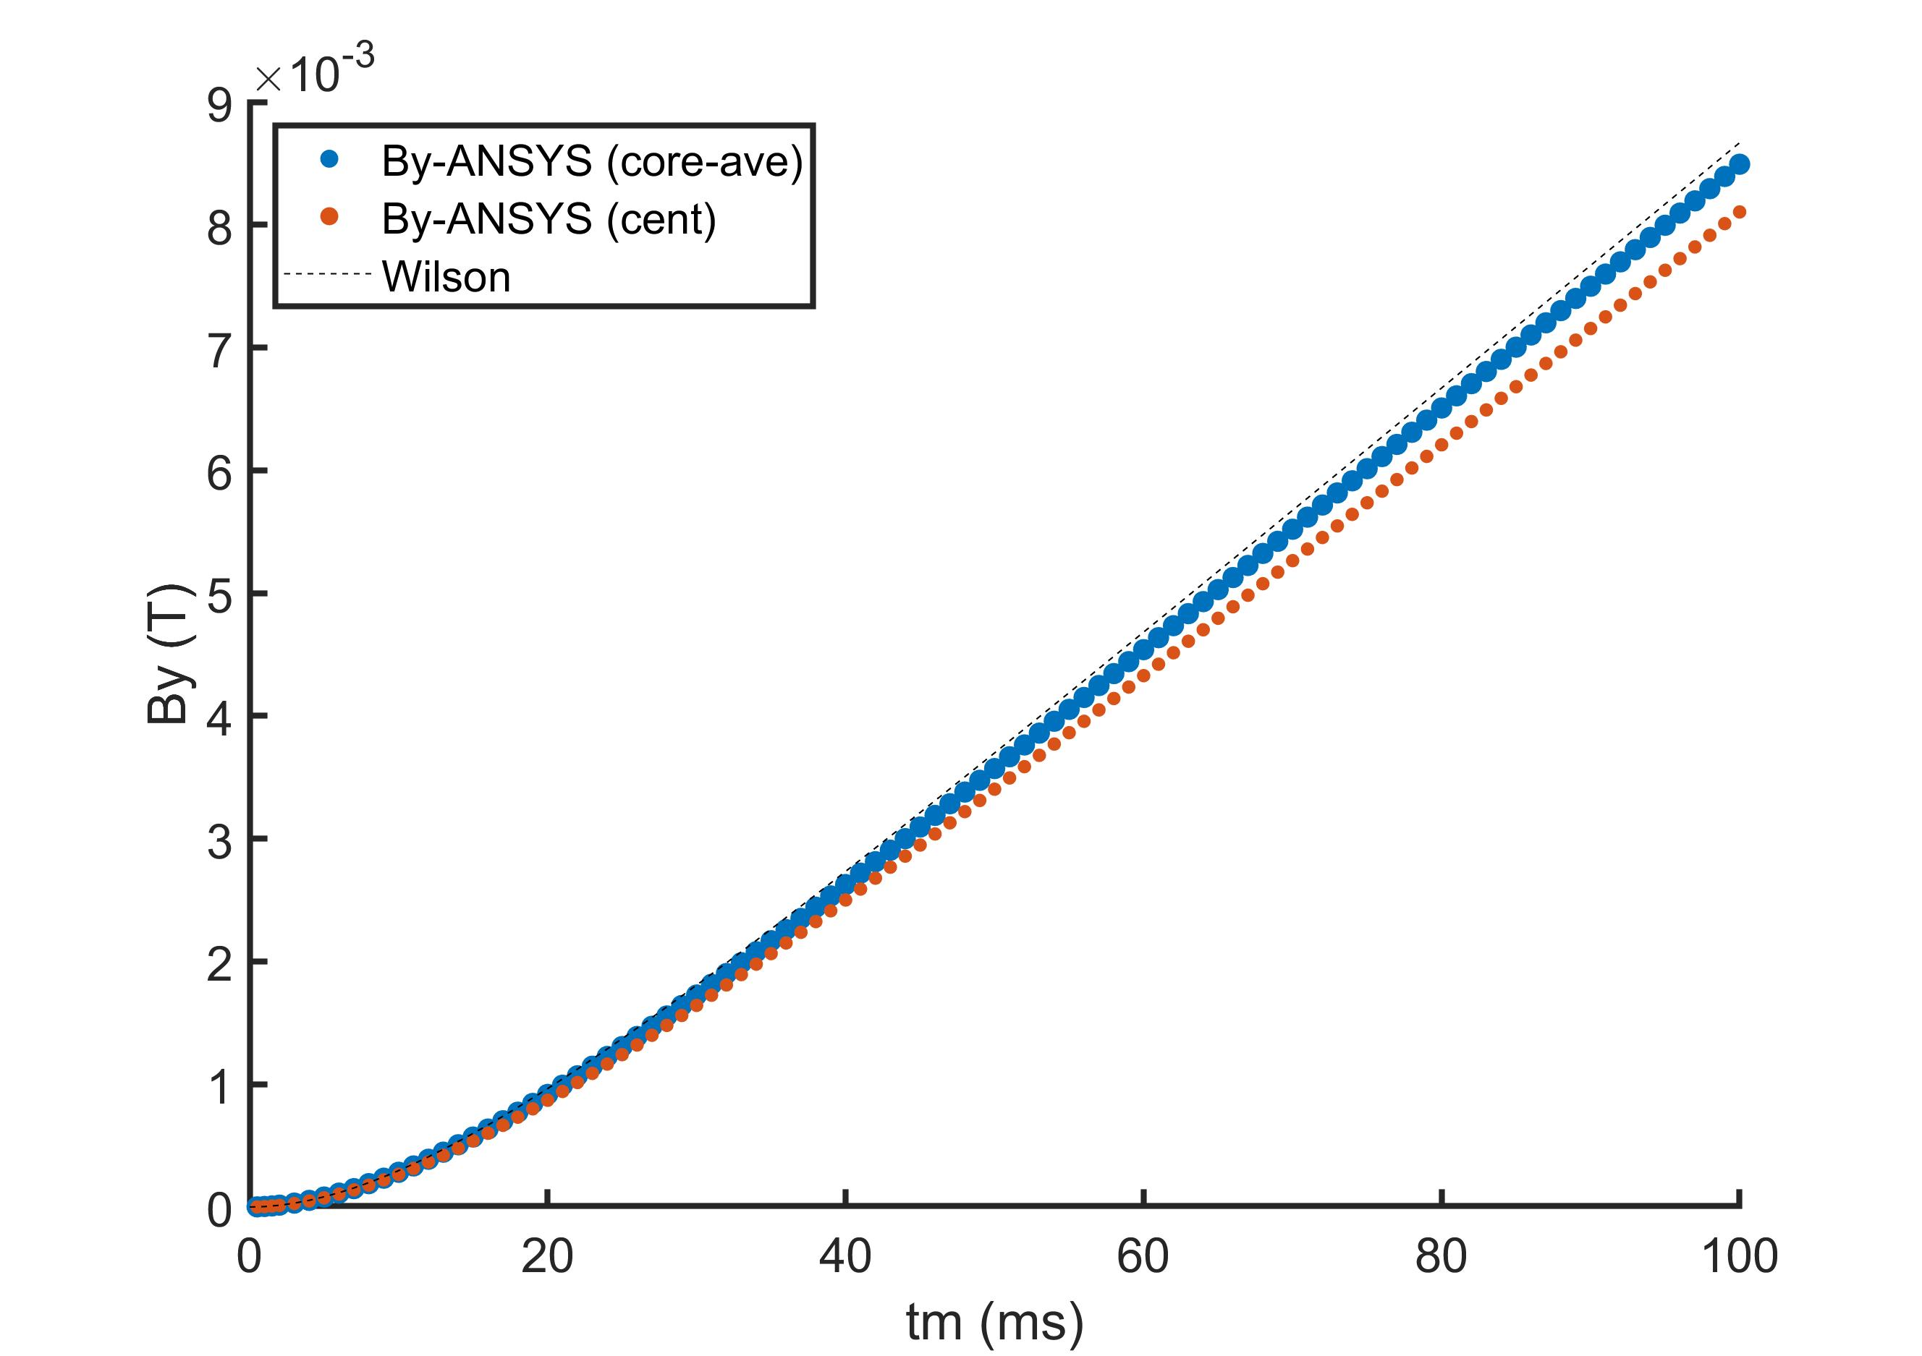
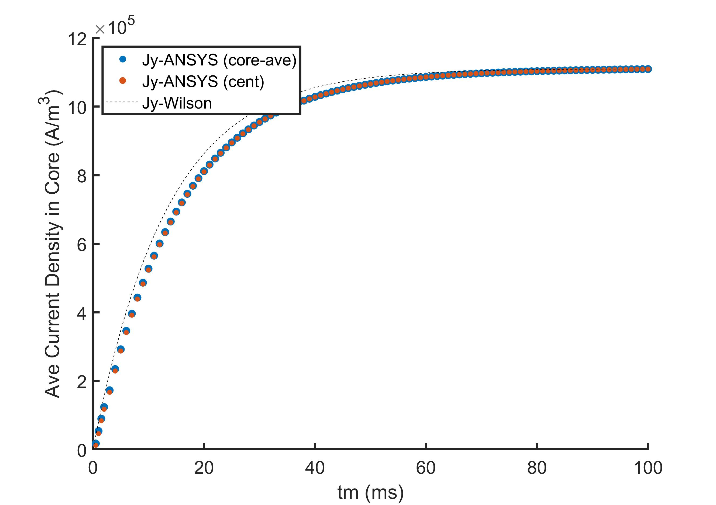
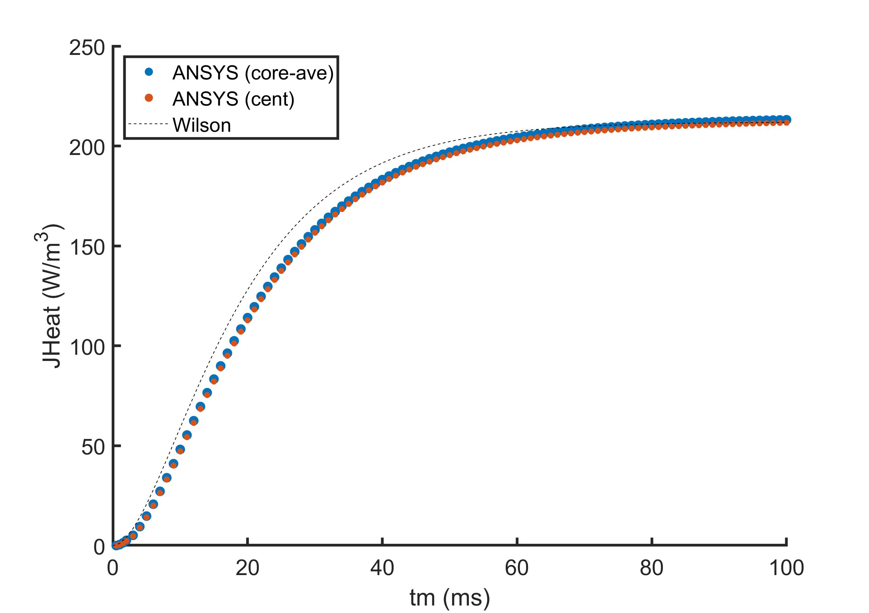
Results for a Single Filament Layer Agree with Wilson’s IFCC Model with No Transport Current

Slide 32
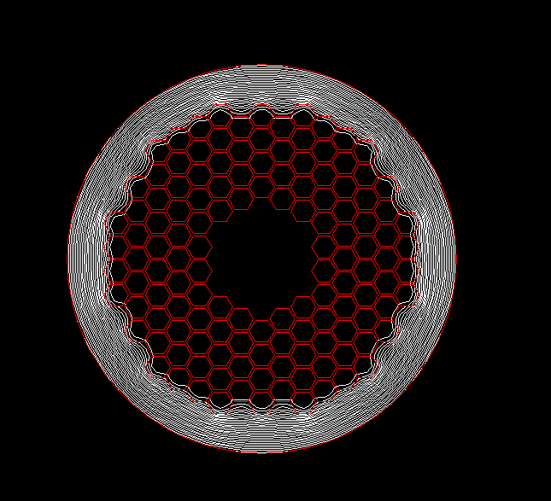
Next Steps
Study how these effects change when power law behavior is included for RRP models
at higher current/field, what is the impact of filament layer saturation?
coupling to thermal will show full quenching process at filament level – this can also be used for instability simulations
ultimate goal: accurately capture coupling current induced quench behavior to improve quench back simulations (feedback into magnet models)
Example, power law model in 2D for RRP strand

Slide 33
Summary
User elements in ANSYS
add IFCC, quench, and material property fits at the point of element matrix generation (all internal to ANSYS)
can simulate IFCC induced quench back (CLIQ) and other strongly coupled thermal, magnetic, and circuit situations
require very little effort beyond standard ANSYS to use
Examples and Validation:
CLIQ simulation for a block dipole
Quench back in Nb₃Sn Undulators
Initial RRP sub-strand models for magnetization and quench
3D quench propagation in Nb-Ti CCT gantry (moved to backup)
Bulk HTS magnetization (moved to backup)

Slide 34
Backup Slides

Slide 35
3D quench propagation in CCT gantry (Nb-Ti)
Stack of 6 insulated wires per channel

Slide 36
3D quench propagation in CCT gantry (Nb-Ti)
Rib thickness changes along length
Magnetic field changes along length and decays with time

Slide 37
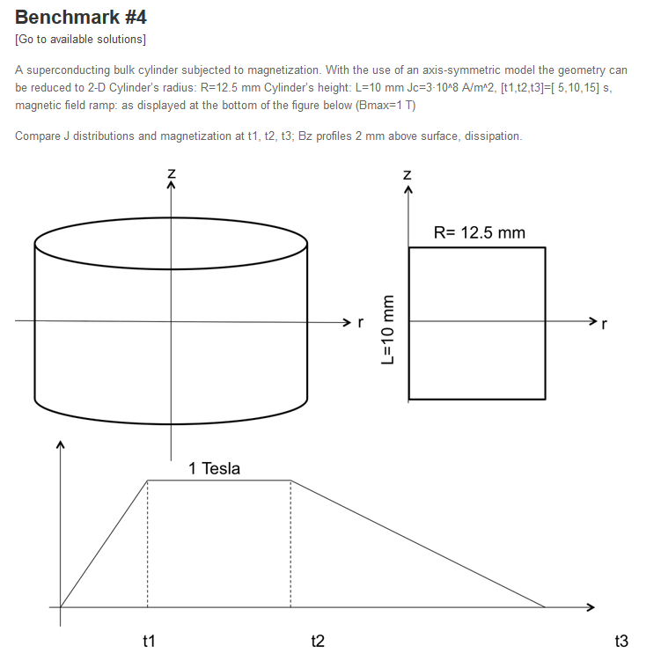

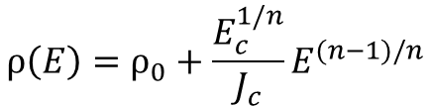

Verification #1: HTS modeling benchmark for bulk magnetization
Bulk cylinder of constant Jc is magnetized using vertical field profile as a function of time
$$E=−∂tA_{z}−∇V$$
$$ρ\left(E\right)=ρ_{0}+\frac{E_{c}^{1/n}}{J_{c}}E^{(n−1)/n}$$
http://www.htsmodelling.com/?page_id=2

Slide 38
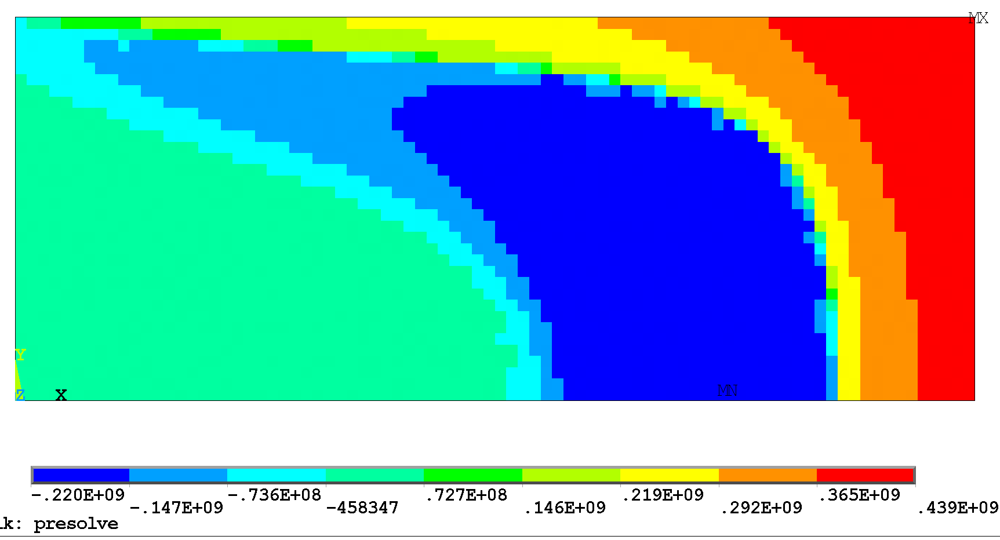
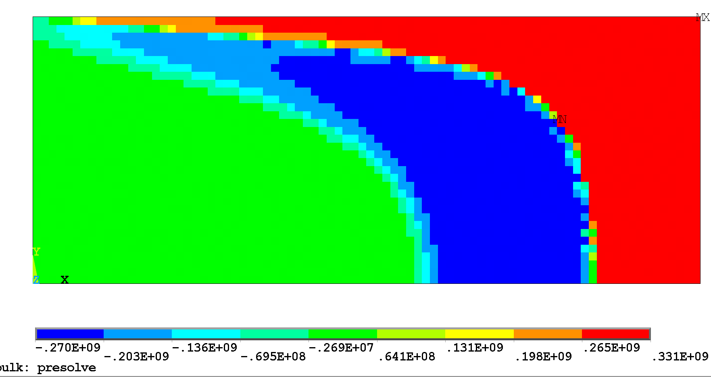
Current Density at Profile End
ANSYS (n=5)
Comsol Benchmark
ANSYS (n=20)

Slide 39
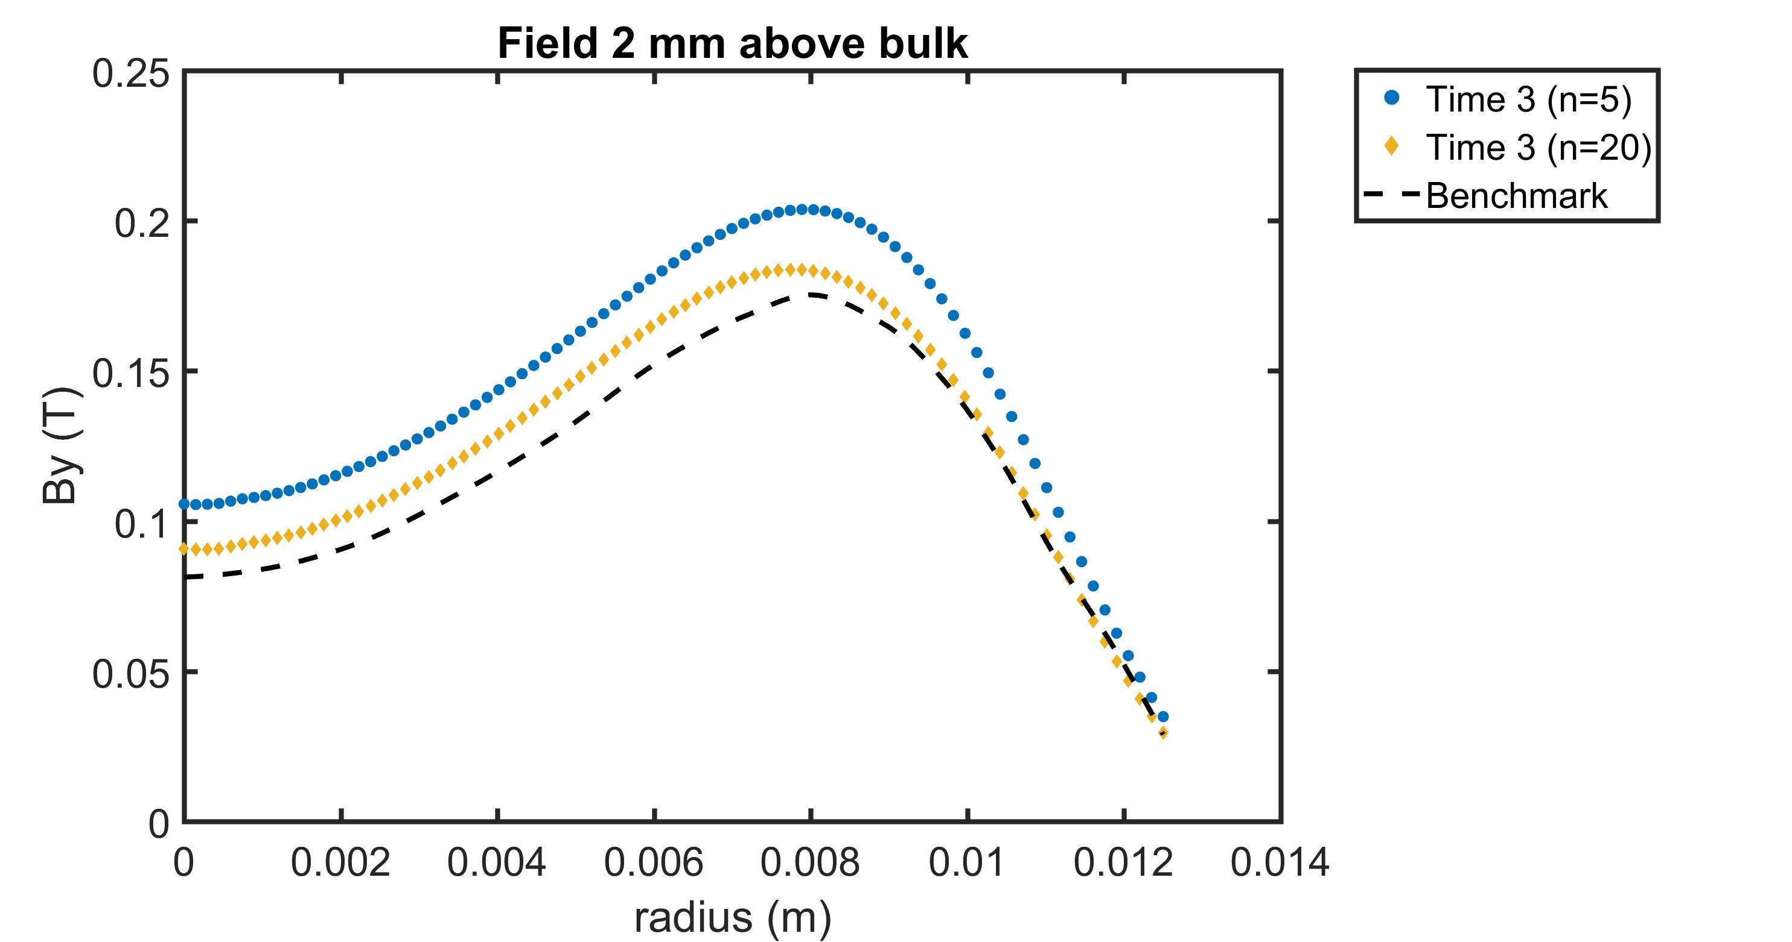
Trapped field at profile end is converging towards benchmark

Slide 40
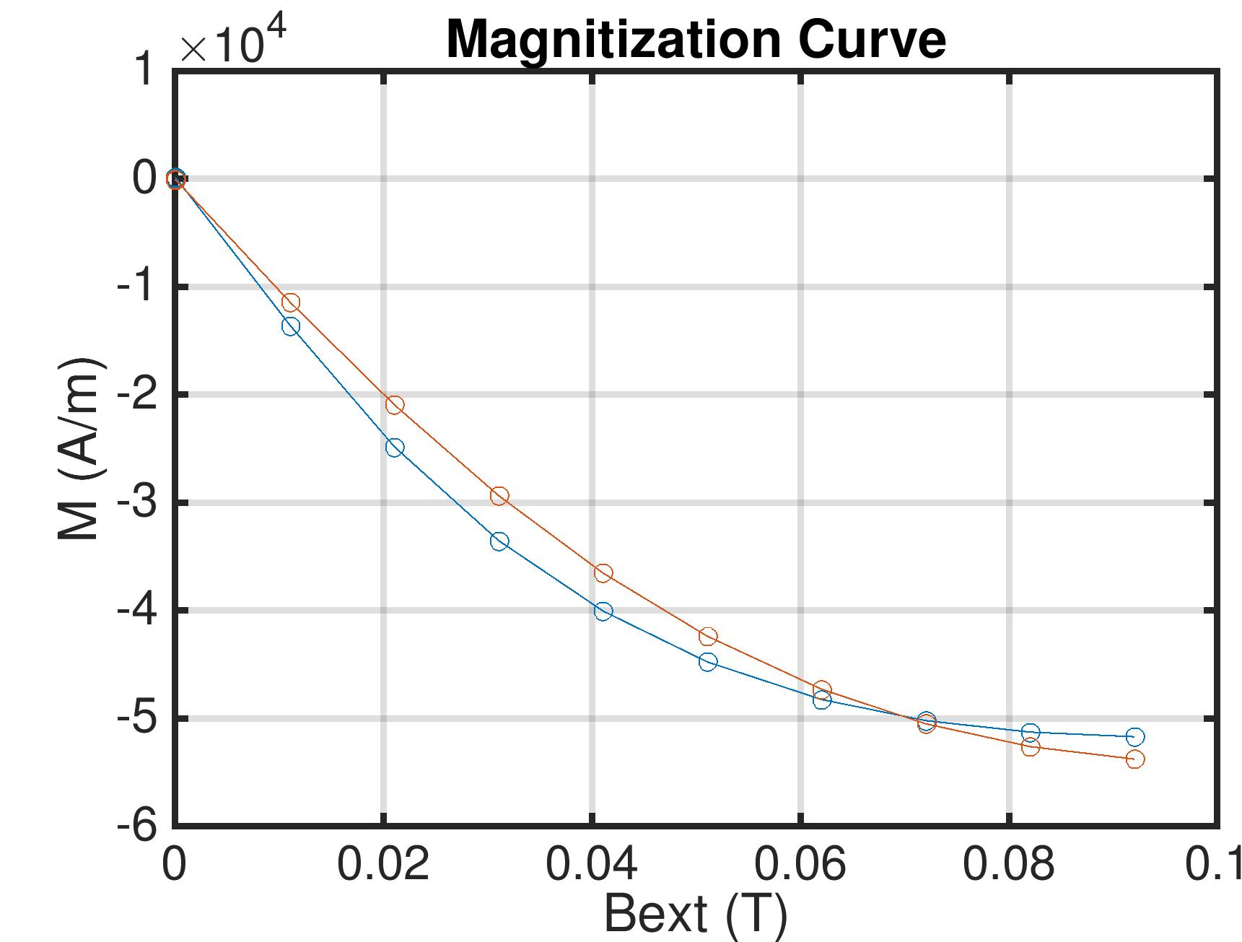
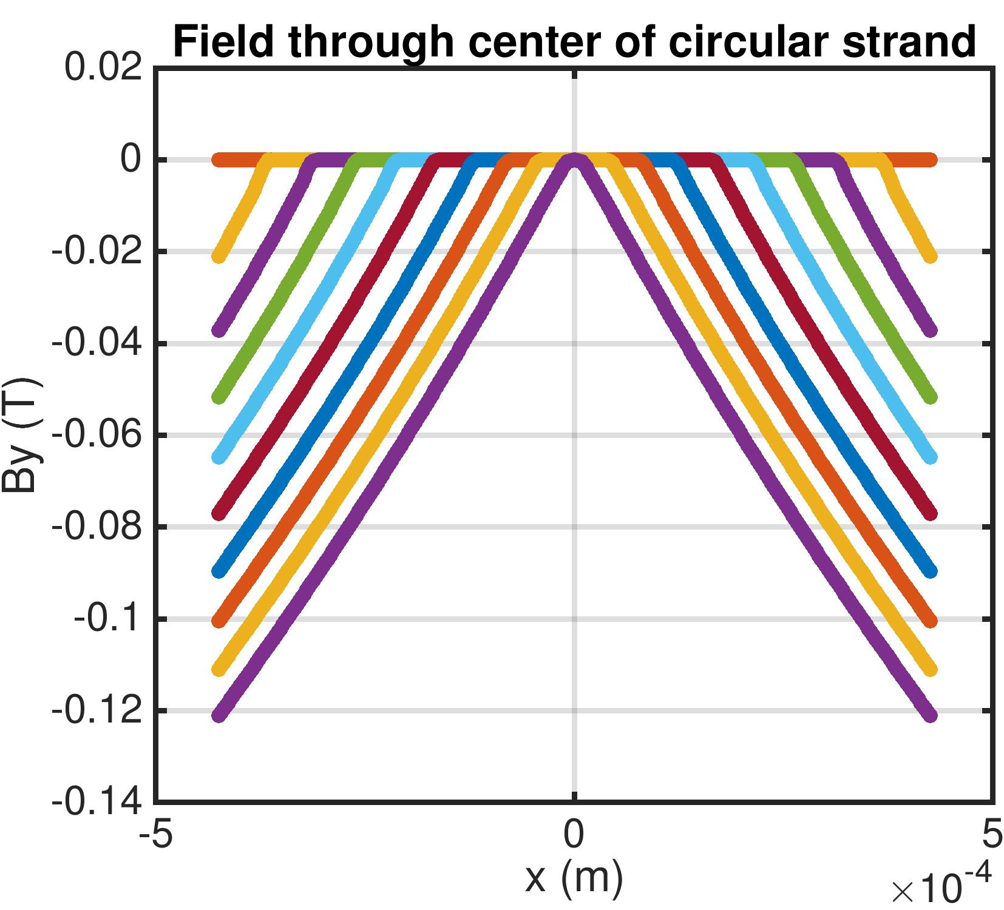
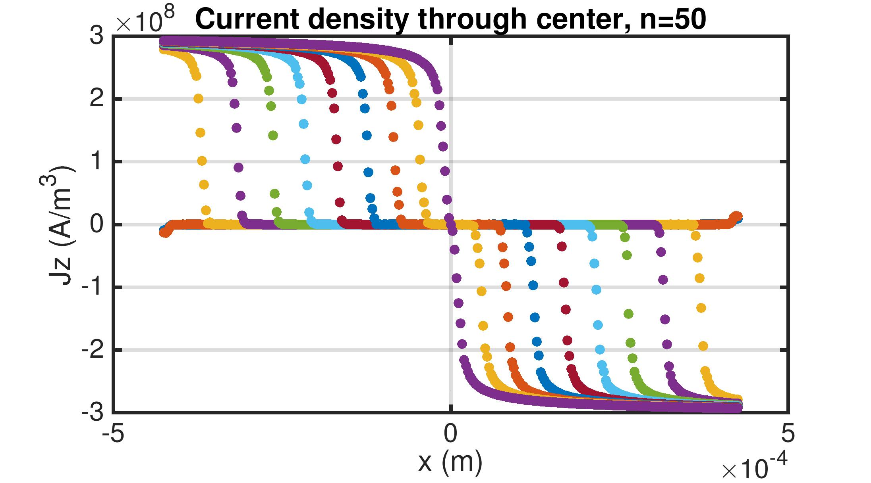
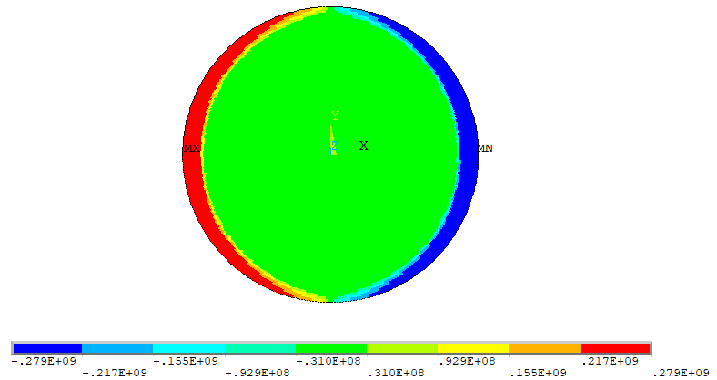
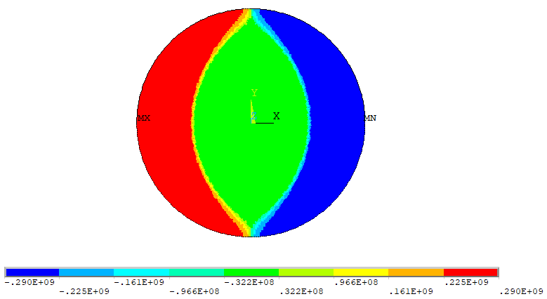
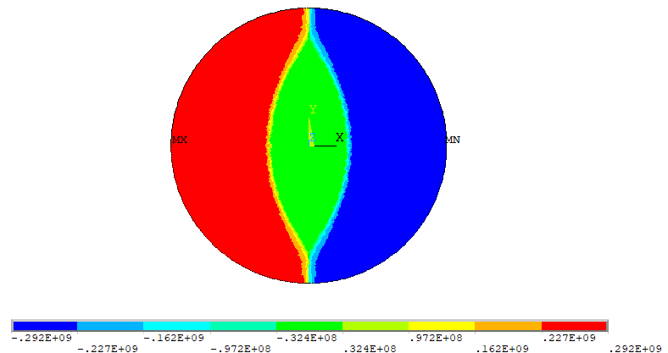
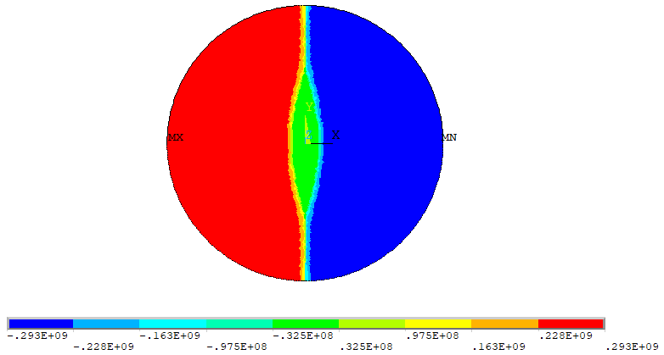
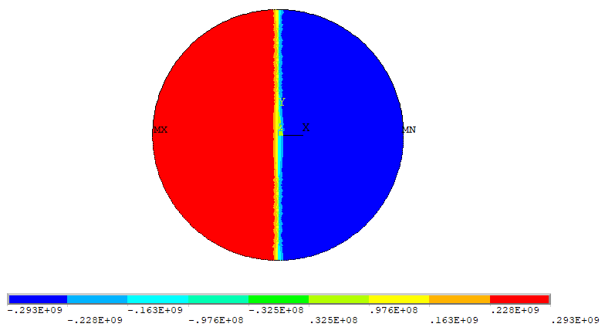
Verification #2: magnetization of a round filament of fixed Jc = 3x10^8
ANSYS
analytic*
*model is slightly different than analytic based on how fields are applied
increasing Bext up to 0.09 T

Slide 41
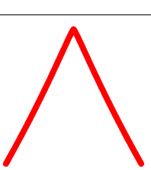
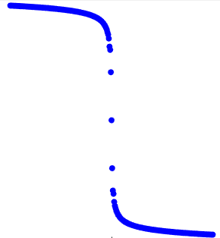













Field
Current

