Slide 1



Why use lumped-element methods or STEAM framework?
Daniel Davis,
Applied Superconductivity Center, National High Magnetic Field Laboratory, Florida State University, Tallahassee, FL, USA

Slide 2
Contents
What is STEAM?
  My thoughts on its use
  What tools are in the network?
What is LEDET?
  What’s new in LEDET?
Applications of LEDET to Bi-2212, CLIQ, and solenoids/dipoles.
  i.e. examples from my PhD work

Slide 3
STEAM

Slide 4
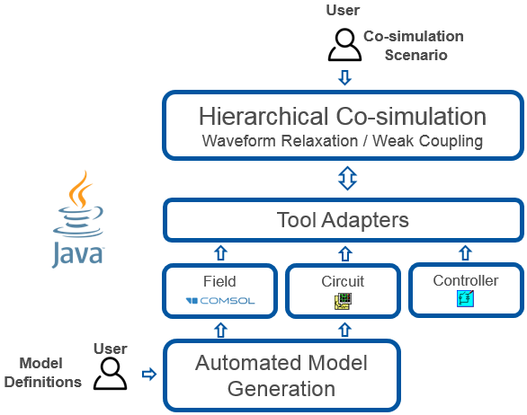
Simulation of Transient Effects in Accelerator Magnets (STEAM)
https://espace.cern.ch/steam/_layouts/15/start.aspx#/
CO-SIM: Needed when individual tools can’t handle, or are inefficient, for a particular physics or scaling
  i.e. CLIQ in a novel circuit, mechanics during a heater protected quench
  Alternative would be something like multi-physics FEM, but solving times grow very quickly for these, especially if 3D geometry
  Co-simulation seems best for large scale or long term efforts that will be exploring many aspects of a magnet
  Individual tools can be used stand-alone (i.e. LEDET, BBQ) for “standard” magnet schemes
Setup is front-end heavy
Requires synchronized variable use
Once built, cases can be batch-run easily and new tool adapters are under development
L. Bortot, B. Auchmann, I. Cortes Garcia, A. Fernandez Navarro, M. Maciejewski, M.Mentink, M. Prioli, S. Schöps, A. Verweij, "STEAM: A co-simulation framework for modelling superconducting accelerator magnet circuits", accepted for publication in IEEE Transactions on Applied Superconductivity.

Slide 5
Tool Summary
LEDET: Quench thermal and electrical transient solution for CLIQ, quench heaters, and simple energy extraction (dump resistor)
SIGMA: generates COMSOL portions of quench transient simulations
BBQ: conductor level quench transient analysis for finer levels of thermal detail
ProteCCT: CCT quench transient simulation utilizing an adjusted cos-theta model and a stand-alone inductance tool
COSIM: This is the tool for controlling multi-tool simulations
  Currently supports: QLASA, LEDET,comsol, PSPICE, LTSPICE
Forthcoming (SING): automated SPICE circuit model generator

Slide 6
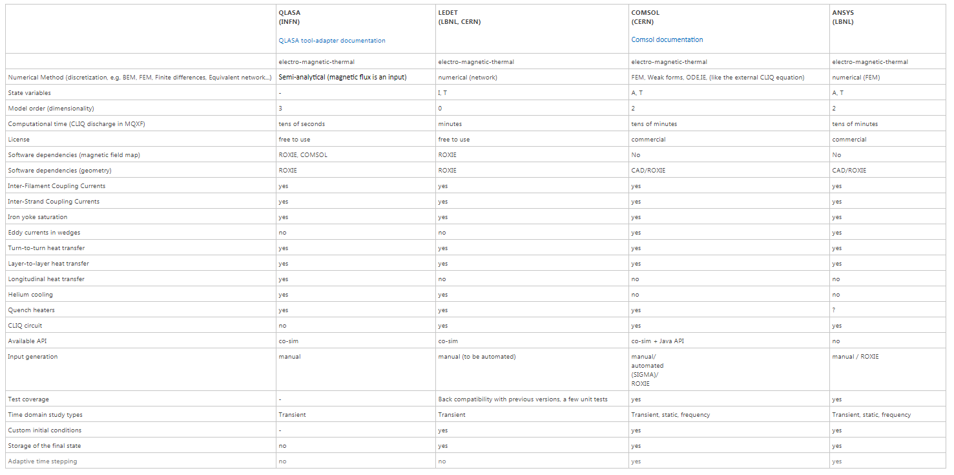
CO-SIM available?
https://espace.cern.ch/steam/_layouts/15/start.aspx#/COSIM/Home.aspx

Slide 7
LEDET

Slide 8
Lumped-Element Dynamic Electro-Thermal
Equivalent Circuit models for:
  Electrical (current, resistance)
  Thermal (heat, temperature)
  Magnetic (coupling currents, inductances)
Requires parametrized models of the behaviors of all system elements.
  For example, interfilament coupling currents use twist pitch and transverse resistivity
E. Ravaioli, B. Auchmann, M. Maciejewski, H. H. J. ten Kate, and A. P. Verweij, “Lumped-Element Dynamic Electro-Thermal model of a superconducting magnet,” Cryogenics, vol. 80, Part 3, pp. 346–356, Dec. 2016, doi: 10.1016/j.cryogenics.2016.04.004.

Slide 9
Lumped-Element Dynamic Electro-Thermal
Freely distributed with acknowledgement & STEAM license agreement
  Tutorial and manual: https://edms.cern.ch/document/2046824
  Well supported by the CERN group (E. Ravaioli for LEDET)
    Executable so changes must be submitted, but I have multiple experimental features being explored
Essentially 1-2D → fast but only as good as the assumed relationships → Correction factors
Any non-linear features added significantly can slow down the simulation (example current sharing), but this can be optimized to reduce the impact.
  Non-linear features are added to specific cases to check for impact
Setup can be heavily automated and parametrized
Good for magnet designers who don’t spend a majority of their time on modelling

Slide 10
Decouples the geometry from the transient simulation
Field constants in x and y (T/A) calculated once with your favorite tool (ROXIE, ANSYS, COMSOL, Biot-Savart)
Inductance calculated once with your favorite tool
  Linear magnets can be calculated by LEDET now (i.e. not solenoids or CCTs / yes common-coil & block)
  ROXIE, ANSYS, COMSOL, Biot-Savart
    Correction for iron is implemented as a correction factor as a function of current
Heat transfer – simplified nearest neighbors and helium cooling
Coupling currents – commonly used multi-filament twisted strand equations

Slide 11
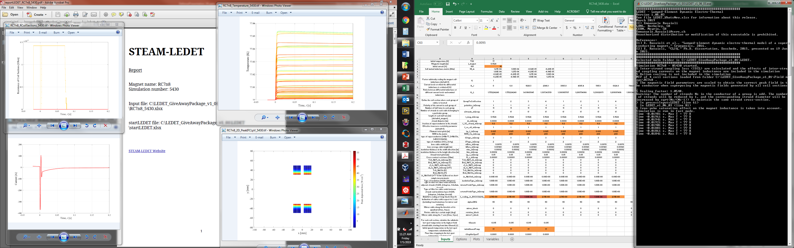
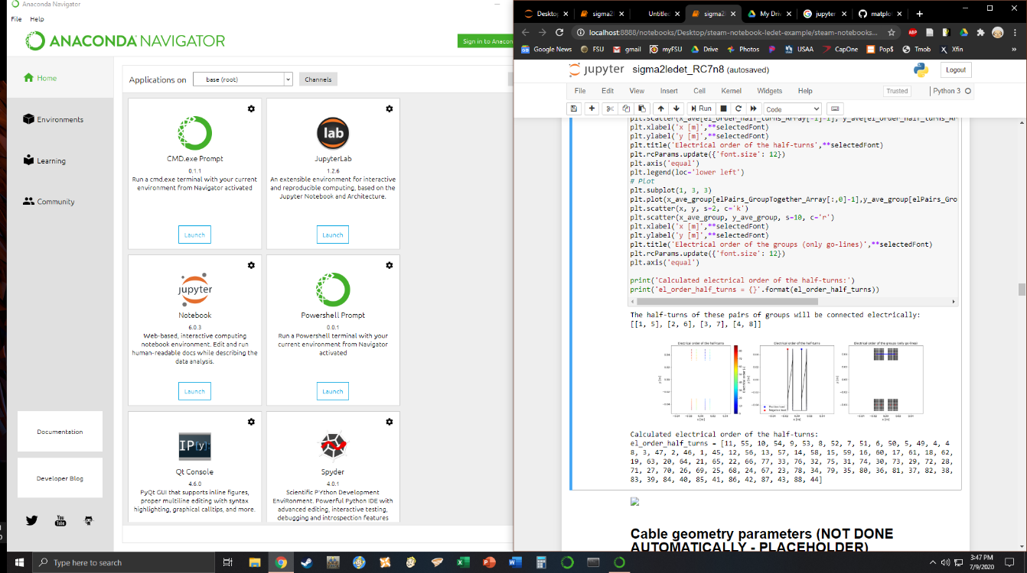
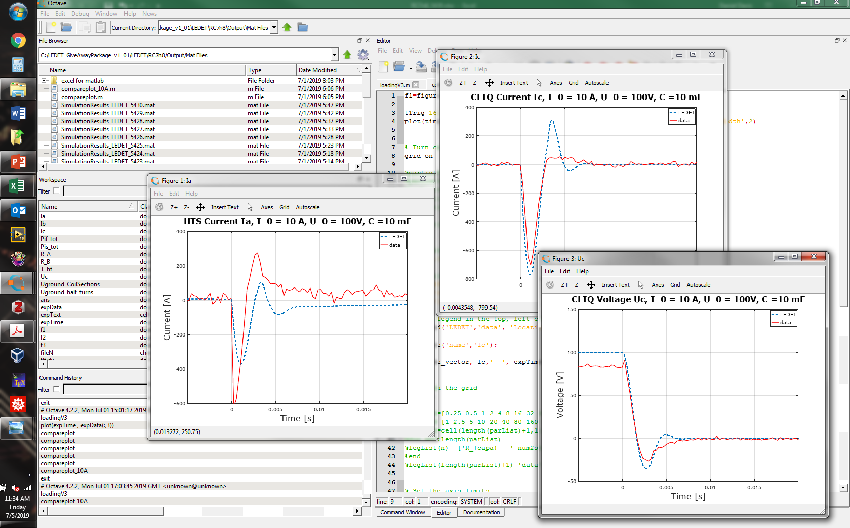
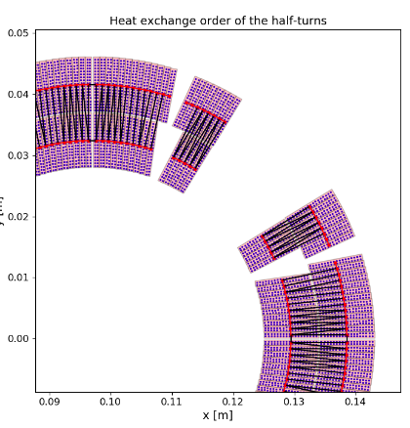
LEDET Simulation Example
Results
Input Excel File
Parameters:
Conductor, Magnet
CLIQ, EE, Quench Heaters
LEDET
Simulation Executable
with archived print log, monitor time step and hot spot for quick debugging
*recent feature
Automated PDF Reports
With key inputs, results, and plots
*new feature:
Interactive input file generator with visualization checks is a Anaconda Jupyter Notebooks
Analysis and Experimental Validation
Data can be obtained as a comma delimited text or MATLAB .m files
Top level results in an excel for all cases of a model for ease of comparison

Slide 12
Application Examples from my work

Slide 13
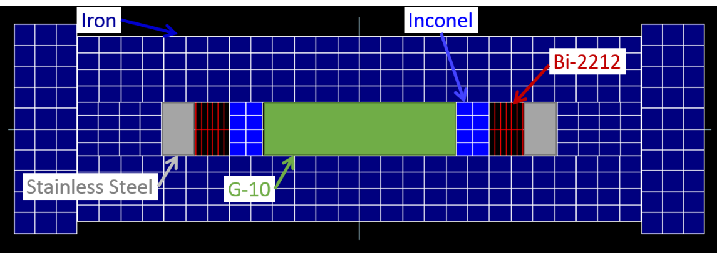
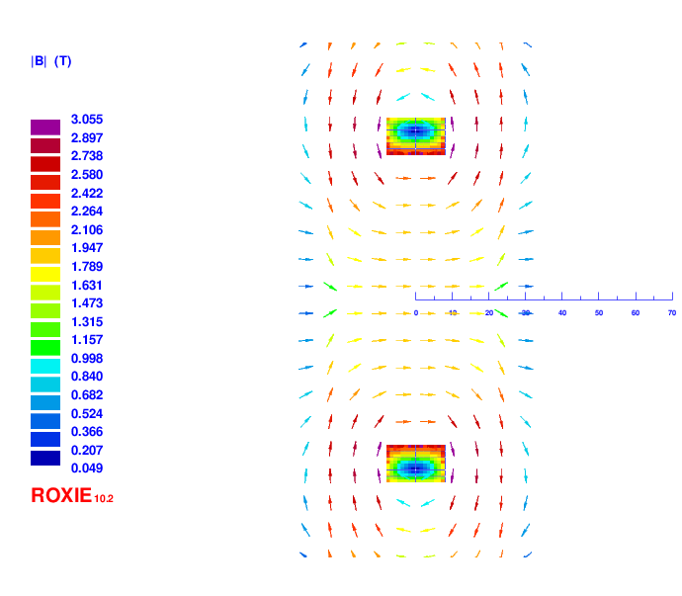
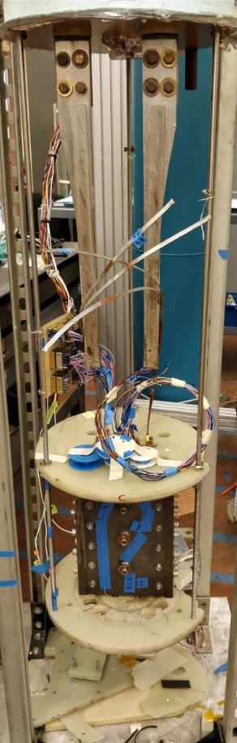
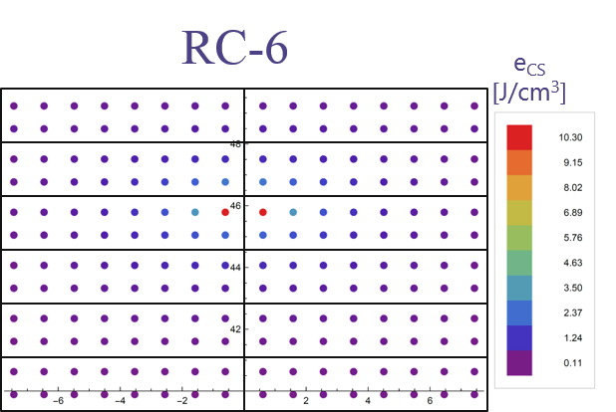
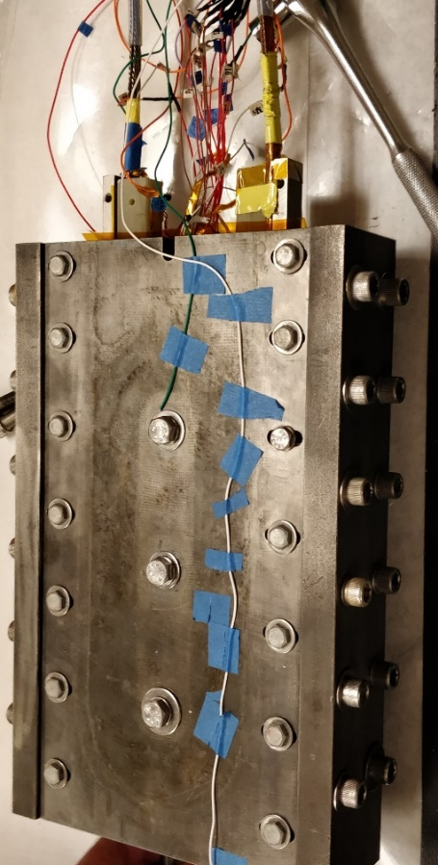
Racetrack Geometry and Iron Field Contribution
10 kA Vapor
Cooled Leads
Bi-2212
Racetrack
in iron
structure
RC6 Strand Margin
to Current Sharing
75% Load-line Ic
Single Racetrack RC6

Slide 14
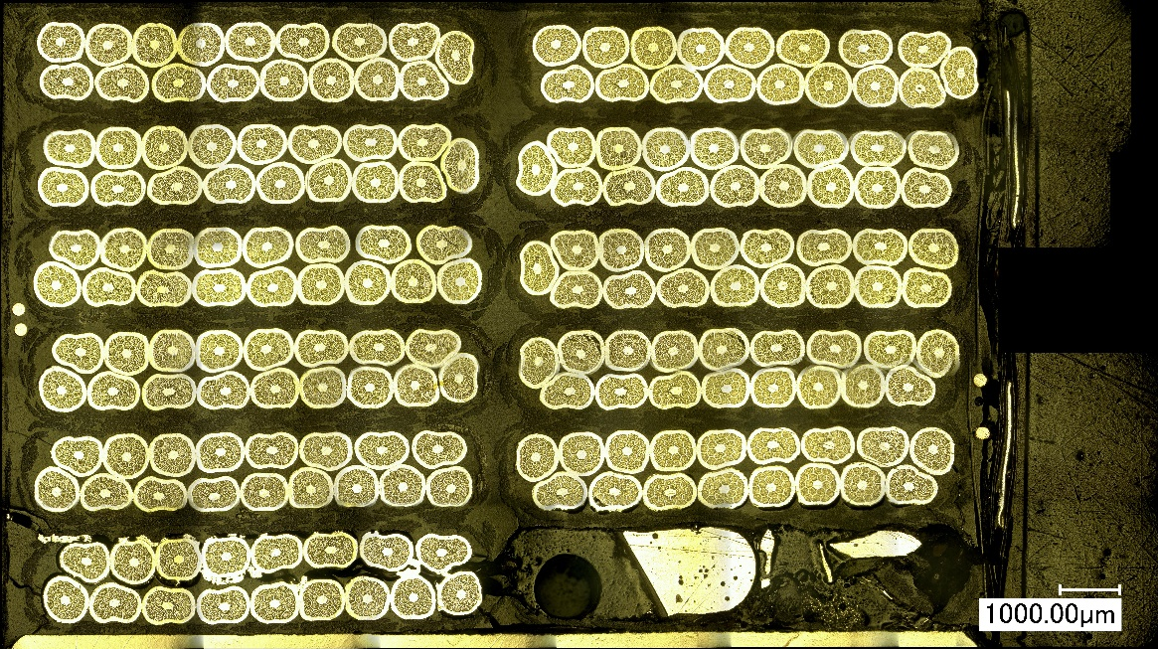
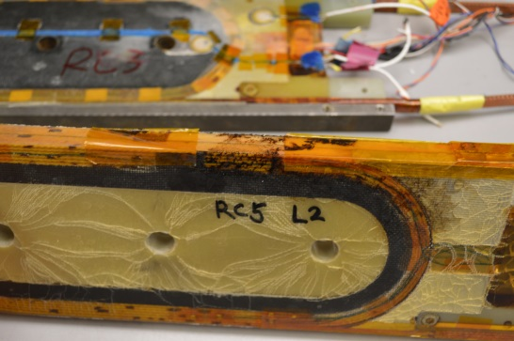
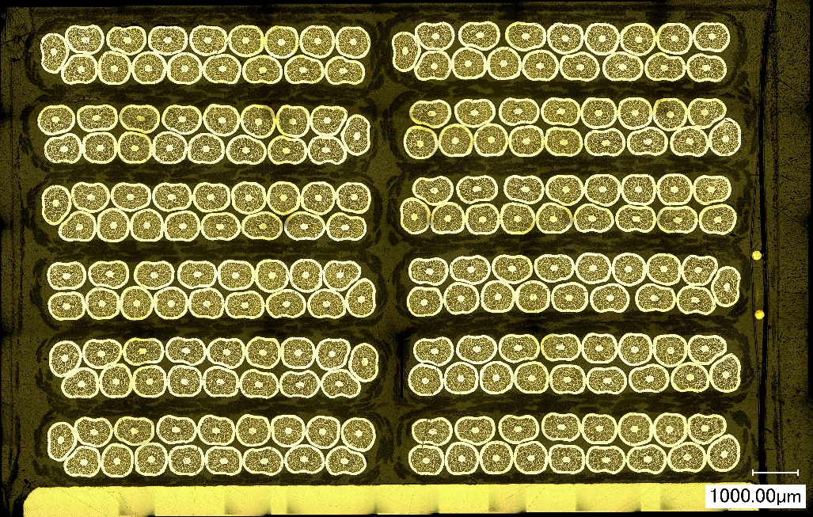
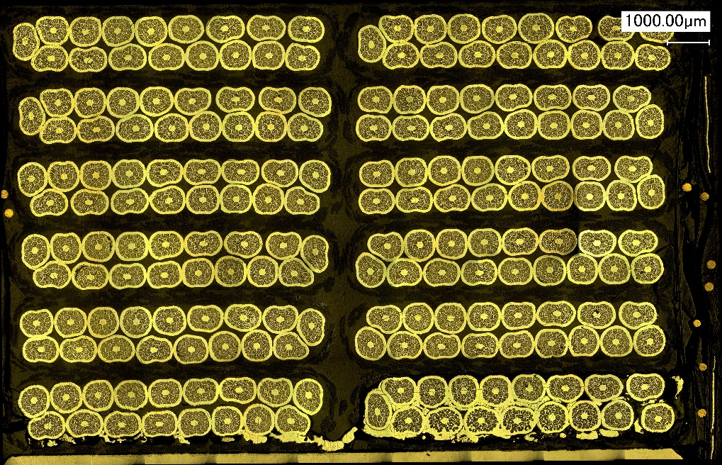
RC-5: Quench Damage Deconstruction
L2-T1
Damage to RC5 coil due to an experimental test error that delayed quench detection and energy extraction at the start of measurements on the second cooldown to look at thermal cycling behavior.
L1-T6
L2-T1
L2-T1
L1-T6
L1-T6

Slide 15
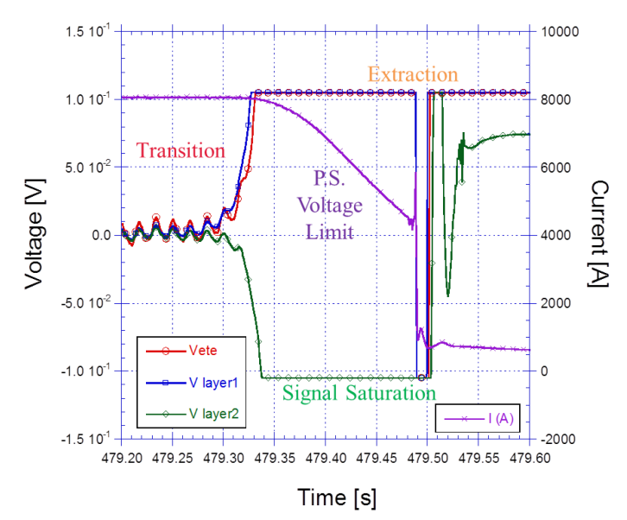
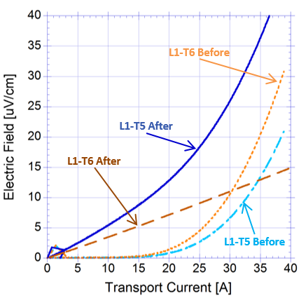
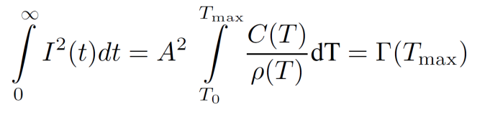
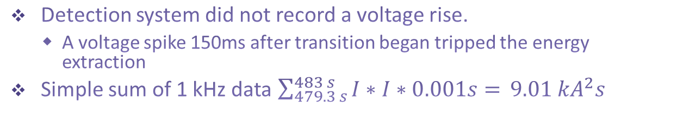
RC5: Delayed extraction led to a high MIITs quench
Liquid Nitrogen Performance Before/After
150 ms
Localized
damage
Detection system did not record a voltage rise.
  A voltage spike 150ms after transition began tripped the energy extraction
Simple sum of 1 kHz data $\sum_{479.3 s}^{483 s}{I∗I∗0.001s= }9.01 {kA}^{2}s$
MIITs (Deposited Energy)

Slide 16
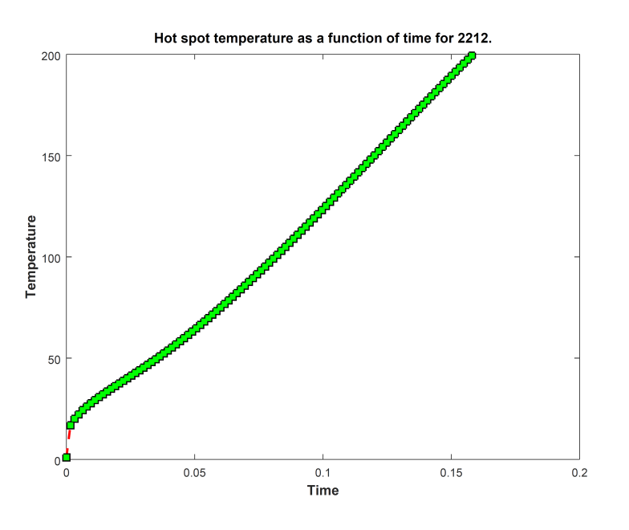
Adiabatic Quenched Turn Prediction
MIITs (Deposited Energy)
200 ºC
Calculates the Z-function of a typical Ag-sheathed
Bi-2212 round wire with a superconductor area ratio of 21% and a packing density as 100% inside 2212 filaments (50 bar HT OP samples)
Current drops linearly from 470 A per strand (7990 A cable) to 265 A (4505 A cable)

Slide 17

Localized damage can be simulated with quench propagation and current sharing
RC5 High MIITs Quench
1 turn quenches at -85ms
No Current Sharing
or Quench Propagation
With Current Sharing
and Quench Propagation
Lower voltage rise before time 0
Turns Quench
All at Once
NZPV 3 cm/s
Initial Quench Spot 1 mm
17

Slide 18
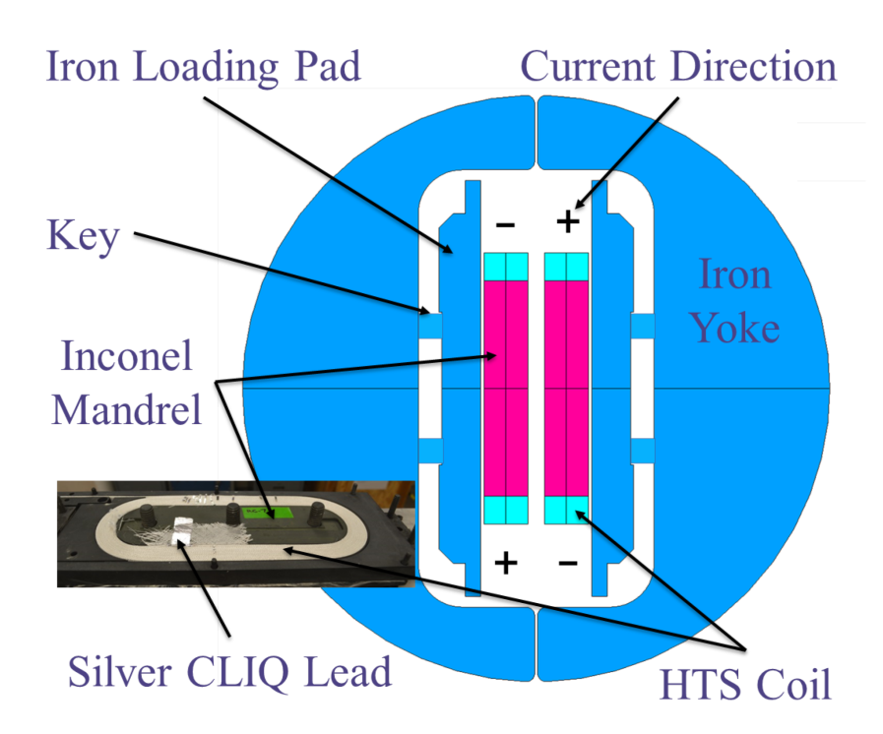
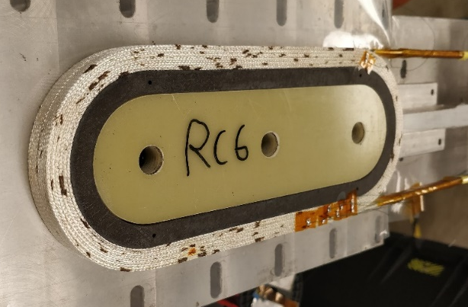
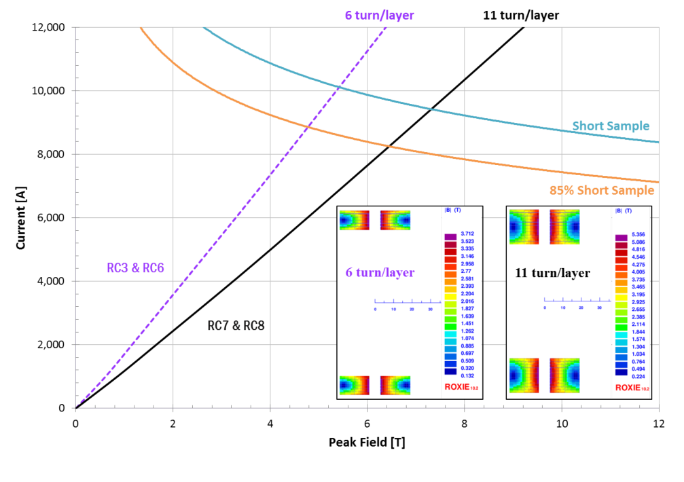
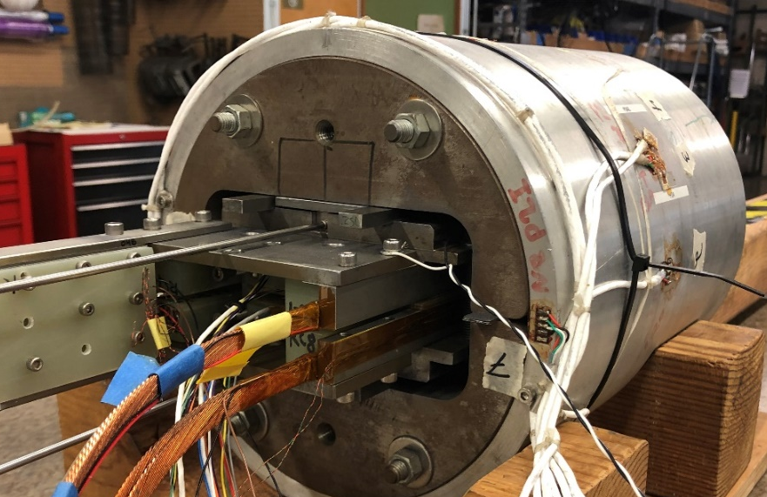
RC7+RC8 Common Coil as a Quench Test-bed
Double Pancake Windings
Silver Mid-Tap
Common Coil RC7+RC8
Key
Joint
Bladder
Strain
Gauges

Slide 19
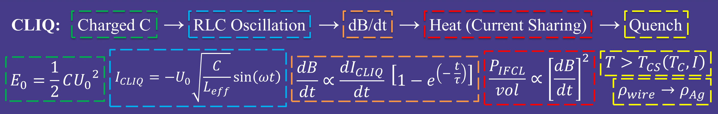
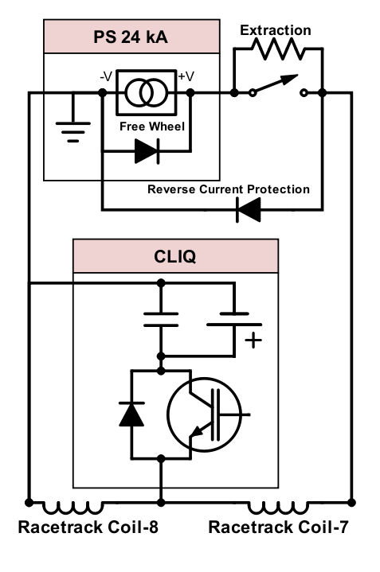
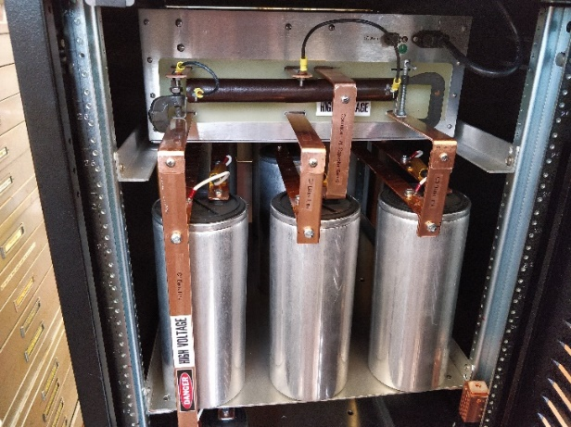
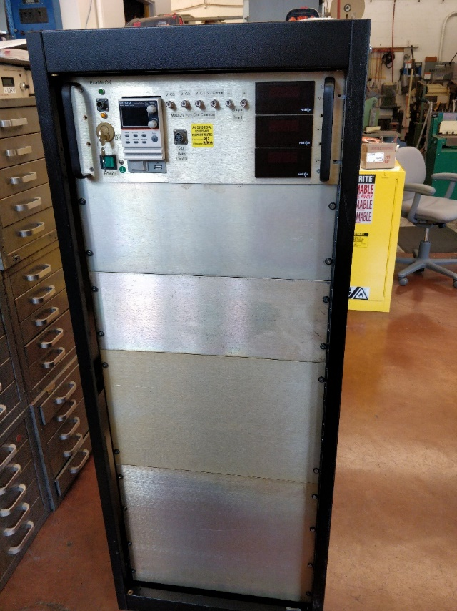
Completion of a High Current CLIQ System at LBL
Capacitor
Bank
High Current
CLIQ Unit
IGBT
IGBT control of parallel capacitor bank triggering
System completed and validated on a room temperature resistor and then RC7+RC8 in liquid nitrogen
CLIQ System Design and Assembly: Marcos Turqueti, Jordan Taylor, and Patricius (Rick) Bloemhard
CLIQ: Charged C → RLC Oscillation → dB/dt → Heat (Current Sharing) → Quench
$$I_{CLIQ}=−U_{0}\sqrt{\frac{C}{L_{eff}}}\sin\left(ωt\right)$$
$$\frac{P_{IFCL}}{vol}∝{\left[\frac{dB}{dt}\right]}^{2}$$
$$T>T_{CS}\left(T_{C},I\right)$$
$$E_{0}=\frac{1}{2}C{U_{0}}^{2}$$
$$\frac{dB}{dt}∝\frac{dI_{CLIQ}}{dt} \left[1−e^{\left(− \frac{t}{τ}\right)}\right]$$
$$ρ_{wire}→ρ_{Ag}$$
Capacitor Bank

Slide 20
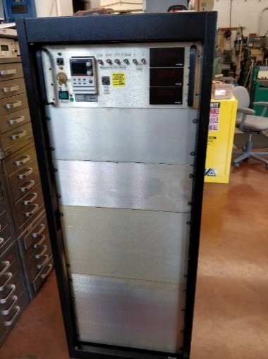
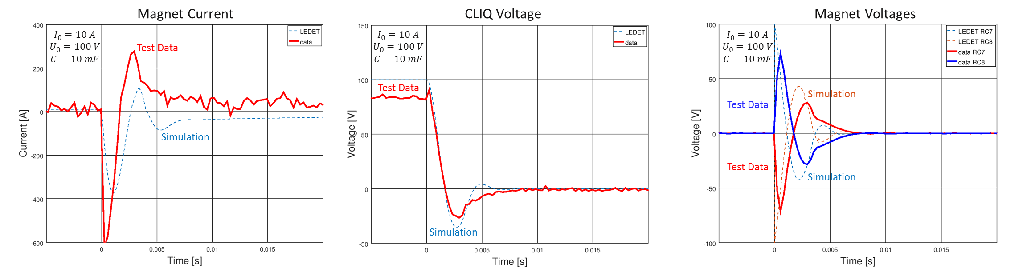
LBL-CLIQ Demonstration on RC7n8 Common Coil Dipole at 77 K
High Current
CLIQ Unit
First CLIQ testing of a Bi-2212 dipole. Ready for liquid helium quench testing.
LEDET simulation matches reasonably with measurement.
  Rapid decay due to dynamic inductance replicated
Further Testing Planned for May 2020

Slide 21
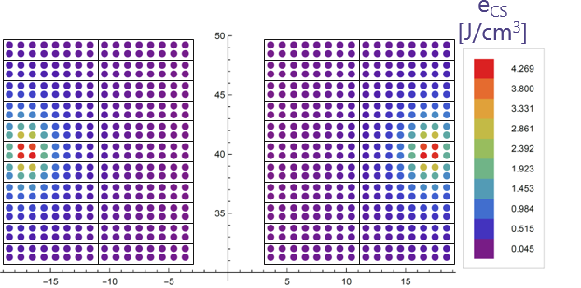
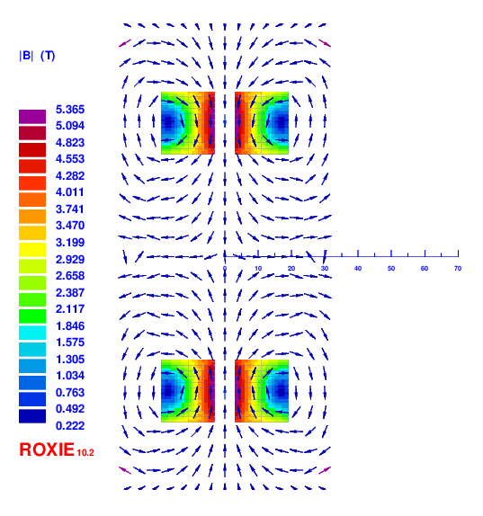
Controlling CLIQ Heat Deposition with Mid-Taps:
Coil Field and Quench Margin
RC7
RC8
Mid-Tap to Mid-Tap
Joint to Negative Terminal

Slide 22
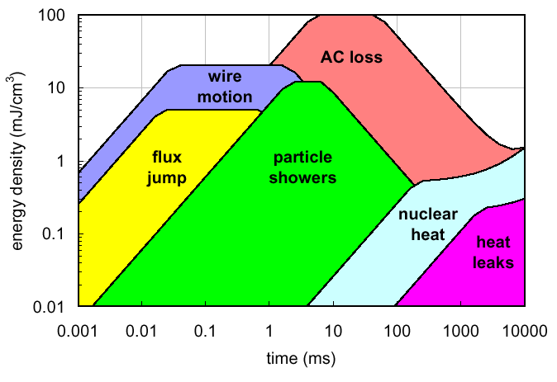
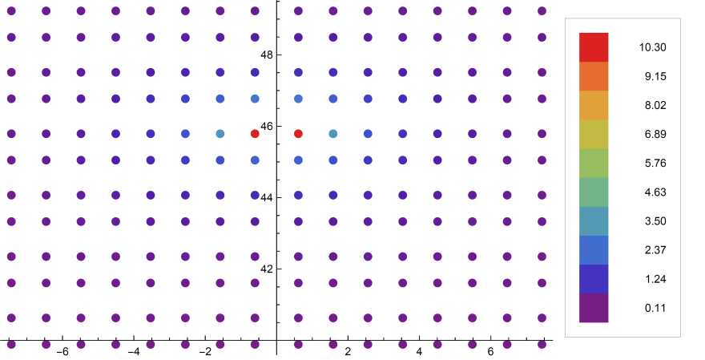
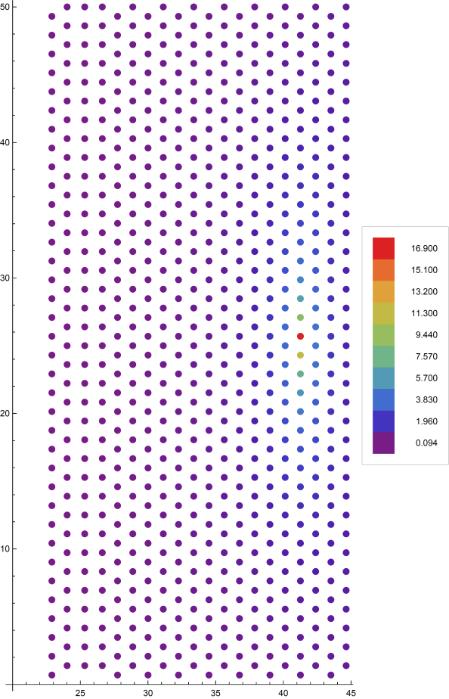
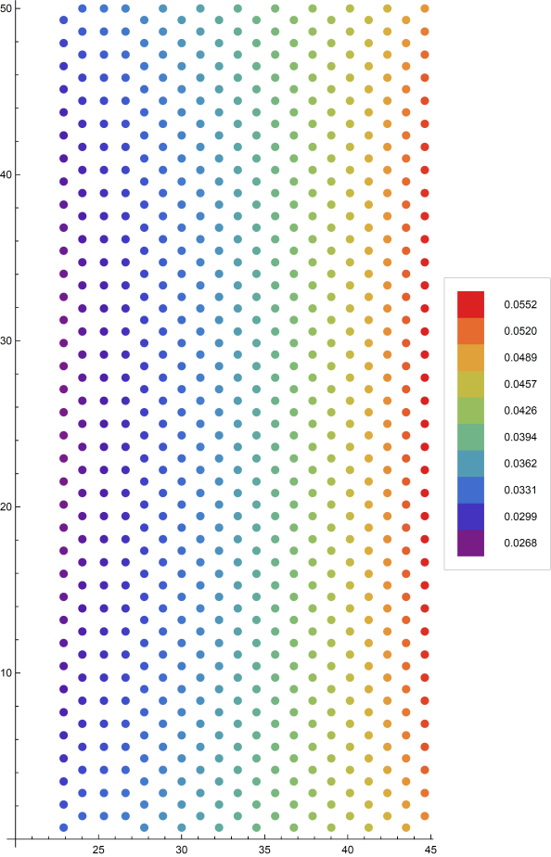
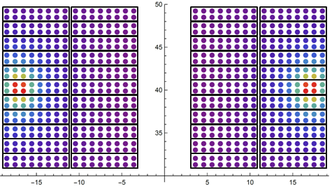
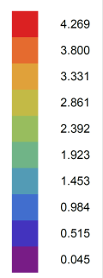
Where the margin is matters:
Quench Margin Ranges, Geometry and Field
e_{cs} [J/cm³] energy density margin to current sharing at I/Ic=0.75
Sub-scale Accelerator
e_{CS}
[J/cm³]
High Field Solenoid (Pup-4)
RC-6
e_{CS}
[J/cm³]
e_{CS}
[J/cm³]
e_{CS}
[J/cm³]
RC-7
&
RC-8
Self Field
w/ 7.829 T Background
w/ Iron Saturation
Notes:
LEDET can be used to match CLIQ deposition with margin calculation to quickly find an efficient configuration.

Slide 23
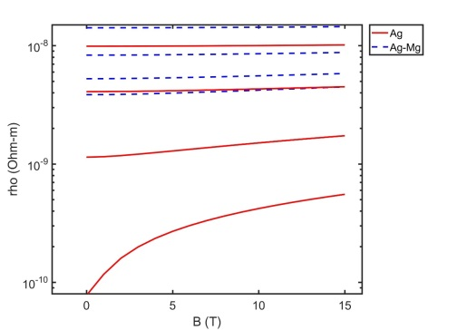
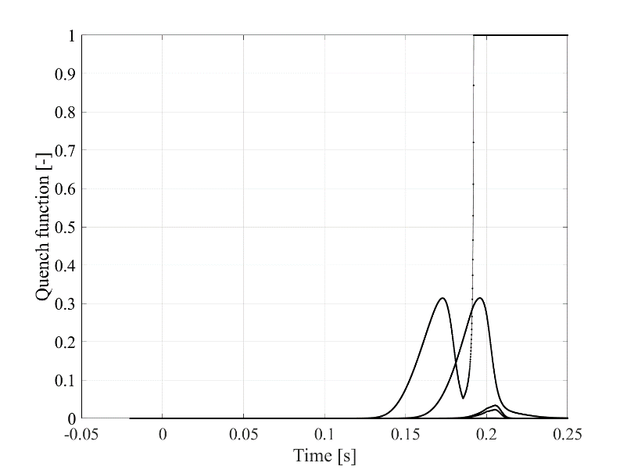
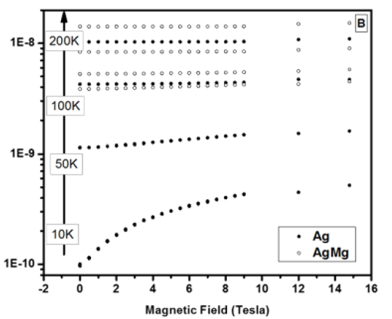
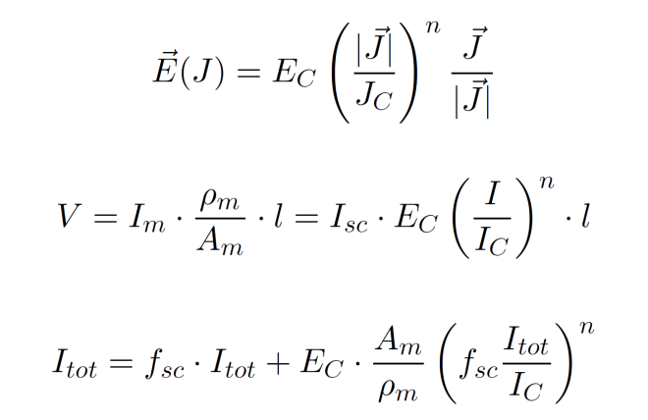
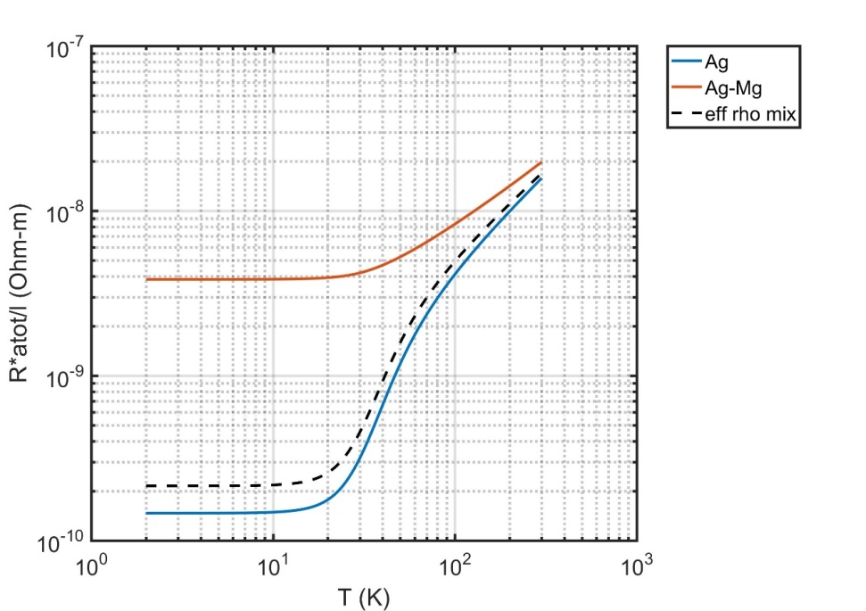
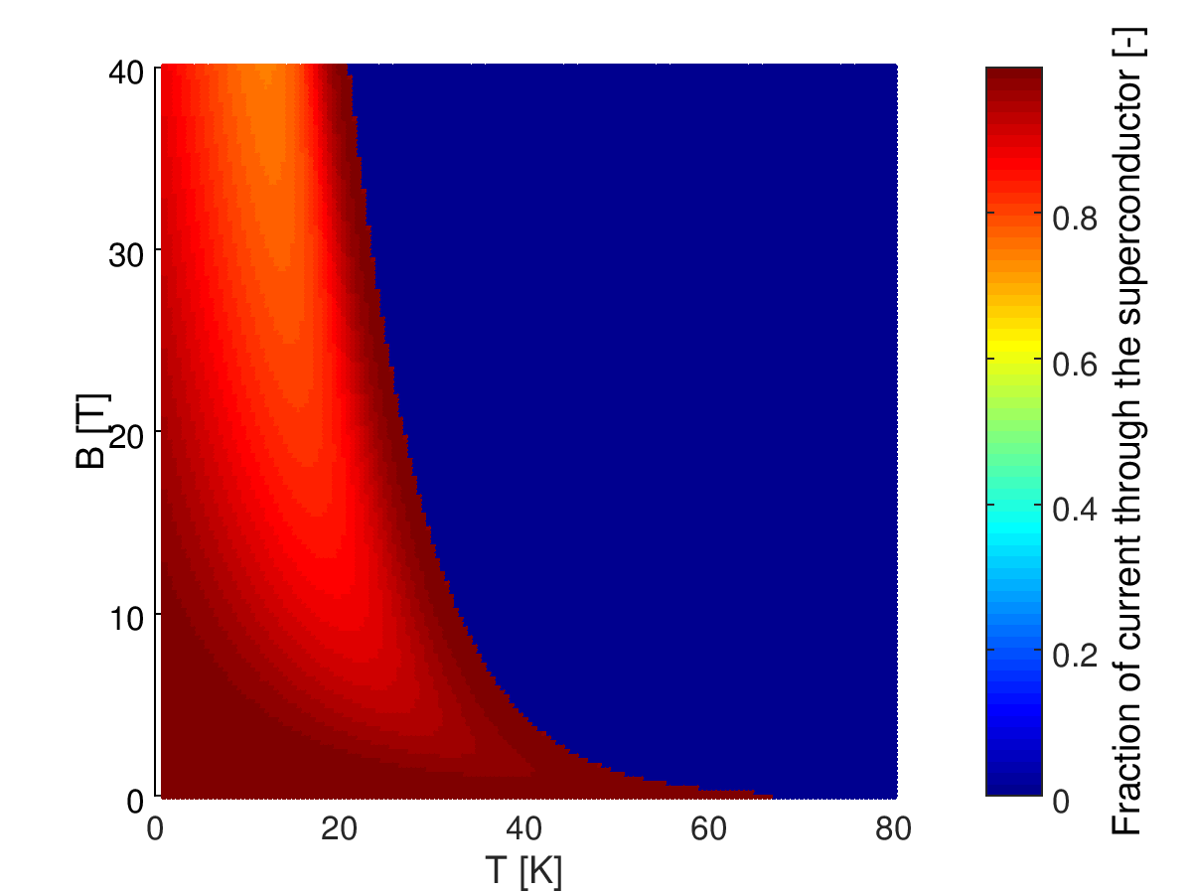
Quick to implement HTS behavior models
Show LEDET changes to smooth transition of resistance
Random Examples
Voltage balance
J = 660 A/mm²
0.8 mm wire
J_{E}(4.2K, 5T)= 511 A/mm²
W/out
With
23

Slide 24
Thank You For Your Attention!

