Slide 1
Costheta cross section (preliminary)
V. Marinozzi
07/28/2020

Slide 2
Assumptions
Goal: develop a 20 T hybrid costheta cross-section
First layout: 6 layers (4 HTS, 2 LTS)
50 mm aperture
HTS is Bi-2212 rutherford cable, with filamentery strands
LTS is Nb₃Sn
No HTS grading
Conductor parameters from existing cable

Slide 3
Conductor
Grey values are preliminary, to be reviewed
Quantity | Bi-2212 | Nb₃Sn
Strand diameter | 0.8 mm | 0.8 mm
Number of strands | 30 | 30
Cu(stabilizer)/SC | 0.8 | 1.5
Bare width | 13.76 mm | 13.3 mm
Bare height (inner) | 1.4 mm | 1.4 mm
Bare height (outer) | 1.5 mm | 1.5 mm
Insulation thickness | 0.15 mm | 0.15 mm
Jc in SC | 1741 A/mm² (20 T, 1.9 K) | 1929 A/mm² (16 T, 1.9 K)
From RC coil (17 strands)
From DCC017

Slide 4
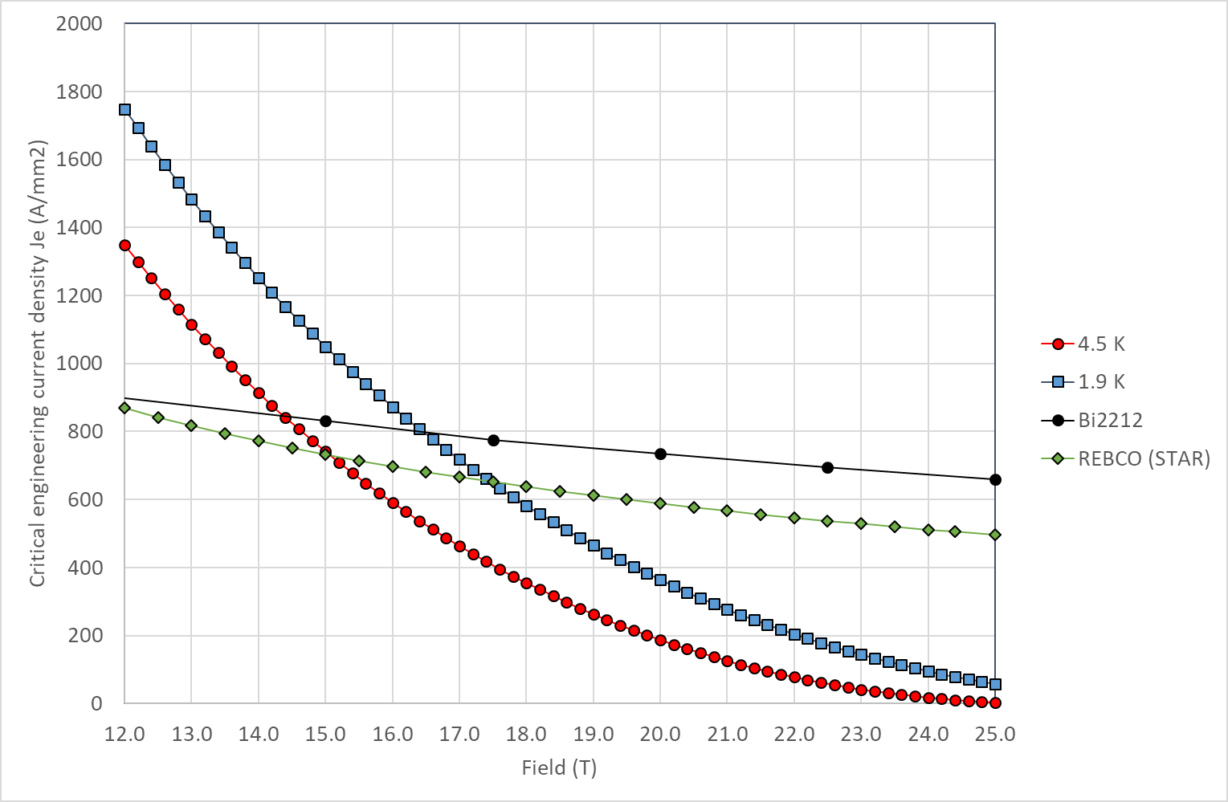
Critical current
Jc in SC obtained by scaling Jc engineering from Paolo slides

Slide 5
Cross section
Layer 1: 15 turns
Layer 2: 22 turns
Layer 3: 24 turns
Layer 4: 24 turns
Layer 5: 27 turns
Layer 6: 30 turns
Total: 142 turns
85 mm

Slide 6
Operating field and margin
Operating current | 12300 A
Operating bore field | 19.97 T
Peak field (Bi-2212) | 20.85 T
Margin on the load line (Bi-2212) | 89.14 %
Peak field (Nb₃Sn) | 13 T
Margin on the load line (Nb₃Sn) | 87 %
Nb₃Sn
Bi-2212

Slide 7
To do
Double check some HTS parameters
Perform field quality optimization
Compute forces (stress management need?)
Computation of quench protection related parameters (inductance, current in stabilizer,...)

