Slide 1
Update on Nb₃Sn CCT Subscale Magnet Program
D. Arbelaez, L. Brouwer, D. Dietderich, S. Caspi, P. Ferracin, R. Hafalia, M. Krutulis, M. Martchevskii, T. Shen, K. McCombs, M. Reynolds, J. Swanson, R. Teyber, X. Wang, S. Prestemon
US Magnet Development Program
Lawrence Berkeley National Laboratory

Slide 2
Outline
Motivation
Fabrication methods
Thin/Thick spar test fabrication progress
CTD SBIR plans and progress (T. Shen: lead at LBL)
Instrumentation plans

Slide 3
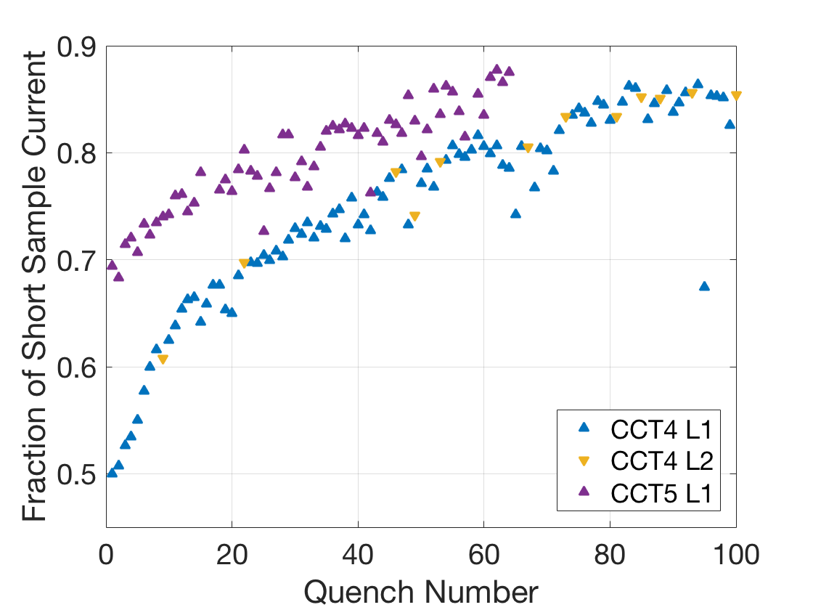
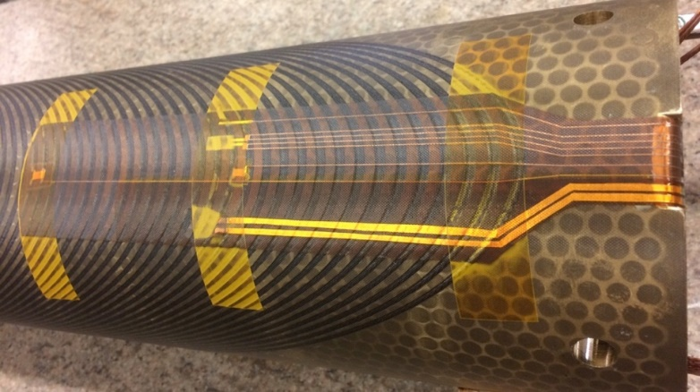
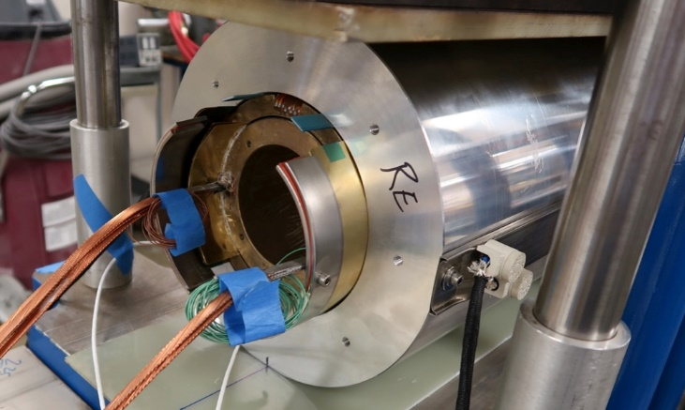
Brief Review of Previous Nb₃Sn CCT Magnets
CCT4
Coils and shell impregnated together
CTD101K epoxy
CCT5
Bend-and-Shim assembly of individually impregnated coils
Mix61 epoxy from FSU
Quench Current Relative to SSL
Training rate after “fast” segment is similar for CCT4/5
Individually Potted Coil
Bend and Shim Assembly
Initial “fast” training eliminated in CCT5

Slide 4
CCT Subscale Program Will Focus On Understanding And Reduction of Training
Significant change in layer-to-layer interface still leads to similar training after initial improvement in CCT5 → focus on cable-in-groove stress
Subscale models can lead to faster turnaround for dedicated training experiments, for example:
  Epoxy (or other impregnation materials) influence on training
  Structural influences
  Interface conditions
Subscale models are complementary to overall CCT program and will give feedback to design of future large CCT models

Slide 5
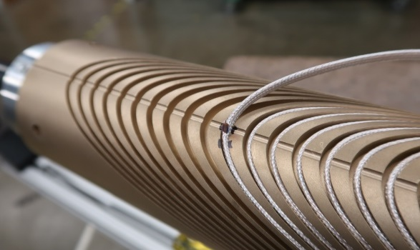
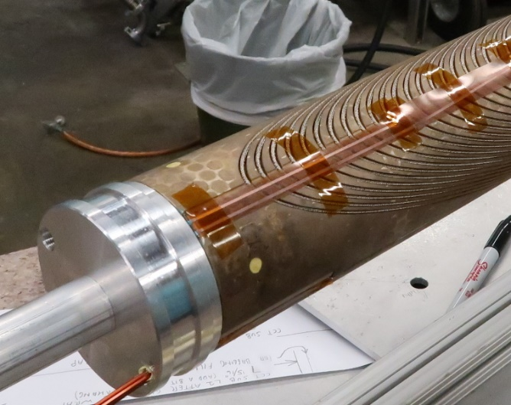
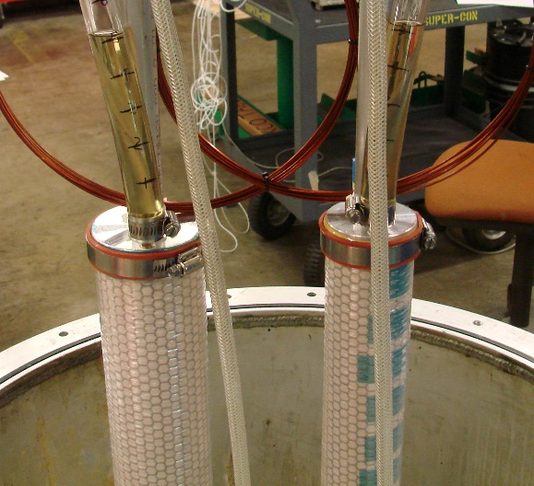
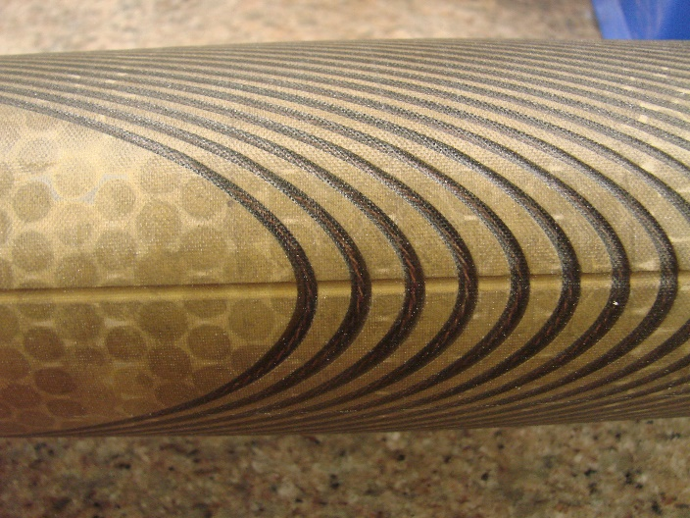
Fabrication Methods
Winding performed with light cable tension (by hand) as conductor is placed in groove
Coils are wrapped in perforated stainless steel sheet for heat treatment
Coil potting procedure is the same as for CCT5 (individual layer impregnation)
  All potting materials are consumable except for end caps
  FSU Mix 61 was used for impregnation as with CCT5
  Epoxy curing performed in an oven
Coil Winding with Vtap Flag
Potting Tooling
Potting Materials
Impregnated Coil

Slide 6
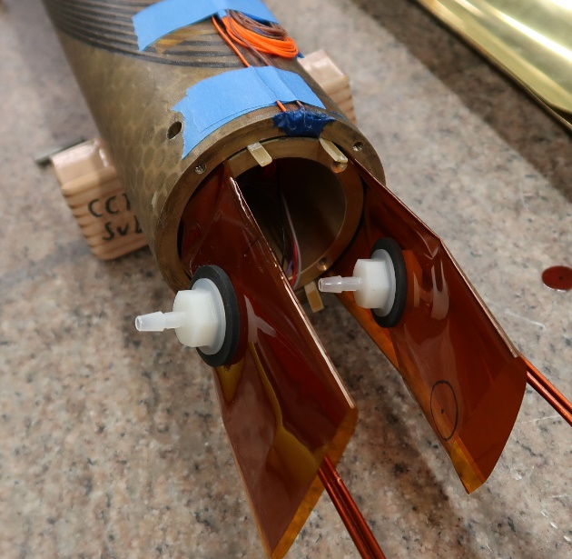
Assembly Method
Contact location between layers is controlled by using shims and Kapton bags that are filled with glass and epoxy
  Allows for control of contact location
  Fracture in interface epoxy does not propagate to the coil
  Improved cooling at the pole regions from direct contact with LHe
Directional preload to reduce energized stress can be applied by bending layers or shell, filling and curing epoxy in bent state, releasing bending pressure
Layer 1,2 Assembly
epoxy filled Kapton bag
Force Release After Cure
shell
Directional
Pre-Load on Coils
layer 1
layer 2
Applied Force

Slide 7
First Subscale Tests will Focus on Understanding effect of cable and cable/groove interface stress on training
Can use geometry of CCT coils to modify the stress in the cable and cable/groove interface
Shear stress can be reduced by reducing spar thickness but normal stress will increase (accumulation of azimuthal force towards midplane + bending of layers)
First set of tests will be of inner layers with thin and thick spars
  Thin spar → reduced interface shear stress and increased normal stress due to bending
  Thick spar → increased interface shear stress and reduced normal stress due to bending
Work is under way for tests that will be performed after initial thin / thick spar tests
  SBIR with CTD (T. Shen) to test different impregnation materials (coil fabrication is in progress)
  Non-impregnated CCT

Slide 8
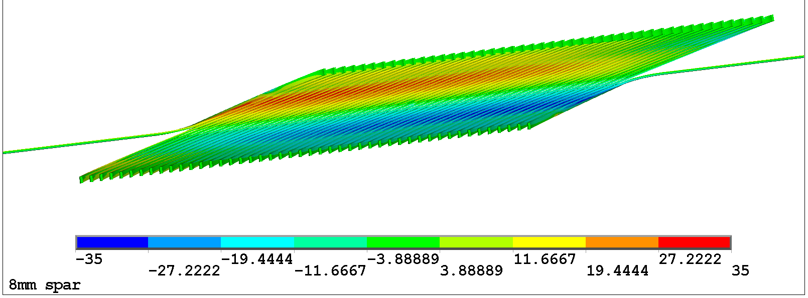
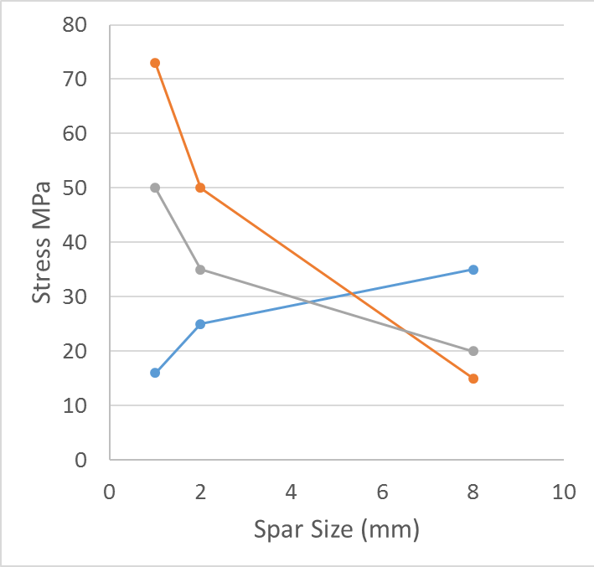
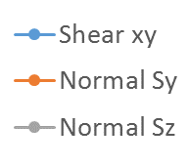
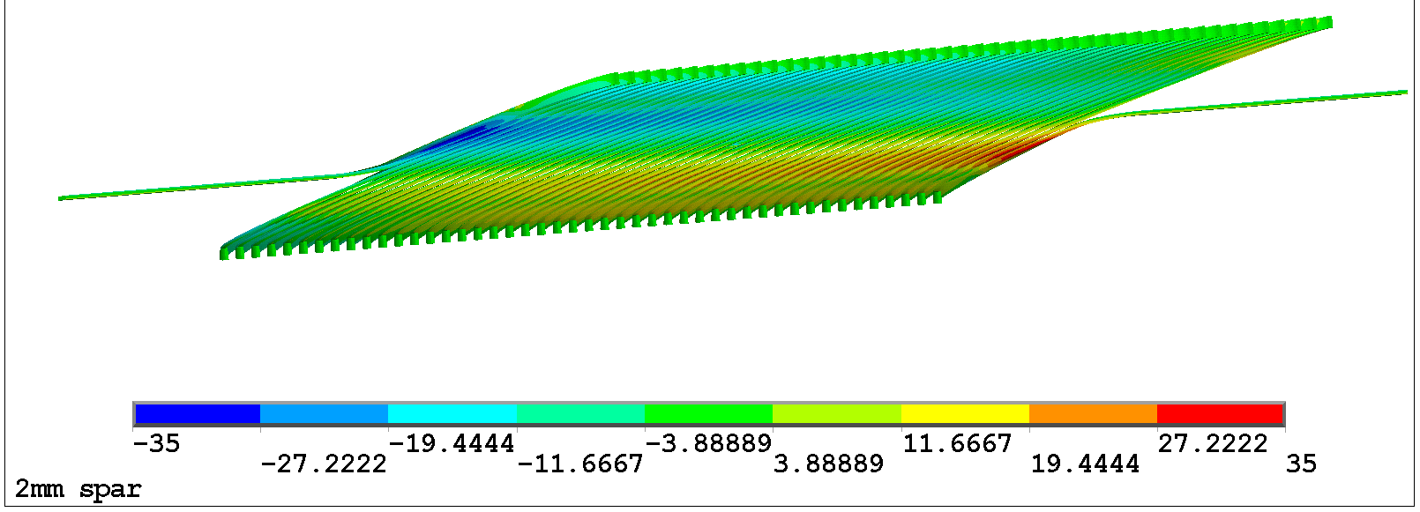
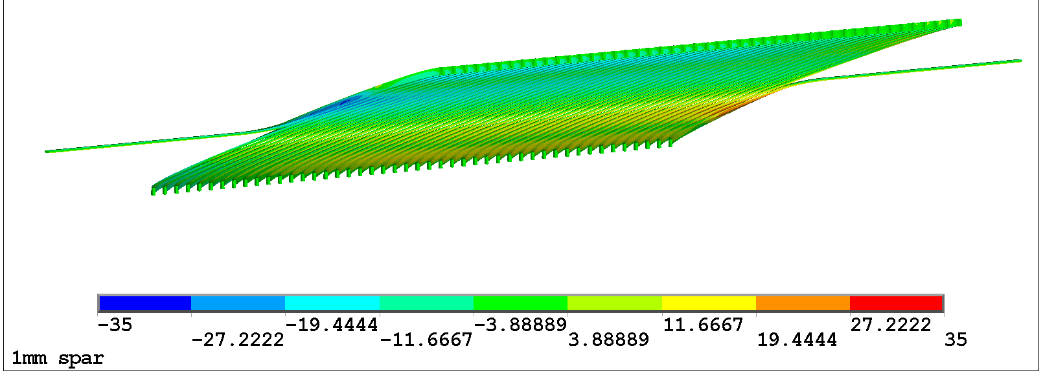
Test of Coils with Thin and Thick Spars Will Have Significantly Different Stress State
Sxy (radial-azimuthal)
Thin spars
Low shear
High normal
Thick spars
High shear
Low normal
8 mm spar
-35 MPa
35 MPa
2 mm spar
-35 MPa
35 MPa
Thin spar test
1 mm spar
Thick spar test
-35 MPa
35 MPa

Slide 9
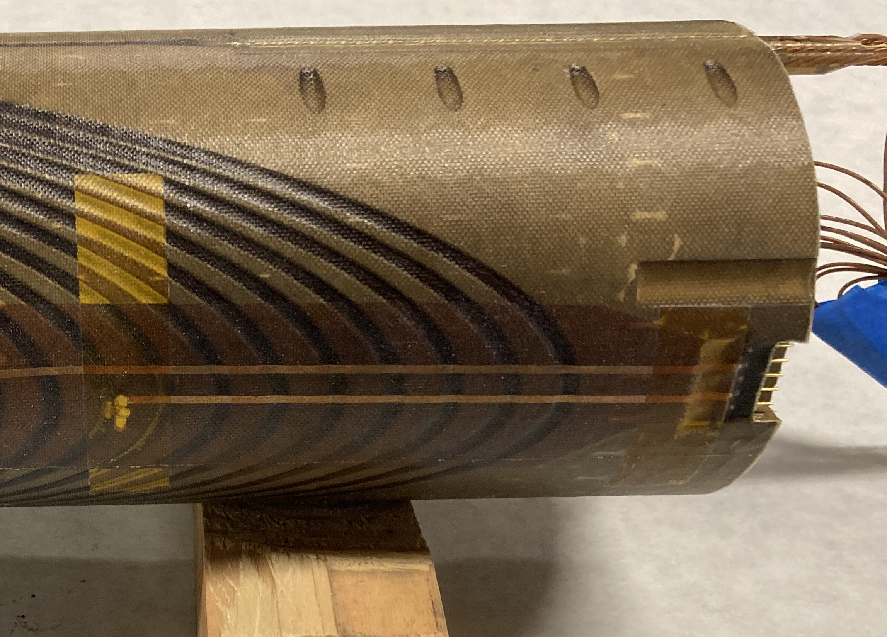
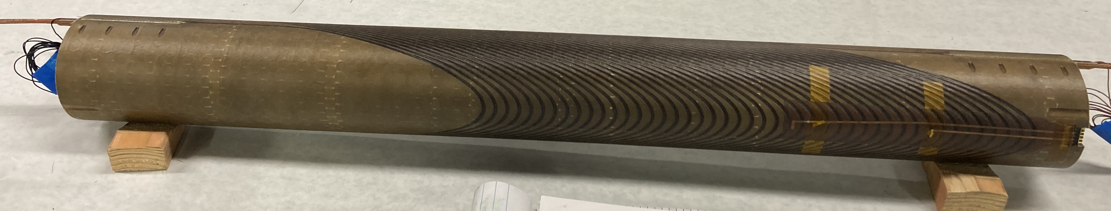
Current Status of Thin/Thick Spar Magnet Fabrication
Mandrel design was updated to improve coil fabrication process
  Clamping features for splices
  Instrumentation ports to reduce test preparation time
1 Outer layer coil is ready
Both thin and thick spar coils have been heat treated and will be impregnated over the next few weeks
Plan to test thin spar coil in October after PSI CCT test

Slide 10
Subscale Nb₃Sn CCT as a R&D vehicle for testing new resins for industry
Description | Description | T_{g} (tan δ)
CTD-101K | Baseline anhydride-cured epoxy resin used in HEP magnets | 150 (avg QA)
CTD-103K2 | Long pot life 2-part formulation with performance similar to CTD-101K | 141
CTD-103LT | Lightly toughened version of CTD-103K2 | 126
CTD-155 | Anhydride-cured epoxy resin with reactive rubber toughener | 147
CTD-7.1E (tank formulation) | Low viscosity, toughened amine-cured epoxy resin | 72
CTD-701X | Extremely low viscosity, tough polyolefin resin system | 131
US DOE SBIR phase II award
Three subscale CCT magnets to be made
The 1st magnet, based on 701x, is being wound.
  A new (non-epoxy) resin with characteristics that seem promising for superconducting magnets – low viscosity, >8 h pot life, sufficient dielectric strength. Potentially radiation hard.
Resin for the 2nd magnet likely will be CTD-155 with 20.vol.% Al₂O₃.
  High thermal conductivity.
  Better CTE match with Cu/Nb₃Sn conductors. Better stress management for epoxy.

Slide 11
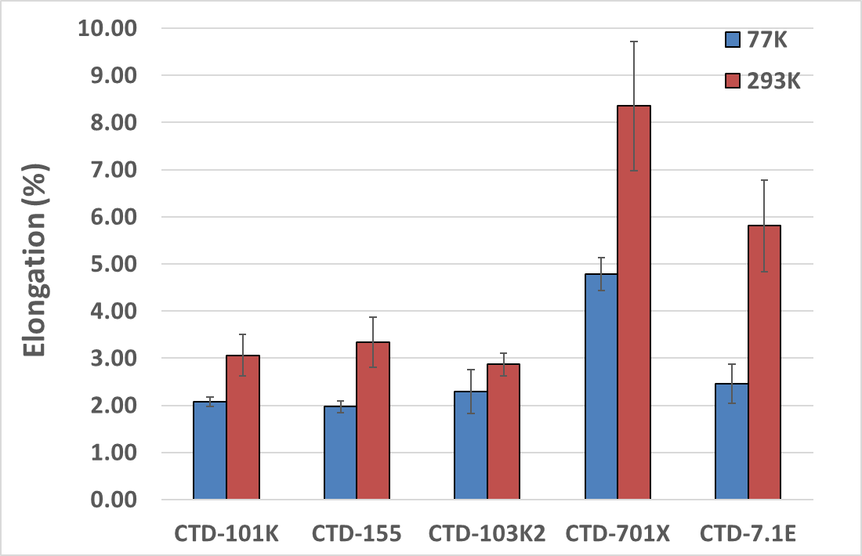
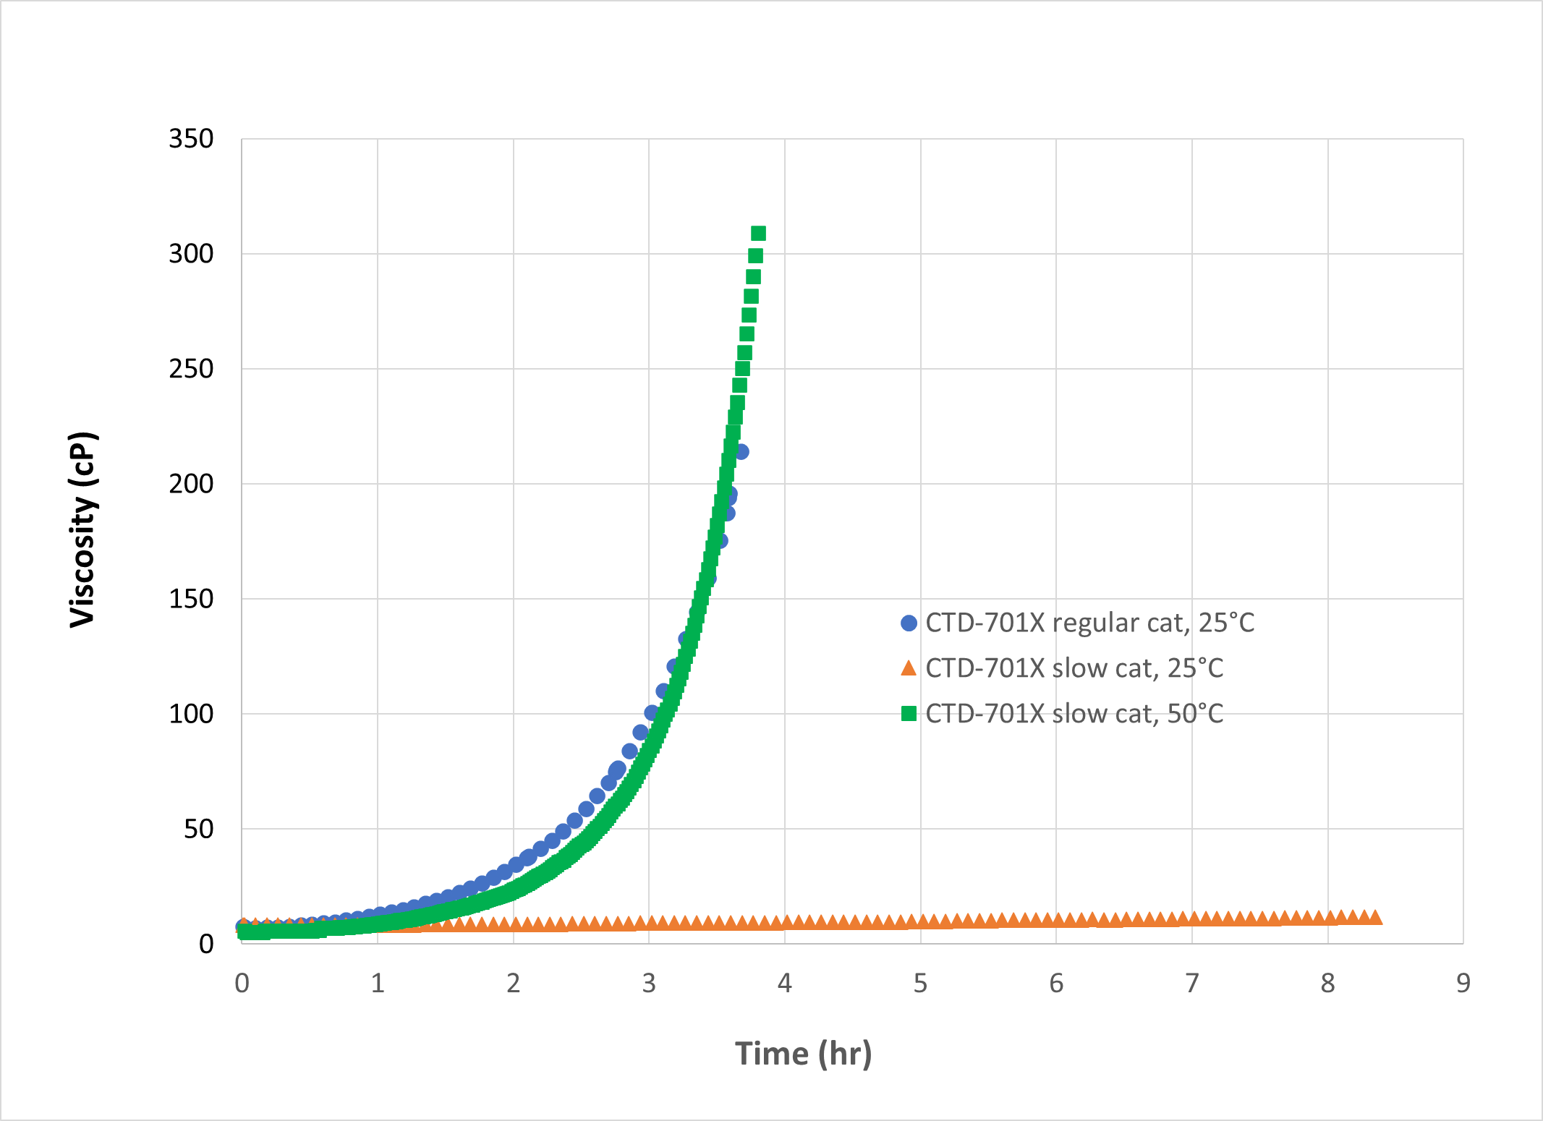
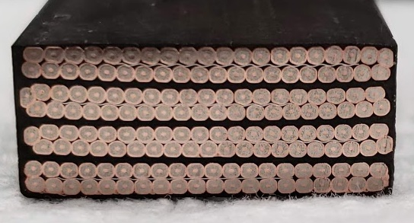
701x - low viscosity and high toughness
CTD-101K did OK. Large cracks first cycle, mostly held together
CTD-155 performed similarly to 101K
CTD-701 is excellent and only one crack was observed
Passed cable stack impregantion test
(S. Krave, Fermilab)

Slide 12
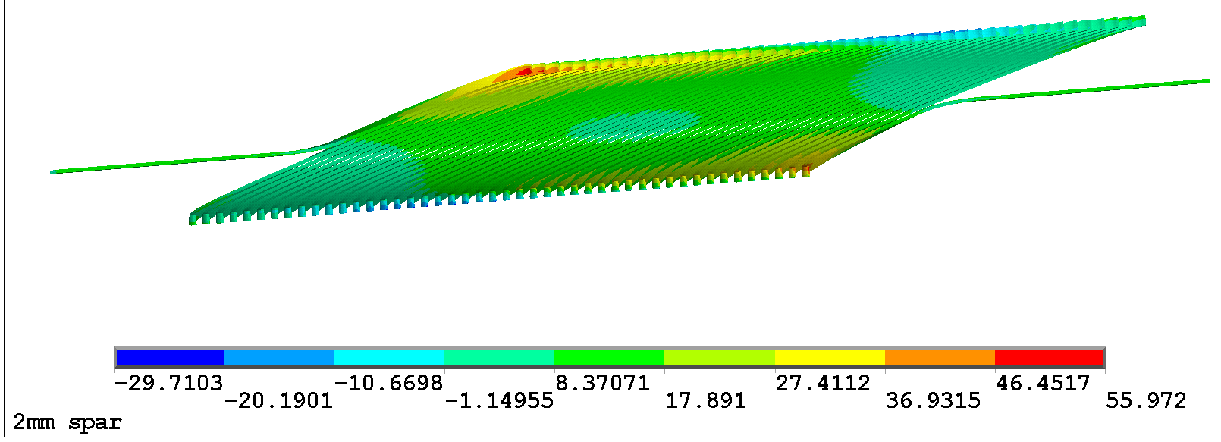
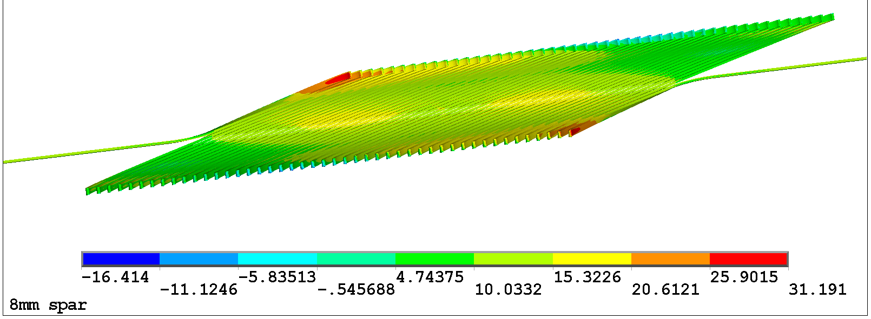
Coil instrumentation is Designed to Give Feedback on Causes of training
Focus instrumentation based on areas that are suspected to cause training from mechanical analysis
  Early training could come from areas near first coil turn
  Azimuthal location is most indicative of type of stress state
σ_{rθ}
σ_{zz}
2 mm spar
2 mm spar
σ_{rθ}
σ_{zz}
8 mm spar
8 mm spar

Slide 13
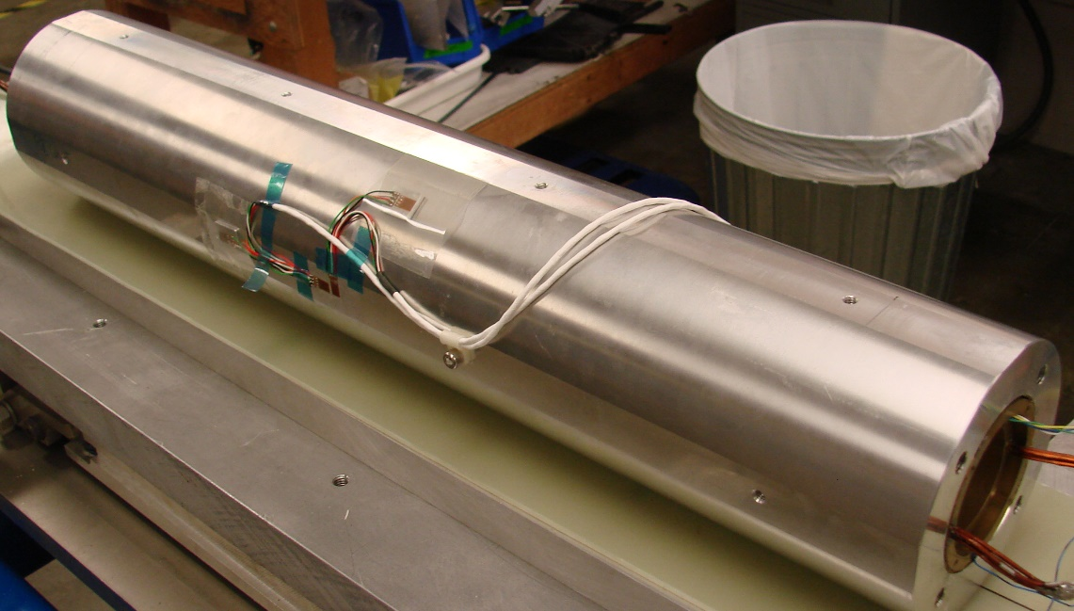
Coil Instrumentation
Voltage taps on both layers
  10 internal taps on inner layer + first turn taps for CTD tests
  4 internal taps on outer layer
Strain gages on shell (two stations for “global” strain measurement)
Acoustic sensors in the bore
Quench antennas (in collaboration with FNAL)
Strain Gages on Shell

Slide 14
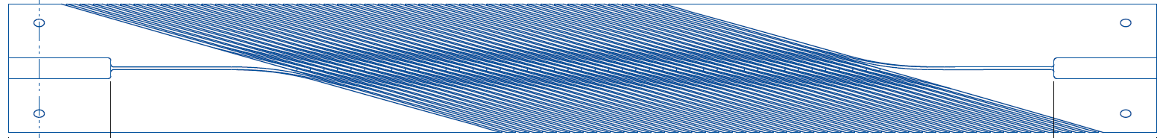

CCT subscale voltage tap arrangement (Baseline Layout)
A12 - lead
A6
A5
A4
A3
A2
A1
IL
Lead on back side
A11
A10
A9
A8
A7
19.75
14.75
9.75
4.75
0.75
Lead on back side
A6
A5
A4
A3
A2
46
0
A12
C1
A1
A11
A10
A9
A8
A7
45.25
41.25
36.25
31.25
26.25
B2
B3
N
OL
B6
B1 +lead
S
8.75
17.75
B4
B5
Tap
turn #
B2
B3
turn #
0
45
B1
B4
B5
B6
27.25
36.25

Slide 15
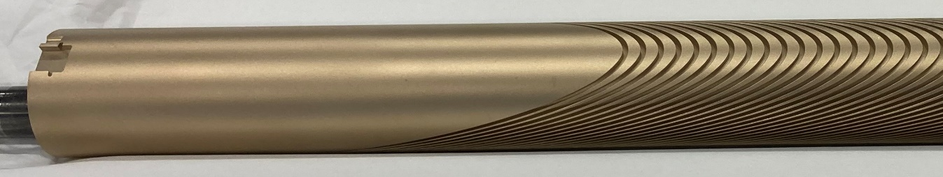
Additional Voltage Taps for CTD SBIR Tests
Additional voltage taps will be added for CTD SBIR tests to probe training (likely location for early training) on the first turn of the inner layer
  High axial stress at the pole
  High shear stress at area between midplane and pole
Lead comes in here
-15-degree
C1
Lorentz force on cable
C3
C2
+15-degree
C4
+60 - degree
+120 - degree

Slide 16
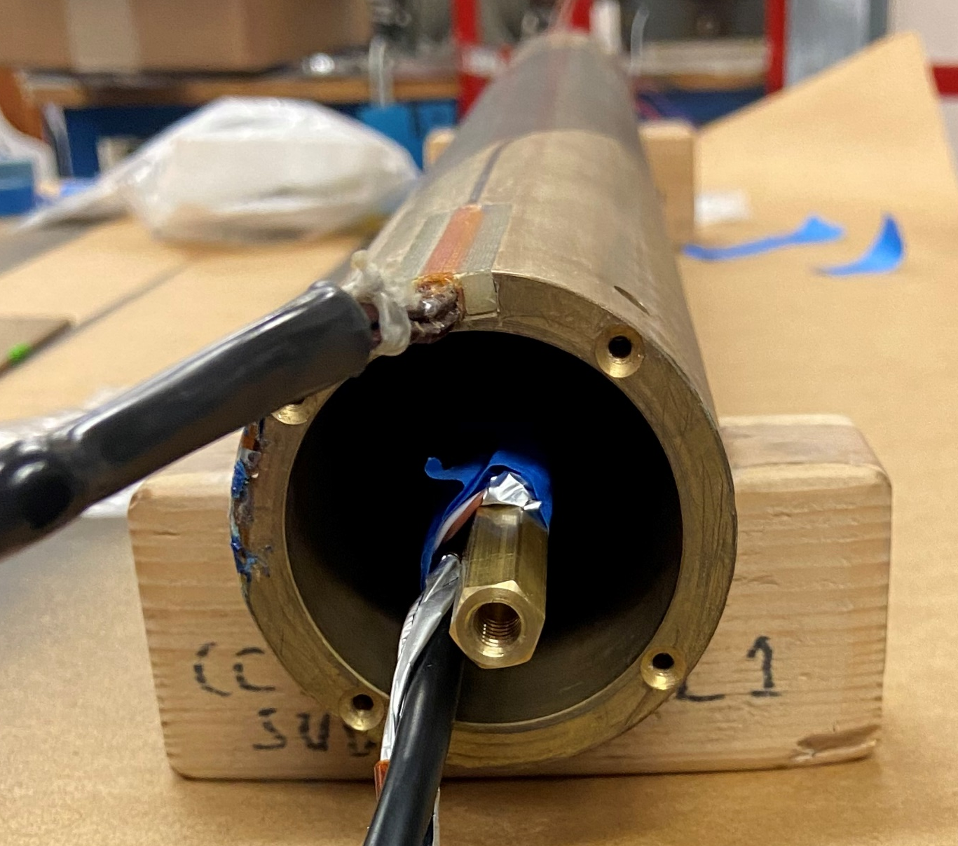
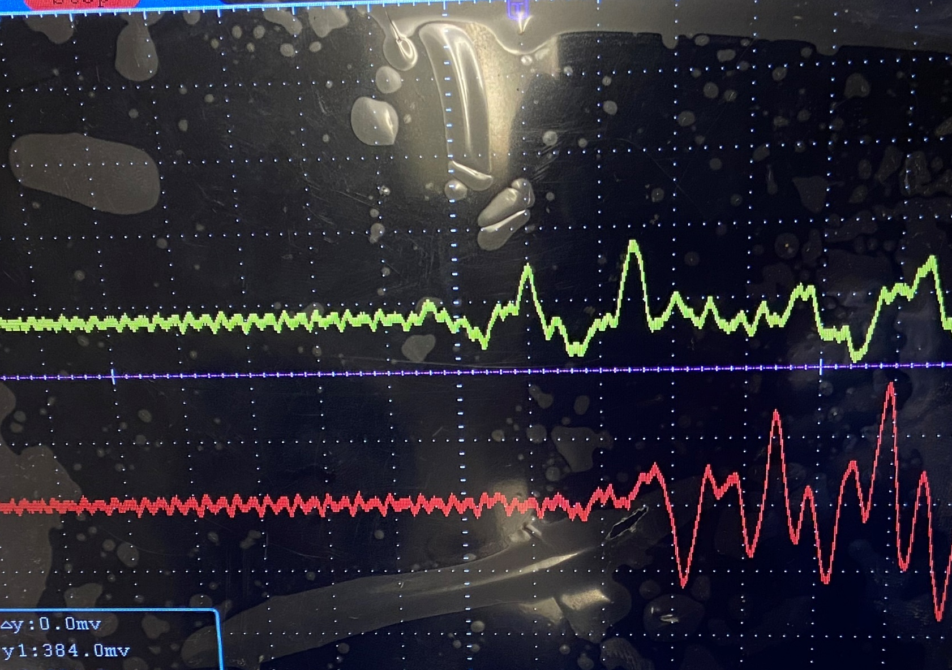
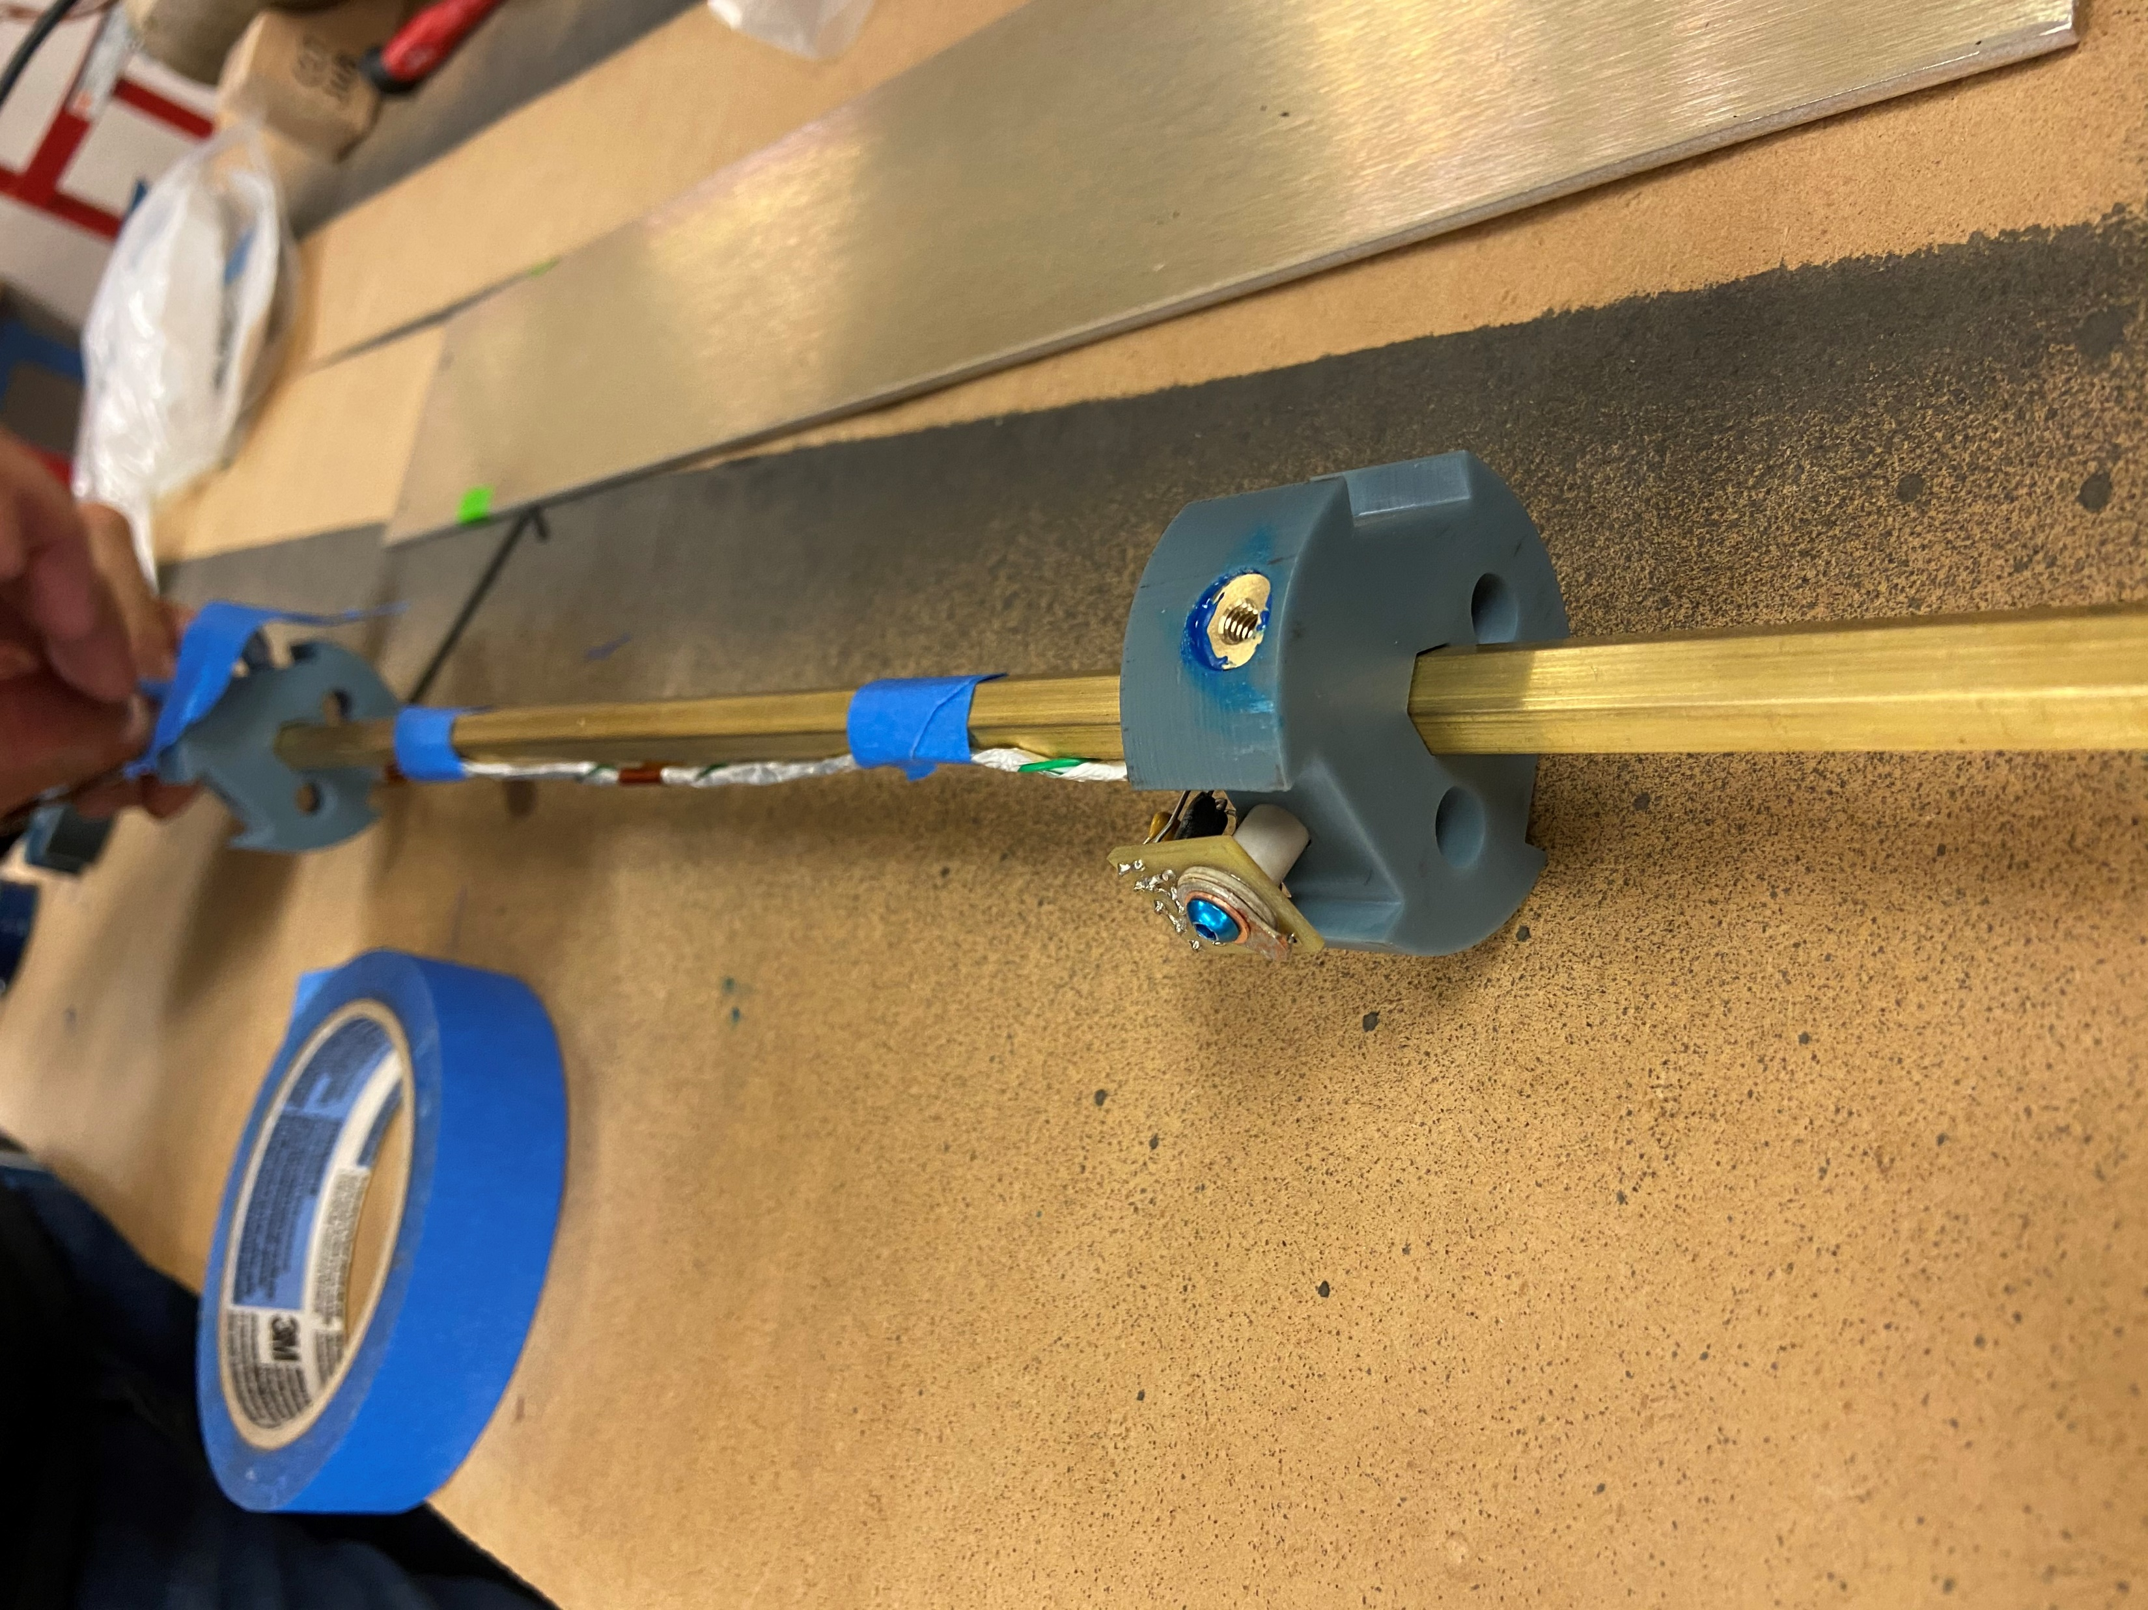
Acoustic emission sensors
Acoustic emissions measurements
  Quench localization
  Analysis of emissions
First subscale test (presented in February MDP gathering)
  3D printed Bluestone “pucks” mounted to brass shaft (modular)
  Spring loaded Acoustic sensors in bore
Issue: central brass bar mechanically coupled sensors
  Spectrograms dominated by single frequency!
Time of flight
Acoustic sensor
Left sensor
Right sensor
Right sensor
Left sensor

Slide 17
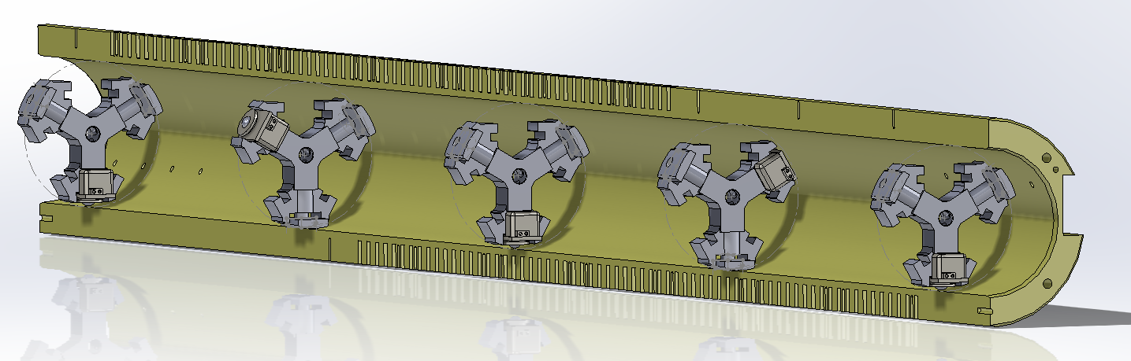
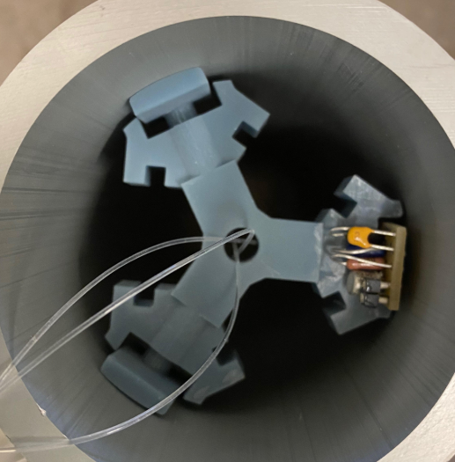
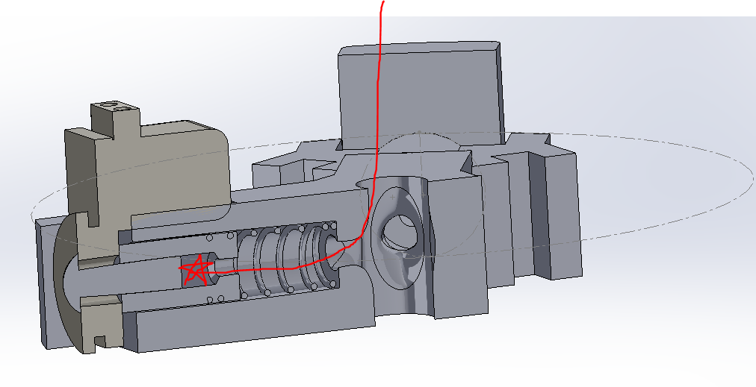
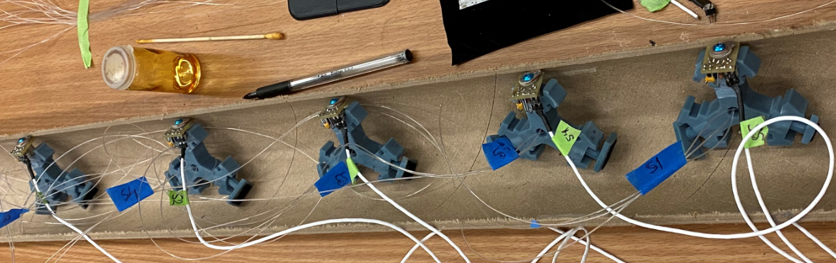
Acoustic emission sensors (PSI)
Mounting foot
Spring-loaded Acoustic sensor
Puck / Disc
Retraction cable
Spring-loaded sensors

Slide 18
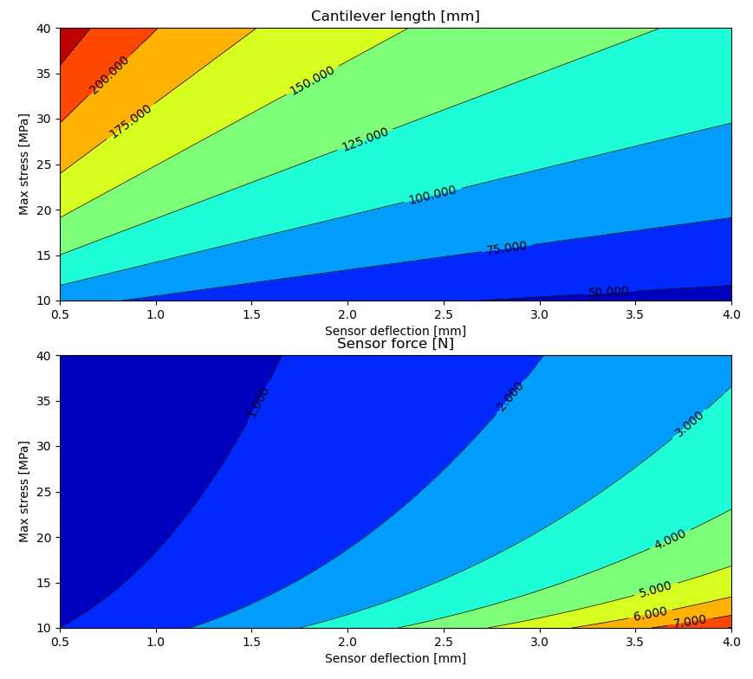
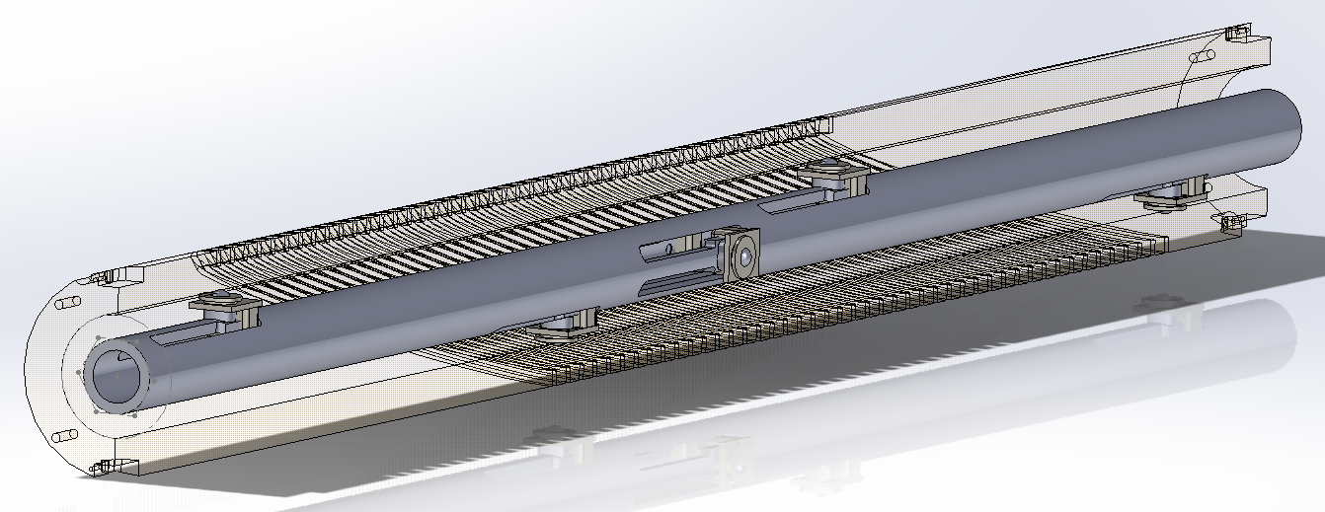
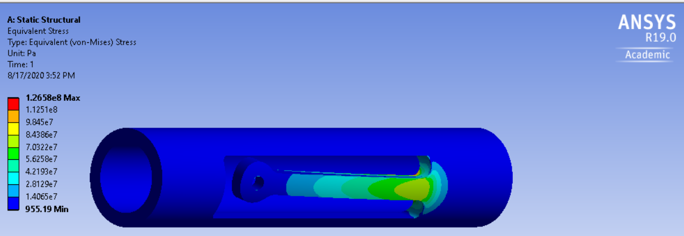
Acoustic emission sensors
For subscale tests
  prefer single setup for all tests
Cantilevered design
  Space efficient, fine-tune mounting force
PEEK washer height varies between tests
Acoustic sensors
G10 Cantilevered tab

Slide 19
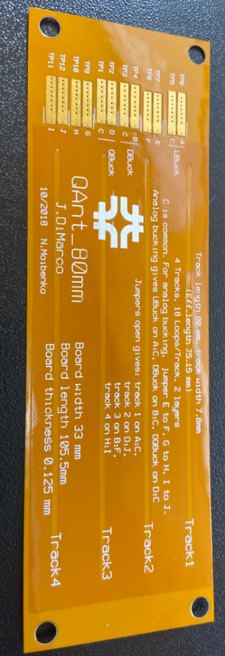
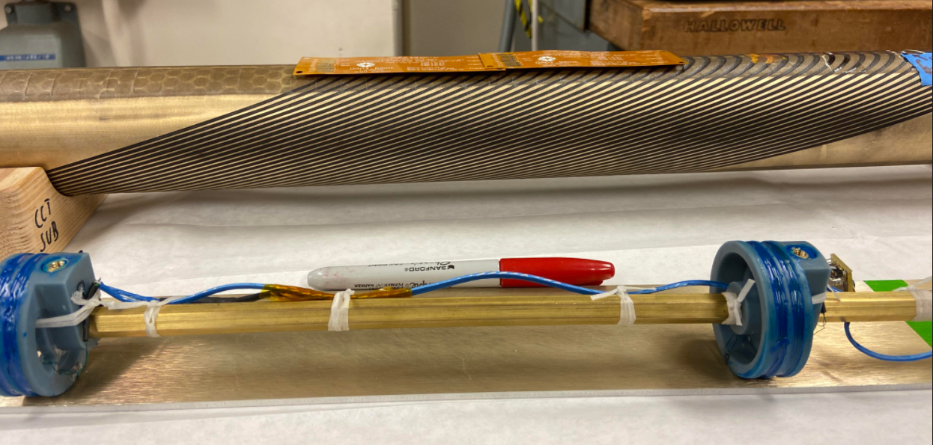
Quench antennas
Thanks FNL - Stoyan + Joe for antennas
Objective here – can we see a signal?
  Resistive heater in cable groove near pole
  QA adjacent to heater, between layers
  Dipole bucked for first test?
If measurable signal, more elaborate implementation in future tests

Slide 20
Conclusions
Fabrication of coils for Thin / Thick spar tests are in progress
  First test is expected in mid October
Coil fabrication has started for SBIR tests
  Winding is starting on first inner layer coils (two more mandrels are being fabricated now in LBL main machine shop)
Initial Instrumentation plan has been developed

