Slide 1
Costheta cross section – v2
(preliminary)
V. Marinozzi
08/25/2020

Slide 2
Assumptions
Goal: develop a 20 T hybrid costheta cross-section
First layout: 6 layers (4 HTS, 2 LTS)
50 mm aperture
HTS is Bi-2212 rutherford cable, with filamentery strands
LTS is Nb₃Sn
No HTS grading
Conductor parameters from existing cable

Slide 3
Conductor
Grey values are preliminary, to be reviewed
Quantity | Bi-2212 | Nb₃Sn
Strand diameter | 0.8 mm | 0.8 mm
Number of strands | 30 | 30
Cu(stabilizer)/SC | 3 | 1
Bare width | 13.76 mm | 13.3 mm
Bare height (inner) | 1.4 mm | 1.4 mm
Bare height (outer) | 1.5 mm | 1.5 mm
Insulation thickness | 0.15 mm | 0.15 mm
Jc in SC | 3870 A/mm² (20 T, 1.9 K) | 1929 A/mm² (16 T, 1.9 K)
From RC coil (17 strands)
From DCC017

Slide 4
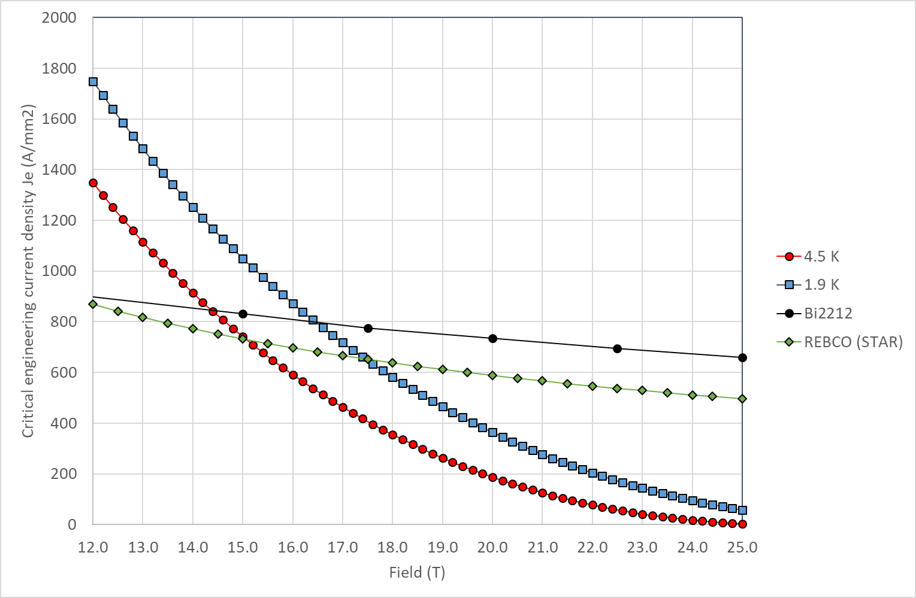
Critical current
Jc in SC obtained by scaling Jc engineering from Paolo slides

Slide 5
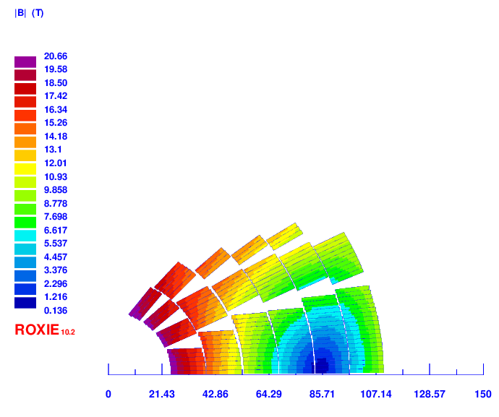
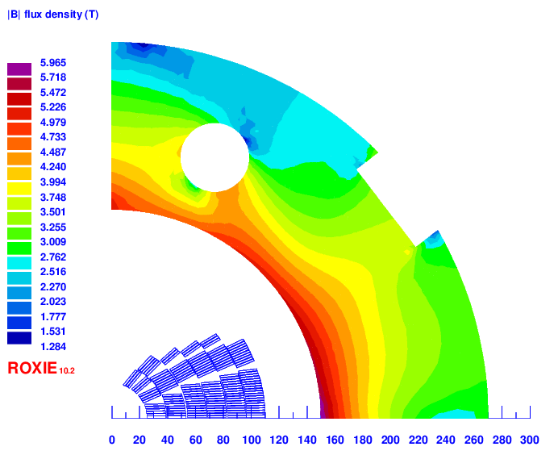
Cross section
Layer 1: 16 turns
Layer 2: 23 turns
Layer 3: 24 turns
Layer 4: 27 turns
Layer 5: 30 turns
Layer 6: 30 turns
Total: 150 turns
Total conductor area (bare):
Bi2212: 1784 mm²
Nb₃Sn: 1150 mm²
Total conductor area (insulated):
Bi2212: 2202 mm²
Nb₃Sn: 1420 mm²
85 mm

Slide 6
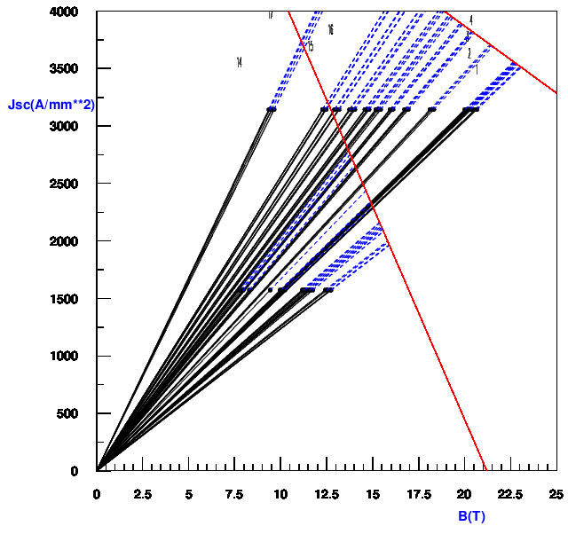
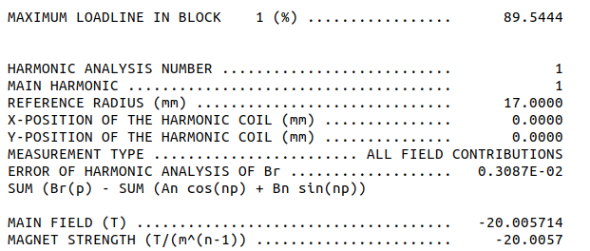
Operating field and margin
Bi-2212
Operating current | 11850 A
Operating bore field | 20 T
Peak field (Bi-2212) | 20.66 T
Margin on the load line (Bi-2212) | 89.54 %
Peak field (Nb₃Sn) | 12.7 T
Margin on the load line (Nb₃Sn) | 80 %
Nb₃Sn

Slide 7
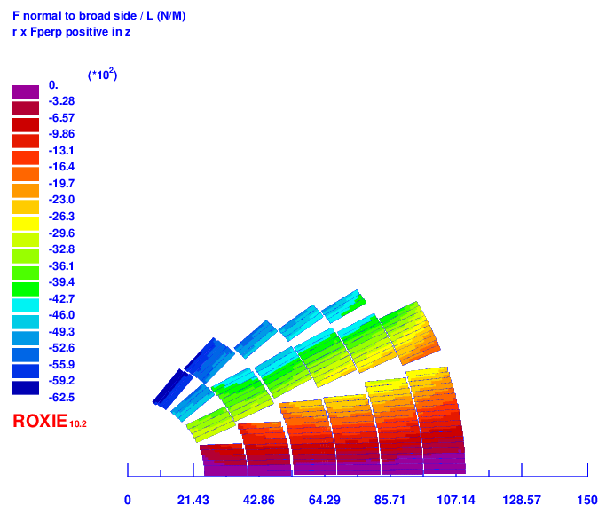
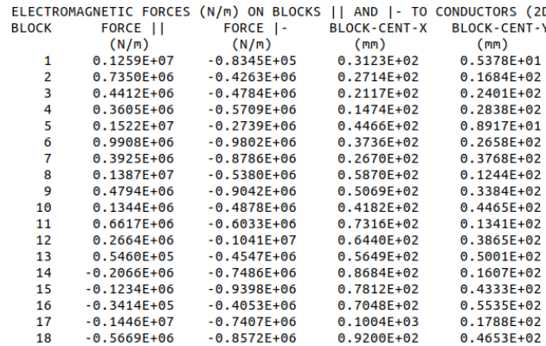
Perpendicular forces (blocks)
Block | Perpendicular pressure [MPa]
4 | 40.59096612
7 | 62.46842325
10 | 34.6825596
13 | 32.32915098
16 | 29.80147059
18 | 63.02941176

Slide 8
Perpendicular forces (layer)
Layer | Perpendicular pressure [MPa]
1 | 110.8484
2 | 151.6349
3 | 137.2229
4 | 149.2388
5 | 153.9485
6 | 117.4926

Slide 9
To do
Increase margin (add 2/4 strands in Bi2212?)
Perform field quality optimization
Improve force computation
Computation of quench protection related parameters (inductance, current in stabilizer,...)

Slide 10
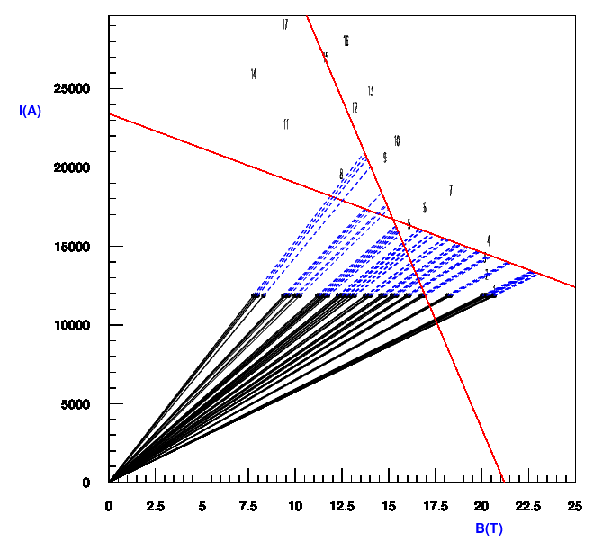
Backup
Bi-2212
Nb₃Sn

