Slide 1
MDP General Meeting
20 T hybrid magnet and comparative analysis
P. Ferracin, G. Ambrosio, E. Barzi, L. Cooley, R. Gupta, V. Kashikhin, V. Marinozzi, I. Novitski, B. Yahia, A. Zlobin
US Magnet Development Program

Slide 2
Outline
Goals of the working group
Model and assumptions
Estimates of radiuses, dimensions, and stresses
  Bi2212 and REBCO cases
Preliminary cos-theta and common coil cross-sections
Appendix
  Design criteria for a 20 T hybrid magnet
  Details of REBCO case

Slide 3
Outline
Goals of the working group
Model and assumptions
Estimates of radiuses, dimensions, and stresses
  Bi2212 and REBCO cases
Preliminary cos-theta and common coil cross-sections
Appendix
  Design criteria for a 20 T hybrid magnet
  Details of REBCO case

Slide 4
1st goal of the working group
Conceptual design of a 20 T hybrid HTS-LTS magnet
  Comparative analysis of different design options for a 20 T hybrid
    Cosϑ design and its stress-management options
      “Traditional” Cosϑ
      Canted Cosϑ (CCT)
      Stress management Cosϑ (SMCT)
    Block-type coil design (block with flared ends)
    Common-coil design (block with racetrack coil)
  Definition of general design criteria: aperture, field, margin…..
  Analysis of challenges specifically of hybrid magnets
    Integration of LTS/HTS, mechanics, protection, powering, diagnostics, test facility…..

Slide 5
2nd goal of the working group
Review and follow-up of current work on hybrid magnets
This current work can be divided based on the field level
  9-10 T
  11-12 T
  13-14 T
  Beyond 15 T
The goal is to collect and organize information from these programs (responsibility of area I and area II) to provide inputs for 20 T hybrid design

Slide 6
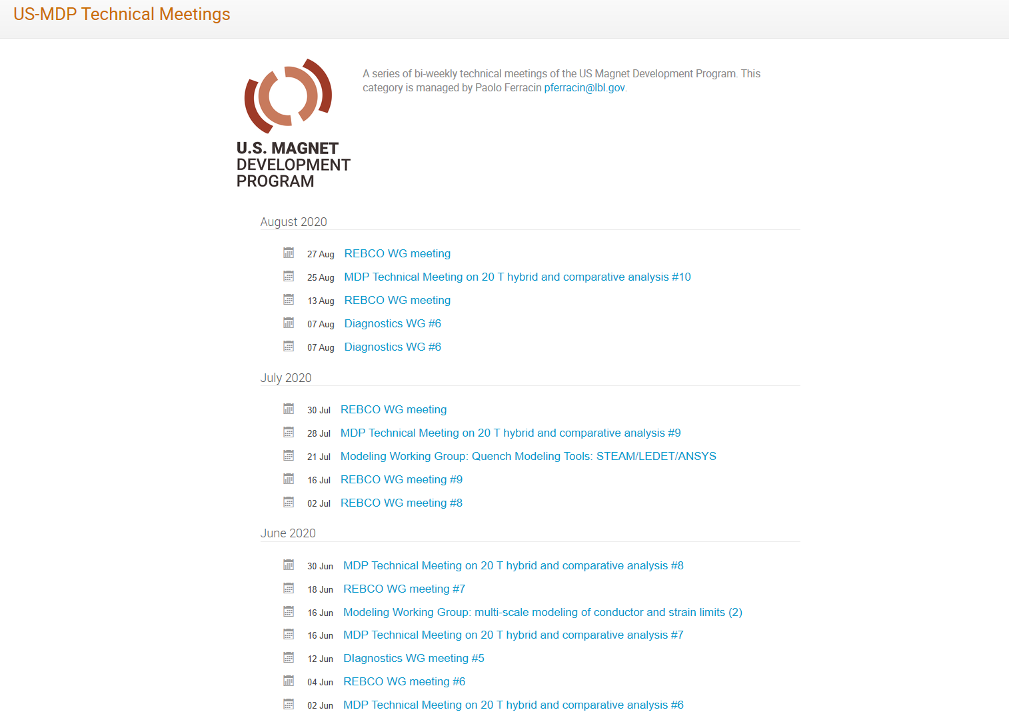
Meetings

Slide 7
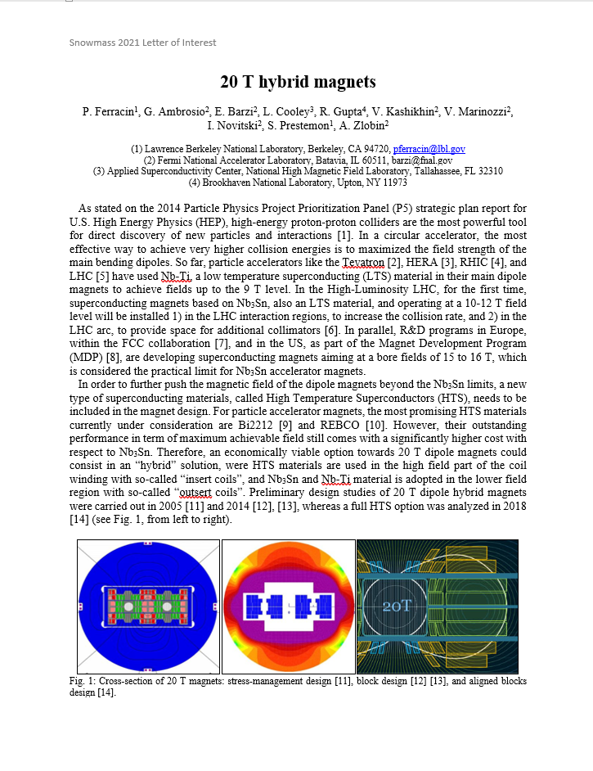
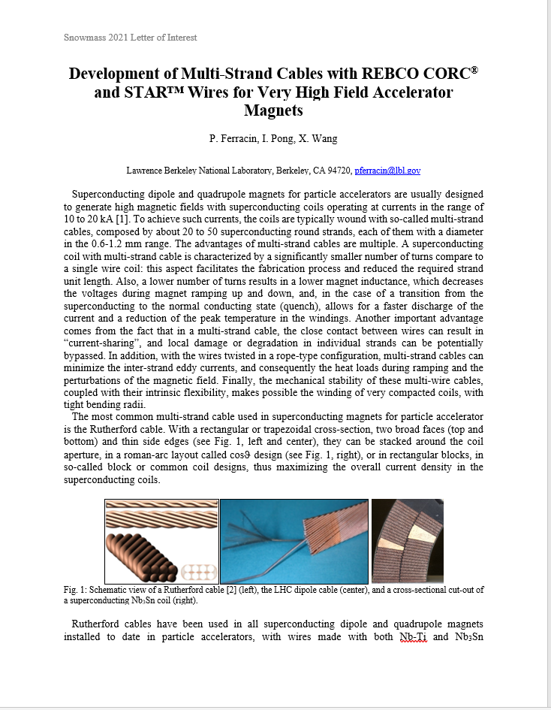
Snowmass LOI

Slide 8
Outline
Goals of the working group
Model and assumptions
Estimates of radiuses, dimensions, and stresses
  Bi2212 and REBCO cases
Preliminary cos-theta and common coil cross-sections
Appendix
  Design criteria for a 20 T hybrid magnet
  Details of REBCO case

Slide 9
Field in at 20 T hybrid dipole magnet
B_{bore_op} = 20 T with load-line margin of 15% → 85% of I_{ss}
  Same load-line margin for HTS and LTS
B_{peak_op} = 20.8 T
  Assumption: 4% increase B_{bore} to B_{peak}
B_{bore_ss} = 23.5 T
B_{peak_ss} = 24.4 T
  Assumption: 4% increase B_{bore} to B_{peak}

Slide 10

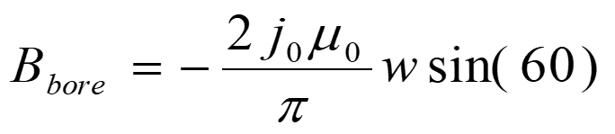
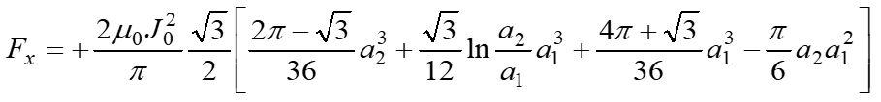
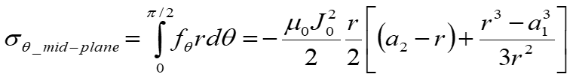
“Sector coil” analytical model
Definitions
  J_{c} = J in superconductor area
  J_{e} = J in strand area
  J_{o} = J in coil area
MQXF/11T cable parameters
  J_{e} = J_{c} * 0.48
  J_{o} = J_{e} * 0.67
  J_{o} = J_{c} * 0.32
No grading
  Same current, same J everywhere
    As if HTS and LTS use the same cable, and are powered in series
Sector coil (60°) with J = J₀ distribution
  No iron
  Constant Jo

Slide 11
Outline
Goals of the working group
Model and assumptions
Estimates of radiuses, dimensions, and stresses
  Bi2212 and REBCO cases
Preliminary cos-theta and common coil cross-sections
Appendix
  Design criteria for a 20 T hybrid magnet
  Details of REBCO case

Slide 12
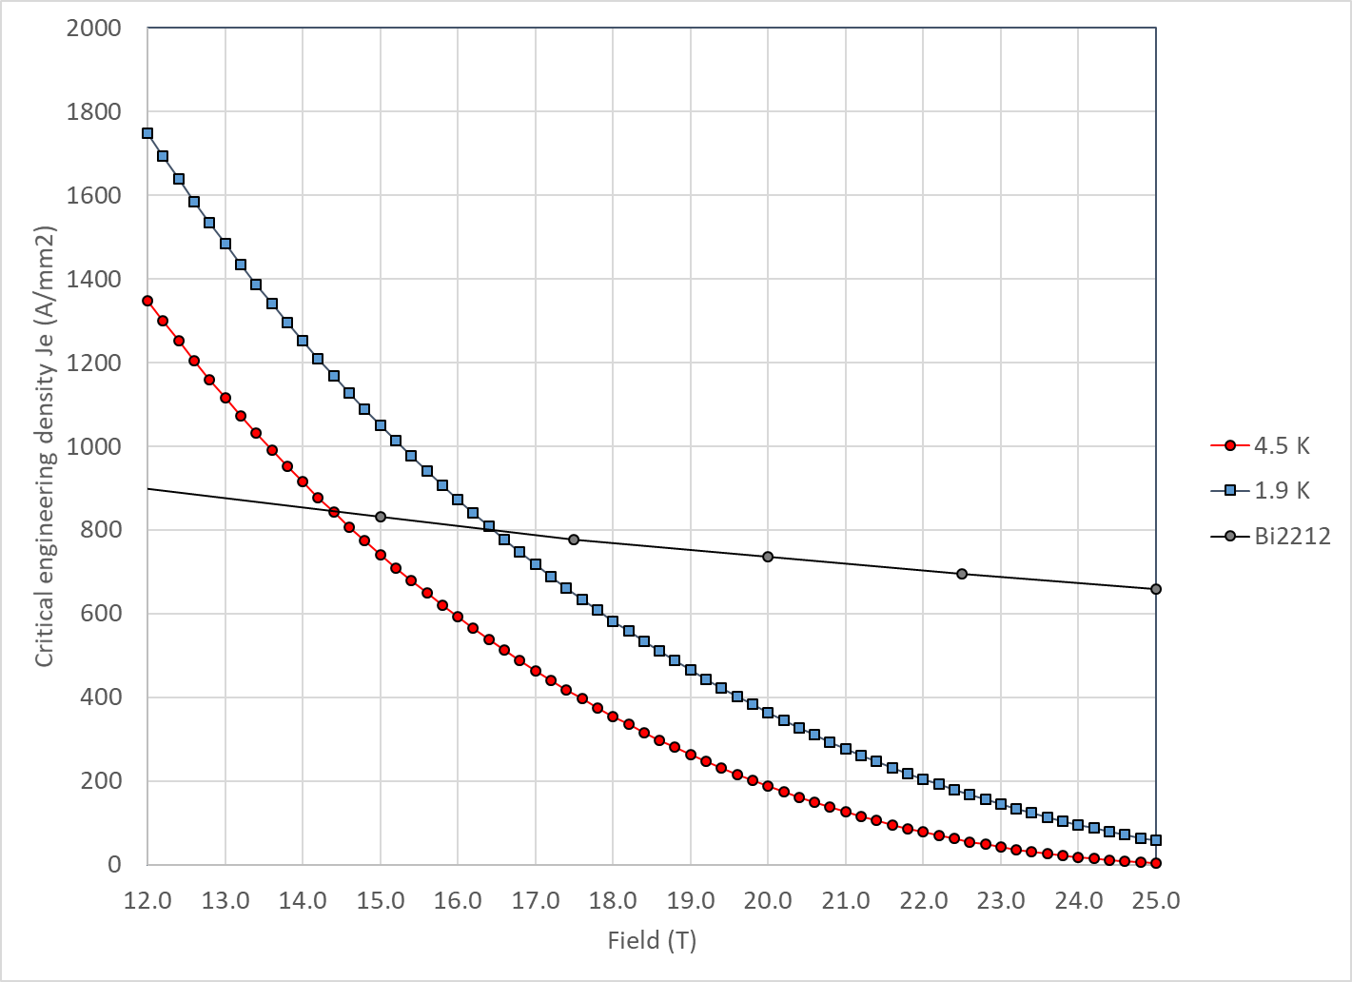
Nb₃Sn vs Bi2212
With properties describe in appendix, Nb₃Sn and Bi2212 cross at 14.5 T at 4.2 K and 16.5 T at 1.9 K

Slide 13
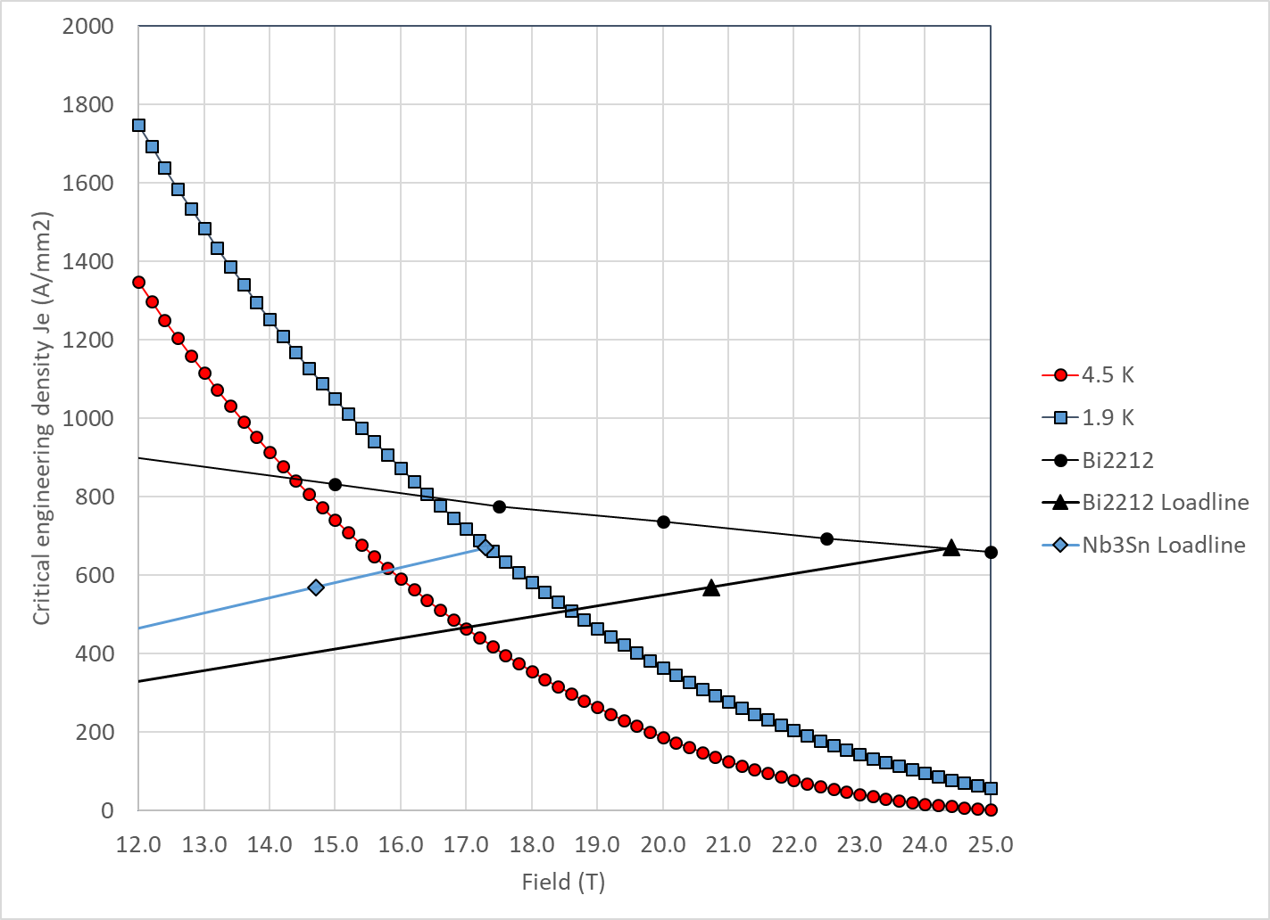
20 T Bi2212-Nb₃Sn hybrid
Bi2212
  At short sample
    B_{p_ss} = 24.4 T
    J_{e_ss} = 670 A/mm2
    J_{o_ss} = 450 A/mm²
  So, at 85% of short sample
    B_{p_op} = 20.8 T
    J_{e_op} = 570 A/mm2
    J_{o_op} = 382 A/mm²

Slide 14
20 T Bi2212-Nb₃Sn hybrid
Nb₃Sn
  At short sample
    B_{p_ss} = 17.3 T
    J_{e_ss} = 670 A/mm2
    J_{o_ss} = 450 A/mm²
  So, at 85% of short sample
    B_{p_op} = 14.7 T
    J_{e_op} = 570 A/mm2
    J_{o_op} = 382 A/mm²

Slide 15
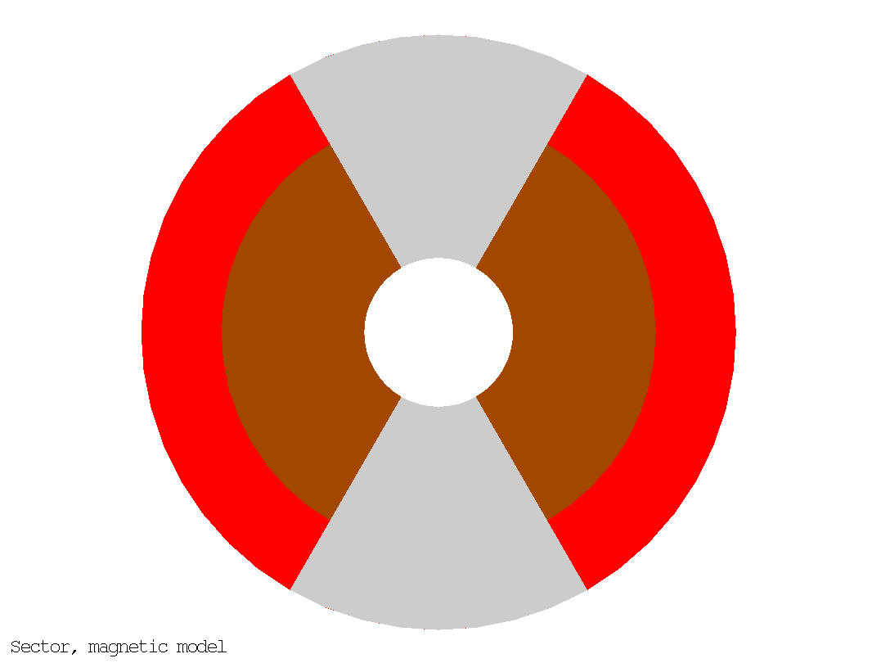
20 T Bi2212-Nb₃Sn hybrid
50 mm aperture
Under the previous assumption (sector coil, constant Jo everywhere, no stress management, no iron)
  ID Nb₃Sn = 146 mm
  OD Nb₃Sn = 200 mm
  76 m total coil thickness
    49 mm thick Bi2212 coil
    27 mm thick Nb₃Sn coil
  Area Bi2212: 2540 mm² (1 quadrant)
  Area Nb₃Sn: 2470 mm² (1 quadrant)
  Stored energy: 2.86 MJ/m (4 quadrants)
20 T = 13 T + 7 T
Nb₃Sn
Bi2212

Slide 16
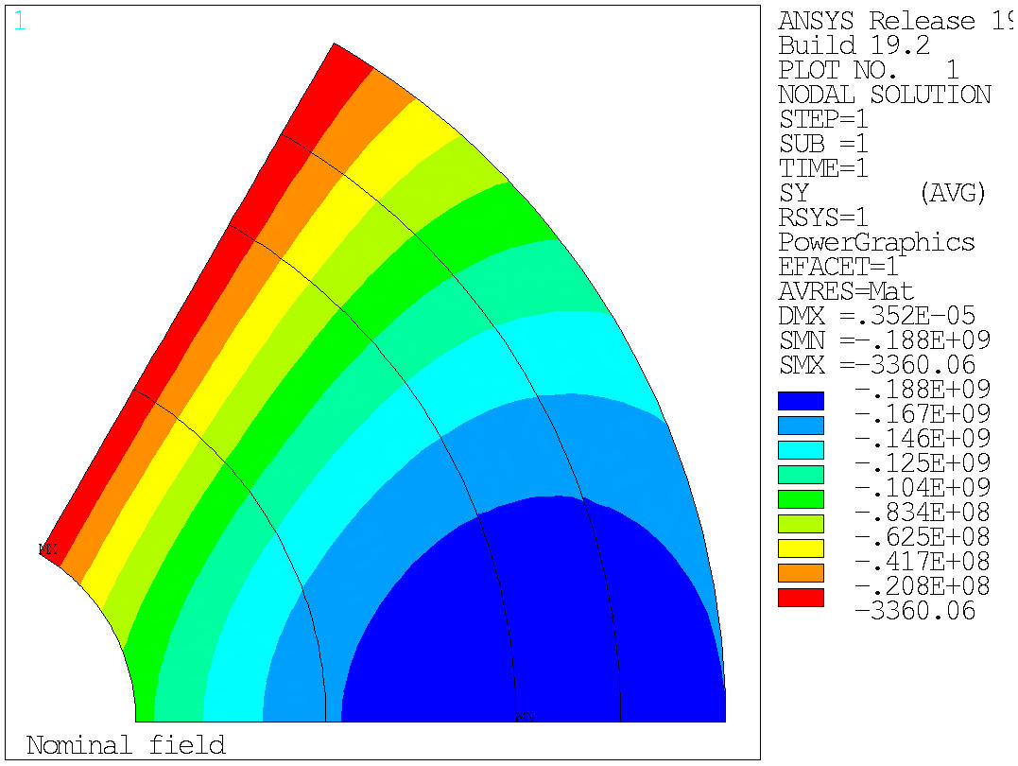
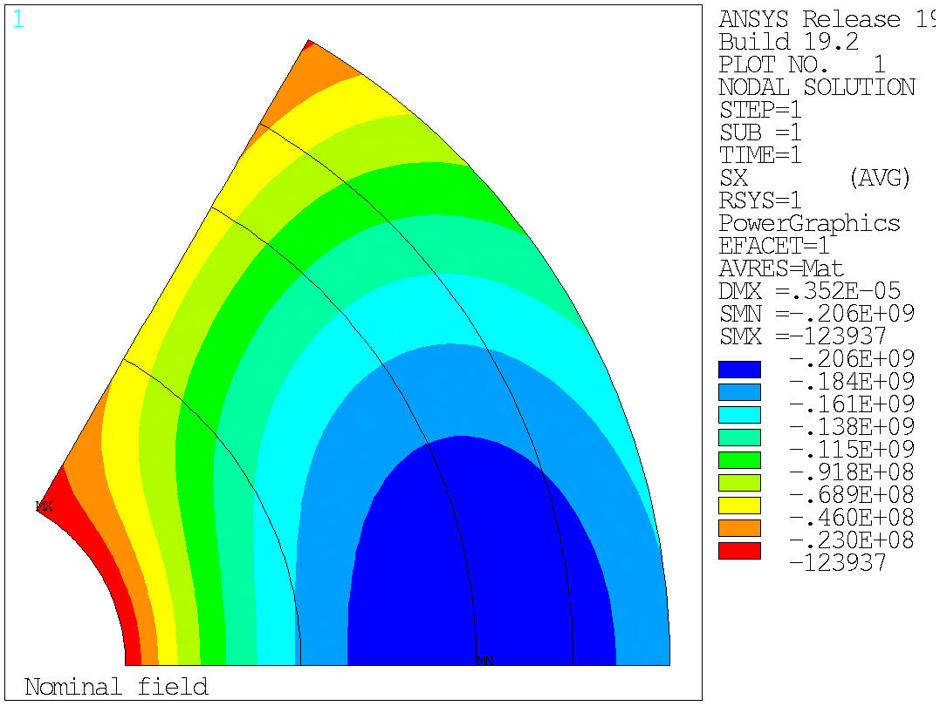
20 T Bi2212-Nb₃Sn hybrid
Stress at B-bore = 20 T
Azimuthal stress on the mid-plane → Max: 188 MPa
Radial stress → Max: 206 MPa
  No shear, no bending….
Azimuthal
Radial

Slide 17
20 T Bi2212-Nb₃Sn hybrid
Test separately the Nb₃Sn and the Bi2212 coils
ID: 50 mm
OD: 200 mm
W: 76 mm
ID: 50 mm
OD: 146 mm
W: 49 mm
ID: 146 mm
OD: 200 mm
W: 27 mm
Nb₃Sn
Nb₃Sn
Nb₃Sn
Bi2212
Bi2212
Bi2212

Slide 18
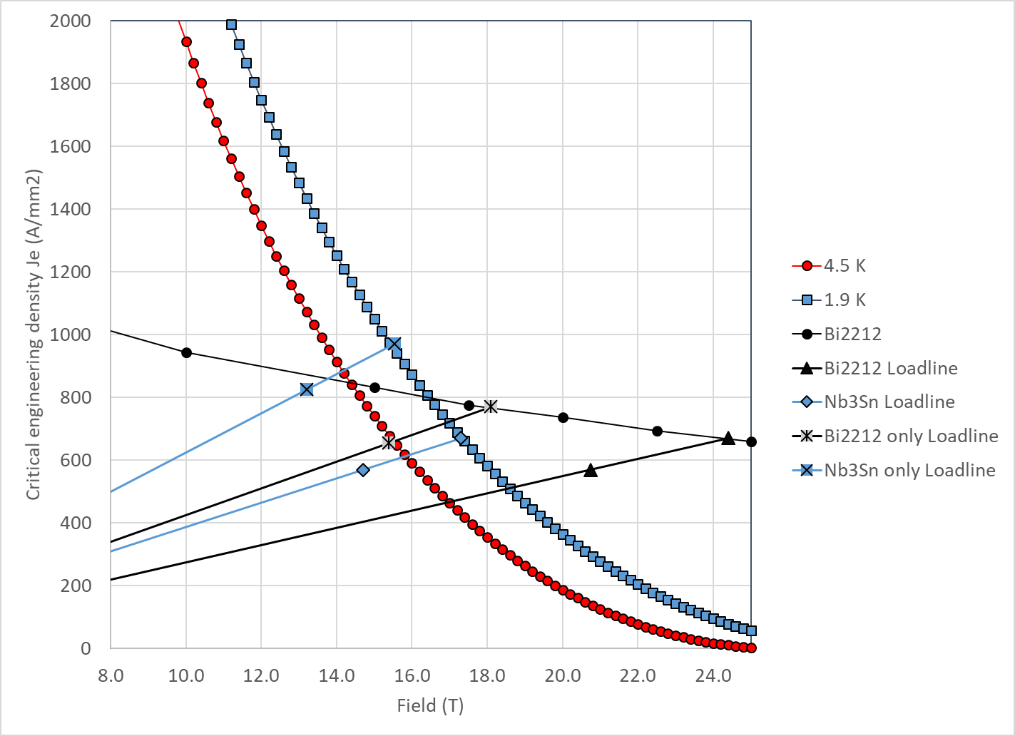
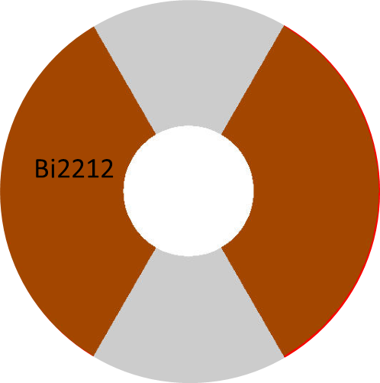
20 T Bi2212-Nb₃Sn hybrid
Bi2212 “only”
Bi2212
  At short sample
    B_{p_ss} = 18.4 T
    B_{bore_ss} = 17.4 T
    J_{e_ss} = 769 A/mm2
    J_{o_ss} = 515 A/mm²
  So, at 85% of short sample
    B_{p_op} = 15.6 T
    B_{bore_op} = 14.7 T
    J_{e_op} = 653 A/mm2
    J_{o_op} = 438 A/mm²

Slide 19
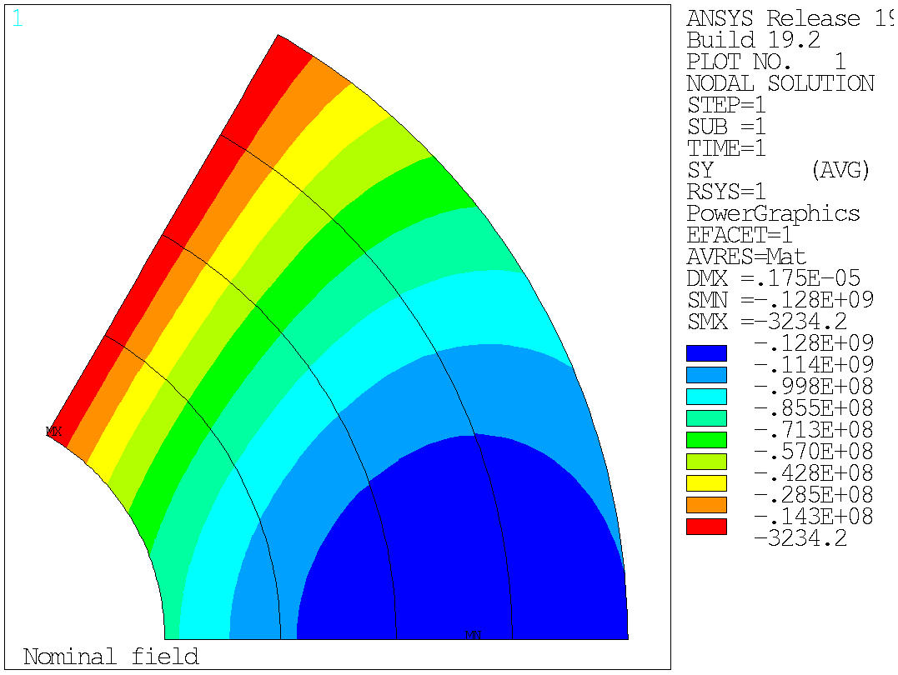
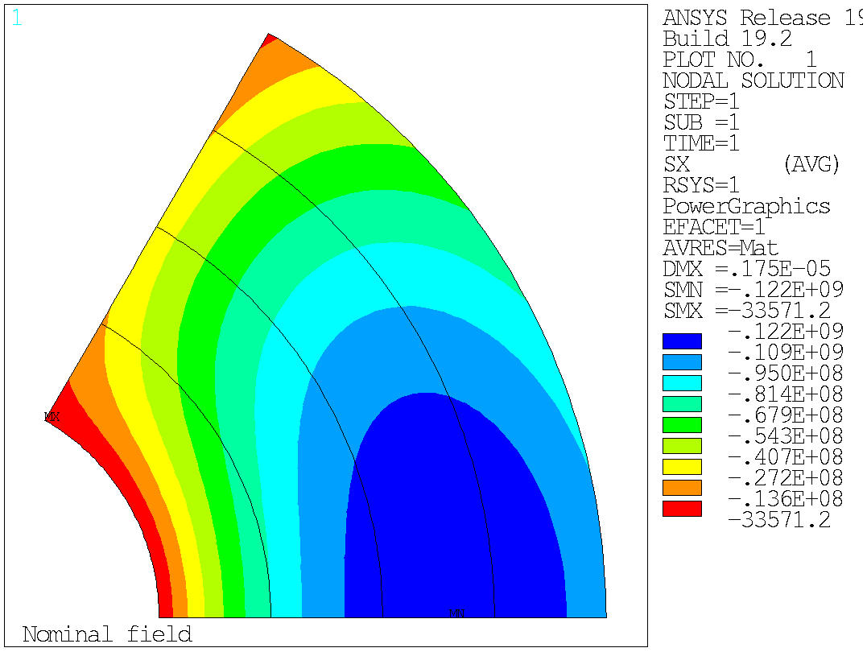
20 T Bi2212-Nb₃Sn hybrid
Bi2212 “only”, Stress at B-bore = 14.7 T
Azimuthal stress on the mid-plane → Max: 128 MPa
Radial stress → Max: 122 MPa
  No shear, no bending….
Azimuthal
Radial

Slide 20
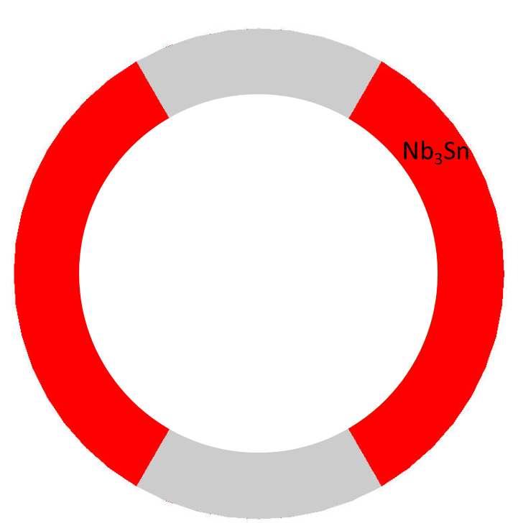
20 T Bi2212-Nb3Sn hybrid
Nb3Sn “only”
Nb3Sn
  At short sample
    B_{p_ss} = 15.3 T
    B_{bore_ss} = 12.1 T
    J_{e_ss} = 985 A/mm2
    J_{o_ss} = 660 A/mm²
  So, at 85% of short sample
    B_{p_op} = 13.0 T
    B_{bore_op} = 10.3 T
    J_{e_op} = 837 A/mm2
    J_{o_op} = 561 A/mm²

Slide 21
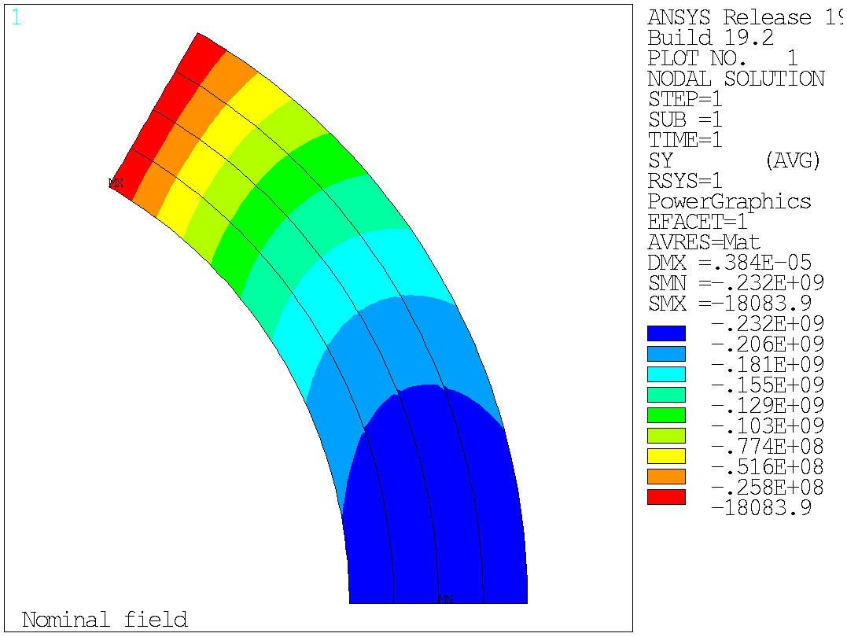
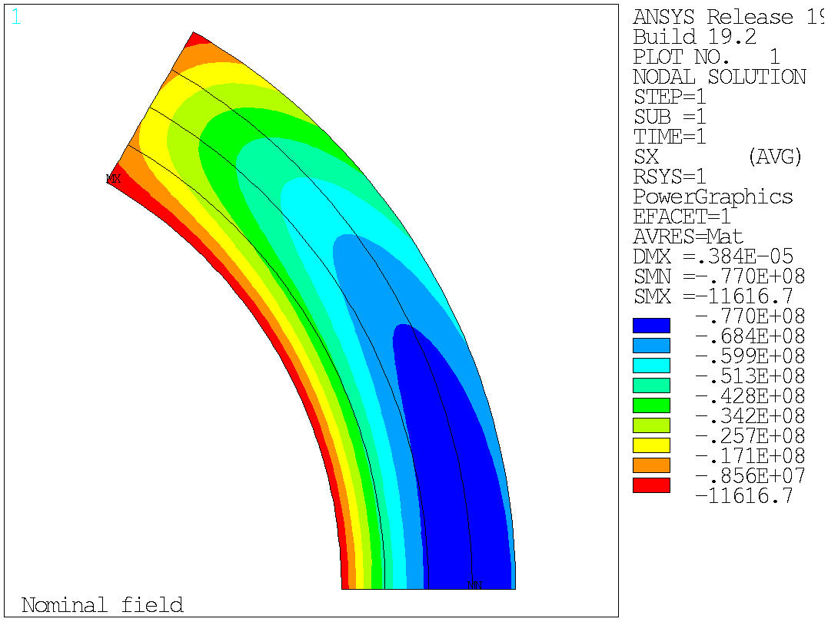
20 T Bi2212-Nb₃Sn hybrid
Nb₃Sn “only”, Stress at B-bore = 10.3 T
Azimuthal stress on the mid-plane → Max: 232 MPa
Radial stress → Max: 77 MPa
  No shear, no bending….
Azimuthal
Radial

Slide 22
Outline
Goals of the working group
Model and assumptions
Estimates of radiuses, dimensions, and stresses
  Bi2212 and REBCO cases
Preliminary cos-theta and common coil cross-sections
Appendix
  Design criteria for a 20 T hybrid magnet
  Details of REBCO case

Slide 23
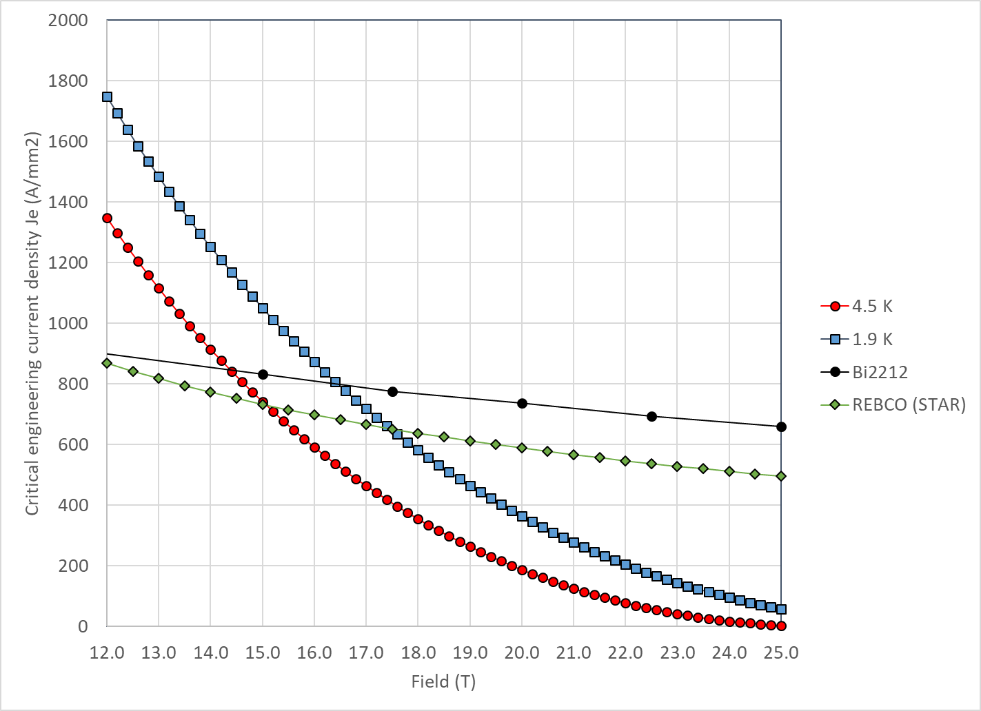
20 T REBCO-Nb₃Sn hybrid (work in progress…)
With properties describe in appendix
  Nb₃Sn and Bi2212 cross at
    14.5 T at 4.2 K
    16.5 T at 1.9 K
  Nb₃Sn and REBCO cross at
    15.0 T at 4.2 K
    17.5 T at 1.9 K

Slide 24
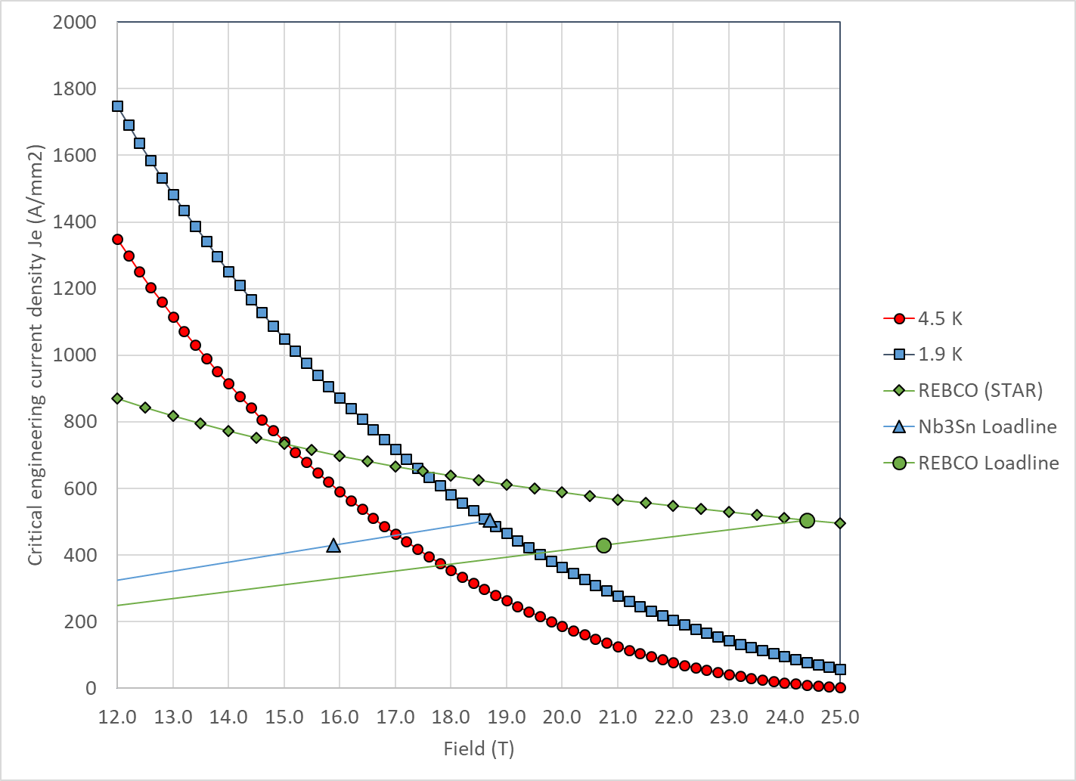
20 T REBCO-Nb₃Sn hybrid
REBCO
  At short sample
    B_{p_ss} = 24.4 T
    J_{e_ss} = 504 A/mm2
    J_{o_ss} = 338 A/mm²
  So, at 85% of short sample
    B_{p_op} = 20.8 T
    J_{e_op} = 429 A/mm2
    J_{o_op} = 287 A/mm²

Slide 25
20 T REBCO-Nb₃Sn hybrid
Nb₃Sn
  At short sample
    B_{p_ss} = 18.7 T
    J_{e_ss} = 504 A/mm2
    J_{o_ss} = 338 A/mm²
  So, at 85% of short sample
    B_{p_op} = 15.9 T
    J_{e_op} = 429 A/mm2
    J_{o_op} = 287 A/mm²

Slide 26
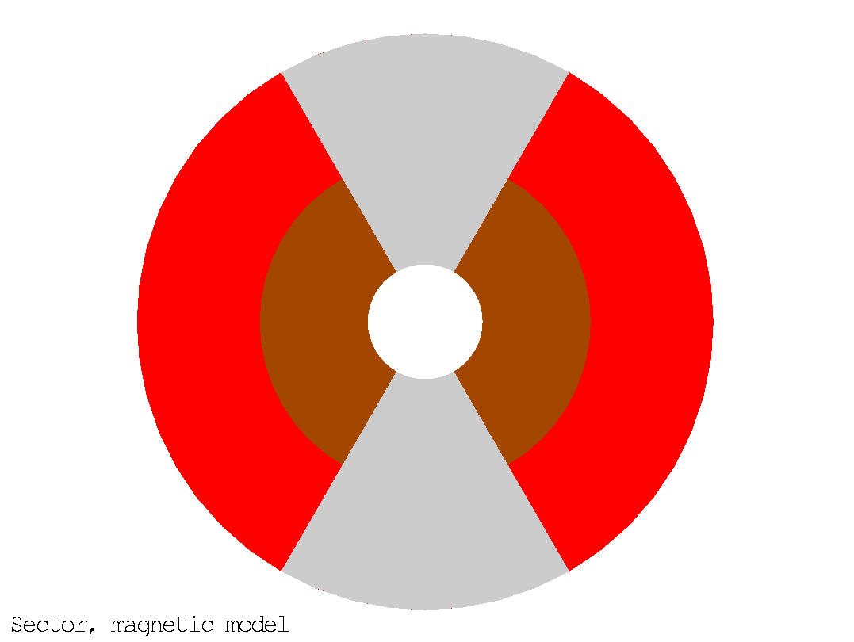
20 T REBCO-Nb₃Sn hybrid
50 mm aperture
Under the previous assumption (sector coil, constant Jo everywhere, no stress management, no iron)
And also, from CORC/STAR Je to Jo like in MQXF → “Rutherford cable with CORC/START wires” (see later)
  ID Nb₃Sn = 144 mm
  OD Nb₃Sn = 252 mm
  101 m total coil thickness
    47 mm thick REBCO coil
    54 mm thick Nb₃Sn coil
  Area Bi2212: 2387 mm² (1 quadrant)
  Area Nb₃Sn: 5532 mm² (1 quadrant)
  Stored energy: 3.92 MJ/m (4 quadrants)
20 T = 9 T + 11 T
Nb₃Sn
REBCO

Slide 27
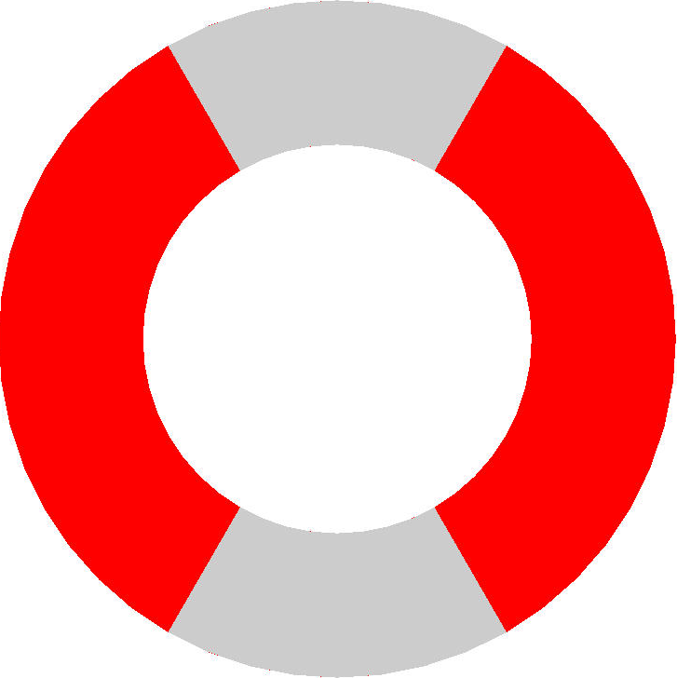
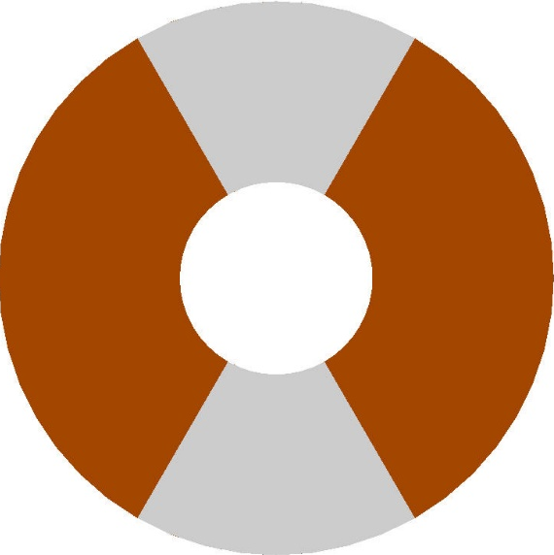
20 T REBCO-Nb₃Sn hybrid
Test separately the Nb₃Sn and the Bi2212 coils
ID: 50 mm
OD: 252 mm
W: 101 mm
ID: 50 mm
OD: 144 mm
W: 47 mm
ID: 144 mm
OD: 252 mm
W: 54 mm
Nb₃Sn
Nb₃Sn
REBCO
REBCO

Slide 28
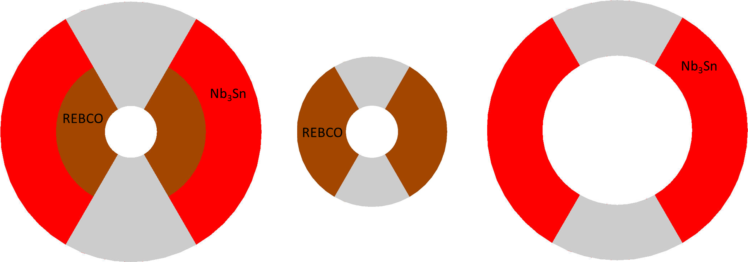
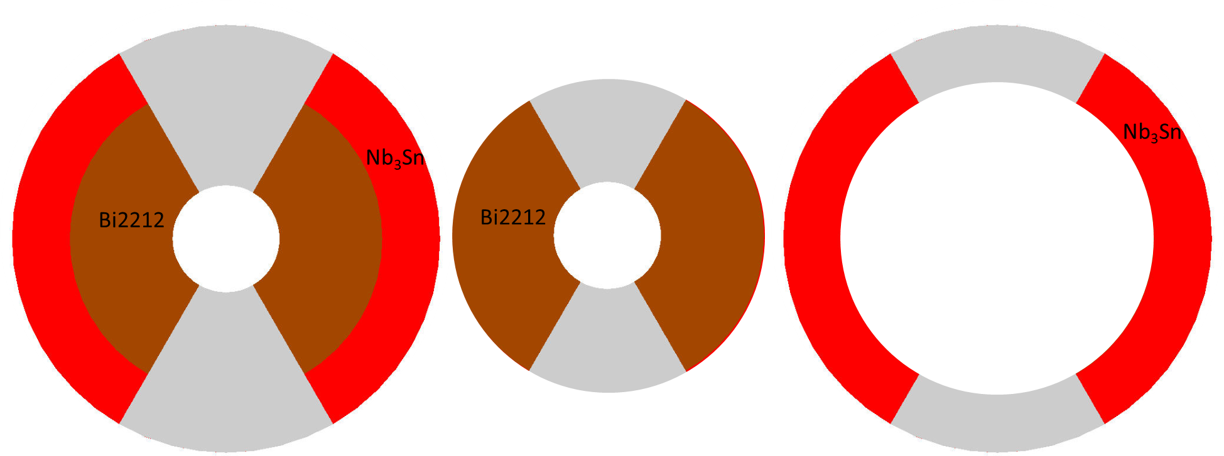
Summary
Bi2212
REBCO
ID: 50 mm
OD: 200 mm
W: 76 mm
B_{_bore_op} = 20 T
σ_{ϑ}/ σ_{r} =188/206
ID: 50 mm
OD: 146 mm
W: 49 mm
B_{_bore_op} = 14.7 T
σ_{ϑ}/ σ_{r} =128/122
ID: 146 mm
OD: 200 mm
W: 27 mm
B_{_bore_op} = 10.3 T
σ_{ϑ}/ σ_{r} =232/77
ID: 50 mm
OD: 252 mm
W: 101 mm
B_{_bore_op} B = 20 T
σ_{ϑ}/ σ_{r} =165/194
ID: 50 mm
OD: 144 mm
W: 47 mm
B_{_bore_op} = 12.8 T
σ_{ϑ}/ σ_{r} =99/93
ID: 144 mm
OD: 252 mm
W: 54 mm
B_{_bore_op} = 13.1 T
σ_{ϑ}/ σ_{r} =201/114

Slide 29
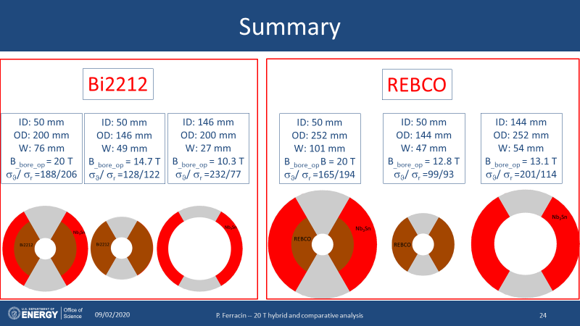
Summary
REBCO hybrid still larger than Bi2212
  Because of a lower J_{e}
    And also with “unrealistic” assumption on J_{o}
We need to build a
  13-14 T HTS magnet (50 mm)
  10-13 T LTS magnet (large bore)
    120 mm seems a good start, but we may need more for an hybrid magnet
In hybrid 20 T, radial stress seems higher than azimuthal
  When tested separately, very high azimuthal stress in LTS

Slide 30
Outline
Goals of the working group
Model and assumptions
Estimates of radiuses, dimensions, and stresses
  Bi2212 and REBCO cases
Preliminary cos-theta and common coil cross-sections
Appendix
  Design criteria for a 20 T hybrid magnet
  Details of REBCO case

Slide 31
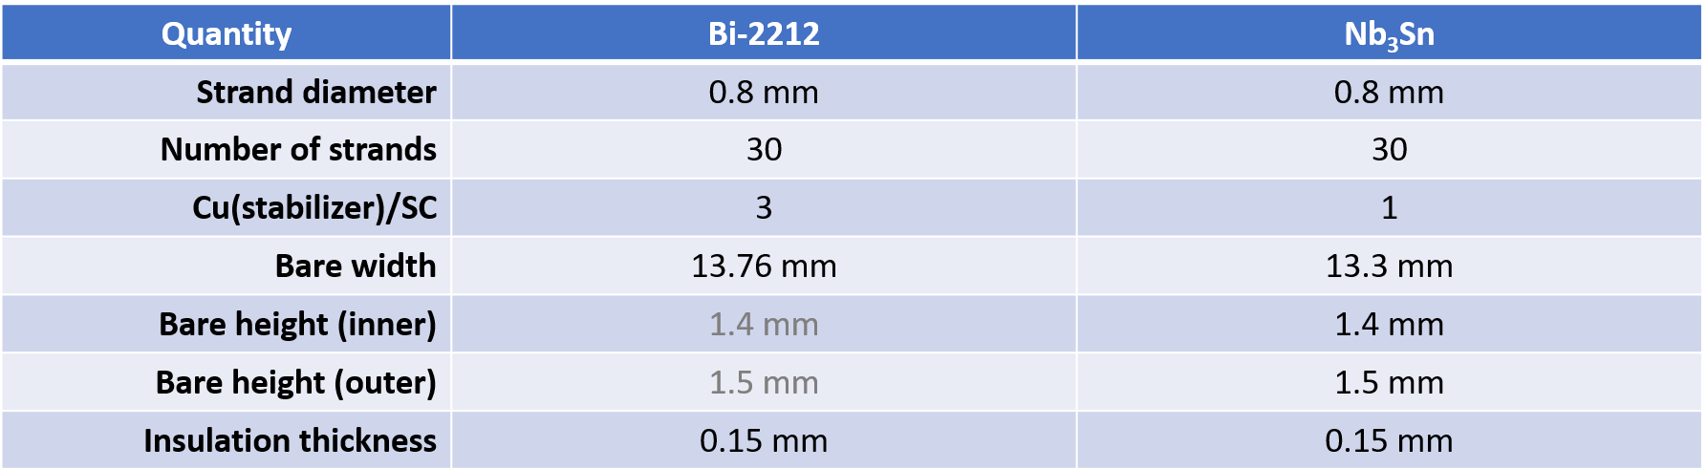
Cosϑ cross-section
(by V. Marinozzi)

Slide 32
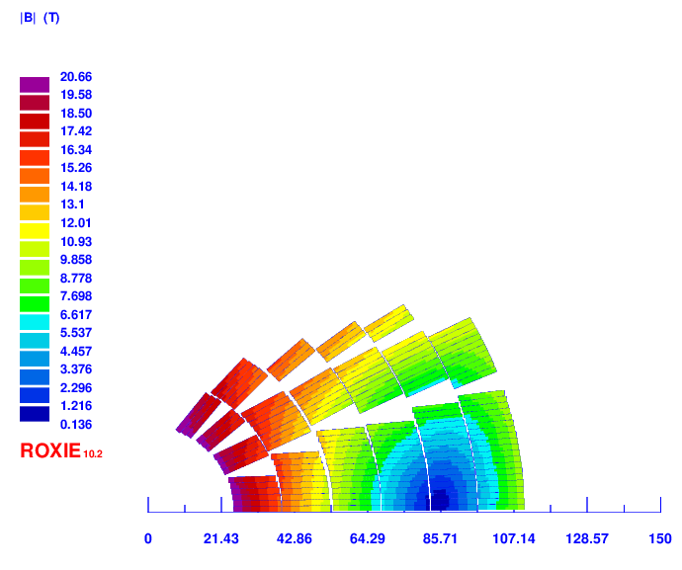
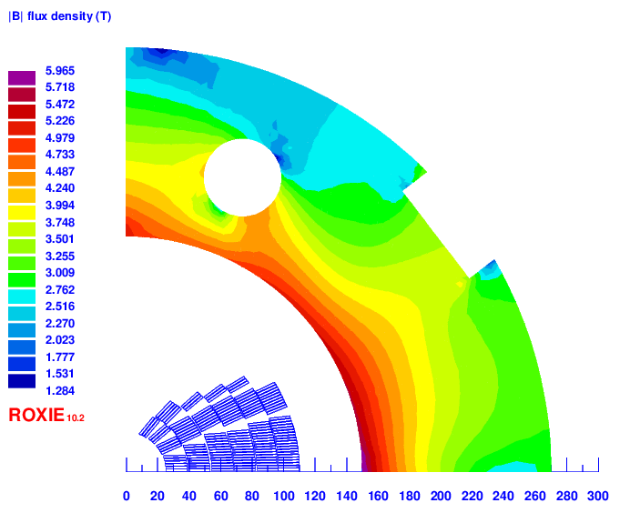
Cosϑ cross-section
(by V. Marinozzi)
Layer 1: 16 turns
Layer 2: 23 turns
Layer 3: 24 turns
Layer 4: 27 turns
Layer 5: 30 turns
Layer 6: 30 turns
Total: 150 turns
Total conductor area (bare):
Bi2212: 1784 mm²
Nb₃Sn: 1150 mm²
Total conductor area (insulated):
Bi2212: 2202 mm²
Nb₃Sn: 1420 mm²

Slide 33
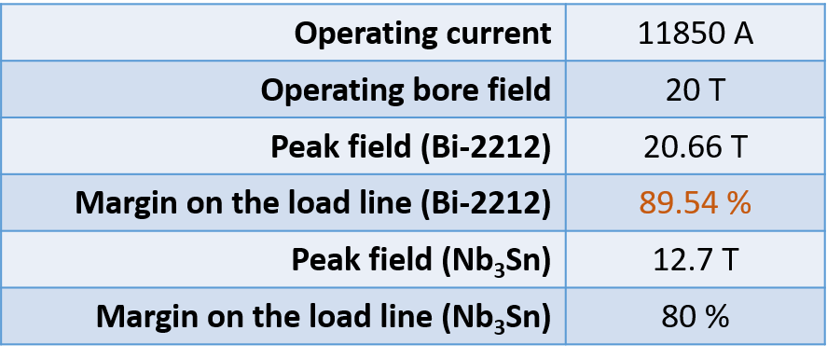
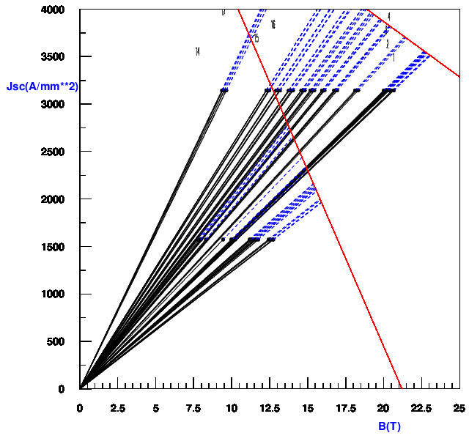
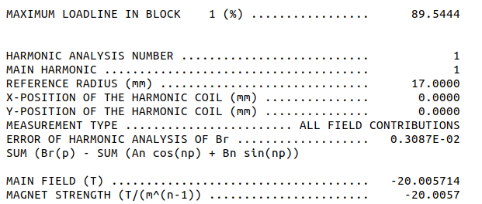
Cosϑ cross-section
(by V. Marinozzi)

Slide 34
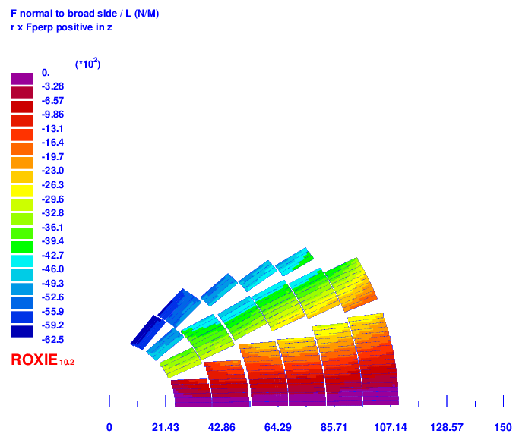
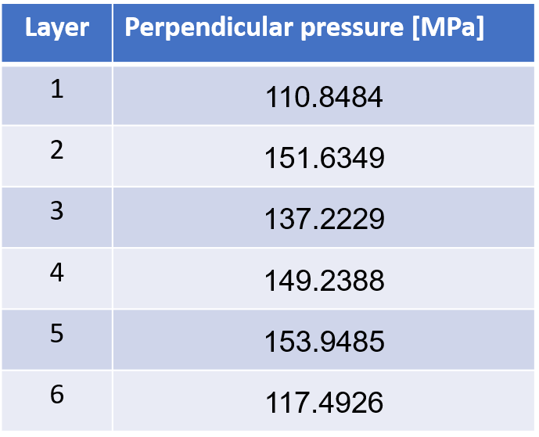
Cosϑ cross-section
(by V. Marinozzi)
Accumulated azimuthal stress on the mid-plane

Slide 35
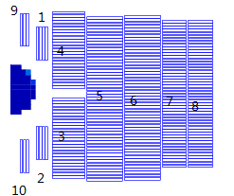
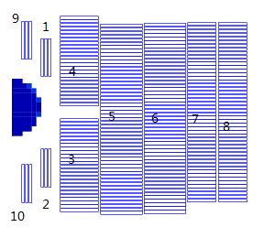
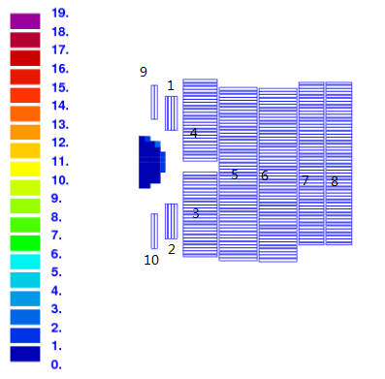
Common-coil design
(by R. Gupta and Qinag LI)
HTS
Nb3Sn Cable 1
Nb3Sn Cable 2

Slide 36
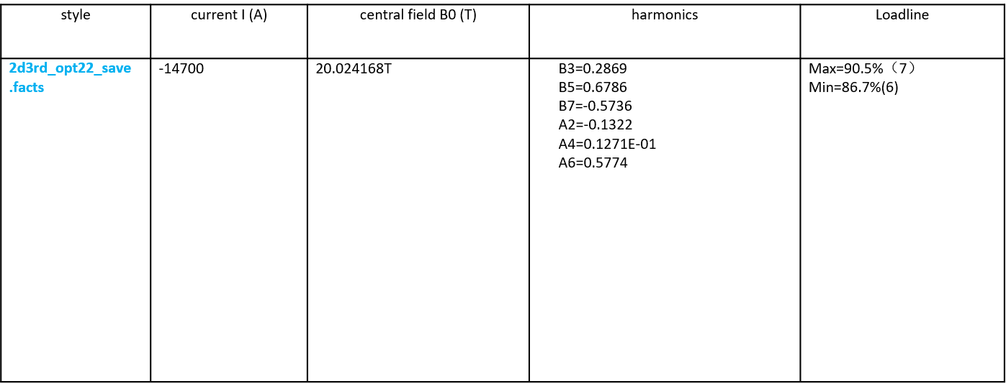
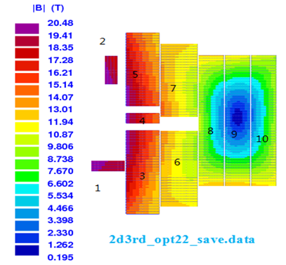
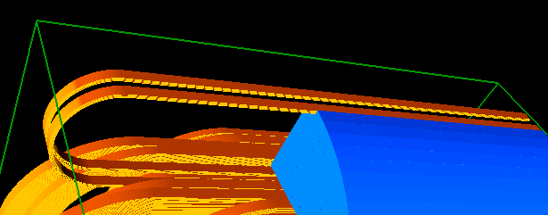
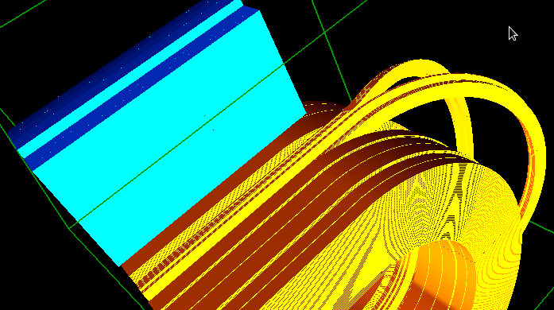
Common-coil design
(by R. Gupta and Qinag LI)

Slide 37
Action items
Converge on a set of strand/cable properties
Continue on CT and CC design
Start SMCT (I. Novitski), CCT, and block design

Slide 38
Appendix
Design criteria
Details of REBCO case

Slide 39
Design criteria for a 20 T hybrid magnet
Previous work within MDP on a 16 T dipole magnet
  GianLuca Sabbi, Alexander Zlobin, MDP General meeting – May 17, 2017
https://conferences.lbl.gov/event/82/

Slide 40
Design criteria for a 20 T hybrid magnet
Geometrical
  Number of apertures 1
  Free coil aperture 50 mm
Comments
  The common coils will naturally provide 2 apertures
    This will be taken into account on the comparison
  No “strong” constraints on
    Magnet total length (<2 m)
    Magnet straight section (>200 mm)
    Maximum magnet OD
      Reference numbers: 620 mm (FNAL/1.9K), 660 mm (BNL/1.9K), 914 mm (LBNL/4.5K)

Slide 41
Design criteria for a 20 T hybrid magnet
Operational
  Reference temperature 1.9 K
    4.5 K option can be considered: it would impact the ratio of HTS vs LTS
  Operational bore field 20 T
  Margin on the load-line @ 1.9K >= 15 %
    With respect to round strand I_{c} including self field and 5% cabling degradation
  Short sample bore field 23.5 T
  Geometrical harmonics at R_{ref}=17 mm and 20 T: b_{n}<5 for n<10
    Magnet straight section
  Target design field 20 T

Slide 42
Design criteria for a 20 T hybrid magnet
Operational
  Maximum Nb₃Sn coil stress >180 (<150) MPa at 1.9 (293) K
  Conditions of coil-pole or rib interfaces at 20 T
    If bonded 20 MPa max. tension
      ‘Corner spikes’ (~1 contact element, 1 mm) neglected
    If separation allowed: Half cable width in contact or < 50 µm max gap
      Conditions may be different depending on the design

Slide 43
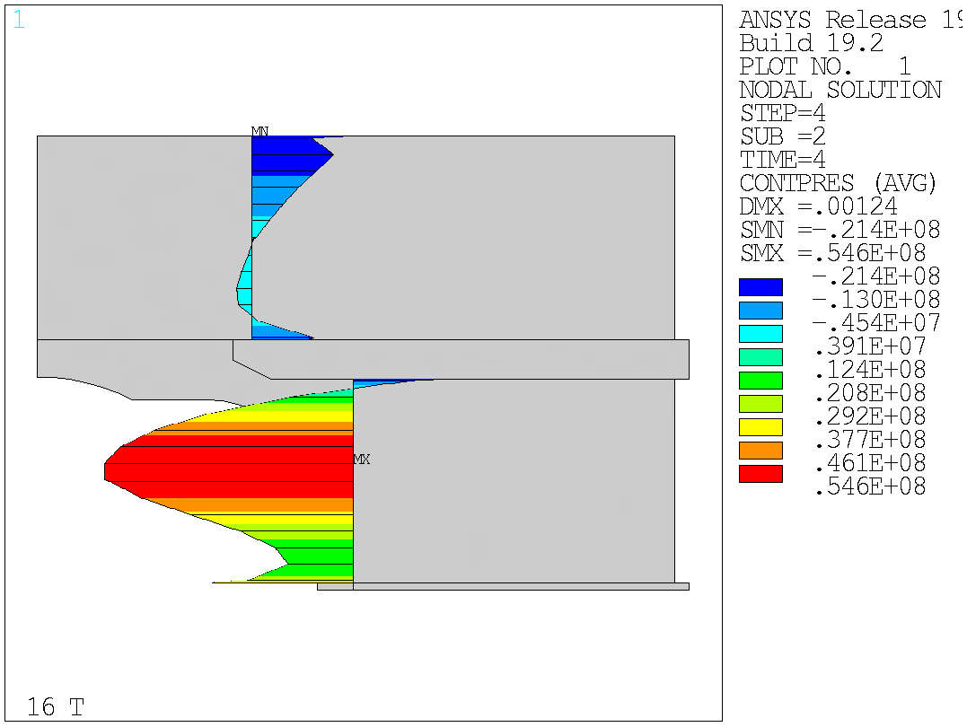
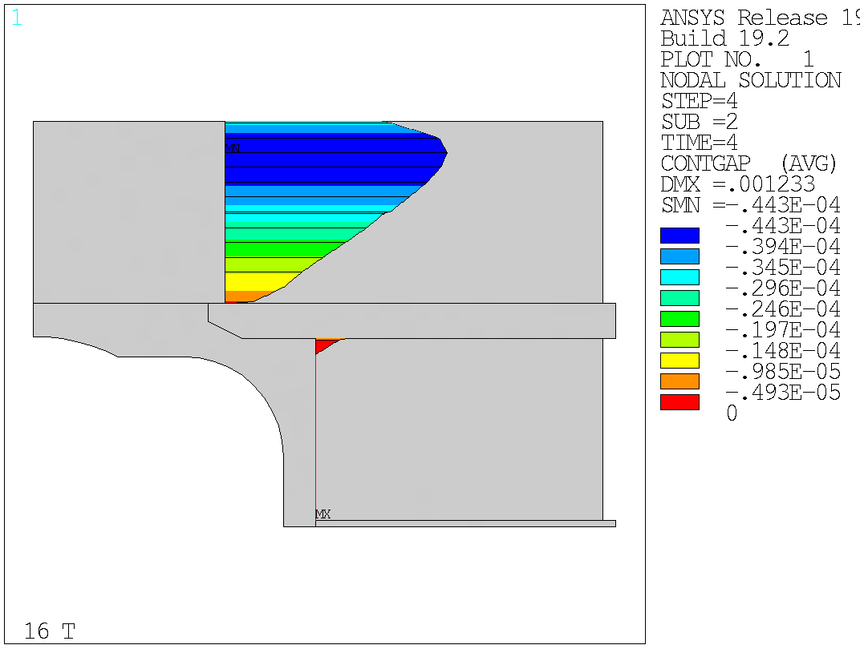
Design criteria for a 20 T hybrid magnet
Bonded vs separation-allowed
  Test Facility Dipole (by G. Vallone)

Slide 44
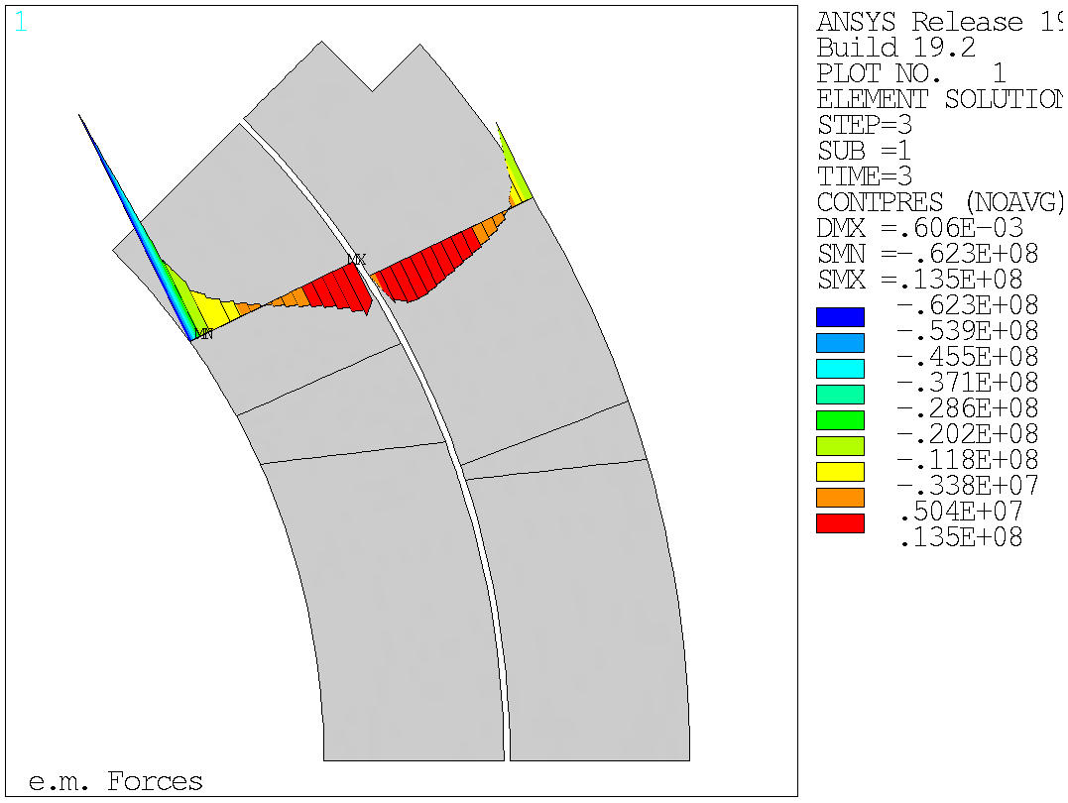
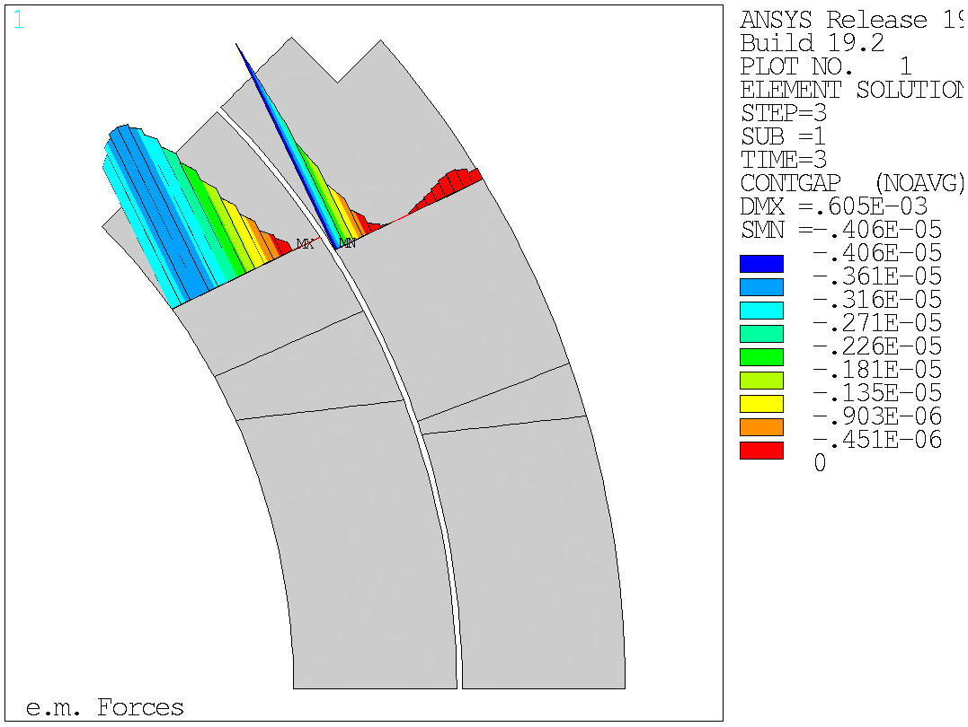
Design criteria for a 20 T hybrid magnet
Bonded vs separation-allowed
  MQXF (by G. Vallone)

Slide 45
Material limits
(by Giorgio Vallone)

Slide 46
Design criteria for a 20 T hybrid magnet
Nb₃Sn Conductor and cable
  Strand diameter 0.7-1.2 mm
  Cu:non-Cu ratio 0.8-2.0
  Non-Cu J_{c} round strand with self-field
    12 T, 4.2 K 2980 A/mm2
    15 T, 4.2 K 1640 A/mm2
    16 T, 4.2 K 1250 A/mm2
      See next slide for reference fit
  RRR (after cabling) >50
  I_{c} degradation due to cabling 5%
  Maximum number of strands in cable 60
  Cable Insulation thickness 0.150 mm

Slide 47
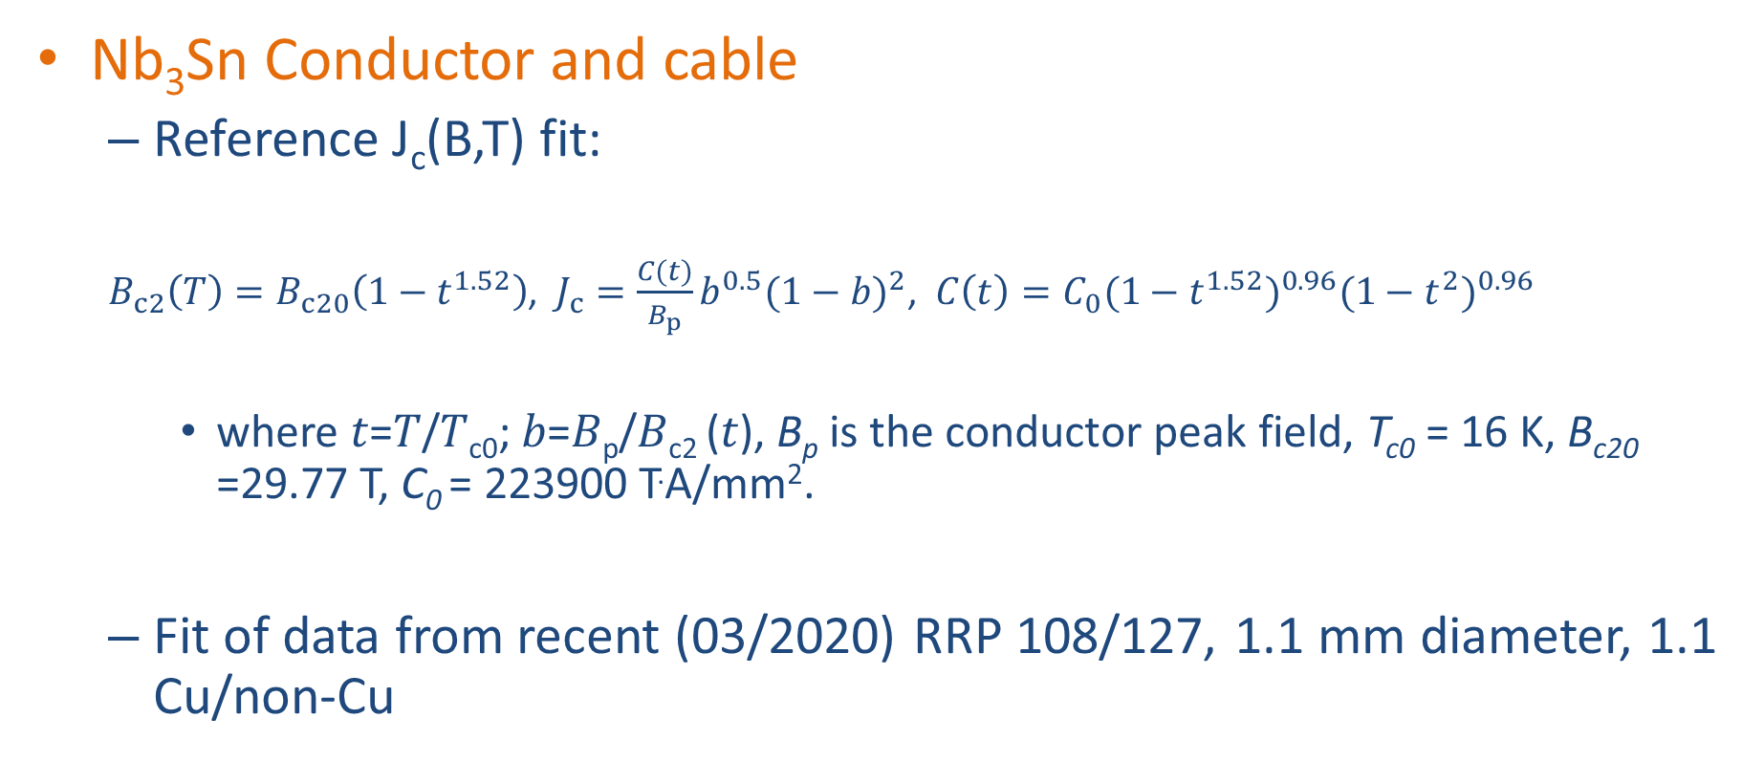
Design criteria for a 20 T hybrid magnet
Nb₃Sn Conductor and cable
  Reference J_{c}(B,T) fit:
  $B_{c2}\left(T\right)=B_{c20}\left(1−t^{1.52}\right)$, $J_{c}=\frac{C(t)}{B_{p}}b^{0.5}{(1−b)}^{2}$, $C\left(t\right)=C_{0}{(1−t^{1.52})}^{0.96}{(1−t^{2})}^{0.96}$
    where 𝑡=𝑇/𝑇_{c0}; 𝑏=𝐵_{p}/𝐵_{c2} (𝑡), B_{p} is the conductor peak field, T_{c0} = 16 K, B_{c20} =29.77 T, C₀ = 223900 T.A/mm².
  Fit of data from recent (03/2020) RRP 108/127, 1.1 mm diameter, 1.1 Cu/non-Cu

Slide 48
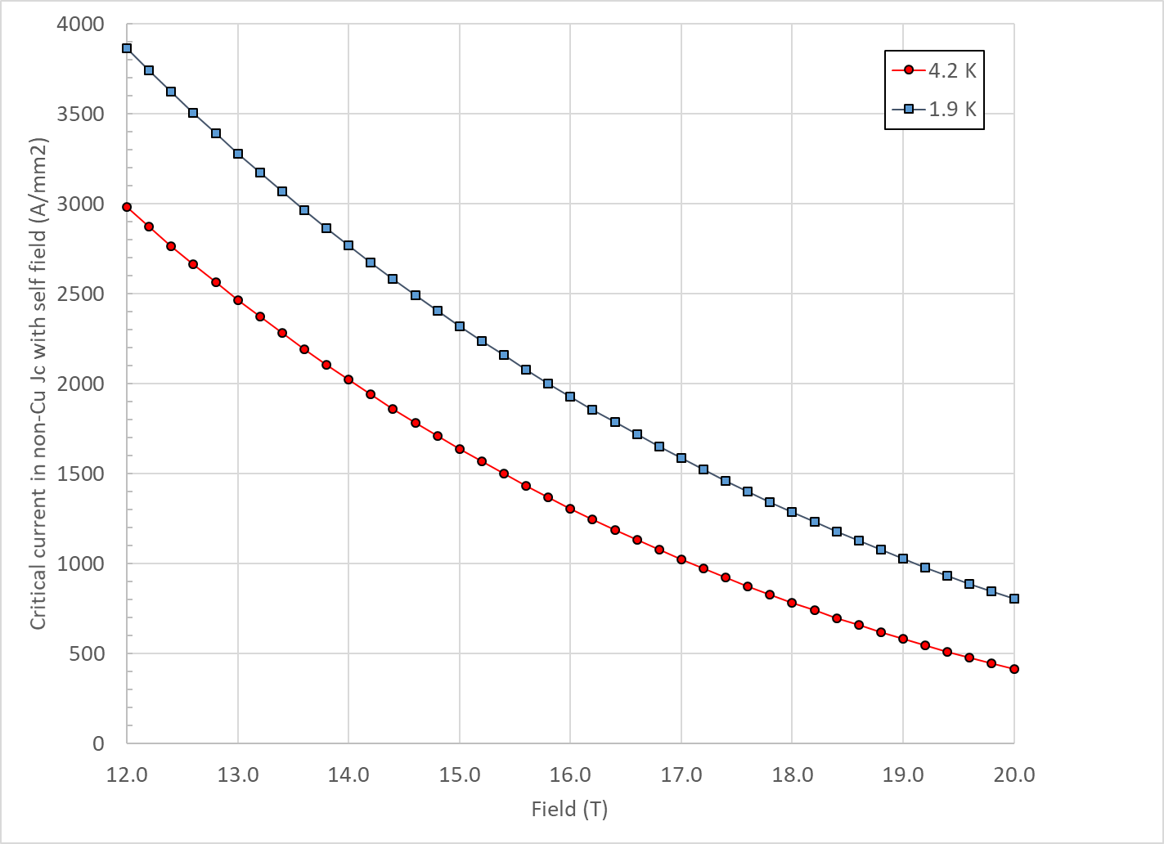
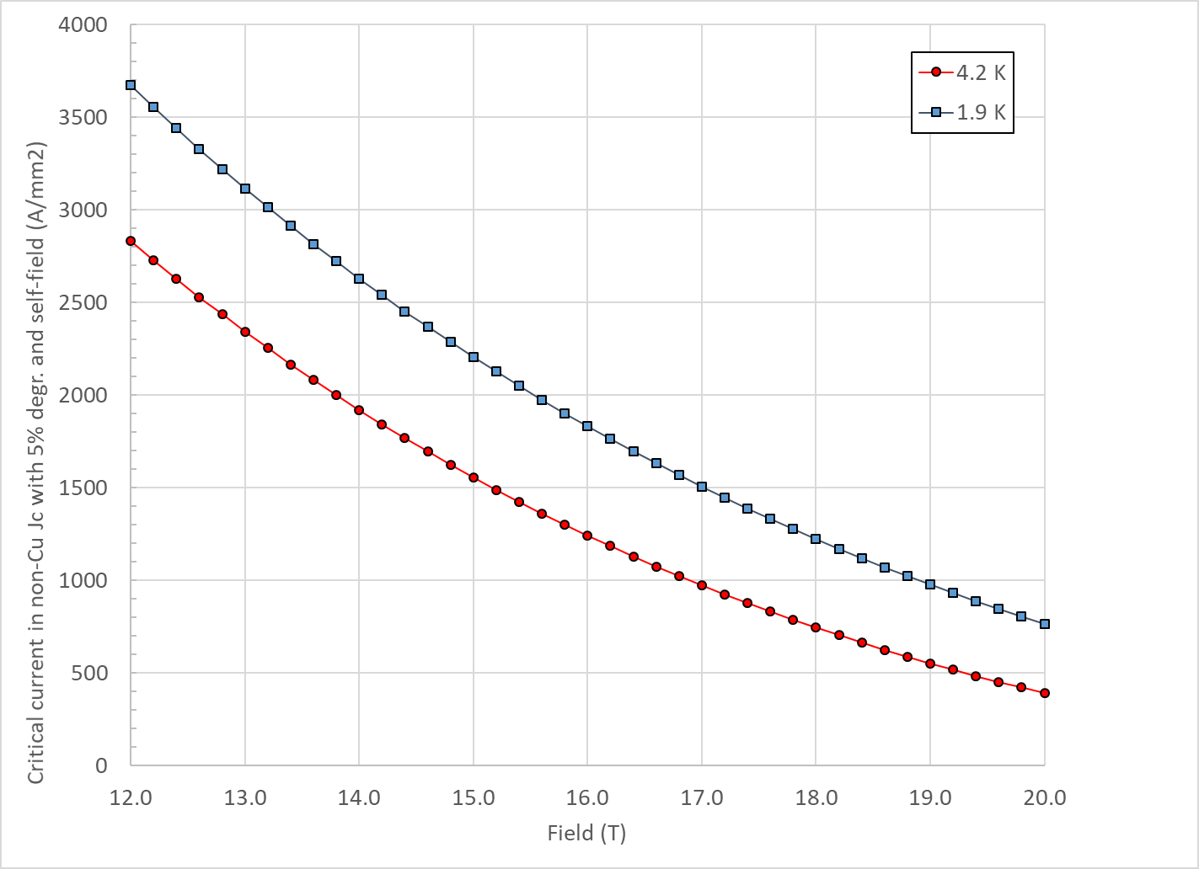
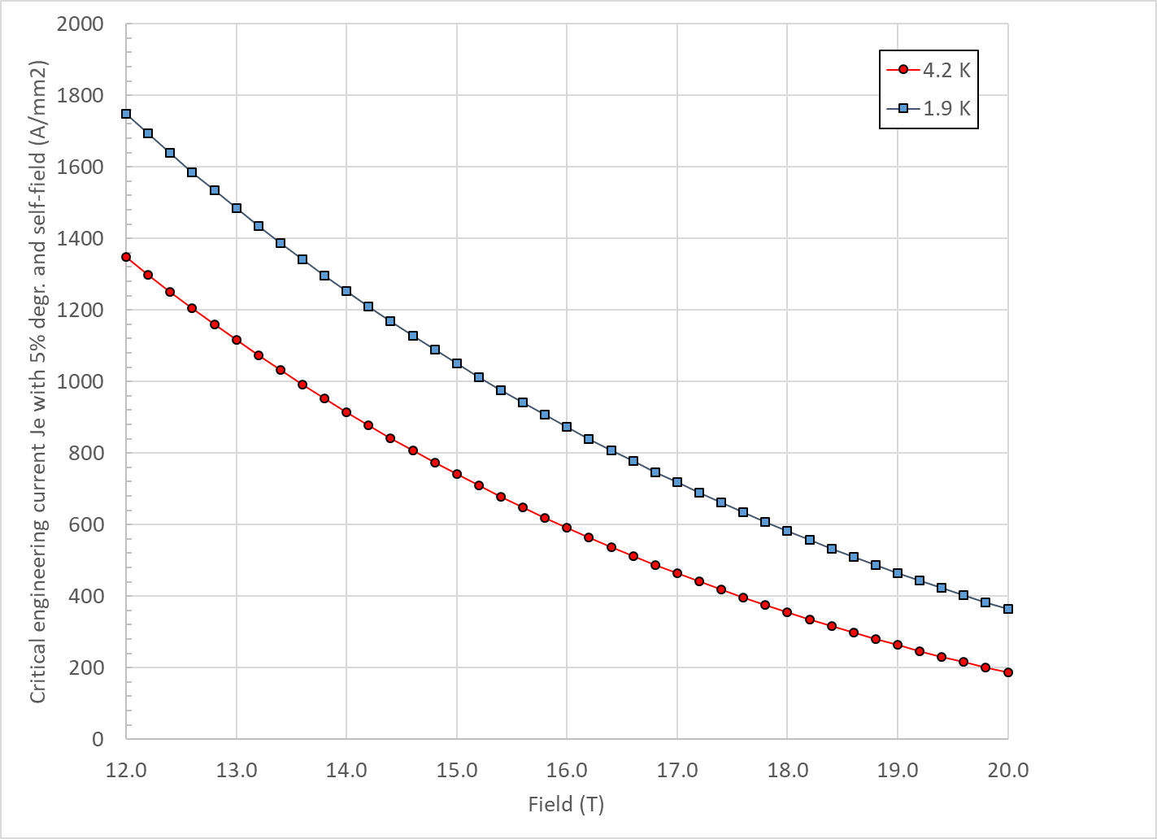
Design criteria for a 20 T hybrid magnet
Nb₃Sn Conductor and cable
  “3000” A/mm² kind of conductor, round, with self field
J_{c} round
J_{c} , 5% deg.
J_{e} , 5% deg.

Slide 49
Design criteria for a 20 T hybrid magnet
Nb₃Sn Conductor and cable
  In general, it would be better to stay within already tested parameters (min, max)
Dimension before reaction; In MQXF, assumed expansion during reaction is 4.5 % (th), 1.2 % (w)

Slide 50
Design criteria for a 20 T hybrid magnet
Bi2212 Conductor and cable (input from T. Shen and L. Garcia Fajardo)
  The wire diameter:
    from 0.6 mm to 1.5 mm
  Cable width: basically same possibilities as with Nb₃Sn cables

Slide 51
Design criteria for a 20 T hybrid magnet
Bi2212 Conductor and cable (input from T. Shen and L. Garcia Fajardo)
  Record performance strand RC5/6 about 20% higher than what is currently “comfortably” produced.

Slide 52
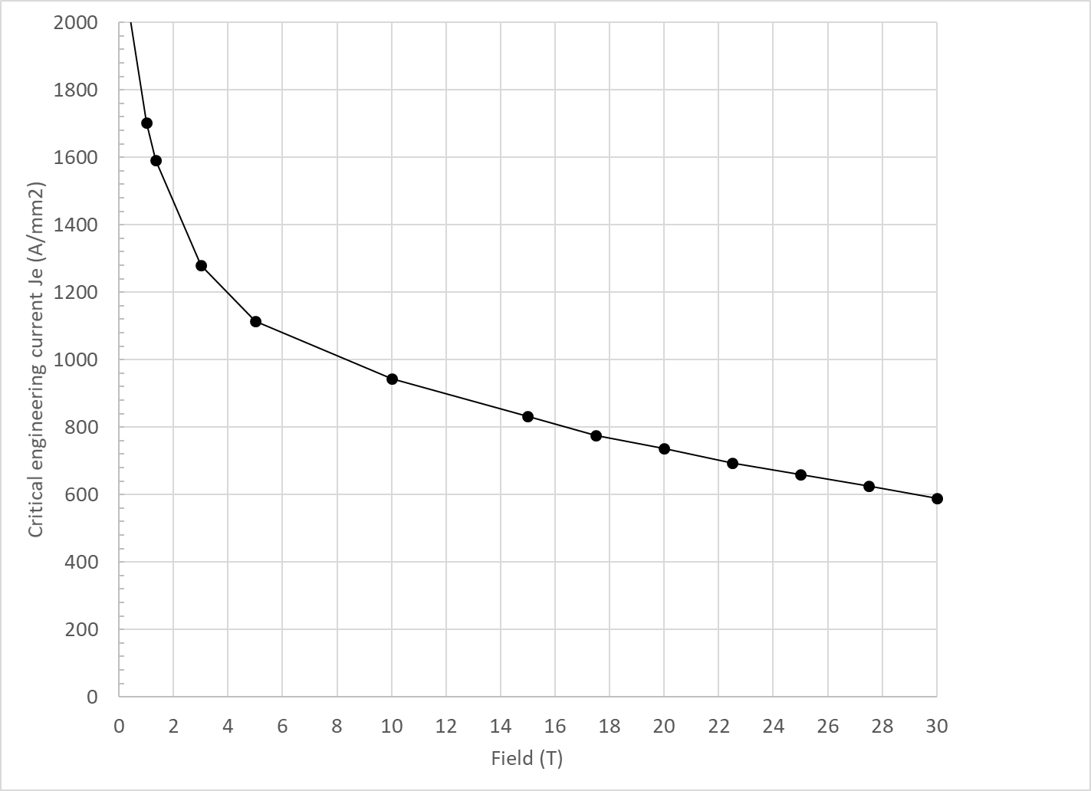
Design criteria for a 20 T hybrid magnet
Bi2212 Conductor and cable (input from T. Shen and L. Garcia Fajardo)

Slide 53


Design criteria for a 20 T hybrid magnet
Bi2212 Conductor and cable
  Maximum Nb₃Sn coil stress: <120 MPa (293) K

Slide 54


Design criteria for a 20 T hybrid magnet
REBCO Conductor
  CORC cable
    3.42mm diameter including 30 micron thick insulation.
  STAR cable
    1.3 mm diameter without insulation (#3)
    2.04 mm diameter without insulation (#4)

Slide 55

Design criteria for a 20 T hybrid magnet
REBCO Conductor
  We use the following parameterization
    Ic(B, 4.2 K) = 10^( α*log(B)+c)
  Where

Slide 56





Design criteria for a 20 T hybrid magnet
REBCO Conductor
  Stress degradation

Slide 57
Design criteria for a 20 T hybrid magnet
With properties describe above
  Nb₃Sn and Bi2212 cross at
    14.5 T at 4.2 K
    16.5 T at 1.9 K
  Nb₃Sn and REBCO cross at
    15.0 T at 4.2 K
    17.5 T at 1.9 K

Slide 58
Design criteria for a 20 T hybrid magnet
Quench protection
  Nb₃Sn
    Maximum hot spot temperature 350 K
    Total time delay 40 ms
    Maximum J in the Cu 1350 A/mm²
    Maximum voltage to ground @ quench 1.0 kV
    Ground insulation design voltage >5 kV
  Bi2212 and REBCO
    See next slides
  Powering in series

Slide 59




Design criteria for a 20 T hybrid magnet
Quench protection
  Bi2212: T_{max}= 400-450 K

Slide 60






Design criteria for a 20 T hybrid magnet
Quench protection
  REBCO

Slide 61
Design criteria for a 20 T hybrid magnet
Summary on Hot spot temperature
  For all 3 materials, 350 K maximum hot spot temperature appears to be a reasonable value

Slide 62

Very…very…preliminary magnet size
20 mm collar
250 mm thick yoke
  However, for a single short model, higher stray field could be accepted
50 mm thick shell
  F_{x}/t = 200 MPa
OD: 850 mm

Slide 63


Size comparison
LHC MQXF FRESCA2 ????

Slide 64
Appendix
Design criteria
Details of REBCO case

Slide 65


20 T REBCO-Nb₃Sn hybrid
Stress at B-bore = 20 T
Azimuthal stress on the mid-plane → Max: 165 MPa
Radial stress → Max: 194 MPa
  No shear, no bending….
Azimuthal
Radial

Slide 66


20 T REBCO-Nb₃Sn hybrid
REBCO “only”
REBCO
  At short sample
    B_{p_ss} = 16.0 T
    B_{bore_ss} = 15.1 T
    J_{e_ss} = 697 A/mm2
    J_{o_ss} = 467 A/mm²
  So, at 85% of short sample
    B_{p_op} = 13.6 T
    B_{bore_op} = 12.8 T
    J_{e_op} = 592 A/mm2
    J_{o_op} = 397 A/mm²

Slide 67


20 T REBCO-Nb₃Sn hybrid
REBCO “only”, Stress at B-bore = 12.8 T
Azimuthal stress on the mid-plane → Max: 99 MPa
Radial stress → Max: 93 MPa
  No shear, no bending….
Azimuthal
Radial

Slide 68

20 T REBCO-Nb₃Sn hybrid
Nb₃Sn “only”
Nb₃Sn
  At short sample
    B_{p_ss} = 17.7 T
    B_{bore_ss} = 15.4 T
    J_{e_ss} = 622 A/mm2
    J_{o_ss} = 417 A/mm²
  So, at 85% of short sample
    B_{p_op} = 15.0 T
    B_{bore_op} = 13.1 T
    J_{e_op} = 529 A/mm2
    J_{o_op} = 354 A/mm²

Slide 69


20 T REBCO-Nb₃Sn hybrid
Nb³Sn “only”, Stress at B-bore = 13.1 T
Azimuthal stress on the mid-plane → Max: 201 MPa
Radial stress → Max: 114 MPa
  No shear, no bending….
Azimuthal
Radial

