Slide 1
Bi-2212 Rutherford Cable Solenoid:
“Baby-Ruth” Design and Fabrication Update
Daniel S. Davis, Ulf P. Trociewitz, George Miller, Youngjae Kim, Ernesto S. Bosque, Jozef Kvitkovic

Slide 2
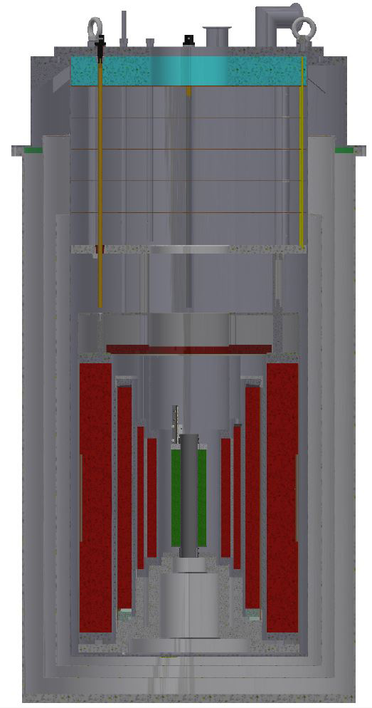
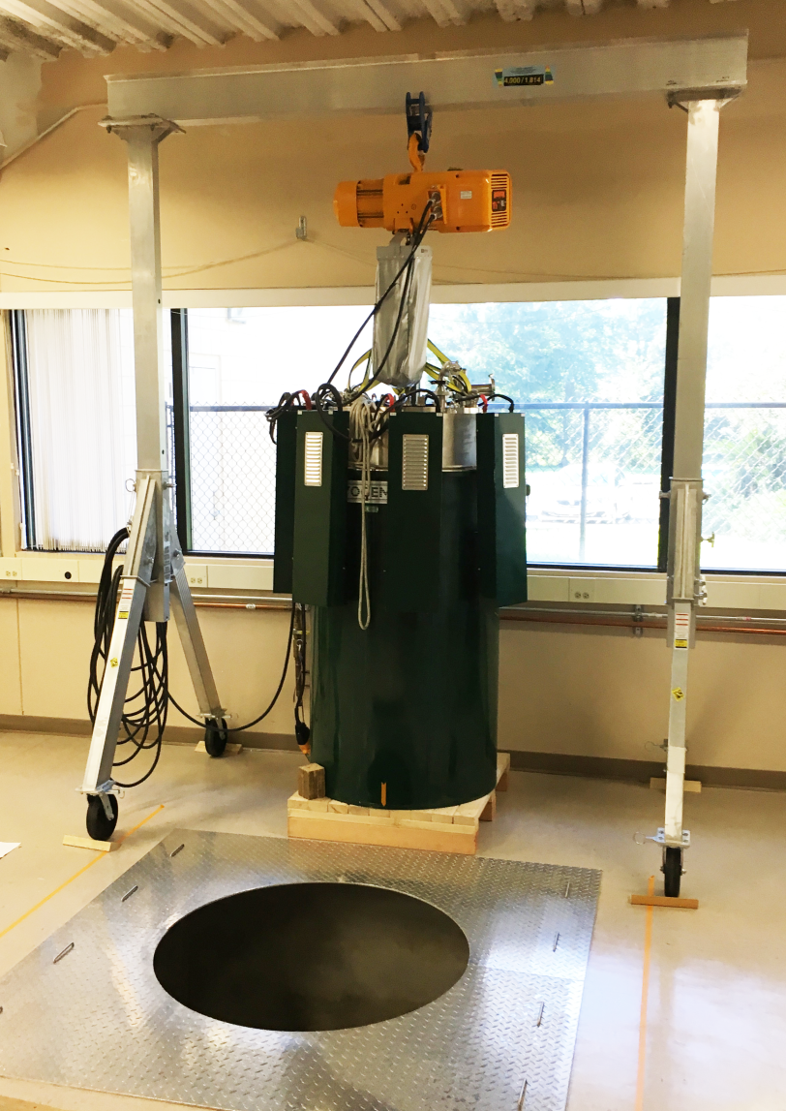
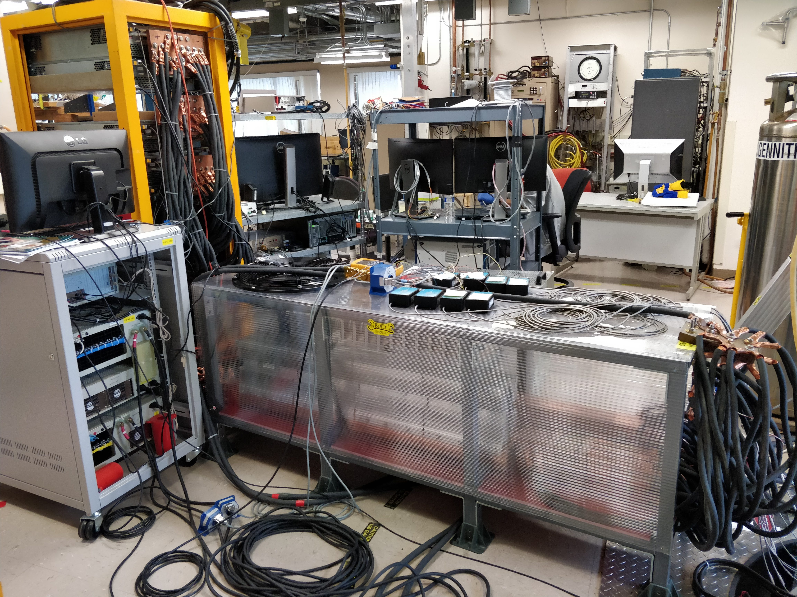
HTS Coil Test Bed
14 T superconducting magnet system:
Magnet bore 161 mm, 128 ppm homogeneity (1 cm DSV), no compensators, no shims
10 kA bus, 5-6 x 1.2 kA P.S. at present
Allows for tests that were not possible in our 8 T magnet system
Magnet provides ample space to run high field insert magnets
  To explore field generation and mechanical limits
  To add additional means to improve field homogeneity (compensation coils)
Insert P.S.
Data Acquisition
Platypus coil
Instrumentation routing
300 mm
LTS P.S.
Air cooled diodes and
10 kA bus
In pit, with 10 kA bus
During installation
2
System in use as of this week

Slide 3
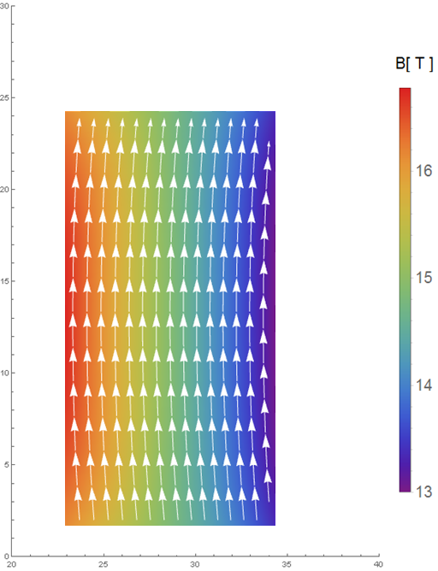
Reinforced Baby-Ruth Coils: +2 T in 14 T LTS
Coil Specs:
  6.45m conductor
  45 mm ID, 6 layers x 6 turns
  2.781 kA (0.75*Ic) at 16.64 T load-line,
  Self Field (1.97 T central field, 2.64 T peak on conductor)
Mechanics:
  At 3.7 kA, 14 T
  400 MPa source stress
  0.38 % strain
  --> we should still have some stress margin left
B_{tot} in coil, I_{op}=0.75% IC

Slide 4
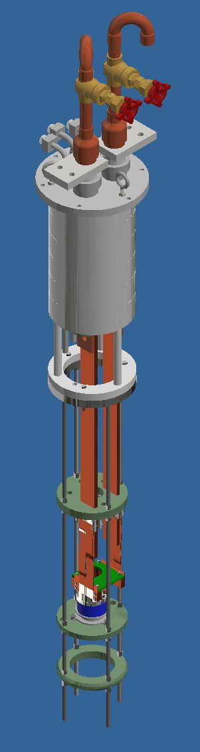
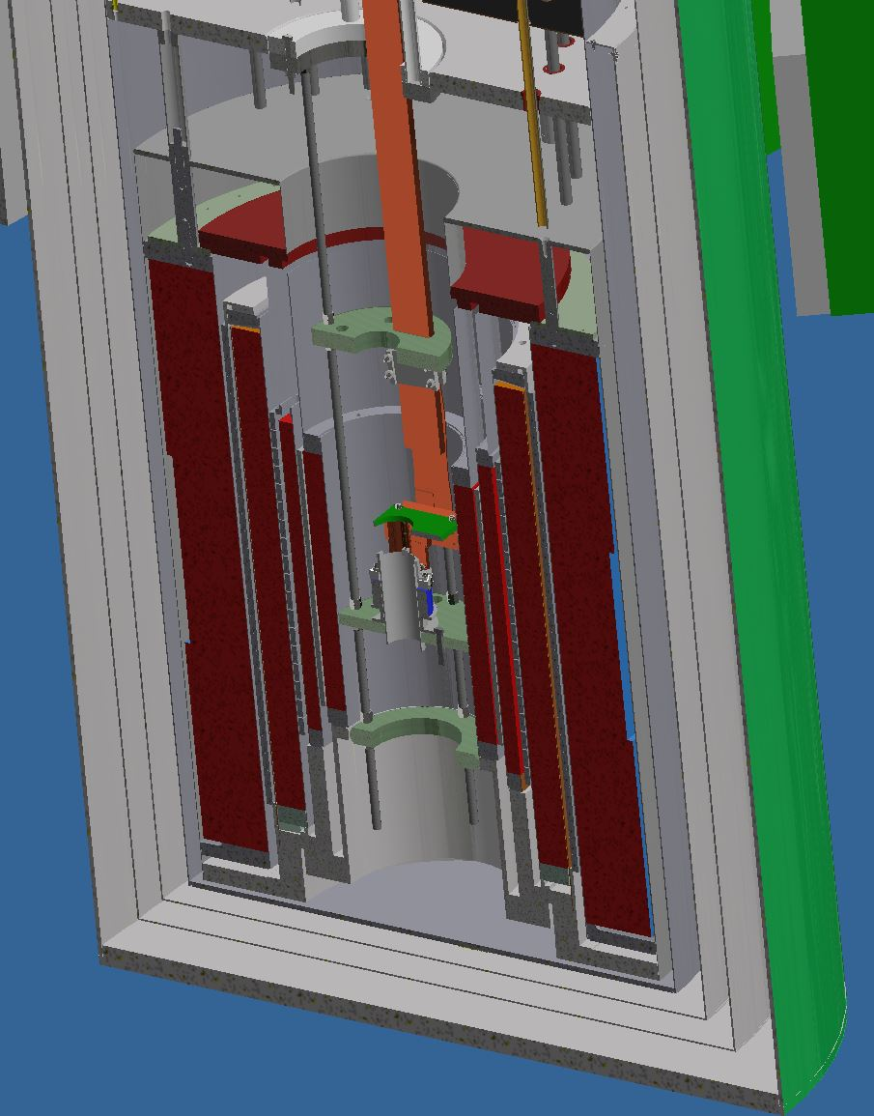
First test coil “Baby-Ruth” Engineering Design Completed
5 kA current leads
  7.5 kA AMI VCL → 5 kA AMI LTS Busbar → ReBCO + flexible Cu → ReBCO + solid Cu Interface → Ag terminal
  Minimize heating with small coil area for current transfer
  Ag terminals ceramic insulated, but epoxy bonded to coil pack
Coil Features
  Ag voltage tap flags on same side as terminals
  Hard-way bend limited to <40 mm diameter
  Test-winding to explore jogged winding vs pitched
  1 meter sealed ends for OPHT
  Insulation: Ti-O₂ + mullite braid
14 T LTS
+2 T HTS

Slide 5
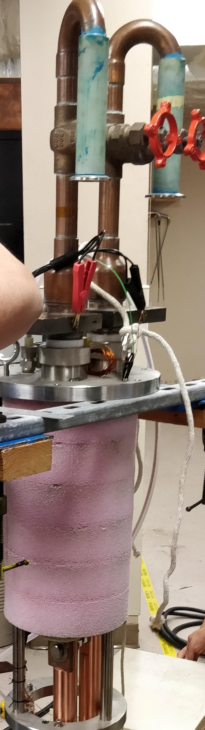
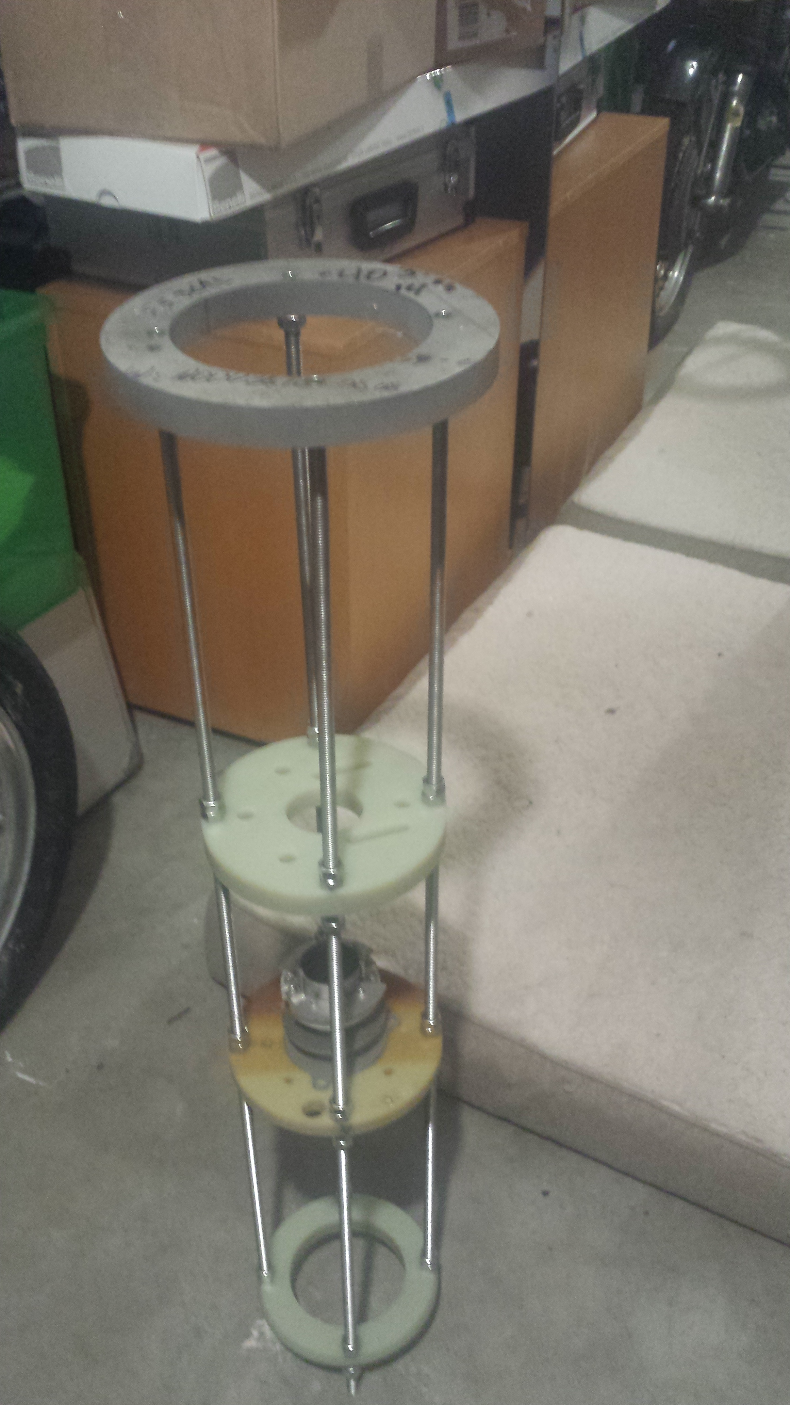
First test coil “Baby-Ruth” Fabrication Well Underway
5 kA leads
  7.5 kA VCL installed on probe head
  5 kA AMI LTS bus-bar due this week (8-week lead time)
Probe supports assembled
Coil structure assembled
  Awaiting welding on coil parts
Coil terminals
  Ag terminals fabricated
  Cu terminal and soldering fixture due mid October
Conductor being insulated on the next sunny day
14 T LTS
+2 T HTS

Slide 6
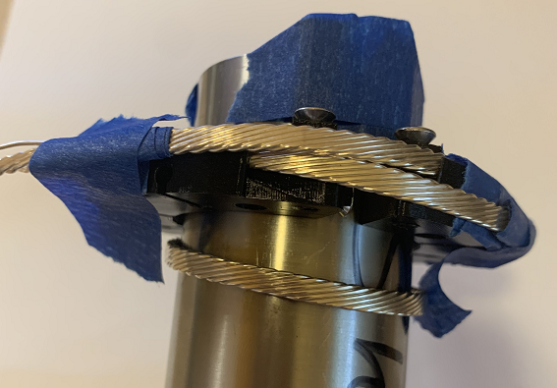
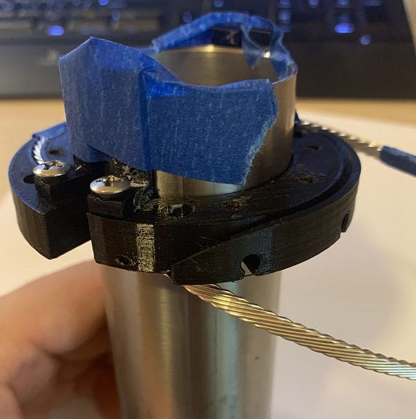
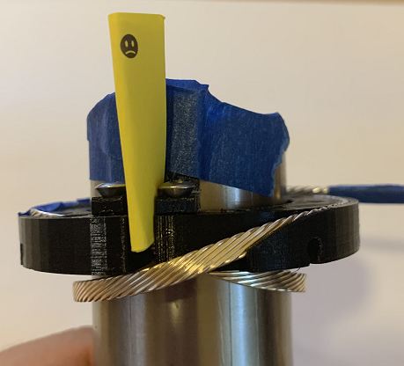
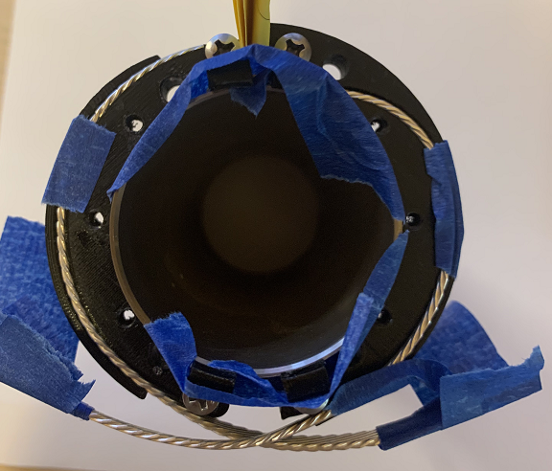
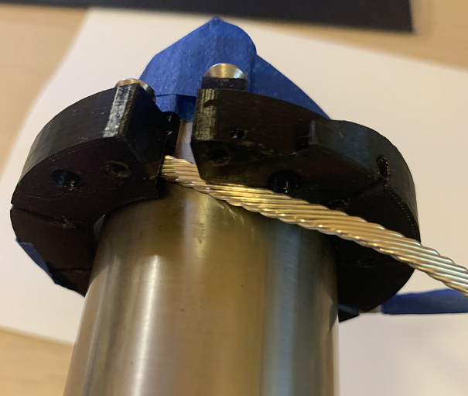
Terminal Designs Test wound with 3D printed test parts
Testing limited bends (hard/easy) and routing 1-meter sealed ends
Lead out terminal’s groove has another downward slope at the end, allowing pigtails to be wrapped to the terminals.
Assuming the winding is done, cable is now introduced to the lead out terminal groove.
(Yellow paper indicates voltage tap locations)
Lead in terminal attached to the bore

Slide 7
Map for Rutherford Cable Solenoids from MDP Meeting
2020 Q1/2 | 2020 Q3/4 | 2021 Q1/2 | 2021 Q3/4 | 2022 Q1/2 | 2022 Q3/4
Coil-1 Engineering Design
Risks
Transverse Pressure (FNAL work, NHMFL-COMSOL)
Reinforcement (explore options, mitigate with reduced J_{W} as needed)
Insulation (Small-scale with existing methods, consider scale up options)
Scale-up OPHT (CCTs, solenoids, witness samples in Renegade)
Coil-1 Fabrication
Coil-1 Test
Coil-1 Review
Coil-2 Engineering Design
Design Finished & Fabrication
On Schedule
Coil-2 Cable Determination
Coil-2 Cable Fabrication
Coil-2 Fabrication
Testing in 14 T B.G.
Coil-2 Test
Coil-2 Review
Coil scale-up options contingent upon successful tests
2-3 T added (17 T total), 8 meter (existing cable) = “Baby-Ruth”
5-6 T added (20 T total), 40 meter needed +back-up
Possible Full-Scale: 100’s of meters for full volume
(11-18 T added 25-30 T total). Major funding and large furnace required.
Coil-3 Cable Determination
Coil-3
7

Slide 8
Coil-2 Cable Determination: Stay with the same to explore coil options
Decisions from discussion on 7/27/2020:
  Continue with 9 strand cable, 55x18 Ø0.8 mm nominal strand
  Existing cable for a Baby-Ruth 2 (similar design and conductor length) (to be confirmed, LBNL cable 2001)
  For coil-3, fabricate a 9-strand cable, >40 m – 80 m, with the MDP5T2212 dipole cable
    Lead time ~1 year
Coil scale-up options contingent upon successful tests
2-3 T added (17 T total), 8 meter (existing cable) = “Baby-Ruth”
5-6 T added (20 T total), 40 meter needed +back-up
Possible Full-Scale: 100’s of meters for full volume
(11-18 T added 25-30 T total). Major funding and large furnace required.

