Slide 1
Interfaces
Steven Krave
Fermilab
US Magnet Development Program

Slide 2
Interfaces are key
Glued or frictionless or something in between.
We apply these boundary conditions to ensure controlled movement in our modeling in a fashion that matches reality
In reality we don’t typically do anything to push conditions in any one direction and have uncertainty
Uncertainty is bad, and leads to unpredictable, erratic performance
We often rely on manufacturer data and idealized cases to generate a parameter-space for simulation
This may be useful where these conditions are replicated

Slide 3
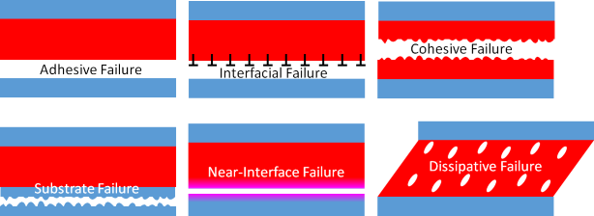
Potential Failure Modes
Interfaces in magnet composites are all a function of adhesion characteristics of the resin and surface properties
Magnet interfaces are so weak that seems unlikely that they directly cause conductor degradation
From: https://www.stevenabbott.co.uk/practical-adhesion/fmodes.php

Slide 4
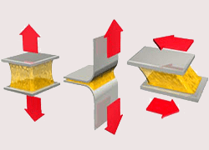
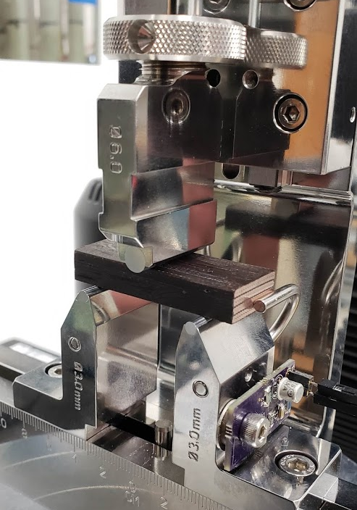
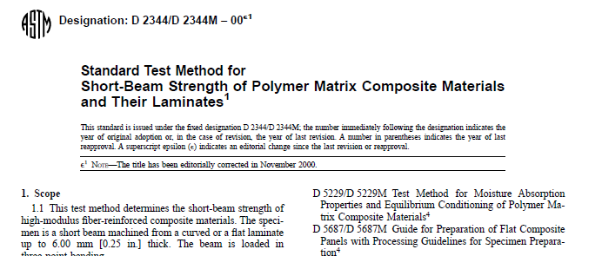
Probing Failure
Tensile Adhesion testing
I’m looking for some useable fixturing
Peel testing
Useful for flexible substrate
We have used for mold release testing
Note, good mold release means had to quantify test data
Could be cable to cable?
Would need some tooling but probably not too difficult
Shear testing
Shear Compression
Short Beam
Others

Slide 5
Example Data
Short Beam Strength per ASTM D2344 of Nb₃Sn Subscale Composite 4-stack

Slide 6
Summary of New Resins tested so Far
CTD 101K with no binder tends to go to ~15 MPa
Quiet until ~80% ultimate
CTD 155 goes to ~25MPa
Quiet until ~50% of ultimate
153 goes to ~22 MPa
Makes noise from 20%
701X goes to ~26 MPA
Reasonably quiet until failure

Slide 7
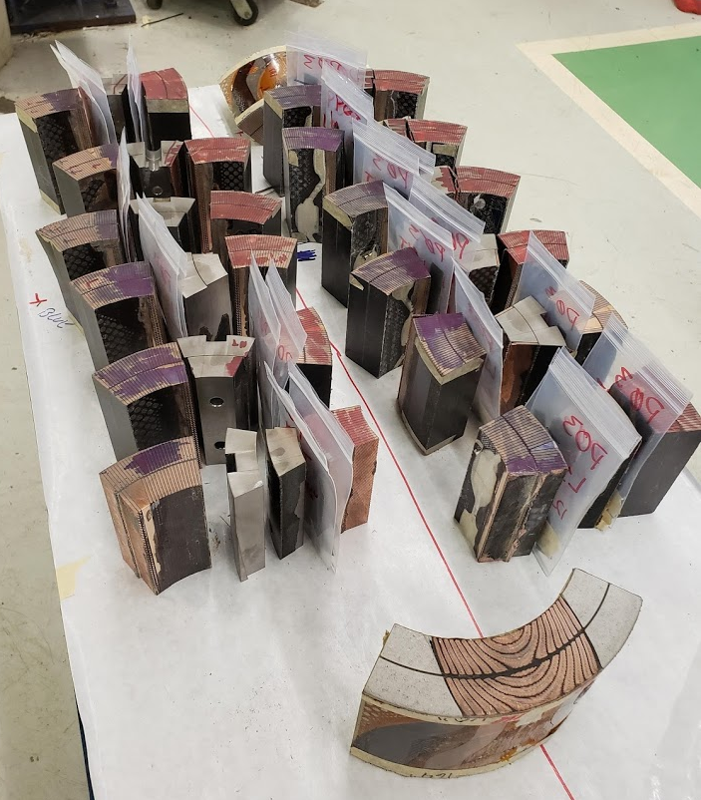
Observations and anecdotal evidence
For QXF we are doing a comparison between a good performing coil and an average performing coil.
Visual testing and Tg Measurements
Aside from some small cosmetic differences these don’t seem to build much of a case for difference in performance
But we had to break them to extract samples
We found it very easy to extract samples from the better performing coil
It was rather difficult to extract samples from the poorly performing coil
Worse Performance: Difficult to separate from pole
Better Performance: Easy to separate from pole

Slide 8
Small scope plans moving forward
We plan on fabricating and testing 4 and ten stacks of reacted Nb3Sn Cable that have been cleaned and measuring shear properties
Samples had insulation ultrasonic cleaned and rinsed in alcohol
Cable ultrasonic cleaned in 2% Citranox and rinsed in alcohol
Clean samples mean clean, clear cable samples
I have not seen this in any other samples made
The tech forgot mold release and needed a hammer and chisel to separate the cable sample from the tooling

Slide 9
Suggestions for potential low friction/ reactable mold releases
Nickel Boron
Nickel plating with embedded boron
Boron aluminum Magnesium
High tech coating
Tungsten Disulfide
Not compatible with epoxy
Good to over 1000C and compatible with thermoplastics
Boron Nitride
Seems to work ok, I have made some samples. It’s not as great as traditional mold releases but works. Adheres to the sample. Radiation concerns.

