Slide 1
Being an Upstander & COVID-19
Mark Bandstra
Jeff Bramble
Heather Crawford
Tom Gallant
Ernst Sichtermann
Speaking up as we come back to the lab

Slide 2
What is an Upstander?
Upstander: someone who observes or experiences microaggressions and speaks up with the aim to stop the behavior from happening again
Upstander behavior: acts of respectful intervention, civility, and setting example with one’s own behaviors
Being an upstander is often not easy…
Few of us feel comfortable ‘calling someone out’ – which is why we all need to understand that this is not what being an upstander means
IDEA Resources: https://ideas-in-action.lbl.gov/topics/upstander and Upstander Action Guide

Slide 3
Upstander Behavior & COVID-19
In the context of COVID-19 and returning to work, upstander behavior is as critical as ever
The main difference is that rather than supporting and advocating for people and communities that share a different background or identity than their own, in the context of COVID-19 we can advocate for our shared health and safety

Slide 4
Speaking Up

Slide 5
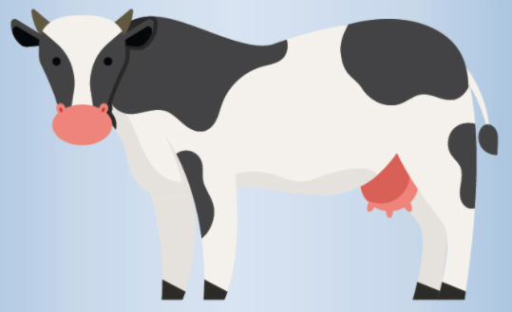
Speaking Up (6’ Away!)
Some useful (?) reference points for 6’ distance:
Fourteen tacos
Three armadillos
One standard ice hockey stick
One dairy cow

Slide 6
Speaking Up

Slide 7
Speaking Up (Wearing your Mask Properly!)

Slide 8
Speaking Up

Slide 9
Things to Keep In Mind
Reminding colleagues about the safety guidelines is just that – chances are that they honestly slipped up and will appreciate the reminder

Slide 10
Things to Keep In Mind
Reminding colleagues about the safety guidelines is just that – chances are that they honestly slipped up and will appreciate the reminder
Everyone has a life they go home to, and we often don’t know what that may include
Many of us have members of at-risk populations in our homes or immediate family circles
More than ever, we cannot and should not second-guess what non-work stresses our colleagues are experiencing – patience and empathy are key

Slide 11
More Things to Keep In Mind
Upstanding in all contexts, including safety and COVID-19 related issues is a person-to-person interaction, plain and simple
Whether you are talking to Director Witherell, your postdoc, the shuttle driver, or your direct supervisor in this context you’re speaking to another human being about your shared safety

Slide 12
Even More Things to Keep In Mind
If you’re reminded of precautions which accidentally you’ve let slip, thank the person who reminded you
Positive responses encourage all of us to repeat a behavior – we’re all more likely to speak up the next time if our actions are received well

Slide 13
Thank you!
Special thanks to the talented actors and production staff of the ‘NSD COVID-19 Mini-Documentary Series’
Jackie Gates, Nishi Intwala, and Jenn Pore

