Slide 1
MDP General Meeting
20 T hybrid magnet and comparative analysis
P. Ferracin, G. Ambrosio, E. Barzi, L. Cooley, R. Gupta, V. Kashikhin, V. Marinozzi, I. Novitski, B. Yahia, A. Zlobin
US Magnet Development Program

Slide 2
Outline
Parameterization curves
  Nb3Sn
  Bi2212
  REBCO

Slide 3
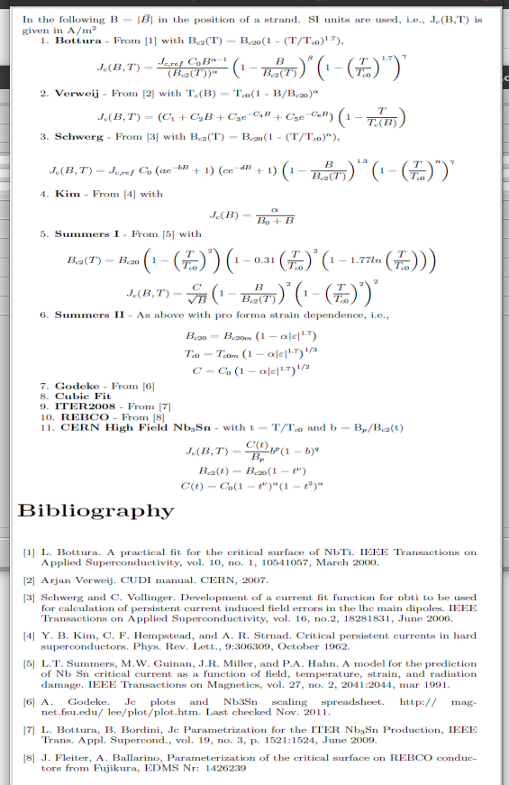
Parameterization options in Roxie

Slide 4
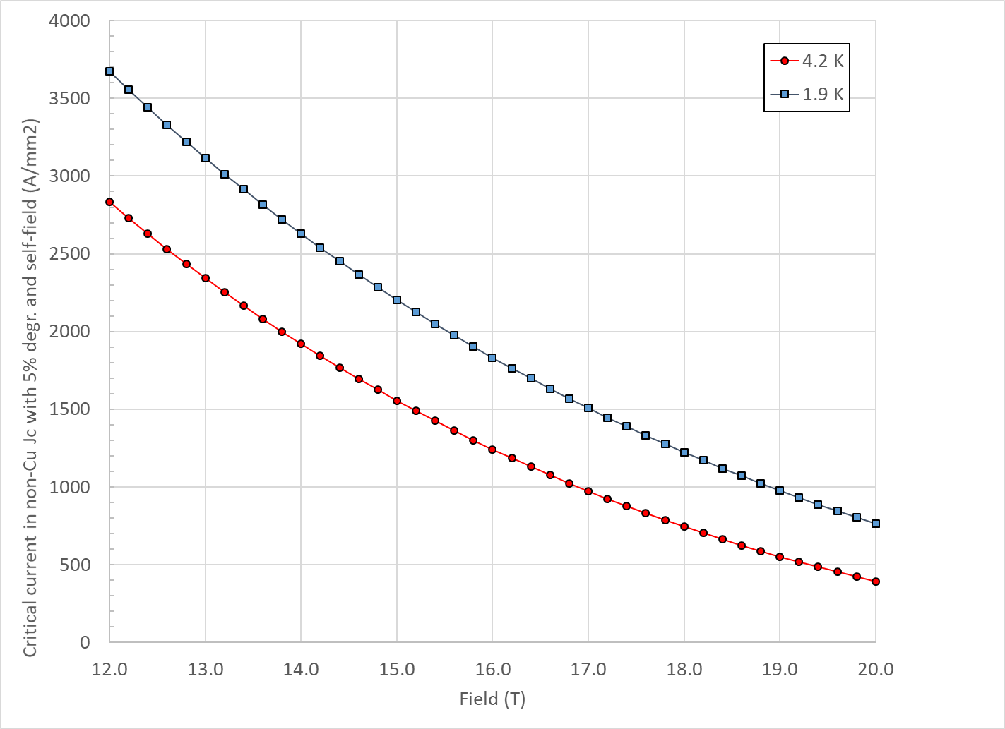
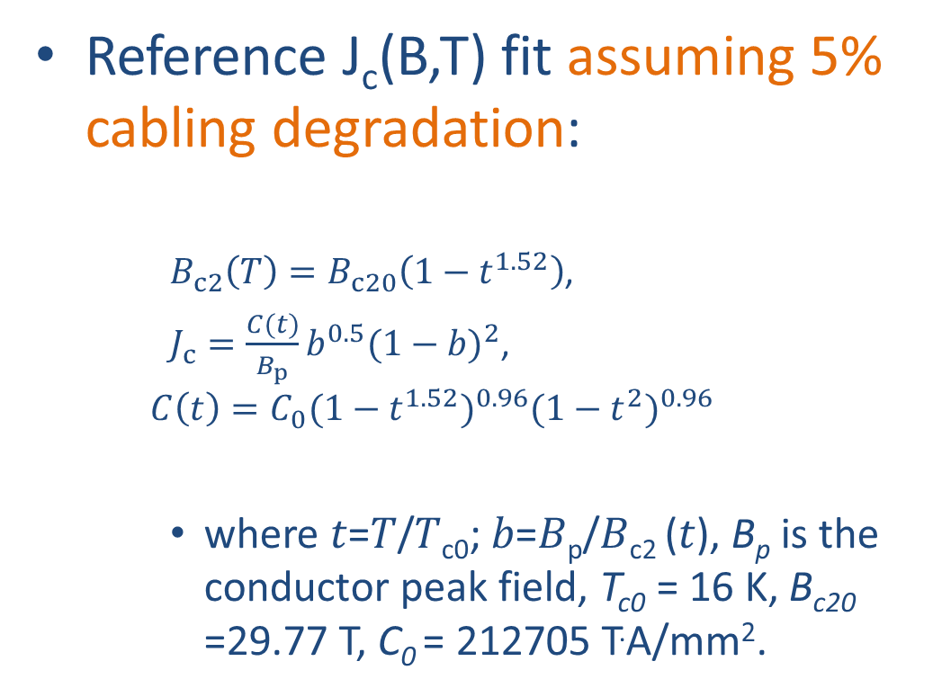
Nb₃Sn
Critical current density
Reference J_{c}(B,T) fit assuming 5% cabling degradation:
  $B_{c2}\left(T\right)=B_{c20}\left(1−t^{1.52}\right)$,
  $J_{c}=\frac{C(t)}{B_{p}}b^{0.5}{(1−b)}^{2}$,
  $$C\left(t\right)=C_{0}{(1−t^{1.52})}^{0.96}{(1−t^{2})}^{0.96}$$
    where 𝑡=𝑇/𝑇_{c0}; 𝑏=𝐵_{p}/𝐵_{c2} (𝑡), B_{p} is the conductor peak field, T_{c0} = 16 K, B_{c20} =29.77 T, C₀ = 212705 T.A/mm².

Slide 5
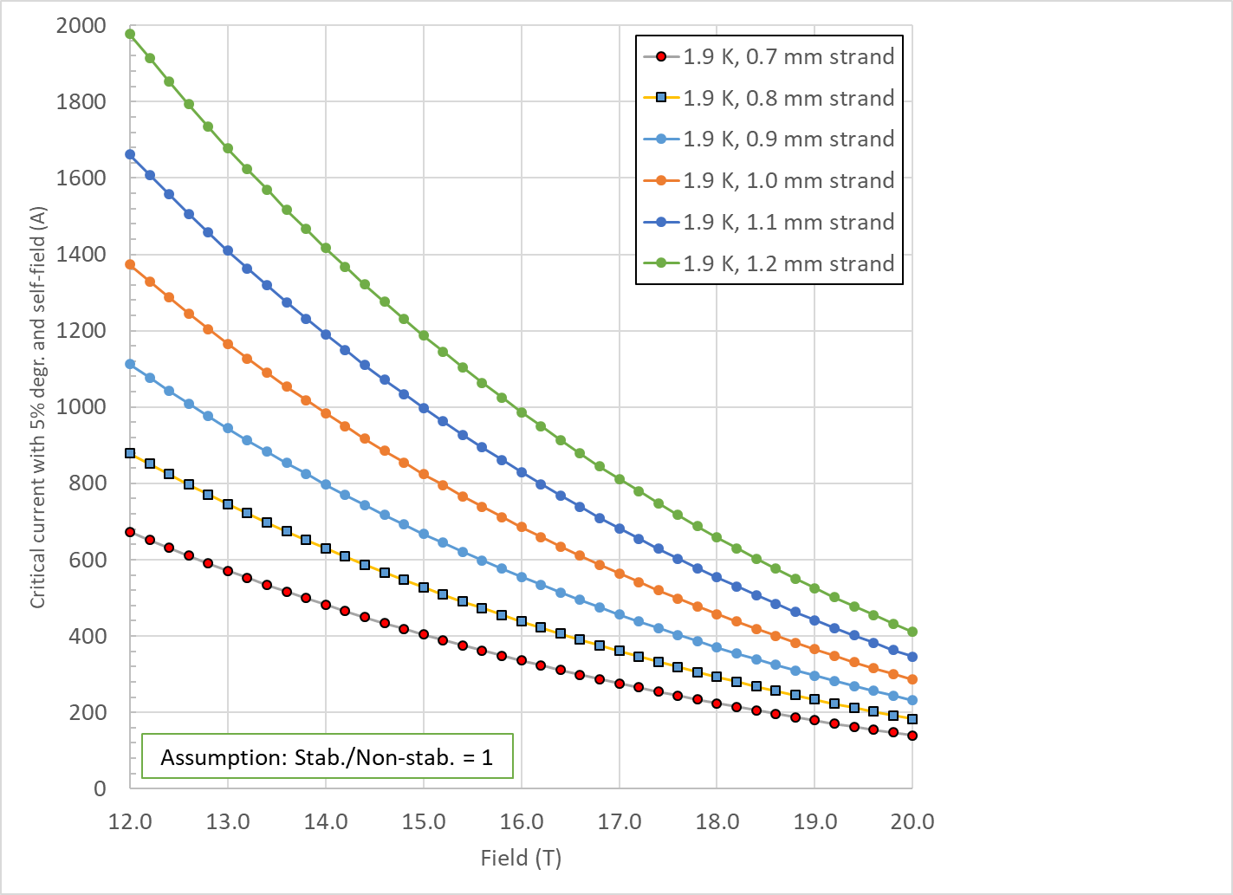
Nb₃Sn
Strand critical current

Slide 6
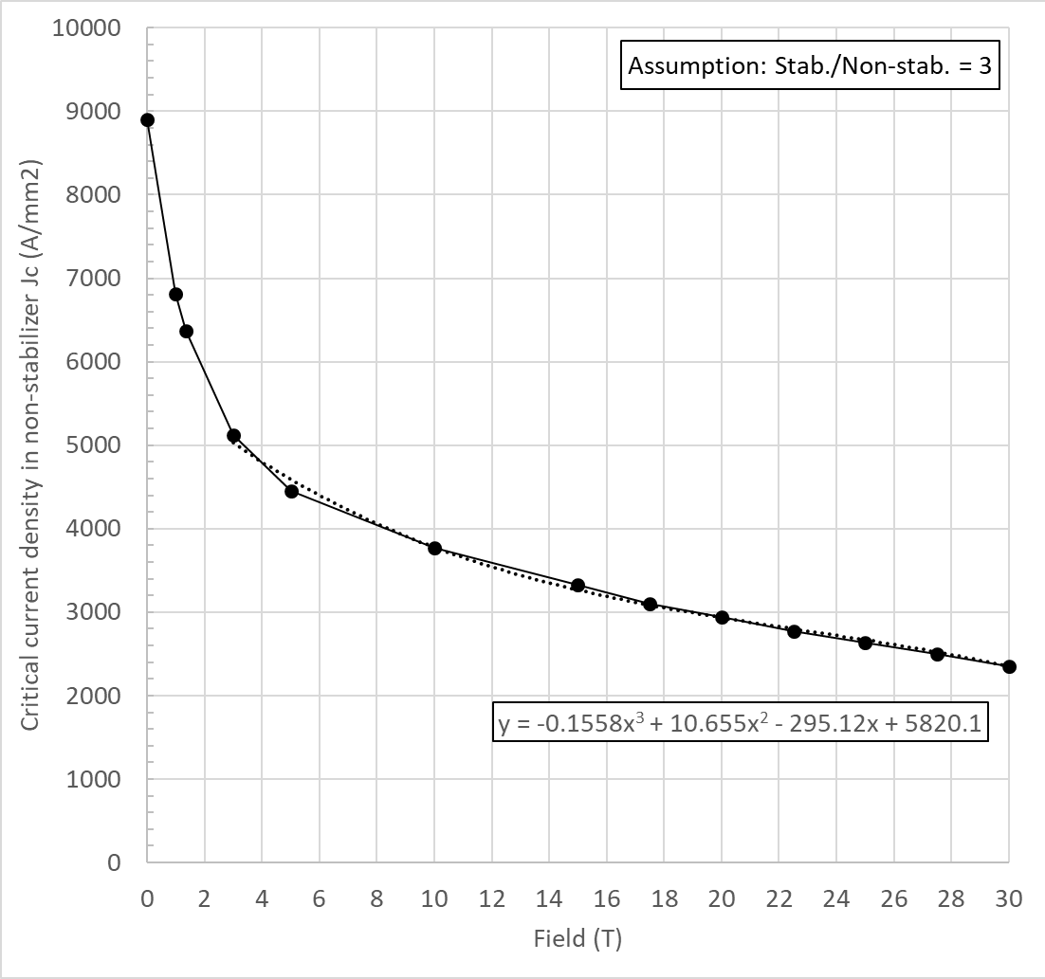
Bi2212
Critical current density
Assumption: Stab./non-stab. = 3
Cubic fit from 3 to 30 T
J_{c} (A/mm²) = a ⋅ B³ + b ⋅ B² + c⋅ B + d
a | -0.1558
b | +10.655
c | -295.12
d | +5820.1

Slide 7
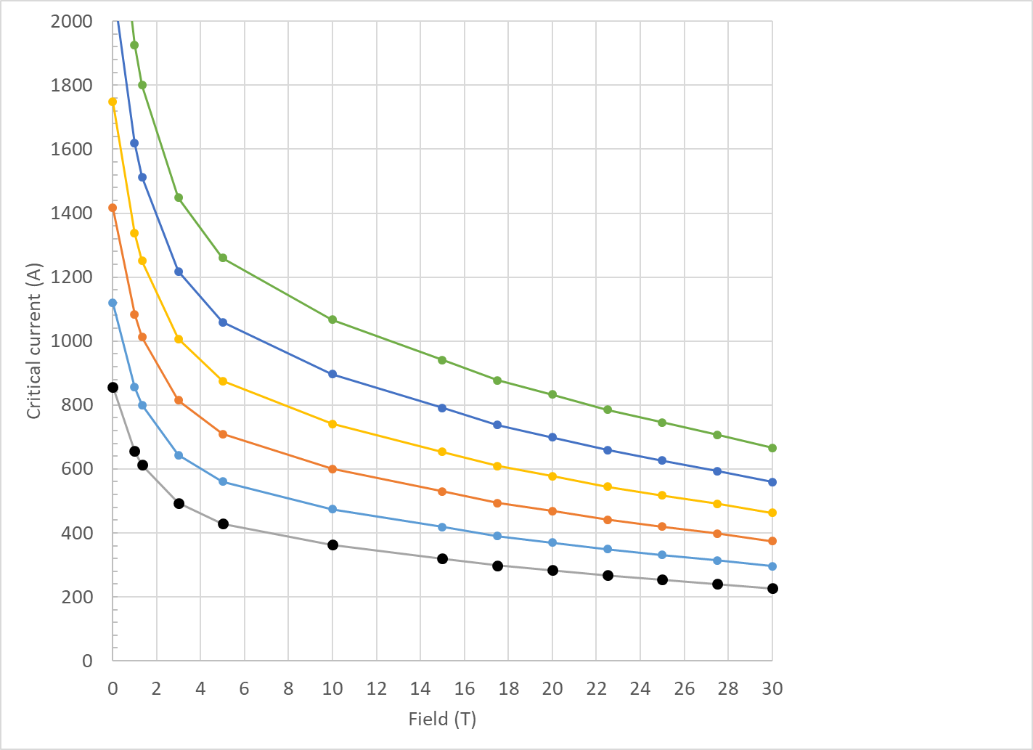
Bi2212
Strand critical current

Slide 8
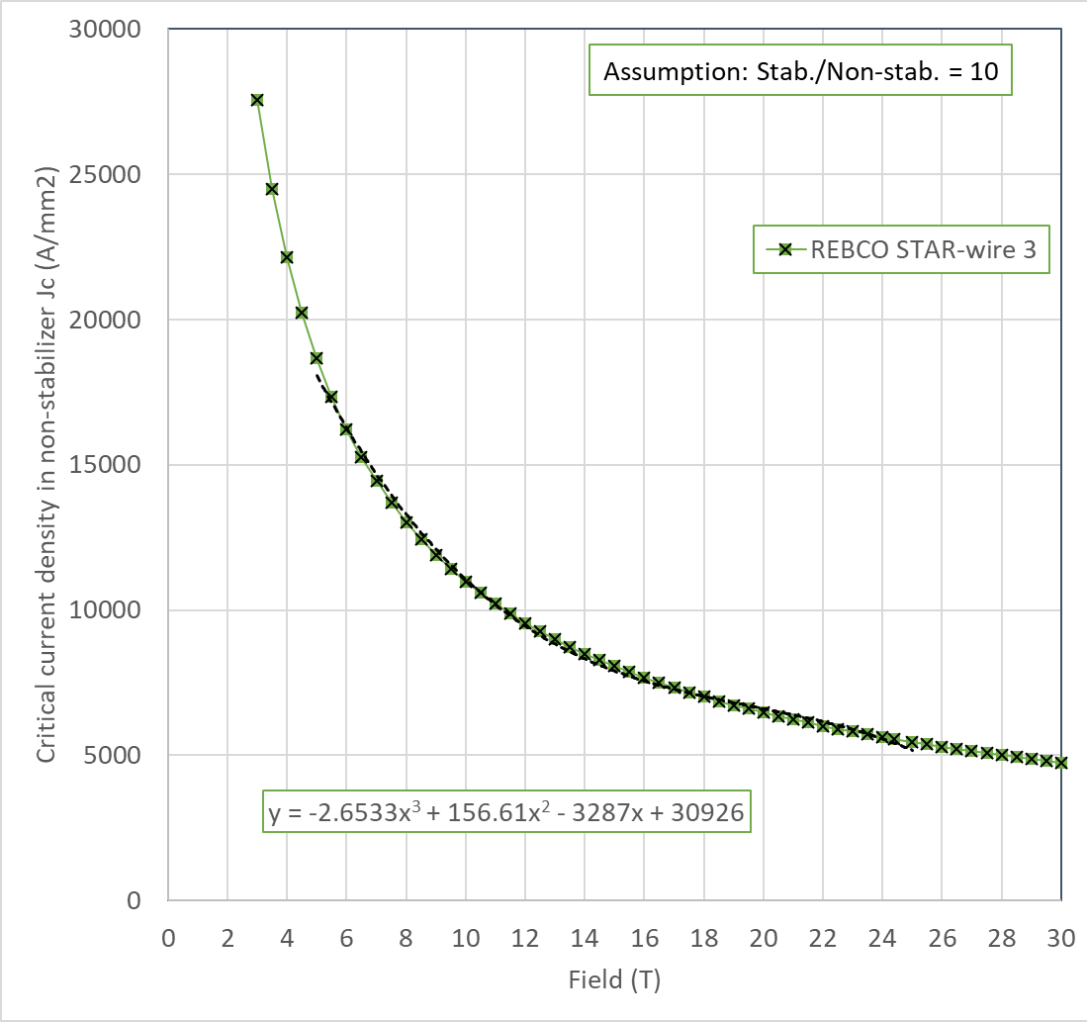
REBCO
Critical current density
Assumption: Stab./non-stab. = 10
Cubic fit from 5 to 25 T
J_{c} (A/mm²) = a ⋅ B³ + b ⋅ B² + c⋅ B + d
a | -2.6533
b | +156.61
c | -3287
d | +30926

Slide 9
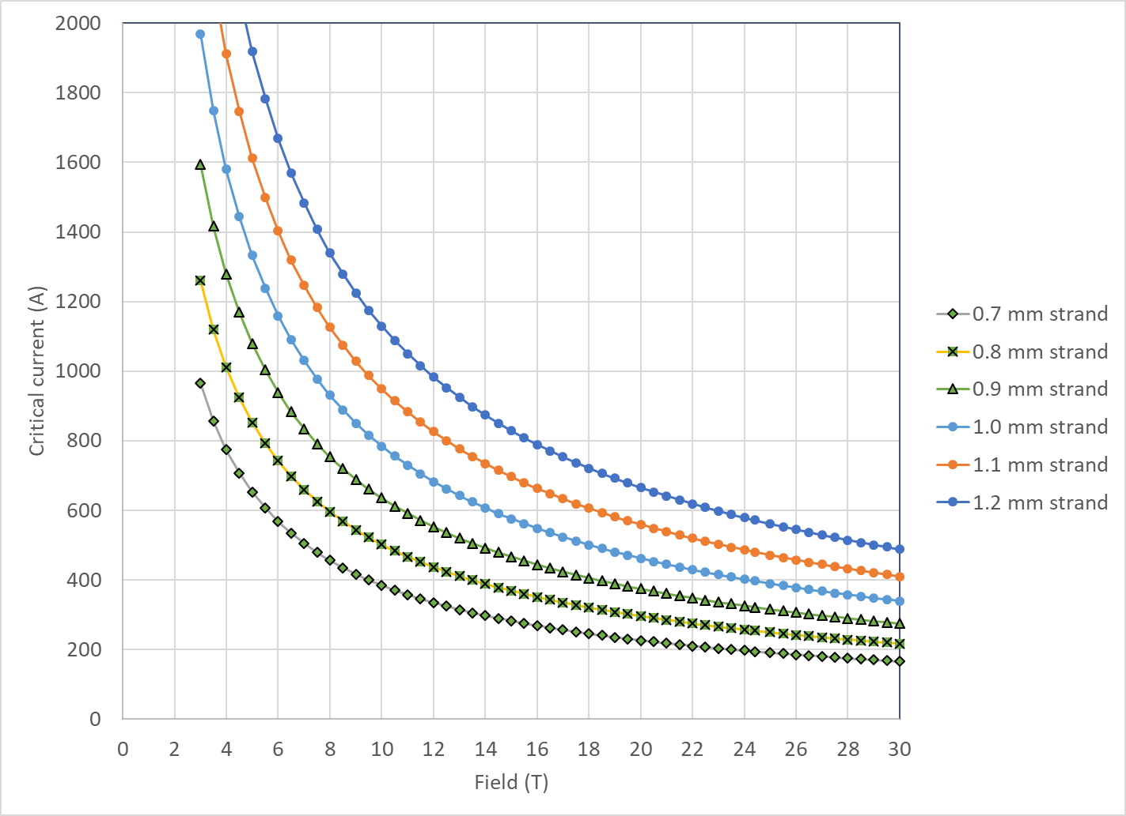
REBCO
Strand critical current

Slide 10
Appendix

Slide 11
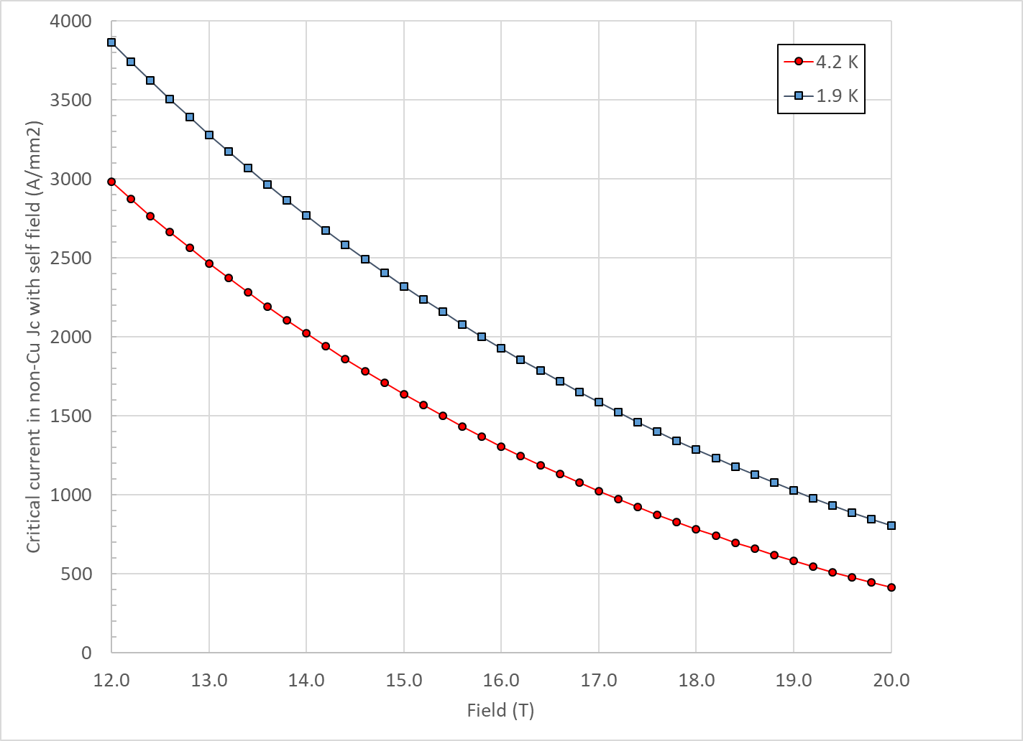

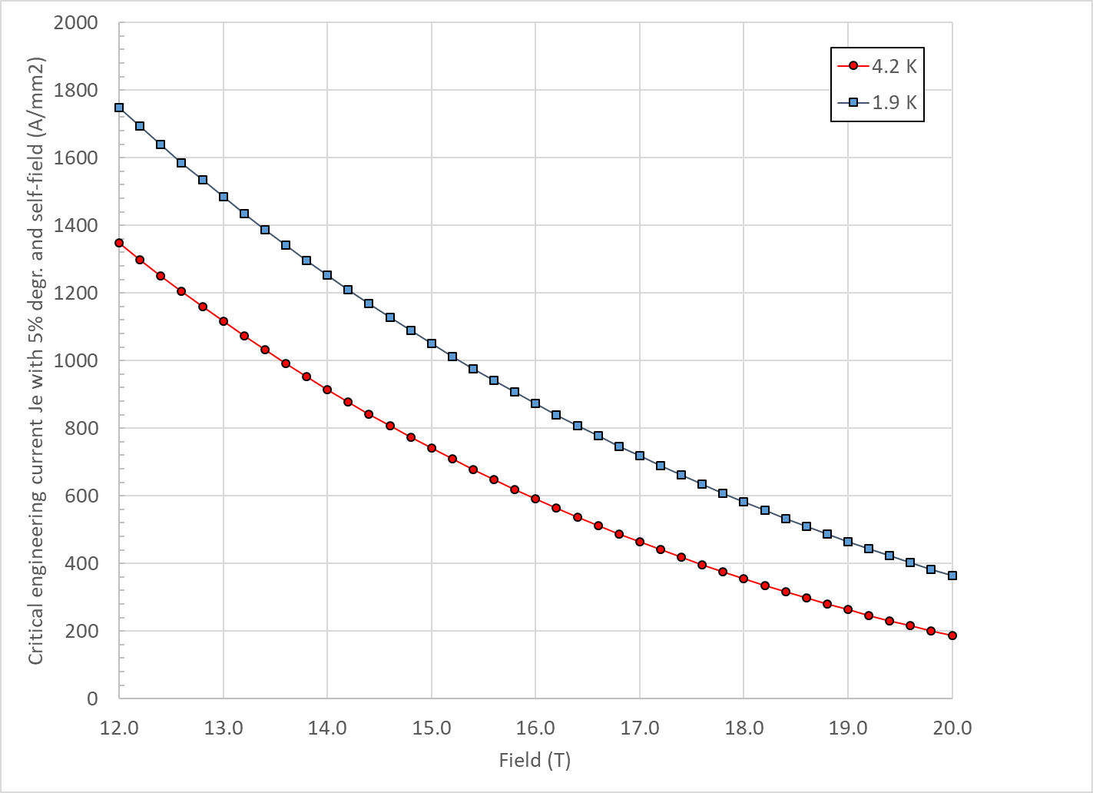
Design criteria for a 20 T hybrid magnet
Nb₃Sn Conductor and cable
  “3000” A/mm² kind of conductor, round, with self field
J_{c} round
J_{c} , 5% deg.
J_{e} , 5% deg.

Slide 12
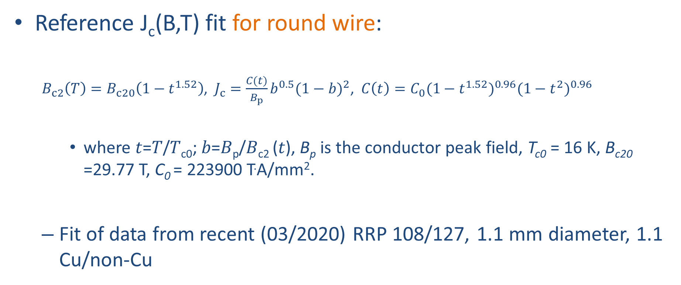
Nb₃Sn
Reference J_{c}(B,T) fit for round wire:
  $B_{c2}\left(T\right)=B_{c20}\left(1−t^{1.52}\right)$, $J_{c}=\frac{C(t)}{B_{p}}b^{0.5}{(1−b)}^{2}$, $C\left(t\right)=C_{0}{(1−t^{1.52})}^{0.96}{(1−t^{2})}^{0.96}$
    where 𝑡=𝑇/𝑇_{c0}; 𝑏=𝐵_{p}/𝐵_{c2} (𝑡), B_{p} is the conductor peak field, T_{c0} = 16 K, B_{c20} =29.77 T, C₀ = 223900 T.A/mm².
  Fit of data from recent (03/2020) RRP 108/127, 1.1 mm diameter, 1.1 Cu/non-Cu

Slide 13
Nb₃Sn
Nb₃Sn Conductor and cable
  Strand diameter 0.7-1.2 mm
  Cu:non-Cu ratio 0.8-2.0
  Non-Cu J_{c} round strand with self-field
    12 T, 4.2 K 2980 A/mm2
    15 T, 4.2 K 1640 A/mm2
    16 T, 4.2 K 1250 A/mm2
      See next slide for reference fit
  RRR (after cabling) >50
  I_{c} degradation due to cabling 5%
  Maximum number of strands in cable 60
  Cable Insulation thickness 0.150 mm

Slide 14
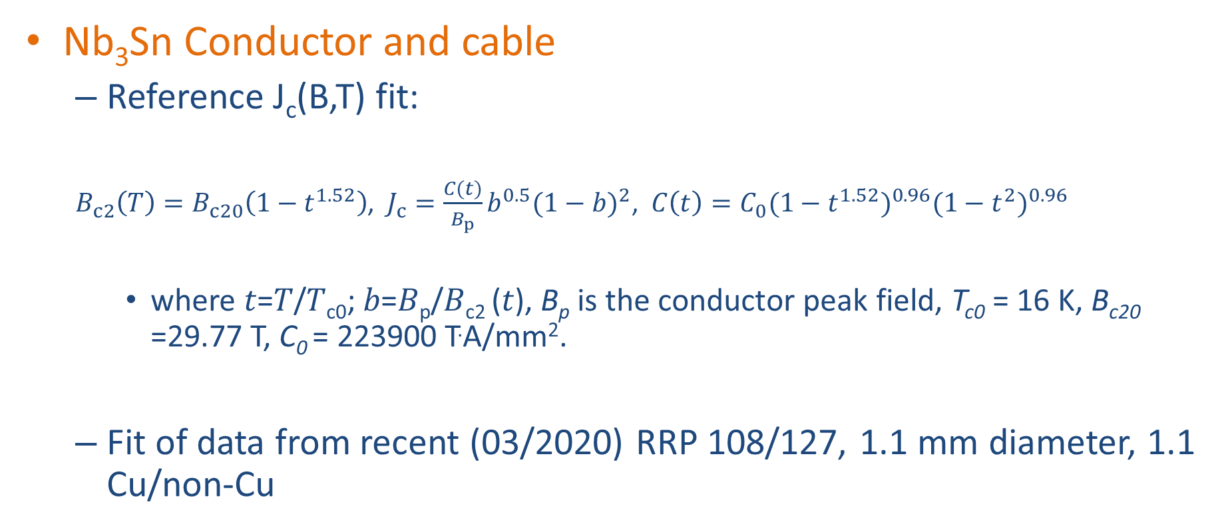
Design criteria for a 20 T hybrid magnet
Nb₃Sn Conductor and cable
  Reference J_{c}(B,T) fit:
  $B_{c2}\left(T\right)=B_{c20}\left(1−t^{1.52}\right)$, $J_{c}=\frac{C(t)}{B_{p}}b^{0.5}{(1−b)}^{2}$, $C\left(t\right)=C_{0}{(1−t^{1.52})}^{0.96}{(1−t^{2})}^{0.96}$
    where 𝑡=𝑇/𝑇_{c0}; 𝑏=𝐵_{p}/𝐵_{c2} (𝑡), B_{p} is the conductor peak field, T_{c0} = 16 K, B_{c20} =29.77 T, C₀ = 223900 T.A/mm².
  Fit of data from recent (03/2020) RRP 108/127, 1.1 mm diameter, 1.1 Cu/non-Cu

Slide 15
Design criteria for a 20 T hybrid magnet
Nb₃Sn Conductor and cable
  In general, it would be better to stay within already tested parameters (min, max)
Dimension before reaction; In MQXF, assumed expansion during reaction is 4.5 % (th), 1.2 % (w)

Slide 16
Design criteria for a 20 T hybrid magnet
Bi2212 Conductor and cable (input from T. Shen and L. Garcia Fajardo)
  The wire diameter:
    from 0.6 mm to 1.5 mm
  Cable width: basically same possibilities as with Nb₃Sn cables

Slide 17
Design criteria for a 20 T hybrid magnet
Bi2212 Conductor and cable (input from T. Shen and L. Garcia Fajardo)
  Record performance strand RC5/6 about 20% higher than what is currently “comfortably” produced.

Slide 18
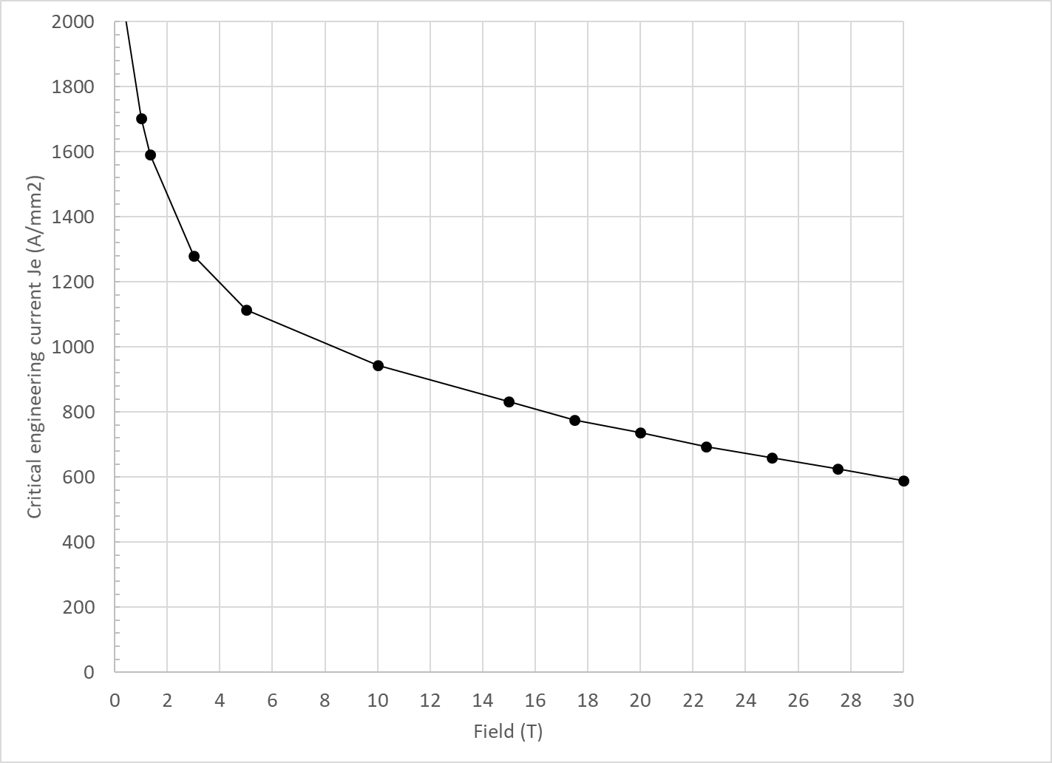
Design criteria for a 20 T hybrid magnet
Bi2212 Conductor and cable (input from T. Shen and L. Garcia Fajardo)

Slide 19
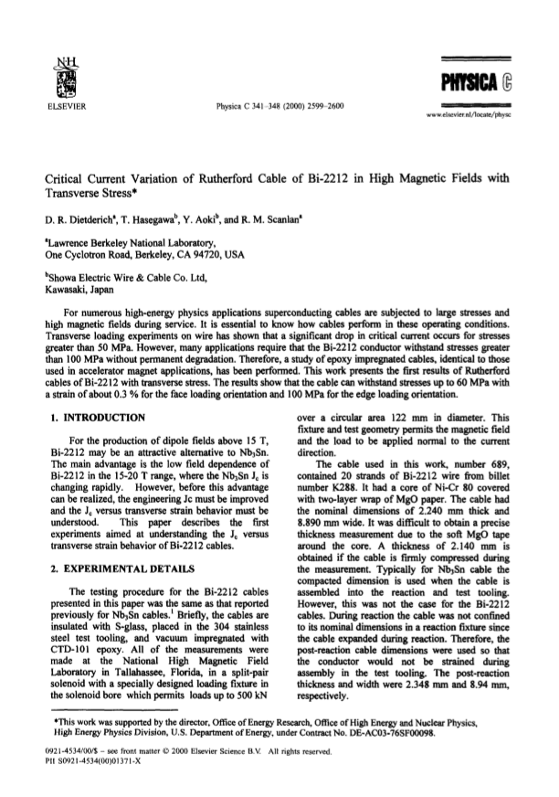
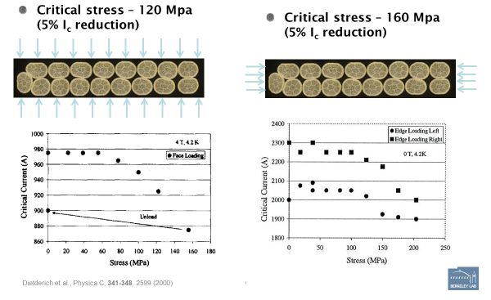
Design criteria for a 20 T hybrid magnet
Bi2212 Conductor and cable
  Maximum Nb₃Sn coil stress: <120 MPa (293) K

Slide 20
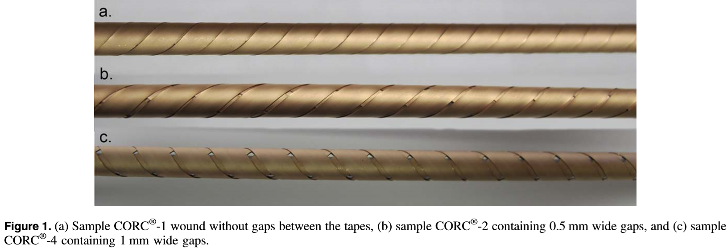
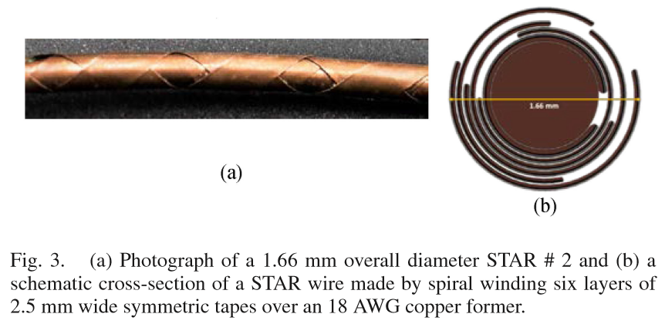
Design criteria for a 20 T hybrid magnet
REBCO Conductor
  CORC cable
    3.42mm diameter including 30 micron thick insulation.
  STAR cable
    1.3 mm diameter without insulation (#3)
    2.04 mm diameter without insulation (#4)

Slide 21
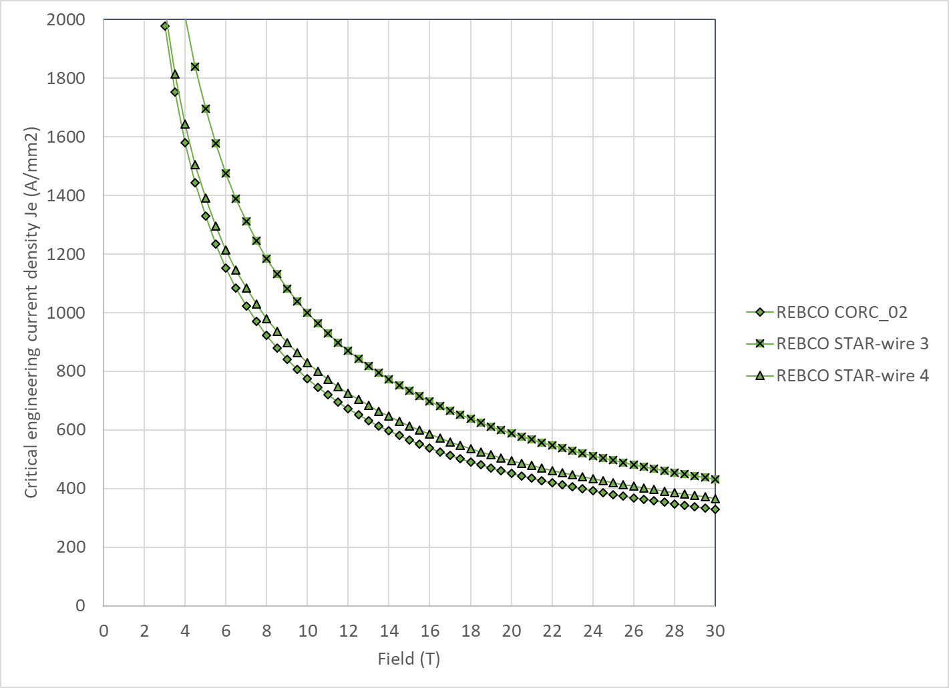
Design criteria for a 20 T hybrid magnet
REBCO Conductor
  We use the following parameterization
    Ic(B, 4.2 K) = 10^( α*log(B)+c)
  Where

Slide 22
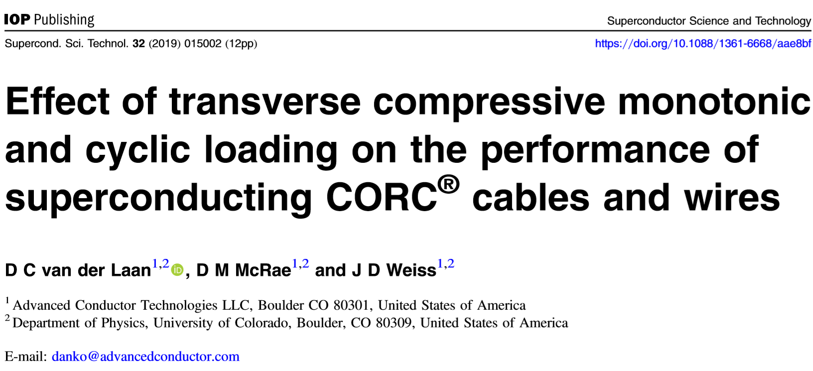
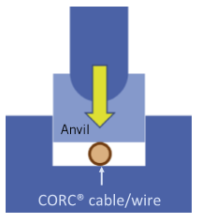
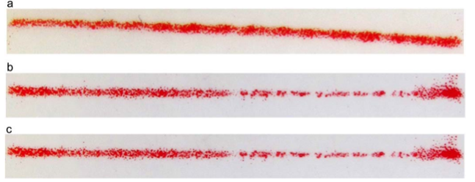
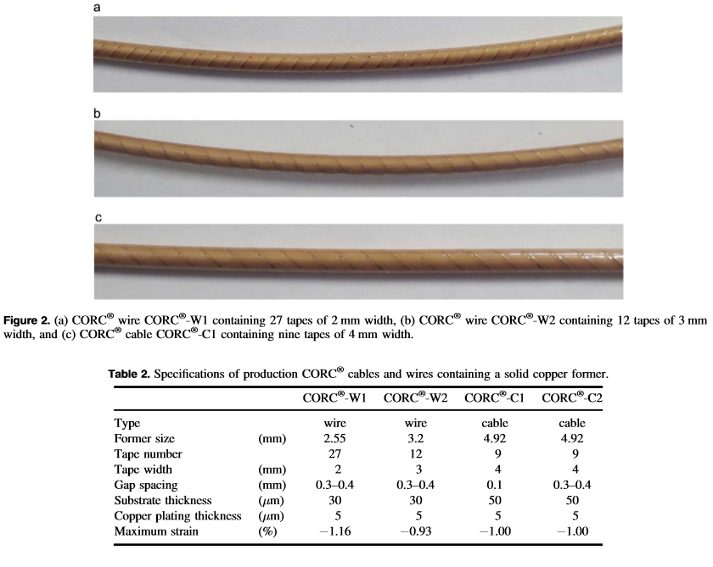
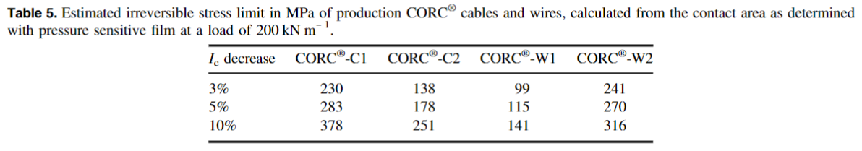
Design criteria for a 20 T hybrid magnet
REBCO Conductor
  Stress degradation

Slide 23
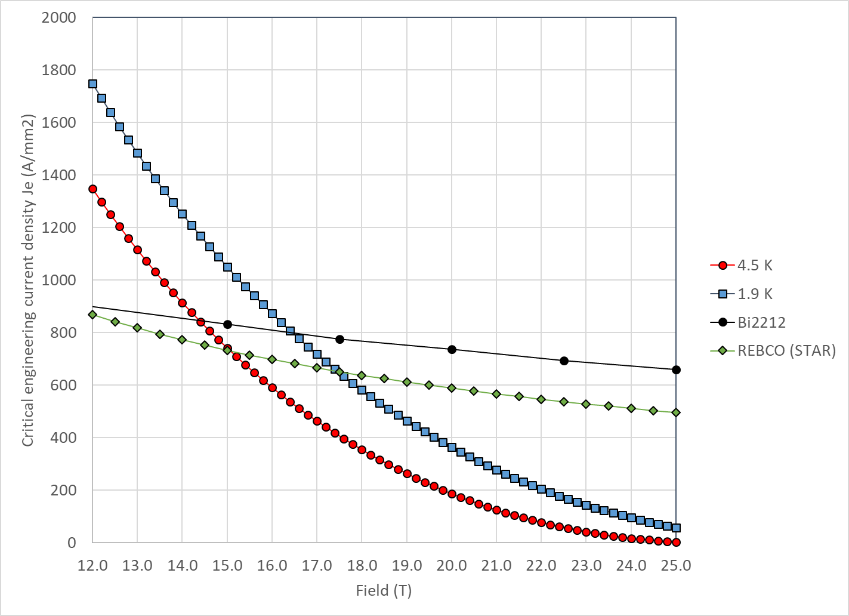
Design criteria for a 20 T hybrid magnet
With properties describe above
  Nb₃Sn and Bi2212 cross at
    14.5 T at 4.2 K
    16.5 T at 1.9 K
  Nb₃Sn and REBCO cross at
    15.0 T at 4.2 K
    17.5 T at 1.9 K

Slide 24
Design criteria for a 20 T hybrid magnet
Quench protection
  Nb₃Sn
    Maximum hot spot temperature 350 K
    Total time delay 40 ms
    Maximum J in the Cu 1350 A/mm²
    Maximum voltage to ground @ quench 1.0 kV
    Ground insulation design voltage >5 kV
  Bi2212 and REBCO
    See next slides
  Powering in series

Slide 25
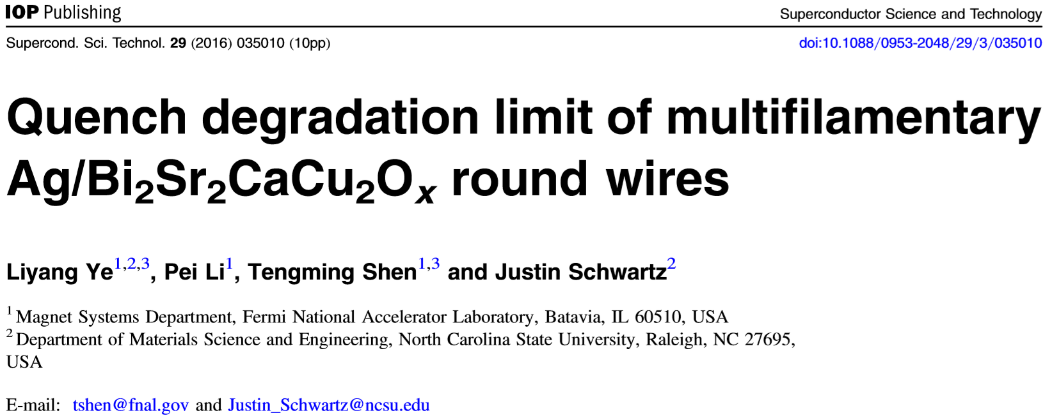
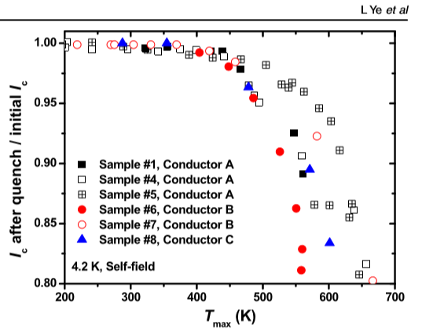
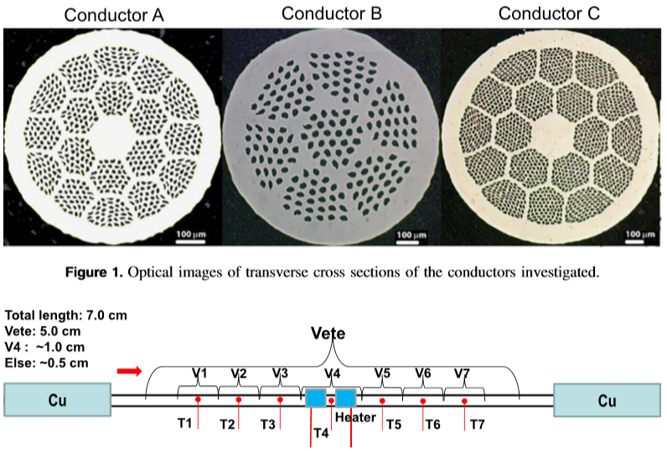
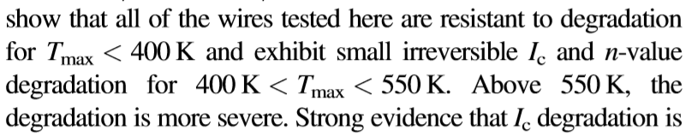
Design criteria for a 20 T hybrid magnet
Quench protection
  Bi2212: T_{max}= 400-450 K

Slide 26
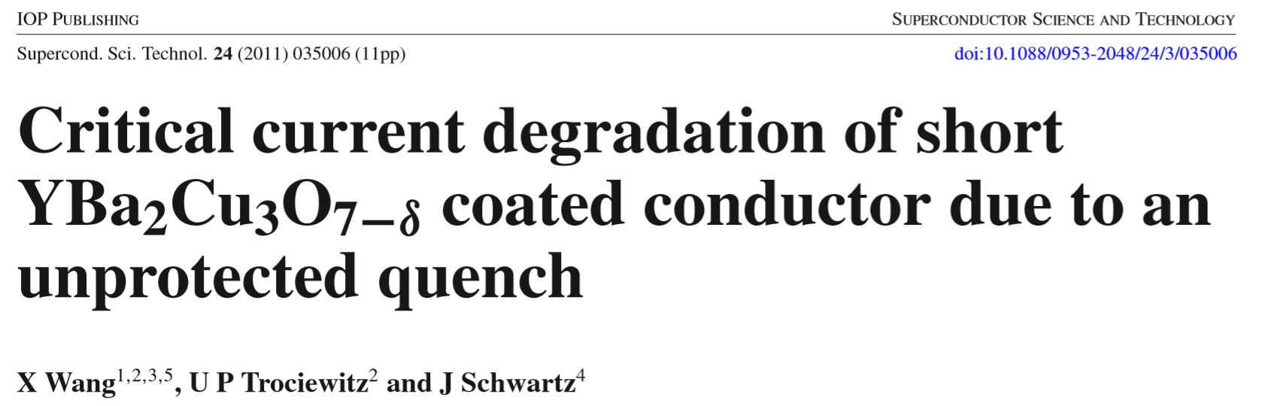
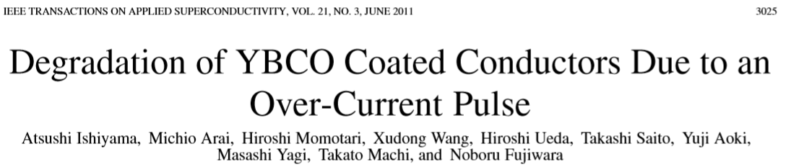
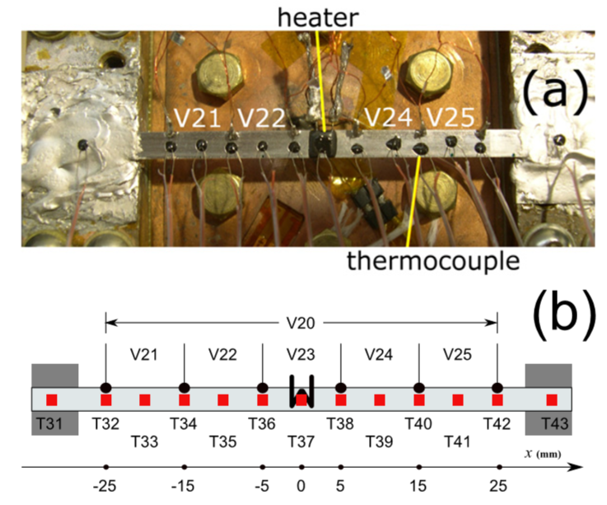
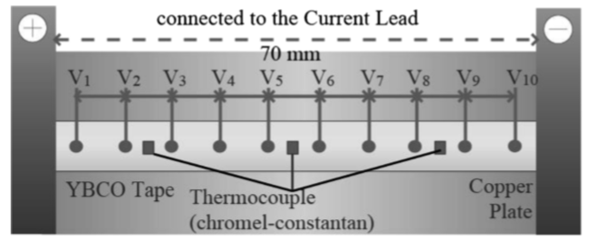
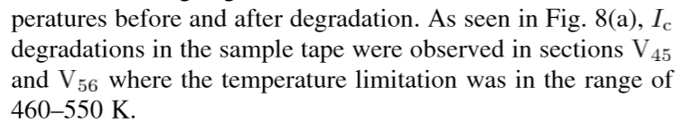
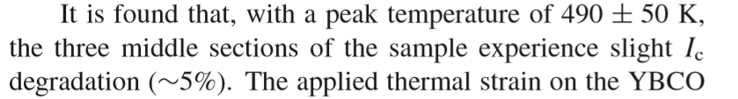
Design criteria for a 20 T hybrid magnet
Quench protection
  REBCO

