Slide 1
Status and plans for the COMB magnet development
Vadim Kashikhin, Vito Lombardo
September 30, 2020

Slide 2
COMB/REBCO development goals
The project objectives are twofold:
development of the novel Conductor on Molded Barrel (COMB) magnet technology and its initial demonstration (proof of principle) with an average-performance CORC® cable made of REBCO High Temperature Superconductor (HTS);
performance demonstration of the HTS accelerator magnet compatible with operation in a hybrid LTS/HTS magnet using the CORC® cable made of the state-of-the-art REBCO tapes (expected dipole self-field over 5 T) to meet the U.S. MDP goal (#2).
This technology, proposed at the beginning of 2019, is well suited for round conductors - including CORC® and STAR cables based on the latest generation of REBCO tapes and round Bi-2212 strands and cables. It offers an elegant solution for producing HTS inserts to boost the magnetic field strength in the superconducting accelerator magnets.

Slide 3
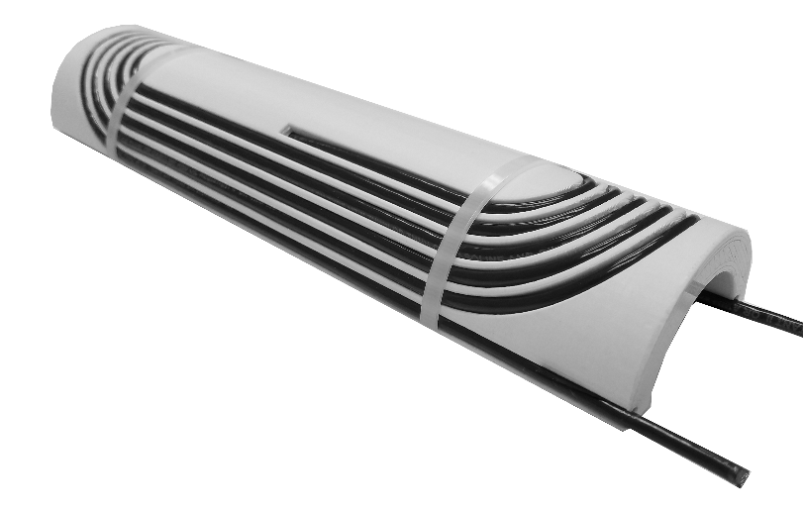
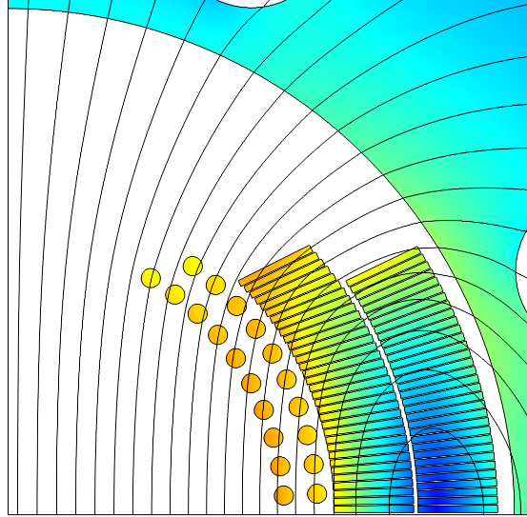

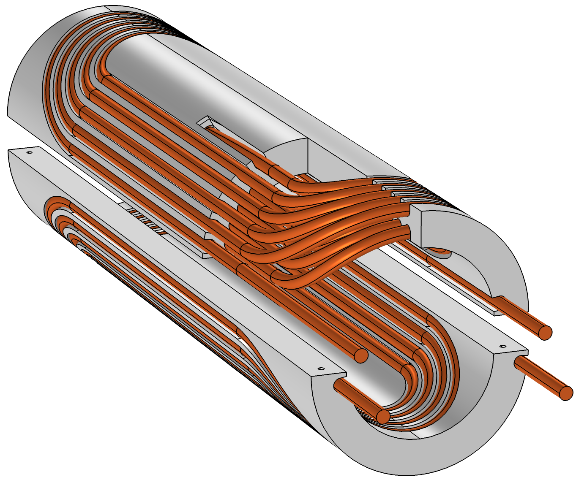
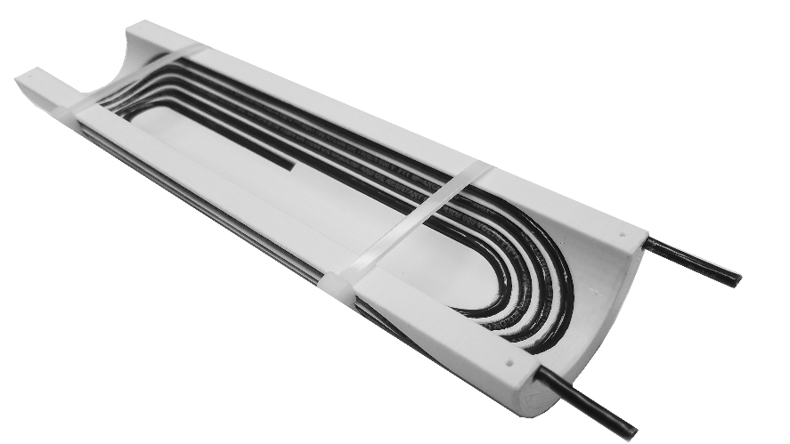
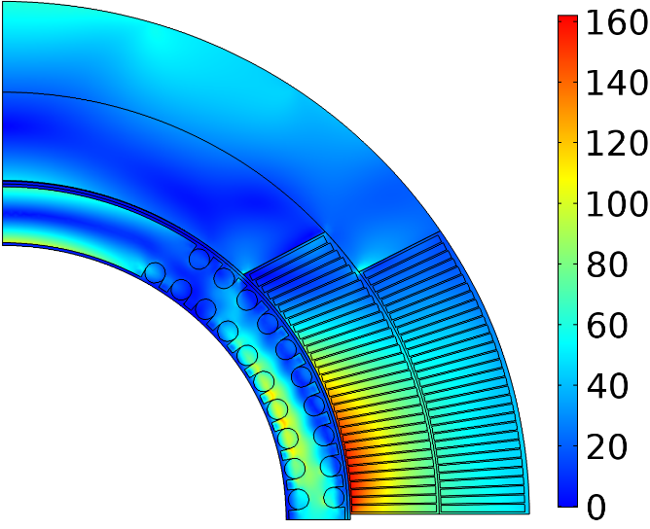
Conductor On Molded Barrel (COMB) magnet technology
Magnetic field (T)
Nb₃Sn coil
HTS coil
+1.25 T in Nb₃Sn 4.4 T standalone
Equivalent stress (MPa)
110 MPa
Mock-up coil built to demonstrate manufacturability
160 MPa
Double-COMB
support structure
Within safe limits

Slide 4
FY21 plans
The FY21 project goals are to design and fabricate one complete COMB dipole magnet (consisting of two half-coils, iron yoke and support structure) with the HTS CORC® conductor and test it in a standalone configuration at LN₂ and LHe temperatures to demonstrate the proof of principle for the new technology with >4 T dipole field produced by the HTS cable in 100 mm bore. The next step is to re-assemble the HTS coils as an insert in the outer Nb­₃Sn coils and structure from the 15-T dipole (with the cold test foreseen in FY22).
20 m of the CORC® cable for the first dipole magnet (two half-coils) has already been procured. Another 20 m of the high-performance CORC® (or STAR - TBD) cable will be needed in FY22 for the performance demonstration model (bore field >5 T). Given the long lead times on SuperPower REBCO tapes, the procurement should start soon.
FY21 milestones:
Stand-alone test of the COMB dipole magnet at LN₂ temperature (expected bore field ~0.8 T).
Stand-alone test of the COMB dipole magnet at LHe temperature (expected bore field ~4.4 T).

Slide 5
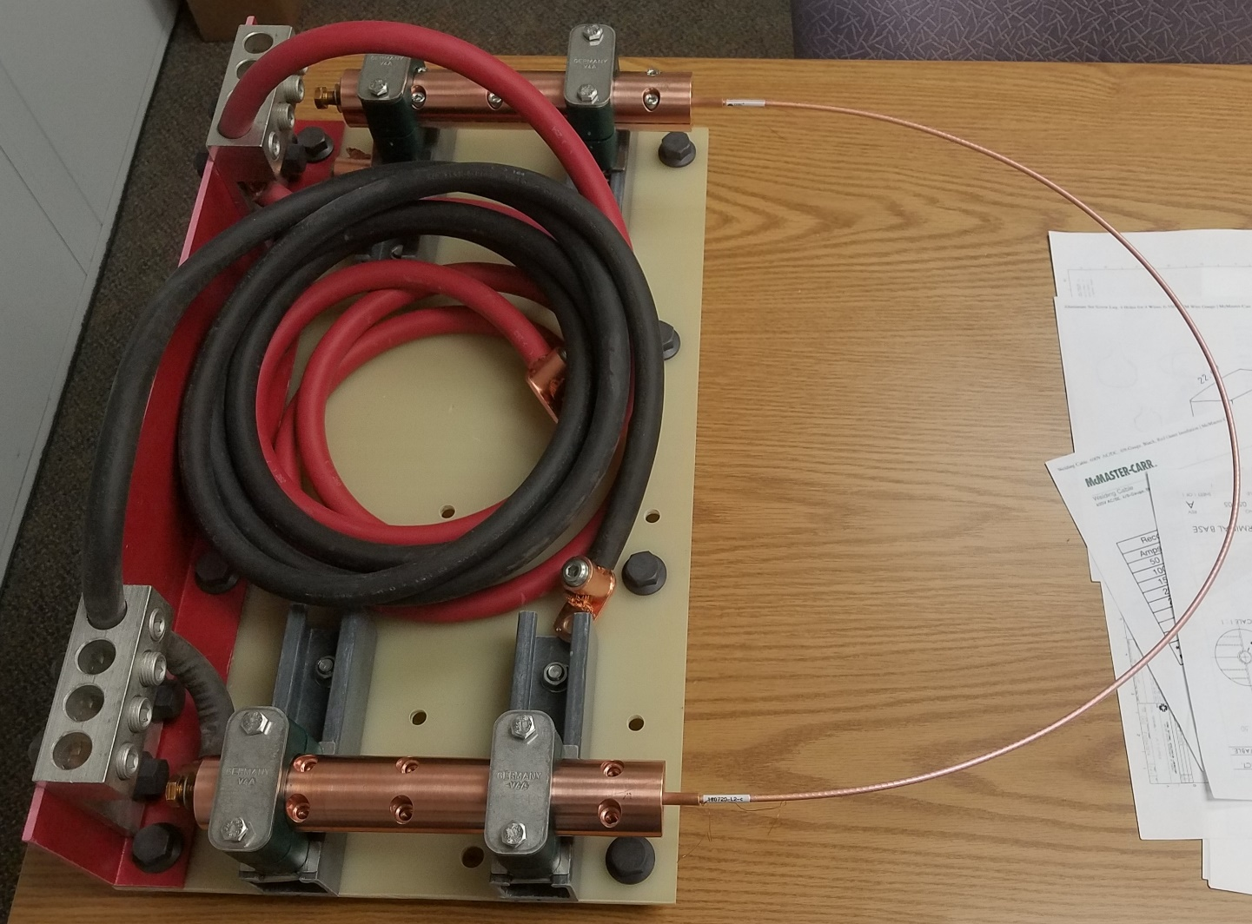
LN₂ test setup
Short-term plans: use 2.5 m of CORC cable provided by LBL to assess the bending degradation.
  The wire was split into two pieces for redundancy.
  Each piece will be first tested in a large U-shape (~0.5 m bending diameter) to measure the undisturbed wire performance.
  Then ~2.5 turns will be wound into the pole groves of the COMB structure (~52 mm minimum bending diameter) and retested.
If the bending degradation is acceptable, we will proceed with the full magnet design and fabrication.
  Otherwise, the coil will have to be redesigned with a larger bending diameter (may no longer fit into the 123 mm bore of the available Nb₃Sn magnet).
ORC is not required. Hazard Analysis is in progress. Testing starts in October.
LBL cable sample
Copper adapters and wire terminals provided by ACT

Slide 6
Schedule

