Slide 1
C3 update
Xiaorong Wang
REBCO Working Group/MDP
MDP weekly meeting, 9/30/2020

Slide 2
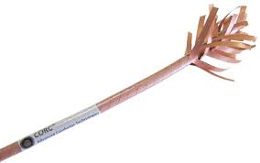
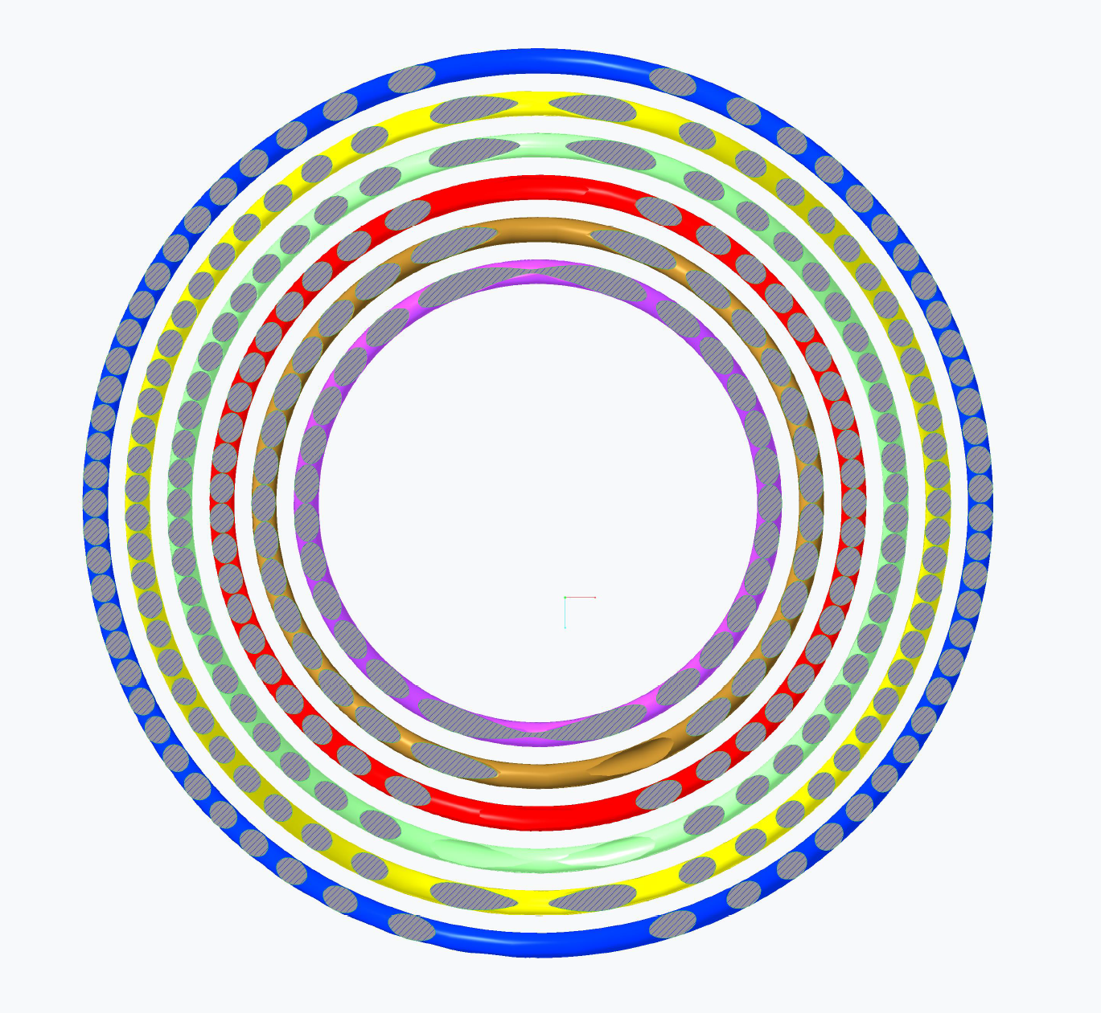
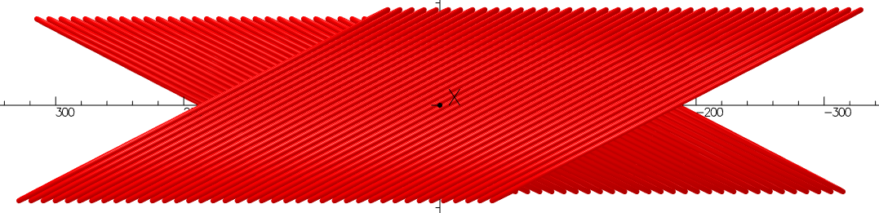
C3 will be a 6-layer CCT magnet aiming at 5 T dipole field using CORC® wires
Magnet ID: 65 mm
OD: 160 mm without external structure
Dipole field transfer function: 0.72 T/kA
Wound with commercial single CORC® wires

Slide 3
C3 will address several key questions for high-field REBCO magnet and conductor technology
Conductor
What is the optimal wire architecture to improve the I_{c} retention?
How does the minimum I_{c} specification work?
What is the actual wire performance?
What needs to be done for future conductors?
Magnet fabrication
Is it feasible to work with full-depth grooves?
What needs to be implemented to address higher Lorentz forces?
What can we learn to generate higher dipole fields?
Magnet performance
Can we generate a 5 T dipole field?
What is the mechanical behavior of the magnet?
What is the transition behavior when the conductors are impregnated?
How can we identify the locations of normal zones and understand the causes?
What is the field quality?

Slide 4
Conductor availability starts hindering the magnet/conductor feedback loop
Expect to receive CORC® conductors for C3 in Q1 2021
First CORC® order placed in Q1 2019
Tape order specified a minimum I_{c} at 4.2 K, 6 T for the first time
Tape delivery to ACT has not yet started
In addition to cost, a longer lead-time is a concern for future magnets
Work with vendors to understand the issues

Slide 5
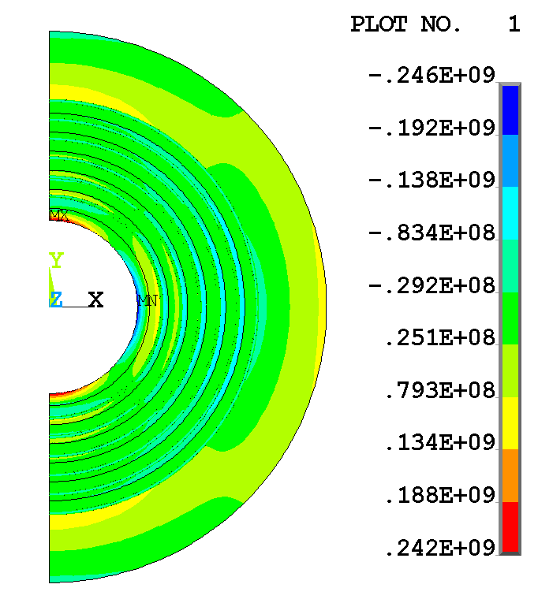
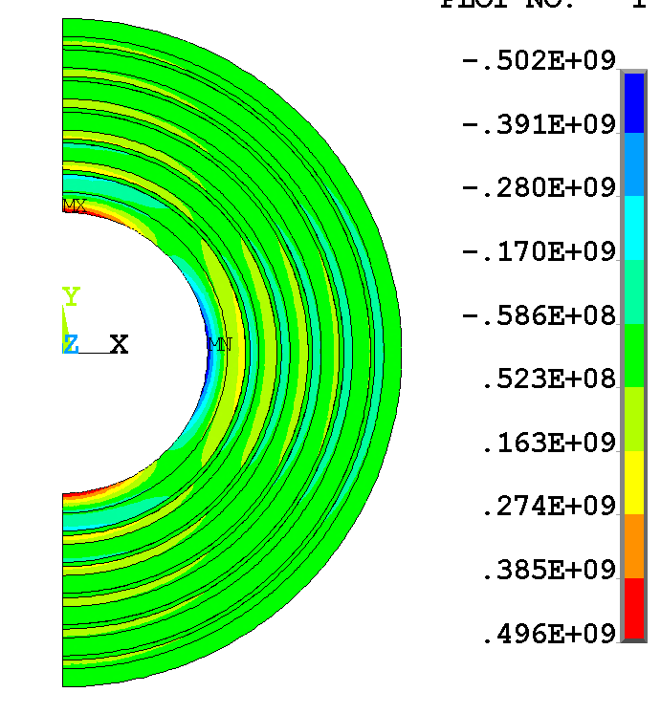
Ongoing mechanical analyses provide feedback to the magnet fabrication
An aluminum shell is necessary to reduce the peak stress on the mandrel from 500 to 250 MPa
aluminum shell
Lucas Brouwer

Slide 6
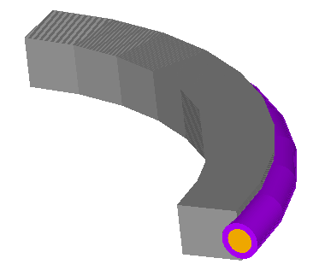
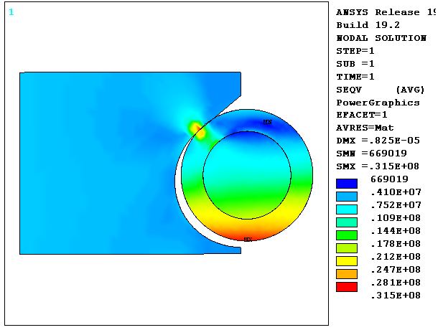
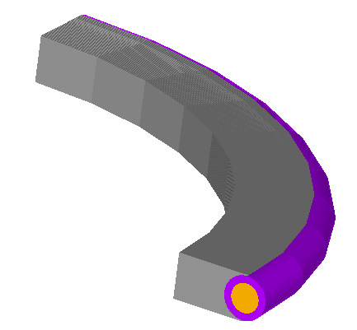
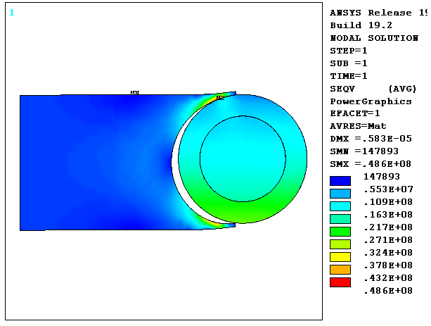
A single-cell model to evaluate the stresses on conductors with different groove designs
Pole region
Mid-plane region
Mariusz Juchno

Slide 7
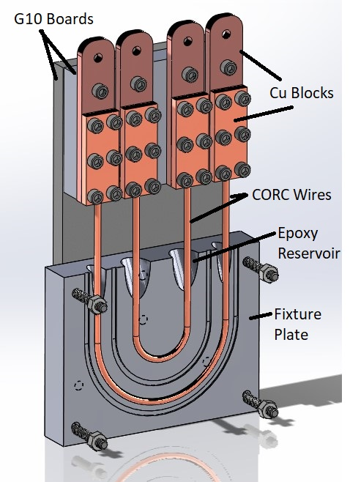
Prepare tests on short CORC® wires to develop the vacuum-pressure impregnation process
Does the VPI process degrade the CORC® wires?
What’s the impact of curing temperature and duration?
Compare the wire I_{c} before and after the VPI process
Apply the successful VPI process on subscale coils, followed by C3
Jillian Stern, Tufts University

Slide 8
Next steps
Complete the mechanical analysis for C3 (Q4 2020)
Complete the baseline fabrication plan for C3
Prove the principle of a new winding concept (Q4 2020)
Confirm the VPI process on CORC® wires (Q4 2020 – Q1 2021)
Complete mandrel fabrication and magnet winding plan (Q4 2020)
Make and test the subscale C3 (Q1 – Q3 2021)
Develop mandrels for the three-turn subscale magnet (Q1 2021)
Work with vendors to delivery the wire in Q1 2021
Make and test the C3 magnet (Q4 2021 – Q2 2022)

Slide 9
Additional questions that we are working on
How to identify the locations of first on-set of flux-flow voltages in the coils?
Explore options of using distributed fiber-optic sensing
Aim to test ideas with the subscale and C3 magnets
What is the stress limit due to Lorentz forces on bent conductors?
Test subscale CORC® CCT coils in background fields

Slide 10
Summary
C3 magnet is the focus of LBNL effort
We are completing the fabrication plan
Deal with Lorentz forces that become serious
Use the C2 technology as the baseline plan
Develop new technologies and introduce them to C3
Conductor availability is a concern
Work with vendors to confirm the delivery schedule of C3 wire
Prepare for bigger uncertainty for future magnets

